Slide 1

Machine Learning Basics
[source]
Datta Lab presentation @ Princeton University
2023-06-29
Martin Lellep
martin.lellep@gmail.com

Slide 2
Purpose of this talk
Teach you the very basic idea behind
Machine Learning (ML)

Slide 3
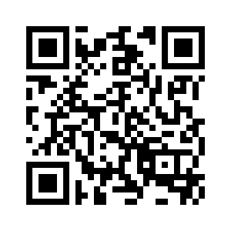
Course materials are available!
http://lellep.xyz/blog/datta-lab-ml-course.html

Slide 4
Questions
Who has heard of ML?
Who has used ML in some way?

Slide 5
Questions
?
Feel free to ask questions!

Slide 6
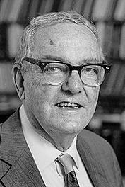
What is ML?
“ML is concerned with computer programs that automatically improve their performance through experience.”
- Herbert Simon
Herbert Simon
(Turing Award &
Nobel Prize)

Slide 7
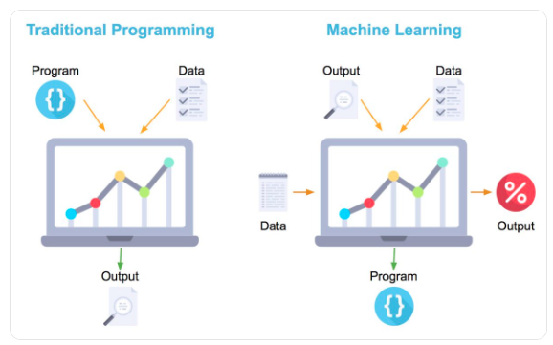
What is ML?
[source]

Slide 8
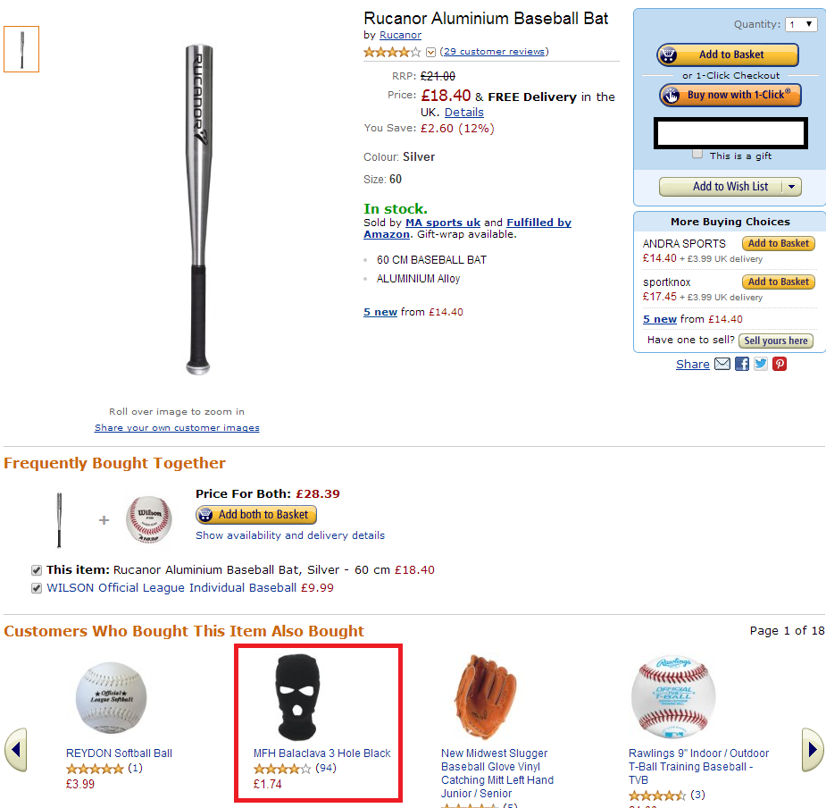
ML in daily life
Most online services
  Facebook
  Google
  Amazon
Everywhere in daily life
  Social media
  Phones
  Cars
“Customers who bought this item also bought”
:-D

Slide 9
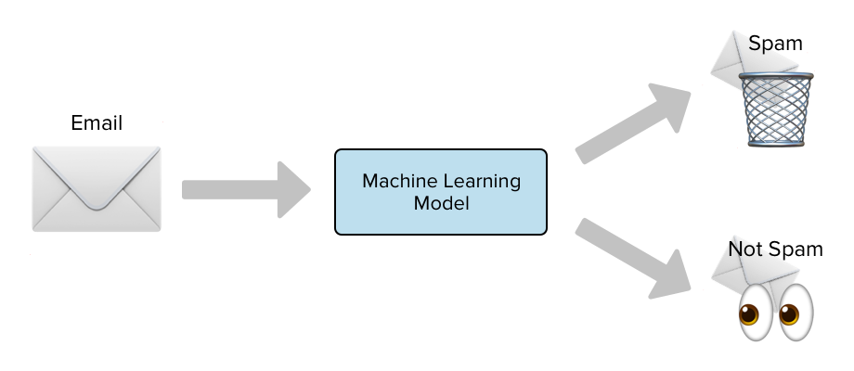
ML in daily life
[source]
Very popular and in operation for ages already: Spam filters

Slide 10
Advantages of ML
ML can adapt to data
ML can solve problems too hard to formulate a traditional algorithm for
Note: There also exist plenty of downsides, too!

Slide 11
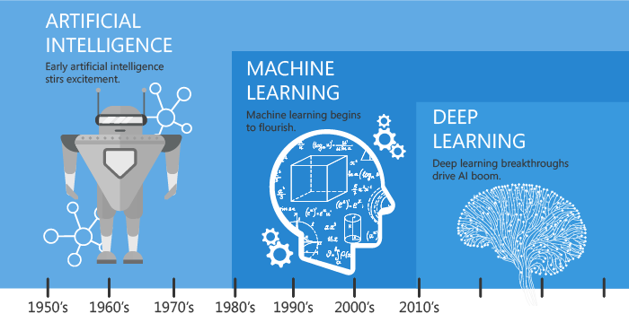
ML and AI: Not to be mixed up
[source]

Slide 12
Concept of ML
Improving w.r.t. some task with experience
Improve over task T
With respect to performance measure P
Based on experience E
“Learning”
Often called “training”

Slide 13
Concept of ML example
Spam filter
Here:
  Task: Identify spam emails
  Performance: accuracy and errors
  Experience: Database of emails
Labour-intensive and expensive!
Also: Labels of these emails if they were spam or not

Slide 14
Data: Training, validation and test
Experience = data that is shown to ML algorithm
  Might come in a database …
  … or in a stream of incoming data
Data is then partitioned
  Training data: Used to train the ML algorithm
  Validation data: Check ML algorithm’s performance
  Test data: Task you care about as user
Not used
for training
but to inform
decisions

Slide 15
Samples and features
some algo’s
are interpretable
and others not
Typical setting:
  Data consists of samples
  Samples consist of input-output pairs
Input is sometimes called features
Input
ML algorithm
Output

Slide 16
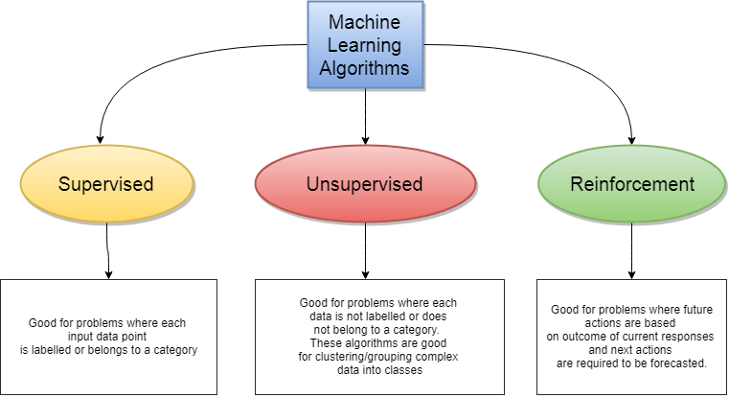
Types of ML
e.g. used to
play games
or control
devices
today:
e.g. clustering
[source]

Slide 17
Supervised learning
Given: Training data
  Input values
  Desired output
Goal: For similar input values, generate reasonable output
Typically: Interpolation, not extrapolation!

Slide 18
Modi of ML
2 major classes:
Classification and
Regression
Classification: predict classes of input data
Regression: predict numerical values of input data
Multiple classes and numerical values possible

Slide 19
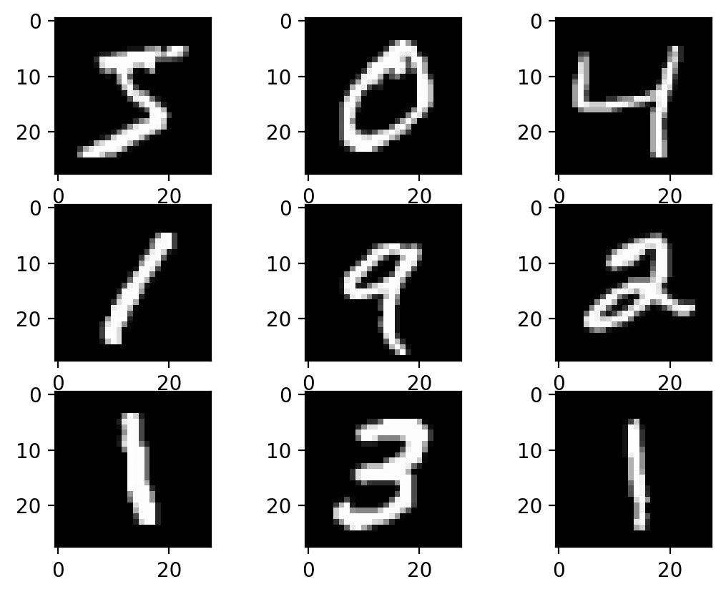
Modi of ML example
2 major classes:
Classification and
Regression
Classification:
Identify handwritten zip codes
Make them machine readable
[source]

Slide 20
Modi of ML example
2 major classes:
Classification and
Regression
Regression:
Given: House ...
  … location
  … living area
  … age
Predict: Its price
… but wait: doesn’t that sound like interpolation? Yes, it does!

Slide 21
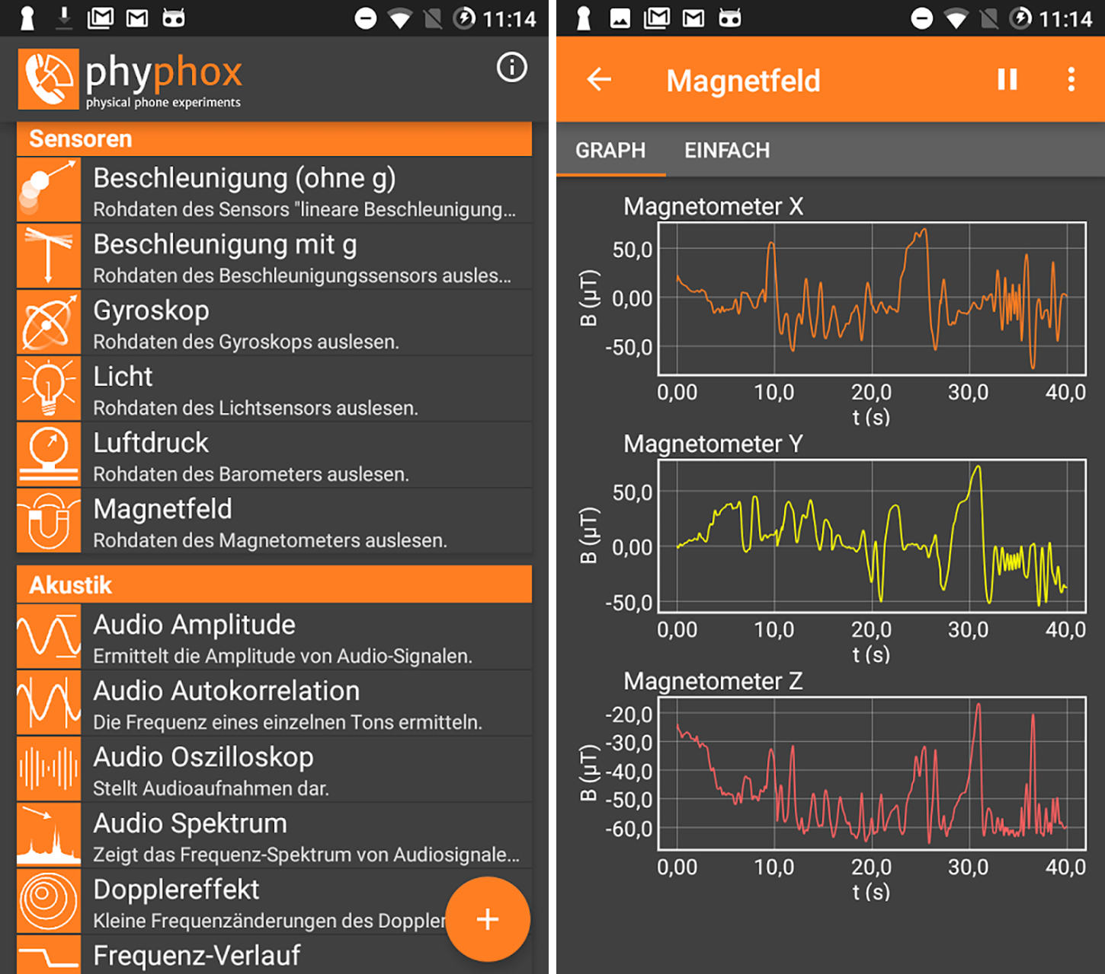
Live demo: phyphox
Educational app
Allows access to all your phone’s sensors

Slide 22
Live demo: ML with phyphox
[Live demo – Part 1 - Preparations]

Slide 23
Support Vector Machines
Classical ML algorithm
Can be used for classification and regression
Here: Use it for classification
Purpose for here:
  Learn a linear decision boundary of data
  … in multi-dimensional space
  … learn an optimal one (in some sense)

Slide 24
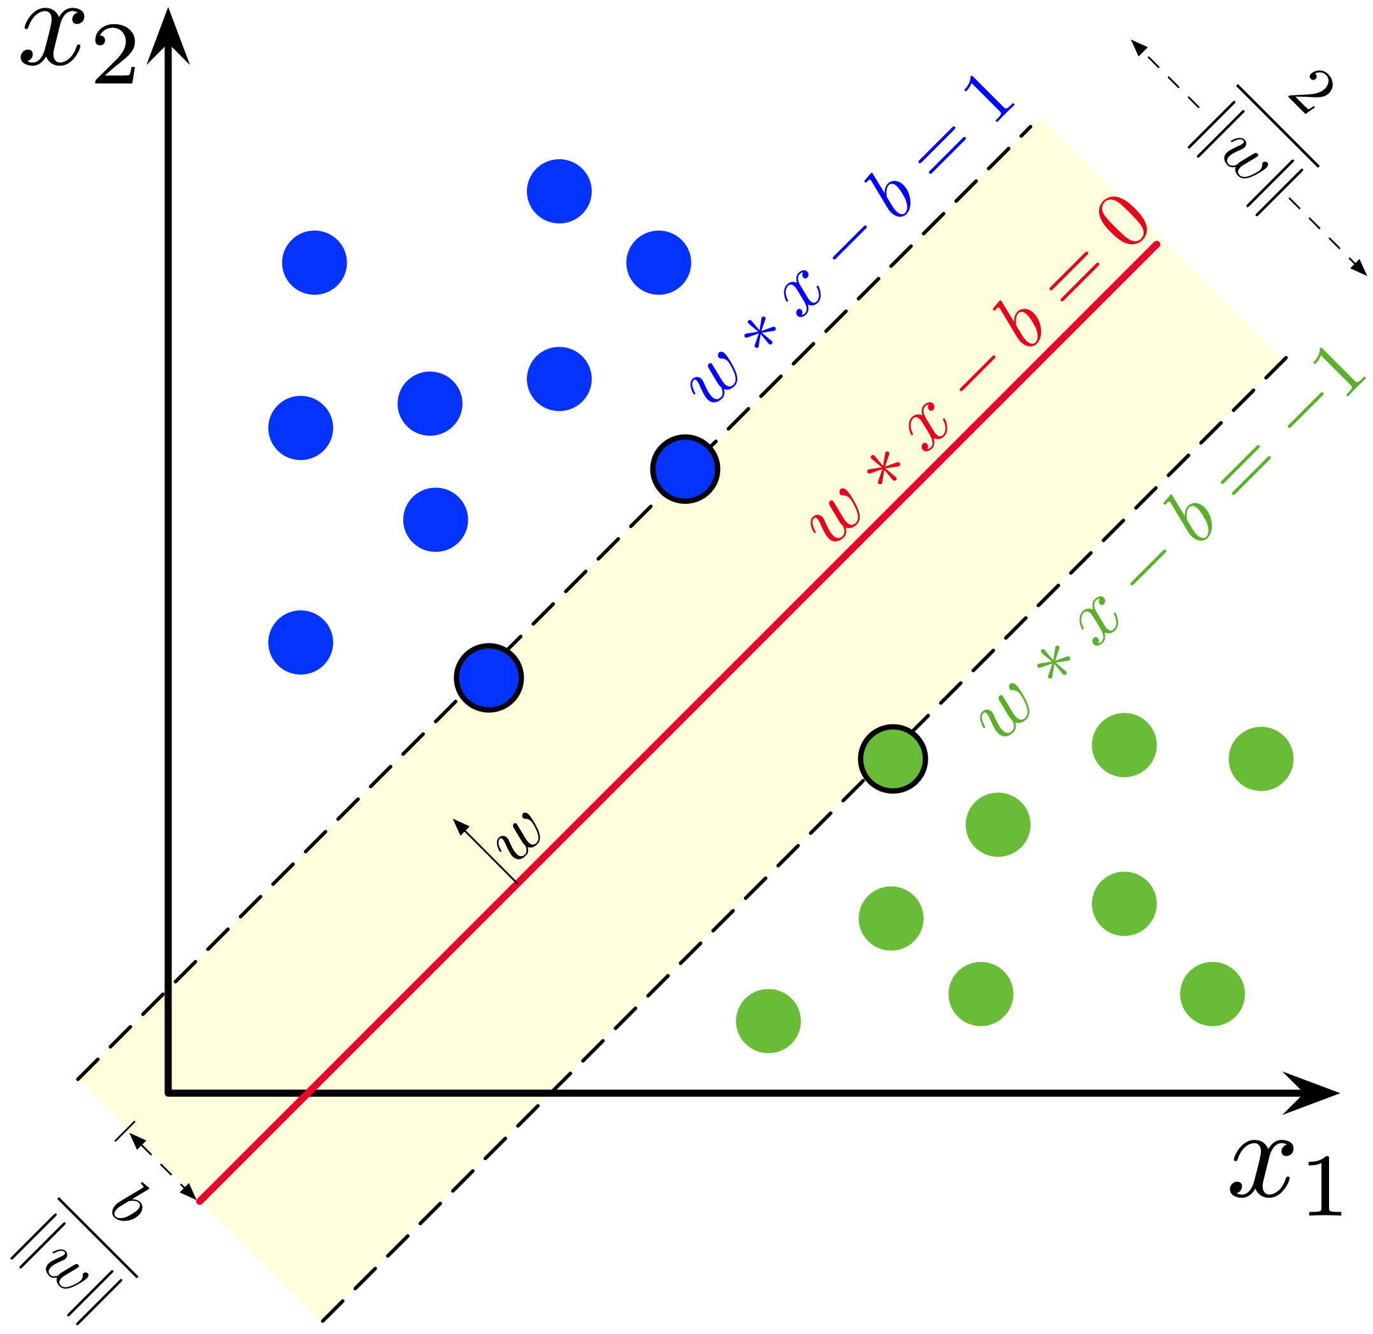
Support Vector Machines
Descision boundary:
Place decision boundary so that margin is maximal
Decision
boundary
=: “Margin”
Note: I show here the linear version. But it also works with non-linear features!
[source]

Slide 25
Example: ML with phyphox
[Live demo – Part 2 – ML 🚀]

Slide 26
ML pipelines
ML application consists of multiple steps
Certain steps repeat for most ML algorithms
These steps called “pipeline”

Slide 27
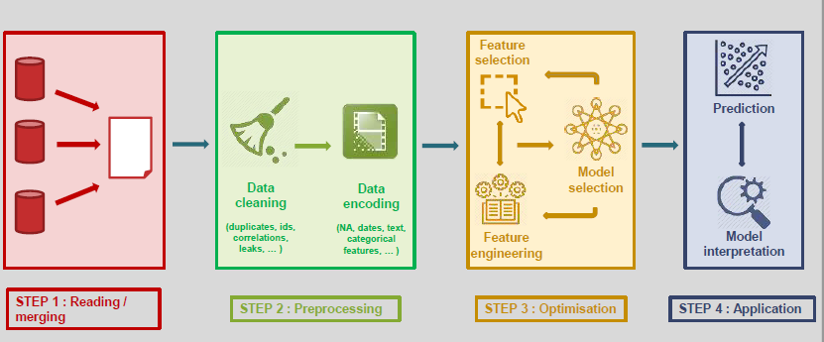
ML pipelines
Most work, typically!
[source]
Cut away transient
and ending
Feed into
ML model
Apply to
new data
Acquire data

Slide 28
Frameworks
Most of the heavy lifting is done by Python packages
Examples:
  sklearn
  Tensorflow
  PyTorch
  … many others!

Slide 29
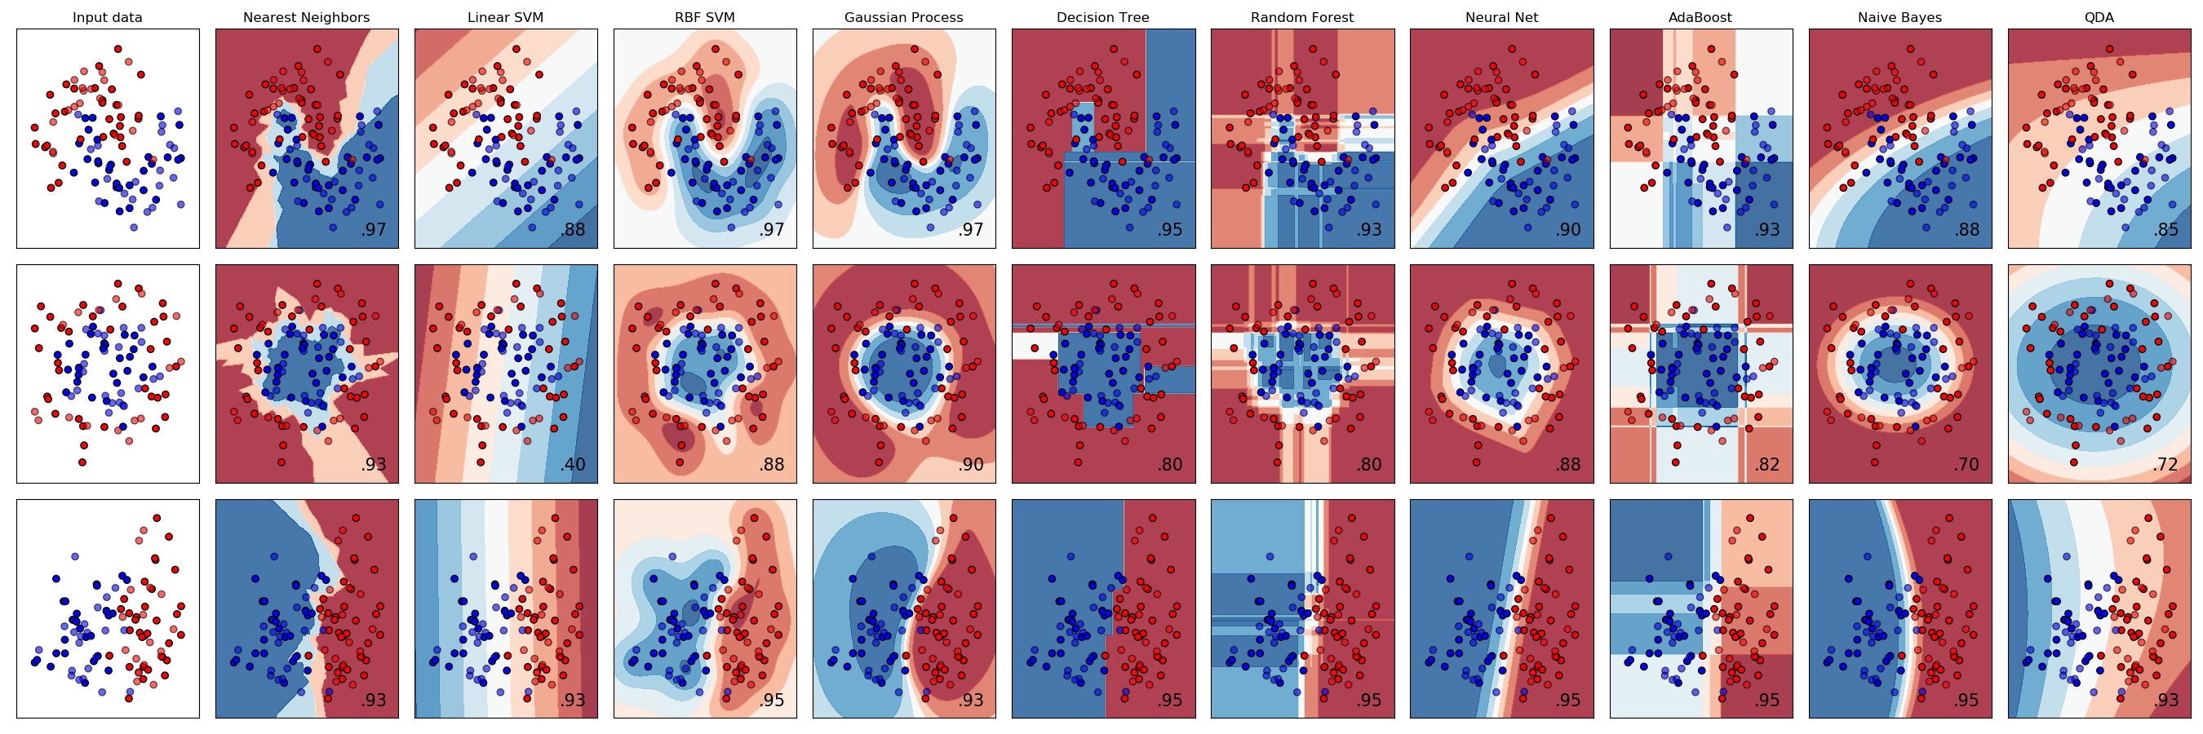
Frameworks: Sklearn
Many ML models available
Lots of utility functions
Example: Different classifiers
[source]

Slide 30
Sources
ML:
  https://de.slideshare.net/liorrokach/introduction-to-machine-learning-13809045
  https://medium.com/fintechexplained/machine-learning-algorithm-comparison-f14ce372b855
  https://medium.com/app-affairs/9-applications-of-machine-learning-from-day-to-day-life-112a47a429d0
  https://towardsdatascience.com/spam-detection-with-logistic-regression-23e3709e522
SVM:
  https://en.wikipedia.org/wiki/Support-vector_machine
  http://web.mit.edu/6.034/wwwbob/svm-notes-long-08.pdf
  https://blog.aylien.com/support-vector-machines-for-dummies-a-simple/
  https://en.wikipedia.org/wiki/Support-vector_machine
Sklearn:
  https://scikit-learn.org/stable/auto_examples/classification/plot_classifier_comparison.html

Slide 31

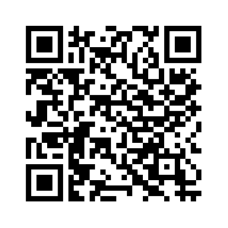
Get in contact
Questions
Next session
?
E-Mail: martin.lellep@gmail.com
Feel free to ask questions!
Tech Blog:
http://lellep.xyz/blog
LinkedIn: https://www.linkedin.com/in/martin-lellep-858600152/
Neural networks
& deep learning

Slide 32
Backup slides

Slide 33
Unsupervised learning
Examples:
K-means clustering
PCA
Autoencoders
Generative Neural Networks

Slide 34
Reinforcement learning
Examples:
Q-learning
State Action Reward State Action (SARSA)

