Slide 1
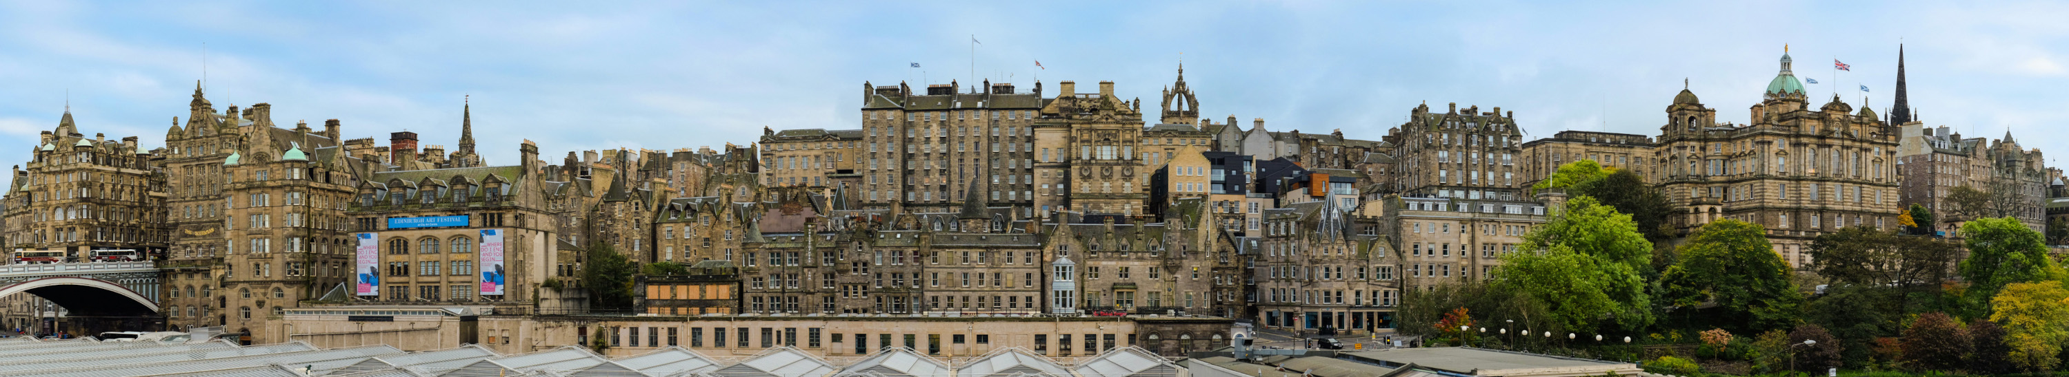
Deep Learning Basics
[source]
Datta Lab presentation @ Princeton University
2023-07-07
Martin Lellep
martin.lellep@gmail.com

Slide 2
Purpose of this talk
Teach you the very basic idea behind
Deep Learning (DL)

Slide 3

Course materials are available!
http://lellep.xyz/blog/datta-lab-ml-course.html

Slide 4
Questions
Who has heard of neural networks?
Who has used neural networks in some way?

Slide 5
Why are Neural Networks cool?
Ever used translator? → Neural network
Ever Amazon suggestions? → Neural network
Ever used subtitles on YouTube? → Neural network
Conclusion: Very powerful tools!
They must be useful for Physics, too!

Slide 6
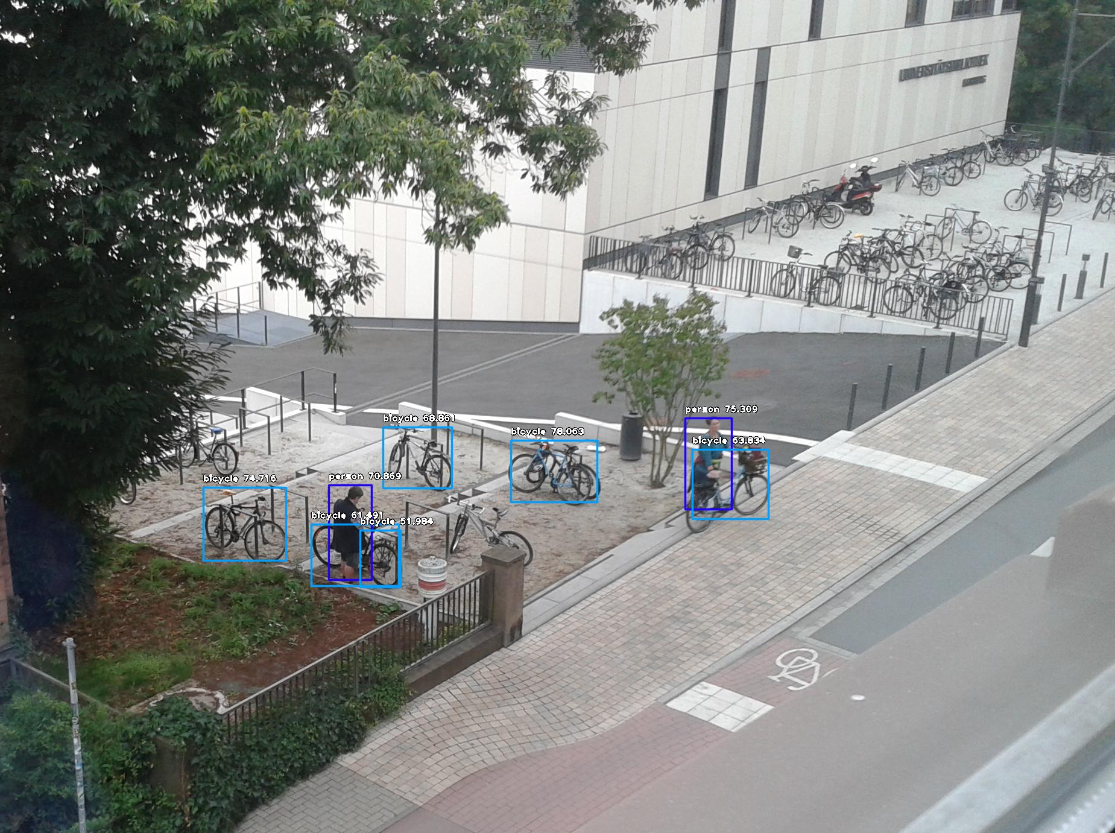
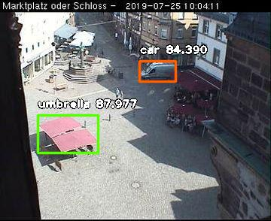
Why are Neural Networks cool?
https://www.marburg.de/portal/seiten/webcam-blick-aufs-landgrafenschloss-und-den-marktplatz-900001035-23001.html
Object detection applied to view on Marburg (=city in Germany

Slide 7
Agenda
Introduction
Neural network (NN) structure
Stochastic gradient descent (SGD)
Back propagation (backprop)
Frameworks
Deep Learning (DL) examples
This scratches only the surface!

Slide 8
Introduction
Examples of simple function approximators:
  Linear function:
  Quadratic function:
All of them:
  Parameterised by a set of parameters
  Can be used to fit given data,

Slide 9
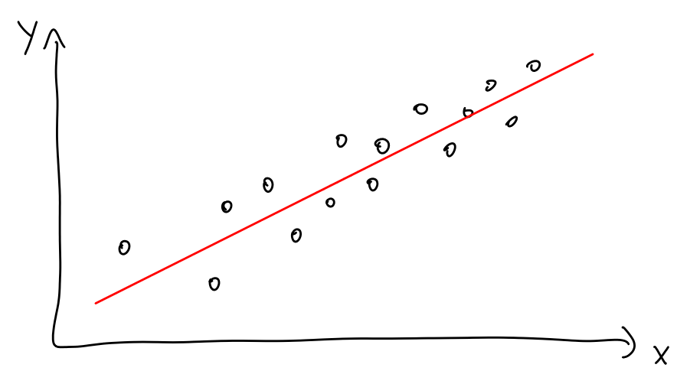
Introduction
Example of fitting a linear function:

Slide 10
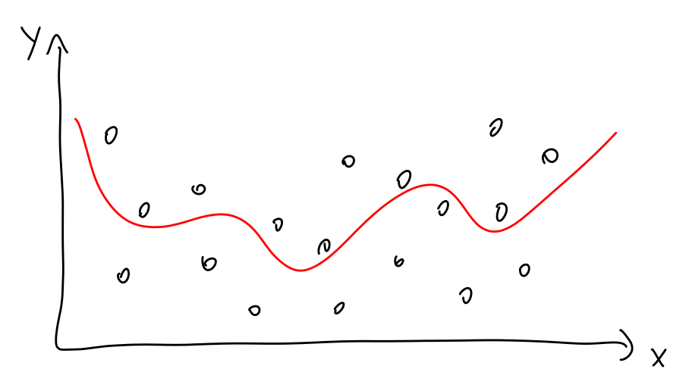
Introduction
Example of fitting a non-linear function:

Slide 11
Introduction
[ Live demo – Fitting function ]

Slide 12
Introduction
Steps for fitting a function
  Data to fit
  A function to fit – called model for here
  An optimisation procedure to perform the fitting
  A cost function that is minimised
Question for this course: How to choose model?
Solution: Use NNs and DL!

Slide 13
NN structure
A NN is a function approximator
  … a complicated function approximator
  … a parameterised function approximator
  … a non-linear function approximator
In fact, so complicated that considered a black box for the most part

Slide 14
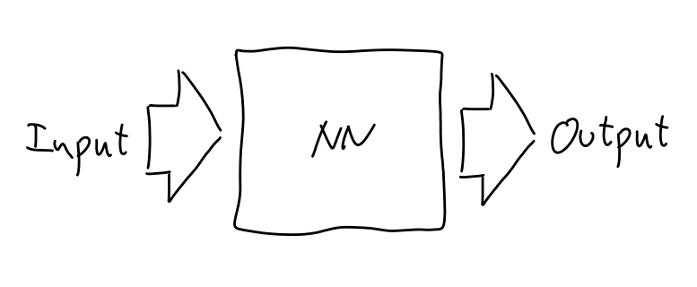
NN structure
Black box character of NNs:

Slide 15
NN structure
NN structure inspired by neurons in brain
NNs consist of layers of neurons:
Directed acyclic graph (DAG)
...
Input
Output
...
...
...
Hidden layers

Slide 16
NN structure
Focus on one single layer:
Neuron j’
Layer i+1
Weights
Layer i
0.3
0.1
0.8
0.5
Neuron: j j+1 j+2

Slide 17
NN structure
(Forward) evaluation of NN:
Linear combination of previous layer
Activation function applied to step 1)

Slide 18
NN structure
Focus on one single layer:
Neuron j’
Layer i+1
Weights
0.1
0.9
0.7
0.4
z = 0.1 x 0.3 + 0.9 x 0.1
+ 0.7 x 0.8 + 0.4 x 0.5 = 0.88
Layer i
0.3
0.1
0.8
0.5
Neuron: j j+1 j+2 j+3
Weighted sum
Linear combination:
Note: Almost all linear operations
can be cast into linear algebra
operations => very fast!
Non-linear function (“activation”):

Slide 19
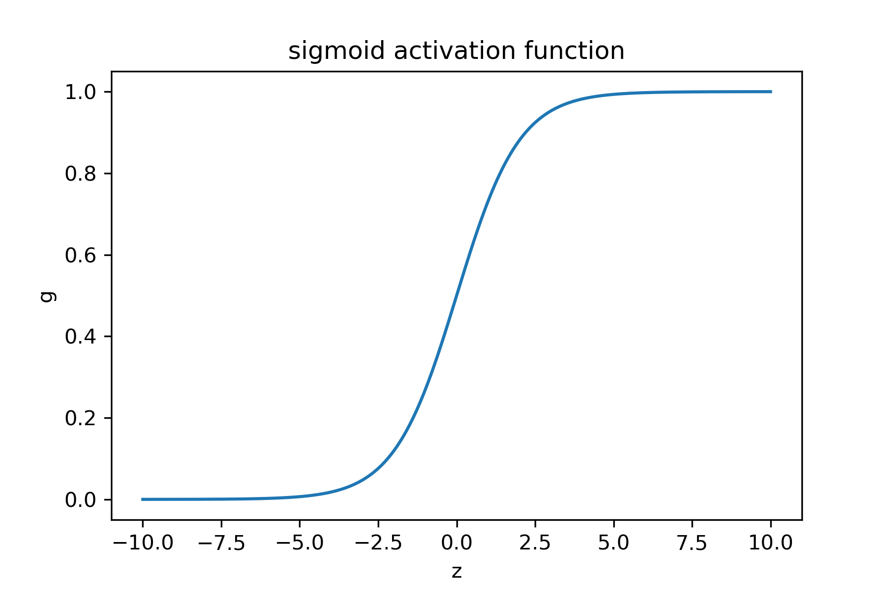
NN structure
Activation functions:
Anything close to a step function
Fast to compute
Easy to differentiate

Slide 20
NN structure
Focus on one single layer:
Neuron j’
Layer i+1
Weights
0.1
0.9
0.7
0.4
z = 0.1 x 0.3 + 0.9 x 0.1
+ 0.7 x 0.8 + 0.4 x 0.5 = 0.88
Layer i
0.3
0.1
0.8
0.5
Neuron: j j+1 j+2 j+3
Linear combination:
y = sigma(0.88) = 0.71
Non-linear function (“activation”):

Slide 21
NN structure
remember: linear vs quadratic
Intermediate summary:
NNs are built from layers
Weights connect adjacent layers
Information flows from input to output
Remaining:
Cost function:
Model
Parameters
True output
value of sample i
NN prediction for
output value of
sample i
also called “loss”
Values of all
weight matrices
Sum over training samples

Slide 22
NN structure
Summary:
We know how to evaluate a given feed forward fully connected NN
Now:
Fit NN to regression task
Called “training” in
analogy to
human learning
Classical optimisation
task

Slide 23
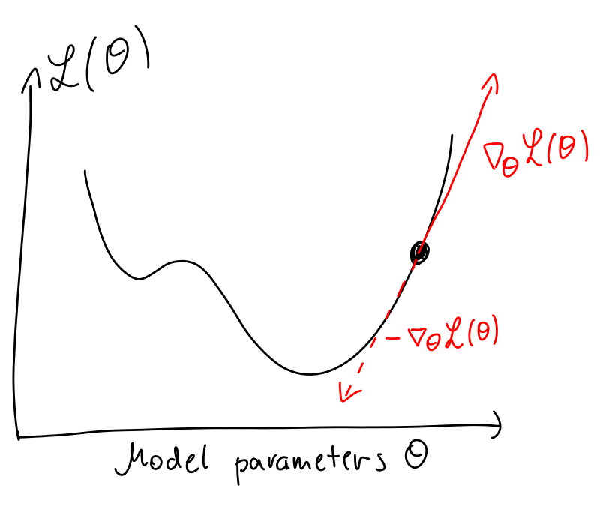
Stochastic Gradient Decent (SGD)
Optimisation procedure to minimise cost function L
Typical first-order optimisation routine: gradient descent
  Follow negative gradient
  Update:
Step size or “learning rate”

Slide 24
SGD
Key problem:
Why?
Solution:
  Use m << N randomly chosen samples
Veeeeeeery large! ~O(1e5)
batch size

Slide 25
SGD
Then:
The neural network structure is known.
Hence: It is possible to compute it!

Slide 26
SGD
Then:
The neural network structure is known.
Hence: It is possible to compute it!
“Backprop” to the rescue!
Stunning side note: SGD helps with avoiding to get
stuck at saddle points or (weak) local minima.

Slide 27
Backprop
“Backprop” = back propagation
Very rough concept:
  Forward pass: Feed data into the network
  Backward pass: Propagate errors backwards to adapt weights
Remember for now:
  Backprop makes computing the derivatives easy
  It is much simpler than computing the gradient naively

Slide 28


Frameworks
Nobody uses plain Python implementations
Nobody who does NN and DL in 2023 at least
Solution: e.g. Tensorflow and Keras!
Deals with tensors
and differentiation
Deals with NNs

Slide 29
Frameworks: Keras
High-level Python library
Useful for:
  Assembly of NN
  Training of NN
  Evaluation of NN (training vs validation vs test data)
  And some others

Slide 30
Frameworks: Keras
NNs, as presented before, are modeled as layers
The user has to provide data
Data:
  Training data
  Validation data
  Test data
Used for training
Used for design optimisations of NN
using unseen data
Test of how well the
NN performs on
unseen data

Slide 31
Frameworks: Keras
[ Live demo – Learn 2D function ]

Slide 32
Deep learning (DL)
DL = Use NNs that have many layers
Previously, we discussed “feed forward” layers (called “Dense” in Keras)
But: There are many more types of layers
  For images (ConvLayers)
  For time series (LSTMs)
In fact: You are only limited by your
imagination when designing layers
(if they perform well is, of course, a
different question)

Slide 33
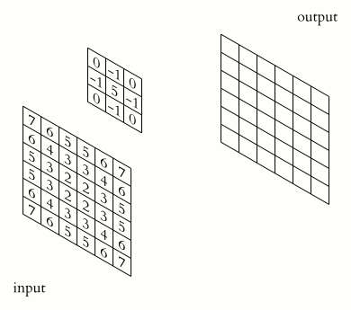
Convolutional NNs (CNNs)
A layer type that learns convolution kernels
Typically used for images
Advantage:
  Less weights than Dense
  Good for translationally invariant features
[source]
Another nice visualisation!

Slide 34

CNNs
[source]

Slide 35
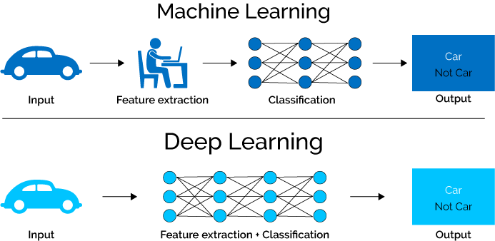
DL vs ML
→ DL learns the features by itself!

Slide 36
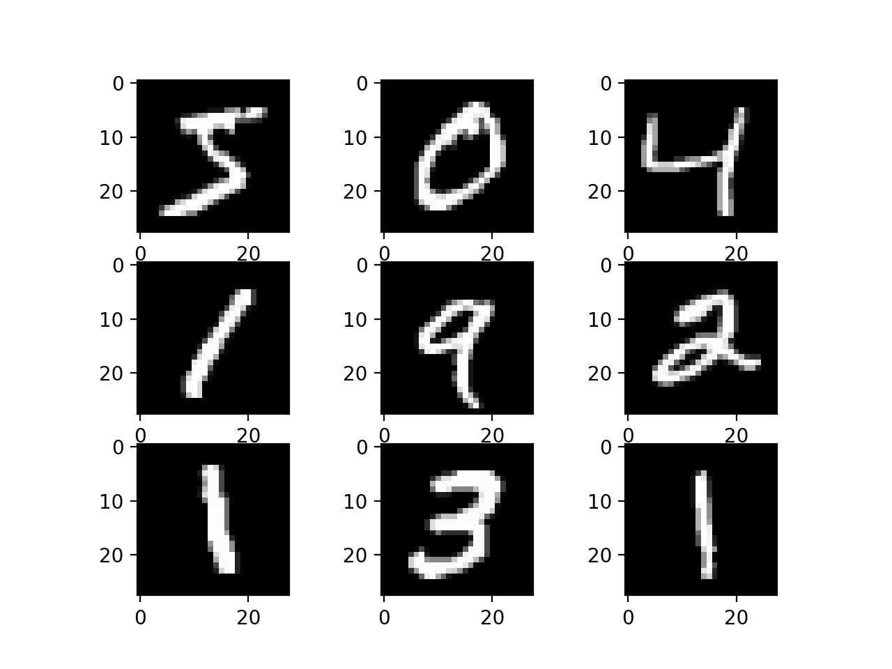
MNIST dataset
A dataset to test machine learning model performances
Widely used in DL to benchmark how well a NN performs
Content: Images of handwritten digits
Exampes:

Slide 37
Advanced example
We train a CNN on MNIST data
We use different layer types
We use other best practises
We use a larger model!
… and see some drawbacks of NNs
They are computationally expensive to train

Slide 38
Frameworks: Keras
[ Live demo – MNIST with CNN ]

Slide 39
Colab
A platform provided by Google
I presented the examples using Jupyter Notebooks
  “Python in the cloud”
Colab uses Jupyter Notebooks that run on Google infrastructure
Advantage: They provide free GPU access whi
http://colab.research.google.com

Slide 40
Outlook
There is much more to DL
Examples:
  LSTM layers
  Autoencoder
  GANs
  VAEs
  Information theory (to understand more details)

Slide 41


Re LSTMs: my weekend project
Small Sunday-only hobby project of mine:
Given pen dynamics, predict written text
Uses LSTMs
Impact: O(10,000) users of open source application
(x, y) points
LSTMs
“Princeton”
Project link & demo video: https://github.com/PellelNitram/xournalpp_htr

Slide 42
Sources
Backprop:
  https://mattmazur.com/2015/03/17/a-step-by-step-backpropagation-example/
CNNs: https://de.wikipedia.org/wiki/Convolutional_Neural_Network
CNN & MNIST example:
  https://keras.io/examples/mnist_cnn/
  Colab: https://colab.research.google.com

Slide 43


Get in contact
Questions
Next session
?
E-Mail: martin.lellep@gmail.com
Feel free to ask questions!
Tech Blog:
http://lellep.xyz/blog
LinkedIn: https://www.linkedin.com/in/martin-lellep-858600152/
Neural networks
& deep learning

