Slide 1
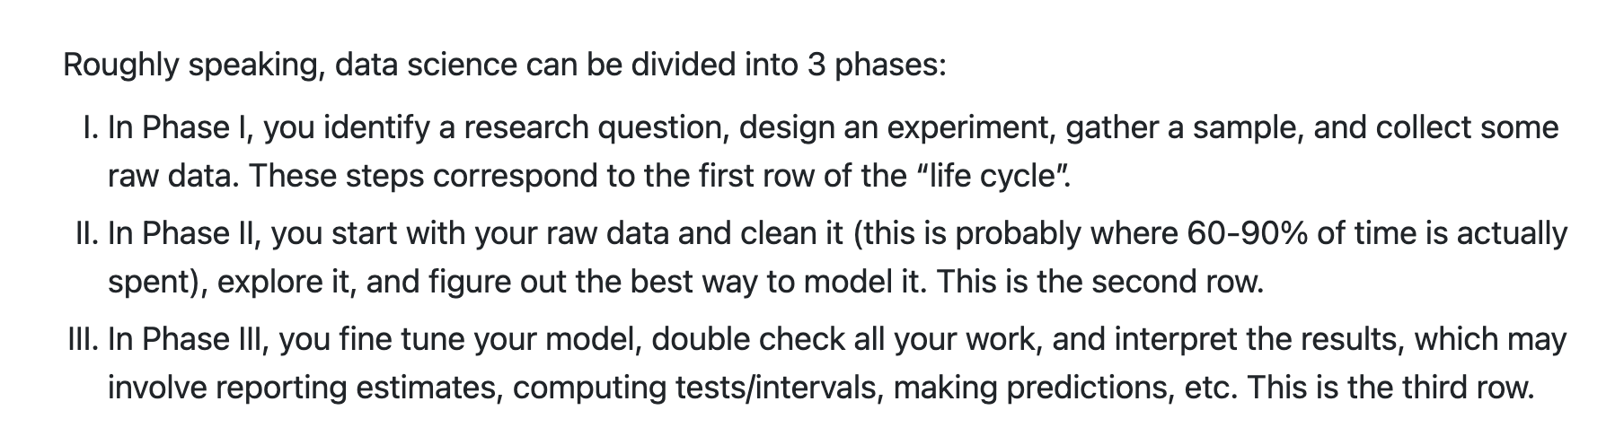
Overview: Statistics and Probability

Slide 2
Population vs Sample
Statistics is primarily the science of studying samples to understand populations. Generally, it’s impractical to observe every member of a population, but luckily this is usually not necessary and a well-drawn sample is sufficient to answer most questions.

Slide 3
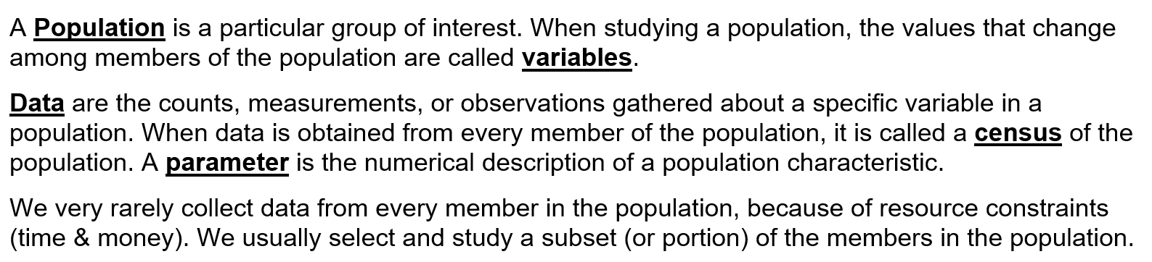

Slide 4
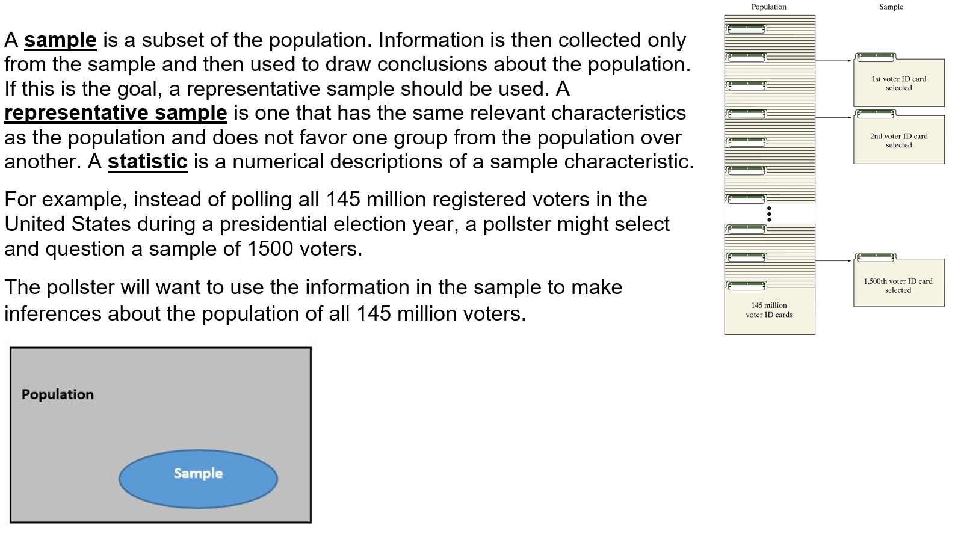

Slide 5
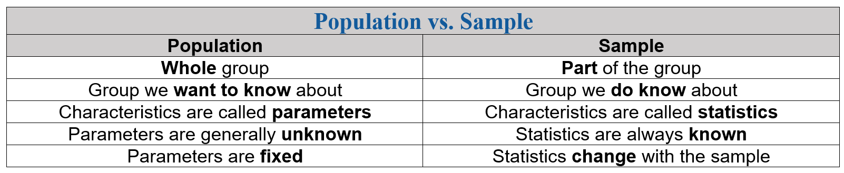

Slide 6
Model vs Data
Using only mathematical logic, we can derive different theoretical probability
models with certain parameters that aim to represent real-world phenomena,
then compare these with real data, i.e. fitting, to evaluate their performance and
make further inferences and/or predictions.
A model is an idealized mathematical representation of a process, e.g. a normal
distribution may be used to model the distribution of human heights.

Slide 7
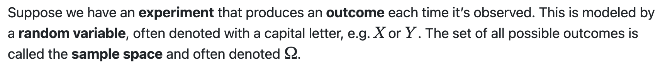
Intro to Probability
Random Variables

Slide 8
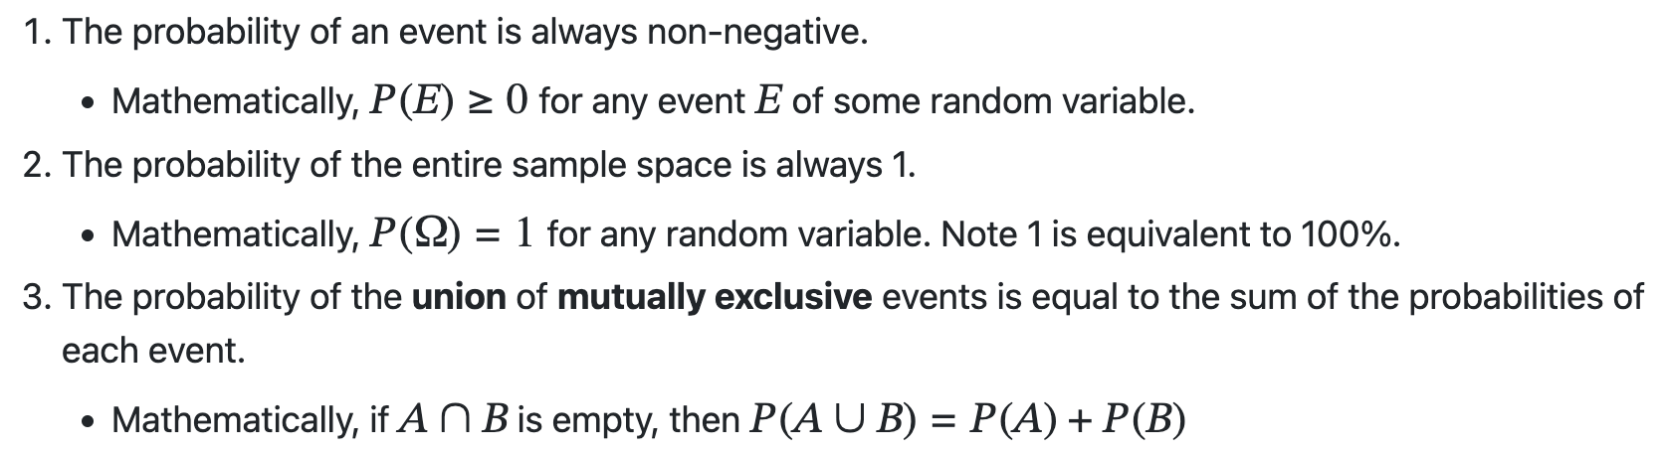
Axioms of Probability

Slide 9
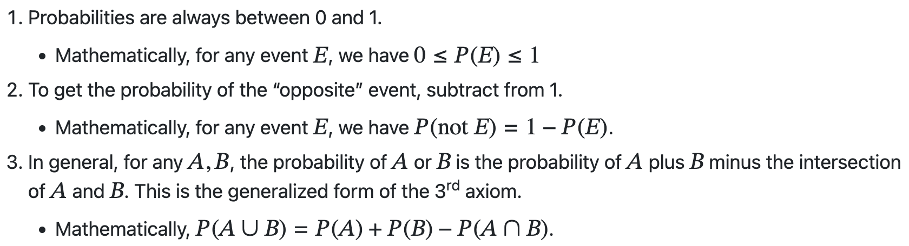
Corollaries of Probability

Slide 10
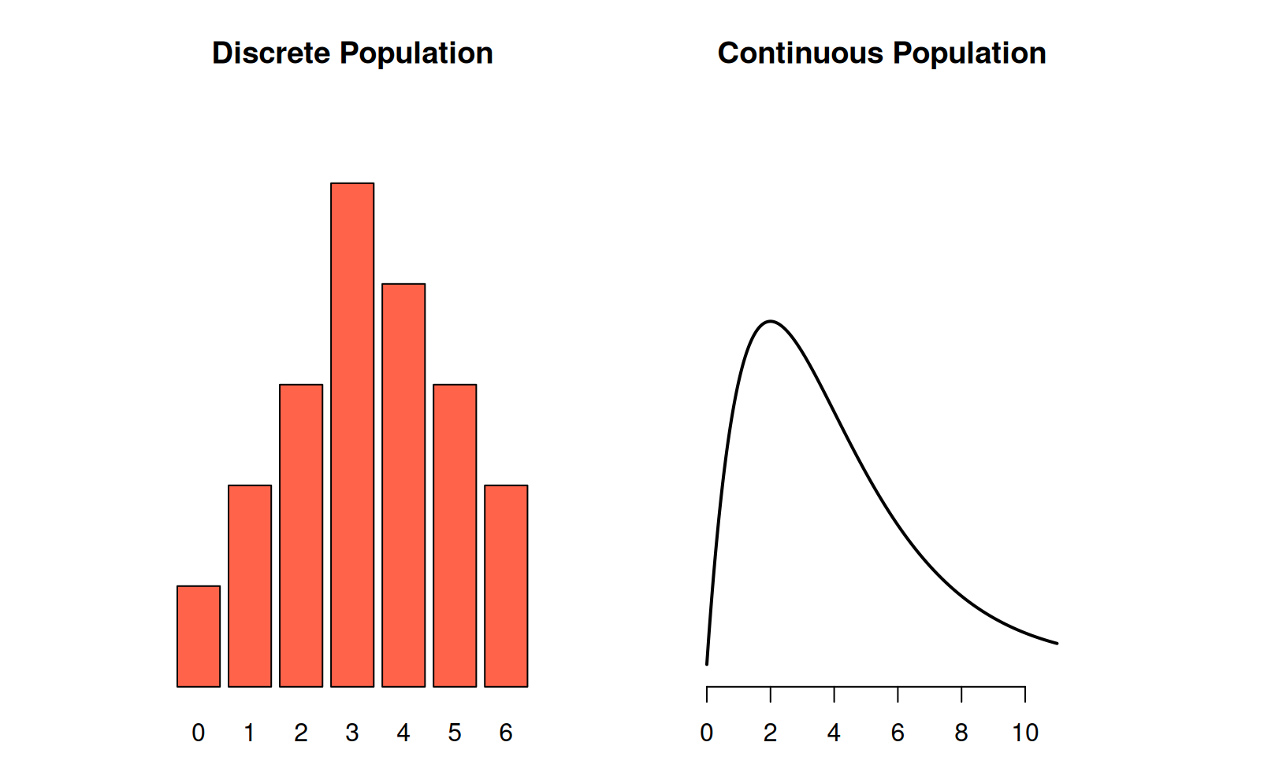
Discrete vs Continuous Random Variables

Slide 11
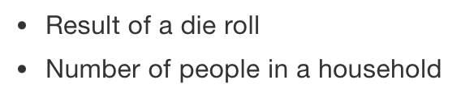

Discrete RV | Continuous RV
Can only take specific values | Can take values in a range
The probability function is given by PMF | The probability function is given by PDF

Slide 12
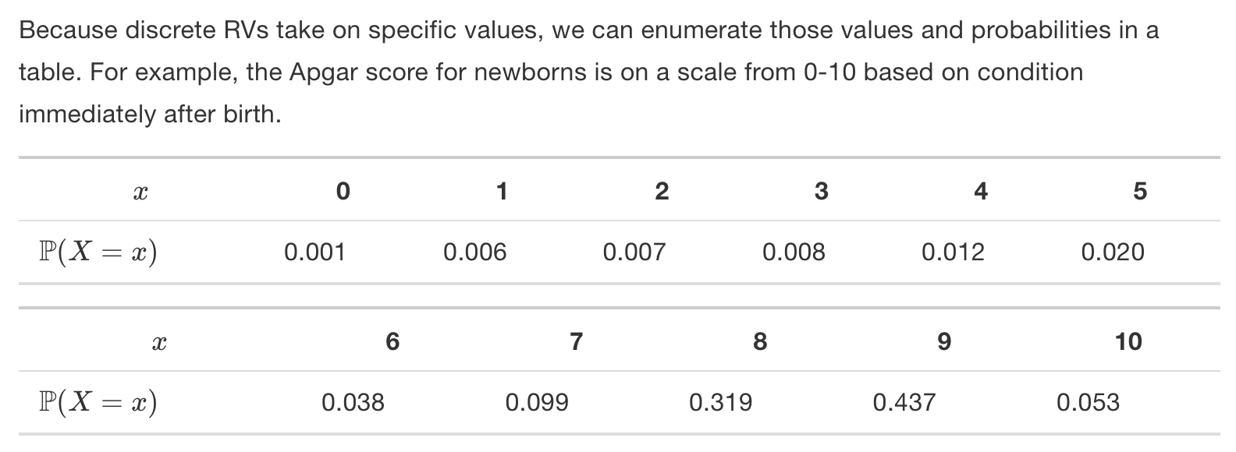
Discrete Random Variables:

Slide 13
