Slide 1
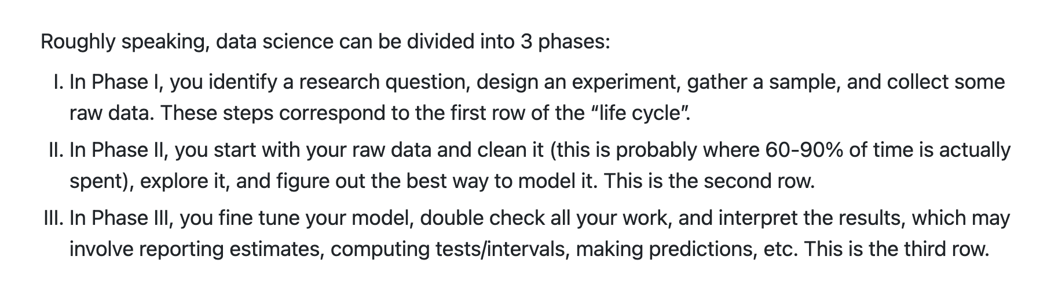
Overview: Statistics and Probability

Slide 2
Population vs Sample
Statistics is primarily the science of studying samples to understand populations. Generally, it’s impractical to observe every member of a population, but luckily this is usually not necessary and a well-drawn sample is sufficient to answer most questions.

Slide 3
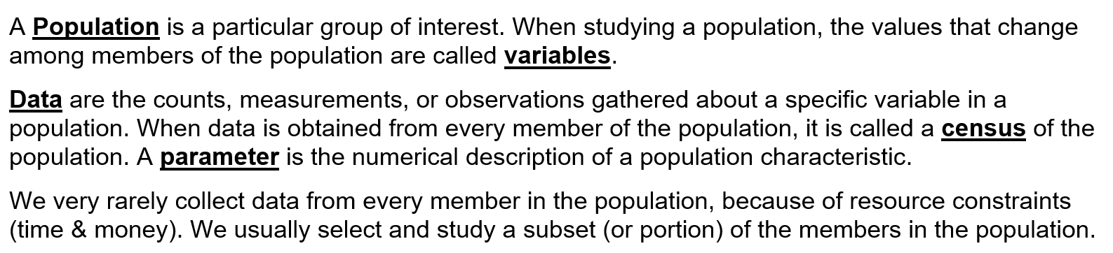

Slide 4
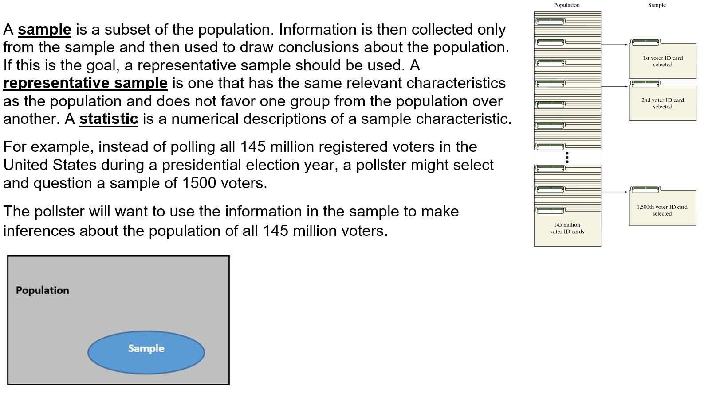

Slide 5
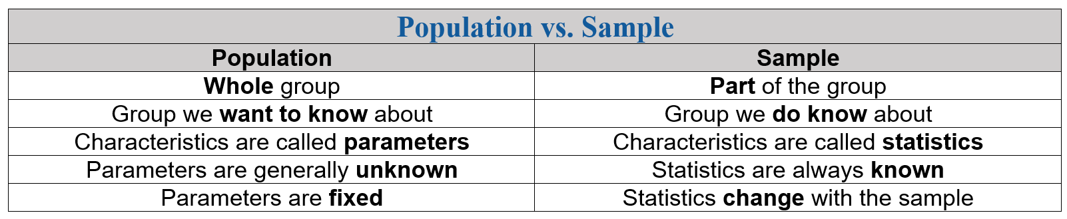

Slide 6
Model vs Data
Using only mathematical logic, we can derive different theoretical probability
models with certain parameters that aim to represent real-world phenomena,
then compare these with real data, i.e. fitting, to evaluate their performance and
make further inferences and/or predictions.
A model is an idealized mathematical representation of a process, e.g. a normal
distribution may be used to model the distribution of human heights.

Slide 7
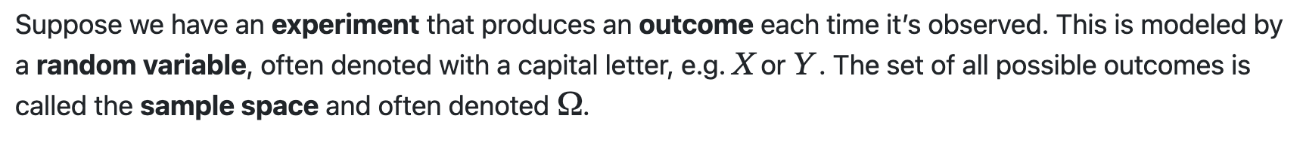
Intro to Probability
Random Variables

Slide 8
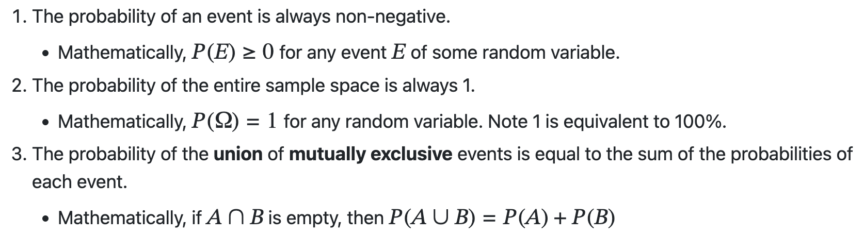
Axioms of Probability

Slide 9
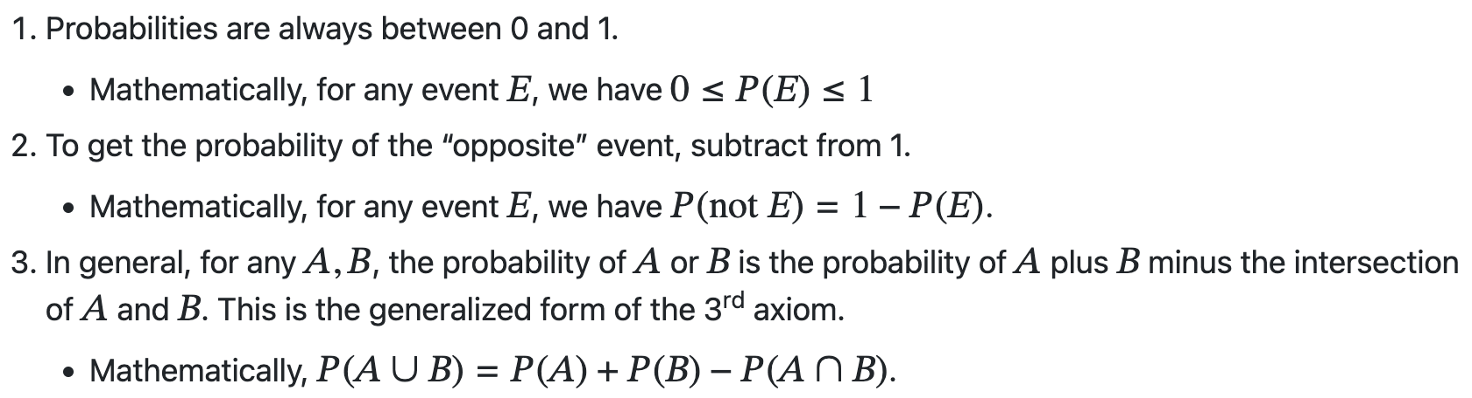
Corollaries of Probability

Slide 10
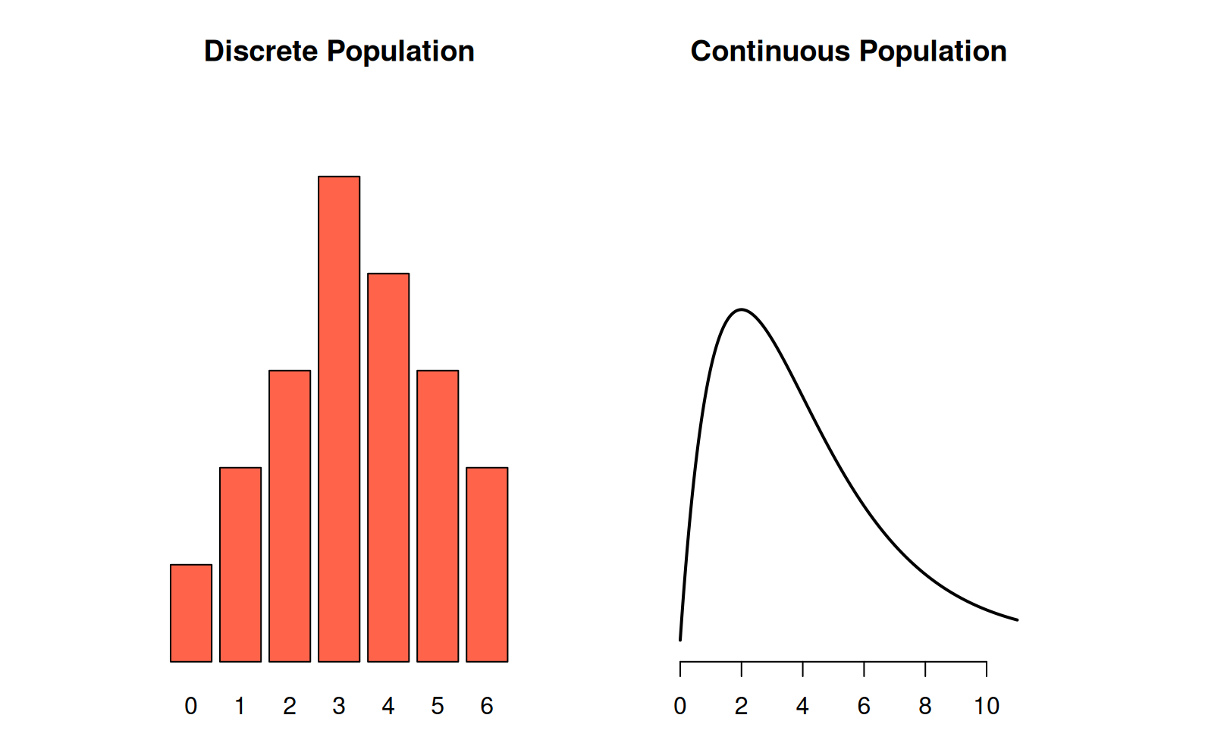
Discrete vs Continuous Random Variables

Slide 11
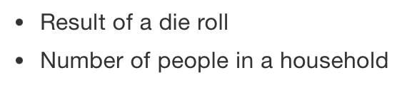

Discrete RV | Continuous RV
Can only take specific values | Can take values in a range
The probability function is given by PMF | The probability function is given by PDF

Slide 12
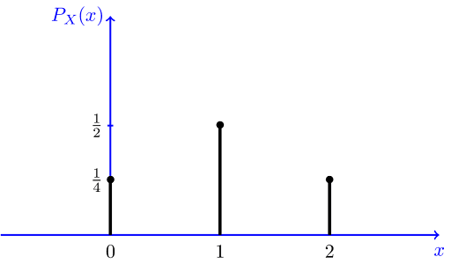
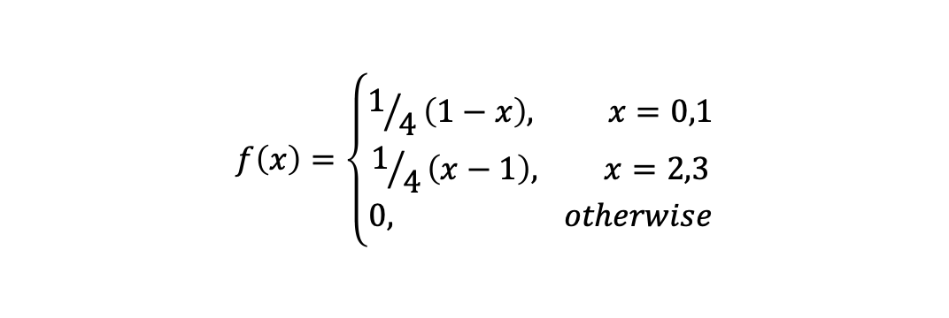
The Probability Mass Function (PMF) is a function that gives the probability at any given point of a discrete random variable. The PMF can be in a table format or given as a function at points x and will be plotted as bar graphs.
Example: The number of Heads (X) when a coin is tossed twice. The sample space created is [HH, TH, HT, TT].
This shows that X can take the values 0 (no heads), 1 (1 head), and 2 (2 heads).
X | P(X=x)
0 | 0.25
1 | 0.5
2 | 0.25
Example: For a discrete random variable X, the pmf can also be given as
$$f\left(x\right)=\left\{\begin{aligned}1/4\left(1−x\right), x=0,1 \\ 1/4\left(x−1\right), x=2,3 \\ 0, otherwise\end{aligned}\right.$$

Slide 13
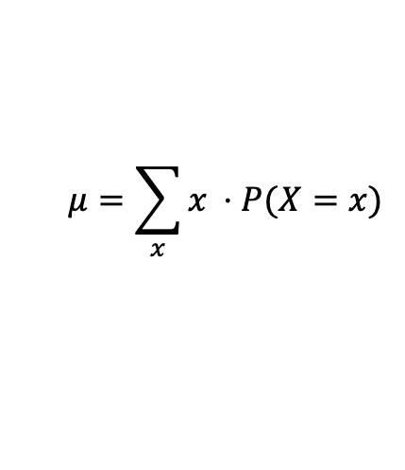

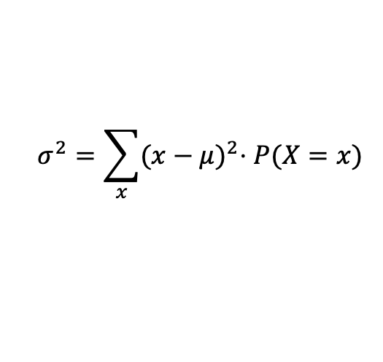

Mean: denoted with $μ$.
$$μ=\sum_{x}{x ⋅P(X=x)}$$
Variance: Denoted with $σ^{2}.$
$$σ^{2}=\sum_{x}{{(x−μ)}^{2}⋅P(X=x)}$$
Standard Deviation: Denoted with $σ$
$$σ= \sqrt{σ^{2}}$$

Slide 14
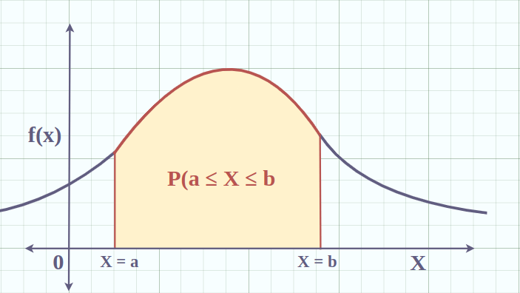
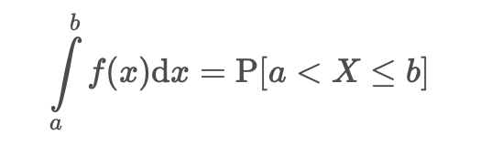
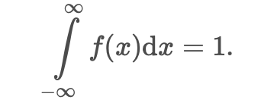
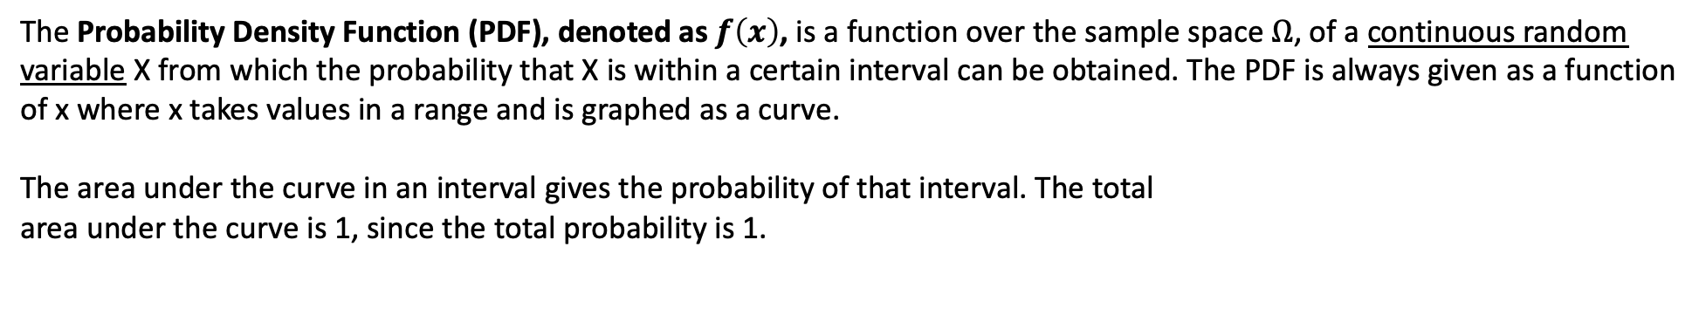
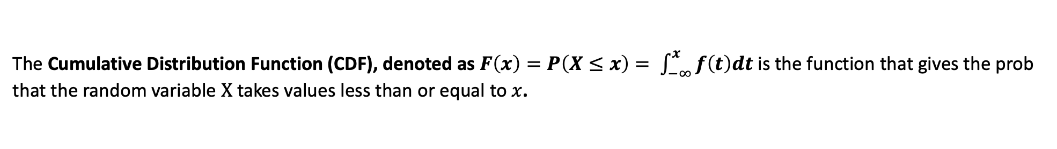
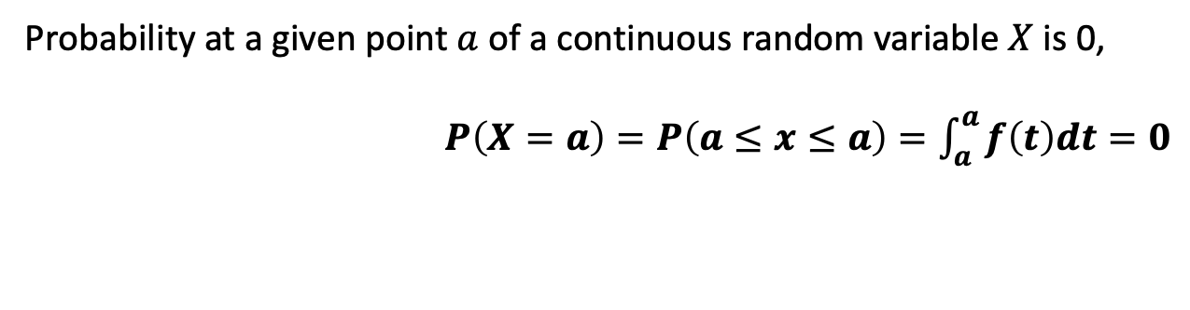
The Probability Density Function (PDF), denoted as $f\left(x\right)$, is a function over the sample space $Ω$, of a continuous random variable X from which the probability that X is within a certain interval can be obtained. The PDF is always given as a function of x where x takes values in a range and is graphed as a curve.
The area under the curve in an interval gives the probability of that interval. The total
area under the curve is 1, since the total probability is 1.
Probability at a given point $a$ of a continuous random variable $X$ is 0,
$P\left(X=a\right)=P\left(a≤x≤a\right)=\int_{a}^{a}{f\left(t\right)dt=0}$
The Cumulative Distribution Function (CDF), denoted as $F\left(x\right)=P\left(X≤x\right)= \int_{−∞}^{x}{f\left(t\right)dt}$ is the function that gives the prob
that the random variable $X$ takes values less than or equal to $x$.

Slide 15
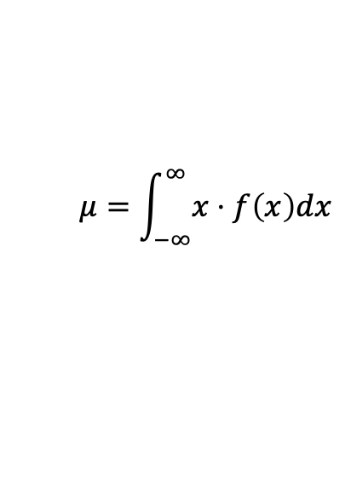
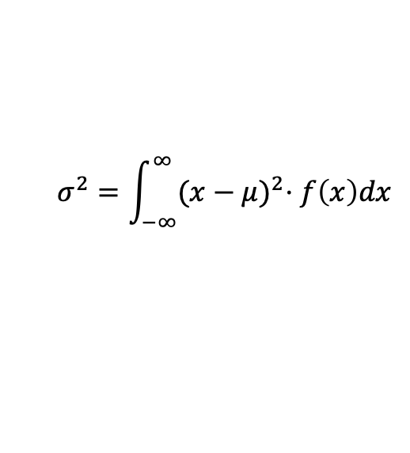
Mean: denoted with $μ$.
$$μ=\int_{−∞}^{∞}{x⋅f\left(x\right)dx}$$
Variance: Denoted with $σ^{2}.$
$$σ^{2}=\int_{−∞}^{∞}{{(x−μ)}^{2}⋅f\left(x\right)dx}$$
Standard Deviation: Denoted with $σ$
$$σ= \sqrt{σ^{2}}$$

