Slide 1
Welcome to Stat 240!
Fall 2024

Slide 2
About Your Instructor

Slide 3

Cameron Jones (he/him) (Call me Cameron!)
B.S. in Statistics from UW-Madison
Third year PhD Student in Statistics
TA’d this course for five semesters
Second time as 240 primary instructor
STAT 240, Fall 2024, Lecture 1

Slide 4
My Promises As Your Instructor
Homework and exams will faithfully reflect lecture content
Expectations, deadlines, and grading criteria will be clearly communicated and applied fairly
We will foster an inclusive learning environment for everyone
We will be responsive, understanding, and accommodating to individual needs and life situations
There is no such thing as a stupid question!
STAT 240, Fall 2024, Lecture 1

Slide 5
The Big Question
What are you going to learn in this class?

Slide 6



Why This Course Matters…
The goal of this class is to equip you to investigate real world questions using data.
Translating broad, unclear, plain language questions into rigorous, testable, numeric ones
Manipulating messy data, thinking critically about what conclusions we can and cannot make from that data
Presenting those conclusions in a way that makes sense to non-experts as well as experts
STAT 240, Fall 2024, Lecture 1

Slide 7


…Even if You’re Not a Data Scientist
These principles are universal, even if you won’t be coding or doing statistical analysis in your career
Learn with an open mind… you might surprise yourself!
STAT 240, Fall 2024, Lecture 1

Slide 8
The Big Picture
How exactly does STAT 240 work?

Slide 9


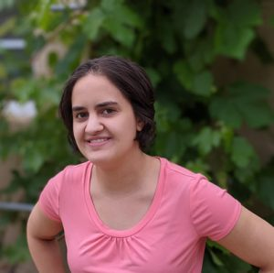

Stat 240: Big Picture
There are six sections of the course across four instructors!
Relatively young course, still evolving and changing
Students of many different years & majors
We do not expect ANY prior coding or statistics experience
Cameron Jones
Professor Bret Larget
Professor Miranda Rintoul
Professor Sahifa Siddiqua
STAT 240, Fall 2024, Lecture 1

Slide 10
Course Flow: Big Picture
First 5ish weeks of semester: Crash Course on R/tidyverse
Ends with take-home exam (“Midterm 1”) on R/tidyverse
Next 5ish weeks of semester: Probability & Random Variables
Ends with in-person exam (“Midterm 2”) on probability/random variables (may include some R concepts from part 1)
Final 5ish weeks of semester: Statistical Inference, Modeling Real Dataset Exploration/Inference
Final Exam is in-person, cumulative
STAT 240, Fall 2024, Lecture 1

Slide 11
Course Flow: Week to Week
The Canvas home page is your number one resource for all course-related information
Three lectures per week on course content, same room, same time, conceptual units roughly spanning one week
The following week, Monday, Tuesday, or Wednesday: in discussion, low-stakes review of previous week with peers, graded on being there and participating (bring your laptop)
Friday after discussion: individual weekly homework due at 11:59pm, graded for correctness
STAT 240, Fall 2024, Lecture 1

Slide 12
Lectures
Lectures will be recorded and videos posted to Canvas, attendance is not required
However, lectures will frequently include live coding activities/checks of understanding, with opportunities to ask questions and interact with your instructor.
Homework and discussion assignments will assume that you are up to date on lecture material.
STAT 240, Fall 2024, Lecture 1

Slide 13
Grading
Your overall score is comprised of these weighted categories:
Discussion Participation (2 free drops): 10%
Individual Weekly Homeworks (1 free drop): 20%
Group Project: 10%
Midterm 1: 20%
Midterm 2: 20%
Final Exam: 20%
STAT 240, Fall 2024, Lecture 1
Notes:
Can straight up read this one

Slide 14
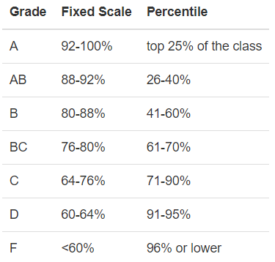
Grading
Your letter grade will be evaluated on two scales, and you’ll receive the BETTER of the two letter grades, if they differ.
STAT 240, Fall 2024, Lecture 1
Notes:
Can straight up read this one

Slide 15
Resources
Asynchronous Help | In-Person Help
Coursewide Piazza | Drop-In Hours*
Email Cameron and/or Jiaxin | Statistics Learning Center
* Also known as “office hours”
STAT 240, Fall 2024, Lecture 1

Slide 16
Installing R and RStudio
On Your Individual Device

Slide 17
Installing R and RStudio
Leave directories and settings as default unless you know what you’re doing!
https://posit.co/download/rstudio-desktop/
TWO steps!
First, click “Download and Install R”. Click “Download R for macOS” or “Download R for Windows” depending on what type of computer you have, in the top box.
MacOS: Click the .pkg file that applies to your computer
Windows: Click “Install R for the first time”, and then “Download R-4.3.2 for Windows”
Then, back at the above link, click “Download Rstudio Desktop”, which will just give you a file.
STAT 240, Fall 2024, Lecture 1

