Slide 1
Car Rental Platform
Pema Yangchen

Slide 2
Project overview
The product:
The Car Rental Platform simplifies vehicle rental for individuals and businesses, offering a user-friendly interface for browsing, comparing prices, making reservations, and managing bookings.
Preview of selected polished designs.
Project duration:
March 2024 to May 2024

Slide 3
Project overview
The problem:
Traditional car rental processes can be time-consuming, manual, and limited, causing customers to struggle to find the right car within their budget, while rental agencies face challenges in efficient booking management.
The goal:
The Car Rental Platform aims to revolutionize car rental experiences by offering a diverse range of vehicles, providing transparent pricing, streamlined bookings, and automating administrative tasks, ultimately improving operational efficiency for rental agencies.

Slide 4
Project overview
My role:
A UX/UI designer who will conduct market research, create wireframes and prototypes, and design an intuitive, visually appealing interface for the Flower Catalogue App project.
Responsibilities:
Conducting interviews, paper and digital wireframing, low and high-fidelity prototyping, conducting usability studies, accounting for accessibility, and iterating on designs.

Slide 5
User research
Personas
Problem statements
User journey maps
Understanding
the user

Slide 6
User research: summary
The Car Rental Platform's user research involved surveys, interviews, and usability testing with various participants. Initially, assumptions were based on industry trends and stakeholder feedback. However, deeper engagement revealed unexpected user preferences, such as flexible rental options and clear pricing transparency. This understanding informed the platform's development, leading to a more user-centered solution.

Slide 7
User research: pain points
1
2
3
4
Complex Reservation Process
Limited Vehicle Selection
Unclear Pricing Structure
Inadequate Customer Support
Users expressed frustration with the reservation process's complexity, time-consuming nature, and overwhelming nature, particularly when faced with unclear instructions or form fields.
Users faced challenges in finding suitable vehicles due to limited options, especially for larger families or those with mobility needs.
Participants criticized the platform's pricing structure, citing hidden fees, ambiguous tiers, and inconsistent information, leading to user distrust and apprehension, affecting bookings.
Users faced challenges in obtaining timely and effective customer support for rental issues, with agents often being unhelpful or delayed, leading to frustration and unsupported experiences.

Slide 8
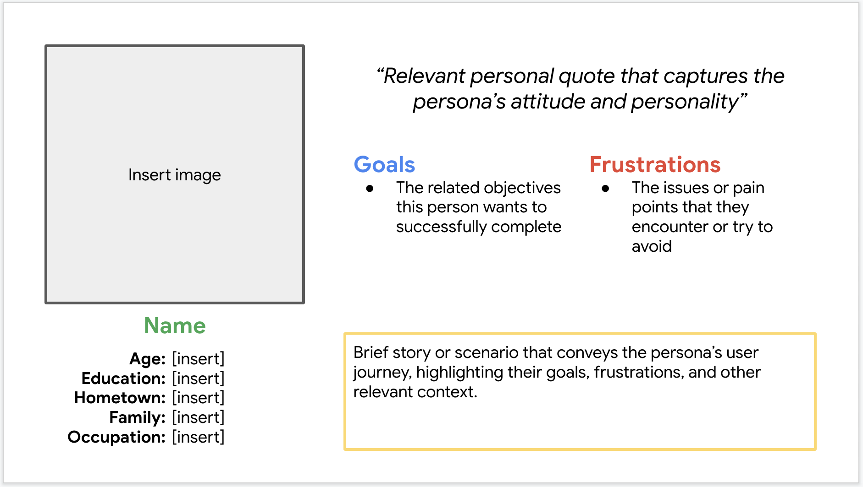
Persona: Karma
Problem statement:
Karma struggles to find a car rental platform that offers a seamless booking process and a wide selection of vehicles to suit his varied travel needs. He often faces challenges with unclear pricing structures and limited availability, which hinder his ability to make informed rental decisions efficiently.

Slide 9
Persona: Lhamo
Problem statement:
Lhamo struggles to find a car rental platform that caters to her budget and provides flexible rental options to accommodate her varying travel needs. She often encounters challenges with inaccessible booking processes and limited availability of affordable vehicles, which hinder her ability to plan spontaneous trips and manage her expenses effectively.

Slide 10
User journey map
[Your notes about goals and thought process]
Image of user journey map

Slide 11
Paper wireframes
Digital wireframes
Low-fidelity prototype
Usability studies
Starting
the design

Slide 12
Paper wireframes
[Your notes about goals and thought process]
Image of paper wireframes including five different versions of the same screen and one image of the new, refined version

Slide 13
Digital wireframes
Description of the element and its benefit to the user
[Your notes about goals and thought process]
Insert first wireframe example that demonstrates design thinking aligned with user research
Description of the element and its benefit to the user

Slide 14
Digital wireframes
Description of the element and its benefit to the user
[Your notes about goals and thought process]
Insert second wireframe example that demonstrates design thinking aligned with user research
Description of the element and its benefit to the user

Slide 15
Low-fidelity prototype
[Link to low-fidelity prototype and brief description of the user flow]
Screenshot of prototype with connections or prototype GIF

Slide 16
Usability study: findings
Our team conducted extensive usability studies on the Car Rental Platform, involving diverse participants like frequent travelers, families, and business professionals, to identify areas for improvement and improve the user experience.
Round 1 findings
Round 2 findings
1
Navigation Complexity
1
Mobile Responsiveness
2
Form Completion Challenges
2
Accessibility Enhancements
3
Visual Clutter
3
Performance Optimization

Slide 17
Refining
the design
Mockups
High-fidelity prototype
Accessibility

Slide 18
Mockups
Before usability study
After usability study
[Your notes about goals and thought process]
Image of selected screen before usability study
Image of selected screen after usability study

Slide 19
Mockups
Before usability study
After usability study
[Your notes about goals and thought process]
Image of selected screen before usability study
Image of selected screen after usability study

Slide 20
Mockups
Main mockup screen for display
Main mockup screen for display
Main mockup screen for display
Main mockup screen for display

Slide 21
High-fidelity prototype
[Link to high-fidelity prototype]
Screenshot of prototype with connections or prototype GIF

Slide 22
Accessibility considerations
1
2
3
Ensure that the platform adheres to WCAG standards, which provide guidelines for making web content more accessible.
Ensure that all functionality within the platform can be accessed and operated using a keyboard alone, without relying on mouse input. This is particularly important for users who may have mobility impairments or prefer keyboard navigation.
Design the platform with screen reader compatibility in mind, ensuring that all content, including text, images, and interactive elements, is properly labeled and accessible to users who rely on screen readers to access information.

Slide 23
Going forward
Takeaways
Next steps

Slide 24
Takeaways
Impact:
The Car Rental Platform can significantly improve the transportation industry by streamlining the car rental process, enhancing customer experience, offering operational efficiency, driving business growth, and promoting sustainability through shared mobility and vehicle utilization.
What I learned:
I learned the importance of user-centric design, agile development, effective collaboration, continuous improvement, and the potential impact of digital solutions in revolutionizing industries.

Slide 25
Next steps
1
2
3
Continuously enhance the platform with new features and functionalities based on user feedback and emerging trends in the car rental industry.
Implement optimizations to improve the platform's speed, scalability, and reliability, ensuring a smooth and responsive user experience even during peak usage periods.
Develop a comprehensive marketing strategy to promote the platform to target audiences through digital marketing campaigns, partnerships with travel agencies, and referral programs.

Slide 26
Insert a few sentences summarizing the next steps you would take with this project and why. Feel free to organize next steps in a bullet point list.
Let’s connect!
For more information about my work or to discuss potential collaborations, feel free to contact me at pemayangchenwt@gmail.com
17956041

Slide 27
Thank you!

