Slide 1
Flower Catalogue Website
Pema Yangchen

Slide 2
Project overview
The product:
The Flower Catalogue Website is a mobile website designed to serve as a comprehensive digital catalog for florists.
Preview of selected polished designs.
Project duration:
March 2024 to May 2024

Slide 3
Project overview
The problem:
Traditional floral catalog systems are cumbersome and difficult to manage, necessitating a modern solution that simplifies ordering, offers diverse floral offerings, and streamlines the process for florists and customers.
The goal:
The primary goal of the Flower Catalogue App is to provide florists with a user-friendly digital platform to showcase their products

Slide 4
Project overview
My role:
A UX/UI designer who will conduct market research, create wireframes and prototypes, and design an intuitive, visually appealing interface for the Flower Catalogue App project.
Responsibilities:
Conducting interviews, paper and digital wireframing, low and high-fidelity prototyping, conducting usability studies, accounting for accessibility, and iterating on designs.

Slide 5
User research
Personas
Problem statements
User journey maps
Understanding
the user

Slide 6
User research: summary
User research revealed florists require robust features like real-time inventory management, personalized arrangement options, and efficient customer communication, leading to a more comprehensive and user-friendly Flower Catalogue Website.

Slide 7
User research: pain points
1
2
3
4
Outdated Catalogue Management:
Limited Customer Engagement:
Inefficient Ordering Process:
Inventory Management Challenges:
Florists' current use of physical brochures and printed materials hinders inventory updates, causing customers to be unaware of available products, leading to missed sales opportunities and customer dissatisfaction.
Florists struggle to effectively engage with customers, especially online shoppers, without digital platforms, leading to a disconnect, reduced loyalty, and repeat business.
Ordering over the phone or in-person is time-consuming and error-prone, causing frustration for customers and burdening florist staff, impacting productivity and other critical tasks.
Florists struggle with real-time inventory management, leading to overstocking, out of stock, and inaccurate orders, resulting in lost sales and disappointed customers.

Slide 8
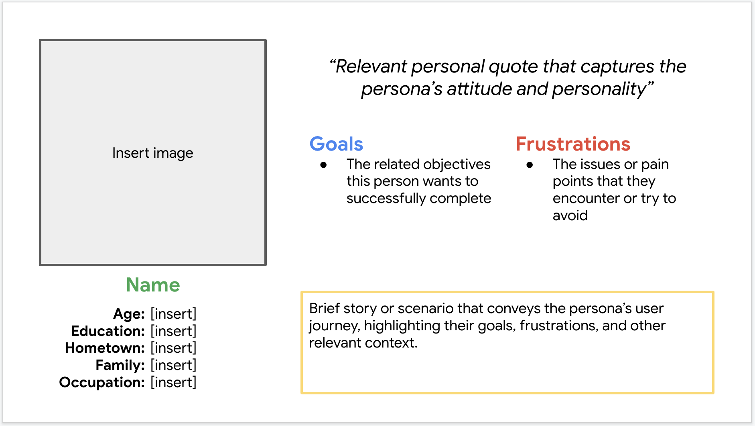
Persona: Lhazin
Problem statement:
Lhazin is a dedicated and creative florist owner who needs an efficient digital catalog and inventory management system because her current manual processes are outdated and prone to errors, leading to missed sales opportunities and customer dissatisfaction.

Slide 9
Persona: Namgay
Problem statement:
Namgay is a tech-savvy and ambitious boutique florist owner who needs an efficient digital catalog and inventory management system because her current manual processes are inefficient and limit her ability to reach a wider audience and provide a seamless customer experience.

Slide 10
User journey map
This concise journey map captures Namgay's key actions, experiences, pain points, and opportunities as she transitions to and uses the Flower Catalogue Website.
Image of user journey map

Slide 11
Paper wireframes
Digital wireframes
Low-fidelity prototype
Usability studies
Starting
the design

Slide 12
Paper wireframes
[Your notes about goals and thought process]
Image of paper wireframes including five different versions of the same screen and one image of the new, refined version

Slide 13
Digital wireframes
Description of the element and its benefit to the user
[Your notes about goals and thought process]
Insert first wireframe example that demonstrates design thinking aligned with user research
Description of the element and its benefit to the user

Slide 14
Digital wireframes
Description of the element and its benefit to the user
[Your notes about goals and thought process]
Insert second wireframe example that demonstrates design thinking aligned with user research
Description of the element and its benefit to the user

Slide 15
Low-fidelity prototype
[Link to low-fidelity prototype and brief description of the user flow]
Screenshot of prototype with connections or prototype GIF

Slide 16
Usability study: findings
To ensure the Flower Catalogue Website meets the needs of florists like Namgay, we conducted a series of usability studies. These studies aimed to identify any usability issues, gather user feedback, and understand how florists interact with the website. Participants included florists of varying tech-savviness, allowing us to gather a diverse range of insights. The findings from these studies will inform the websites's iterative design and development process.
Round 1 findings
Round 2 findings
1
Navigation Complexity
1
Improved Navigation Labels
2
Loading Times
2
Enhanced Performance
3
Usability Issues
3
Streamlined Website

Slide 17
Refining
the design
Mockups
High-fidelity prototype
Accessibility

Slide 18
Mockups
Before usability study
After usability study
[Your notes about goals and thought process]
Image of selected screen before usability study
Image of selected screen after usability study

Slide 19
Mockups
Before usability study
After usability study
[Your notes about goals and thought process]
Image of selected screen before usability study
Image of selected screen after usability study

Slide 20
Mockups
Main mockup screen for display
Main mockup screen for display
Main mockup screen for display
Main mockup screen for display

Slide 21
High-fidelity prototype
[Link to high-fidelity prototype]
Screenshot of prototype with connections or prototype GIF

Slide 22
Accessibility considerations
1
2
3
Ensuring high color contrast between text and background elements to improve readability for users with visual impairments, making the app accessible to a wider audience.
Ensuring that all interactive elements, such as buttons and links, have a sufficiently large touch target size to accommodate users with motor impairments or those using assistive devices, reducing the likelihood of errors.
Designing the website to be fully navigable using a keyboard, ensuring that users with mobility impairments can efficiently interact with all website functionalities without relying on touch gestures.

Slide 23
Going forward
Takeaways
Next steps

Slide 24
Takeaways
Impact:
The design of the Flower Catalogue App has received positive feedback from peers and study participants, with one stating, "The app's intuitive interface and accessibility features make it incredibly easy to find and order the perfect floral arrangement." This feedback underscores the app's potential to enhance customer satisfaction and streamline the purchasing process for florists.
What I learned:
The Flower Catalogue Website project highlighted user-centered design, accessibility, and collaboration, ensuring a user-friendly, effective, and accessible product that aligns with technical feasibility and business objectives.

Slide 25
Next steps
1
2
3
The website will undergo continuous iteration based on user feedback and design trends, identifying areas for improvement and implementing updates to improve user experience and address usability issues.
The website's growth and user adoption suggest scaling and expansion opportunities, including adding new features, expanding product offerings, or launching in new markets.
Regular audits and assessments are essential for maintaining websites accessibility standards and ensuring inclusivity, allowing for prompt remediation to reach a broader audience.

Slide 26
Insert a few sentences summarizing the next steps you would take with this project and why. Feel free to organize next steps in a bullet point list.
Let’s connect!
For more information about my work or to discuss potential collaborations, feel free to contact me at pemayangchenwt@gmail.com
17956041

Slide 27
Thank you!

