Slide 1
Flower Buying App
Pema Yangchen

Slide 2
Project overview
The product:
The Flower Buying App is a mobile app that offers a convenient and diverse selection of flowers, plants, and bouquets, complete with detailed descriptions, pricing, and purpose.
Preview of selected polished designs.
Project duration:
March 2024 to May 2024

Slide 3
Project overview
The problem:
Customers face challenges in purchasing flowers due to limited access, inconsistent quality, inconvenience of in-person visits, and lack of transparency in availability and pricing.
The goal:
The goal of the Flower Buying App is to create a user-friendly digital platform that streamlines the process of purchasing flowers.

Slide 4
Project overview
My role:
A UX/UI designer who will conduct market research, create wireframes and prototypes, and design an intuitive, visually appealing interface for the Flower Catalogue App project.
Responsibilities:
Conducting interviews, paper and digital wireframing, low and high-fidelity prototyping, conducting usability studies, accounting for accessibility, and iterating on designs.

Slide 5
User research
Personas
Problem statements
User journey maps
Understanding
the user

Slide 6
User research: summary
User research on the Flower Buying App revealed customers value personalized bouquet options, real-time inventory updates, and reliable delivery tracking, leading to a more comprehensive and user-friendly app.

Slide 7
User research: pain points
1
2
3
4
Limited Access to Quality Flowers
Inconvenient Purchasing Process
Lack of Customization Options
Unreliable Delivery Services
Customers often face challenges in finding high-quality flowers, particularly in areas lacking well-stocked shops or with limited options, leading to dissatisfaction and concerns about freshness and quality.
Traditional flower buying can be time-consuming and inconvenient, especially for busy or home-based customers who need to compare options and prices across multiple shops or websites.
Traditional flower buying methods often lack customizable options, limiting customers' ability to create personalized floral arrangements for special occasions or preferences.
Unreliable delivery services often cause customer frustration, especially for important events or gifts, affecting trust and potential loss of repeat business.

Slide 8
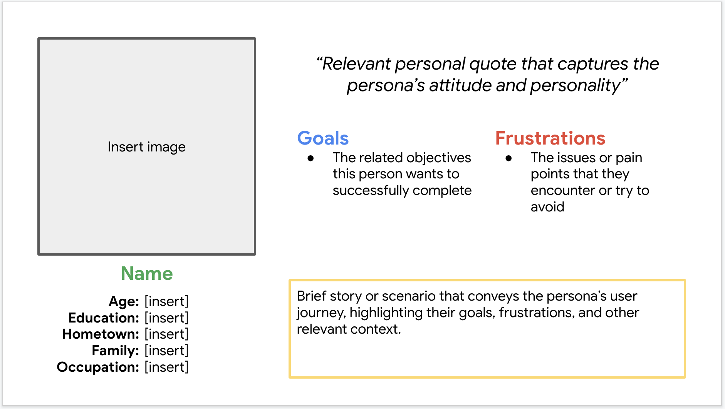
Persona: Sonam
Problem statement:
Sonam is a busy marketing manager who needs a convenient and reliable flower buying app because her tight schedule prevents her from visiting physical flower shops, and she requires a trustworthy platform to ensure high-quality and timely floral deliveries for both professional and personal occasions

Slide 9
Persona: Phuntsho
Problem statement:
Phuntsho is a passionate school teacher and gardening enthusiast who needs a comprehensive and user-friendly flower buying app because he struggles to find a diverse selection of flowers locally and requires detailed information about flower care to make informed purchasing decisions.

Slide 10
User journey map
This concise journey map captures Sonam's key actions, experiences, pain points, and opportunities as she transitions to and uses the Flower Buying App.
Image of user journey map

Slide 11
Paper wireframes
Digital wireframes
Low-fidelity prototype
Usability studies
Starting
the design

Slide 12
Paper wireframes
[Your notes about goals and thought process]
Image of paper wireframes including five different versions of the same screen and one image of the new, refined version

Slide 13
Digital wireframes
Description of the element and its benefit to the user
[Your notes about goals and thought process]
Insert first wireframe example that demonstrates design thinking aligned with user research
Description of the element and its benefit to the user

Slide 14
Digital wireframes
Description of the element and its benefit to the user
[Your notes about goals and thought process]
Insert second wireframe example that demonstrates design thinking aligned with user research
Description of the element and its benefit to the user

Slide 15
Low-fidelity prototype
[Link to low-fidelity prototype and brief description of the user flow]
Screenshot of prototype with connections or prototype GIF

Slide 16
Usability study: findings
The Flower Buying App underwent usability studies with diverse participants to identify pain points, assess design effectiveness, and gather feedback for improvements. The study included tech-savvy professionals and hobbyists, ensuring a comprehensive understanding of user requirements.
Round 1 findings
Round 2 findings
1
Navigation Complexity
1
Improved Navigation
2
Slow Load Times
2
Enhanced Loading Speed
3
Insufficient Product Information
3
Detailed Product Information

Slide 17
Refining
the design
Mockups
High-fidelity prototype
Accessibility

Slide 18
Mockups
Before usability study
After usability study
[Your notes about goals and thought process]
Image of selected screen before usability study
Image of selected screen after usability study

Slide 19
Mockups
Before usability study
After usability study
[Your notes about goals and thought process]
Image of selected screen before usability study
Image of selected screen after usability study

Slide 20
Mockups
Main mockup screen for display
Main mockup screen for display
Main mockup screen for display
Main mockup screen for display

Slide 21
High-fidelity prototype
[Link to high-fidelity prototype]
Screenshot of prototype with connections or prototype GIF

Slide 22
Accessibility considerations
1
2
3
Allowing users to adjust text size within the app to ensure all text remains legible for those with visual impairments.
Implementing high color contrast between text and background elements to improve readability for users with visual impairments.
Designing the app to be fully navigable using a keyboard to accommodate users with mobility impairments.

Slide 23
Going forward
Takeaways
Next steps

Slide 24
Takeaways
Impact: The Flower Buying App has garnered positive feedback from peers and study participants, with one user praising its easy navigation and personalized options, indicating its potential to enhance the flower purchasing experience and customer satisfaction.
What I learned:
The Flower Buying App project highlighted the importance of user-centered design and accessibility features, resulting in an inclusive product. Engaging with real users and collaborating with developers and stakeholders ensured clear communication and iterative feedback, meeting technical and business requirements.

Slide 25
Next steps
1
2
3
Gather user feedback post-launch to identify areas for improvement and implement updates to enhance user experience and address any usability issues.
Explore opportunities for scaling the app by adding new features, expanding product offerings, and launching in additional markets to meet the evolving needs of customers.
Perform regular audits to ensure ongoing compliance with accessibility standards, maintaining inclusivity and reaching a broader audience.

Slide 26
Insert a few sentences summarizing the next steps you would take with this project and why. Feel free to organize next steps in a bullet point list.
Let’s connect!
For more information about my work or to discuss potential collaborations, feel free to contact me at pemayangchenwt@gmail.com
17956041

Slide 27
Thank you!

