Slide 1
Mastering Python Basics
Unlock the fundamentals of Python programming, from data types to operators, and lay the groundwork for your coding journey. This guide is crafted for beginner programmers like you!

Slide 2
CHAPTER 1
Strings and Operators: The Building Blocks
In Python, strings are sequences of characters. They can be manipulated using various operators to create new strings or extract information.
Concatenation with '+'
Repetition with '*'
Length with len()
Join two or more strings together to form a single string. 'Well, ' + "it's a small " + 'world.' results in "Well, it's a small world."
Create multiple copies of a string. 'Spam, ' * 4 produces 'Spam, Spam, Spam, Spam, '
The len() function returns the number of characters in a string. len('Spam') gives 4.

Slide 3



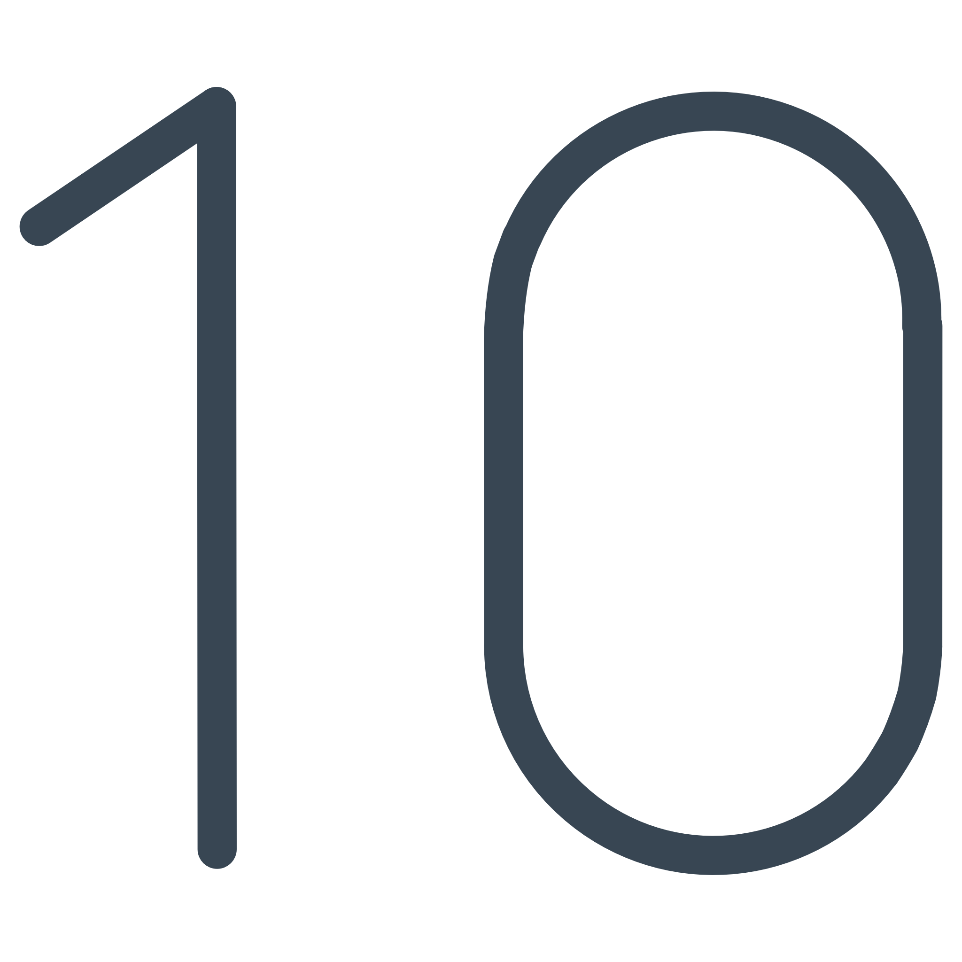


Understanding Python's Core Data Types
Every value in Python has a specific "type" that defines its characteristics and how it can be used. Recognizing these types is fundamental to writing correct code.
Floating-Point (float)
Numbers with fractional parts, represented with a decimal point. Example: 42.0
Integer (int)
Whole numbers, positive or negative, without a decimal point. Example: 2
String (str)
Sequences of characters enclosed in quotes. Example: 'Hello'

Slide 4

The type() Function and Type Conversion
Python provides the type() function to inspect the type of any value. You can also convert values between types using int() and float().
Checking Types
Converting Types
type(2) returns int
int(42.9) converts to 42 (rounds down)
type(42.0) returns float
float(42) converts to 42.0
type('Hello, World!') returns str
int('126') converts string to integer
float('12.6') converts string to float
Remember: a sequence of digits in quotes, like '126', is a string, not a number! Attempting arithmetic operations with incorrect types will result in a TypeError.

Slide 5
KEY CONCEPTS
Formal vs. Natural Languages
Understanding the distinction between these language types is crucial for effective programming.
1
Natural Languages
2
Formal Languages
Evolved naturally (e.g., English, Spanish)
Designed by people for specific applications (e.g., Python, math notation)
Full of ambiguity and redundancy
Context-dependent meaning
Nearly or completely unambiguous
Literalness is rare (idioms, metaphors)
Meaning is exact, regardless of context
Always literal in interpretation
Python, as a formal language, requires precision. Small errors can lead to big problems!

Slide 6
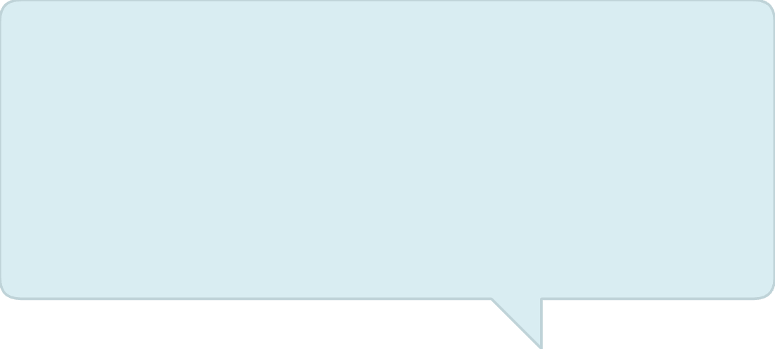
The Art of Debugging: Finding and Fixing Errors
Programming errors, or "bugs," are inevitable. Debugging is the process of tracking them down and correcting them. It's a fundamental skill for any programmer.
Identify the Bug
Locate the Error
Correct and Test
Recognize when your code isn't doing what you expect.
Use error messages and careful inspection to pinpoint the source.
Implement a fix and verify that the problem is resolved.
Embrace debugging as a learning opportunity. It builds resilience and problem-solving abilities far beyond coding.

Slide 7
GLOSSARY
Essential Python Terminology
Familiarize yourself with these core terms as you embark on your Python programming journey.
Value
A fundamental piece of data, like 2, 42.0, or 'Hello'.
Type
A category of values (e.g., int, float, str).
Operator
A symbol that performs an operation on values (e.g., +, *).
Operand
A value on which an operator operates.
Expression
A combination of values, variables, and operators that Python can evaluate.
Function
A named sequence of instructions that performs a specific task.
Syntax Error
An error in the program's structure that prevents it from running.

