Slide 1
Functions & Refactoring: Building Better Code
This presentation explores how functions can enhance code organization and reusability, focusing on refactoring techniques to improve existing programs.
We'll cover core concepts like interface design, generalization, and the importance of clear documentation.

Slide 2
REFACTORING WITH FUNCTIONS
Arc & Circle
Defining an Arc
Redefining a Circle
def arc(radius, angle): arc_length = 2 * math.pi * radius * angle / 360 n = 30 length = arc_length / n step_angle = angle / n polyline(n, length, step_angle)
def circle(radius): arc(radius, 360)
By utilizing the arc function, we can now define a circle as an arc that spans 360 degrees. This simplifies the circle's implementation significantly.
An arc is a segment of a circle. This function calculates the arc's length and then uses polyline to draw it in small segments.

Slide 3
THE POWER OF REFACTORING
Improving Code Without Changing Behavior
Refactoring is the process of restructuring existing computer code—changing the factoring—without changing its external behavior. It's about making the code cleaner, more readable, and easier to maintain.
Why Refactor?
When to Refactor?
Enhances readability and understanding.
When you gain new insights into the problem.
Reduces complexity and potential for bugs.
When code becomes difficult to understand or modify.
Improves maintainability and extensibility.
Before adding new features to ensure a solid foundation.
Often a sign of deeper understanding of the problem domain.
Regularly, as part of a development plan.

Slide 4
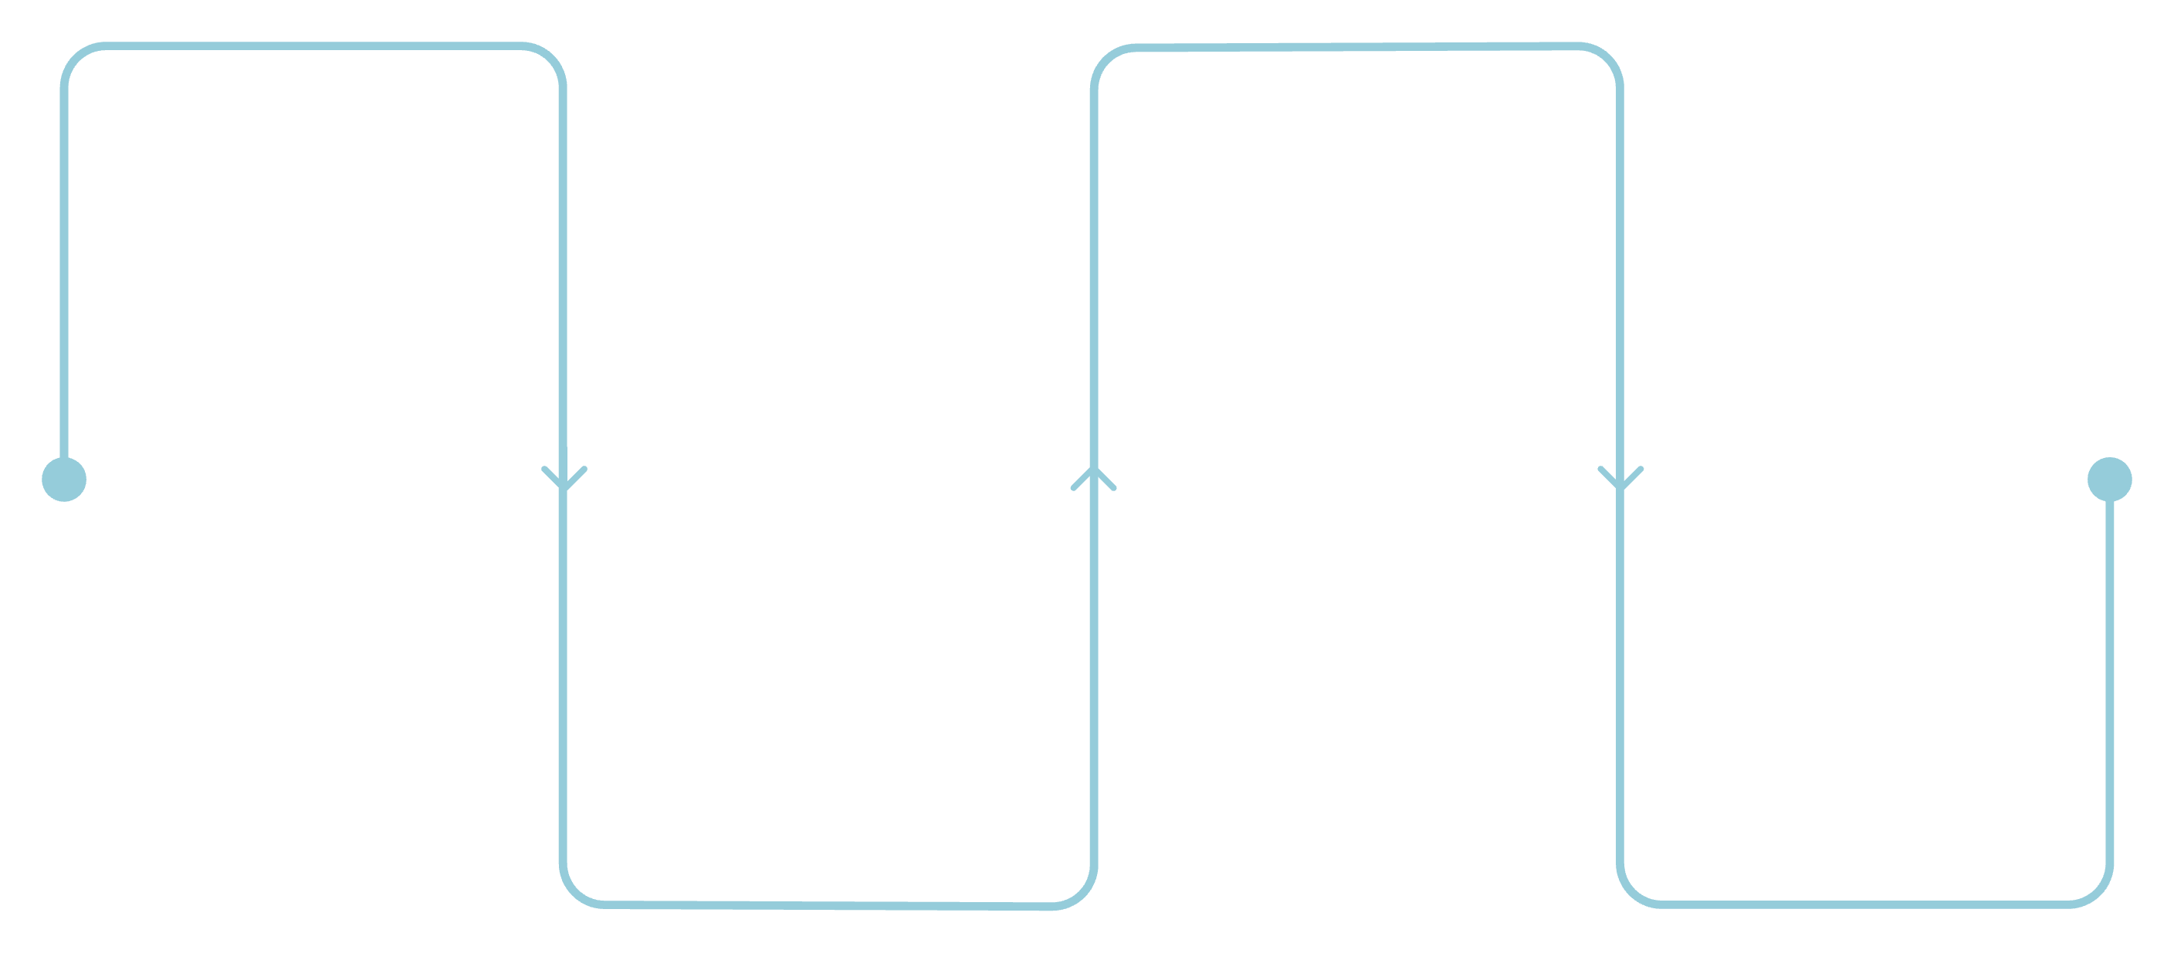
VISUALIZING FUNCTION CALLS
Understanding the Call Stack
Main
arc
calls circle()
radius, angle, step_angle
polyline
circle
n, length, step_angle
radius, angle
Parameters are local, meaning you can use the same parameter name in different functions; it’s a different variable in each function, and it can refer to a different value.

Slide 5
A GUIDED APPROACH TO PROGRAMMING
The Encapsulation & Generalization Plan
01
02
Start Small
Encapsulate
Begin with a minimal program without function definitions. Get it working correctly first.
Identify a coherent block of working code and wrap it into a function, giving it a descriptive name.
03
04
Generalize
Iterate & Refine
Enhance the function by adding parameters, making it more flexible and reusable for various scenarios.
Repeat the process. Continuously look for opportunities to refactor and improve existing functions, even if they already work.
This iterative development plan allows for designing as you code, adapting to new insights and understanding.

Slide 6


FUNCTION DESIGN PRINCIPLES
Interface vs. Implementation
Interface
The "what": Defines how a function is used externally. This includes its name, parameters, and what it promises to do.
Public face of the function.
Focuses on usability and clarity.
Example: circle(radius) - it draws a circle with a given radius.
Implementation
The "how": Details the internal workings of a function—the specific code that achieves the promised behavior.
Hidden from the caller.
Can change without affecting the interface.
Example: The internal code within circle that uses polygon or arc to draw.
A well-designed function maintains a consistent interface, even if its implementation evolves.

Slide 7


DOCUMENTING YOUR CODE
The Importance of Docstrings
def polyline(n, length, angle): """Draws line segments with the given length and angle between them. n: integer number of line segments length: length of the line segments angle: angle between segments (in degrees) """ for i in range(n): forward(length) left(angle)
Docstrings are triple-quoted strings at the start of a function that succinctly explain its purpose, parameters, and expected behavior. They are crucial for interface design.
Clarity: Explains what the function does, not how it does it.
Parameters: Details the role and type of each parameter.
Maintainability: Makes code easier for others (and future you) to understand and use.

Slide 8



ENSURING ROBUST CODE
Preconditions & Postconditions
Preconditions
Postconditions
Requirements that must be met by the caller before a function executes. If violated, the bug is in the caller.
Guarantees made by the function after its execution. Includes intended effects and any side effects.
Clear pre- and postconditions define the "contract" between a function and its caller, making debugging significantly easier.
Debugging Tip: If preconditions are met but postconditions are not, the bug is within the function itself. If preconditions are violated, the issue lies with how the function was called.

Slide 9




A GUIDED APPROACH TO PROGRAMMING
Iterative Development Cycle
Start Small
Encapsulate
Begin with a minimal, working program. Prioritize core functionality before expanding.
Extract coherent blocks of code into named functions to improve readability and modularity.
Iterate & Refine
Generalize
Continuously review and improve code, seeking opportunities for further refactoring and optimization.
Introduce parameters to functions, making them flexible and reusable across different contexts.
This cyclical approach fosters a flexible development process, allowing design decisions to evolve with deeper understanding.

