Slide 1

SCHOOL ACADEMIC
MANAGEMENT SYSTEM
( S A M S )
A Visual Programming Group Project — COSC 31112 / BECS 31242
Group 11
PS/2022/142 – W.A.P.V. Weerasingha PS/2022/199 – L.A.P. Prabodhitha
PS/2022/070 – A.M.A.D.M. Alagiyawanna PS/2022/219 – K.A.C.K. Kulathunga
Department of Statistics & Computer Science | Faculty of Science | University of Kelaniya

Slide 2
OVERVIEW
Agenda
01
Introduction
05
Class Teacher Module
What SAMS is and the problem it solves
Profile, marks & discipline tracking
02
User Roles
06
Subject Teacher Module
Admin, Class Teacher & Subject Teacher
Profile & subject mark sheets
03
Authentication
07
Key Highlights
Secure login and account registration
What makes SAMS effective
04
Admin Module
08
Team Contributions
Dashboard, users, students & classes
Who built what
School Academic Management System • Group 11
2

Slide 3



INTRODUCTION
What is SAMS?
A desktop application built to help school staff manage day-to-day academic administration.
Users sign in through a secure login and land on a dashboard tailored to their role.
Covers student information management, disciplinary tracking, and academic performance monitoring.
Supports bulk upload of marks via Excel, cutting down manual data-entry errors.
Three role-based dashboards
Admin
Full system oversight
Class Teacher
Class-level records
Subject Teacher
Subject mark sheets
School Academic Management System • Group 11
3

Slide 4
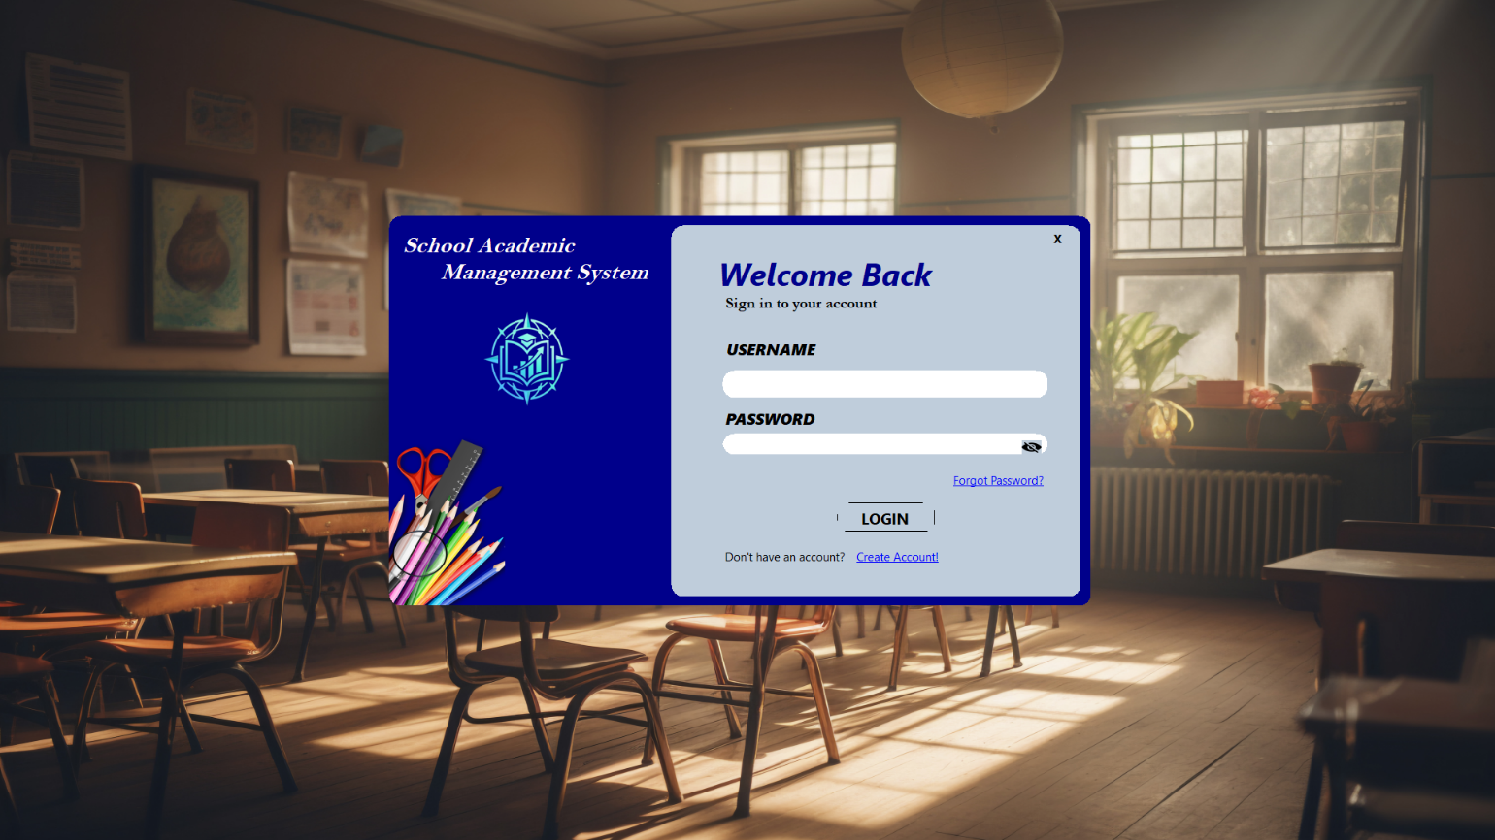
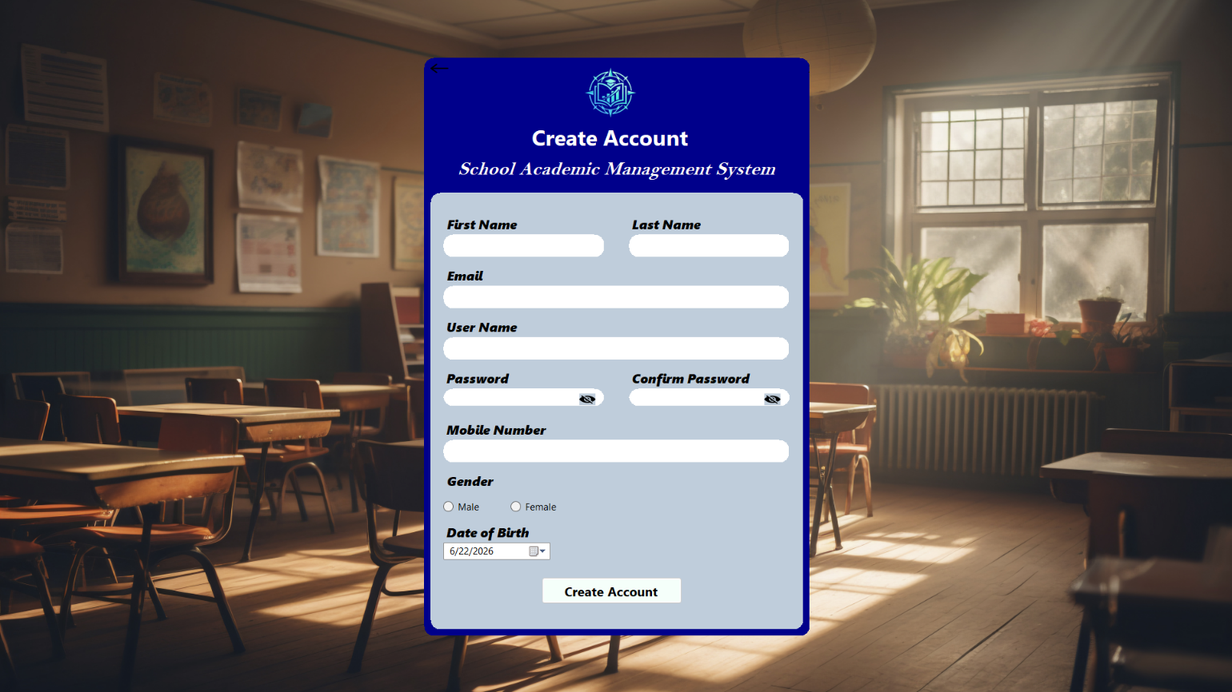
AUTHENTICATION
Signing In & Getting Access
Login Page
Create Account
Login: username & password sign-in, with show/hide password and a Forgot Password link. Register: new staff submit their details to request access, pending Admin approval.
School Academic Management System • Group 11
4

Slide 5
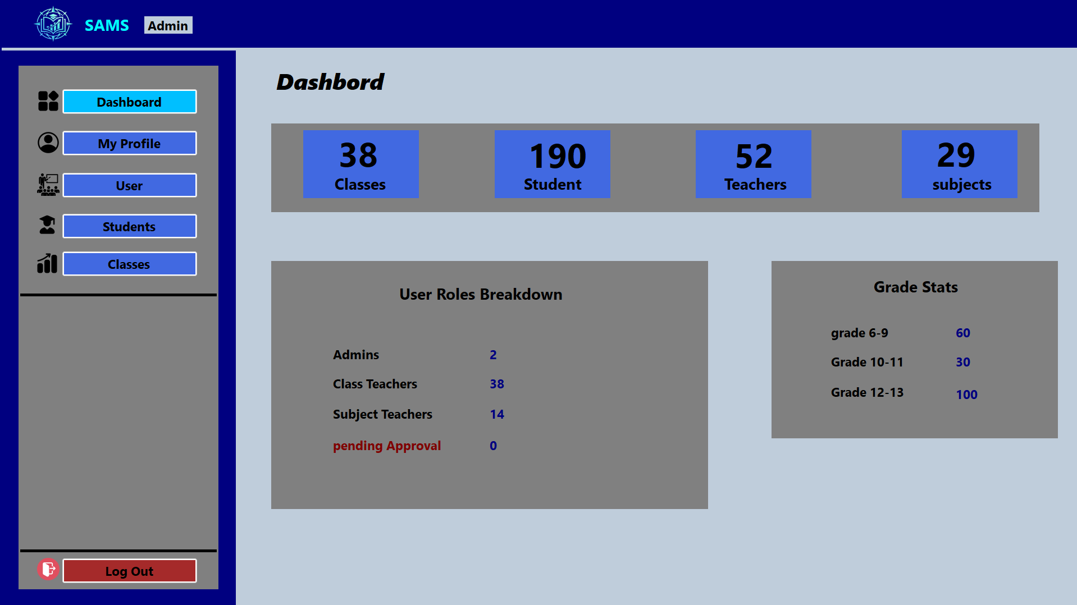
ADMIN MODULE
Admin Dashboard
School-wide snapshot: total classes, students, teachers and subjects.
User-roles breakdown — Admins, Class Teachers, Subject Teachers & pending approvals.
Grade-wise student statistics across all grade bands.
A single screen Admins land on right after logging in.
School Academic Management System • Group 11
5

Slide 6
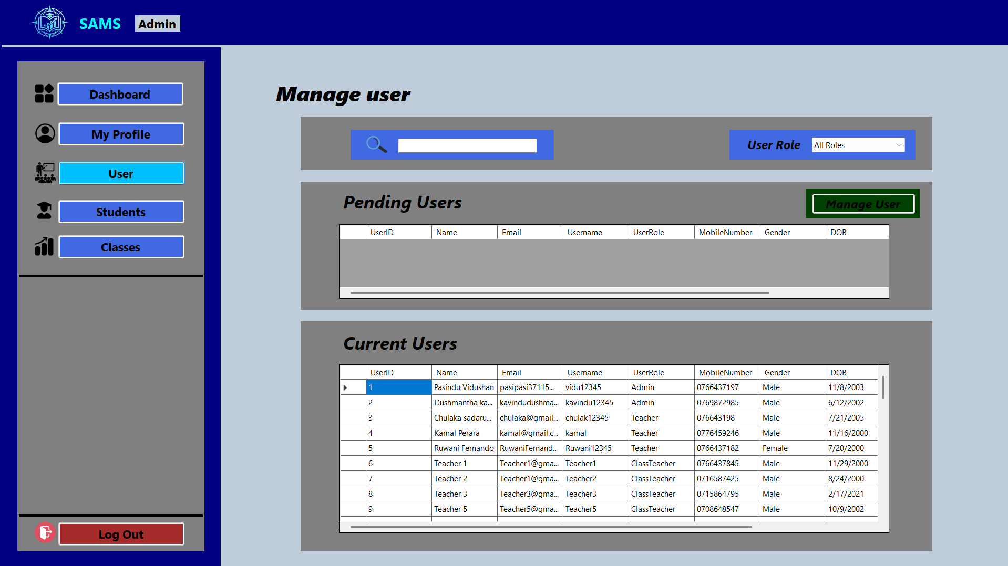
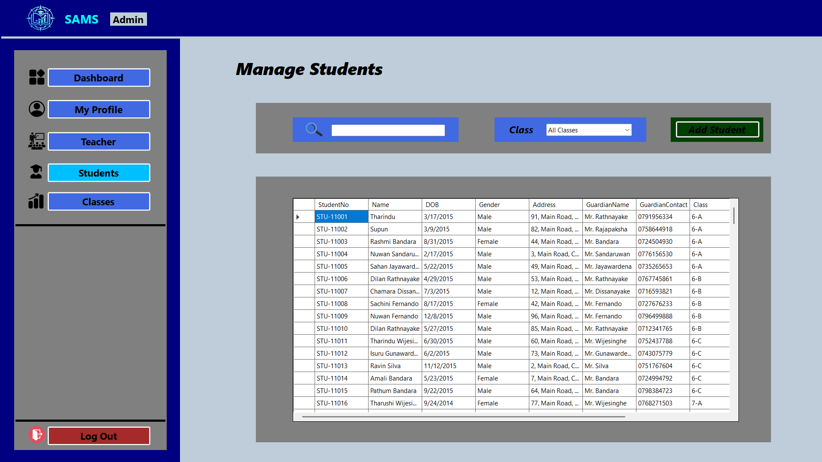
ADMIN MODULE
Managing Users & Students
Manage Users
Manage Students
Users: search/filter by role, review pending registrations, approve or manage accounts. Students: filter by class and view full records — guardian name, contact, and address.
School Academic Management System • Group 11
6

Slide 7
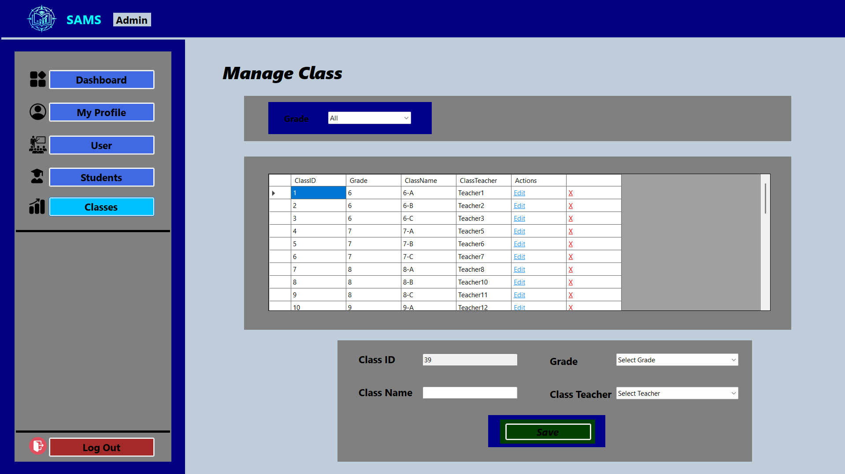
ADMIN MODULE
Managing Classes
Filter the full class list by grade.
See every class with its assigned Class Teacher at a glance.
Create new classes or edit/delete existing ones from the same screen.
Keeps grade structure and staffing consistent across the school.
School Academic Management System • Group 11
7

Slide 8
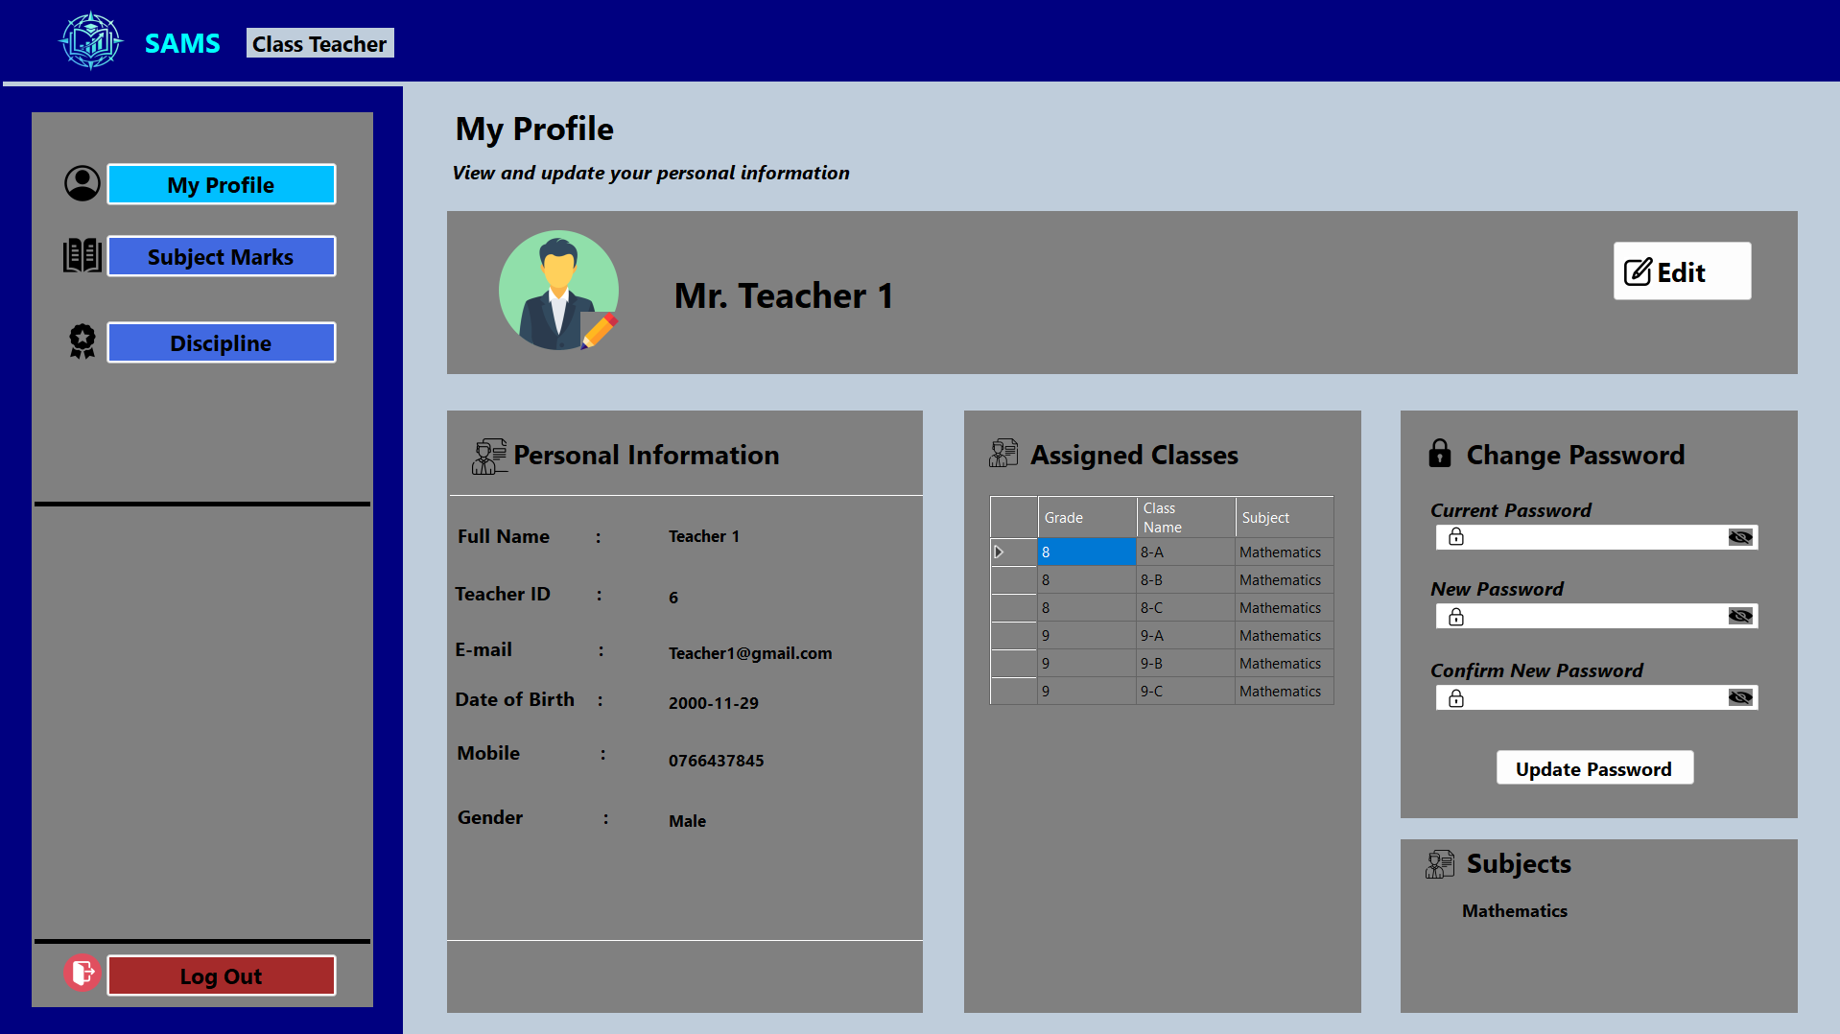
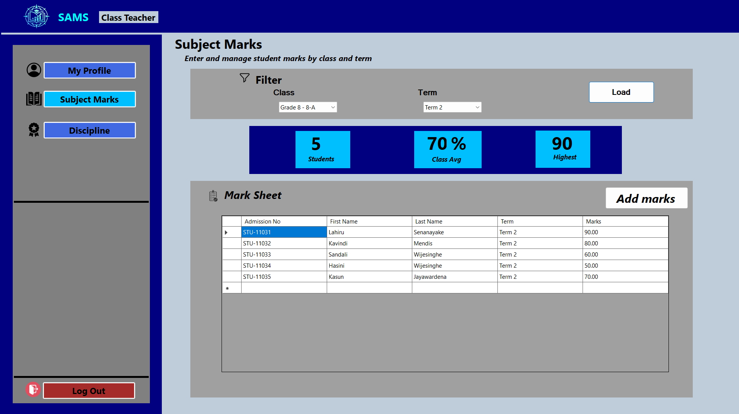
CLASS TEACHER MODULE
Class Teacher Workspace
My Profile
Subject Marks
Profile: personal details plus assigned classes & subject. Subject Marks: filter by class & term to load a mark sheet, with class average and highest score shown instantly.
School Academic Management System • Group 11
8

Slide 9
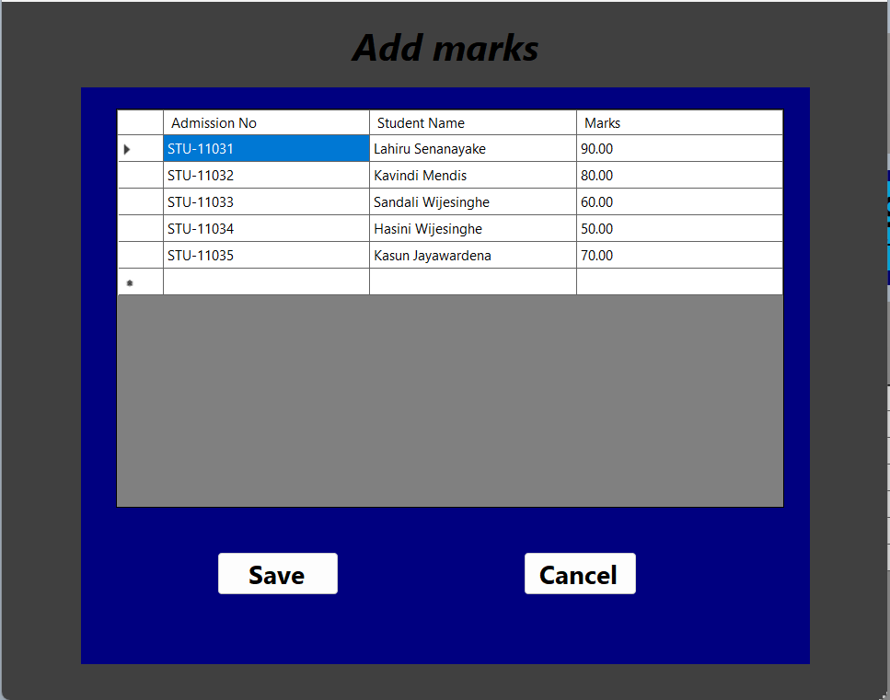
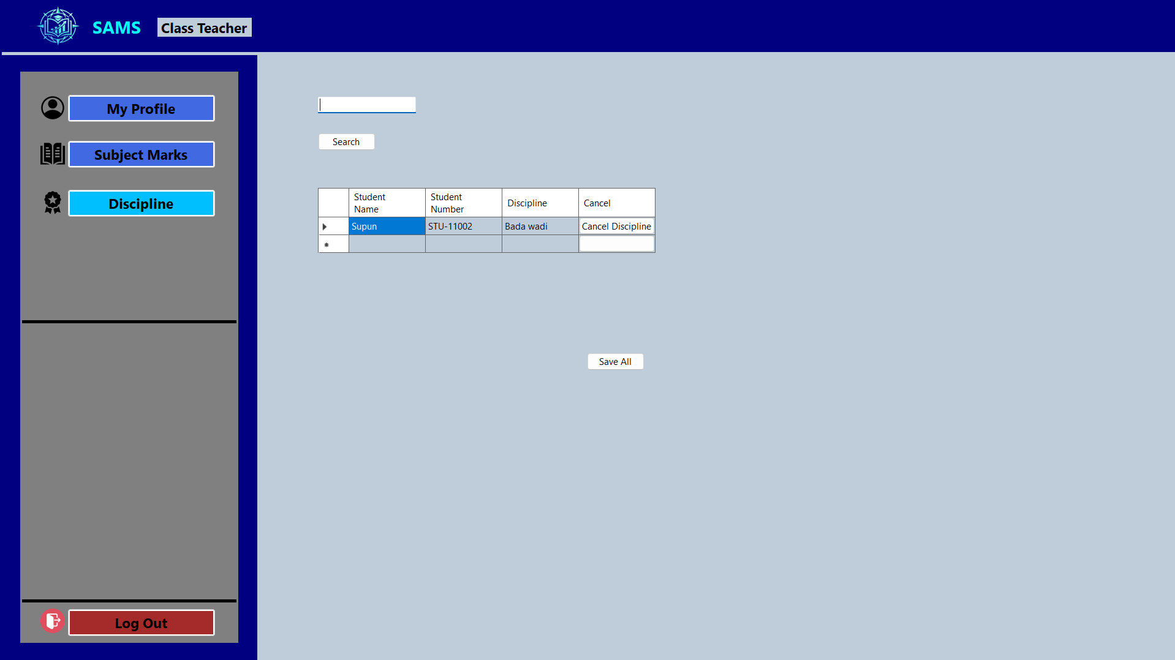
CLASS TEACHER MODULE
Recording Marks & Discipline
Add Marks
Discipline Records
Add Marks: a dedicated grid to enter or update every student’s mark before saving. Discipline: search a student, log a disciplinary entry, and cancel it once resolved.
School Academic Management System • Group 11
9

Slide 10
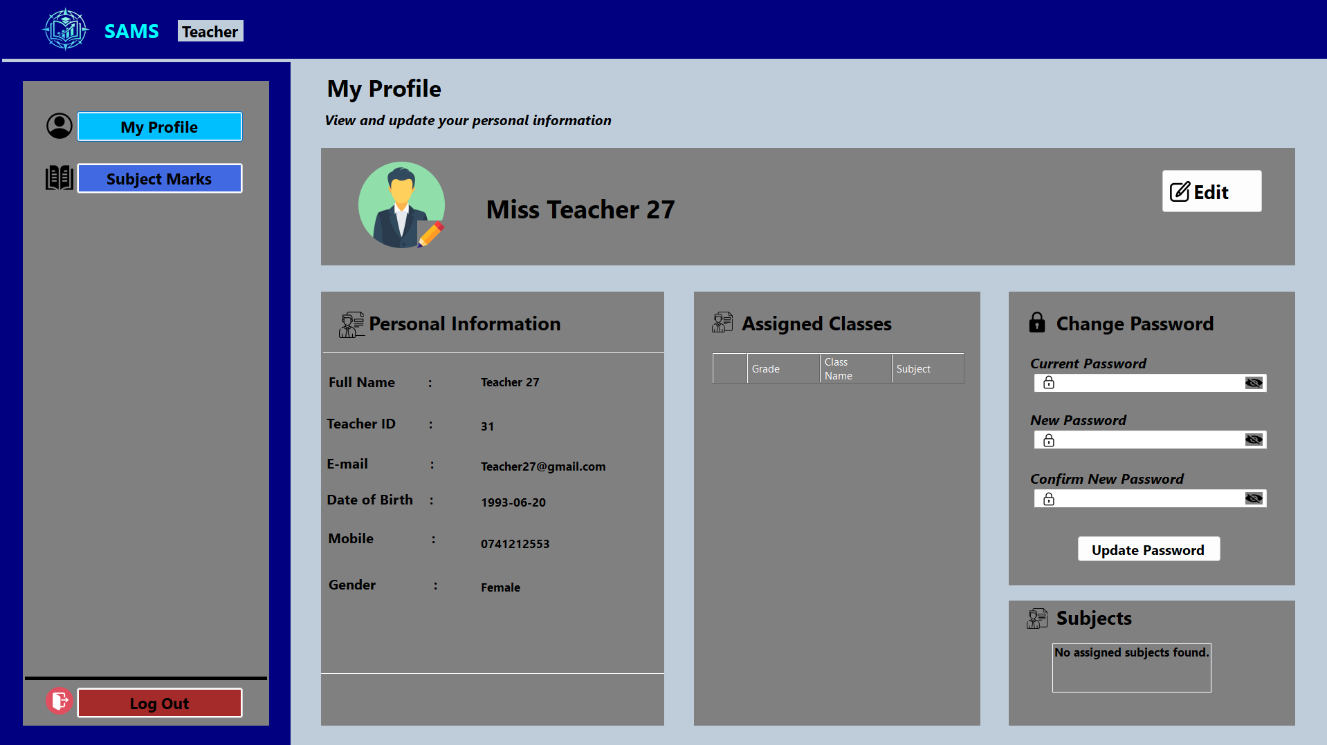
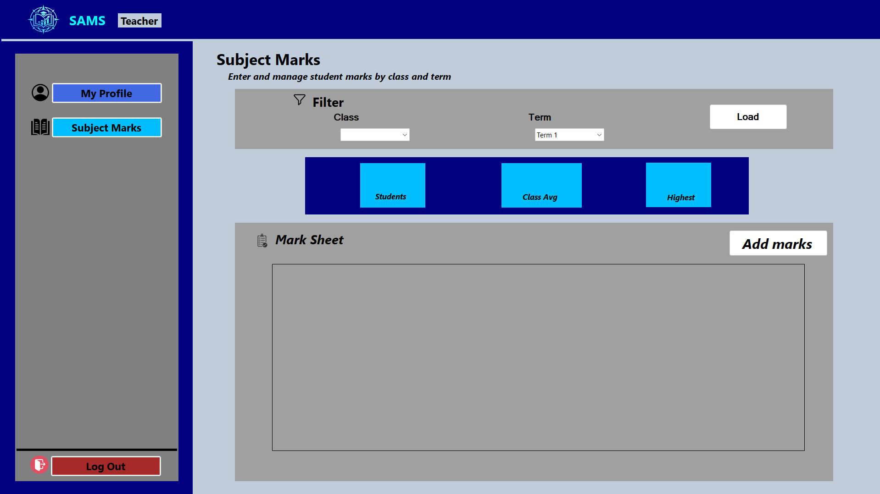
SUBJECT TEACHER MODULE
Subject Teacher Workspace
My Profile
Subject Marks
Profile: personal information and assigned classes/subject in one place. Subject Marks: the same load-and-manage mark sheet, scoped to the subject they teach.
School Academic Management System • Group 11
10

Slide 11






WHY SAMS
Key Highlights
Role-Based Access
Secure Authentication
Bulk Excel Upload
Admins, Class Teachers and Subject Teachers each see only what's relevant to them.
Encrypted login with password visibility toggles and account recovery.
Marks can be imported in bulk, cutting manual entry errors.
Live Dashboards
Discipline Tracking
Centralized Records
Real-time stats on students, classes, teachers and subjects.
Quick logging and resolution of student disciplinary records.
One system for student, class and academic-performance data.
School Academic Management System • Group 11
11

Slide 12
OUR TEAM
Team & Contributions
Member | Modules / Forms Developed
PS/2022/142 – W.A.P.V. Weerasingha | Form1.cs • Register.cs • AdminDashboard.cs • Admin_Teacher.cs • Manage_users.cs
PS/2022/199 – L.A.P. Prabodhitha | Admin_Classes.cs • Class_Teacher_Subject_marks.cs • add_mark_form.cs
PS/2022/070 – A.M.A.D.M. Alagiyawanna | Admin_profile.cs • Admin_student.cs • Student_registration.cs • Class_Teacher_Profile.cs • Teacher_profile.cs
PS/2022/219 – K.A.C.K. Kulathunga | Class_Teacher_Discipline.cs • Subject_Marks.cs • subject_teacher_mark_add.cs
School Academic Management System • Group 11
12

Slide 13
Thank You
Questions & Discussion
Group 11 — School Academic Management System (SAMS)
Department of Statistics & Computer Science | Faculty of Science | University of Kelaniya

