Slide 1


Fresh
Ceylon
Fresh Food Management System (FFMS)
Empowering Sri Lanka's Farming Community
COSC 31103 / BECS 31233 • Web & Internet Technologies
Group PS-09
PS/2022/046 N.M.T.Madhuwantha • PS/2022/070 A.M.A.D.M.Alagiyawanna • PS/2022/152 E.M.T.Bandara • PS/2022/199 L.A.P.Prabodhitha • PS/2022/219 K.A.C.K.Kulathunga

Slide 2





OVERVIEW
What is Fresh Ceylon?
A web-based platform connecting Sri Lanka's farmers, sales persons, and transporters — reducing food waste and improving market access.
Food Wastage
No Coordination
No Transparency
Produce spoils with no direct farmer-to-buyer channel
Zero centralized system for listing, ordering & transport
Hidden pricing, availability gaps, unknown delivery status
Target Audience
Farmers
Sales Persons
Transporters
Individual & Cooperative
Retailers & Wholesalers
Drivers & Truck Owners

Slide 3





FEATURES
Key Features
Secure Auth
Farmer Tools
Sales Dashboard
Auto Transport Match
Login & signup with full validation
List produce, manage inventory & orders
Browse, filter & book produce orders
Transporters matched by service area
Live Notifications
Rating System
Advanced Search
Account Settings
Real-time order & delivery alerts
Post-delivery star ratings & reviews
Filter by crop, type & city
Profile, password & coverage areas

Slide 4
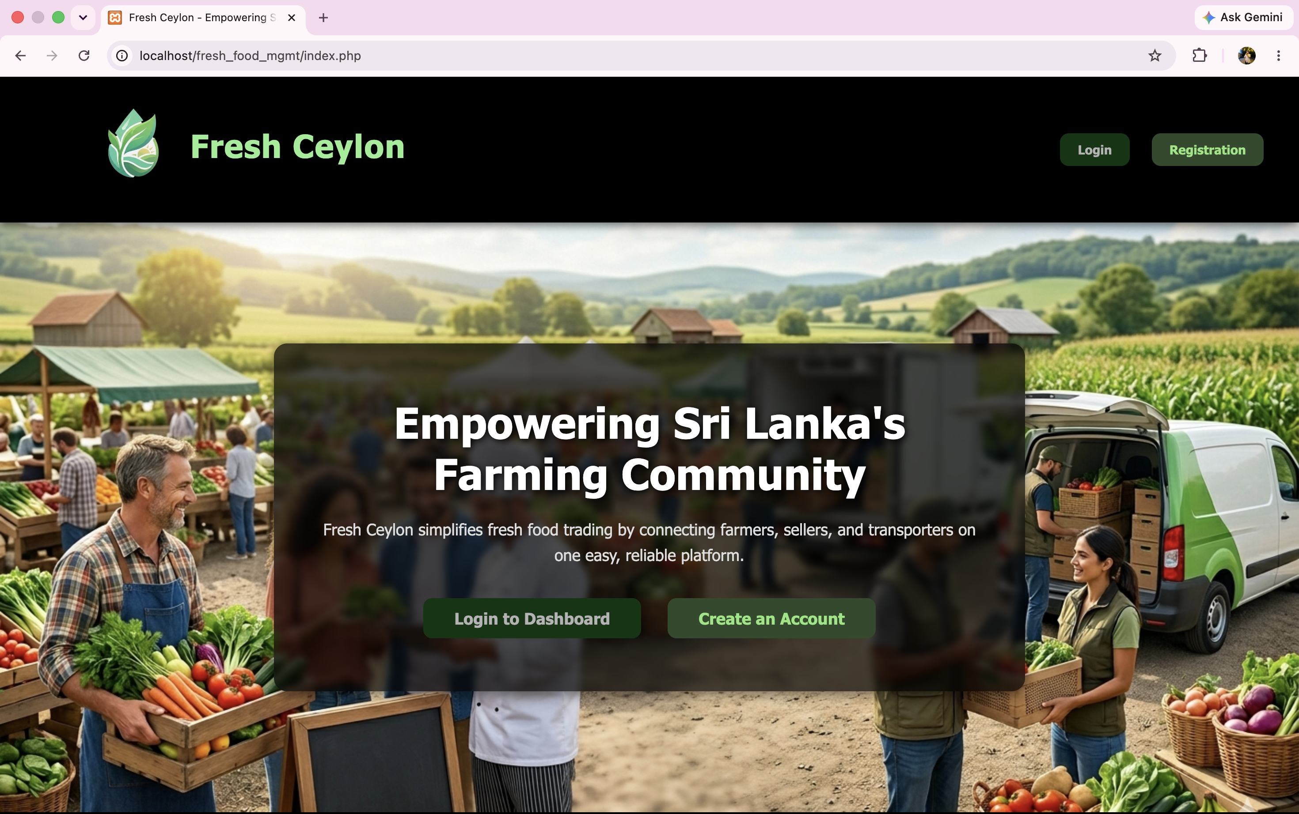
LANDING PAGE
Home Page
Hero banner with farming imagery
Clear value proposition headline
Login & Create Account CTAs
Quick Links & Contact in footer
Responsive dark-themed design
localhost/fresh_food_mgmt/index.php

Slide 5
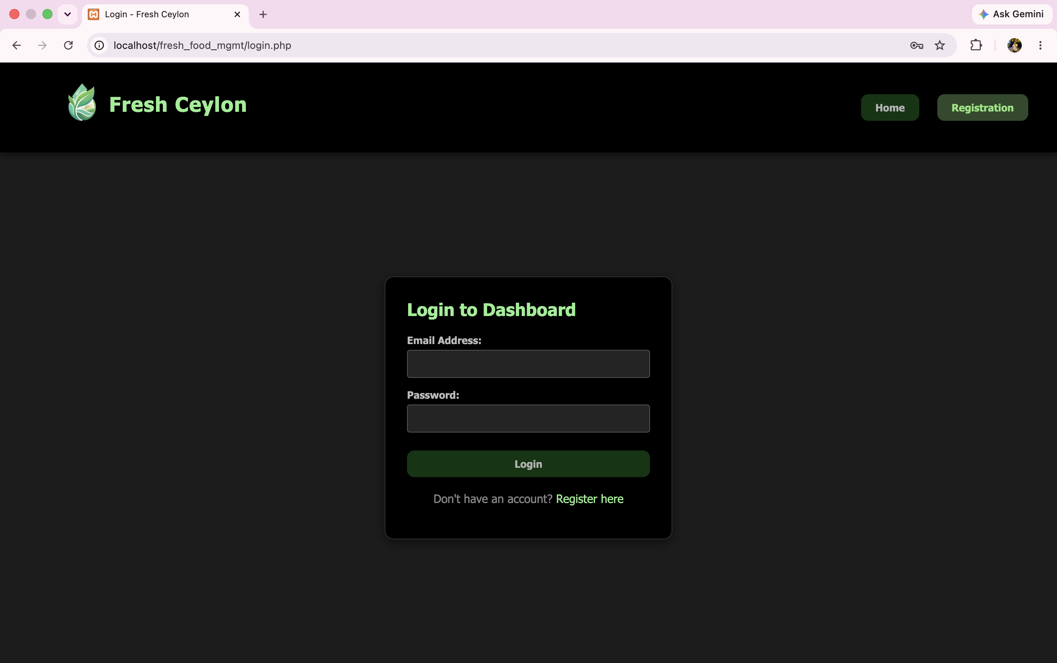
LOGIN INTERFACE
Sign In Screen
Clean two-field login form
Email & password authentication
Quick link to registration page
Dark-themed branded design
Centered card layout
Consistent site-wide navigation

Slide 6
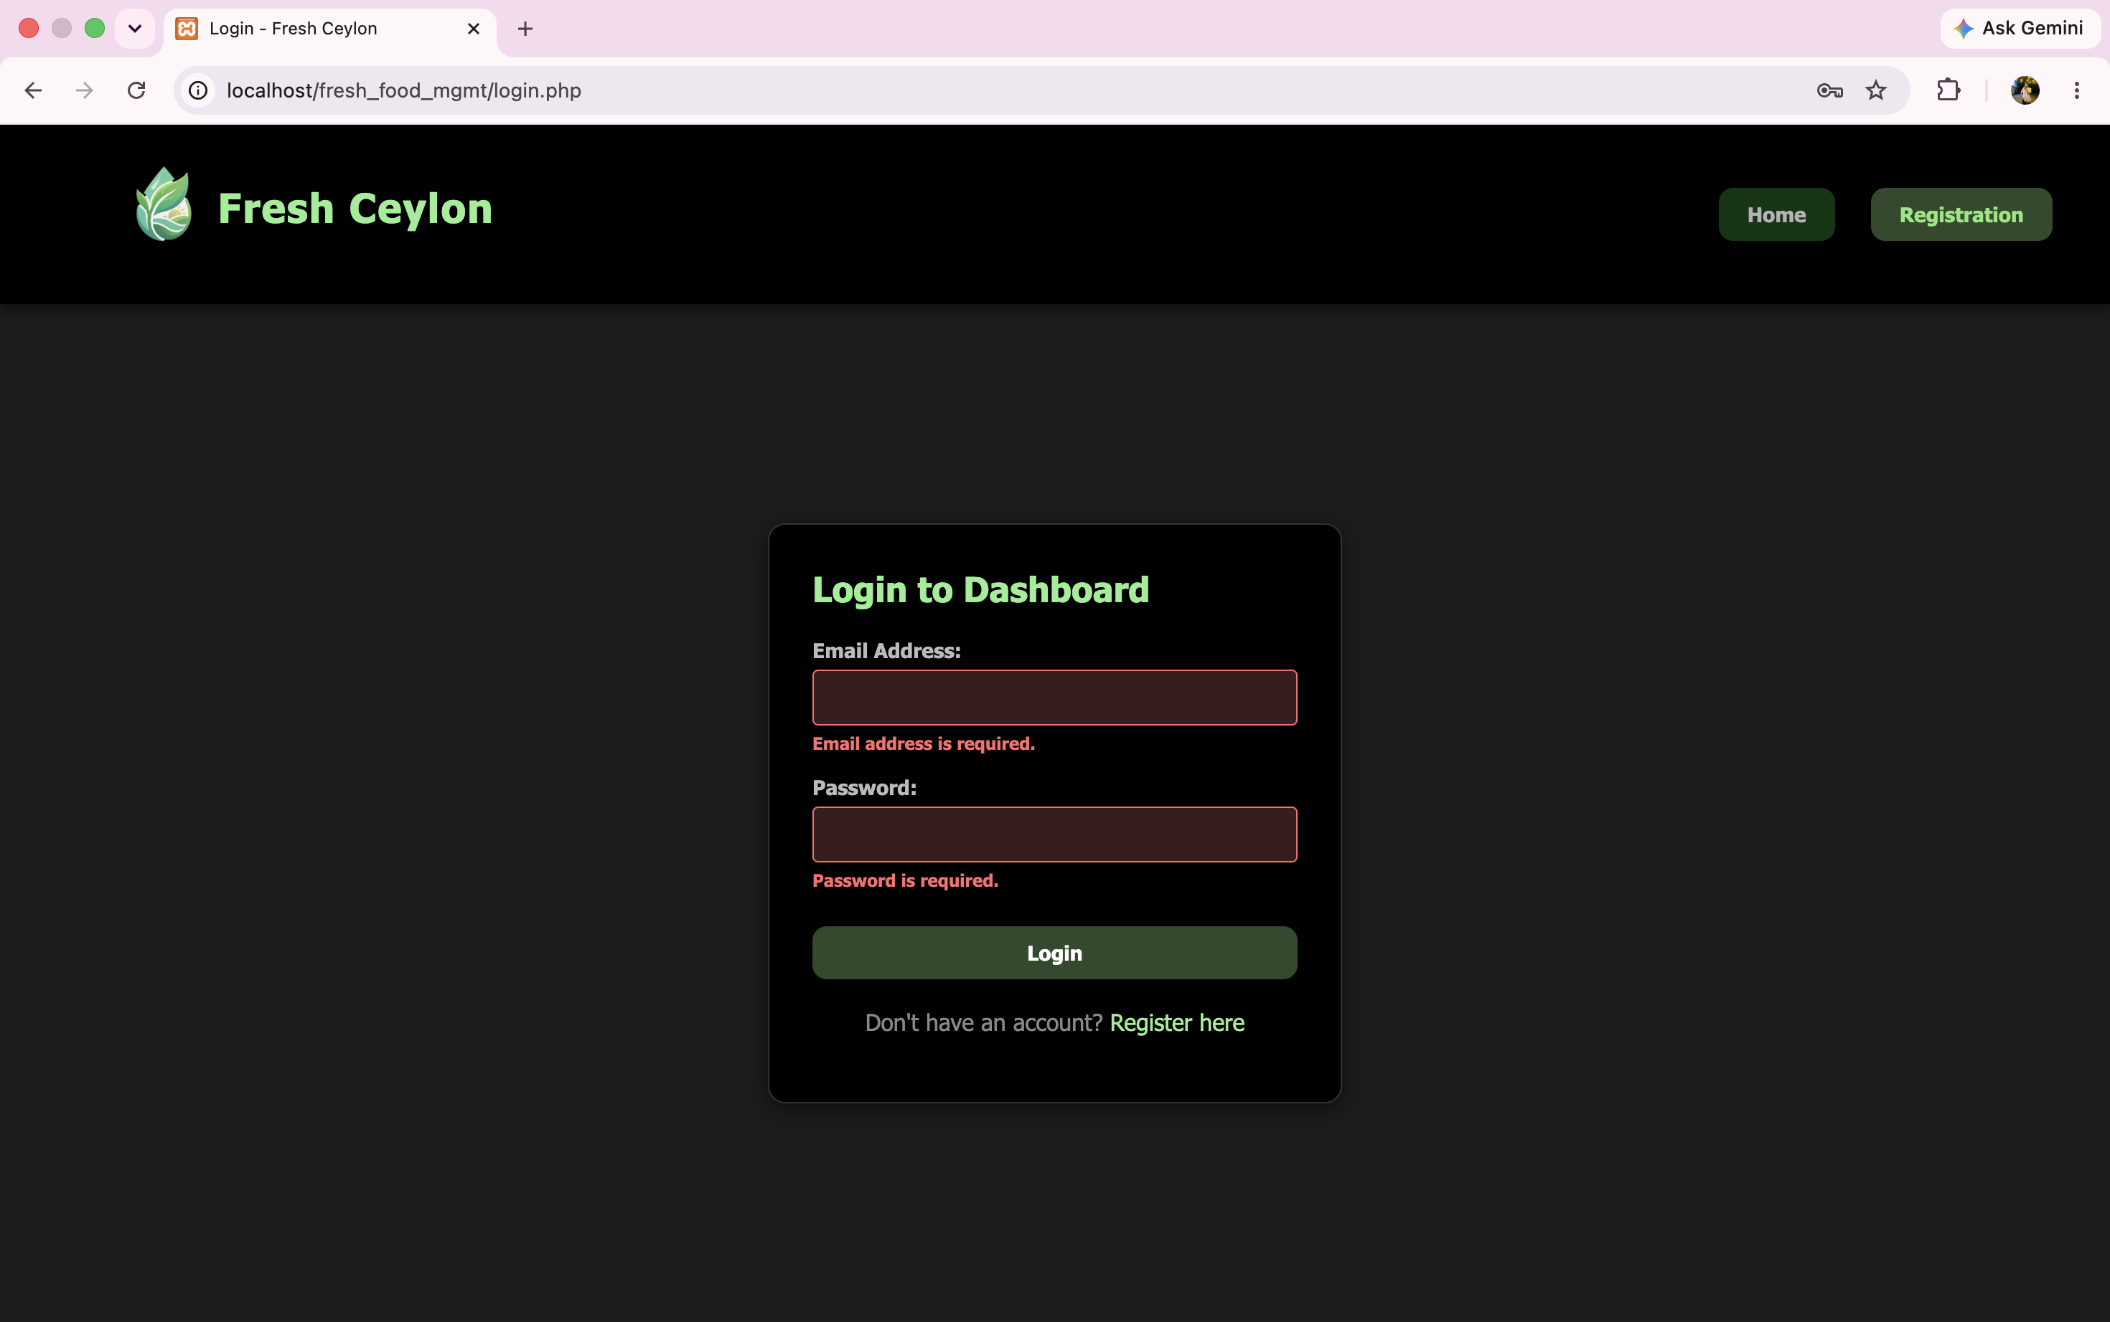
FORM VALIDATION
Real-Time Validation
Inline required-field checks
Red highlight on empty inputs
Clear error text per field
Stops incomplete submissions
Instant feedback before submit
Guides users to correct entry

Slide 7
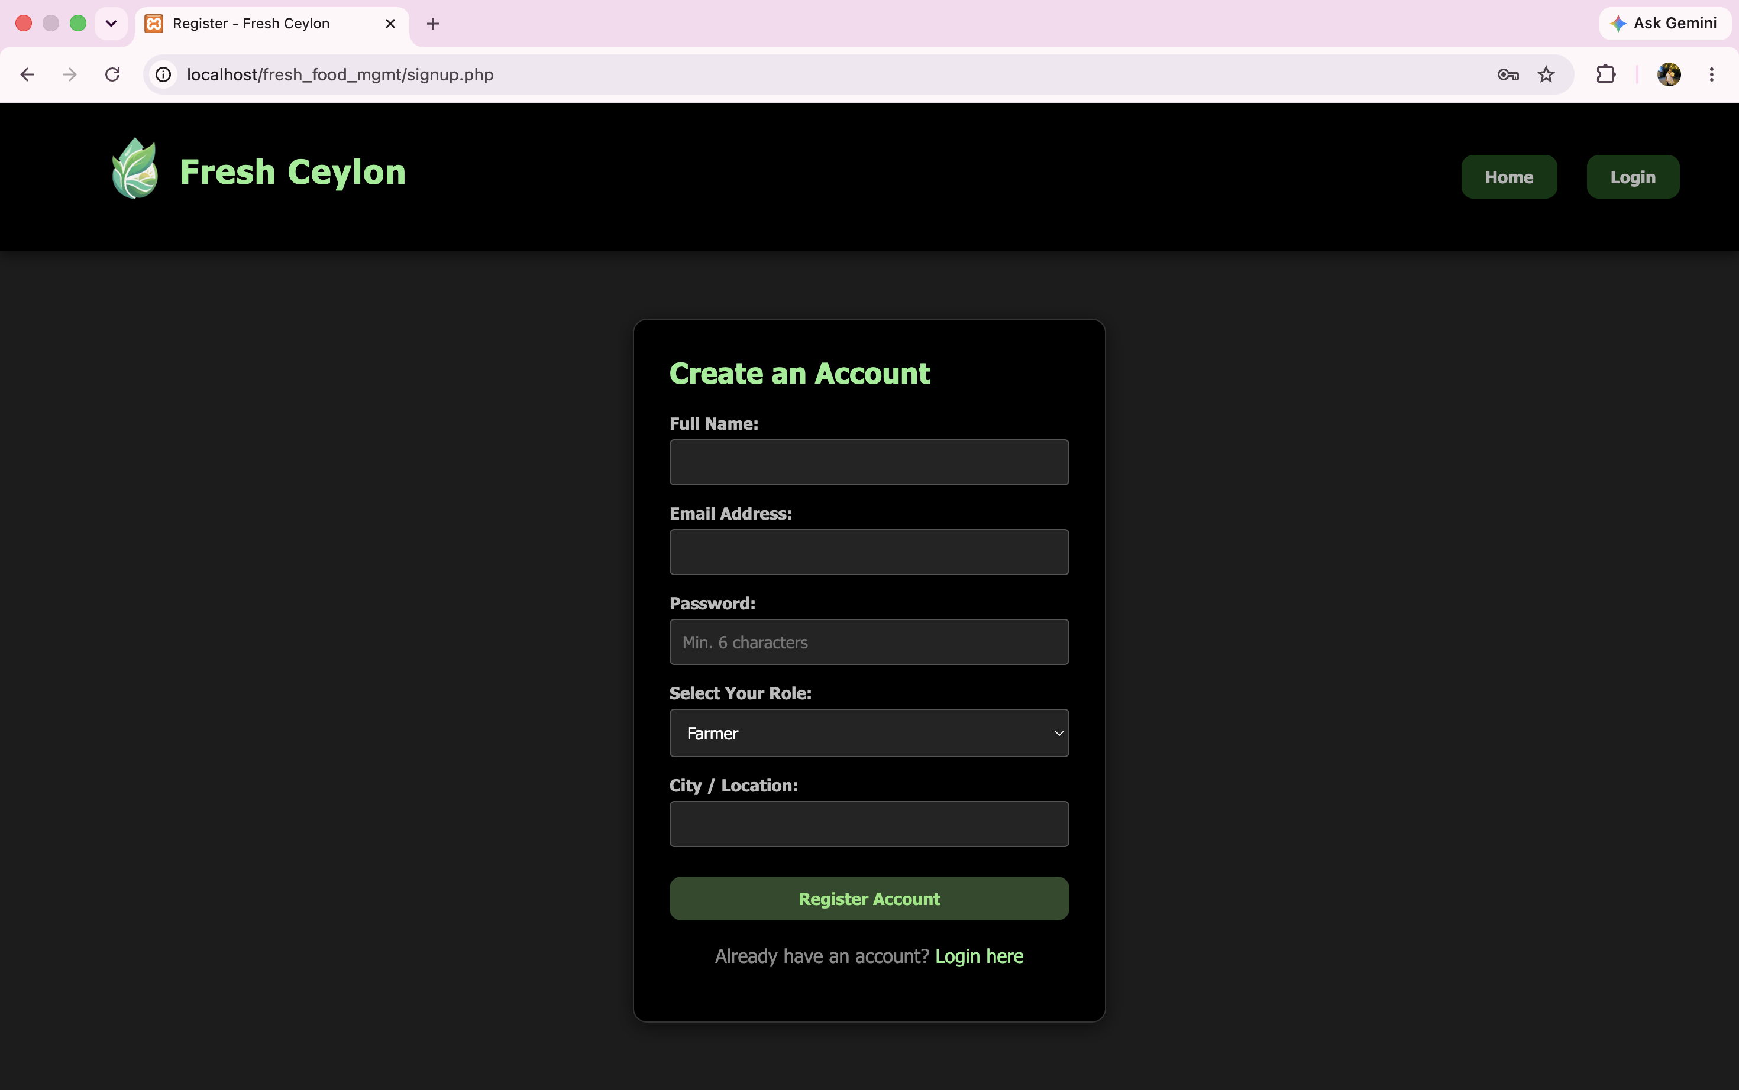
ACCOUNT CREATION
Registration Form
Full name, email & password fields
Role selector: Farmer, Sales, Transporter
City / Location capture field
Password minimum length hint
Link back to login page
Single unified signup flow

Slide 8
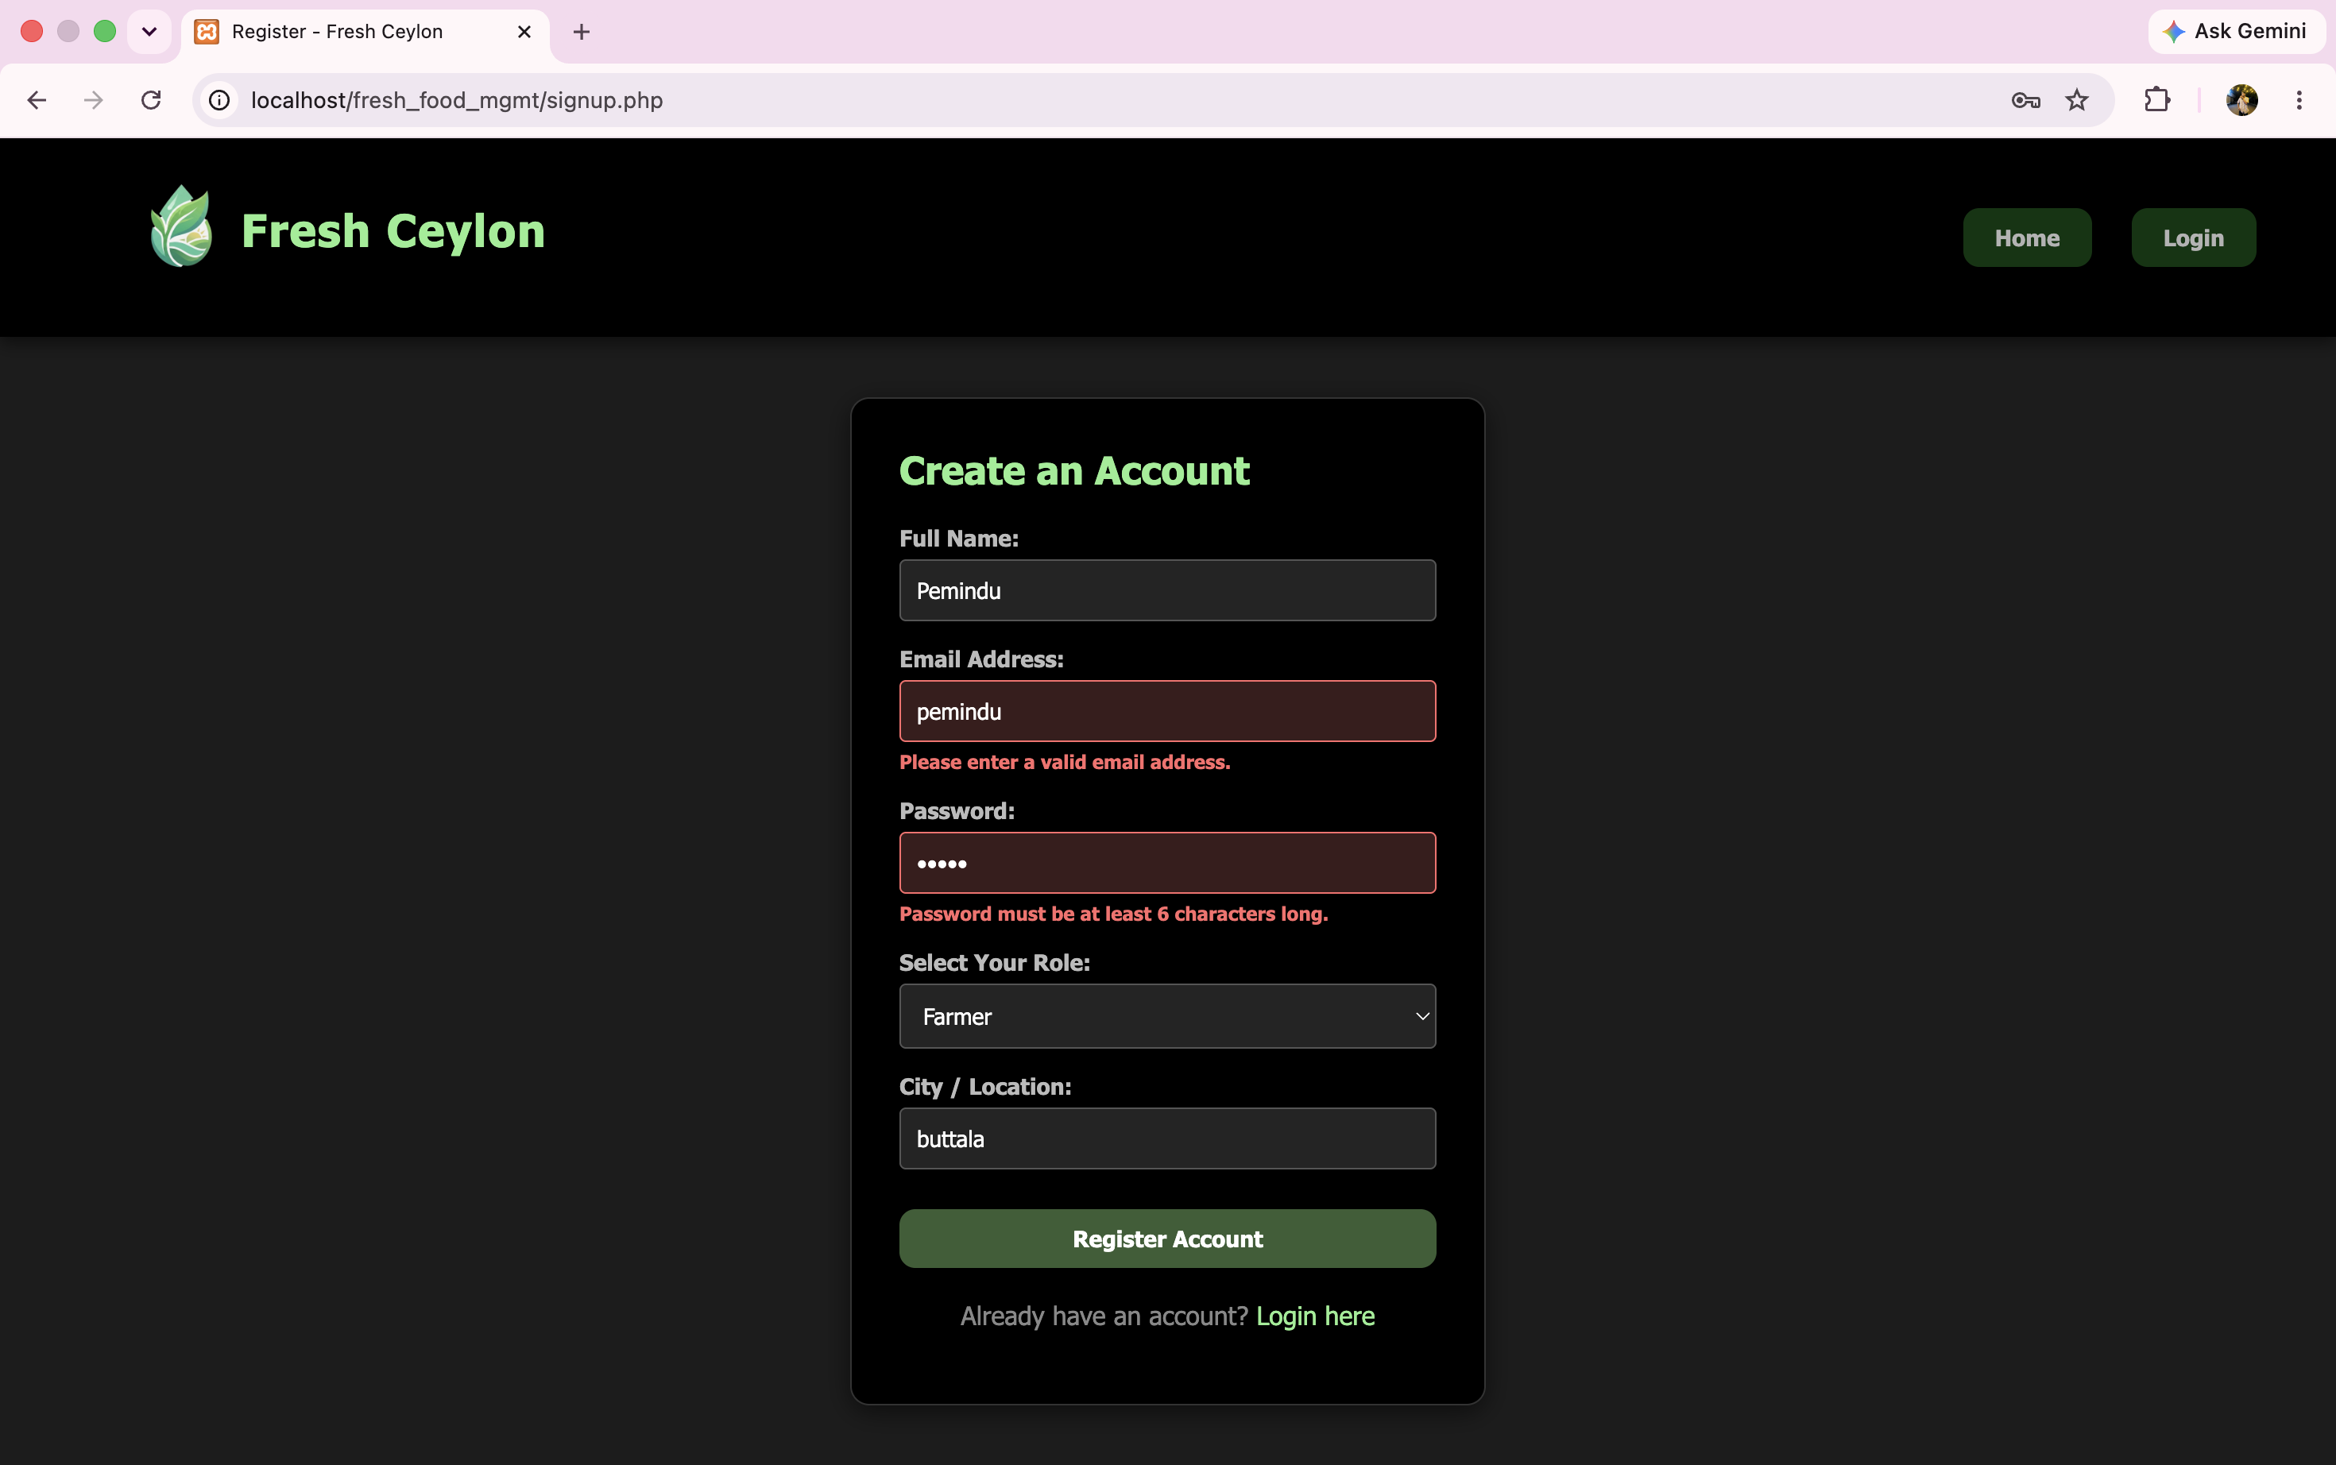
ERROR HANDLING
Input Error Handling
Validates correct email format
Enforces 6-character password
Field-level inline error text
Retains valid entries on error
Prevents bad data submission
Consistent red error styling

Slide 9
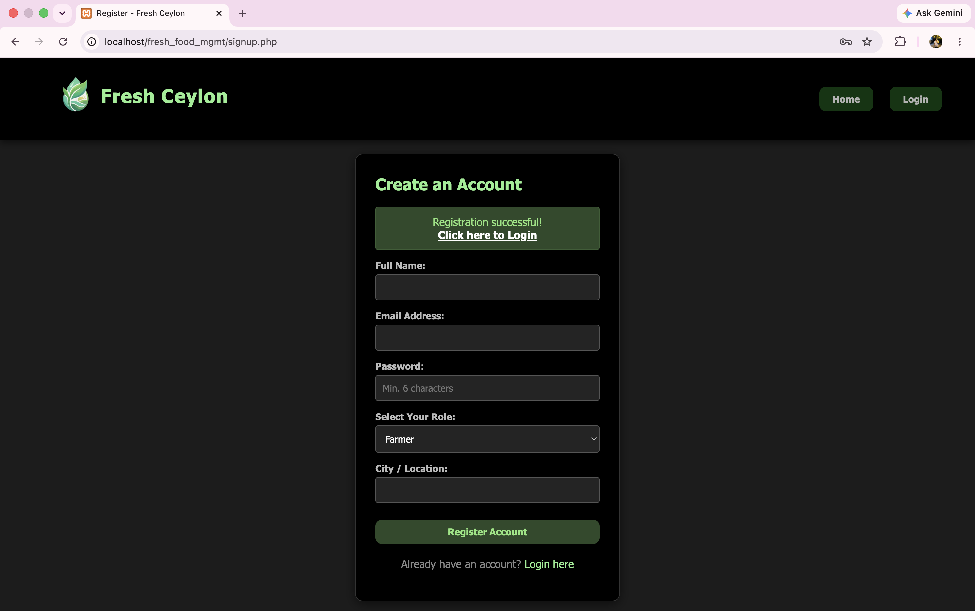
SUCCESS STATE
Registration Success
Green confirmation banner shown
One-click redirect to login
Form fields reset automatically
Confirms account was created
Smooth handoff to sign-in
Seamless onboarding experience

Slide 10
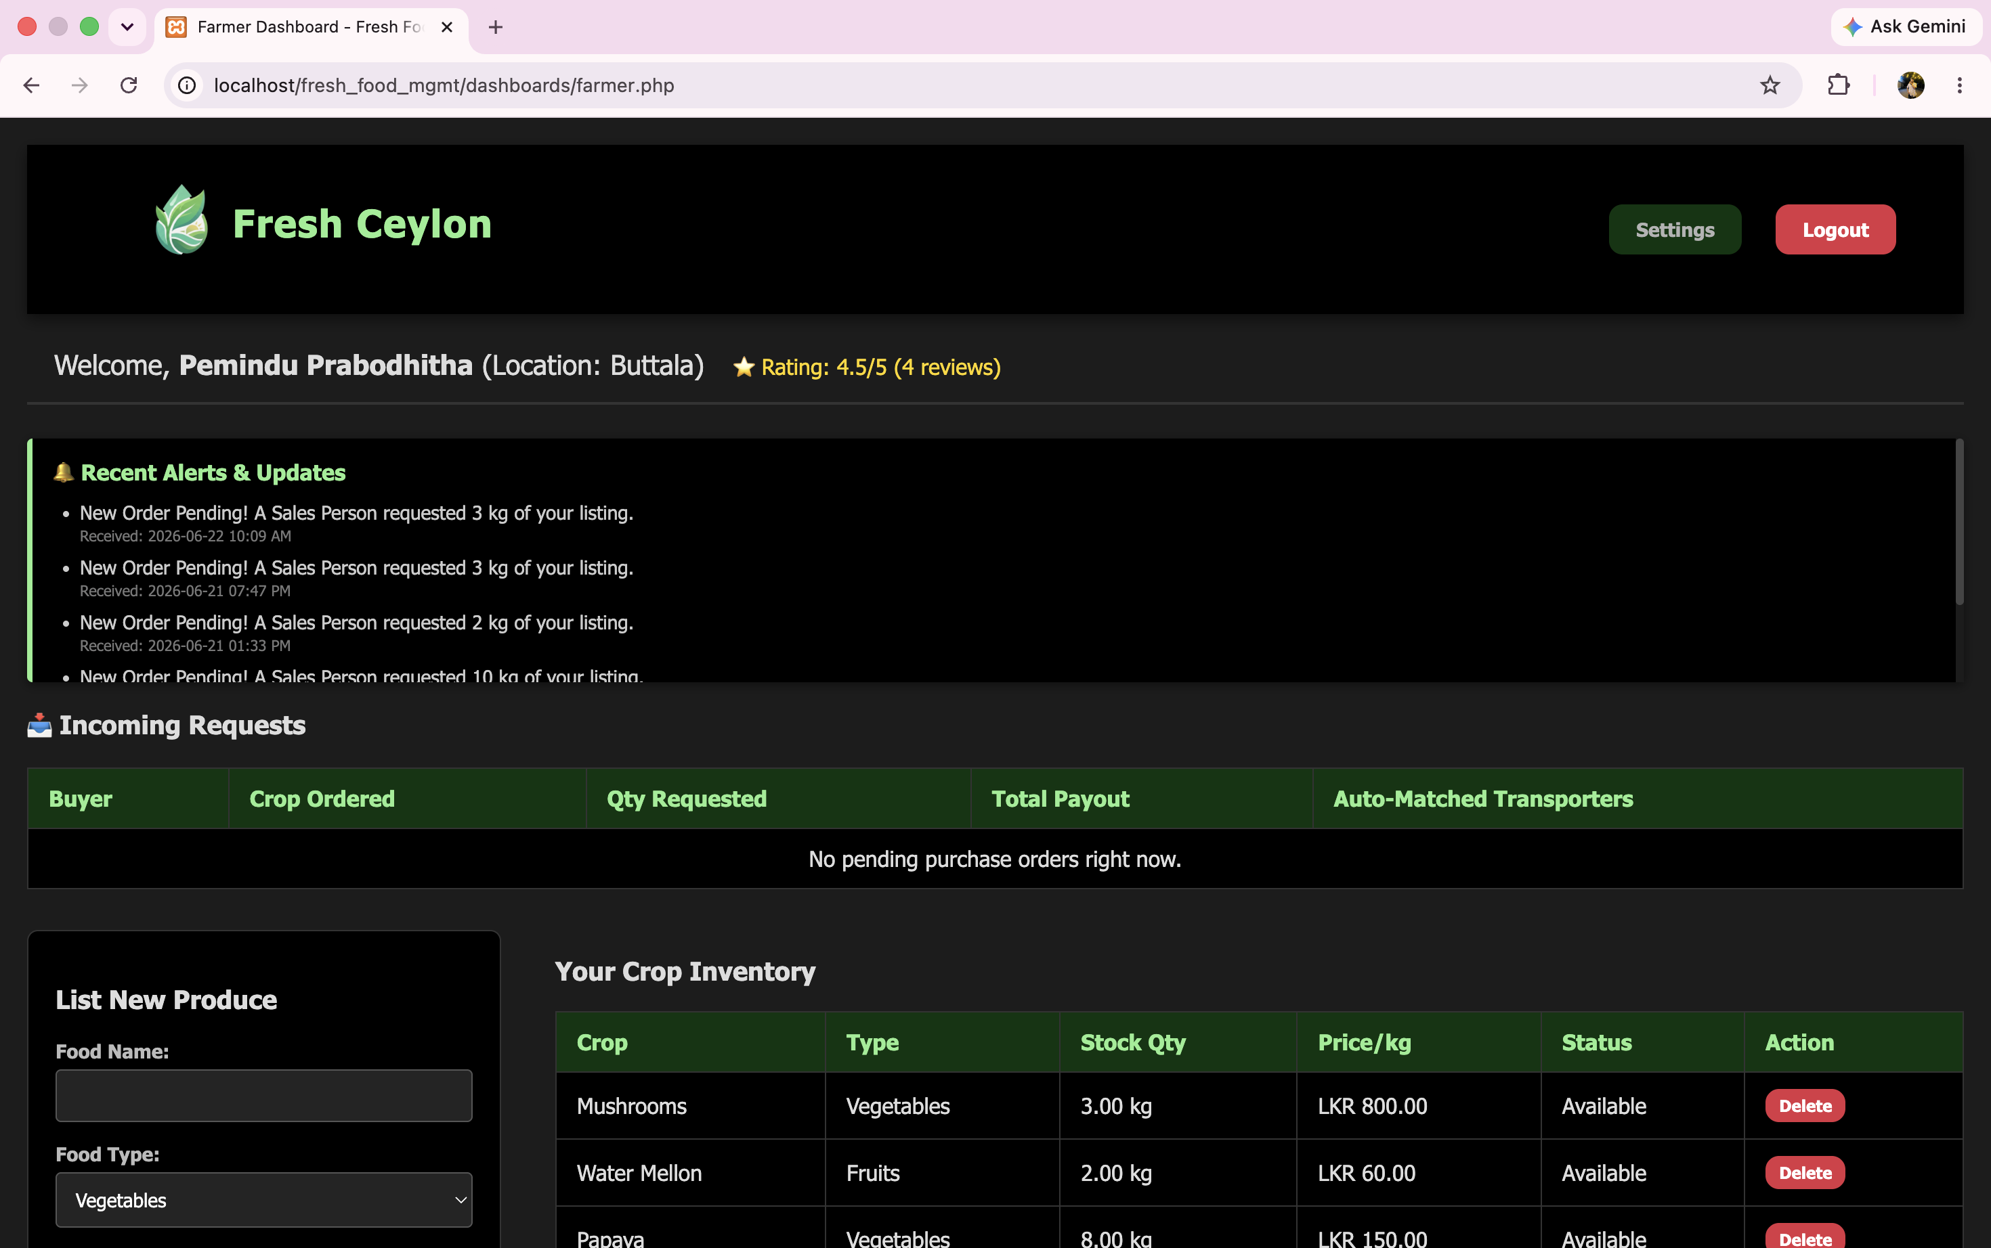
FARMER DASHBOARD
Farmer Control Centre
Rating display on welcome banner
Real-time alerts & notifications
View & manage incoming orders
List produce with price & type
Crop inventory with stock levels
Auto-matched transporter display

Slide 11
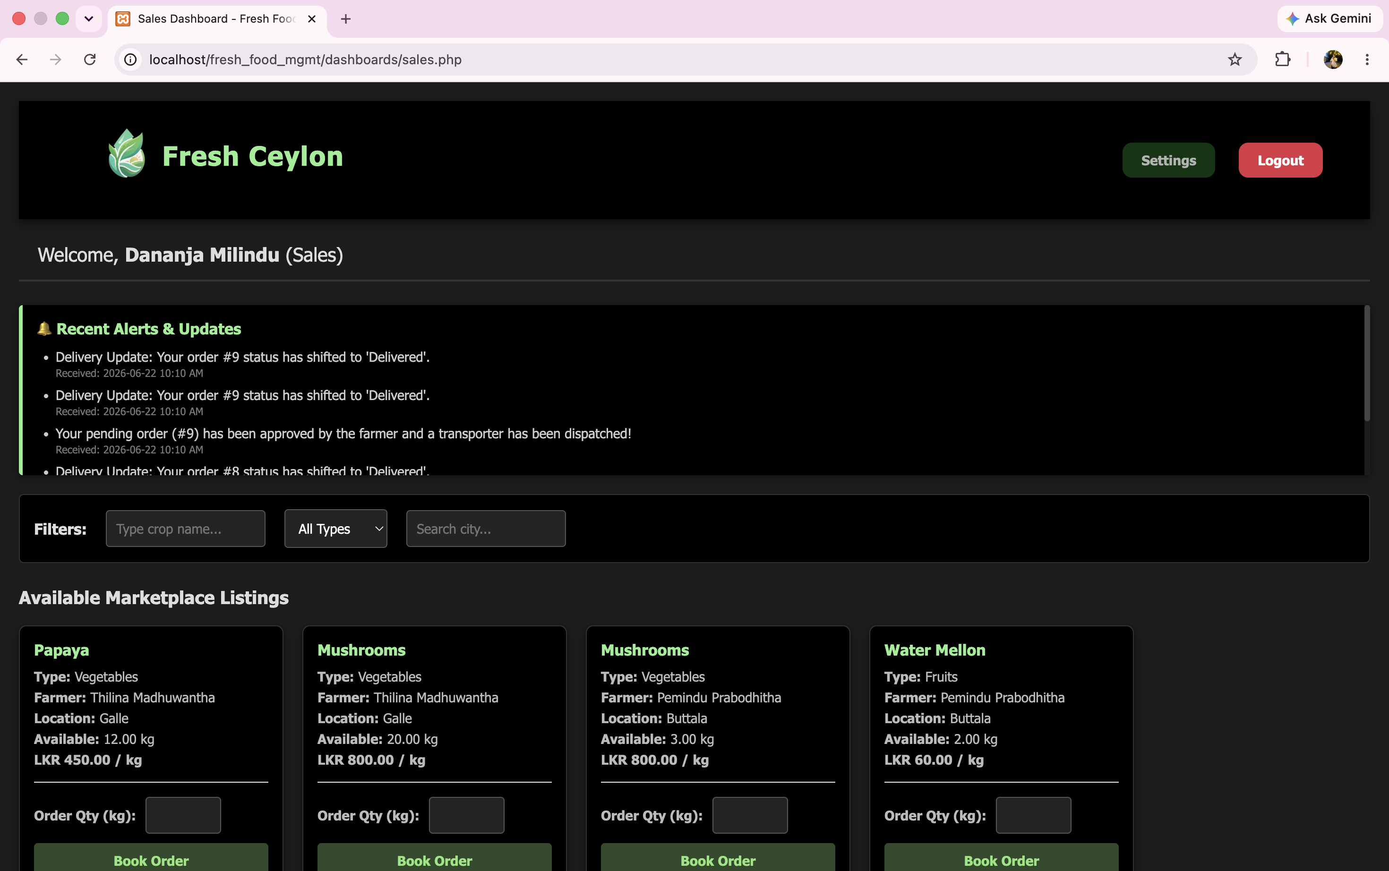
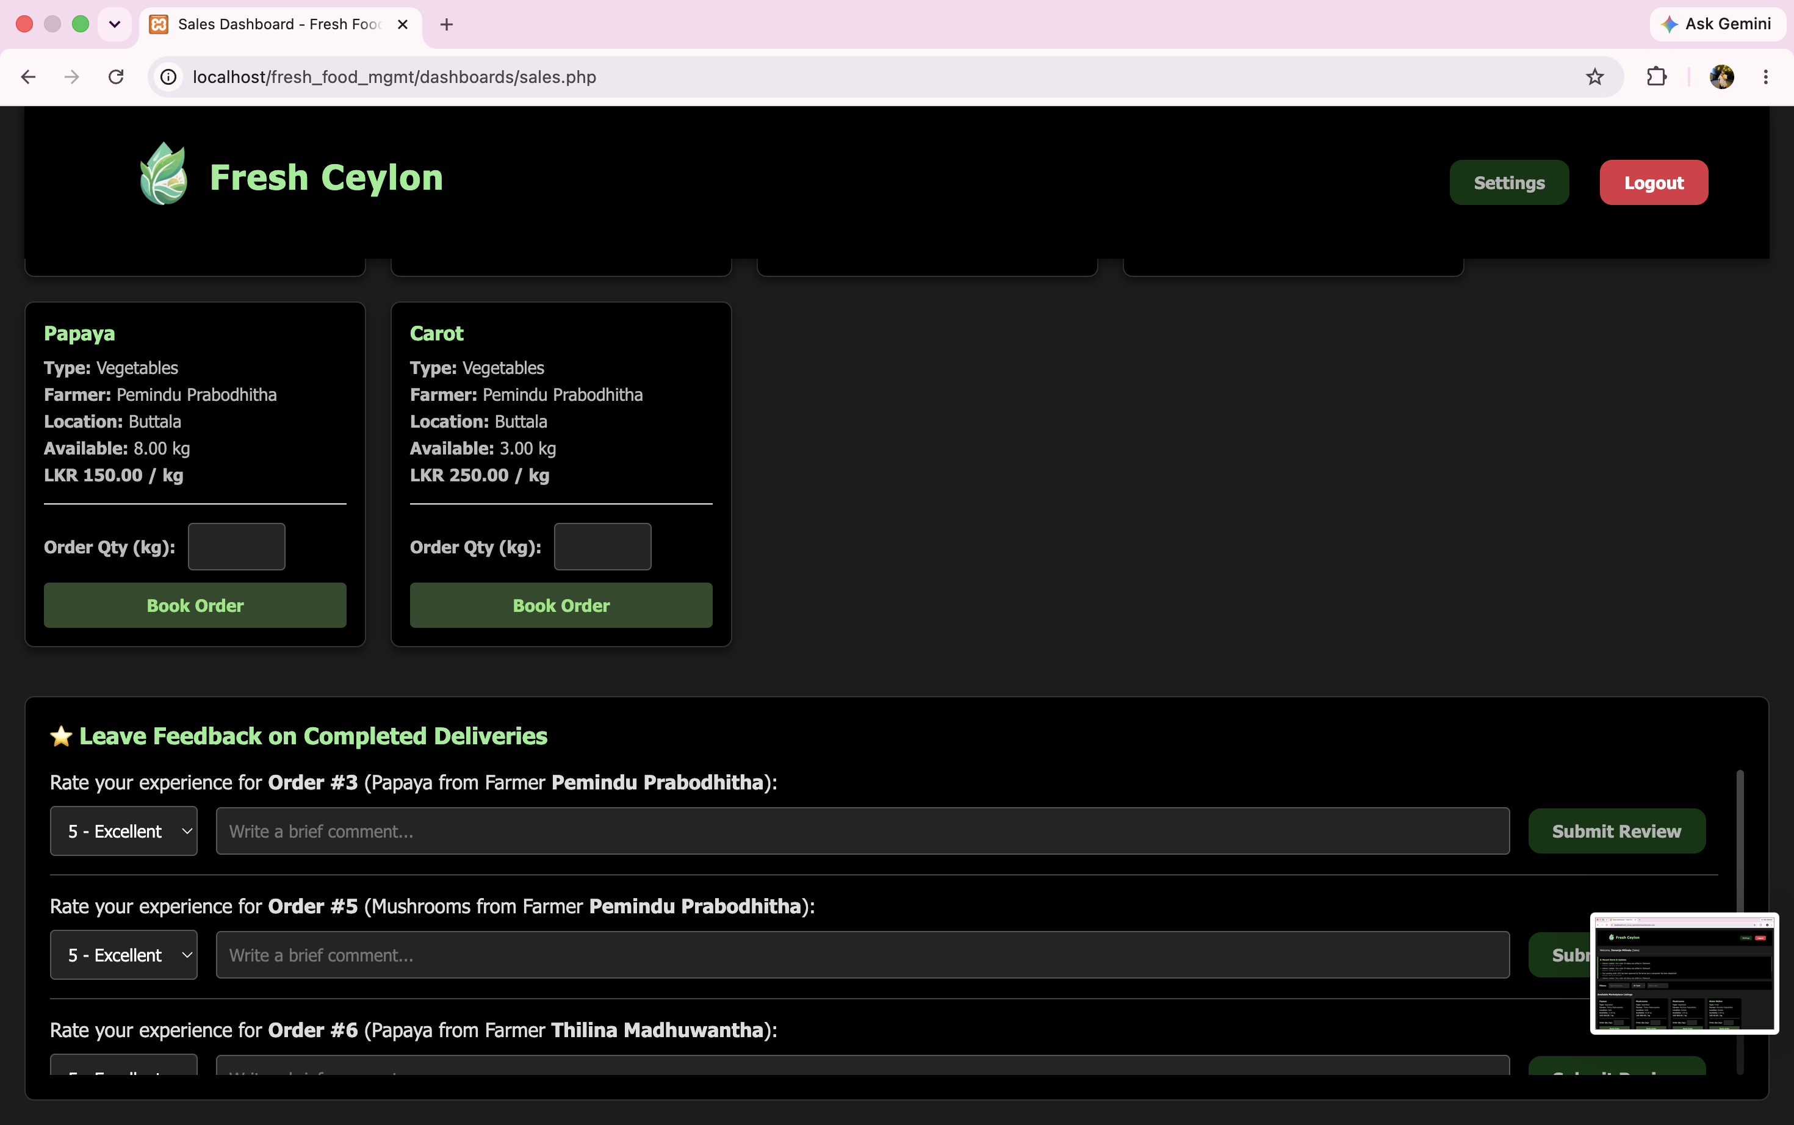
SALES DASHBOARD
Sales & Marketplace
Marketplace Listings
Feedback & Reviews
Filter by crop, type & city
Book orders with quantity
Live delivery notifications
Star ratings & comments

Slide 12
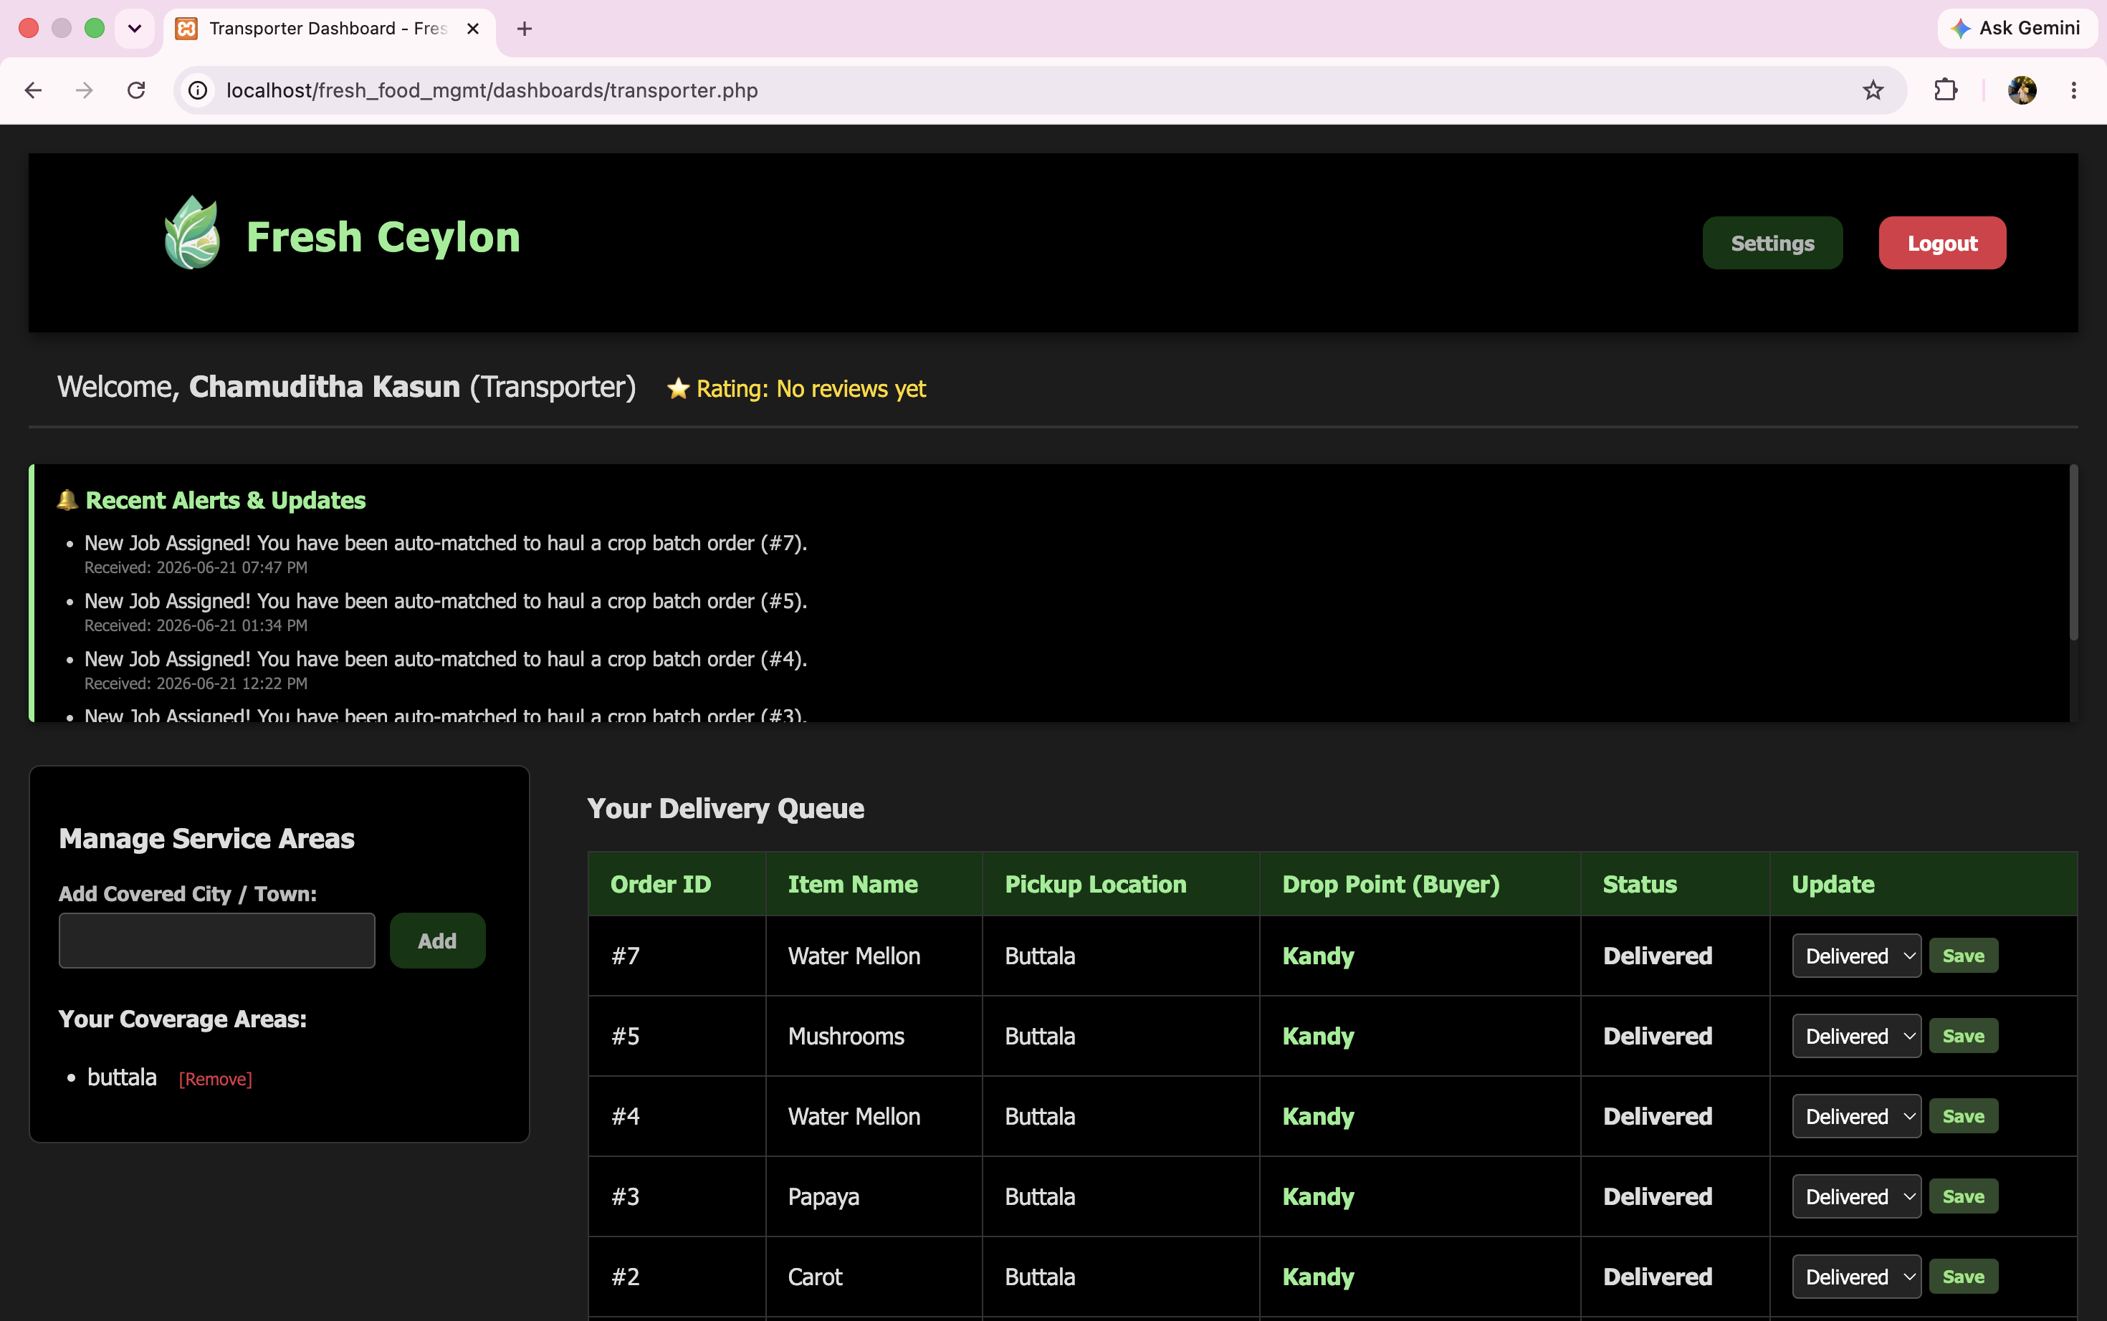
TRANSPORTER DASHBOARD
Transporter Control Centre
Manage covered service areas
Add / remove coverage cities
Full delivery queue with routes
Update delivery status live
Receive auto-matched job alerts
Star rating visible on profile

Slide 13
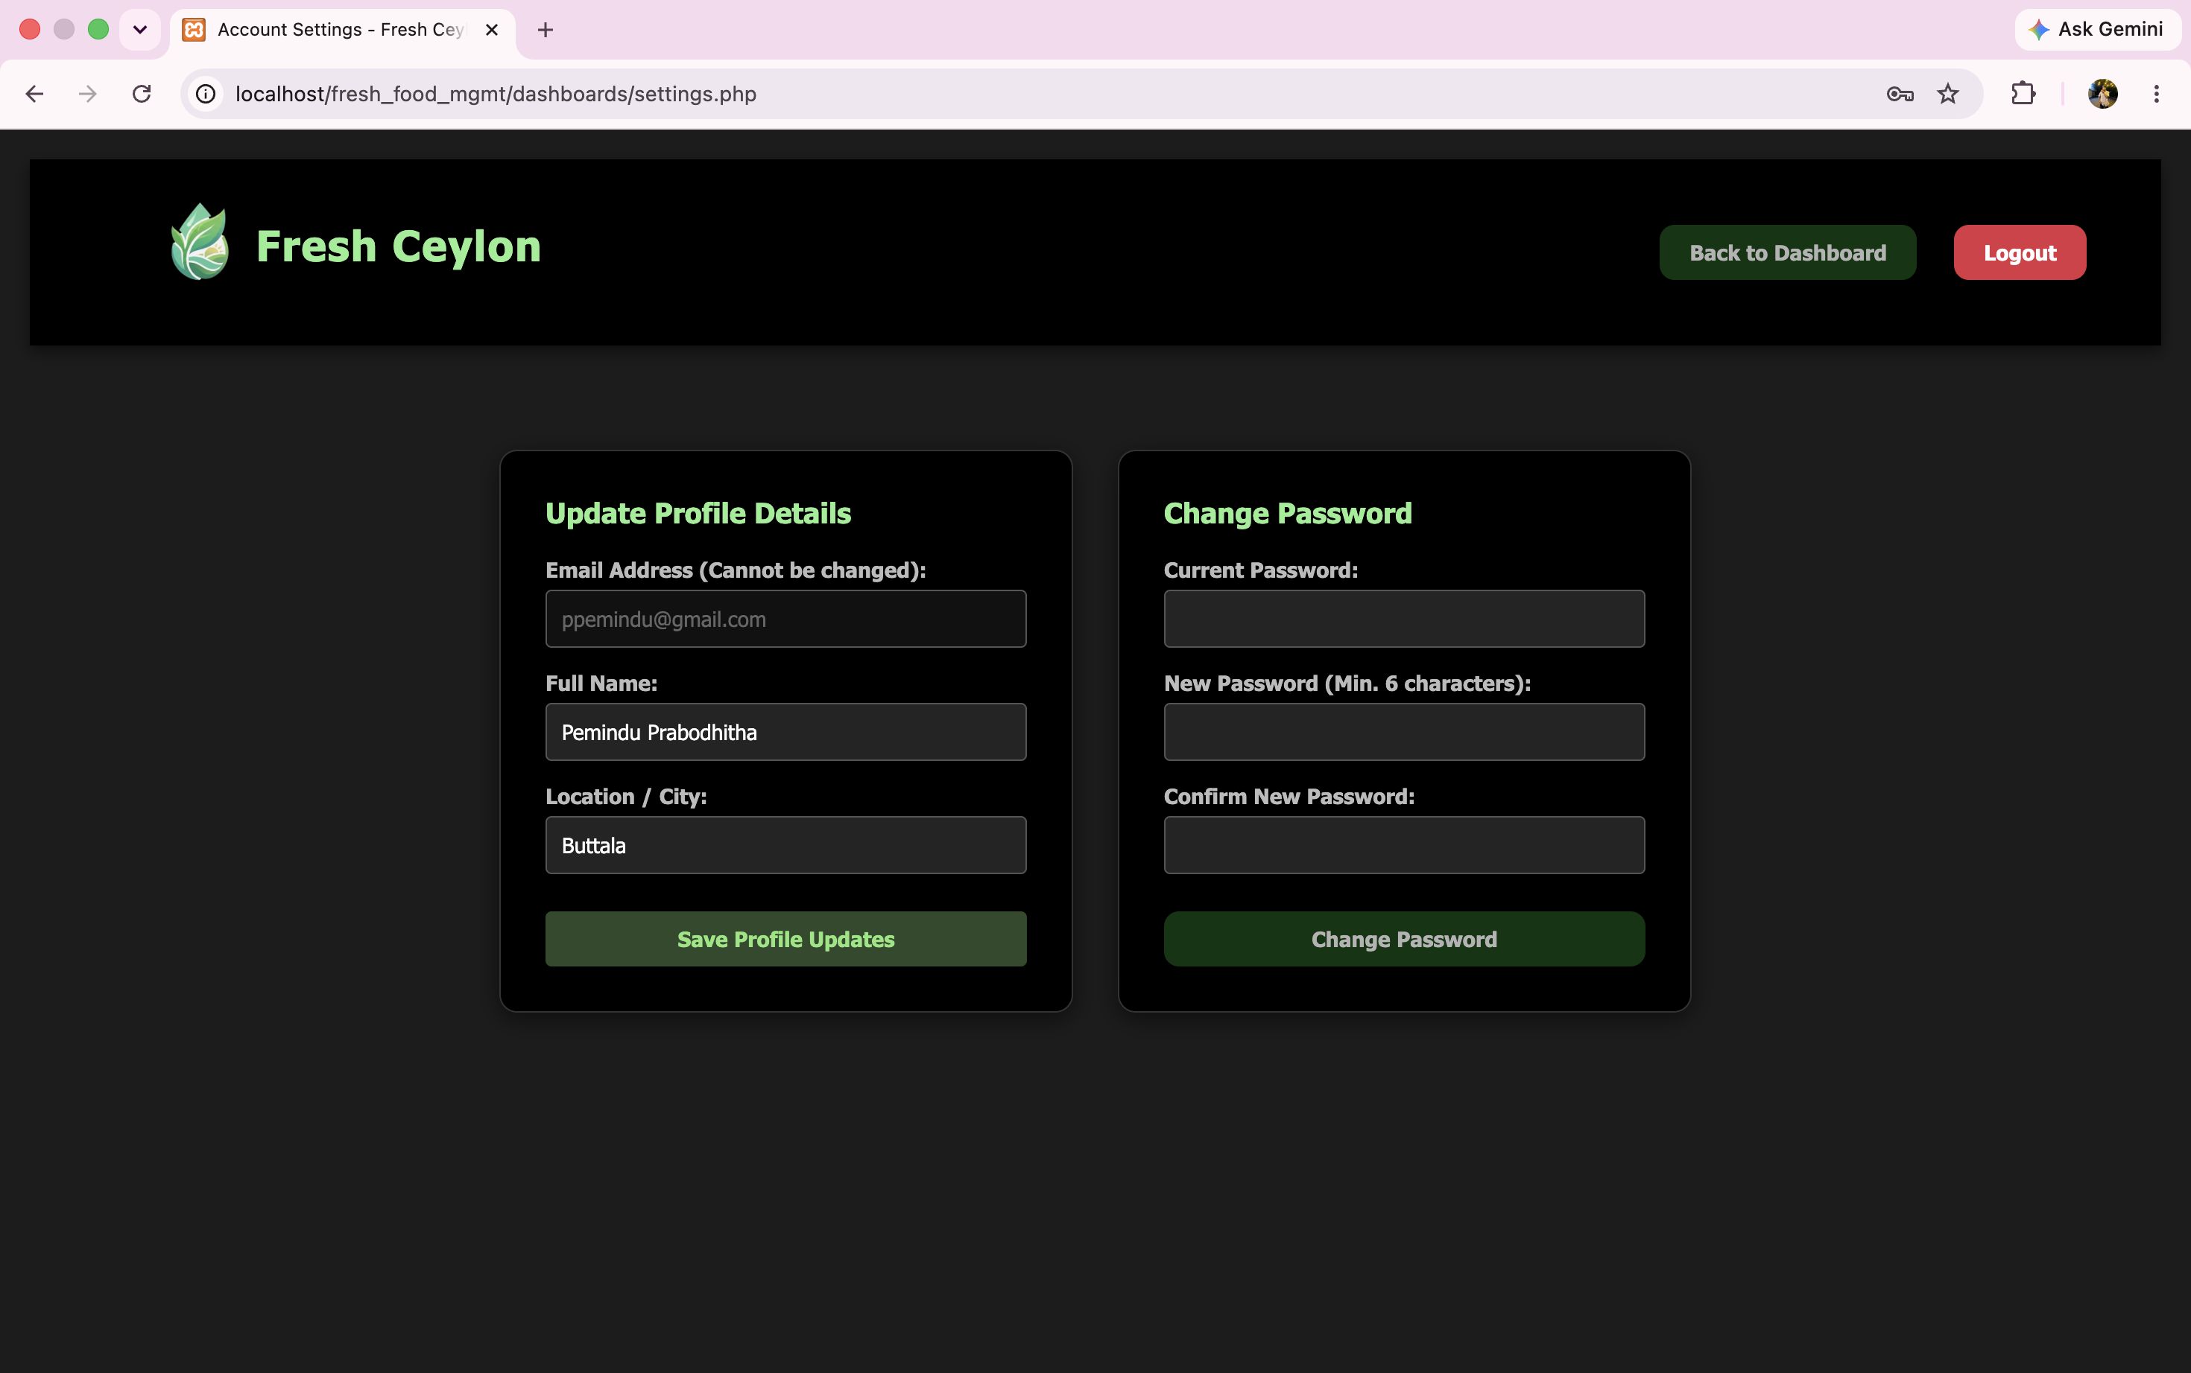
SETTINGS & STACK
Account Settings
Update full name & location
Email is read-only for security
Secure password change flow
Confirm new password field
One-click logout button
Technology Stack
PHP • Backend
MySQL • Database
HTML/CSS/JS • Frontend
XAMPP • Local Server

Slide 14
SYSTEM FLOW
How It Works
01
02
03
04
Farmer
Lists Produce
▶
Buyer
Places Order
▶
Farmer
Approves Order
▶
Transporter
Dispatched
Crops added with price, type & quantity
Sales person selects quantity & books
Farmer reviews & accepts the request
Auto-matched driver picks up & delivers
Notifications Sent
Status Updates Live
Buyer Leaves Review
Farmer Rating Updated
All parties alerted automatically
Transporter marks in-transit / done
Star rating & comment submitted
Reputation score reflected
Every action triggers automatic notifications to all involved parties in real time

Slide 15
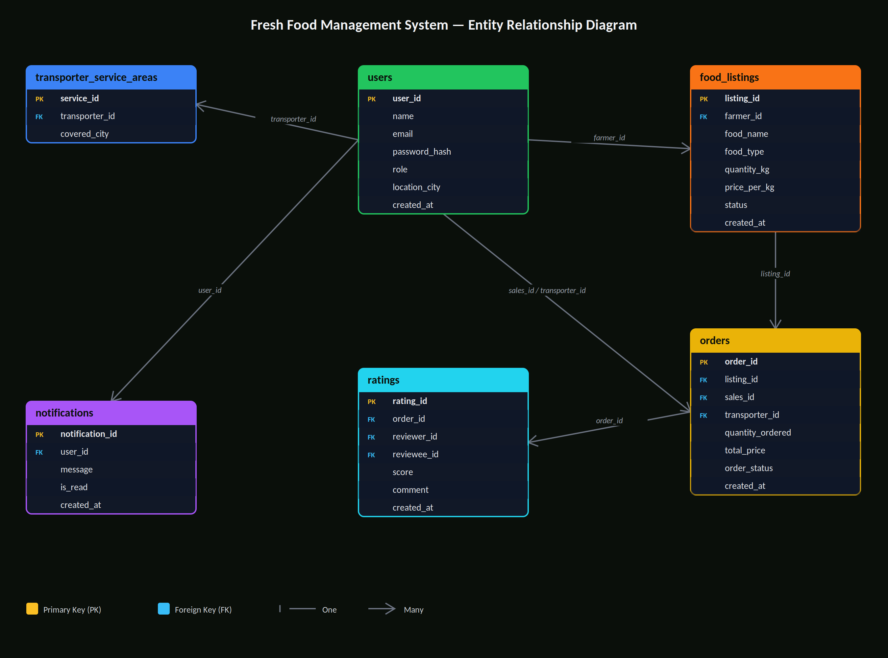
DATABASE SCHEMA
ER Diagram
6 tables · 5 relationships
users
Farmer · Sales · Transporter · Admin
food_listings
Produce listings by farmers
orders
Sales orders with transporter
notifications
Real-time user alerts
ratings
Post-delivery star reviews
transporter_service_areas
Coverage city mapping

Slide 16
REFERENCES
References & Resources
[1] PHP Official Documentation
https://www.php.net/docs.php
[2] MySQL
https://mariadb.com/kb/en/documentation/
[3] XAMPP Documentation
https://www.apachefriends.org/
[4] phpMyAdmin Documentation
https://www.phpmyadmin.net/docs/
[5] HTML5 / CSS3 Standards (MDN)
https://developer.mozilla.org/
[6] University of Kelaniya — COSC 31103
Web & Internet Technologies — Course Material
[7] W3Schools PHP & MySQL Tutorials
https://www.w3schools.com/php/

Slide 17
Fresh Ceylon
Thank You!
A platform built to empower Sri Lanka's farming community
by connecting farmers, buyers, and transporters on one reliable system.
Reduce Food Waste
Fair Pricing
Easy Transport
Real-time Updates
Trusted Ratings
University of Kelaniya • COSC 31103 / BECS 31233 • freshceylon@gmail.com • 070-4282988

