Slide 1
Fully Automated Migration Framework from Windows 11 to Linux Mint
Japhet Kofi Appau Arthur

Slide 2
MOTIVATION
Motivation
Idea
Method
Evidence
Takeaway

Slide 3
MOTIVATION
Meaningful control over digital infrastructure, data flows, and computational processes.
— Floridi (2020); Pohle & Thiel (2020)
Windows 11 cannot be fully audited or constrained — this project asks whether a migration tool can close that gap.

Slide 4
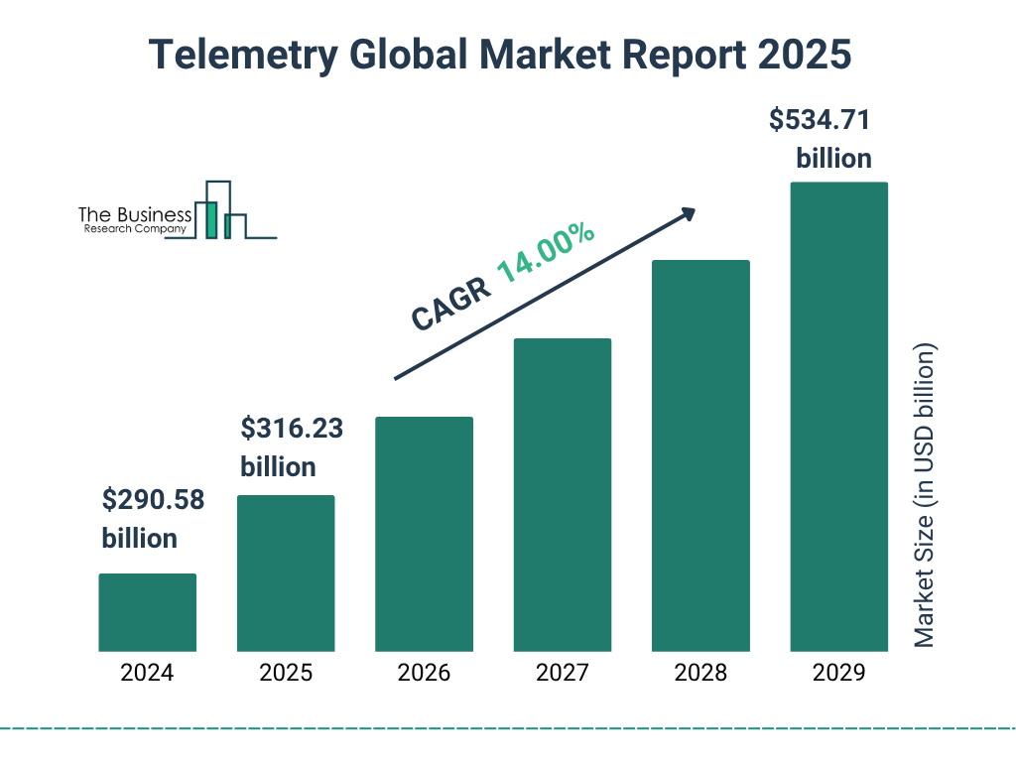
MOTIVATION
https://www.thebusinessresearchcompany.com/report/telemetry-global-market-report

Slide 5
MOTIVATION
Sovereignty, measured — not claimed
sovereignty_score = integrity_score + openness_bonus — every restore reports one

Slide 6
IDEA
Motivation
Idea
Method
Evidence
Takeaway

Slide 7
IDEA
Extending semi-auto-migration POC into a working tool
TERM PAPER
“Digital Sovereignty Through Semi-Automated Migration from Windows to Linux”
Japhet Arthur — Julius-Maximilians-Universität Würzburg, Lehrstuhl für Kommunikationsnetze
RESEARCH QUESTION IT ASKED
How can semi-automated migration frameworks reduce technical barriers to OS-level
sovereignty restoration while maintaining user control, data integrity, and workflow continuity?
WHAT IT BUILT — AND STATED AS LIMITATIONS
A working 5-phase pipeline (Assess → Review → Prepare → Migrate → Verify).
“…heuristic matching… not guaranteeing feature parity.”

Slide 8
IDEA
The proof of concept this project actually started from
🖥
📋
🧪
📦
Tkinter GUI
25 mappings
0 tests
Two binaries
no Qt, no CLI parity
claim made
substring match
only, 1 stage
no automated
regression coverage
built separately, no auto-embed
github.com/PenCoder/semi-auto-migration
INHERITED DEFECT, FOUND AND FIXED THIS SESSION
The proof of concept's apt-get install is one atomic batch call — no per-package fallback, no timeout,
failures silently logged and ignored. Same defect existed here until this session's fix.
Notes:
The proof of concept's apt-get install is one atomic batch call — no per-package fallback, no timeout,
failures silently logged and ignored. Same defect existed here until this session's fix.

Slide 9
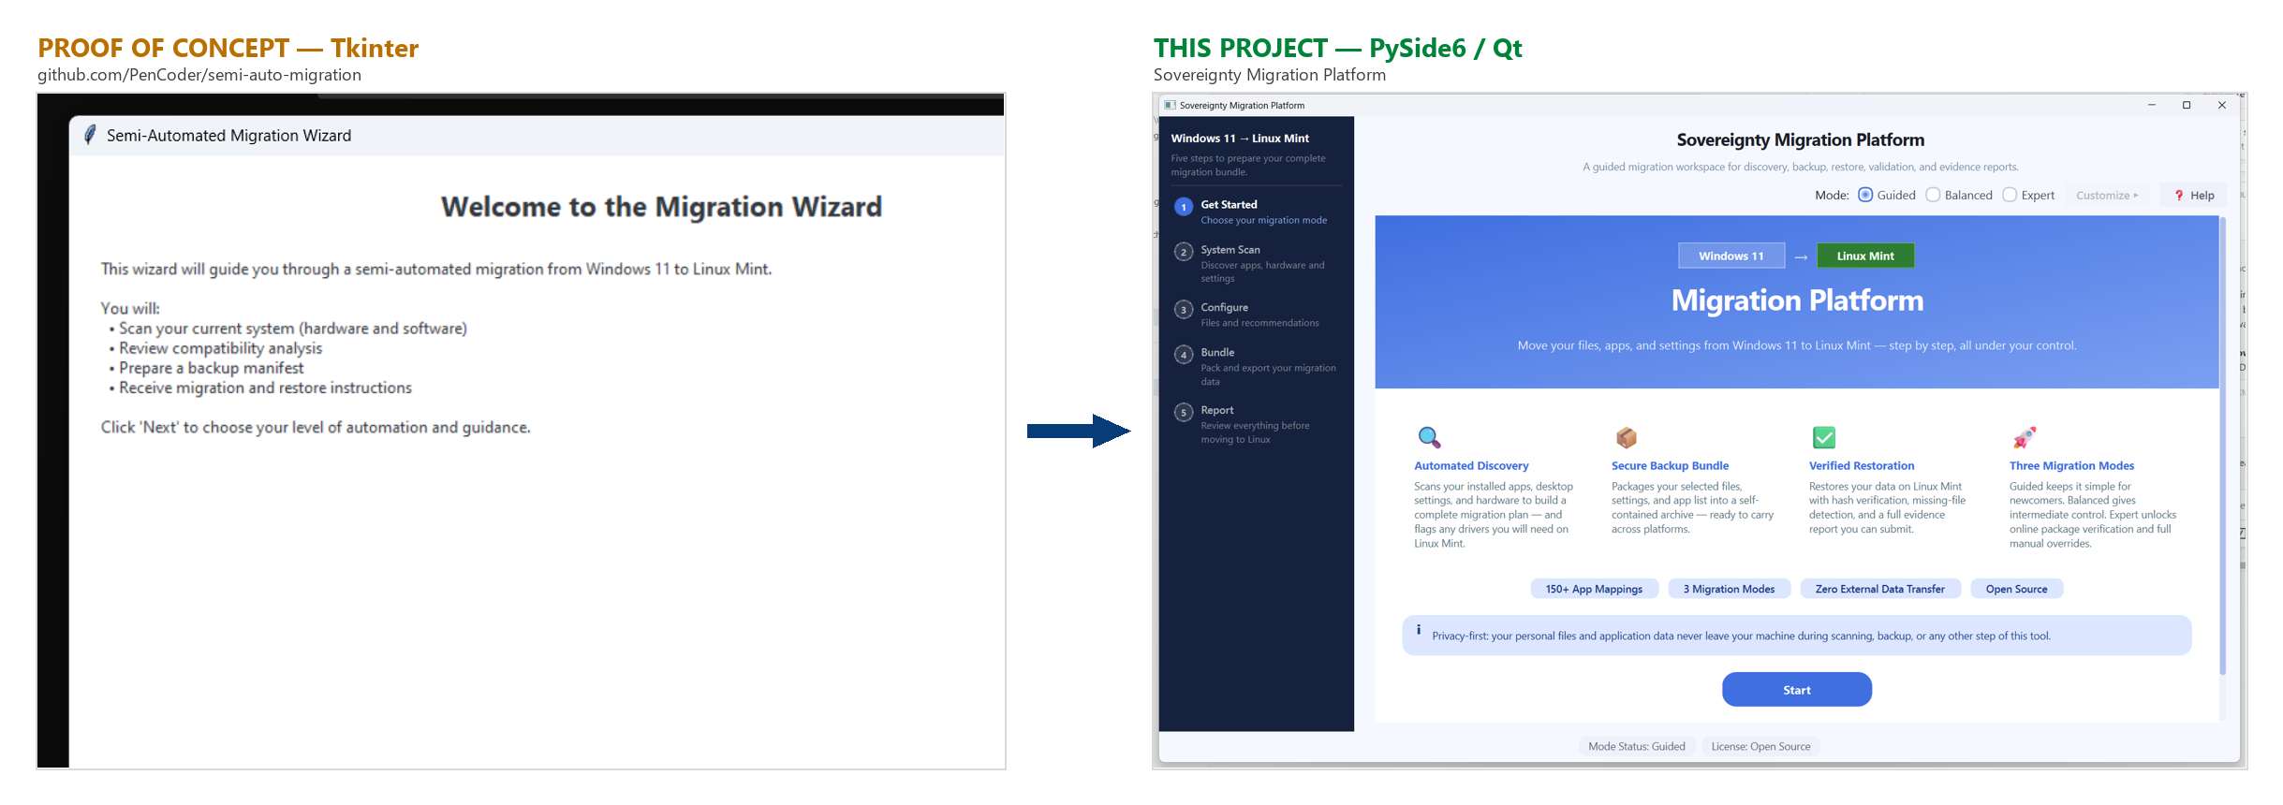
IDEA
Same idea, a different UI toolkit
Both running live, side by side — not a description of the difference.

Slide 10
IDEA
Same pipeline, three levels of control
Guided
Zero decisions after mode pick
Balanced
+ file type selection
Expert
+ overrides + online verification
Only Expert mode touches the network — only to verify a package already chosen, never to find it.
Notes:
Decreasing automation, increasing manual control, top to bottom.

Slide 11
METHOD
Motivation
Idea
Method
Evidence
Takeaway

Slide 12
METHOD
Two machines, four clean layers
1 — Prepare (Windows)
2 — Restore (Linux Mint)
Scan → map apps → pack a bundle
Unzip → restore → verify → report
inventory/
analysis/
services/
qt_ui/ + cli
17,467 LOC (src) · 3,595 LOC (tests) · 89 files · MIT licensed
Verified on Windows 10 and Windows 11 (VirtualBox VM) — full scan-to-restore flow, no issues.

Slide 13
METHOD
One shared decision module, two call paths
Qt Wizard
CLI — python -m src.cli scan
OperationsController / AutomationCoordinator
scan_command()
src/orchestration/mode_policy.py
• should_run_analysis(mode)
• should_run_file_recommendations(mode)
• resolve_app_recommendation_strategy(mode)
Services Layer — MigrationService · RecommendationService · FileRecommendationService · RestoreService
Notes:
Verified by identity, not output: Qt.resolve_app_recommendation_strategy is CLI.resolve_app_recommendation_strategy — both call paths hold the same function object, so a policy change can't silently apply to only one interface.

Slide 14
METHOD
Windows app → Linux package — and a named gap, closed
📋
🔍
🛡
🌐
CSV mapping (238)
Fuzzy match
Confidence floor
Repology check
Term paper: “Compatibility mapping relies on heuristic matching... not guaranteeing feature parity.”
WHAT THIS PROJECT FIXED
1
Fuzzy matching (SequenceMatcher) replaces exact-string-only lookup
2
Confidence floors stop the algorithm silently downgrading curated matches
3
Live Repology verification — package existence checked, not assumed

Slide 15
METHOD
Measurable objectives, defined at project start
Objective | Target | Result
O1 — Manual steps | ≤ 3 in guided mode | 3
O2 — App coverage | ≥ 80% of top-50 | 238 entries
O3 — File integrity | ≥ 95% pass SHA-256 | 100%
O4 — Sovereignty Score | ≥ 85% | Scored every run
O5 — Qt/CLI parity | Identical policy, both interfaces | One shared module
O6 — Cycle time | < 20 min for ≤ 5GB | Not met — see Evidence

Slide 16
EVIDENCE
Motivation
Idea
Method
Evidence
Takeaway

Slide 17
EVIDENCE
Quantified improvement over the proof of concept
Aspect | Proof of concept | This project | Change
App mappings | 25 | 238 | 9.5×
Source LOC | 4,031 | 17,467 | 4.3×
Automated tests | 0 | 192 | 0 → 192
GUI framework | Tkinter | Qt (PySide6) | rewritten
App-matching stages | 1 (substring) | 3 (fuzzy + confidence + online) | 1 → 3
Platforms packaged | 2 (Win + Linux, manual) | 2 (Win + Linux, auto-embed) | manual → automatic
github.com/PenCoder/semi-auto-migration
Notes:
New capabilities with no proof-of-concept equivalent: settings/wallpaper migration, desktop shortcuts, full reset/undo, completeness scoring.

Slide 18
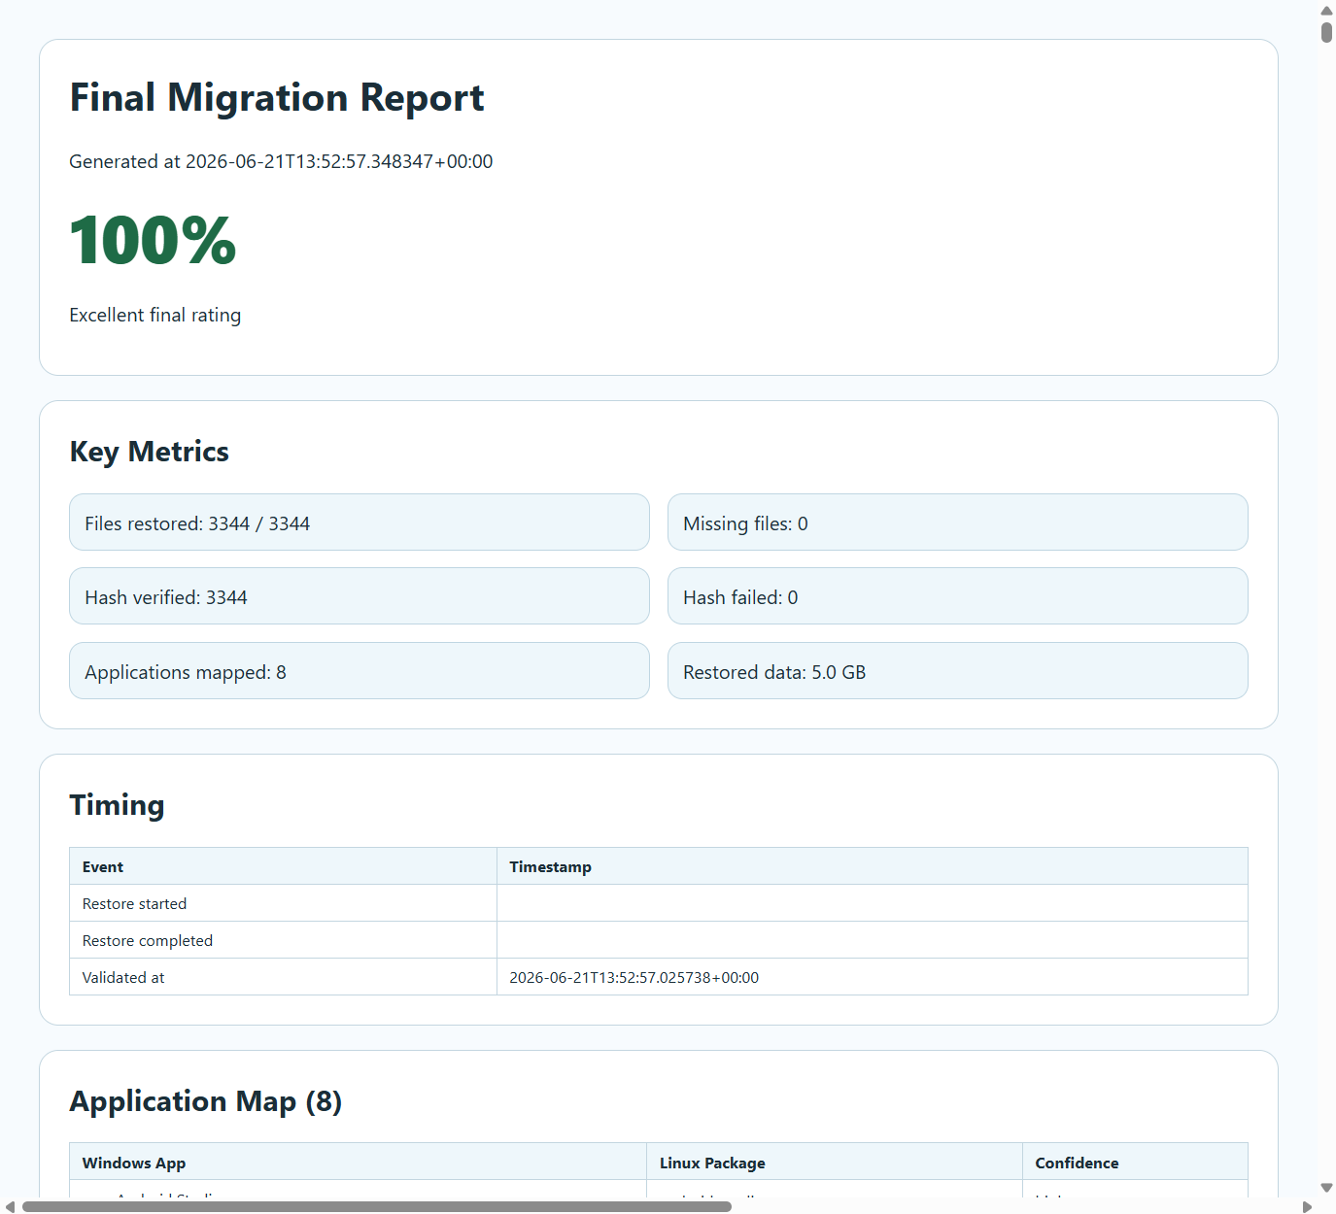
EVIDENCE
7 guided steps, then 1 click
1
2
3
4
5
6
7
Welcome
Mode
Scan +
Match
Data
Review
Backup
Bundle
Report
1
Restore & Report
Real report — actual VM restore, 3,344 files
Notes:
→ migration_bundle.zip (manifest + SHA-256, apps, settings, optional Linux binary)
Restore, verify (SHA-256), and report
all happen within that one click.
Failed step? Restart or Review & Complete Anyway. Reset undoes files, shortcuts, the wallpaper file, and (opt-in) apps.

Slide 19
EVIDENCE
192 tests — and 4 bugs only a live VM run exposed
!
Bad package name failed ALL installs
✓
per-package fallback
!
Shortcuts matched requested, not installed
✓
matched to actual installs
!
Silent multi-minute log gaps
✓
periodic progress logging
!
Unanswered prompt could hang forever
✓
120s timeout per attempt
CI passing ≠ the real app works.

Slide 20
EVIDENCE
Reset undoes the whole restore
📁
🔗
🖼
📦
Files
Shortcuts
Wallpaper
Apps (opt-in)
Reset now undoes all of the above — opt-in for apps, live progress in the Activity Log.

Slide 21
EVIDENCE
Double-click distribution
🪟
🐧
migrate.exe
PyInstaller; can bake the Linux
binary in for a single-file standalone.
restore (ELF binary)
Built on the target distro; embedded
automatically into every bundle.
Live now: github.com/PenCoder/full-auto-migration — migrate.exe downloadable from a real GitHub Release.
Docs site: pencoder.github.io/full-auto-migration — user guide, project walkthrough, and Praktikum report, published.

Slide 22
EVIDENCE
Two things that didn't hold up
Checking our own claims against the system found two honest gaps:
O6 — CYCLE TIME
Target was <20 min for ≤5GB; the real logged run took ~30–35 minutes for extract+restore+verify alone.
RECOMMENDATION QUALITY
Precision/recall is 0% measured. Methodology is defined; no ground-truth evaluation script has been built or run.
Both are carried forward as named, open items — not silently dropped.

Slide 23
TAKEAWAY
Motivation
Idea
Method
Evidence
Takeaway

Slide 24
TAKEAWAY
Conclusion & future work
DELIVERED
NEXT
✓
Dynamic recommendation engine
→
Real precision/recall evaluation script
✓
Unified mode policy (Qt + CLI)
→
Real E2E test, physical machines
✓
Per-stage execution timing
→
Live USB write automation
✓
192 test regression coverage
→
Resume/checkpoint for large restores
✓
Real-VM-tested reliability fixes
✓
Full undo/reset + packaging
✓
Public docs site + GitHub release

Slide 25
TAKEAWAY
Documentation & downloads
Everything in this talk is public — code, docs, and a downloadable build.
DOCUMENTATION SITE
pencoder.github.io/full-auto-migration
User guide, project walkthrough, full automation exposé, Praktikum report, testing docs.
DOWNLOAD & SOURCE
github.com/PenCoder/full-auto-migration
v1.0.0 release with migrate.exe attached — clone, build, or download and run today.

Slide 26
TAKEAWAY
References — sovereignty framing cited from the term paper
• Floridi, L. (2020). The fight for digital sovereignty. Philosophy & Technology, 33(3), 369–378.
• Pohle, J., & Thiel, T. (2020). Digital sovereignty. Internet Policy Review, 9(4).
• Roberts, H., et al. (2021). Safeguarding European values with digital sovereignty. Internet Policy Review, 10(3).
• Wehnes, H. (2024). Preventing digital colony and lock-in. INFORMATIK 2024, Gesellschaft für Informatik.
• Wire (2025); StatCounter Global Stats (2025). Digital sovereignty survey & OS market share, Europe.
• The Business Research Company (2025). Global Telemetry Market Report.
Full bibliography: Arthur, J. — Digital Sovereignty Through Semi-Automated OS Migration (term paper).

Slide 27
Thank you
Questions & live demo

