Slide 1
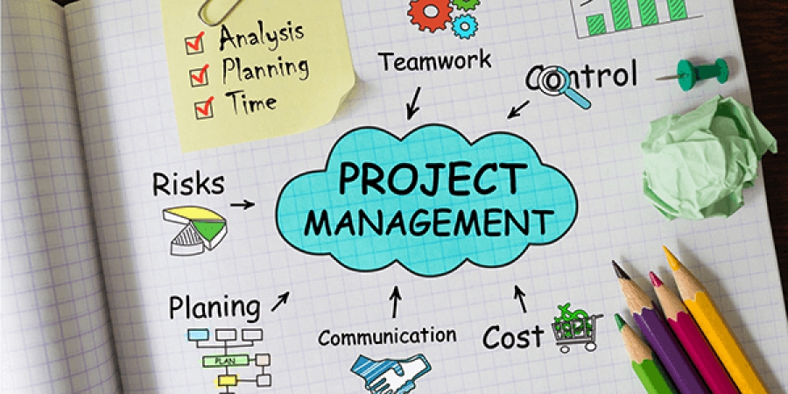
Project 2 Group 2
Oluwatobi Olukunle
Matthew Bernhardt
Miguel Pena
Github:
https://github.com/mattbernhardt23/Revature_Project_2/

Slide 2
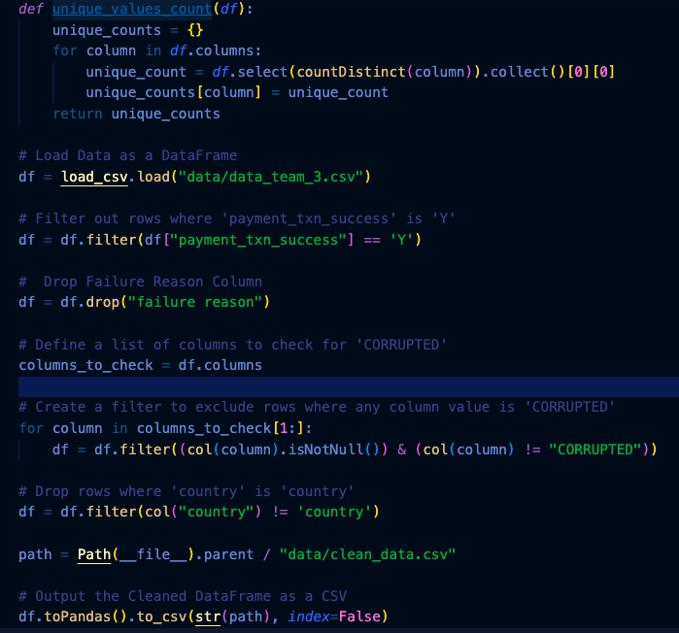
Data Cleaning
Import CSV
Filter out all of the rows in which the transaction failed, then drop related columns
Filter out all rows containing the value of ‘CORRUPTED’.
Filter out all of the rows in which country is equal to ‘country’
Export cleaned CSV for analysis

Slide 3
Question
What is the top selling category of items? Per country?

Slide 4
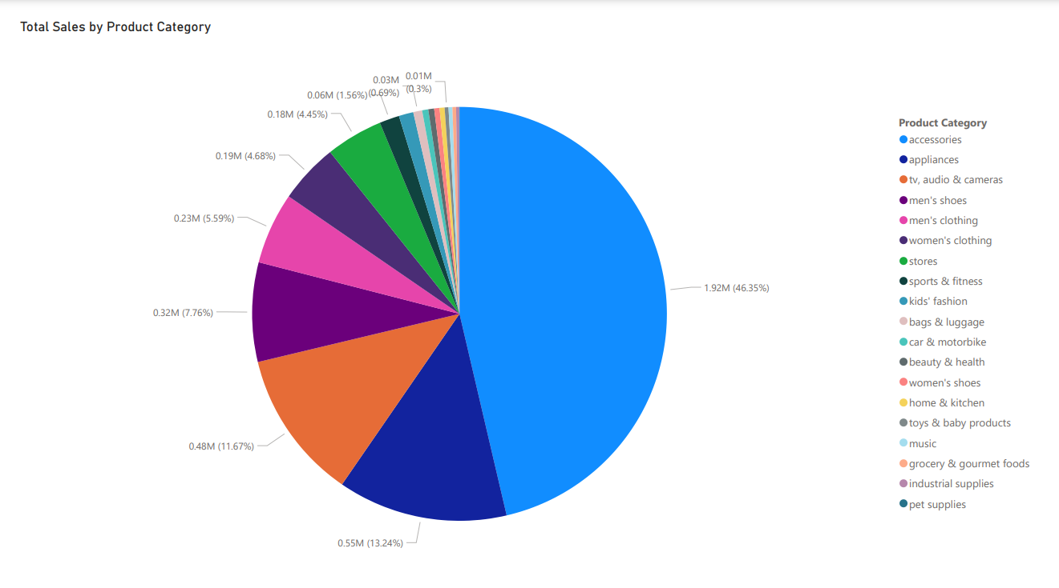

Slide 5
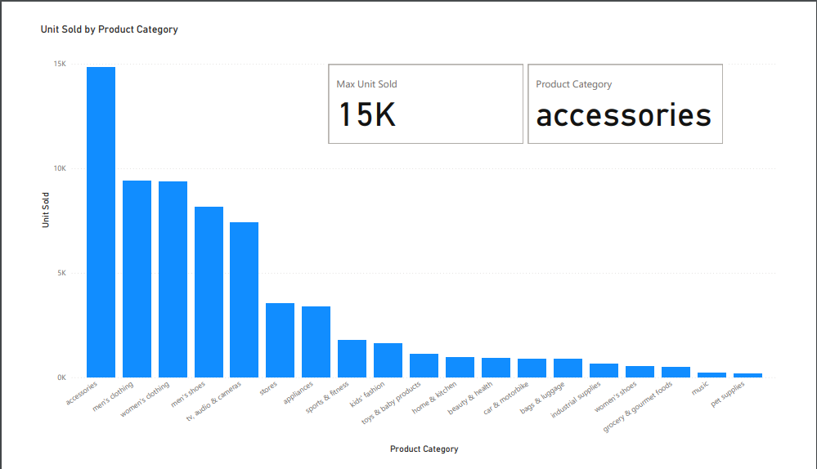

Slide 6
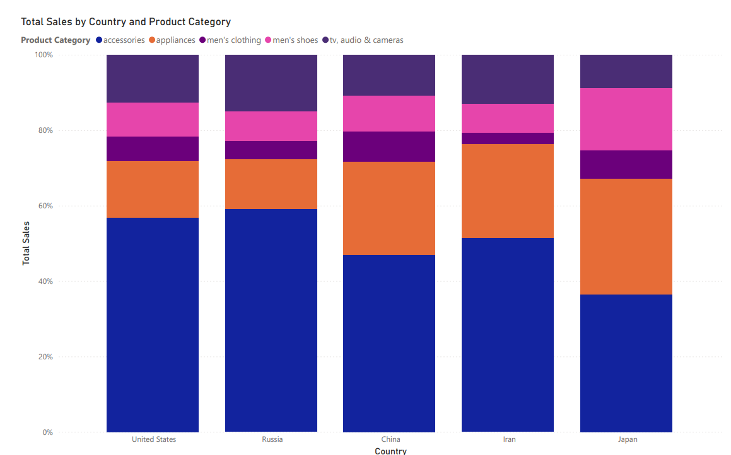

Slide 7
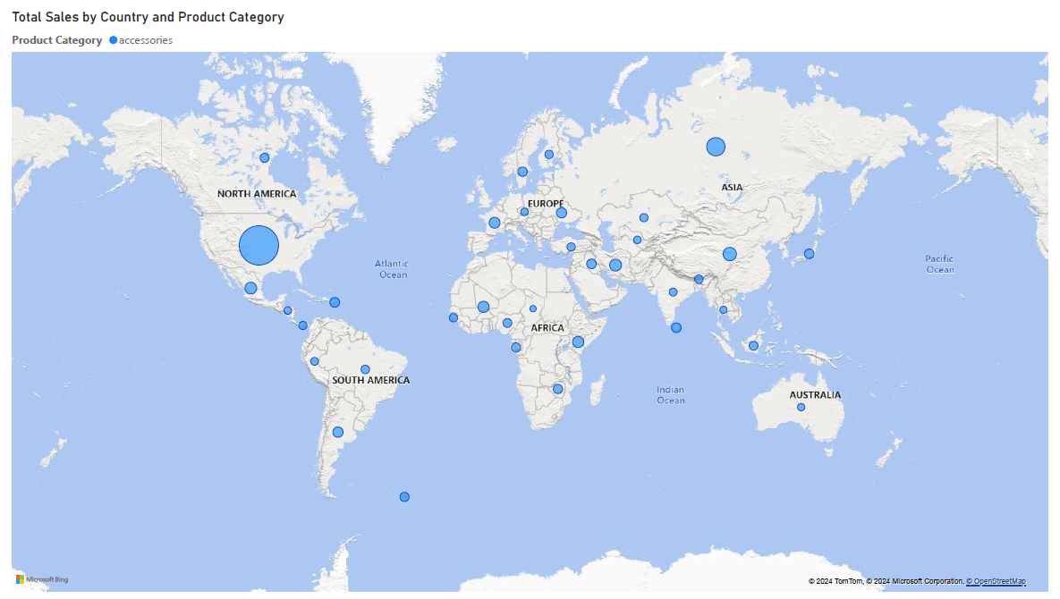

Slide 8
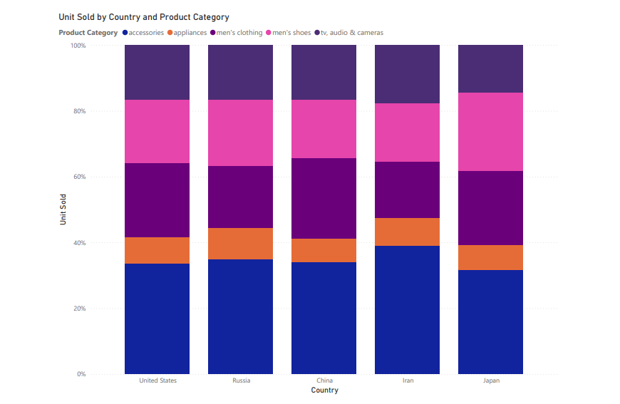

Slide 9
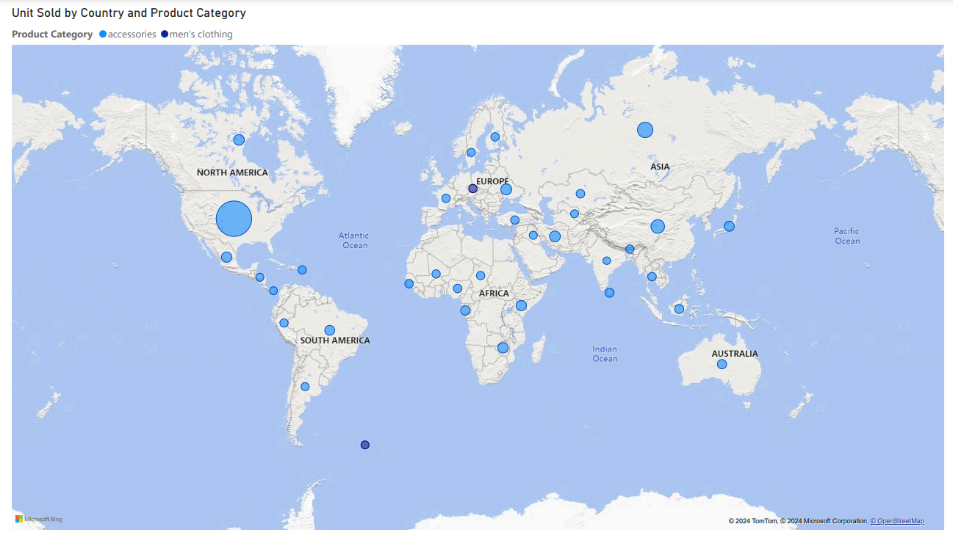

Slide 10
Question
How does the popularity of products change throughout the year? Per country?

Slide 11
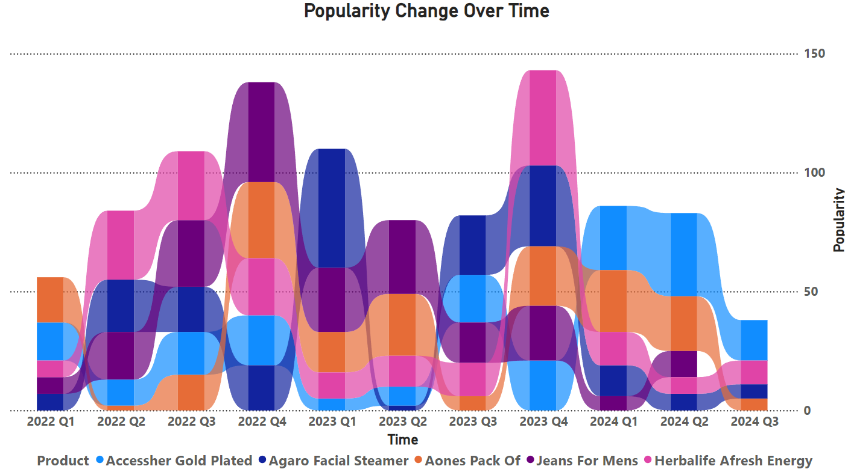
Notes:
Full Product Name:
ACCESSHER Gold Plated Traditional Vilandi Kundan Embellished Delicate Floral Design Clip On/Non-Piercing Nose Pin/Nath for… {accessories}
AGARO FS2117 Facial Steamer With Nano Ionic Hot Steaming Technology, Hot Mist Moisturizing, Opening Skin Pores, Home Sauna… {beauty and health}
AONES Pack of 2 Silicone & Metal Chain Belt Watch Strap Compatible for Samsung Galaxy Watch Active 2 44mm Watch Band Black {kid’s fashion}
Jeans For Mens For Smartness.(pack of 2) {men’s clothing}
Herbalife Afresh Energy Drink (Lemon, Ginger, Elaichi, Cinnamon and Peach Flavour) Pack of 5 (50 g Each) {grocery and gourmet foods}

Slide 12
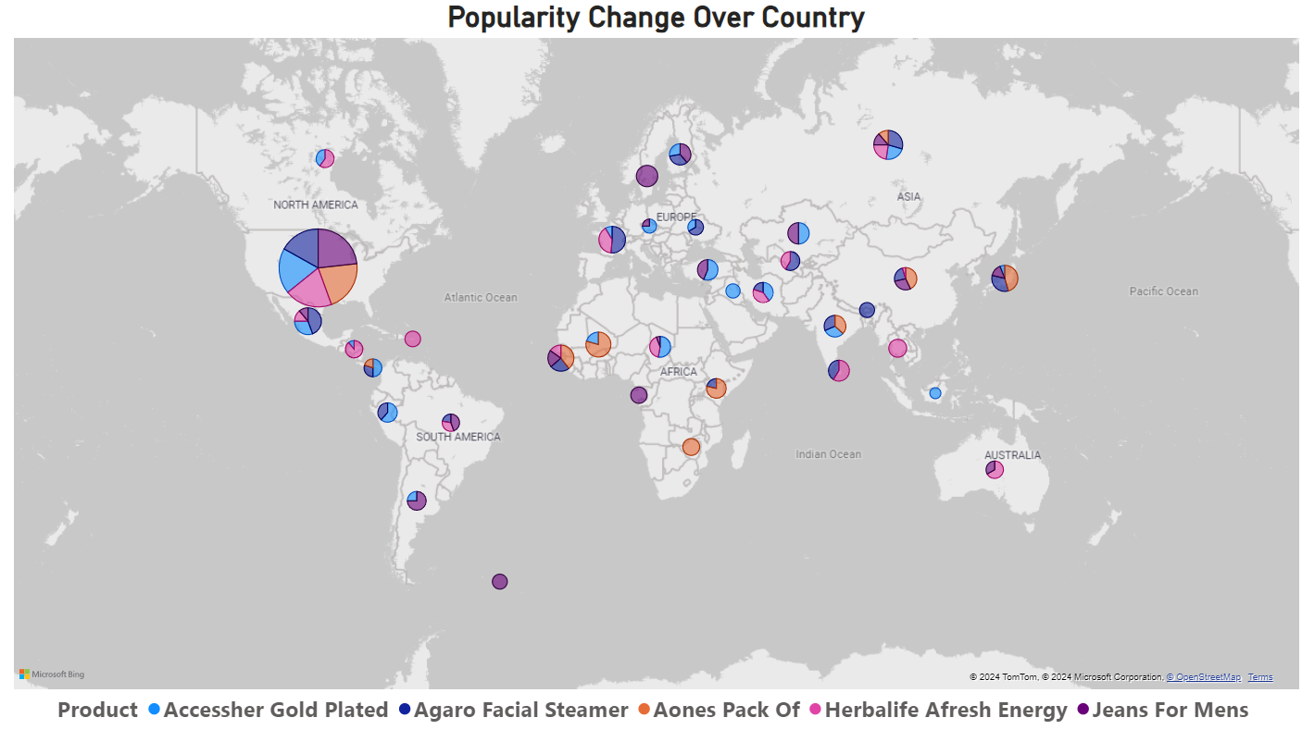
Notes:
Full Product Name:
ACCESSHER Gold Plated Traditional Vilandi Kundan Embellished Delicate Floral Design Clip On/Non-Piercing Nose Pin/Nath for… {accessories}
AGARO FS2117 Facial Steamer With Nano Ionic Hot Steaming Technology, Hot Mist Moisturizing, Opening Skin Pores, Home Sauna… {beauty and health}
AONES Pack of 2 Silicone & Metal Chain Belt Watch Strap Compatible for Samsung Galaxy Watch Active 2 44mm Watch Band Black {kid’s fashion}
Jeans For Mens For Smartness.(pack of 2) {men’s clothing}
Herbalife Afresh Energy Drink (Lemon, Ginger, Elaichi, Cinnamon and Peach Flavour) Pack of 5 (50 g Each) {grocery and gourmet foods}

Slide 13
Question
What locations see the highest traffic in sales?

Slide 14
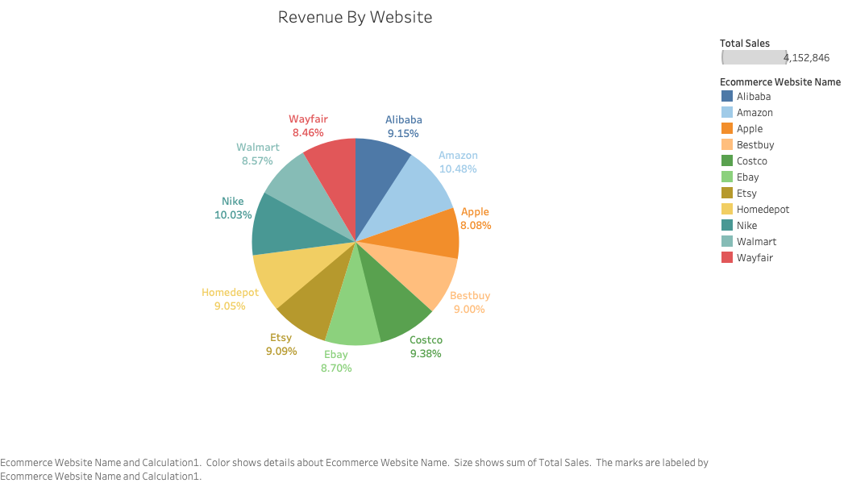

Slide 15
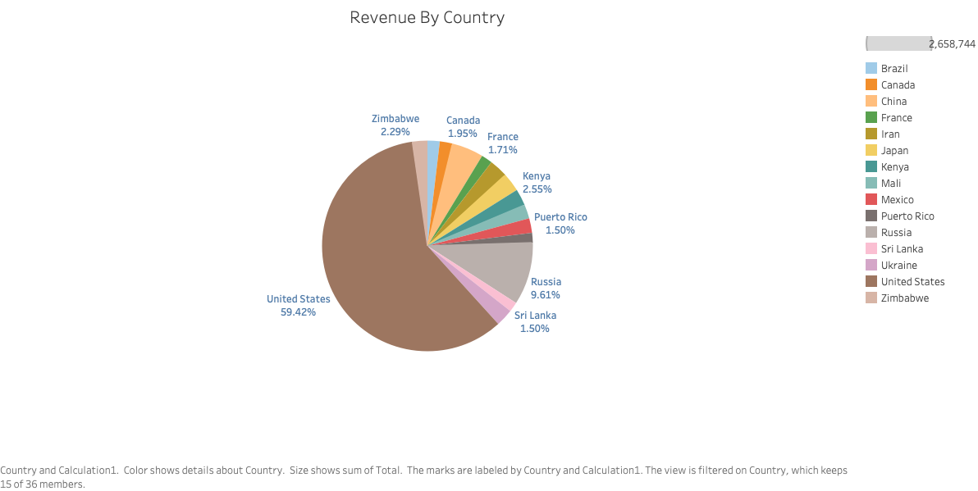

Slide 16
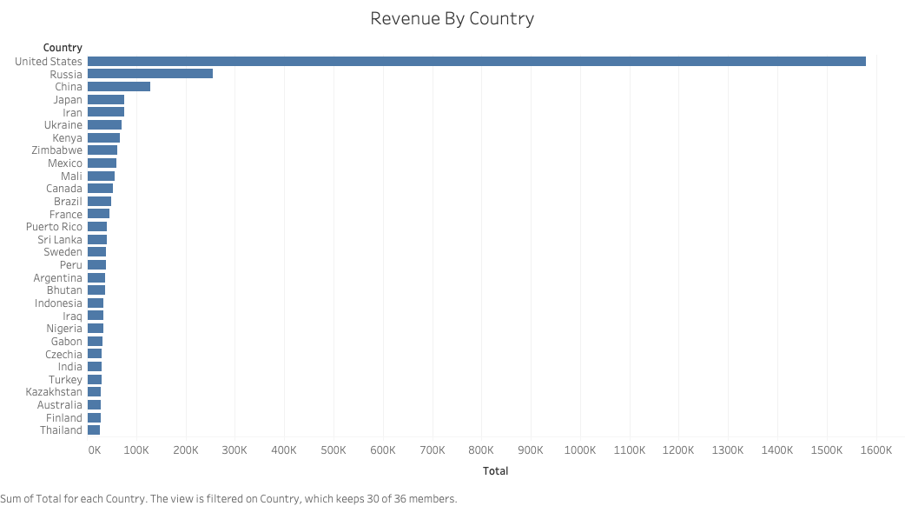

Slide 17
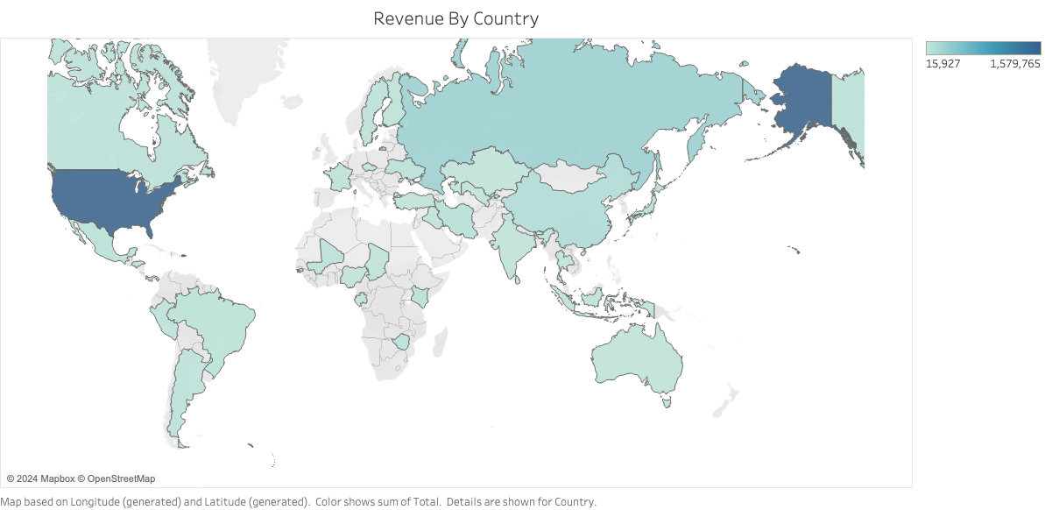

Slide 18
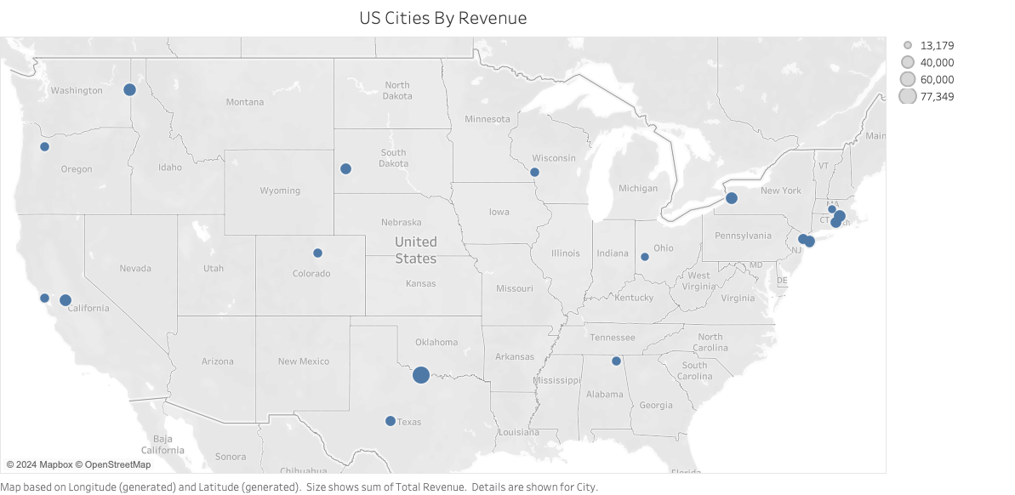

Slide 19
Question
What time sees the highest traffic in sales?

Slide 20
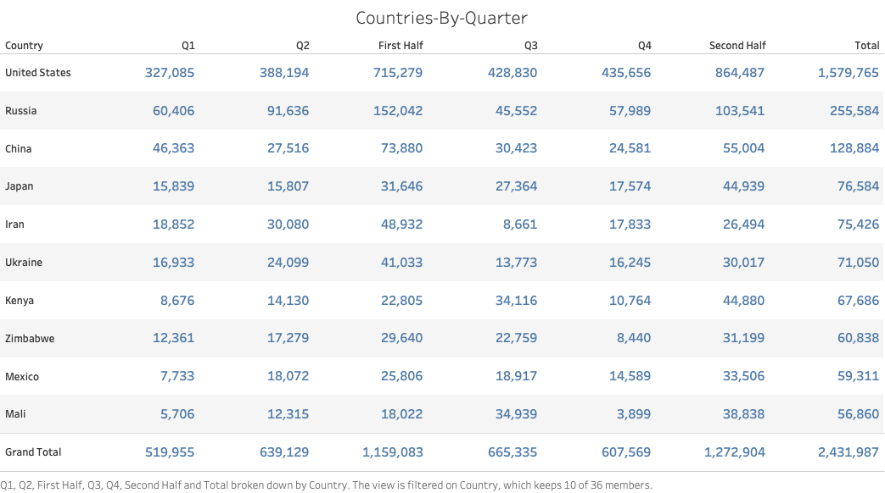

Slide 21
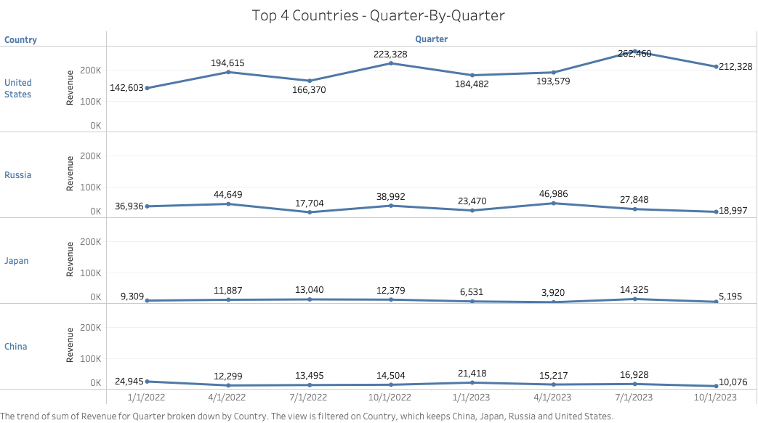

Slide 22
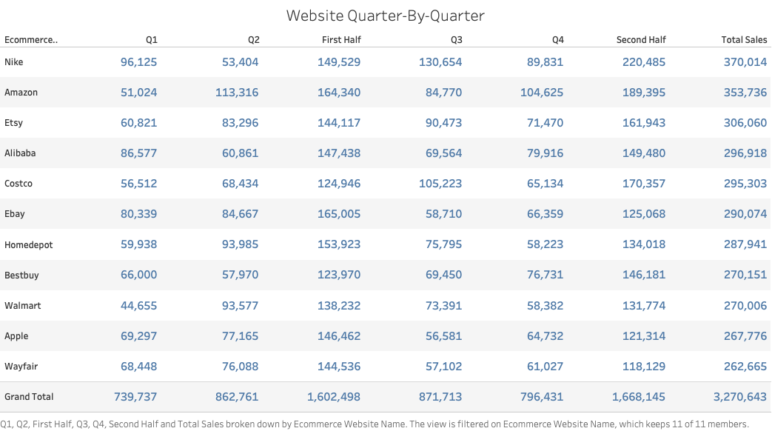

Slide 23
Questions?

Slide 24
Resources

Slide 25
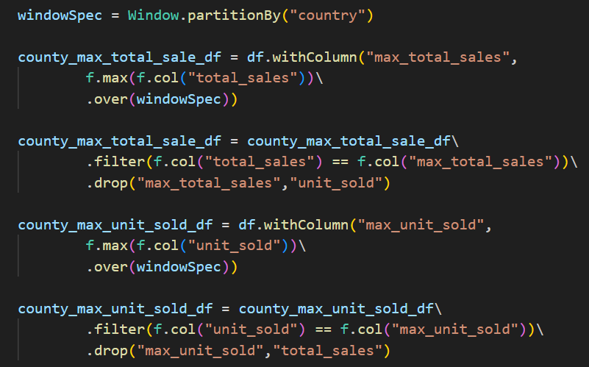
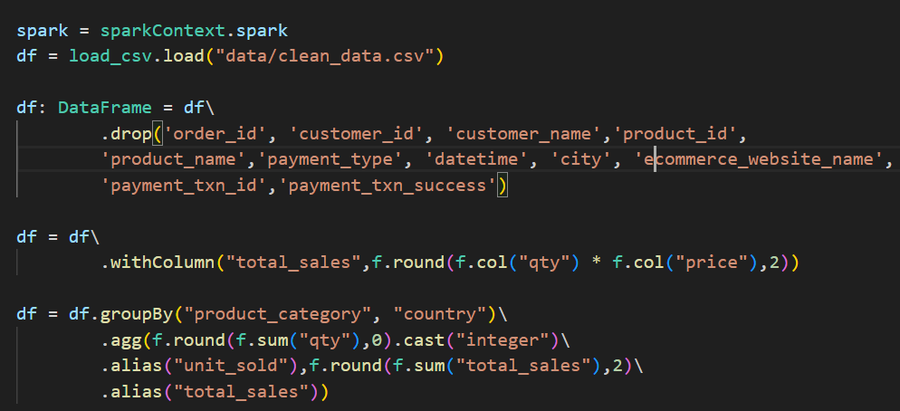
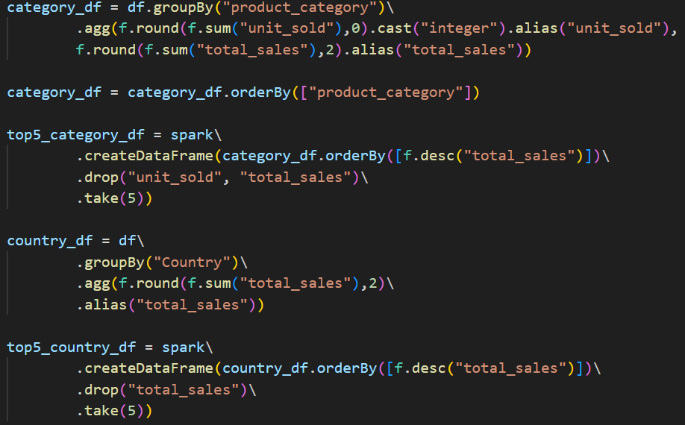
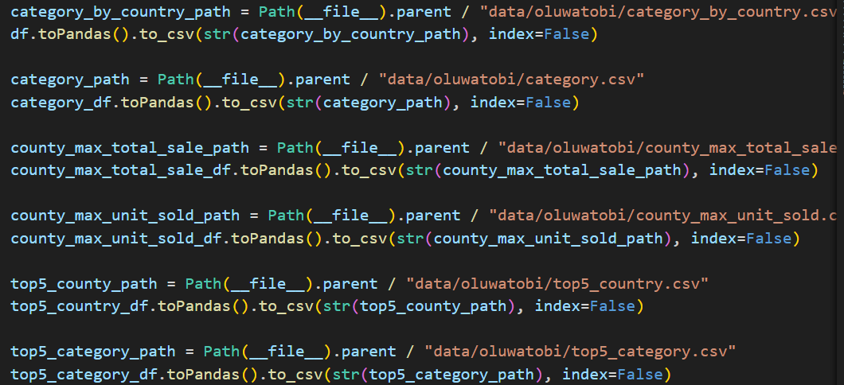
Oluwatobi Code

Slide 26
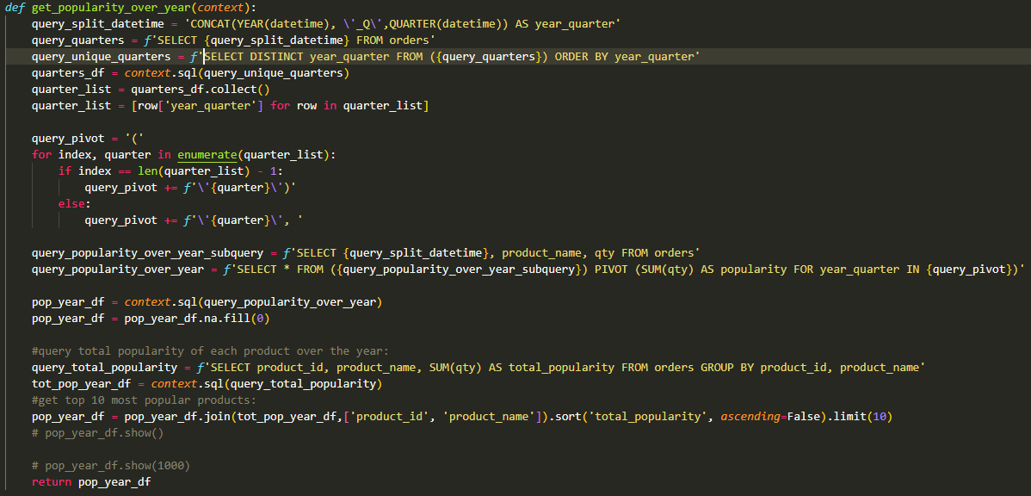
Miguel Code -> Popularity Over Time

Slide 27
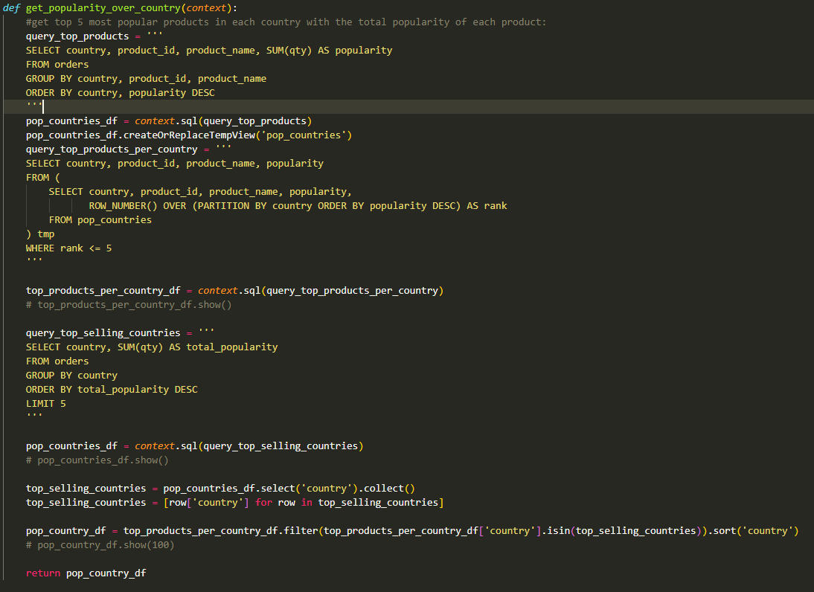
Miguel Code -> Popularity Over Country

Slide 28
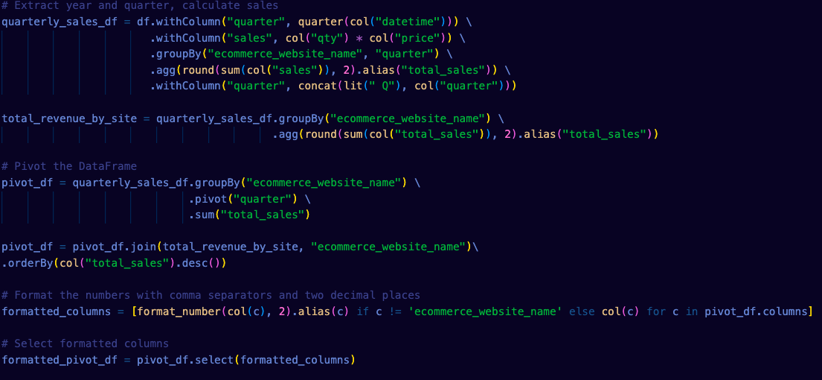
Matt: Website-By-Quarter

Slide 29
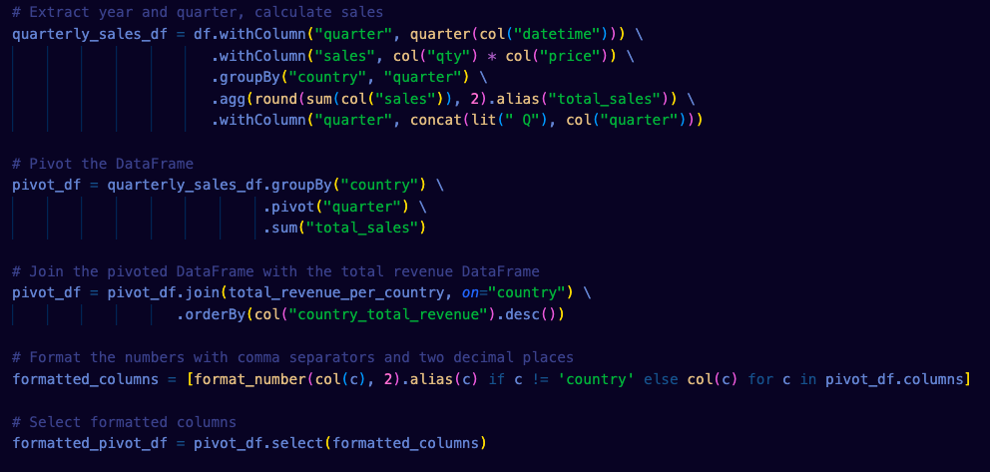
Matt: Country-By-Quarter

