Slide 1
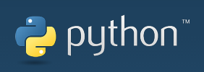
Windows Installation Tutorial
For Python help, contact:
Abhijeet Mote
abhijeetmote@gmail.com

Slide 2
Installing Python 3.4.3
https://www.python.org/downloads/

Slide 3
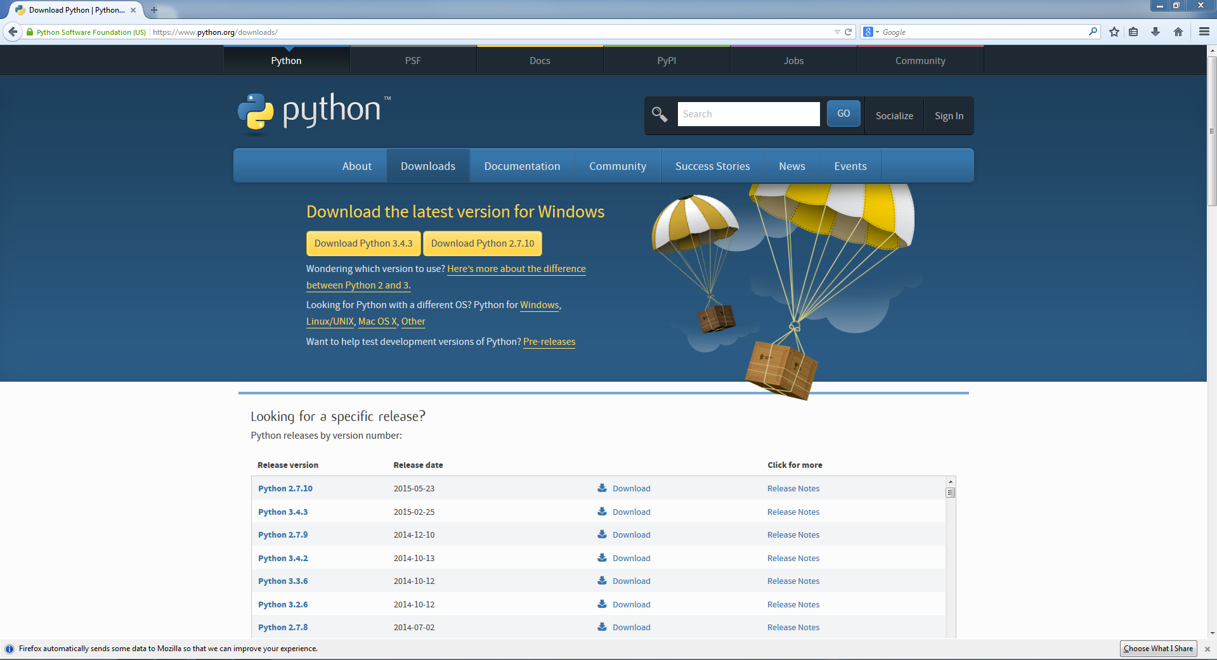
Go to: https://www.python.org/downloads/
Click the “Download Python 3.4.3 Button”

Slide 4
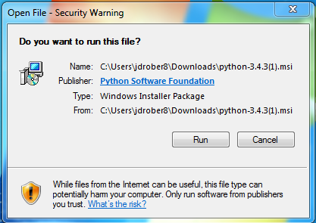
Open the “.msi” downloaded file
Click the “Run” Button
Then follow the directions to install Python 3.4.3

Slide 5
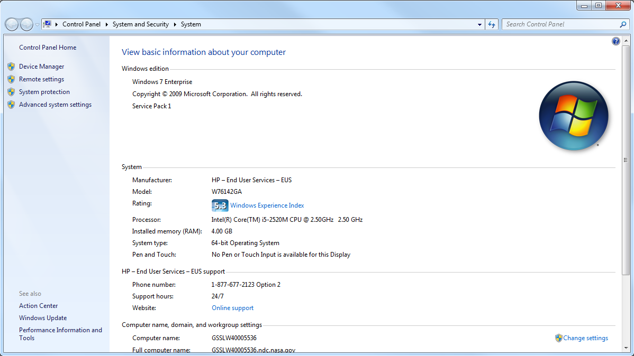

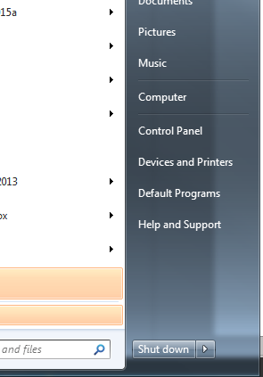
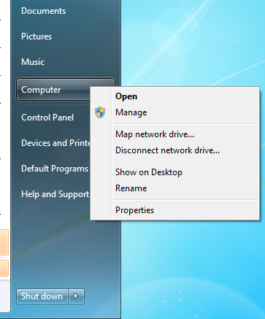
Once Python 3.4.3 is installed…
Open the start menu:
Click the “Advanced System Settings” Button
**RIGHT** click on the “Computer” Button
Click “Properties”

Slide 6
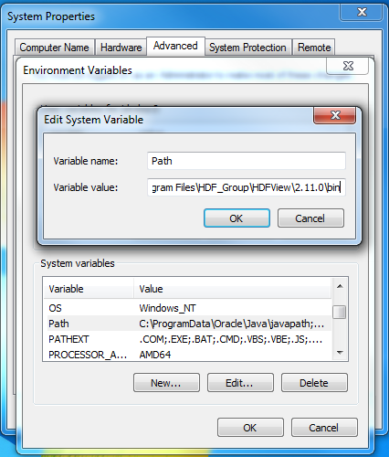
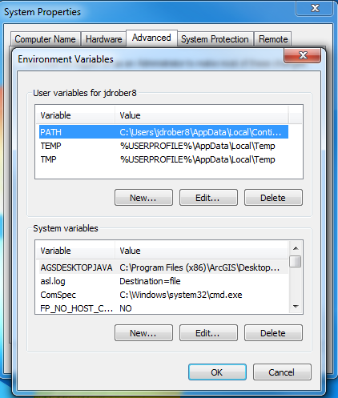
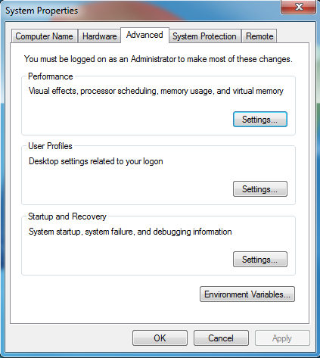
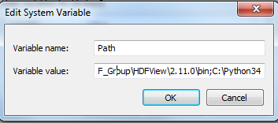
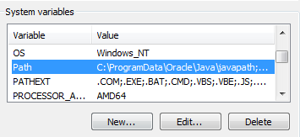
Setting your environment path
Scroll to the very end of this line of text…
Click “Ok” to all open properties windows
…and add the text: “;C:\Python34” to the end
Click on the variable “Path” so that it is highlighted, and then click “Edit..”
Go to the “System Variables” window, and scroll down until you find the “Path” variable
Click the “Environment Variables” Button

Slide 7
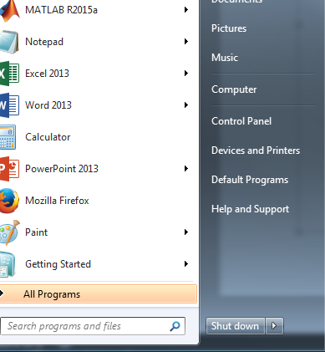
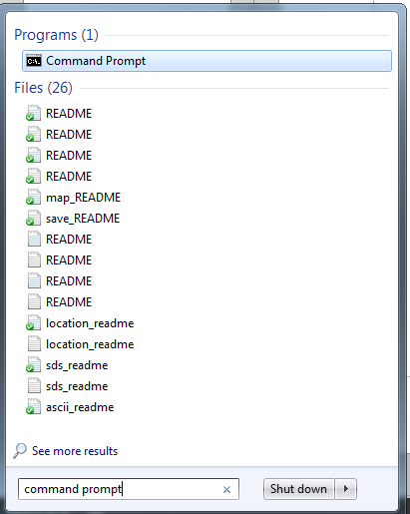
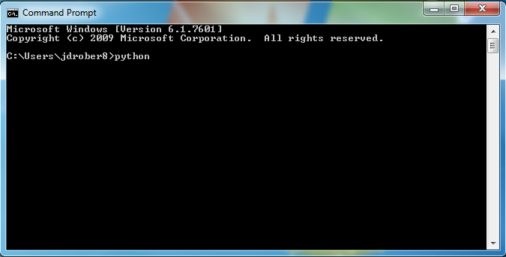
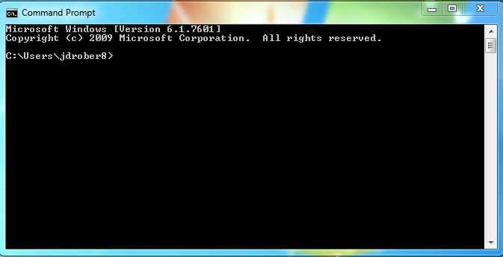
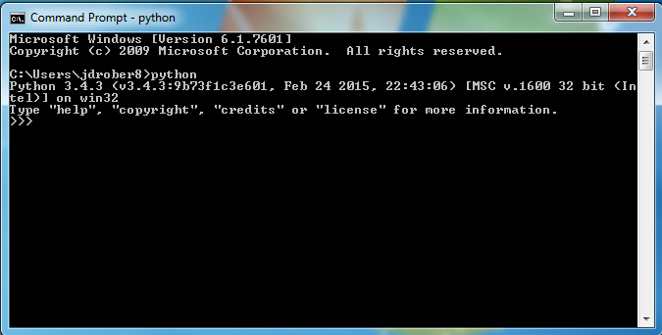
Test Python 3.4.3 installation
Open the start menu:
Open Command Prompt
Type “python”…
…and hit Enter
If your command prompt now says: “Python 3.4.3”, you’ve completed the tutorial correctly! If not, you may have missed something…
Search here for “Command prompt”

Slide 8
Installing Python 3 Packages
Python Package Index: Pip command
https://pypi.python.org/pypi/

Slide 9
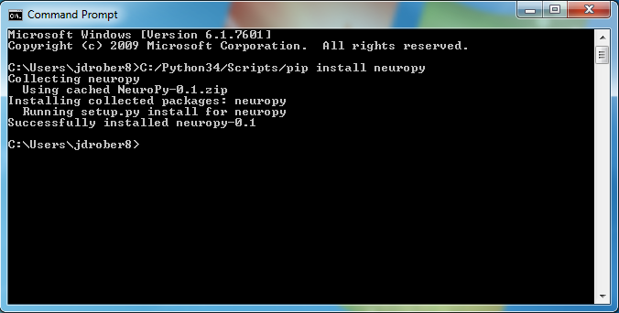
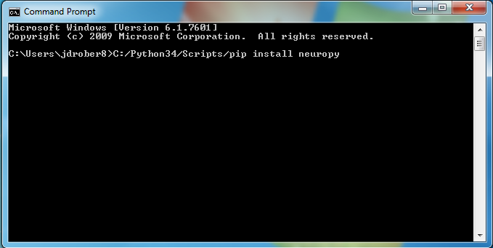
Open the Command Prompt
Many python packages are available for installation through the simple “pip” command.
Try the following command:
"C:\Program Files\Python37\Scripts\pip" install <name of the package>
"C:\Program Files\Python37\Scripts\pip" install NeuroPy
And hit Enter.

Slide 10
Installing Python 3 Packages
Windows Binary Files (.whl): Pip command
http://www.lfd.uci.edu/~gohlke/pythonlibs/

Slide 11
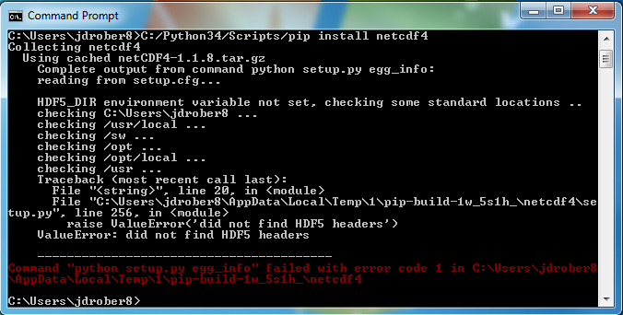
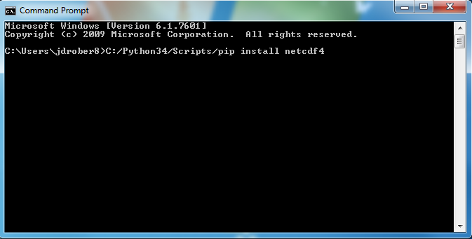
Go to http://www.lfd.uci.edu/~gohlke/pythonlibs/
Many python packages are not available for installation through the simple “pip” command.
For example. Try to install “netCDF4” the same way as NeuroPy in the previous slide.
If you get an error like this while installing a python package. Go to the link at the top of this page.

Slide 12
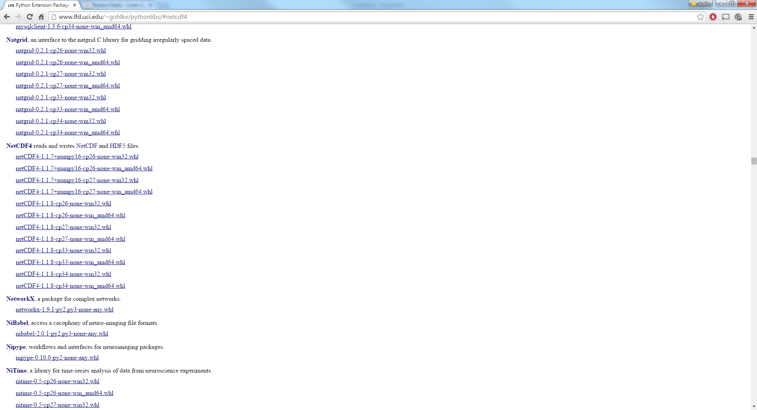
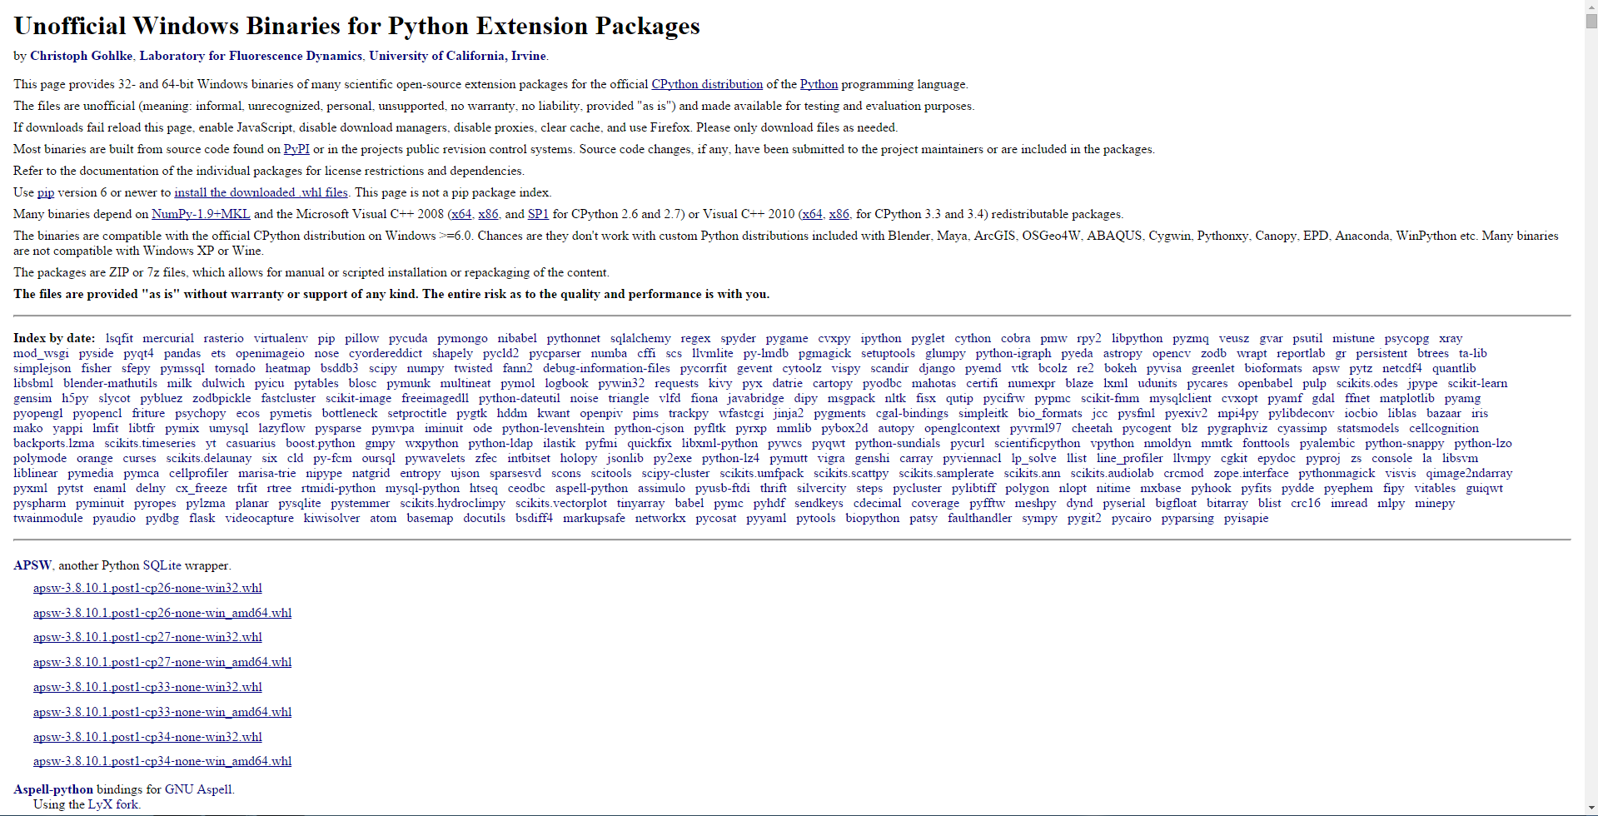
Downloading a “.whl” file
Scroll down until you find the package you’re looking for
Once you find your desired package…
Click on the link corresponding to your version of python and your type of computer. For example, this link is correct for someone with Python 3.4 installed (cp34), and if your computer is 32-bit (win32)

Slide 13
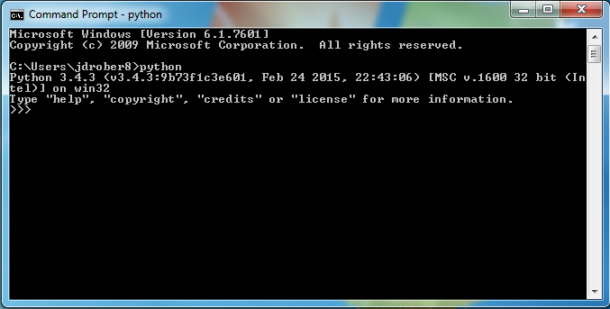
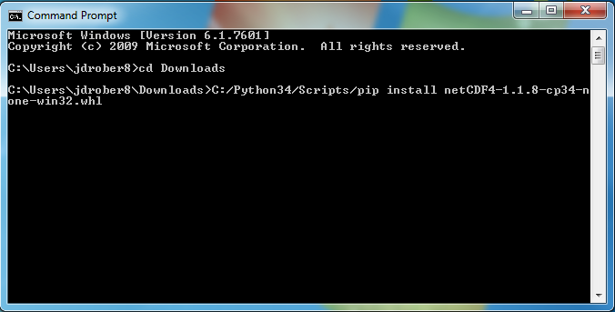
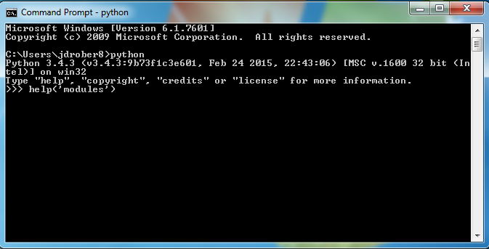
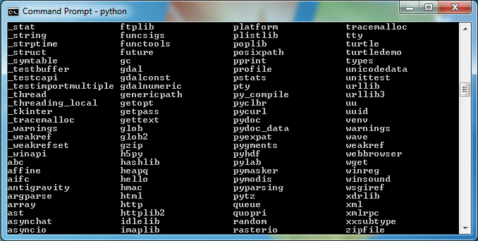
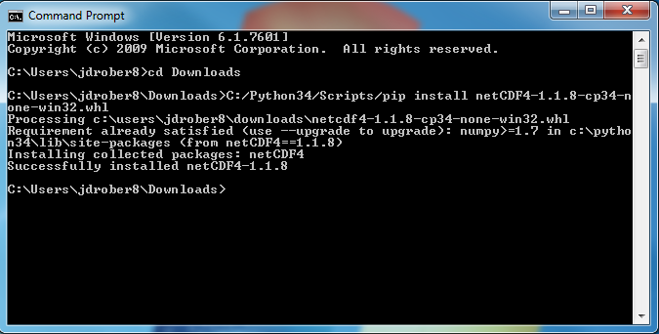
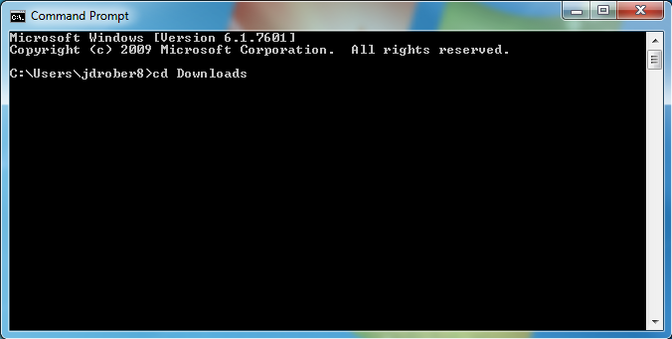
Installing the “.whl” file
Navigate to your “Downloads” folder
Open Command Prompt
Install the “.whl” netCDF4 package with this command
To view all of your currently installed python modules, type “python” and hit enter
Then type “help(‘modules’)” and hit enter
This should install the package successfully. If you get an error, it’s possible that you downloaded a file with the incorrect version of python, or the incorrect choice of 32 vs 64 bit computer
A list of all of your currently installed modules will appear!

Slide 14
Linux Environment
Python is already installed, no need to install. If its not avaialable in customize os
sudo apt-get install python
Install third party libraries using pip
sudo pip install <package name>

