Slide 1
Hi ! I’m Abhijeet - I work at UST Global(Intel) - Python Dev, Data Engineer,

Slide 2
Handling Data
Understand the problem
Reading from data sources
Exploratory Analysis
Data Cleansing

Slide 3
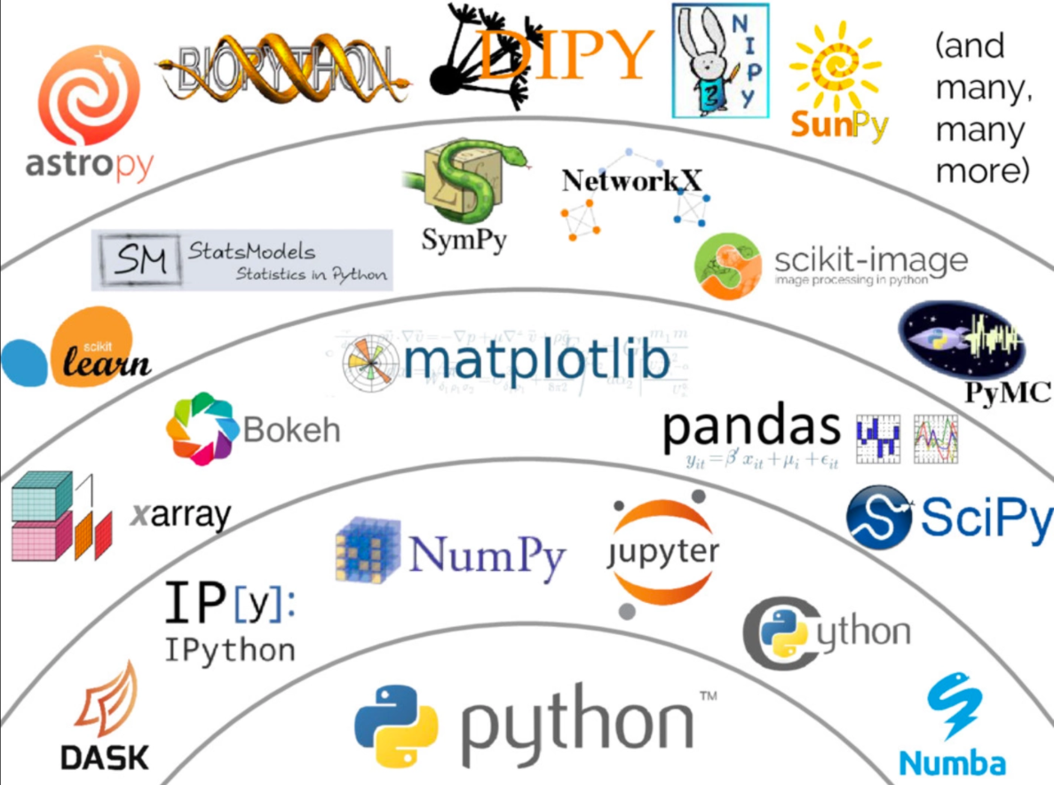
Python Ecosystem

Slide 4
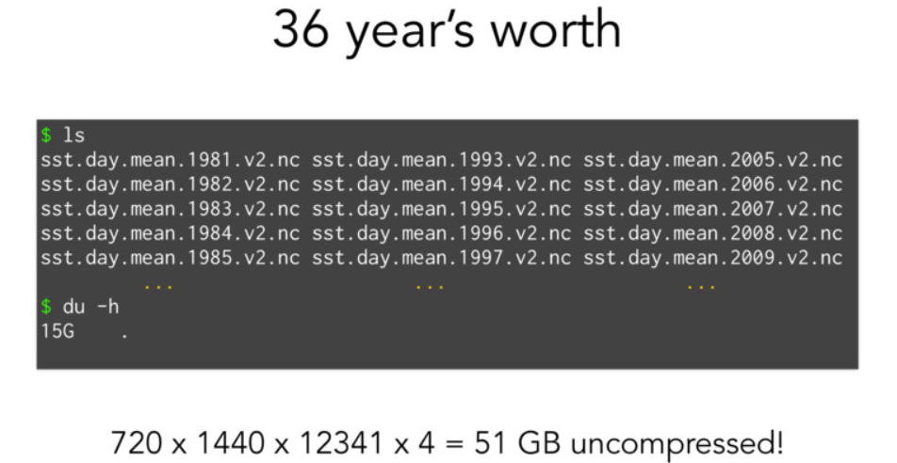

Slide 5
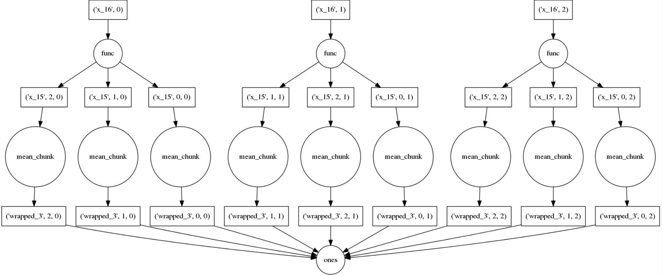
Cant Just load this all into Numpy… What Now?
Solution : Blocked Algorithams!

Slide 6
Dask
Parallelizing the Python Ecosystem

Slide 7
What is DASK???
A parallel computing framework
Lets you work on larger-than-memory datasets
Written in pure Python
That leverages the excellent Python ecosystem
Using blocked algorithms and task scheduling

Slide 8
What is DASK???
High Level : Parallel Pandas, Numpy, Scikit-Learn
Low Level : High Performance Task Scheduling

Slide 9
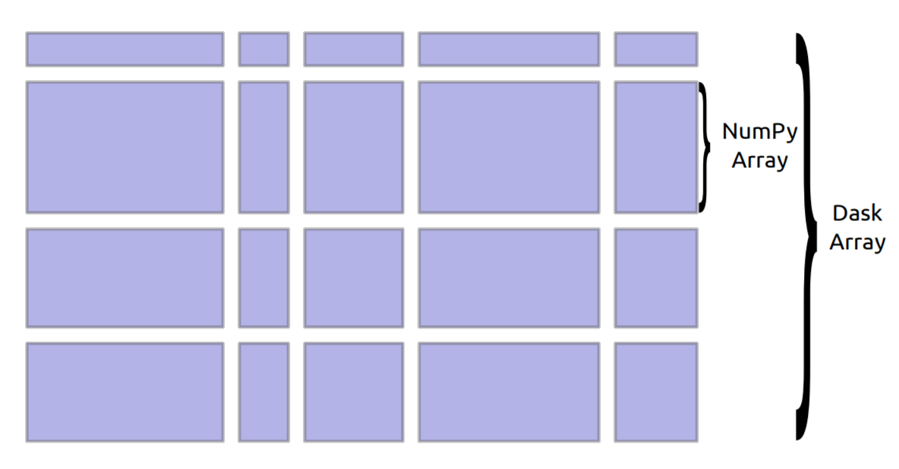
Dask.array
Parallel and out-of-core array library
Mirrors NumPy interface
Coordinate many NumPy arrays into single logical Dask array

Slide 10
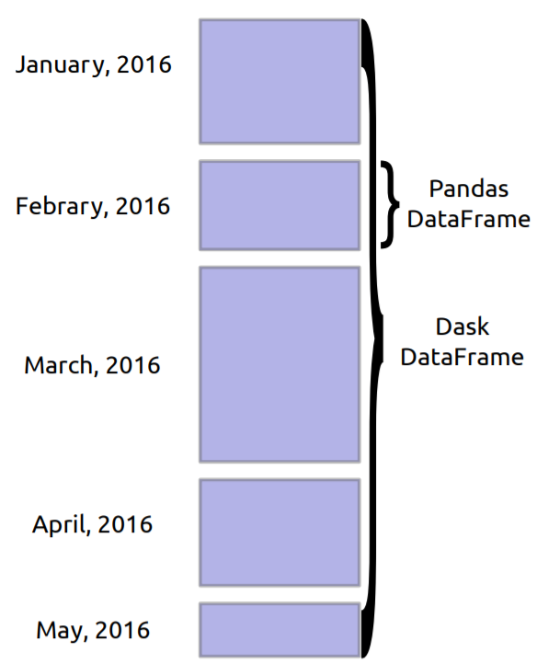
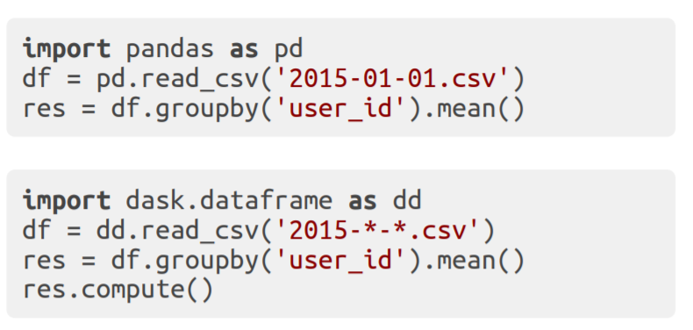
Dask.dataframe
Parallel and out-of-core
dataframe library
Mirrors the Pandas interface
Coordinates many Pandas
DataFrames into single logical
Dask DataFrame
Index is (optionally) sorted,
allowing for optimizations

Slide 11
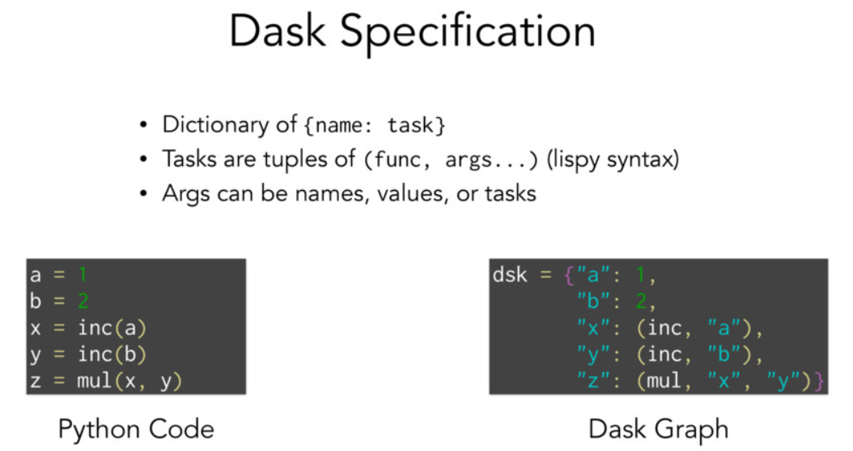

Slide 12
Complex graphs

Slide 13
Tool for creating arbitrary task graphs
Dead simple interface (one function)
results = {}
for a in A:
for b in B:
results[a, b] = fit(a, b)
best = score(results)

Slide 14
Dask Delayed

Slide 15
Single Machine Scheduler
Optimized for larger-than-memory use
Parallel CPU: Uses multiple threads or processes
Minimizes RAM: Choose tasks to remove intermediates
Low overhead: ~100us per task
Concise: ~600 LOC, stable

Slide 16
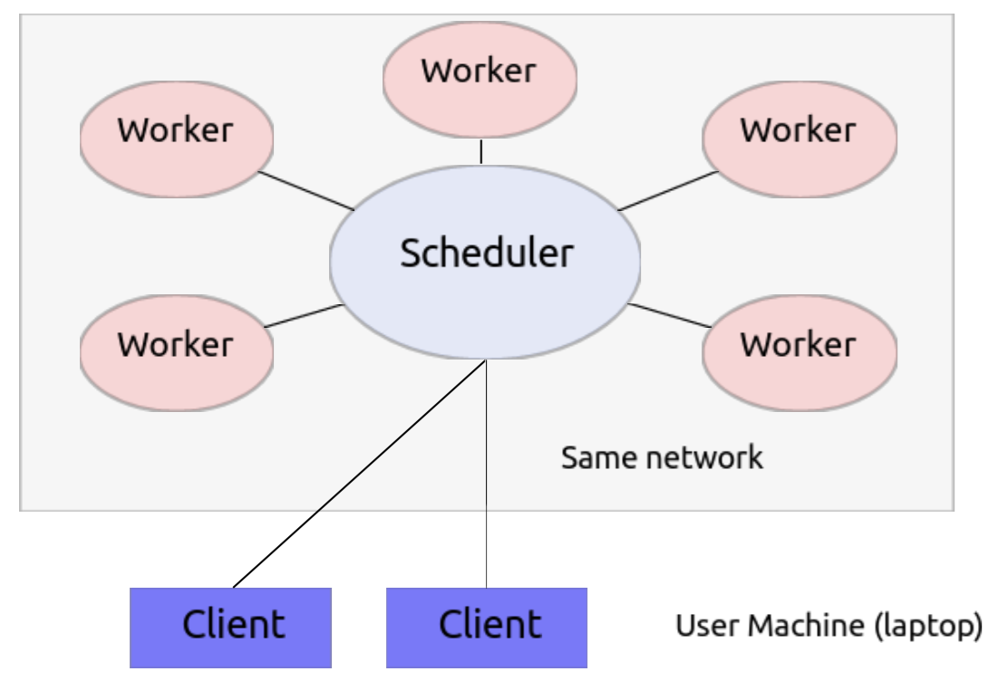
Distributed Scheduler
Distributed: One scheduler coordinates many workers
Data local: Tries to moves computation to "best" worker
Asynchronous: Continuous non-blocking conversation
Multi-user: Several users can share the same system
HDFS Aware: Works well with HDFS, S3, YARN, etc..
Less Concise: ~3000 LOC Tornado TCP application

Slide 17
To summarise: Dask is
Dynamic task scheduler for arbitrary computations
Familiar: Implements NumPy/Pandas interfaces
Flexible: Handles arbitrary task graphs efficiently (custom workloads,
integration with other projects)
Fast: Optimized for demanding applications
Scales up: Runs resiliently on clusters with 1000s of cores
Scales down: Pragmatic on a laptop
Responsive: for interactive computing
Dask builds on the existing Python ecosystem

Slide 18
Demo
https://github.com/abhijeetmote/Dask_Introduction

Slide 19
Reference
https://github.com/dask/dask-tutorial
https://dask.pydata.org/en/latest/
https://github.com/jcrist
http://conference.scipy.org/proceedings/scipy2015/pdfs/matthew_rocklin.pdf

Slide 20
Questions???
Contact
Abhijeet Mote
abhijeetmote@gmail.com
+60 111 4376251

