Slide 1
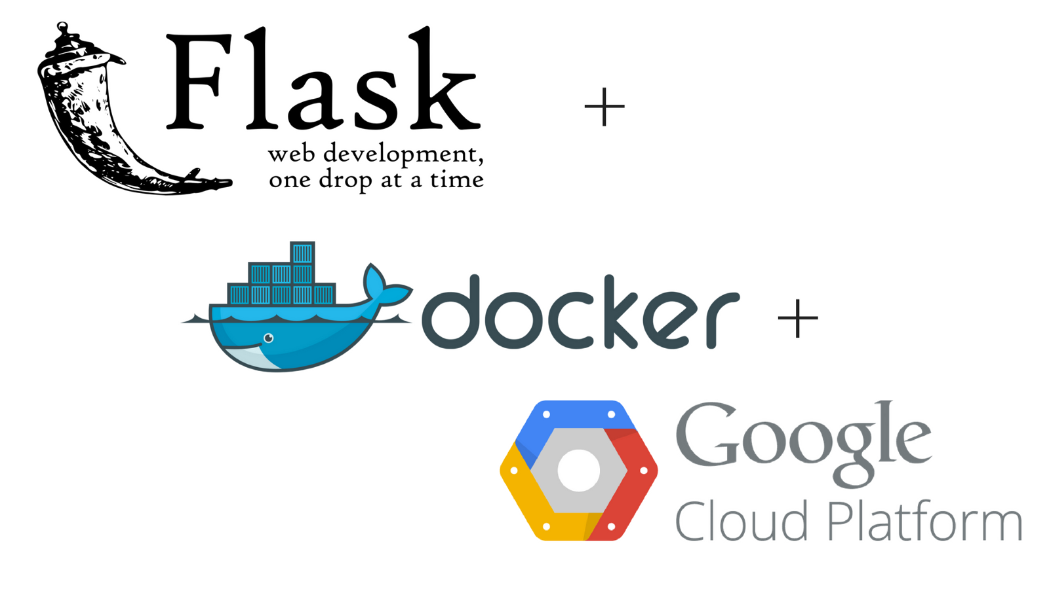
Flask API and deploy using Docker on Google Clouds

Slide 2
What is Flask?
Flask is a web application framework
WSGI Web Server Gateway Interface
Werkzeug
Jinga2

Slide 3
Prerequisites
Python3
Flask
Installation
pip3 install Flask

Slide 4
Flask App development
from flask import Flask
app = Flask(__name__)
@app.route("/")
def hello():
return "Hello World!"
if __name__ == "__main__“ :
app.run()

Slide 5
How to run it
Python hello.py

Slide 6
Dockerize the Flask app
Create Dockerfile
Create docker-compose.yml
Create requirements.txt

Slide 7
Useful commands :
docker build .
docker list images
docker container ls –all
sudo docker exec -i -t 332812a08554 ash

Slide 8



Thank you ☺
Follow us on twitter, facebook and github
@PenangPython
https://twitter.com/pythonpeople
https://www.facebook.com/groups/PenangPython/
https://github.com/PenangPython

