Slide 1


Poker Bots
By Team4

Slide 2
Ціль проекту
Написати
штучний інтелект
для гри
в покер
By Team4

Slide 3
Документація
Статут проекту
Технічне завдання
By Team4

Slide 4
Огляд проекту
Проект дозволяє випробувати
свої навики гри
в покер
проти штучного інтелекту
By Team4

Slide 5
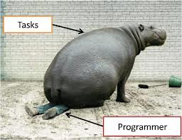
By Team4

Slide 6

Функціонал
Registration/
Authentication
By Team4

Slide 7

Функціонал
Create Game
By Team4

Slide 8

Функціонал
Choose bot strategy
By Team4

Slide 9
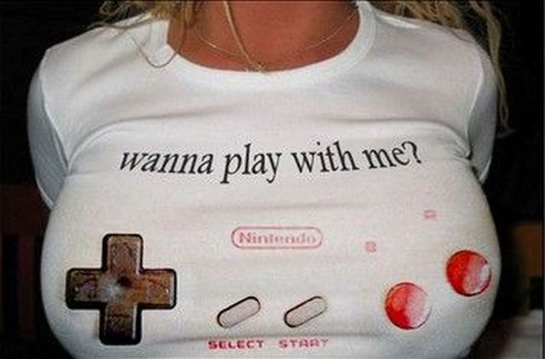
Функціонал
Play game
By Team4

Slide 10

Функціонал
Check your
By Team4

Slide 11
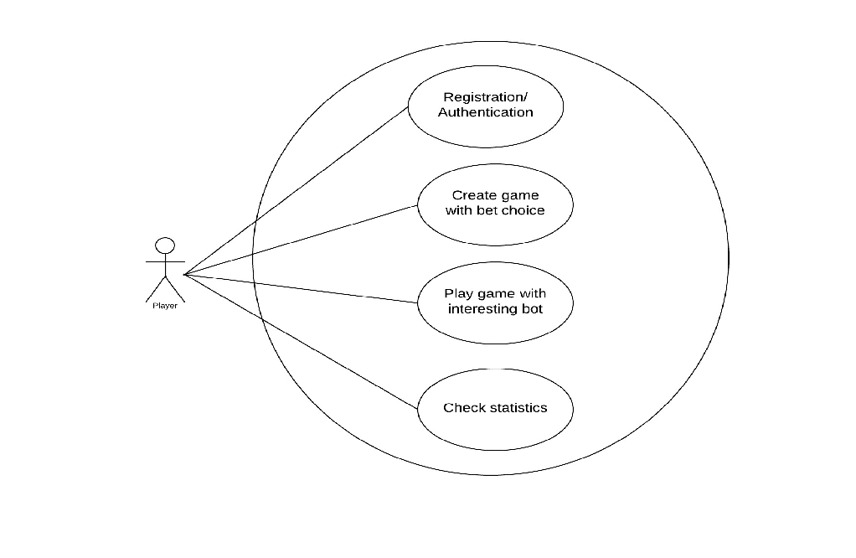
Діаграмма використань
By Team4

Slide 12
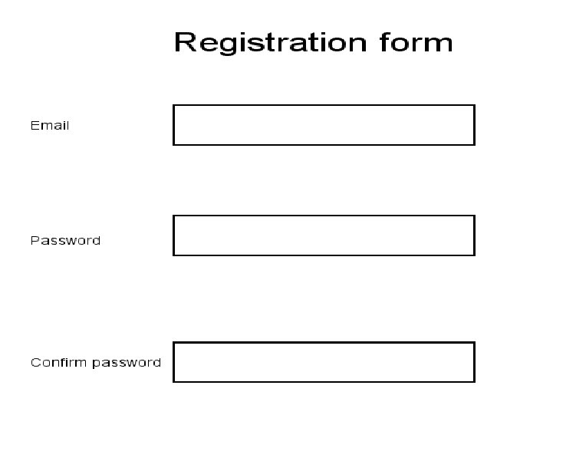
By Team4

Slide 13
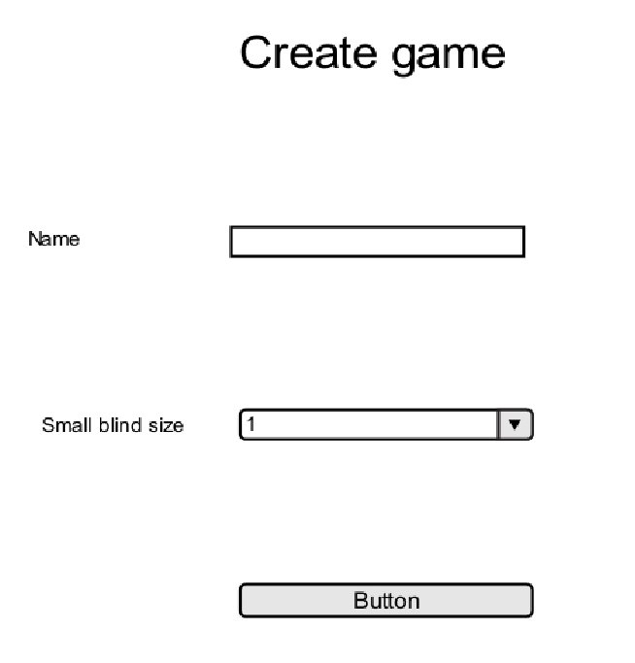
By Team4

Slide 14
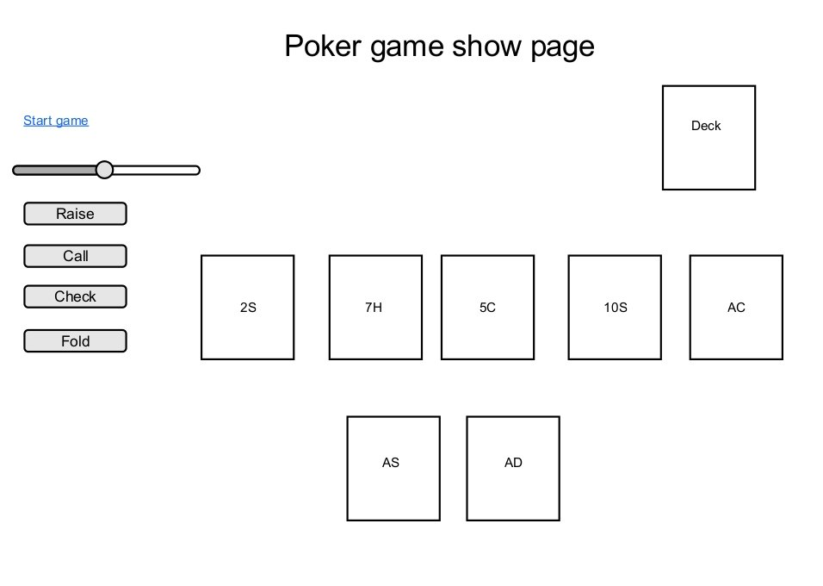
By Team4

Slide 15
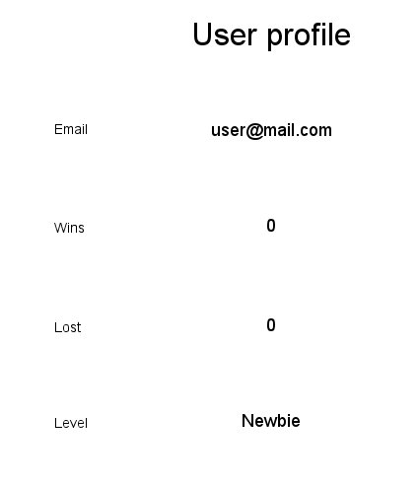
By Team4

Slide 16



Використані технології
RubyOnRails
REST
Twitter Bootstrap
By Team4

Slide 17
Особливості RubyOnRails
Принципи RubyOnRails
Convention over Configuration
Agile Programming Principle
Don't Repeat Yourself
By Team4

Slide 18
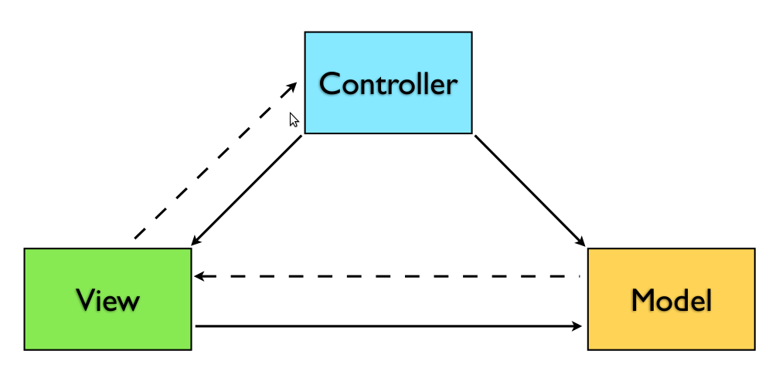
MVC
By Team4

Slide 19
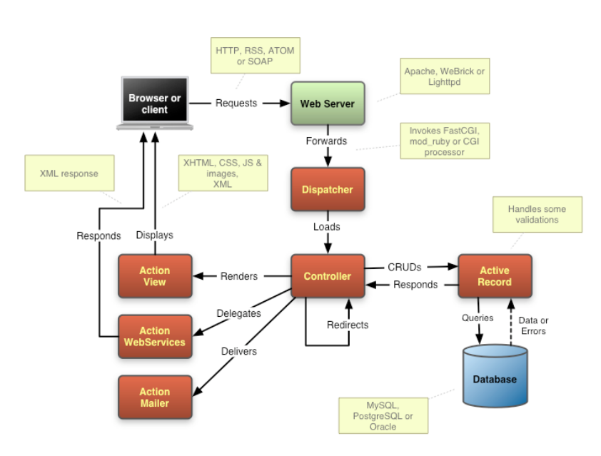
MVC в RubyOnRails
By Team4

Slide 20
Особливості Bootstrap
CSS Preprocessors
LESS
SASS
Responsive Design
By Team4

Slide 21
REST
REpresentational State Transfer
Everything is resource
Each resource has a uniform interface
By Team4

Slide 22
REST
Key principles
Give everything ID
By Team4

Slide 23
REST
Key principles
Give everything ID
Use standard methods
By Team4

Slide 24
REST
Key principles
Give everything ID
Use standard methods
Multiple representations
By Team4

Slide 25
REST
Key principles
Give everything ID
Use standard methods
Multiple representations
Readable links
By Team4

Slide 26
REST
Suitable for Mobile Devices
An HTTP server implementation
is feasible for mobile devices
REST over HTTP vs SOAP
reduces message processing
By Team4

Slide 27
REST API
put
/games/:id/start
Start previously created game
By Team4

Slide 28
REST API
put
/games/:id/check
Make check turn
By Team4

Slide 29
REST API
put
/games/:id/fold
Make fold turn
By Team4

Slide 30
REST API
put
/games/:id/raise
Make raise turn
By Team4

Slide 31
REST API
put
/games/:id/call
Make call turn
By Team4

Slide 32
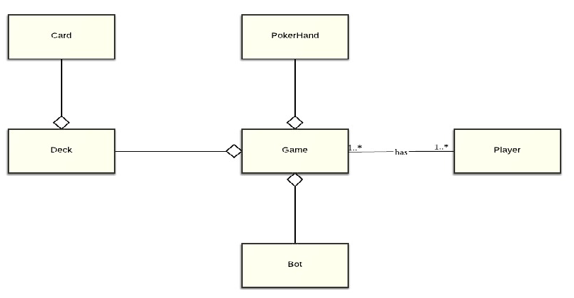
Діаграмма класів
By Team4

Slide 33
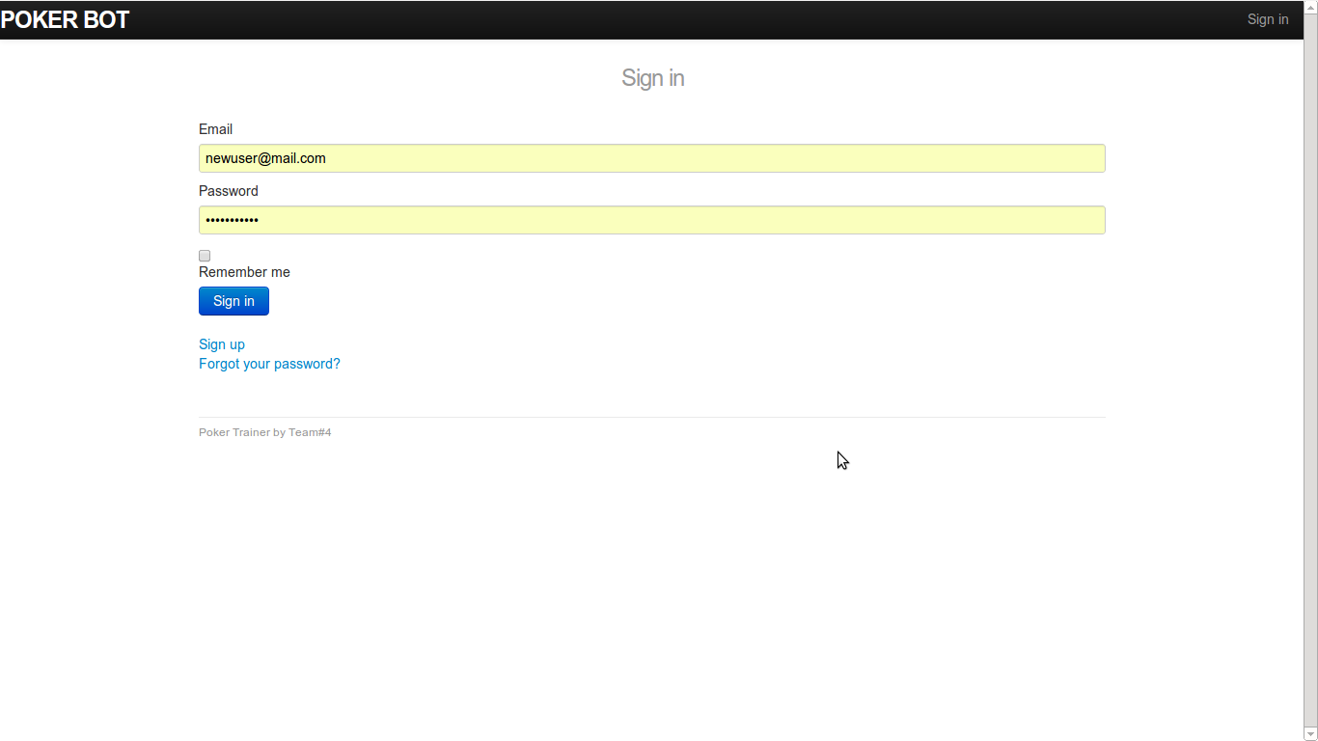
By Team4

Slide 34
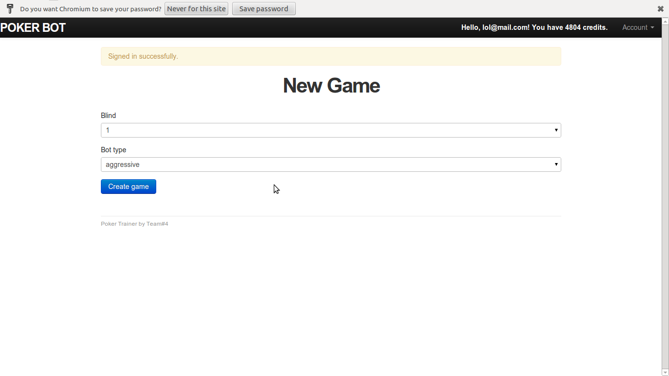
By Team4

Slide 35
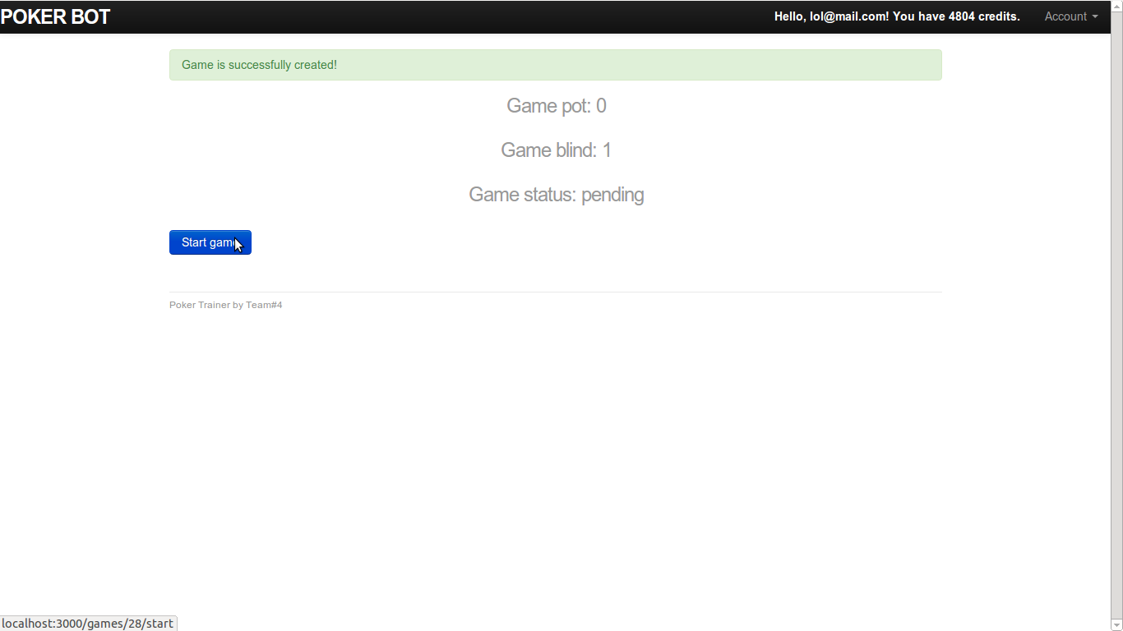
By Team4

Slide 36
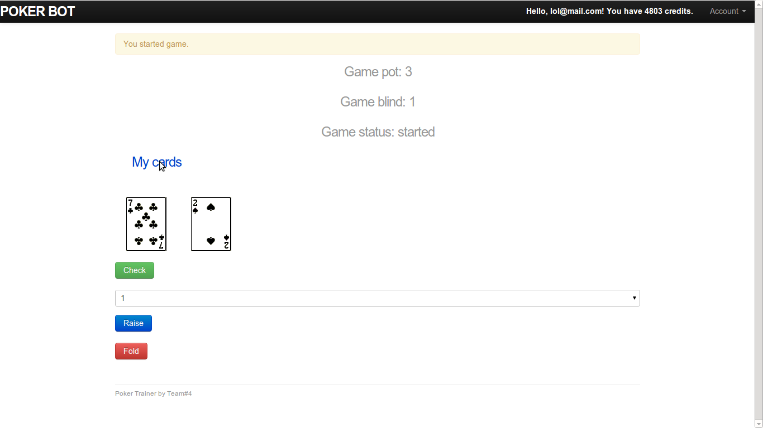
By Team4

Slide 37
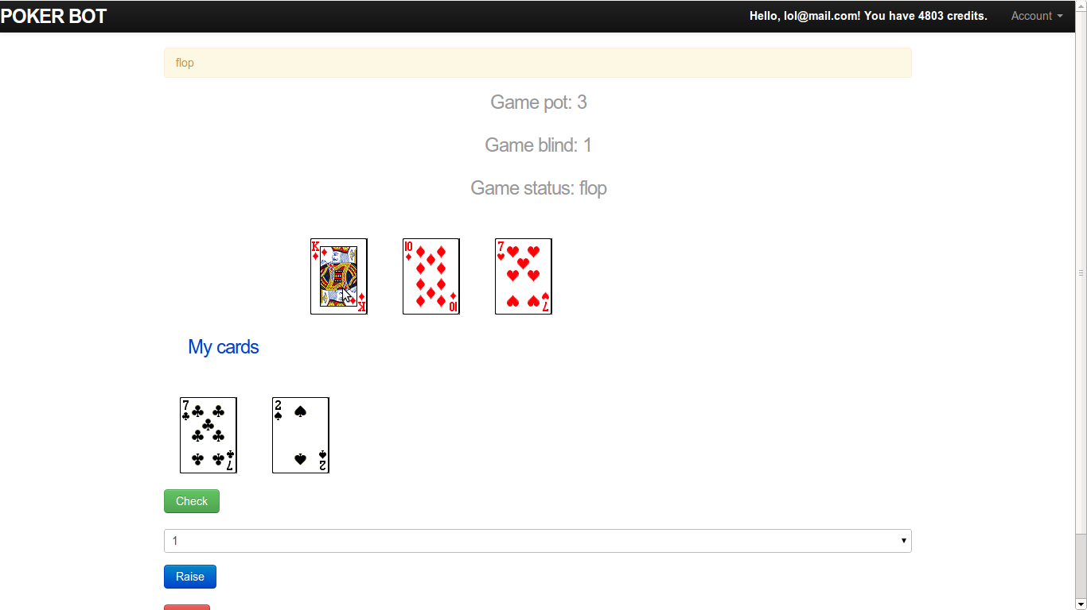
By Team4

Slide 38
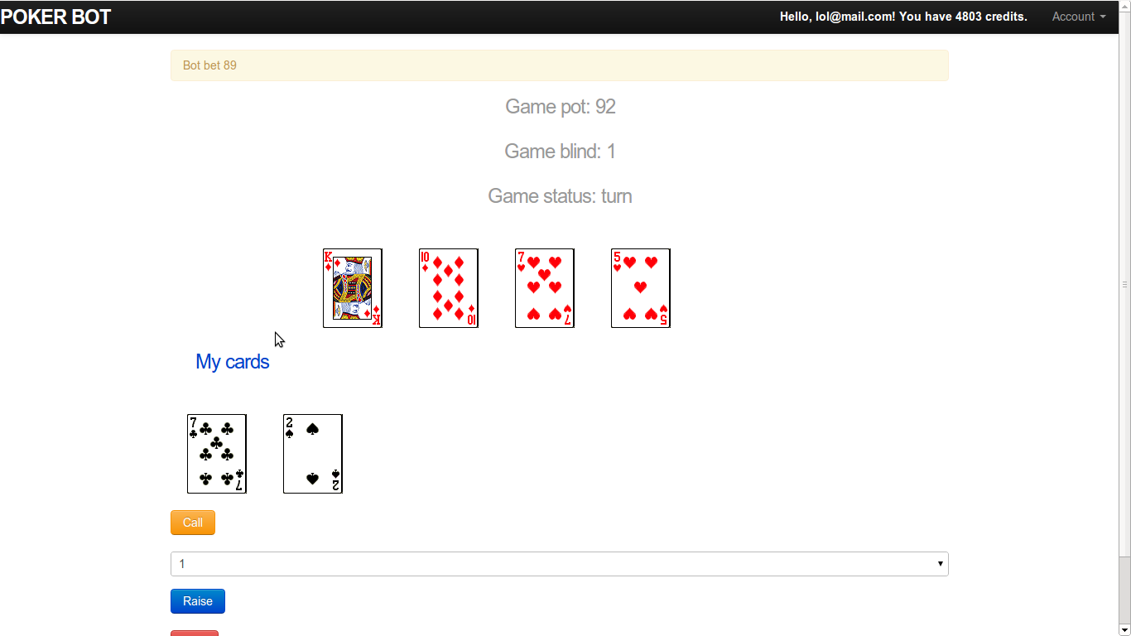
By Team4

Slide 39
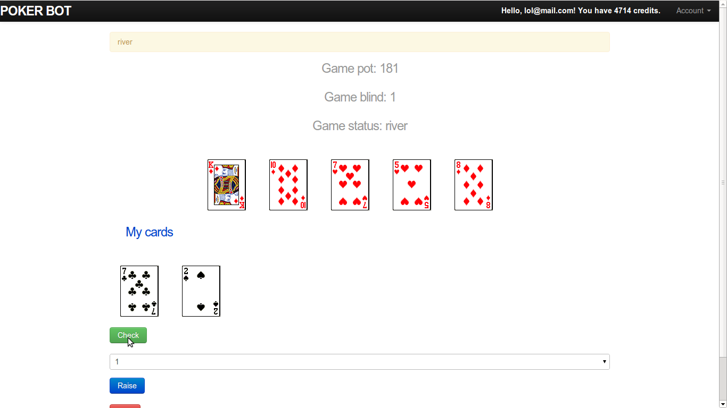
By Team4

Slide 40
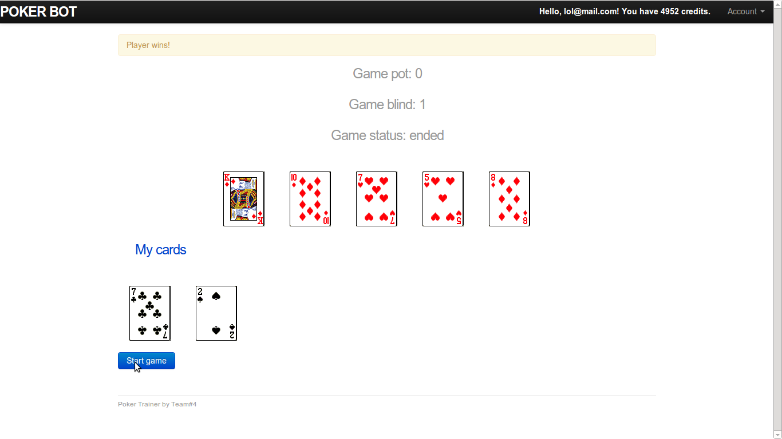
By Team4

Slide 41
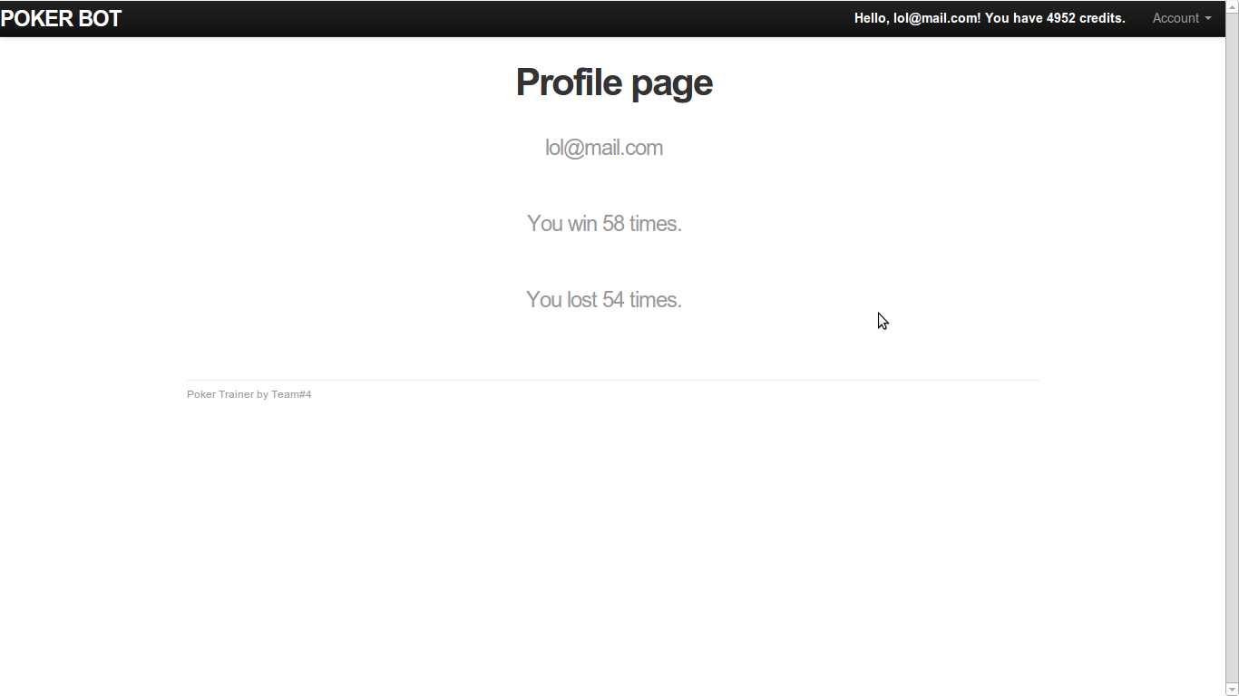
By Team4

Slide 42

Велике
дякую
за
увагу
By Team4

