Slide 1
CRICKETSCOPE
IPL DATA ANALYTICS
Project by:-
Dinkar Saroj
Someshwar
Penchala Teja

Slide 2

PROJECT LOGO

Slide 3
INDIAN PREMIER LEAGUE
The IPL, short for the Indian Premier League, is a premier Twenty20 cricket tournament held annually in India.
It features franchise teams representing different cities and states, drawing top cricketing talent from around the world.
Renowned for its high-octane matches, star-studded line-ups, and vibrant atmosphere, the IPL has become a global phenomenon, captivating millions of fans and setting new standards in cricket entertainment.

Slide 4
OBJECTIVE
Utilize data analytics to uncover patterns, trends, and performance metrics within cricket match data.
Enhance the cricketing spectacle by delivering engaging insights and narratives derived from data analysis.
Provide actionable insights to assist our client in making informed decisions regarding player selection, team strategies, and match tactics.

Slide 5
SCOPE
This project aims to streamline the data analysis workflow by designing a relational database schema for efficient data storage.
Using SQL to manipulate and query the data to extract meaningful insights.
Furthermore, we will conduct thorough data analysis and preprocessing before developing an interactive dashboard in Power BI to visualize key metrics and insights for effective decision-making.

Slide 6
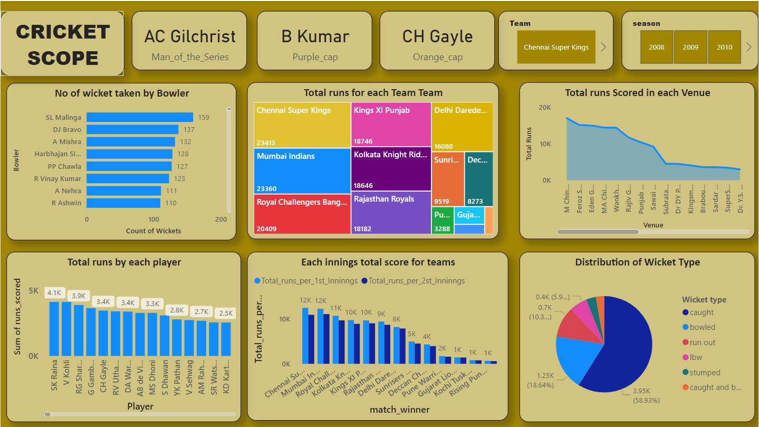
DASHBOARD

Slide 7

CHALLENGES
Importing huge data
Connecting mysql with Powerbi
Time Management

Slide 8

LEARNING OUTCOMES
Importing data into mysql workbench
Learning about Connector
Time Management

Slide 9


