Slide 1
Contents
Dashboard Approach
Dashboard Access- Table
Dashboard Views ( Access / Chart) – Visualization and Source
DVP View
GDC Head View
Functional view
Priority/Phase of rollout ( Phase 1 / Phase 2 : With and without metrics)

Slide 2
NMD GDC Dashboard Approach
Dashboards will be represented based on type of view
DVP View
GDC Head View
Functional Leads/Service Delivery Leads View
Dashboards will be rolled out in 2 phases and classified as
Master Data for the Dashboards
Data source shall be excel file
Each of the dashboard classified above shall have one spreadsheet each
Phase 1 Roll out: | Phase 2 Roll out:
Executive Dashboard Resource Dashboard Financial Dashboard | Program Metrics Inventory Dashboard

Slide 3
GDC Dashboard- Access
Not Applicable
Phase 1 Roll out
Phase 2 Roll out
Dashboard | Frequency of updates | DVP | GDC Head | Functional Leads / Service Delivery Leads
Executive Summary | Monthly | Executive Dashboard High Level Key Program RAG Status Milestones/Metrics Key Message Key Risk/ Issue | Executive Dashboard High Level Key Program RAG Status Milestones/Metrics Key Message Key Risk/ Issue
Program Status | Weekly |  | 1) Program Metrics ( Quality , Performance) 2) Training Compliance 3) Program level Risks | 1) Functional level Metrics ( Quality , Performance) 2) Training Compliance 3) Functional level Risks
Resource Metrics | Monthly | 1) Resource Utilization -Overall GDC | 1) Resource Utilization -Overall GDC 2) Resource Experience Levels- Across GDC 3) Resource Experience in abbott 4) Resource Onboarding Status across GDC 5) Resource attrition across GDC 6) Resource Upskill across GDC | Based on Functional Lead's login- 1) Resource Utilization -Program wise 2) Resource Experience Levels- Program wise 3) Resource Experience in abbott -Program wise 3) Resource Onboarding Status - Program wise 4) Resource attrition Program wise 5) Resource Upskill Program wise
Financial Metrics | Monthly | Overall Financial Burn down | 1) Program level Burn down | 1) Functional /Program Financial burn down
Lab Utilization | Bi-Weekly | 1) Lab utilization Summary | 1) Lab utilization Summary 2) Asset specific utilization 3) Inventory 4) Calibration / PM summary | Lab utilization Summary Asset specific utilization Program specific asset utilization Inventory Calibration / PM summary

Slide 4
DVP Head View

Slide 5
DVP View: Executive Dashboard
Program Health Indicators
Key Messages
 | Gemini | Jupiter | Aquarius
Budget
Resources
Schedule
Overall, Health
Gemini
e:
FDA Approval Received,
Design Transfer Completed,
Launch planned during Jan’2023.
Jupiter
Jupiter Release:
Design Input Completed,
Launch planned during Dec’2023 or Jan’2024 based on FDA approval.
Milestones/Metrics
Risks/Issues
Jupiter
DIDR – 07th Oct 2022
DODR – 16th Jan 2023
DVDR – 14th Apr 2023
FDA BSI Submission – 28th Apr 2023
FDA Approval Expected – 01st Dec 2023
Jupiter Release:
Jupiter Release:
Under review with customer
Jupiter Release:
Quality Metrics er Release:
Performance Metrics Re lease:
Training Compliance Release:

Slide 6
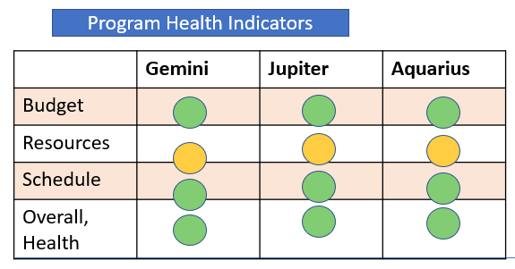
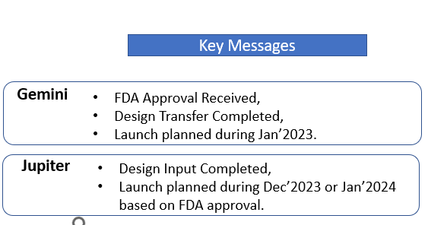
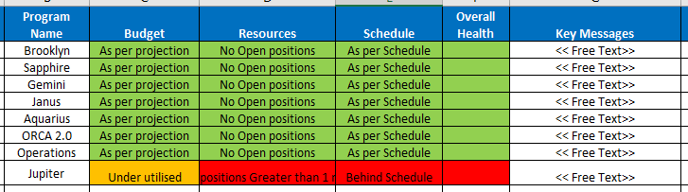
DVP View: Executive Dashboard: Data Source
Source of Date | NMD_Dashboards_Master_Data_28_Nov.xlsx
Sheet Name | “Master Data-Executive Dashboard”
Location | Refer to snapshot
Frequency of update | Monthly
Cont..

Slide 7
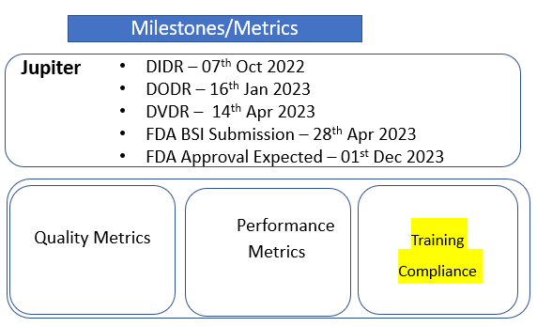
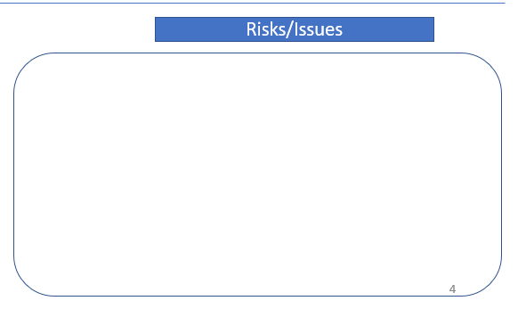
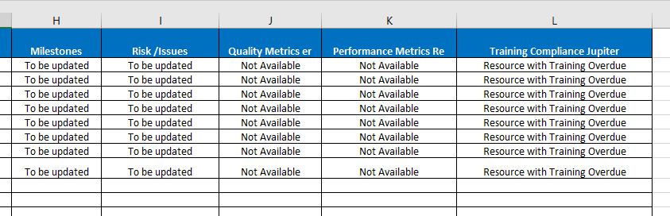
DVP View: Executive Dashboard: Data Source

Slide 8
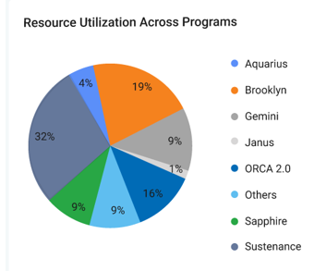
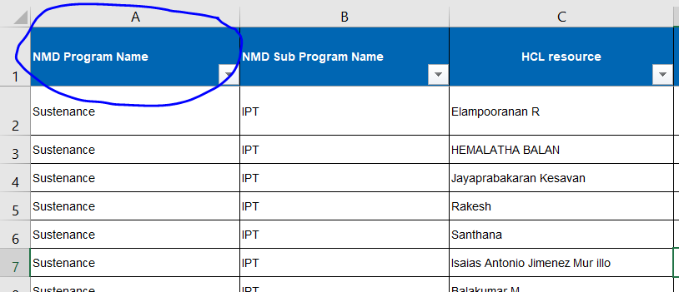
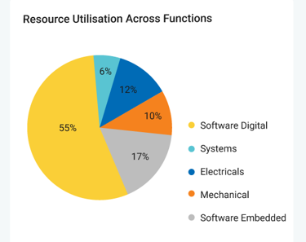
DVP View & GDC Head View: Resource Utilization -Overall GDC
Source of Date | NMD_Dashboards_Master_Data_28_Nov.xlsx
Sheet Name | “Master Data-Resource”
Location | “NMD Program Name “
Frequency of update | On need basis ( Triggered from Onboarding and Offboarding)
Data Reference

Slide 9
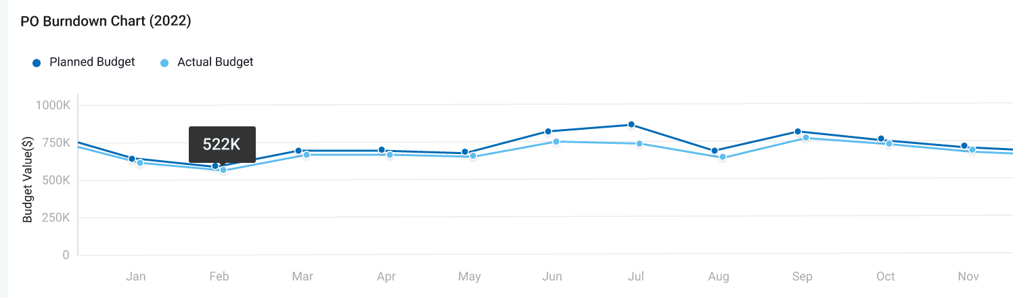
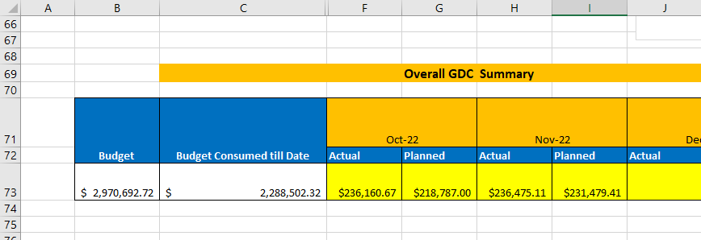
DVP View: Financial Dashboard
Source of Date | NMD_Dashboards_Master_Data_28_Nov.xlsx
Sheet Name | Master Data- Finance
Location
Frequency of update | Monthly

Slide 10
GDC Head View

Slide 11
GDC Head : Resource Dashboard
These dashboards are visible only in GDC Head Login
Resource Upskill across GDC
Cont..

Slide 12
GDC Head : Resource Dashboard
Source of Date | NMD_Dashboards_Master_Data_28_Nov.xlsx
Sheet Name | Master Data-Resource
Chart Reference | GDC_H_Resource_Pivots
Frequency of update | Monthly

Slide 13
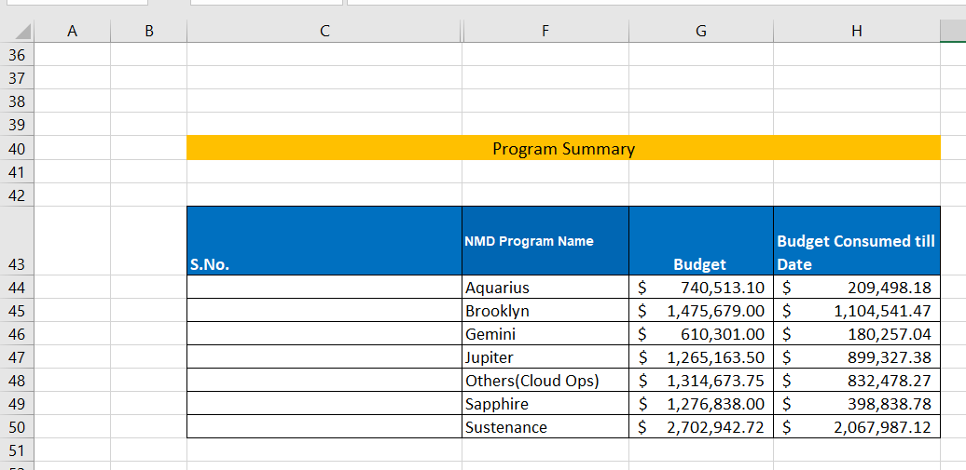
GDC Head : Financial CONSUMPTION Program wise
Source of Date | NMD_Dashboards_Master_Data_28_Nov.xlsx
Sheet Name | Master Data- Finance
Frequency of update | Monthly
Location

Slide 14
Functional Leads / Service Delivery Leads View

Slide 15
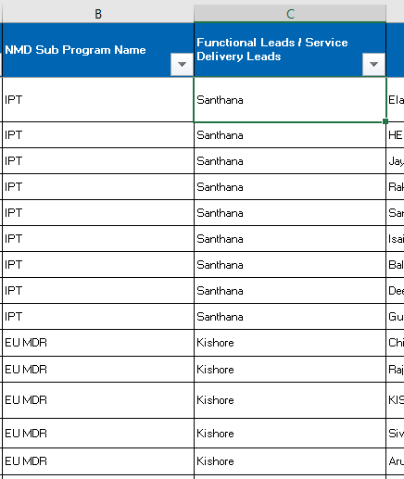
SDL/ Function Leads : Resource Dashboard
Based on Functional Lead's login the resource dashboards shall be displayed based on the program mapping. Available in the following location
Source of Date | NMD_Dashboards_Master_Data_28_Nov.xlsx
Sheet Name | Master Data-Resource
Frequency of update | Monthly
Chart Reference | SDL_Resource_Pivots
Cont..

Slide 16
SDL/ Function Leads : Resource Dashboard

Slide 17
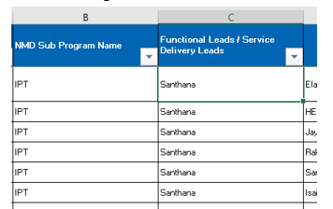
SDL/ Function Leads : Financial Dashboard
Based on Functional Lead's login the Financial dashboards shall be displayed based on the program mapping. Available in the following location
Source of Date | NMD_Dashboards_Master_Data_28_Nov.xlsx
Sheet Name | Master Data-Resource
Source of Date | NMD_Dashboards_Master_Data_28_Nov.xlsx
Sheet Name | Master Data- Finance
Frequency of update | Monthly
Location
Functional /Program Financial burn down

Slide 18
Roll out plan
Sl No. | Key Activities | Q4-22 |  |  |  |  |  |  |  |  | Q1-23
 |  | November |  |  |  | December |  |  |  |  | Jan |  |  |  | Feb |  |  |  | March
 |  | Wk 44 | Wk 45 | Wk 46 | Wk 47 | Wk 48 | Wk 49 | Wk 50 | Wk 51 | Wk 52 | Wk1 | Wk2 | Wk3 | Wk4 | Wk5 | Wk6 | Wk7 | Wk8 | Wk9 | Wk10 | Wk11 | Wk12
1 | Digital Dashboard- Intial review with customer
2 | Customer feedback Sessions
3 | Digital Dashboard- Structure finalization
4 | Customer approval on final dashboard contents
5 | Input gathering and data sanity check- end of Nov.
6 | Identification of suitable source of capturing the data
7 | Dashboard Build- Phase1( Without Metrics and Lab details)
8 | Dashboard Build- Phase2
9 | Validation of the Dashboard( Similar to End user Validation)
10 | Workflow for capturing the data
11 | Final Roll out to GDC team
Varun to update / split #7 and #8
 | Ongoing
 | Planned
 | Completed

Slide 19
End of the Slide

