Slide 1
Quarto PowerPoint Example

Slide 2
Quarto
Quarto enables you to weave together content and executable code into a finished presentation. To learn more about Quarto presentations see https://quarto.org/docs/presentations/.

Slide 3
Bullets
When you click the Render button a document will be generated that includes:
Content authored with markdown
Output from executable code

Slide 4
Slide with Code and Output
summary(cars)
speed dist Min. : 4.0 Min. : 2.00 1st Qu.:12.0 1st Qu.: 26.00 Median :15.0 Median : 36.00 Mean :15.4 Mean : 42.98 3rd Qu.:19.0 3rd Qu.: 56.00 Max. :25.0 Max. :120.00

Slide 5
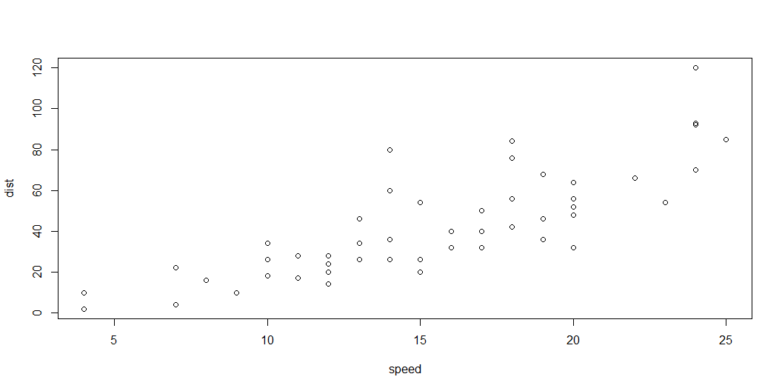
Slide with Plot

Slide 6
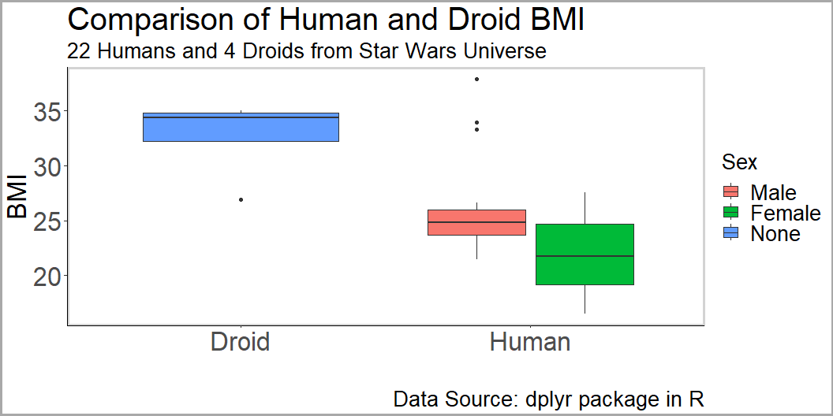
Star Wars Plot from Week 1

