Slide 1
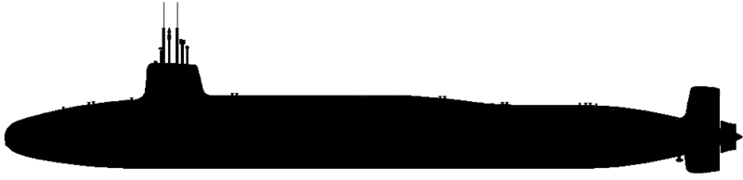
Advanced Radio-Graphical Undersea System A R G U S
Vanguard Class SSBN silhouette by Antiochus the Great. wikimedia.org

Slide 2
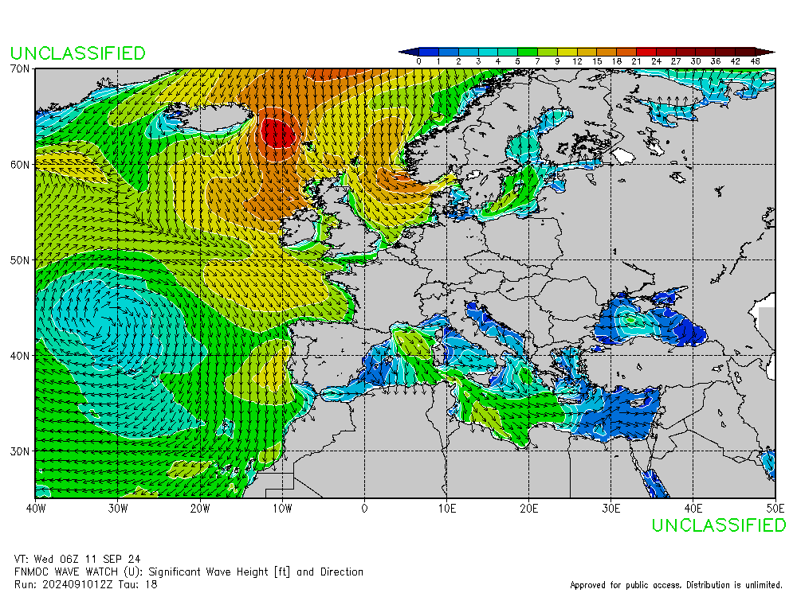
Background
Weather Data:
The current method of communicating weather data to submarines is to send a weather gif of wave height and direction for a specific AOR. This is not available on the VLF broadcast.

Slide 3

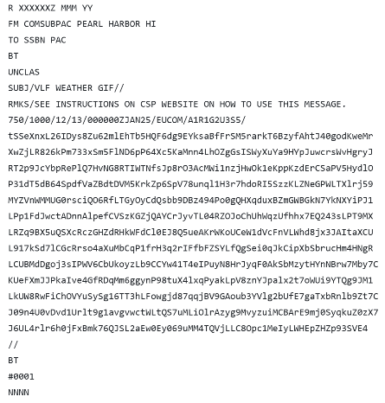


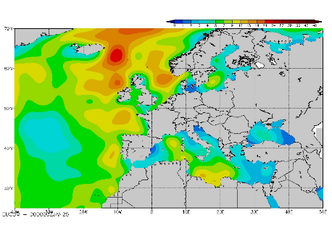
Procedure Overview
ARGUS is a program developed in Python which converts the existing weather gif product to a VLF message and then uses a template to reproduce the wave heights for the boats at sea. It achieves a more than 1:4500 compression ratio to do so.
ARGUS
ARGUS
VLF

Slide 4
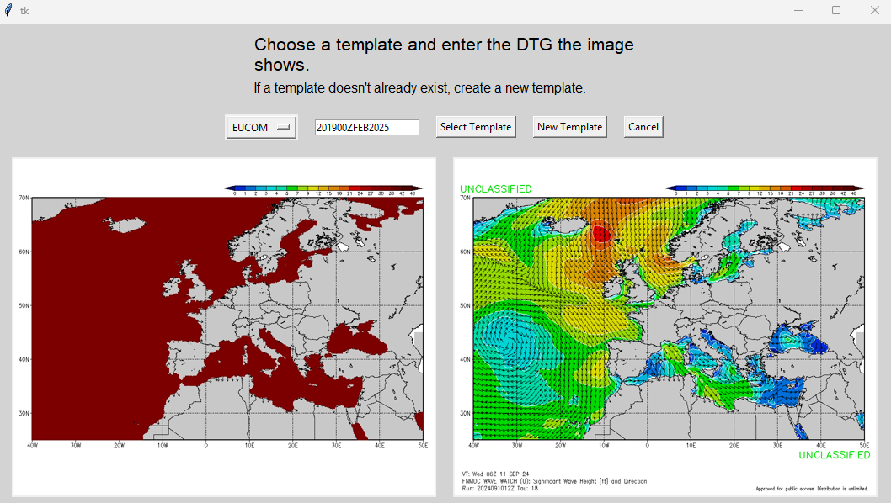
Procedure Overview
Shoreside will: pull the normal weather gif from Fleet Numerical Meteorology and Oceanography Center (FNMOC) and open it with ARGUS. They will then choose a template to use.
ARGUS will: look for all the Red, Green, Blue (RGB) values corresponding to wave heights, compress the data as text, paste the text into a message template, and save the message as a text file.

Slide 5
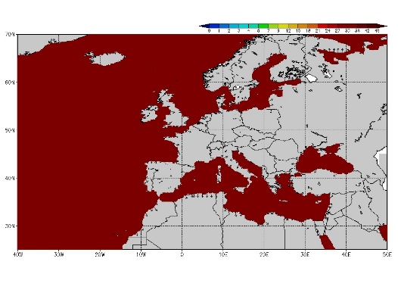
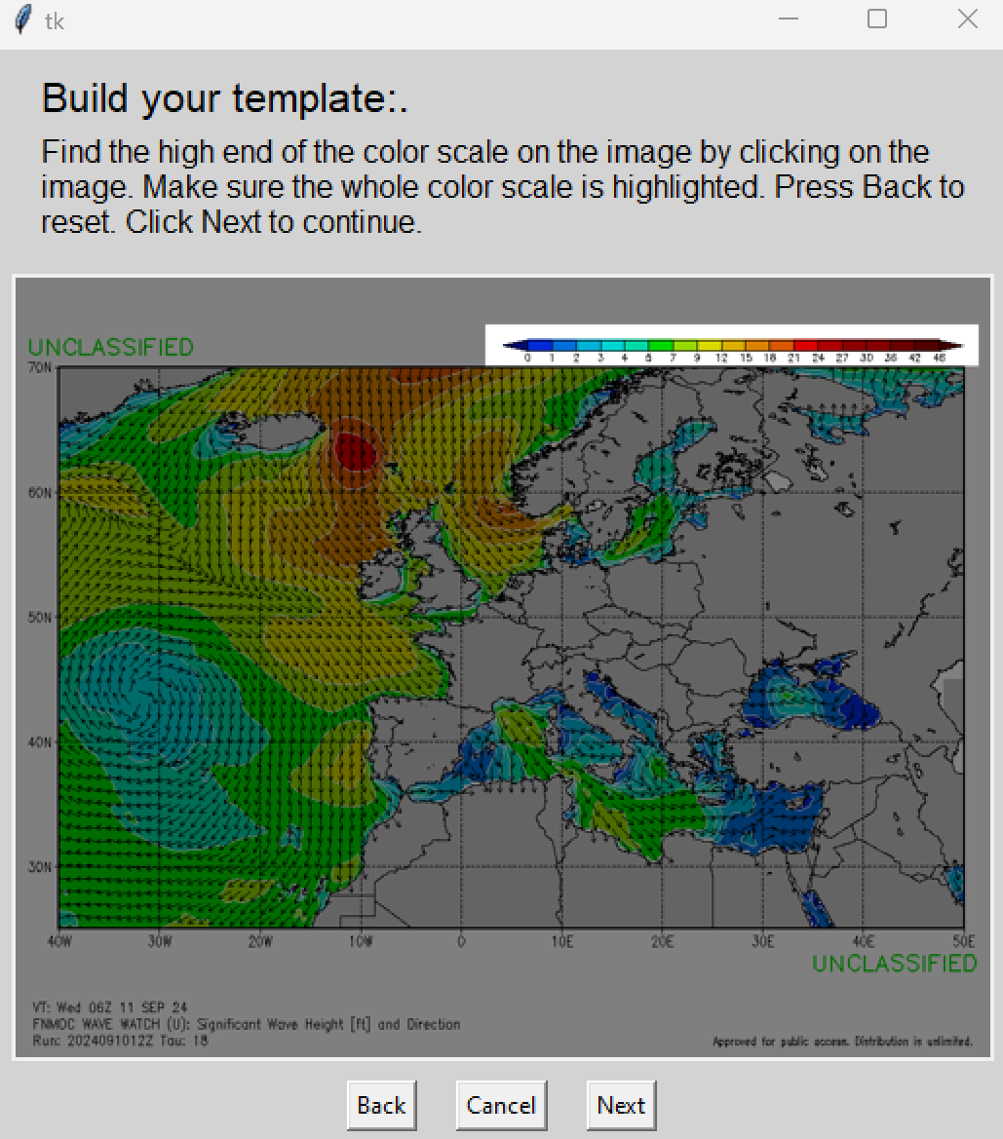
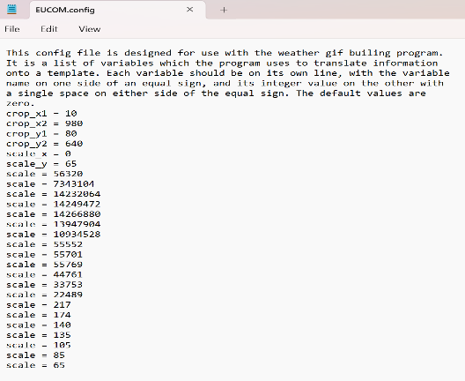
Procedure Overview
Shoreside will: make a new template only if the AOR has never been used with ARGUS. The output is a template jpg and a config file.
ARGUS will: use the color scale on the image to encode RGB values, save the list of RGB values into a config file, replace all the pixels of the image with a dummy color, and save the template and config files to a templates folder.

Slide 6



Procedure Overview
Subs will: while in active communications, download the template files.
EHF, SHF, UHF

Slide 7
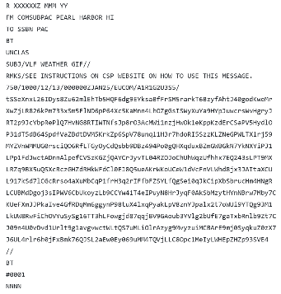


Procedure Overview
Subs will: copy the VLF broadcast as normal. When they receive an ARGUS message, they open the message with the ARGUS program.
ARGUS will: look for the template name in the message, uncompress the text into an array of wave heights, replace the dummy color with the RGB values corresponding to those wave heights, and save the output as a jpg.

Slide 8
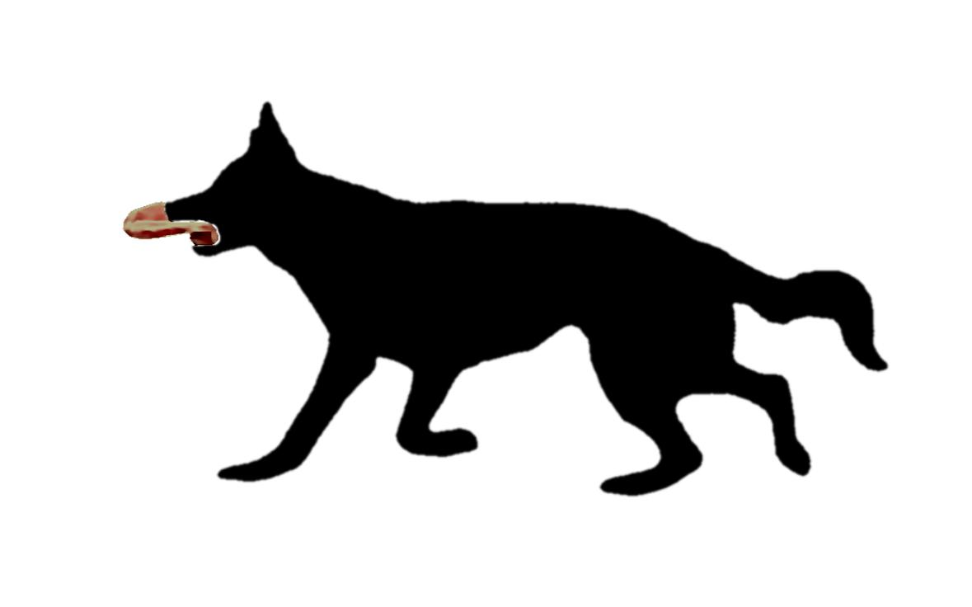
Contact Info
LCDR Sean Peneyra
peneyra.s@gmail.com
https://github.com/Peneyra/Gif_Builder
https://www.linkedin.com/in/peneyra/

Slide 9
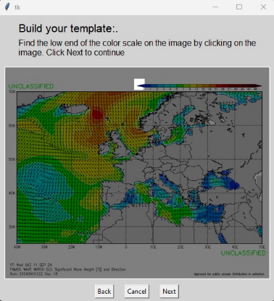
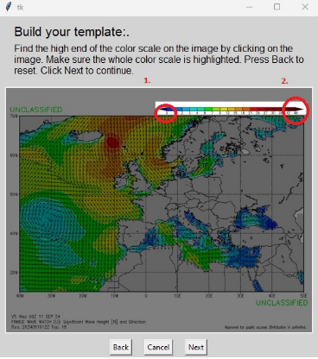
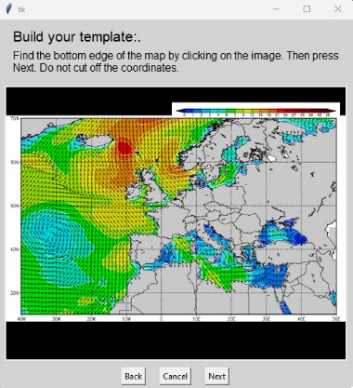
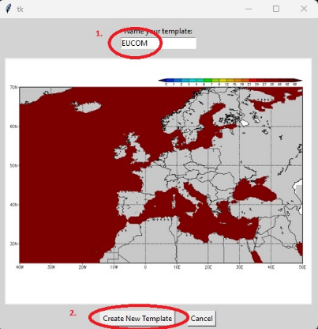
Appendix A - Templatization
The template building process takes the user through using a graphic to produce a re-usable template which works with the user to:
Crop out specific data and keep the an image frame to populate with specific data
Highlight the numerical scale on the image so that ARGUS can read the RGB scale
ARGUS then:
Reads the RGB value across the highlighted key. Records an ordered set of unique RGB values which meet the following criteria:
Is identical to 3 adjacent pixels (within a small tolerance)
Is not RGB = [0,0,0] or [255,255,255]
Writes the RGB values and the horizontal/vertical crop pixel values to a configuration file in the templates folder
Replaces all the valid scale values in the provided image with RGB = [0,0,128] (only these pixels will be replaced when rebuilding an image from a VLF message)
Crops out the areas specified by the user
Writes the template image to a _template.jpg file in the templates folder

Slide 10


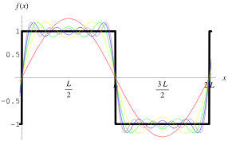
Appendix B – Discrete Fourier Transform
Discrete Fourier Transform (DFT) - Theory
DFT is a mathematical method to convert a given N-dimensional manifold from a time domain to a frequency domain
In English: a DFT estimates the shape of a function by adding up weighted sines and cosines
In one dimension, the conversion between a given function and its frequency domain is
OpenCV is a Python Package which uses a Fast Fourier Transform algorithm to produce a DFT output
The DFT is a matrix of floats, similar to the shape of the original image, which gives the weights of the different sine and cosine frequencies
The benefit is that even if the higher frequency terms are removed, the DFT will still produce a “good” approximation to the original picture (as shown below)
function
sin/cos weights
sin/cos weights
function
Example from https://mathworld.wolfram.com/FourierSeriesSquareWave.html
The function (f(x)) is the black square wave
Each of the colors represents the sum of a different number of weighted sine waves
red = F(0) * base frequency sine wave
yellow = red + F(1) * twice the base frequency
green = yellow + F(2) * three times the base frequency
where F(k) are the weight factors. As more terms are added, the sinusoid gets closer to the desired function
R
R

Slide 11

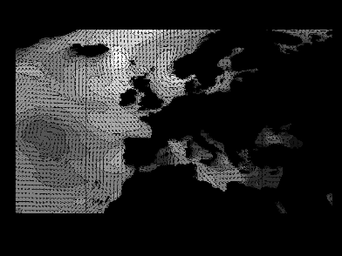
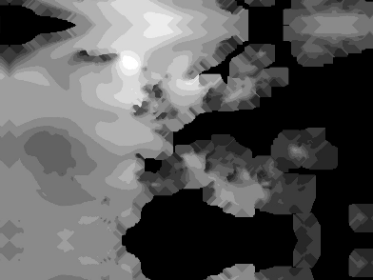


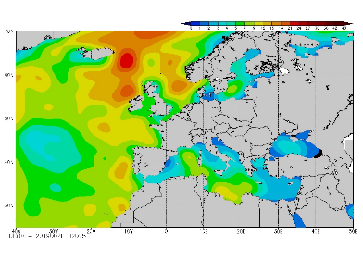
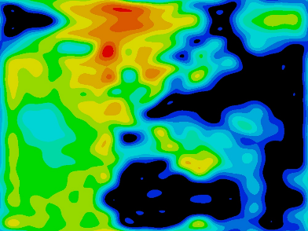
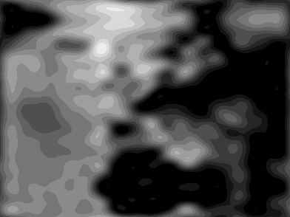

Appendix B – Discrete Fourier Transform
Discrete Fourier Transform (DFT) - Application
ARGUS uses the following procedure to process the image:
Ask for an image to compress and a template name then uses the config file for the specified template to identify all the important RGB values
Replace the important RGB values with a wave height numbers instead of color values
Apply a smoothing function to help the resulting DFT be more accurate in the areas we care about
Apply OpenCV’s DFT method to the image to extract the sin/cos coefficients
Remove the higher frequency coefficients -> the remaining coefficients are written to the VLF message (see appendix C)
Reproduce the wave heights from the curtailed DFT using the Inverse DFT (IDFT)
Reapplies the RGB values for each wave height
Applies the correct template to overlay onto the wave heights
1
2
3
4
8
7
6
5

Slide 12
Appendix B – Discrete Fourier Transform
Discrete Fourier Transform (DFT) - Application
Notes:
ARGUS keeps the lowest n = 12 frequency coefficients along both axes which keeps the message short enough, but retains enough accuracy
Since the DFT matrix has both real and imaginary components in two dimensions, n = 12 results in 1152 total coefficients retained (1152 = (12^2) * 4 quadrants * (1 re + 1 im))
On the sub, ARGUS will ingest the coefficients from the VLF message, rebuild the DFT matrix, and use OpenCV’s built in IDFT function to reproduce the wave heights

Slide 13
Appendix C – Text Compression
Numerical Change of Basis – Theory
There are several common number bases which appear in programming:
Decimal – Base 10 – “normal” Arabic number system we use to count in everyday life (e.g. the number 1,123)
Binary – Base 2 – used as the basis for all classical computer information (e.g. 1111 in bin is 15 in dec)
Hexadecimal – Base 16 – used in encoding RGB values (convenient because each digit stores exactly 4 digits in binary, aka bits) (e.g. 10 in hex is 16 in dec)
We can swap between the different number bases by using the following:
Note: The modulo (mod) function just gives the remainder of one number divided by another (e.g. 15 mod 7 = 1 since 15 divided by 7 is 2 remainder 1)
Converting [ x integer in base10 ] to
[ y string in baseN ] we can use the following pseudocode:
y = “”
while x != 0:
y = char_convert(x mod N) + y # however you are defining
# your characters in baseN
x -= x mod N
x = x // N # this will always be a whole number since we
# removed the remainder in the previous step
return y
Converting [ y string in baseN ] to
[ x integer in base10 ] we can use the following pseudocode
x = 0
e = 1
for char in y[::-1]: # take each character of y backwards
x += num_convert(char) * e # however you are defining
# your characters in baseN
e = e * N
return x

Slide 14
Appendix C – Text Compression
Numerical Change of Basis – Application
Given the limited valid characters available in a VLF message (ASCII character set), I decided to encode the output message in base62 – assigns the following written [base10] = [base62]:
[0-9] = [0-9]; [10-35] = [A-Z]; [36-61] = [a-z]
ARGUS uses the following procedure to compress the coefficients:
Flatten the matrix of low frequency coefficients output from the DFT
Sort the flattened list so that the lowest frequency coefficients are first (assuming the lowest frequency coefficients are more likely to be large, this theoretically means the large coefficients are at the front)
Normalize the list of coefficients to make the largest coefficient 1000 (e.g. multiply the entire array by [1000 / max])
Bin the values into 54 categories as below (features of the binning: descending by absolute value, can be encoded so each coefficient is a single digit in base62, and logarithmic)

Slide 15
Appendix C – Text Compression
Numerical Change of Basis – Application
ARGUS uses the following procedure to compress the coefficients (cont.):
Segment the flattened list of coefficients into groups which will occupy each line of the VLF message
Perform a change of basis to compress each list segment as much as possible
Each line of the VLF message can only be 70 characters
To maximize the number of coefficients on each line, ARGUS: assumes the list of coefficients of each line is an n-digit number in baseA (where A is the maximum coefficient in the line), then does a change of basis to base62
This method allows ARGUS to store more coefficients in fewer characters when the maximum in a line is small
Write each line to the VLF message template where the first character is the maximum coefficient used in the change of basis from the step above, and the remaining characters are the 68 digit base62 number following the change of basis
Example:
A list of coefficients [0 8 3 0 8 11 1 10 5 6 1 0 0 16 1 15 18 5 10 0 4 7 9 18 19 4 5 0 0 10 2 4 18 0 14 0 0 3 1 2 0 0 3 0 8 2 3 3 9 0 0 0 13 1 2 5 6 3 1 0 18 0 1
2 0 4 8 0 9 6 1 0 0 4 11 3 0 3 6 0 0 0 6 2 0 0 7 2 0 3 2 0 ]
each converted to base62 [0 8 3 0 8 B 1 A 5 6 1 0 0 G 1 F I 5 A 0 4 7 9 I J 4 5 0 0 A 2 4 I 0 E 0 0 3 1 2 0 0 3 0 8 2 3 3 9 0 0 0 D 1 2 5 6 3 1 0 I 0 1 2 0 4 8 0 9
6 1 0 0 4 B 3 0 3 6 0 0 0 6 2 0 0 7 2 0 3 2 0 ]
listed as a single number assumed to be baseJ 08308B1A56100G1FI5A0479IJ4500A24I0E00312003082339000D1256310I0120480961004B30360006200720320
can then be converted to a single number base62 KjupOrYBmQgWiPvkWiSuHN6xCZiyorFrE4cF2WSrumFup6svri6dvEax15q8xMRBCYqX7
and finally a leading J is added JKjupOrYBmQgWiPvkWiSuHN6xCZiyorFrE4cF2WSrumFup6svri6dvEax15q8xMRBCYqX7
so the change of basis can be undone. This
example reduced 91 characters to 70.

