Slide 1

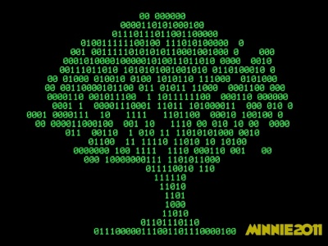
Advanced Programming
Lecture 07 Files
Zibang Zhang
Dept. of Optoelectronic Engineering, Jinan University

Slide 2

What is a File on a Computer?
In computing, a file is a named collection of data stored on a storage device (like a hard drive, SSD, or USB stick) that a computer treats as a single unit.

Slide 3
What is a File on a Computer?
Key characteristics
  Name and extension — e.g., report.docx.
  The extension (.docx) often hints at the format or the program that opens it.
  Content — the actual data: text, images, video, code, or raw bytes.
  Metadata — information about the file, such as size, creation/modification dates, and permissions.
  Location — a path in the file system, e.g., C:\Users\Alex\Documents\report.docx.
  Type — files are broadly either text (human-readable characters) or binary (encoded data meant for programs).

Slide 4
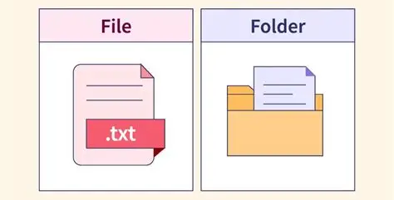
Files vs. Folders
A folder (directory) is a container that holds files and other folders.
The file system organizes everything into a hierarchy, and the operating system manages how files are created, read, written, and deleted.

Slide 5
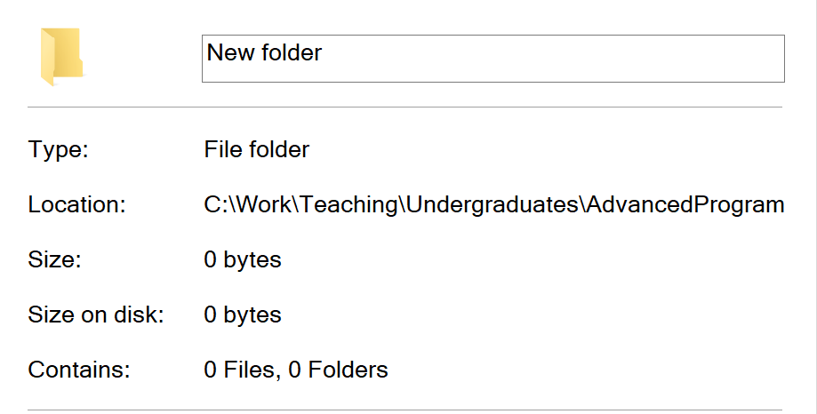
Does an empty file or folder occupy storage?
The short answer is yes
Both empty files and empty folders consume some storage space, but the amount is often so tiny that the operating system may report it as "0 bytes."
The exact behavior depends heavily on the file system (like NTFS on Windows or ext4 on Linux).

Slide 6
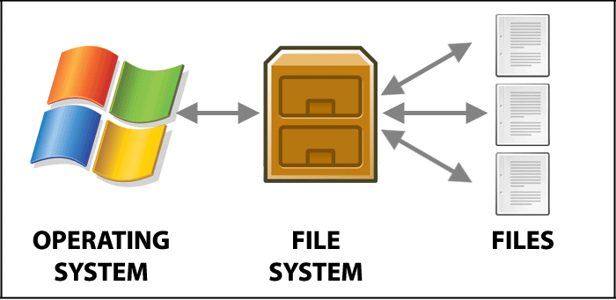
What is a File System?

Slide 7
What is a File System?
Common file systems
File system | Typical use
NTFS | Windows system and data drives
FAT32 / exFAT | USB sticks, cross-platform removable media
ext4 | Linux
APFS | macOS and iOS
HFS+ | Older macOS
XFS / Btrfs / ZFS | Linux servers, advanced features (snapshots, checksums)
ISO 9660 / UDF | Optical discs (CD/DVD)

Slide 8
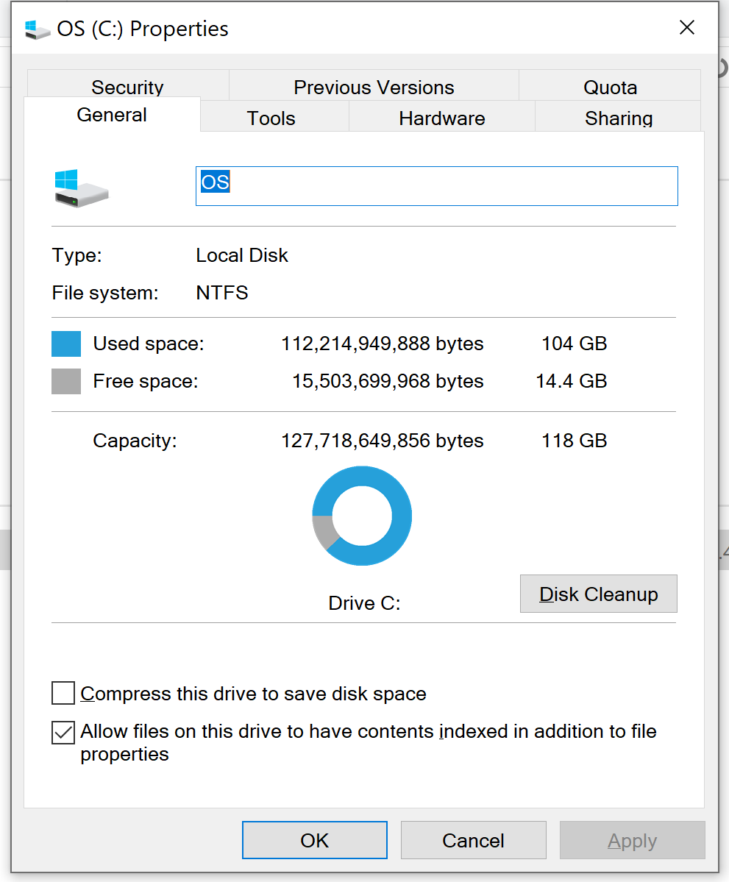
What is a File System?

Slide 9
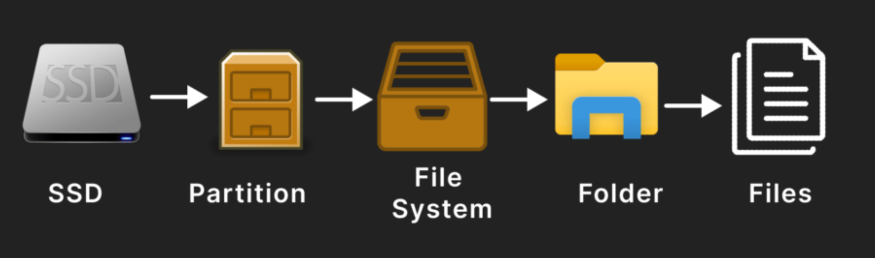
What is a File System?
A file system is the method and data structure an operating system uses to organize, store, retrieve, and manage files and folders on a storage device.
Think of it as the filing system and rulebook for a disk: it defines how data is laid out physically, where each file lives, and who can access it.
Without a file system, a hard drive would just be a massive, unorganized sequence of bytes with no way to tell where one file ends and another begins.

Slide 10
What is a File System?
Core responsibilities of a file system:
  Naming and paths — gives files names and organizes them into a hierarchy
  (e.g., C:\Users\Alex\Documents\report.docx).
  Space management — tracks which blocks/clusters on the disk are free, used, or reserved.
  Metadata storage — keeps records of file size, timestamps, permissions, and ownership.
  Access control — enforces read/write/execute permissions per user or group.
  Reliability — handles fragmentation, journaling (crash recovery), and error checking.
  Abstraction — hides the raw hardware so programs can just say "open this file" instead of dealing with disk sectors.

Slide 11
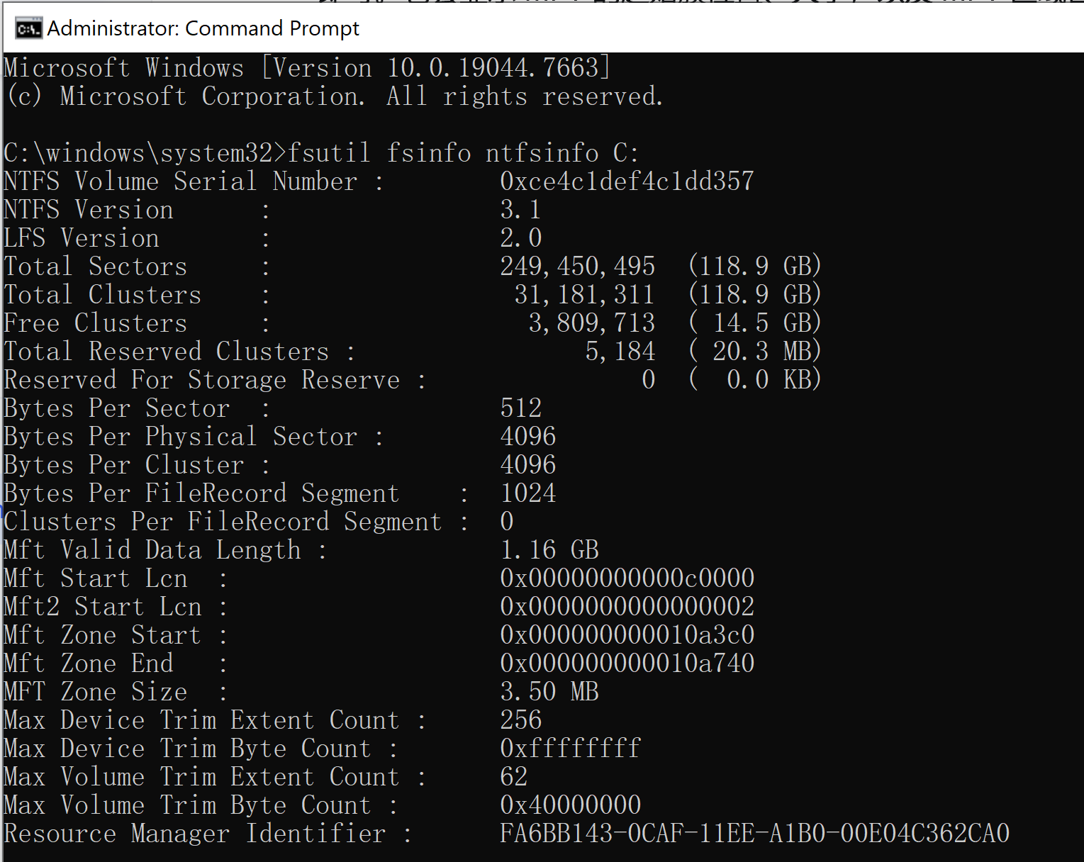
Where is the Metadata of a File Stored?
For 📄 NTFS (Windows)
Metadata is centrally stored in the Master File Table (MFT).
Each file or directory corresponds to a record in the MFT, containing the file name, timestamps, permissions, and other attributes.
“fsutil fsinfo ntfsinfo C:”

Slide 12
Types of files in Python
Text File
Binary File
This is a text file which contains readable characters for human
010101010101
101101010101011011011010101010101010101010100101
Myfile.txt
Myfile.bin

Slide 13
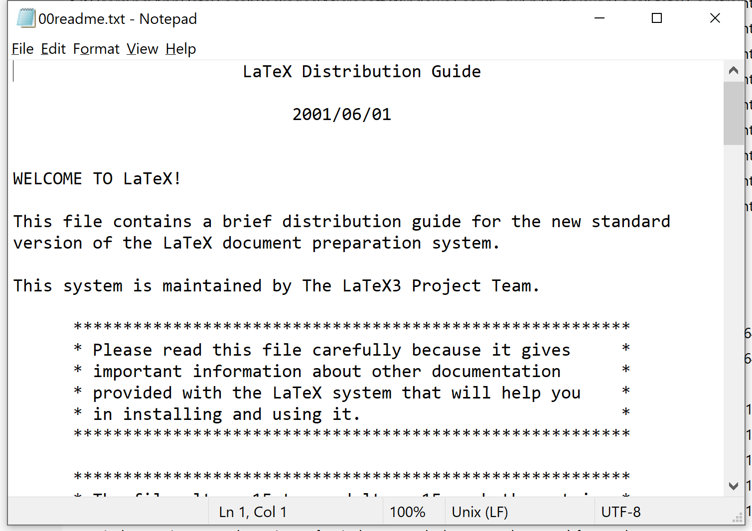
Text File
One of the simplest and most fundamental types of computer files
Stores data as a sequence of human-readable characters encoded in a standard character encoding scheme

Slide 14
Character Encoding – How text is encoded
A text file is ultimately just bytes; the encoding tells the software how to map bytes to characters
Mismatched encoding is a common cause of "mojibake" (garbled text, like æ–‡ä»¶).
Encoding | Description
ASCII | 7-bit, 128 characters (English letters, digits, basic punctuation).
UTF-8 | Variable-width, backward-compatible with ASCII, supports virtually all languages and emoji. Now the dominant standard.
UTF-16 / UTF-32 | Fixed/variable width, used in some Windows and legacy contexts.
Latin-1 (ISO-8859-1) | 8-bit Western European characters.
GBK / GB2312 | Chinese character encodings (legacy; UTF-8 is preferred today).

Slide 15
“这是1个文本文件” in UTF-8
The phrase "这是1个文本文件" contains 7 Chinese characters
In UTF-8,each common CJK character (in the U+4E00–U+9FFF range) is encoded as 3 bytes, each Latin character is encoded as 1 byte.
So: 7 × 3 + 1 × 1 = 22 bytes
UTF-8

Slide 16
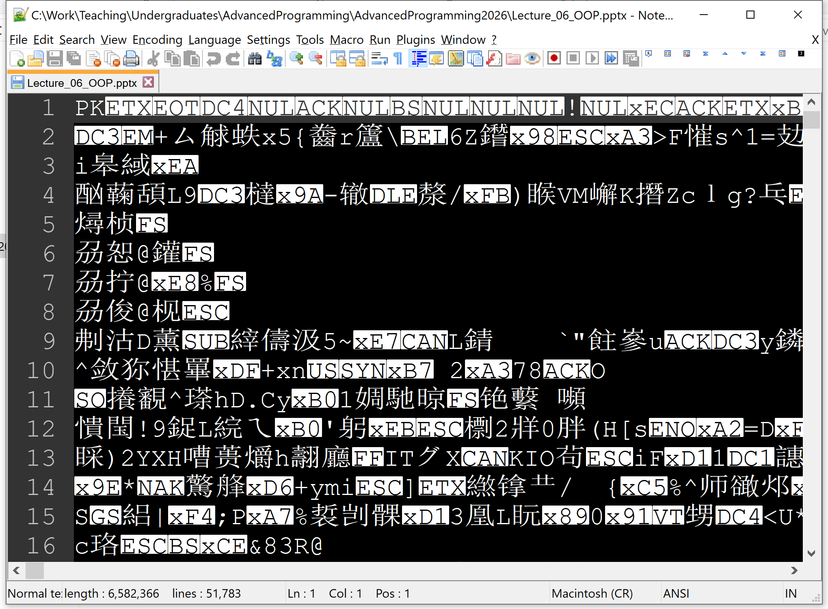
Binary File
A binary file is any file whose content is stored as raw bytes intended to be interpreted by a specific program or according to a specific format — rather than as human-readable text
A binary file (.pptx) viewed in Notepad++ (text editor)

Slide 17
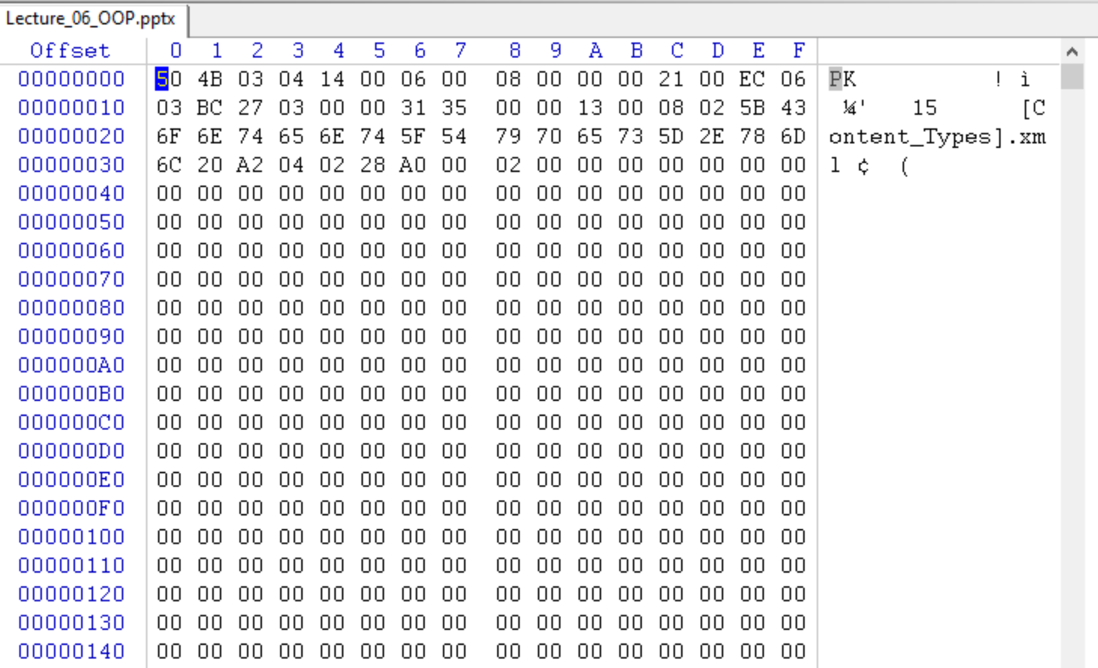
Binary File
A binary file is any file whose content is stored as raw bytes intended to be interpreted by a specific program or according to a specific format — rather than as human-readable text
A binary file (.pptx) viewed in WinHex (hex editor)

Slide 18
Read / Write a File in Python
You can manage files manually with open() and close()
The key rule: always call close() — otherwise data may not be flushed to disk and the file handle leaks. The safest pattern is try/finally, so the file gets closed even if an error occurs mid-way.
f = open('example.txt', 'r', encoding='utf-8')
try:
content = f.read()
print(content)
finally:
f.close()

Slide 19
open()
The built-in open() function is the primary gateway for file operations in Python.
open(filepath, mode='r', buffering=-1, encoding=None, \
errors=None, newline=None, closefd=True, opener=None)
The Core Parameters
  filepath (required)
    The path to the file you want to open.
    This can be a string or a path-like object. It is the only mandatory argument.
  mode (default: ‘r’)
    A string that determines how the file is opened.

Slide 20
Open a File in Text Mode
filepath = r'c:/myfile.txt'
file = open(filepath, mode='r', encoding='utf-8')

Slide 21
Open a File in Binary Mode
filepath = r'c:/myfile.bin'
file = open(filepath, mode=‘rb')

Slide 22
The Fundamental Modes
These are the base modes that define the primary operation :
  'r' (Read, default): Opens the file for reading only.
  The file must exist, otherwise a FileNotFoundError is raised.
  The file pointer starts at the beginning.
  'w' (Write): Opens the file for writing only.
  If the file exists, it is truncated (emptied) first. If it doesn't exist, a new file is created.
  'a' (Append): Opens the file for writing.
  If the file exists, the pointer starts at the end, so new data is added without overwriting existing content. If it doesn't exist, a new file is created.
  'x' (Exclusive Creation): Opens the file for exclusive creation.
  It works like 'w', but fails with a FileExistsError if the file already exists.
  This is useful for preventing accidental overwrites .

Slide 23
The File Pointer
The file pointer starts at the beginning.
The file pointer starts at the end.

Slide 24
📍 tell(): Where am I?
returns the current position of the file object's pointer. Its meaning depends entirely on the mode you opened the file in:
  Binary mode ('rb', 'wb', etc.): Returns an integer representing the exact byte offset from the beginning of the file . This is straightforward and interpretable.
  Text mode ('r', 'w', etc.): Returns an opaque number . You cannot interpret this number as a byte count or character count. Its only valid use is to pass it back to seek() to return to that exact spot later.

Slide 25
🎯 seek(): Go to a position
seek(offset, whence) moves the pointer. The whence argument (default 0) defines the reference point:
  0 (or os.SEEK_SET): From the beginning of the file. offset must be ≥ 0.
  1 (or os.SEEK_CUR): Relative to the current position. offset can be positive or negative.
  2 (or os.SEEK_END): From the end of the file. offset is usually negative

Slide 26
🎯 seek(): Go to a position
seek(offset, whence) moves the pointer. The whence argument (default 0) defines the reference point:
  0 (or os.SEEK_SET): From the beginning of the file. offset must be ≥ 0.
  1 (or os.SEEK_CUR): Relative to the current position. offset can be positive or negative.
  2 (or os.SEEK_END): From the end of the file. offset is usually negative

