Slide 1

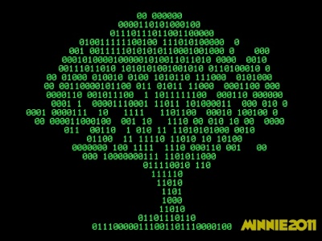
Advanced Programming
Lecture 02
Fundamentals in Computer Science
Zibang Zhang
Dept. of Optoelectronic Engineering, Jinan University

Slide 2


Outline
Computers
Hardware
Software

Slide 3
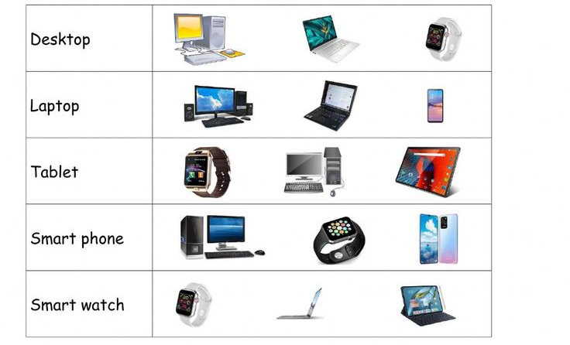
Different Types of Computers
There are many different types of computers, and they come in all shapes and sizes—from tiny chips inside your washing machine to massive machines that fill entire rooms.

Slide 4
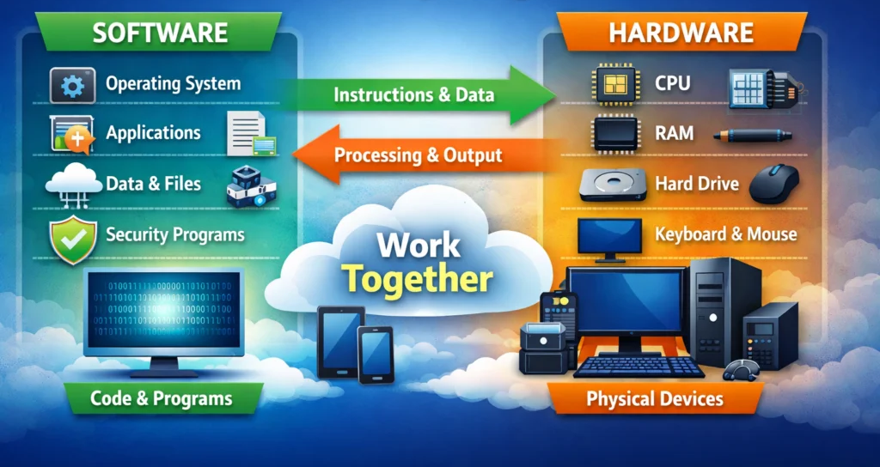
What Compter Made of?
The Big Picture
  Hardware is the physical parts you can touch
  Software is the invisible instructions that tell the hardware what to do

Slide 5
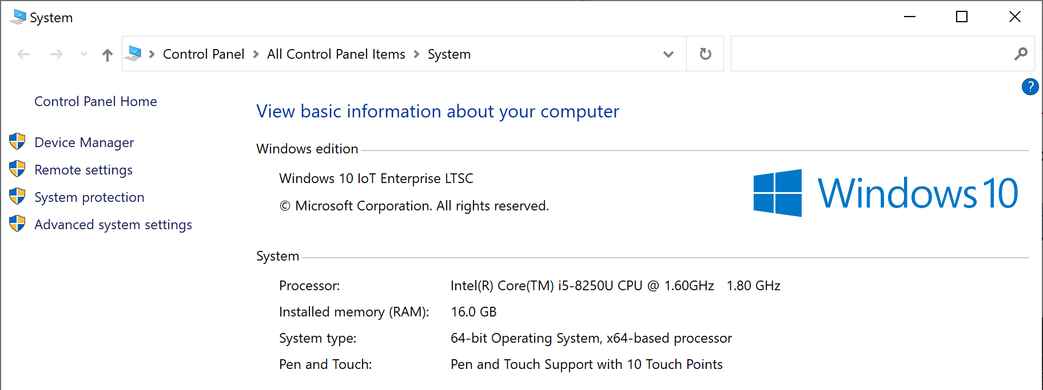
Basic information about my (your) computer
“System” dialog
Microsoft Surface Pro 6

Slide 6
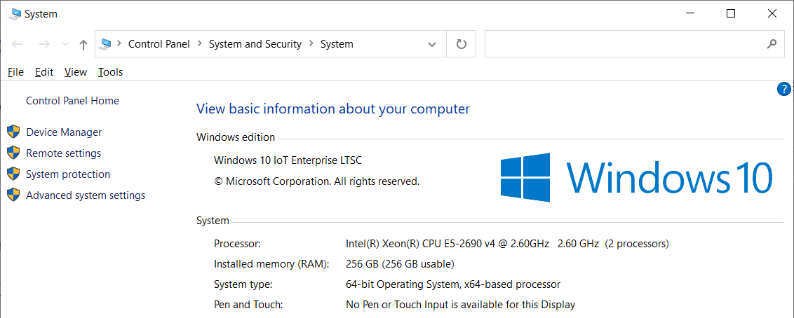
Basic information about my (your) computer
“System” dialog
My working computer

Slide 7
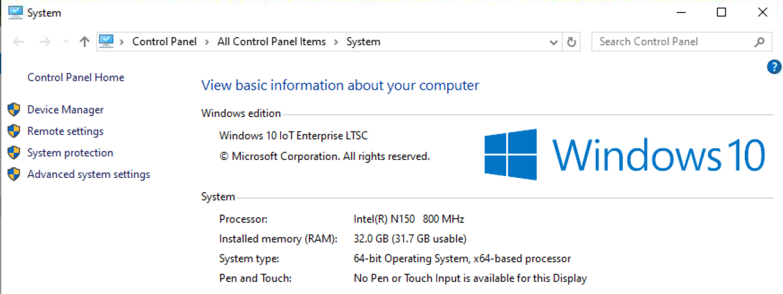
Basic information about my (your) computer
“System” dialog
My 7x24 NAS at home

Slide 8
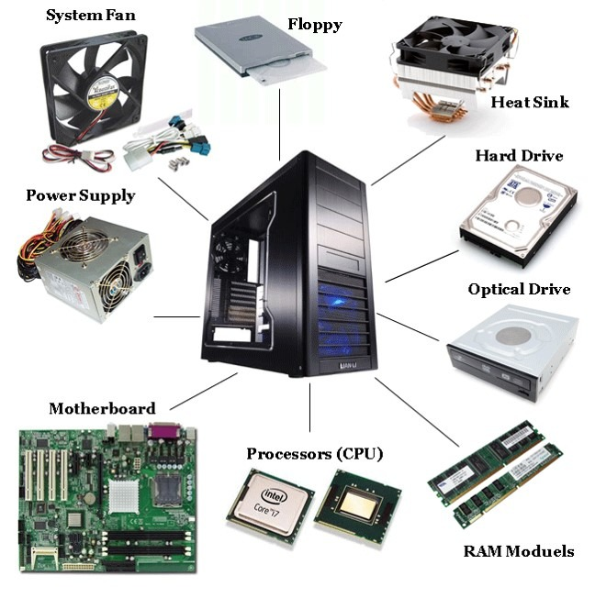
Hardware – The Physical Body
The fundamentals of computer hardware systems usually include:
  CPU (Central Processing Unit) – the "brain"
  Memory (RAM, ROM, cache)
  Storage (hard drives, SSDs)
  Motherboard – connects everything
  Input/Output devices (keyboard, monitor, etc.)
  Bus systems – how data travels between components
  Power supply and cooling systems
Notes:
【装机教程】全网最好的装机教程，没有之一。The best PC building tutorial you can find on the internet.
https://www.youtube.com/watch?v=ST65L4pG_6w&t=736s

Slide 9
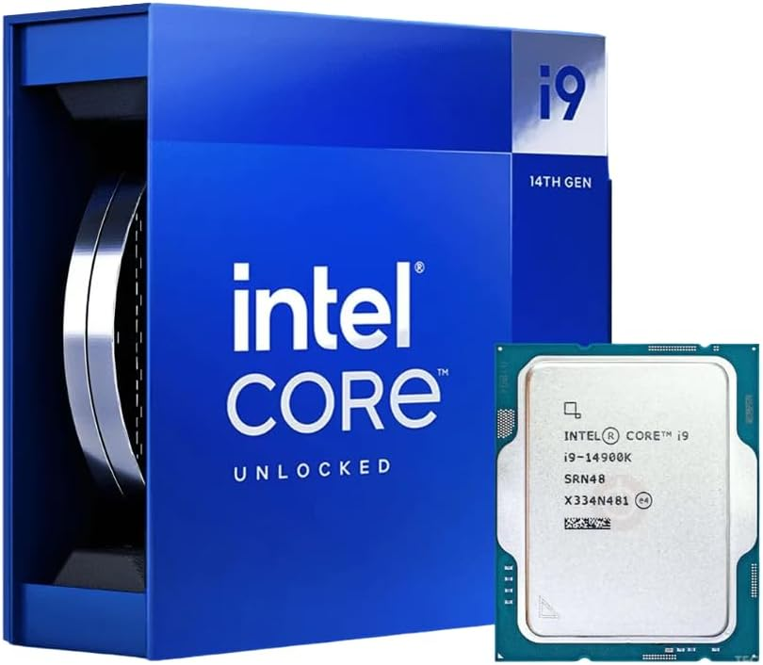
CPU (Central Processing Unit)
The "brain" of a computer, executing instructions from computer programs and performing all the fundamental arithmetic, logic, control, and input/output (I/O) operations
Key specifications:
  Clock speed (measured in ghz)
  Cores
  Threads
  Cache memory (L1~L3)
  TDP (measured in watts)
Major manufactures: Intel, AMD
Intel 14th Gen Raptor Lake Core i9-14900K CPU 6.0GHz

Slide 10
CPU (Central Processing Unit)
 | Intel Core i9-14900K (desktop) | Intel Core i5-8250U (laptop)
Clock Speed (GHz) | Base: 3.2 GHz (P-cores) / 2.4 GHz (E-cores) Max turbo: 6.0 GHz | Base: 1.60 GHz Max turbo: 3.40 GHz
Cores | 24 cores (8 P-cores + 16 E-cores) | 4 cores
Threads | 32 threads | 8 threads
Cache Memory | L3: 36 MB L2: 32 MB (Total) | L3: 6 MB (Intel Smart Cache)
TDP (Watts) | Base: 125 W Max turbo: 253 W | Base: 15 W Max turbo: 10 W ~ 25 W

Slide 11
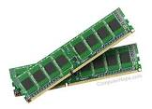
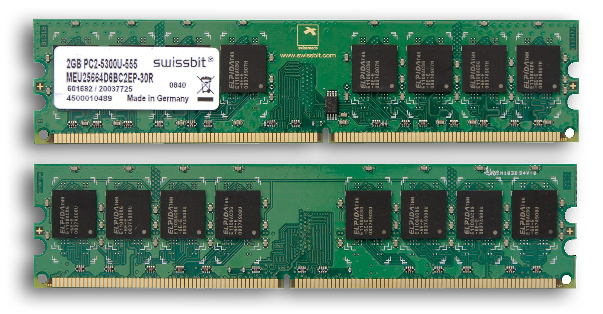
RAM (Random Access Memory)
Computer's short-term, temporary memory. It is a form of volatile memory, meaning that all data stored in RAM is erased immediately when the computer is turned off or restarted.
Key specifications:
  Capacity (such as 8 GB, 16 GB, 32 GB, 64 GB+)
  Speed (measured in MHz or MT/s, DDR4: 2133 MHz~3200 MHz, DDR5: 4800 MHz ~ 8000+ MHz)
  Latency

Slide 12
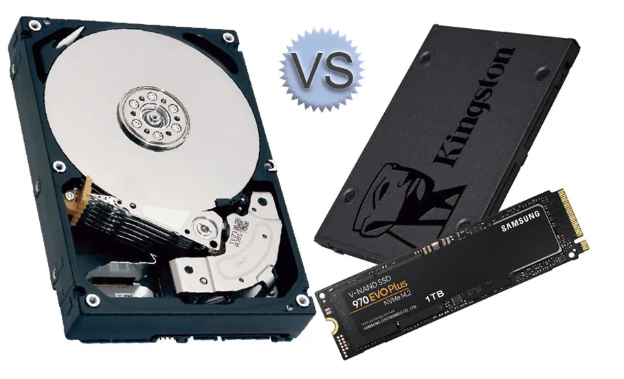
Storage
HDD (Hard Disk Drive) is mechanical. It contains spinning magnetic platters (like a CD or record) and a read/write head that moves back and forth to read or write data on the spinning disks. It is essentially a precise record player.
SSD (Solid State Drive) is electronic. It has no moving parts. It uses NAND flash memory chips (similar to a giant, high-speed USB flash drive) to store data. Data is accessed instantly via electrical circuits.

Slide 13
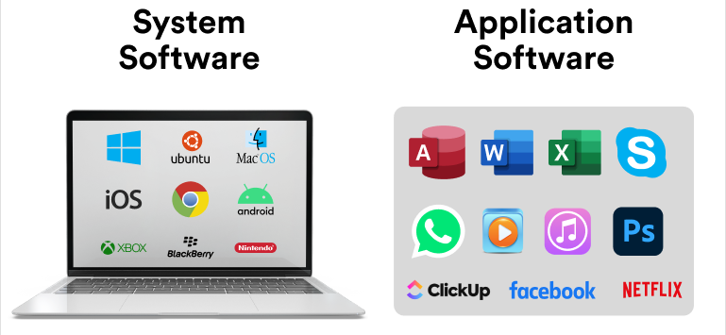
Software – The Invisible Instructions
Software is divided into two main layers:
  System software
  Application software

Slide 14
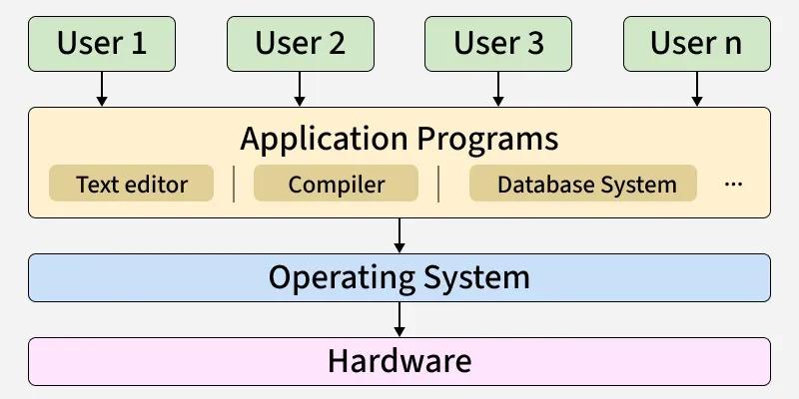
Operating System (OS)
The most important software that runs on a computer. It acts as a bridge or middleman between:
  You (the user) and the hardware (CPU, RAM, storage, keyboard, mouse, screen).
  Your applications (like a web browser, Word, or a game) and the physical components of the machine.

Slide 15
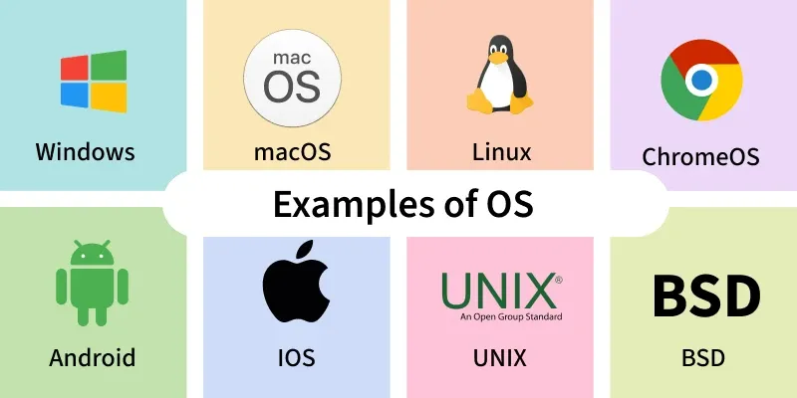
Operating System (OS)
Examples of Operating System

Slide 16
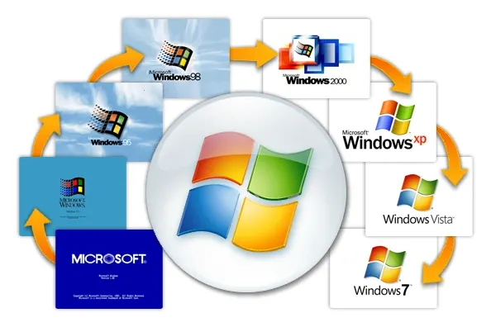
Microsoft Windows
A family of graphical operating systems developed and marketed by Microsoft Corporation. Since its first release in 1985, it has become the most widely used operating system for personal computers (PCs) globally.
A Brief History & Key Versions:
  Windows 1.0 (1985)
  Windows 3.0 (1990)
  Windows 95 (The Revolution)
  Windows XP (2001)
  Windows Vista (2007)
  Windows 7 (2009)
  Windows 8 / 8.1 (2012-2013)
  Windows 10 (2015)
  Windows 11 (2021 - Present)

Slide 17
Recommended Applications
Operating System: Windows 10 LTSC 2021 / Windows 7
Recommendations:
  WinRAR File compression & archiving
  Supermium Web browser
  Office 2016 / Office 2010 Office producity suite
  HoneyView Image viewer
  K-Lite Video player with codec pack
  Winamp Audio / media player
  Notepad++ Text / code editor
  WinHex Hex editor

Slide 18



Putting Them All Together -- How a Computer Works?
Storage
CPU
Data
Data
Input/output devices
App
RAM
OS
App
Notes:
Putting it all together (The Step-by-Step Flow):
You double-click an App icon on your screen (Output).
The OS tells the Storage to send the App's code to the RAM.
The CPU pulls the code from RAM and starts executing it.
The App asks you to open a file. You press a key on your keyboard (Input).
That Data goes from the keyboard to the CPU, which processes it.
The CPU puts that typed data into RAM so it can work on it.
You hit "Save." The OS takes that data from RAM, compresses it, and writes it permanently to the Storage.
The OS tells the monitor (Output) to display a "Save Successful" message.
In short: The Storage holds everything. The OS coordinates everything. The RAM feeds the CPU quickly. The CPU processes the Data, and the I/O devices let you put data in and get results out.

Slide 19
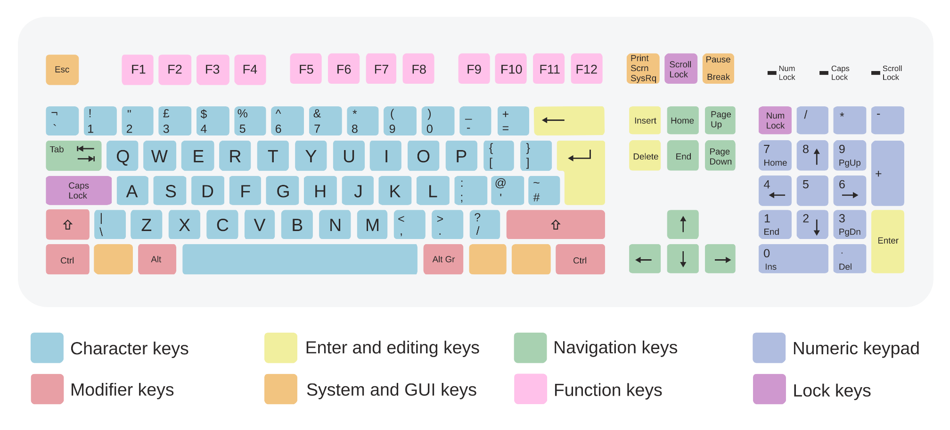
Keyboard
A standard keyboard has about 104 to 108 keys

