Slide 1


Advanced Programming
Lecture 03
Data Types & Expression
Zibang Zhang
Dept. of Optoelectronic Engineering, Jinan University

Slide 2
Outline
Identifer, Variable, Assignment
Built-in Data Types
Operator & Expression
Basic Input / Ouput

Slide 3
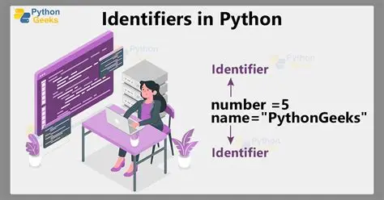
Identifier, Variable, Assignment
Identifer 标识符
  What is it?
  Simply a name given to entities like variables, functions, classes, modules, or other objects
  Rules for Identifiers
    ✅ Allowed characters (same as C)
      Letters (A–Z, a–z)
      Digits (0–9) — but cannot start with a digit
      Underscore (_)
    ❌ Not allowed
      Spaces or special characters like @, #, $, %, !
      Cannot be a Python keyword (reserved words like if, else, for, while, def, class, etc.)

Slide 4
Identifier, Variable, Assignment
Identifer 标识符
  Valid Examples
    my_var = 10
    _name = "private"
    variable1 = 5
    user_name = "John"
    _private = True
    myFunction = "hello"
    MyClass = "example"
  Invalid Examples
    1variable = 10 # Can't start with a digit
    my-var = 20 # Hyphen not allowed
    my var = 30 # Space not allowed
    class = "test" # 'class' is a reserved keyword
    @name = "John" # @ symbol not allowed

Slide 5
Identifier, Variable, Assignment
Identifer 标识符
  Naming Conventions (Best Practices)
  While not enforced by Python, these are strongly recommended:
Convention | Example | Use Case
snake_case | user_name, total_count | Variables, functions, modules
PascalCase | MyClass, UserProfile | Class names
UPPER_CASE | PI, MAX_LIMIT | Constants
_single_leading | _internal | "Private" by convention
__double_leading | __private | Name mangling in classes

Slide 6
Identifier, Variable, Assignment
Identifer 标识符
  Importatnt Notes
  Case-sensitive
  Unicode allowed: Python supports Unicode characters in identifiers (though not commonly used)
  Dunder (double underscores): Methods like __init__ have special meaning in Python

Slide 7
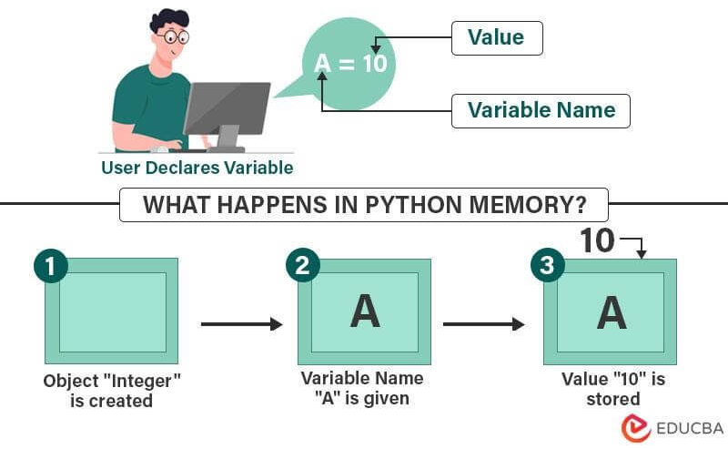
Identifier, Variable, Assignment
Variable 变量
A variable is a named container that stores a value in memory.

Slide 8
Identifier, Variable, Assignment
Variable 变量
Key Characteristics of Python Variables:
  No Declaration Required
  Unlike many languages, you don't need to declare a variable's type beforehand. Python figures it out automatically.
  Dynamically Typed
  Variables can change type at any time
  Case-Sensitive
  myvar, MyVar, and MYVAR are three different variables.

Slide 9
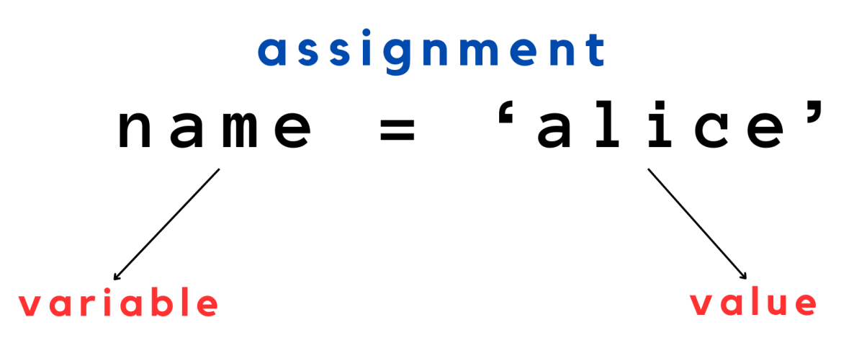
Identifier, Variable, Assignment
Assignment 赋值

Slide 10
Outline
Identifer, Variable, Assignment
Built-in Data Types
Operator & Expression
Basic Input / Ouput

Slide 11
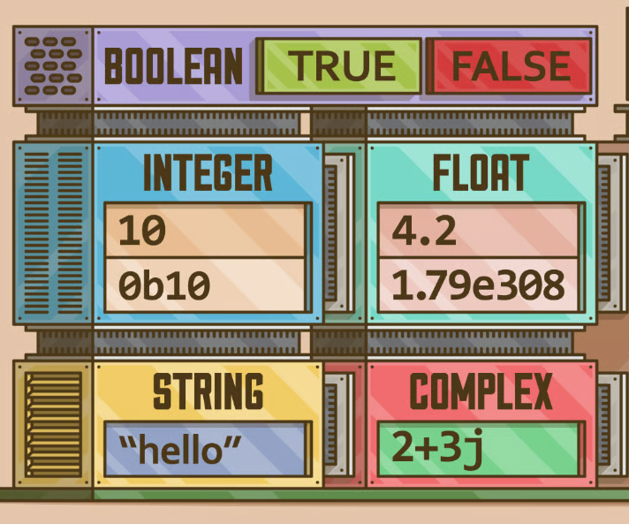
Built-in Data Types 内置数据类型
Boolean 布尔型
Integer 整型, Float 浮点型, Complex 复数型
String 字符串型
NoneType 空型

Slide 12
Built-in Data Types 内置数据类型
Boolean 布尔型
Integer 整型, Float 浮点型, Complex 复数型
String 字符串型
NoneType 空型
is_student = True
is_married = False

Slide 13
Built-in Data Types 内置数据类型
Boolean 布尔型
Integer 整型, Float 浮点型, Complex 复数型
String 字符串型
NoneType 空型
age = 25
year = 2000
month = 12
day = 25

Slide 14
Built-in Data Types 内置数据类型
Boolean 布尔型
Integer 整型, Float 浮点型, Complex 复数型
String 字符串型
NoneType 空型
height = 168.6
weight = 55.0
PI = 3.14159
LIGHT_SPEED = 2.99792458e8
dist_sun_earth = 1.49597870700e11

Slide 15
Built-in Data Types 内置数据类型
Boolean 布尔型
Integer 整型, Float 浮点型, Complex 复数型
String 字符串型
NoneType 空型
height = 168.6
weight = 55.0
PI = 3.14159
LIGHT_SPEED = 2.99792458e8
dist_sun_earth = 1.49597870700e11
Exercise: Calculate how long it takes light to travel from the Sun to the Earth.

Slide 16
Built-in Data Types 内置数据类型
Boolean 布尔型
Integer 整型, Float 浮点型, Complex 复数型
String 字符串型
NoneType 空型
coeft = 12.3 + 4.56j

Slide 17
Built-in Data Types 内置数据类型
Boolean 布尔型
Integer 整型, Float 浮点型, Complex 复数型
String 字符串型
NoneType 空型
nationality = "China"
name = "Zibang Zhang"
major = "光电信息科学与工程"

Slide 18
Built-in Data Types 内置数据类型
Boolean 布尔型
Integer 整型, Float 浮点型, Complex 复数型
String 字符串型
NoneType 空型
supervisor = None

