Slide 1


Advanced Programming
Lecture 03
Data Types & Expression
Zibang Zhang
Dept. of Optoelectronic Engineering, Jinan University

Slide 2
Outline
Identifer, Variable, Assignment
Built-in Data Types
Operator & Expression
Basic Input / Ouput

Slide 3
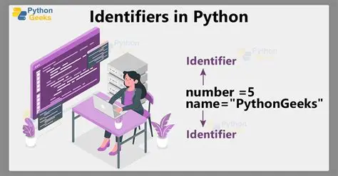
Identifier, Variable, Assignment
Identifer 标识符
  What is it?
  Simply a name given to entities like variables, functions, classes, modules, or other objects
  Rules for Identifiers
    ✅ Allowed characters (same as C)
      Letters (A–Z, a–z)
      Digits (0–9) — but cannot start with a digit
      Underscore (_)
    ❌ Not allowed
      Spaces or special characters like @, #, $, %, !
      Cannot be a Python keyword (reserved words like if, else, for, while, def, class, etc.)

Slide 4
Identifier, Variable, Assignment
Identifer 标识符
  Valid Examples
    my_var = 10
    _name = "private"
    variable1 = 5
    user_name = "John"
    _private = True
    myFunction = "hello"
    MyClass = "example"
  Invalid Examples
    1variable = 10 # Can't start with a digit
    my-var = 20 # Hyphen not allowed
    my var = 30 # Space not allowed
    class = "test" # 'class' is a reserved keyword
    @name = "John" # @ symbol not allowed

Slide 5
Identifier, Variable, Assignment
Identifer 标识符
  Naming Conventions (Best Practices)
  While not enforced by Python, these are strongly recommended:
Convention | Example | Use Case
camalCase | getText, setValue, loadData | Functions
snake_case | user_name, total_count | Variables, modules, files
PascalCase | MyClass, UserProfile | Class names
UPPER_CASE | PI, MAX_LIMIT | Constants
_single_leading | _internal | "Private" by convention
__double_leading | __private | Name mangling in classes

Slide 6
Identifier, Variable, Assignment
Identifer 标识符
  Importatnt Notes
  Case-sensitive
  Unicode allowed: Python supports Unicode characters in identifiers (though not commonly used)
  Dunder (double underscores): Methods like __init__ have special meaning in Python

Slide 7
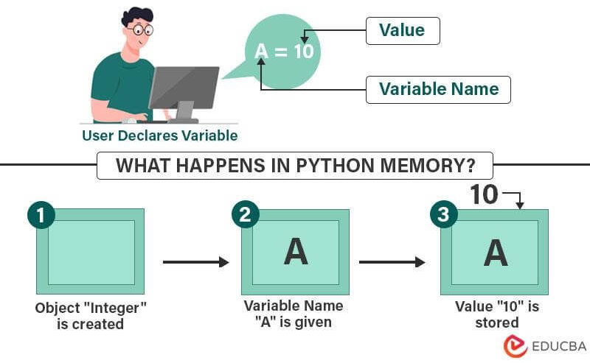
Identifier, Variable, Assignment
Variable 变量
A variable is a named container that stores a value in memory.

Slide 8
Identifier, Variable, Assignment
Variable 变量
Key Characteristics of Python Variables:
  No Declaration Required
  Unlike many languages, you don't need to declare a variable's type beforehand. Python figures it out automatically.
  Dynamically Typed
  Variables can change type at any time
  Case-Sensitive
  myvar, MyVar, and MYVAR are three different variables.

Slide 9
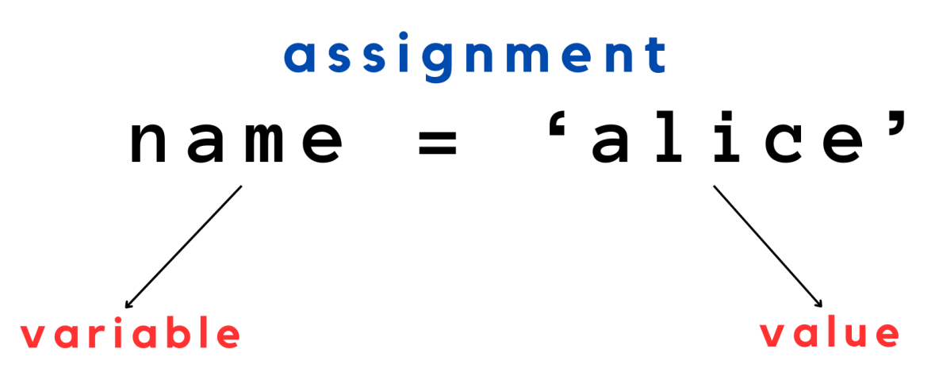
Identifier, Variable, Assignment
Assignment 赋值

Slide 10
Outline
Identifer, Variable, Assignment
Built-in Data Types
Operator & Expression
Basic Input / Ouput

Slide 11
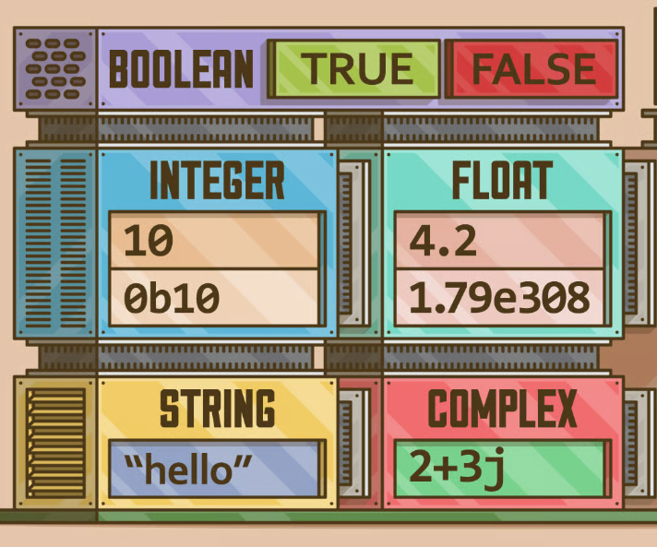
Built-in Data Types 内置数据类型
Boolean 布尔型
Integer 整型, Float 浮点型, Complex 复数型
String 字符串型
NoneType 空型

Slide 12
Built-in Data Types 内置数据类型
Boolean 布尔型
Integer 整型, Float 浮点型, Complex 复数型
String 字符串型
NoneType 空型
is_student = True
is_married = False

Slide 13
Built-in Data Types 内置数据类型
Boolean 布尔型
Integer 整型, Float 浮点型, Complex 复数型
String 字符串型
NoneType 空型
age = 25
year = 2000
month = 12
day = 25

Slide 14
Built-in Data Types 内置数据类型
Boolean 布尔型
Integer 整型, Float 浮点型, Complex 复数型
String 字符串型
NoneType 空型
height = 168.6
weight = 55.0
PI = 3.14159
LIGHT_SPEED = 2.99792458e8
dist_sun_earth = 1.49597870700e11

Slide 15
Built-in Data Types 内置数据类型
Boolean 布尔型
Integer 整型, Float 浮点型, Complex 复数型
String 字符串型
NoneType 空型
height = 168.6
weight = 55.0
PI = 3.14159
LIGHT_SPEED = 2.99792458e8
dist_sun_earth = 1.49597870700e11
Exercise: Calculate how long it takes light to travel from the Sun to the Earth.

Slide 16
Built-in Data Types 内置数据类型
Boolean 布尔型
Integer 整型, Float 浮点型, Complex 复数型
String 字符串型
NoneType 空型
coeft = 12.3 + 4.56j

Slide 17
Built-in Data Types 内置数据类型
Boolean 布尔型
Integer 整型, Float 浮点型, Complex 复数型
String 字符串型
NoneType 空型
nationality = "China"
name = "Zibang Zhang"
major = "光电信息科学与工程"

Slide 18
Built-in Data Types 内置数据类型
Boolean 布尔型
Integer 整型, Float 浮点型, Complex 复数型
String 字符串型
NoneType 空型
supervisor = None

Slide 19
String Formatting 字符串格式化
%-formatting (also called printf-style string formatting) is one of the oldest ways to format strings. It uses the % operator to substitute values into a string
name = "Alice"
print("Hello, %s!" % name)
name = "Bob"
age = 25
print("%s is %d years old." % (name, age))
pi = 3.14159265
print("Pi is approximately %.2f" % pi)
# Output: Pi is approximately 3.14
print("Pi is approximately %10.3f" % pi)
# Output: Pi is approximately 3.142
print("%5d" % 42) # Output: " 42" (right-aligned)
print("%-5d|" % 42) # Output: "42 |" (left-aligned)
print("%05d" % 42) # Output: "00042" (zero-padded)
Common Format Specifiers
Specifier | Meaning
%s | String
%d | Integer
%f | Floating-point number
%x | Hexadecimal (lowercase)
%o | Octal
%% | A literal % character

Slide 20
Data Type Conversion 数据类型转换
Data type conversion (also called type casting) means changing a value from one data type to another.
There are two main kinds:
  Implicit conversion 隐式转换 — Python does it automatically.
  Explicit conversion 显示转换 — you do it manually using built-in functions.

Slide 21
Implicit Conversion (automatic)
Python automatically converts a "smaller" type to a "larger" type when needed, without losing information.
num_int = 10
num_float = 2.5
result = num_int + num_float
print(result) # 12.5
print(type(result)) # <class 'float'>

Slide 22
Explicit Conversion (manual)
Use explicit conversion functions when you need control; Python only converts automatically when it is safe and lossless (mainly between numeric types).
Function | Converts to
int() | Integer
float() | Float
str() | String
bool() | Boolean
list() | List
tuple() | Tuple
set() | Set
dict() | Dictionary
x = "123"
x_int = int(x) # 123
x_float = float(x) # 123.0
x_str = str(123) # "123"
x_bool = bool(x) # True
x_list = list(x) # ['1', '2', '3']

Slide 23
Outline
Identifer, Variable, Assignment
Built-in Data Types
Operators & Expressions
Basic Input / Ouput

Slide 24
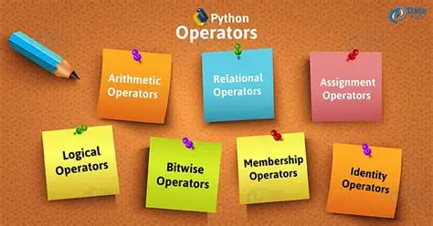
Operators 运算符
Operators are special symbols or keywords that perform operations on values and variables (called operands). Python groups them into several categories.

Slide 25
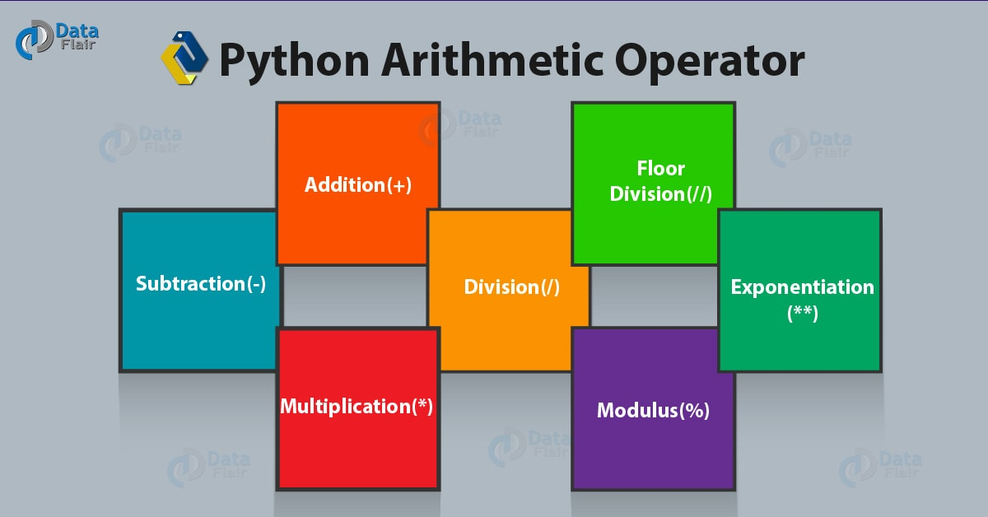
Arithmetic Operators 算数运算符

Slide 26
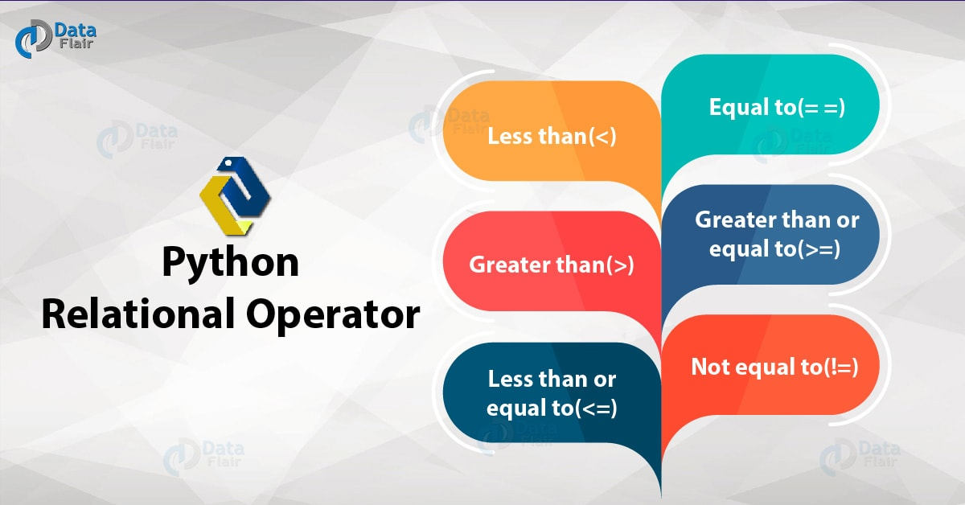
Relational Operators 关系运算符

Slide 27
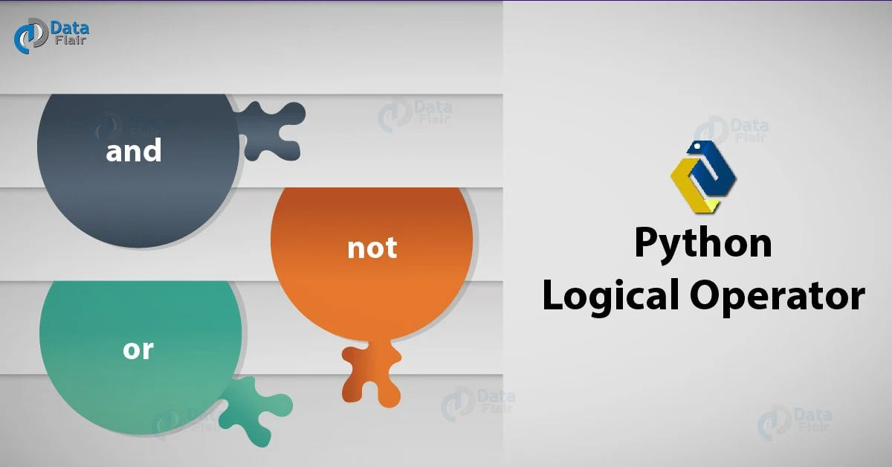
Logical Operators 逻辑运算符

Slide 28
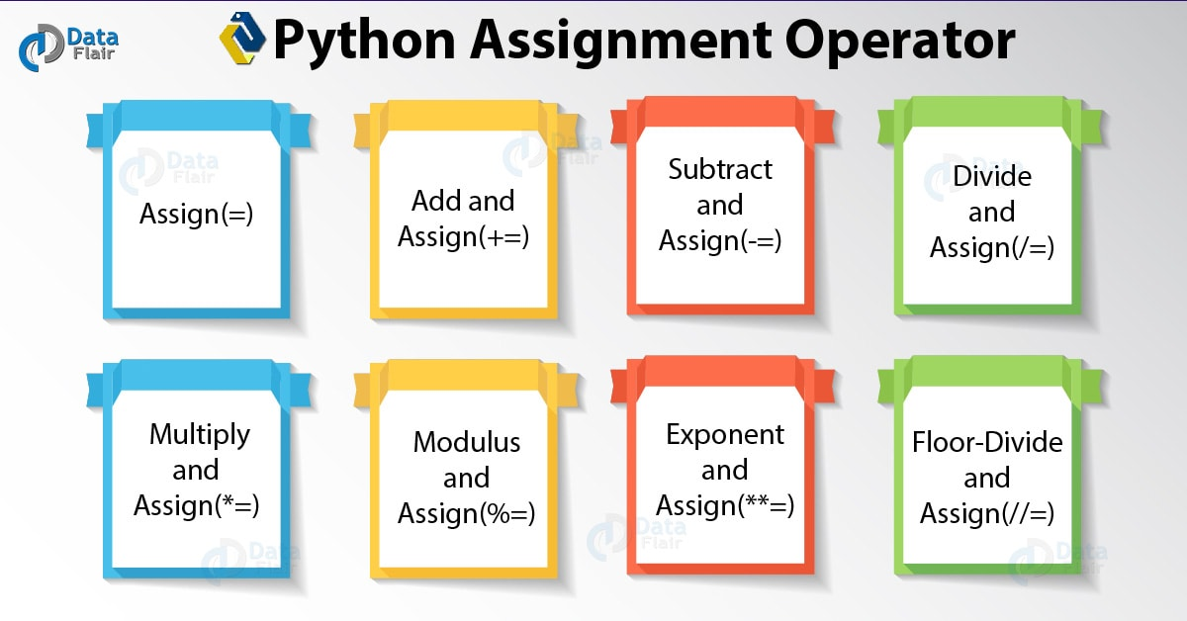
Assignment Operators 赋值运算符

Slide 29
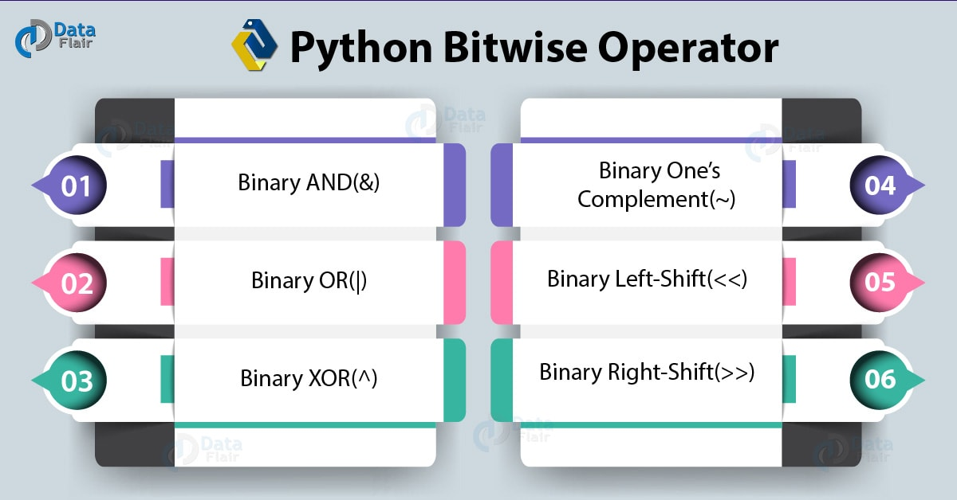
Bitwise Operators（按）位运算符

Slide 30

Membership & Identity Operators 成员&身份运算符

Slide 31
Membership & Identity Operators 成员&身份运算符
Membership Operators: Test whether a value is in a sequence.
Identity Operators: Check whether two variables refer to the same object in memory (not just equal values).
print("a" in "apple") # True
print("z" not in "apple") # True
print(2 in {1, 2, 3}) # True
a = [1, 2, 3]
b = [1, 2, 3]
c = a
print(a == b) # True (same value)
print(a is b) # False (different objects)
print(a is c) # True (same object)

Slide 32
Outline
Identifer, Variable, Assignment
Built-in Data Types
Operators & Expressions
Basic Input / Ouput

Slide 33
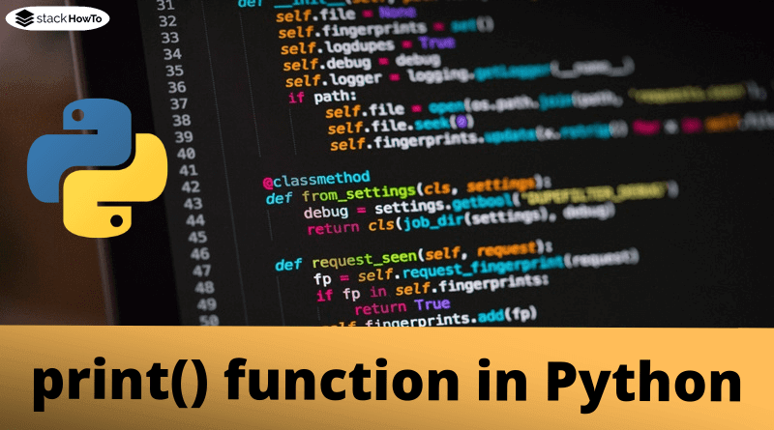
Basic Input / Output
Python uses simple built-in functions for input and output: input() for reading data from the user and print() for displaying data.

Slide 34
Escape Characters
An escape character is a backslash (\) followed by a special character.
It lets you include characters in a string that would otherwise be difficult or impossible to type directly — like a newline, a tab, or a quote inside a quoted string.
Escape | Name | Meaning
\n | Newline | Moves to the next line
\t | Tab | Inserts a horizontal tab
\\ | Backslash | Inserts a literal \
\' | Single quote | Inserts a literal '
\" | Double quote | Inserts a literal "
\r | Carriage return | Moves cursor to the start of the line
\b | Backspace | Moves cursor back one character
\f | Form feed | Page break
\v | Vertical tab | Vertical tab
Escape | Name | Meaning
\a | Bell (alert) | Attempts to beep (often ignored — see below)
\0 | Null | Null character
\ooo | Octal | Character with octal value ooo
\xhh | Hex | Character with hex value hh
\N{name} | Unicode name | Character by Unicode name
\uxxxx | Unicode 16-bit | Character with 16-bit hex value
\Uxxxxxxxx | Unicode 32-bit | Character with 32-bit hex value

