Slide 1


Advanced Programming
Lecture 04
Control Flow
Zibang Zhang
Dept. of Optoelectronic Engineering, Jinan University

Slide 2
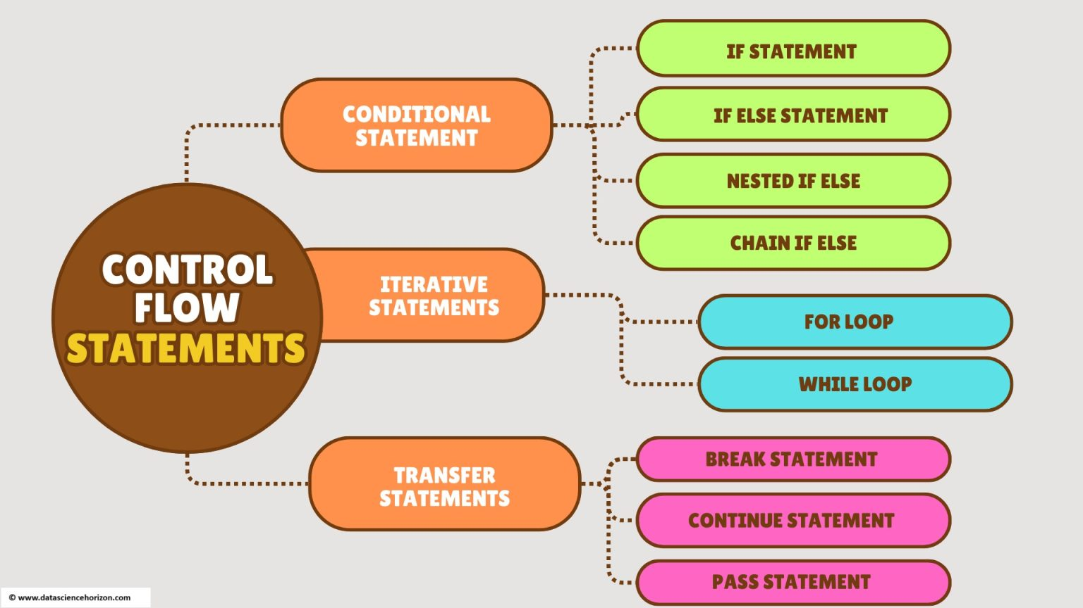
Control Flow
Control flow in Python refers to the order in which individual statements, instructions, or function calls are executed or evaluated.
By default, Python executes code sequentially from top to bottom, but control flow statements let you change that order — making decisions, repeating actions, or jumping around.

Slide 3
Outline
Conditional statements
Loop statements

Slide 4

Conditional Statements
Conditional statements in Python let your program make decisions — they execute certain code blocks only when specific conditions are met. They're a core part of control flow.

Slide 5
if Statement
Runs a block only if the condition is True.

Slide 6
if / else Statement
Provides an alternative when the condition is False.

Slide 7
if / elif / else Statement
Chains multiple conditions, checked top to bottom. The first true branch runs; the rest are skipped.

Slide 8
match / case Statement (Python 3.10+)
A cleaner alternative for many elif branches — structural pattern matching:

Slide 9
Outline
Conditional statements
Loop statements

Slide 10
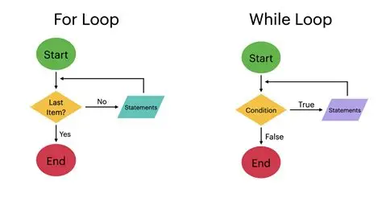
Loop Statements
Loop statements in Python let you repeat a block of code multiple times. Python has two main loop types: for and while

Slide 11
for Statement
Iterates over items of a sequence (list, tuple, string, range, dict, etc.).

Slide 12
for Statement
enumerate() — index + value

Slide 13
for Statement
range() variants

Slide 14
for Statement
zip() — loop over multiple sequences

Slide 15
while Statement
Repeats while a condition stays True

Slide 16
Loop Control Keywords
break — exit the loop immediately
continue — skip to the next iteration
pass — do nothing (placeholder)

Slide 17
for vs while — When to Use
Use for when... | Use while when...
You know the sequence | You loop until a condition changes
Iterating over data | Waiting for user input / events
Fixed number of repeats | Unknown number of iterations

