Slide 1
Spectroscopy and Spectral Imaging
光谱与光谱成像
From Fundamental Spectroscopy to Spectral Imaging Applications
Fundamentals of Spectroscopy • Principles of Spectral Imaging
Data Processing & Analysis • Applications & Future Trends
Technical English Group Presentation
Based on research papers (2003–2025)

Slide 2
Contents
Presentation Structure · 目录
01
Fundamentals of Spectroscopy
02
Principles of Spectral Imaging
光谱学基础
光谱成像原理
Electromagnetic waves · Spectra · Atomic & molecular energy levels
Data cube · Whiskbroom / Pushbroom / Staring · MSI vs. HSI
03
Data Processing & Analysis
04
Applications & Future Trends
光谱数据处理与分析
应用案例与未来趋势
Calibration · PCA / MNF · Spectral classification & validation
Remote sensing · Agriculture · Biomedicine · Miniaturization & AI
2 / 63

Slide 3
PART 01
Fundamentals of Spectroscopy
光谱学基础
Light as electromagnetic waves · Spectroscopy
Atomic & molecular energy levels · Historical development
Key parameters · Beer–Lambert law · Eight technique families
3 / 63

Slide 4
1 · Light as Electromagnetic Waves
Part 1 · Fundamentals of Spectroscopy
English
Wave can be defined as any disturbance made in the medium that propagates through space. Most of the waves require some of the supporting media for propagation. The time dependence of displacement at any single point in the space often oscillates about some equilibrium position. For example, sound waves travel through the medium of air, and disturbance is the small collective displacement of air molecules. Therefore, it has properties of waves such as ocean waves, and light waves have crests and troughs. The distance between two successive crests or troughs is known as wavelength. Frequency can be defined as the number of waves passing from a point in one second. The velocity of light is the product of the wavelength of light and frequency of light. The different colors of light have different frequencies and wavelengths.
中文
波可以定义为在空间传播的介质中产生的任何扰动。大多数波需要一些支持介质才能传播。空间中任何单点位移的时间依赖性常常围绕某个平衡位置振荡。例如，声波通过空气介质传播，扰动是空气分子的微小集体位移。因此，它具有海浪等波的性质，光波也有波峰和波谷。两个连续波峰或波谷之间的距离称为波长。频率可以定义为一秒钟内从一点经过的波数。光速是光的波长和光的频率的乘积。不同颜色的光有不同的频率和波长。光可以直线穿过某些物体，但不是所有物体。
Crest & Trough
Wavelength λ
Frequency ν
c = λ · ν
波峰与波谷：振荡的最高点和最低点
波长：相邻波峰/波谷间距，nm、µm
频率：每秒经过一点的波数，单位 Hz
光速 = 波长 × 频率
4 / 63
Garini et al., 2006 · Prasad et al., 2024

Slide 5
2 · Spectroscopy
Part 1 · Fundamentals of Spectroscopy
English
Spectroscopy is a term that is used to describe different phenomena, and we limit our discussion to optical spectroscopy, mainly in the visible light range. A spectrum is a collection of light intensities at different wavelengths. Spectroscopy, the science of acquiring and explaining the spectral characteristics of matter, is a broad, well established and old science.
中文
光谱学是一个用于描述不同现象的术语，我们将讨论限制在光学光谱学上，主要是在可见光范围内。光谱是不同波长的光强度的集合。光谱学是一门获取和解释物质光谱特征的科学，是一门广泛、完善的古老科学。
Historical chain — Newton (1666) → Balmer (1885) → Bohr (1913) → Schrödinger (1926)
1666
1900
1885
1913
1926
Newton
Spectrograph
Balmer
Bohr
Schrödinger
dispersion of white light into its constituent colours
a system for measuring a spectrum, widely used
explained the spectrum of hydrogen
the Bohr model of the atom
development of quantum mechanics
5 / 63
Garini et al., 2006 · Prasad et al., 2024

Slide 6
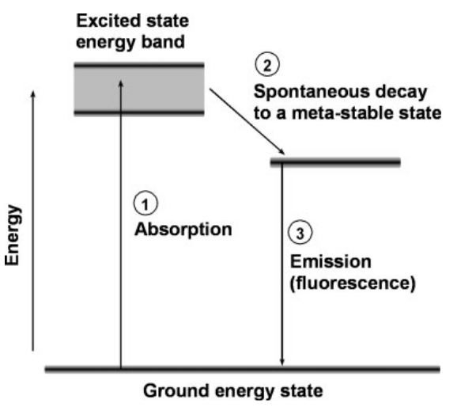
3 · The Basic Principle of Spectroscopy
Part 1 · Fundamentals of Spectroscopy
English
The structure of atoms and molecules is directly related to spectroscopy. The spectrum is a direct measurement of the energy levels of the detected structure (Fig. 1). Molecules (and atoms) have a specific energy-band structure. In an absorption process (which occurs in both brightfield and fluorescence microscopy), an electron is excited from the ground state to an excited energy band (1 in Fig. 1). In fluorescence, the electron rapidly decays to a meta-stable energy level (2 in Fig. 1). Then, light is emitted when the electron decays back to the ground state (3 in Fig. 1). The energy levels are intrinsic properties of the molecule, and the spectrum, therefore, provides a precise fingerprint of the molecule.
1
Absorption — the electron is excited from the ground state to the excited energy band by absorbing a photon.
中文
原子和分子的结构与光谱学直接相关。光谱是对所检测结构能级的直接测量（图 1）。分子（和原子）具有特定的能带结构。在吸收过程（明场显微镜和荧光显微镜中都会发生）中，电子从基态激发到激发能带（图 1 中的 1）。在荧光中，电子迅速衰减到亚稳态能级（图 1 中的 2）。然后，当电子衰变回到基态时就会发射光（图 1 中的 3）。能级是分子的固有属性，因此光谱提供了分子的精确指纹。
2
The electron decays rapidly to a meta-stable energy level.
3
The electron falls back to the ground state, emitting a photon of lower energy (fluorescence).
FIG. 1. Energy-level diagram of a fluorescent molecule (Garini et al., 2006)
6 / 63
Garini et al., 2006 · Prasad et al., 2024

Slide 7
4 · Main Parameters of a Spectrum
Part 1 · Fundamentals of Spectroscopy
English
Some of the important characteristics of a spectrum include:
1. The spectral resolution determines the closest wavelengths that can be distinguished.
2. The spectral range in which spectra can be measured.
3. The lowest detectable signal and dynamic range, which defines the smallest measurable signal and the number of distinguishable levels in a given measurement. These parameters also depend on the shape of the measured spectrum. A sharp laser line has a better detectable signal because the energy is concentrated at a single wavelength when compared to a broad spectrum with equal energy which is distributed over a large spectral range.
中文
光谱的一些重要特征包括：
1. 光谱分辨率决定了可以区分的最接近的波长。
2. 可测量光谱的光谱范围。
3. 最低可检测信号和动态范围，定义了给定测量中的最小可测量信号和可区分级别的数量。这些参数还取决于测量光谱的形状——尖锐的激光线能量集中在单个波长处，比等能量宽光谱具有更好的可检测信号。
Spectral Resolution
closest distinguishable wavelengths
Spectral Range
wavelength interval that can be measured
Detectable Signal & Dynamic Range
smallest signal · number of distinguishable levels
7 / 63
Garini et al., 2006 · Prasad et al., 2024

Slide 8
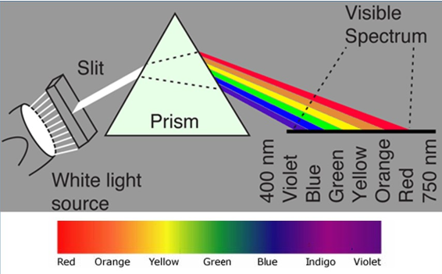
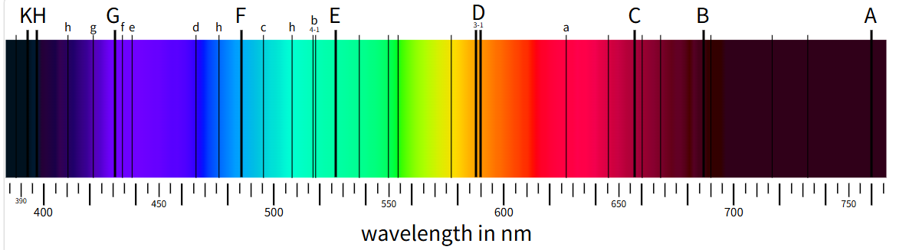
5 · Historical Developments (17th–19th Century)
Part 1 · Fundamentals of Spectroscopy
Prism spectroscopy (17–18th century)
The earliest observations of spectroscopic phenomena can be traced back to experiments conducted by Isaac Newton in the late 17th century. He demonstrated that white light could be separated into its component colors using a prism, revealing the spectrum of visible light.
Spectral analysis (19th century)
In the early 19th century, Joseph von Fraunhofer systematically studied the absorption lines in the solar spectrum; he discovered hundreds of dark lines — Fraunhofer lines — caused by absorption of specific wavelengths by elements in the Sun's atmosphere. Gustav Kirchhoff and Robert Bunsen further advanced the field in the mid-19th century, developing flame emission spectroscopy and laying the foundation for quantitative analysis of chemical elements based on their spectral signatures.
8 / 63
Garini et al., 2006 · Prasad et al., 2024

Slide 9
5 · Historical Developments (20th–21st Century)
Part 1 · Fundamentals of Spectroscopy
Quantum mechanics and atomic spectra (Early 20th century)
The development of quantum mechanics in the early 20th century revolutionized our understanding of atomic structure and spectral lines. Scientists such as Niels Bohr, Max Planck, and Werner Heisenberg formulated theories to explain the discrete energy levels of atoms and the quantized nature of electromagnetic radiation. The Bohr model of the atom, proposed by Niels Bohr in 1913, provided a theoretical framework for understanding atomic spectra and the transitions of electrons between energy levels.
Modern spectroscopic techniques (20th–21st century)
Throughout the 20th and 21st centuries, spectroscopic techniques have continued to evolve with technological advancements and instrumentation. Developing techniques such as infrared (IR) spectroscopy, Raman spectroscopy, nuclear magnetic resonance spectroscopy, and X-ray spectroscopy has expanded the range of applications in fields such as chemistry, physics, biology, materials science, and medicine. Innovations in detectors, lasers, optics, and computational methods have enabled higher sensitivity, resolution, and versatility.
Key People
Niels Bohr · Max Planck · Werner Heisenberg — discrete energy levels & quantized radiation
Key Techniques
IR · Raman · NMR · X-ray spectroscopy — higher sensitivity, resolution and versatility
9 / 63
Garini et al., 2006 · Prasad et al., 2024

Slide 10
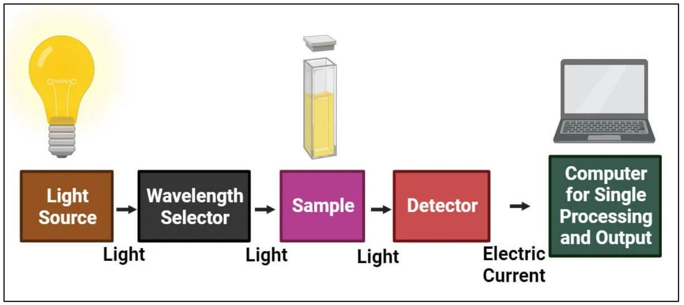
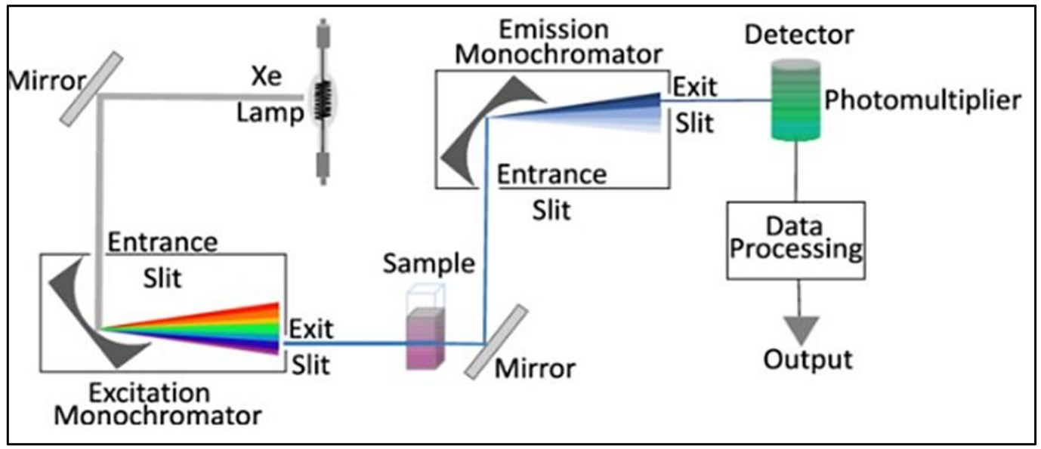
6 · Classification and Types of Major Spectroscopic Techniques
Part 1 · Absorption & Emission Instrumentation
a) Absorption instrumentation
The radiation from a white source is directed by some guiding device onto the sample, from which it passes through an analyzer, which selects the frequency that reaches the detector at any given time. The signal from the analyzer passes to a recorder synchronized with the analyzer to produce a trace of absorbance as the frequency varies. A modulator is often placed between the sample and the analyzer to manipulate the properties of light and extract specific information from a sample.
b) Emission instrument
Emission instrumentation refers to the devices and systems used to measure the emission spectra of atoms, molecules, or ions. Many instruments are developed based on the emission mechanism, such as atomic emission spectroscopy, optical emission spectroscopy, inductively coupled plasma emission spectroscopy, laser-induced breakdown spectroscopy, and fluorescence spectroscopy.
10 / 63
Garini et al., 2006 · Prasad et al., 2024

Slide 11
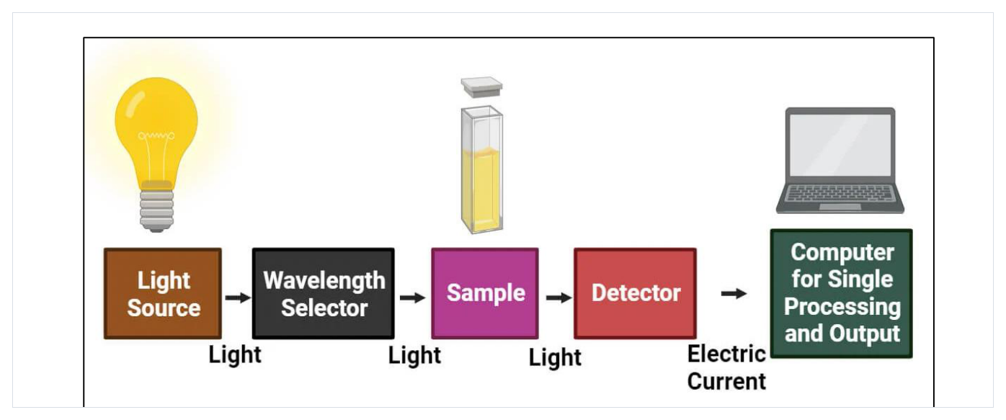
Figures from the Literature · Inside a UV-Vis Spectrometer
Part 1 · Absorption Spectroscopy Instrumentation
Fig. 1. A pictorial representation of UV-Vis spectroscopy: the measured sample absorbs selected wavelengths from the selector, and the detector converts transmitted light into an electric signal. (Prasad et al., 2024)
Common chain of every absorption instrument: light source → wavelength selector → sample → detector → readout / computer
11 / 63
Prasad et al., 2024

Slide 12
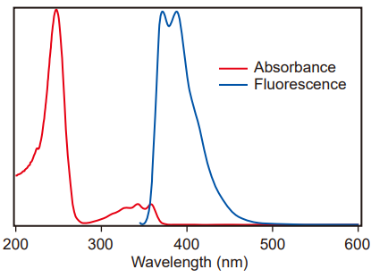
7 · Measurement Principles of Absorption and Emission Spectra
Part 1 · Fundamentals of Spectroscopy
Absorption spectra — Beer–Lambert's law
In optical spectroscopy, the absorption of light by a sample is typically described by Beer-Lambert's law: the absorbance of light is proportional to the concentration of the absorbing species, the path length of the light through the sample, and the molar absorptivity of the species at a given wavelength. By measuring absorbance at different wavelengths, one obtains an absorption spectrum revealing the characteristic absorption bands or peaks associated with specific molecular or electronic transitions.
A = ε · c · l
Emission spectra — fluorescence & phosphorescence
In emission spectroscopy, the intensity of light emitted is measured. This light, which may occur instantaneously or with a delay, contains information about the energy levels, electronic states, and chemical environment of the emitting species. The two main types are fluorescence and phosphorescence spectroscopy, distinguished by their respective mechanisms of excited-state relaxation and lifetime.
Absorbance and fluorescence vs. wavelength
Emission may be instantaneous or delayed
fluorescence (fast relaxation) vs. phosphorescence (longer lifetime)
12 / 63
Garini et al., 2006 · Prasad et al., 2024

Slide 13
8 · Major Spectroscopic Techniques
Part 1 · Eight Families of Modern Spectroscopic Methods
光学光谱 Optical Spectroscopy
振动光谱 Vibrational Spectroscopy
1
2
UV-Vis 紫外-可见 ｜ UPS 紫外光电子能谱 ｜ 荧光光谱 Fluorescence
FT-IR 傅里叶变换红外 ｜ Raman 拉曼 ｜ SERS 表面增强拉曼
电子光谱 Electron Spectroscopy
磁共振光谱 Magnetic Resonance
3
4
XPS X射线光电子能谱 ｜ AES 俄歇电子能谱 ｜ EELS 电子能量损失谱
NMR 核磁共振 ｜ FMR 铁磁共振
质谱 Mass Spectrometry
热光谱 Thermal Analysis
5
6
TOF-MS 飞行时间质谱 ｜ MALDI-MS 基质辅助激光解吸电离质谱
TGA 热重分析
光发射光谱 Optical Emission
其它 Miscellaneous
7
8
OES 光发射光谱 ｜ ICP-OES 电感耦合等离子体光发射光谱
XAS X 射线吸收光谱（含 XANES / EXAFS）｜ AAS 原子吸收光谱
13 / 63
Garini et al., 2006 · Prasad et al., 2024

Slide 14
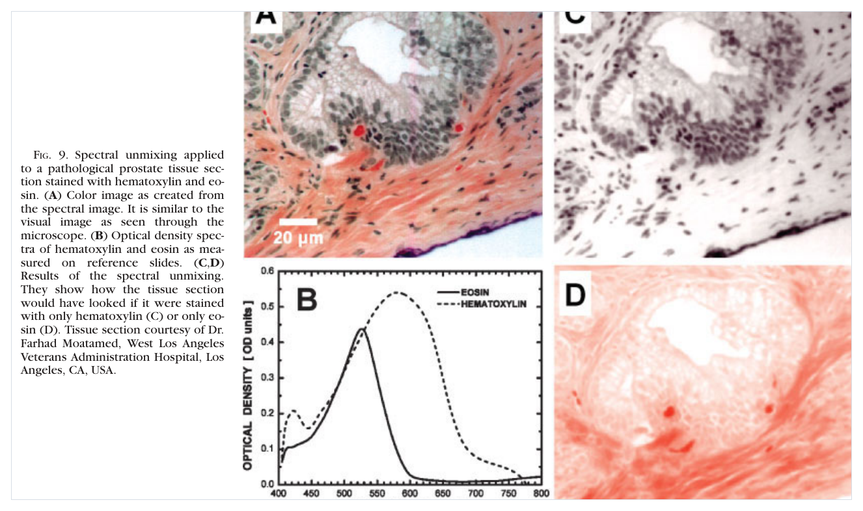
Figures from the Literature · Spectral Unmixing of Tissue
Part 1 · Spectral Imaging in the Life Sciences
How to read this figure
(A) Colour image created from the spectral image — similar to the visual image seen through the microscope.
(B) Optical-density spectra of two reference stains: eosin and hematoxylin, measured on reference slides.
(C, D) Unmixing results: how the tissue would look if stained with only hematoxylin (C) or only eosin (D).
Linear unmixing: the measured spectrum at each pixel is decomposed into a weighted sum of pure reference spectra.
Fig. 9. Spectral unmixing applied to a pathological prostate tissue section stained with hematoxylin and eosin. (Garini et al., 2006)
14 / 63
Garini et al., 2006

Slide 15
PART 02
Principles of Spectral Imaging
光谱成像原理
From single-point spectroscopy to the spectral data cube I(x, y, λ)
Whiskbroom · Pushbroom · Staring acquisition modes
Spatial–spectral resolution trade-off · Multispectral vs. hyperspectral
15 / 63

Slide 16
Overview · Three Topics of Spectral Imaging
Part 2 · Principles of Spectral Imaging
1
单点光谱扩展到光谱成像
From Single-Point Spectroscopy to Spectral Imaging
2
光谱成像的主要模式
Three Primary Spectral-Imaging Acquisition Modes
3
光谱分辨率与空间分辨率及其权衡
Trade-off Between Spatial Resolution and Spectral Resolution
4
多光谱与高光谱
Multispectral and Hyperspectral
16 / 63
[1] Mukhtar et al., 2025 · [2] Lu & Fei, 2014

Slide 17
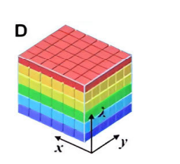
From Single-Point Spectroscopy to Spectral Imaging
Part 2 · Principles of Spectral Imaging
1
Conventional single-point spectroscopy only obtains spectral information at one fixed spatial location: it answers “what” material the target is.
2
Traditional 2-D imaging only records spatial information: it answers “where” the object is located.
3
Spectral imaging combines spectroscopy and imaging, generating a 3-D spectral data cube I(x,y,λ). It answers: where is what.
4
The data cube contains two spatial dimensions (x,y) and one spectral dimension (λ).
FIGURE 1. 3-D data cube [1]
two spatial dimensions (x, y) + one spectral dimension (λ)
where is what — WHAT + WHERE together
17 / 63
[1] Mukhtar et al., 2025 · [2] Lu & Fei, 2014

Slide 18
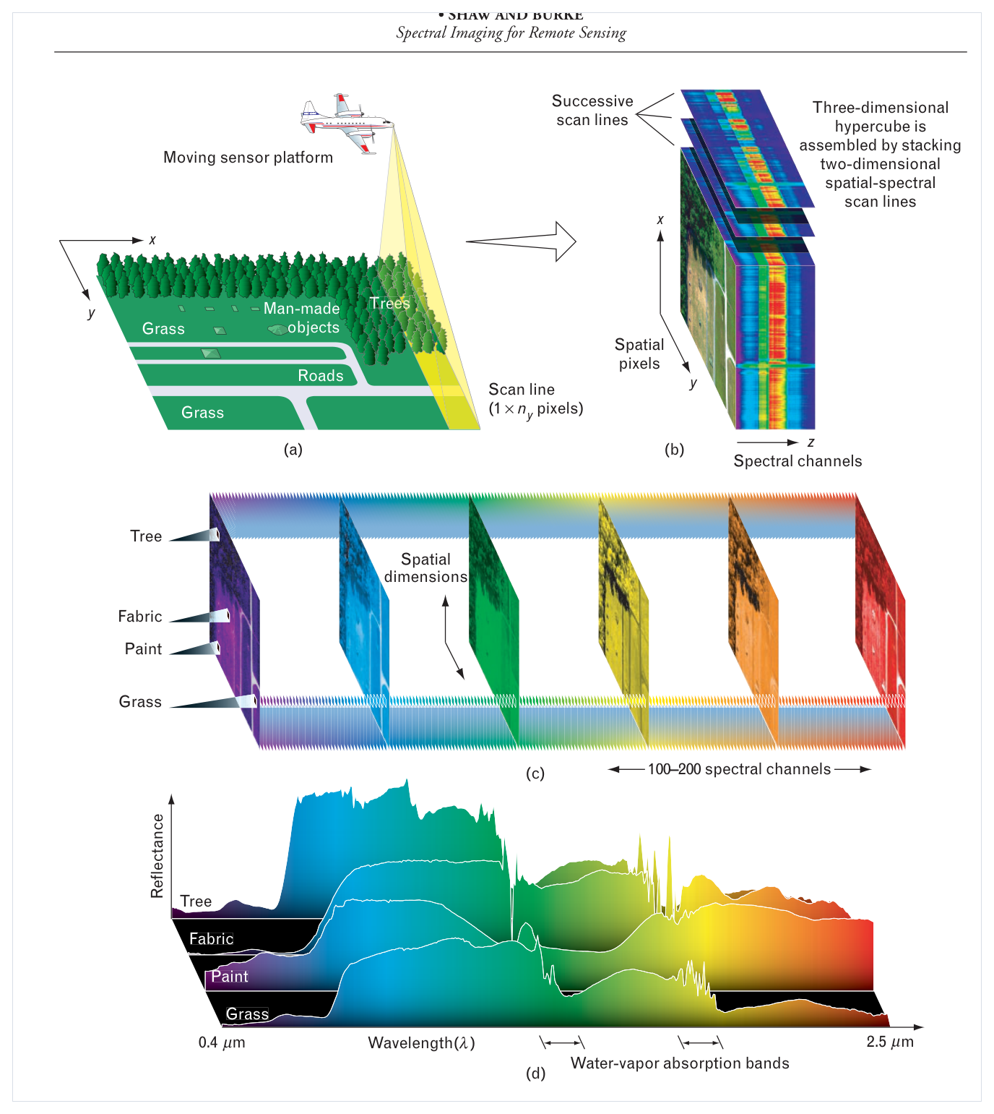
Figures from the Literature · Anatomy of a Hyperspectral Cube
Part 2 · Principles of Spectral Imaging
How to read the cube
(a) A push-broom platform collects one scan line at a time as the platform moves.
(b) Each line carries all wavelengths; successive lines are stacked into the 3-D cube I(x, y, λ).
(c) Cutting across wavelengths gives a stack of monochrome band images — one image per λ.
(d) Cutting across space at one pixel gives a continuous spectrum; tree, fabric, paint and grass each show a distinct, diagnostic spectral curve.
Material identification = matching measured curves against known spectral signatures.
FIGURE 4. Concept of the hyperspectral data cube: spatial scanning builds a stack of co-registered wavelength bands. (Shaw & Burke, 2003)
18 / 63
Shaw & Burke, 2003

Slide 19
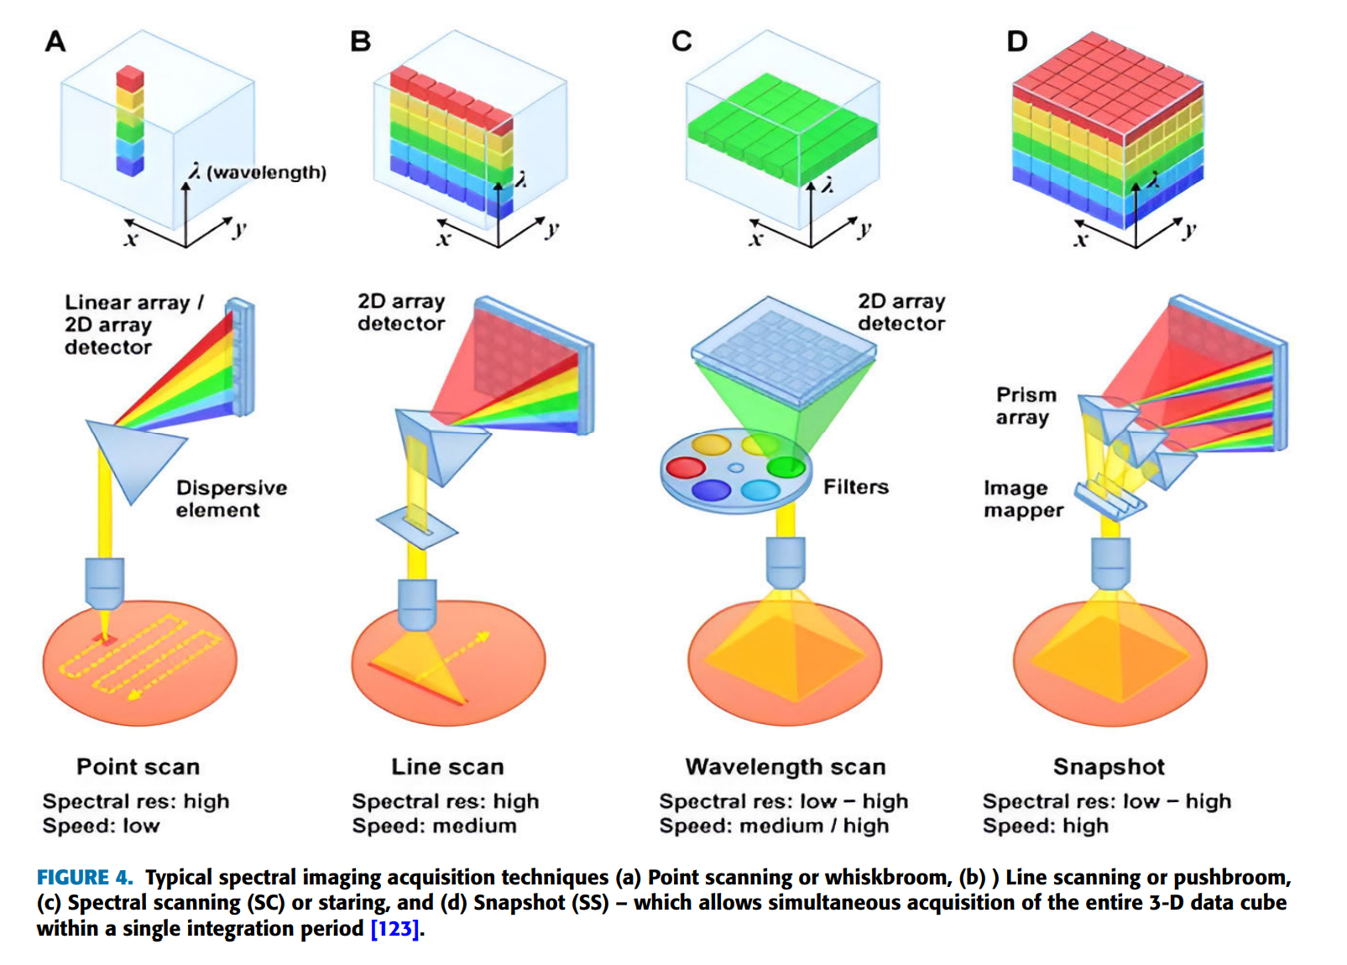
Acquisition Modes: Whiskbroom & Pushbroom
Part 2 · Scanning Imagers
Whiskbroom Mode (Point-Scanning，扫帚式 / 点扫描)
Optical path: a scanning mirror moves across the scene, one spatial point at a time. Each single point acquires its complete full spectrum; the cube is built by scanning every pixel point-by-point.
✅ Pros: high spectral quality for each sampled point; good SNR.
❌ Cons: two-axis mechanical scanning; long acquisition time; moving-part artifacts.
Pushbroom Mode (Line-Scanning，推扫式 / 线扫描)
Optical path: simultaneously captures an entire line of spatial information plus the full spectrum for each pixel on that line. The complete 2-D area is obtained via relative platform motion (aircraft / satellite / translation stage).
✅ Pros: much faster than whiskbroom; widely used in remote sensing.
❌ Cons: depends on steady relative movement between sensor and target.
FIGURE 2. (a) Point scanning or whiskbroom, (b) Line scanning or pushbroom [1]
19 / 63
[1] Mukhtar et al., 2025 · [2] Lu & Fei, 2014

Slide 20
Acquisition Mode: Staring
Part 2 · Spectral Scanning (SC)
Staring Mode (Spectral Scanning，凝视式 / 光谱扫描)
Optical path: keep the whole scene stationary on the detector; use tunable optical filters (AOTF, LCTF, FPI, LVF) to sequentially select one wavelength band. Stack a series of 2-D images to reconstruct the full 3-D data cube.
✅ Pros
Captures the full-field scene for each wavelength; no spatial mechanical scanning.
❌ Cons
Wavelength scanning takes time; poor performance for dynamic moving scenes.
FIGURE 3. (c) Spectral scanning (SC) or staring [1]
20 / 63
[1] Mukhtar et al., 2025 · [2] Lu & Fei, 2014

Slide 21
Trade-off Between Spatial Resolution and Spectral Resolution
Part 2 · Principles of Spectral Imaging
1
Intrinsic trade-off
2
Higher spectral resolution
In conventional spectral-imaging optical systems, there exists an intrinsic trade-off between spatial resolution and spectral resolution [1].
Requires more, narrower spectral bands. Under limited photon budget and detector constraints, this often sacrifices spatial sampling performance.
3
Higher spatial resolution
4
Advanced approaches
If you pursue fine spatial details, the number of available spectral channels will be limited.
Snapshot imaging and compressive computational imaging can mitigate this conflict, but cannot completely eliminate the fundamental physical limits from photon availability.
21 / 63
[1] Mukhtar et al., 2025 · [2] Lu & Fei, 2014

Slide 22
MULTISPECTRAL IMAGING 多光谱成像
Part 2 · Multispectral Imaging (MSI)
English [1]
By capturing and analyzing how objects reflect, absorb, or emit light across different spectral bands, MSI uncovers information about the composition, structure, and properties of a scene or object. [1]
中文
通过捕捉和分析物体在不同光谱带中反射、吸收或发射光的方式，多光谱成像（MSI）能够揭示场景或物体的组成、结构和特性信息。
22 / 63
[1] Mukhtar et al., 2025 · [2] Lu & Fei, 2014

Slide 23
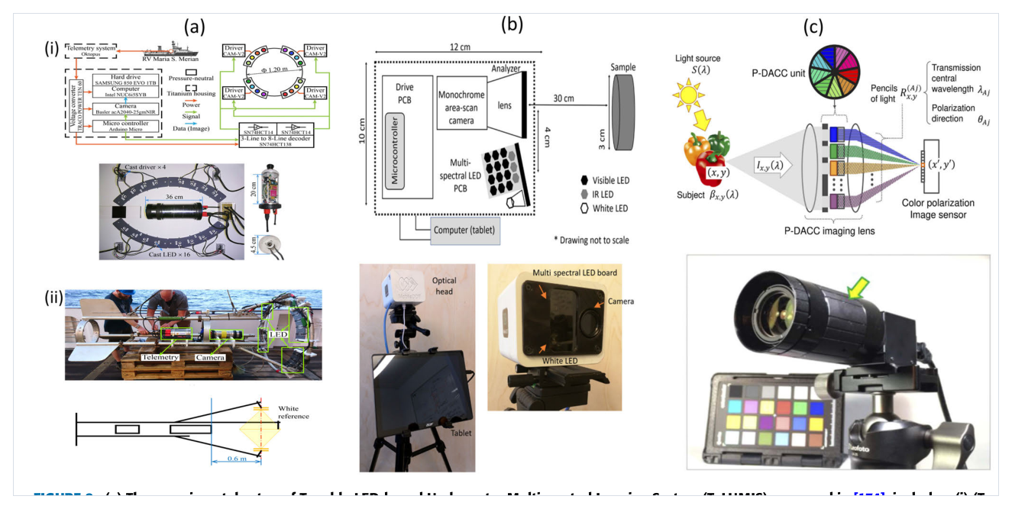
Figures from the Literature · Real Multispectral Imaging Platforms
Part 2 · Multispectral Imaging (MSI)
FIGURE 8. Representative MSI systems: tunable-LED underwater imager, portable LED-based field imager, and a snapshot pixel-wise polarization camera. (Mukhtar et al., 2025, IEEE Access)
(a) TuLUMIS — underwater MSI
(b) Portable LED MSI imager
(c) Snapshot P-DACC camera
Tunable LED-based underwater multispectral system: LEDs, camera and control electronics, here mounted on the PELAGIOS frame during a deployment cruise.
Low-cost multispectral imager with a multi-spectral LED board and a tablet for real-time visualisation — compact for field applications.
Pixel-wise polarization sensor with colour wheel and imaging lens: a single exposure captures a multispectral / polarisation data cube.
23 / 63
Mukhtar et al., 2025 (IEEE Access)

Slide 24
HYPERSPECTRAL IMAGING 高光谱成像
Part 2 · Hyperspectral Imaging (HSI)
English [1]
While MSI systems have long provided a balance between spectral information and ease of implementation, the HSI systems have pushed the boundaries in terms of providing deep spectral insight. [1]
中文
虽然多光谱成像（MSI）系统长期以来一直在光谱信息与实施便捷性之间寻求平衡，但高光谱成像（HSI）系统在提供深入的光谱洞察方面则突破了界限。
24 / 63
[1] Mukhtar et al., 2025 · [2] Lu & Fei, 2014

Slide 25
HSI · Advantages in Agriculture & Food Quality Estimation
Part 2 · Hyperspectral Imaging (HSI)
The pros of using Hyperspectral Imaging in different applications such as agriculture, and food quality estimation are as follows [2]:
(i)
(ii)
(iii)
It is a non-invasive, non-contact, non-destructive technology that ensures the quality and safety of food goods.
The experiments use no chemicals, therefore environmentally safe.
The time required to process for quality evaluation and food control/storage is low compared to chemical and traditional approaches.
(iv)
(v)
(vi)
It gives an improved understanding of the chemical elements of food products and is generally known as chemical imaging.
It provides appropriate area selection for critical analysis of the image.
It gains spatial and spectral information together to provide more appropriate and accurate data concerning chemical samples from interested platforms and enhance a chance to data refine and achieve further experiments.
25 / 63
[2] Lu & Fei, 2014

Slide 26
HSI · Limitations
Part 2 · Hyperspectral Imaging (HSI)
Despite its pros, Hyperspectral Imaging also has some cons [2].
(i) High cost
(ii) Large data size
A hyperspectral imaging system is highly costly compared to other image processing techniques.
Since the data size of hyperspectral imaging is large, there is a demand for high-speed computers for the processing of data and extensive capacity drives for the storage of data.
(iii) Ambient interference
(iv) Difficult discrimination
While acquiring the images, the signal could be impacted by ambient surroundings such as scattering, illumination, etc., therefore producing a destitute signal-to-noise ratio.
Detection and identification of different items within the equivalent image using spectral data is mostly difficult except the diverse objects have distinct absorption features.
26 / 63
[2] Lu & Fei, 2014

Slide 27
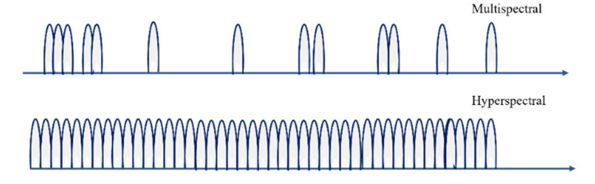
Multispectral Imaging VS Hyperspectral Imaging
Part 2 · Multispectral vs. Hyperspectral
 | Multispectral Imaging 多光谱成像 | Hyperspectral Imaging 高光谱成像
Spectral bands 光谱波段 | Discrete widely-spaced bands (typically 3–25 bands) | Hundreds of contiguous narrow spectral bands
Spectral signature 光谱特征 | Coarse spectral sampling | Dense continuous spectral fingerprint per pixel
Data volume 数据量 | Small, easy to process | Large 3-D data cube, heavy computation load
Typical strength 优势 | Higher spatial / temporal resolution; low cost | Fine material discrimination by continuous spectrum
27 / 63
[1] Mukhtar et al., 2025 · [2] Lu & Fei, 2014

Slide 28
PART 03
Data Processing & Analysis
光谱数据处理与分析
Preprocessing: radiometric & atmospheric correction
Dimensionality reduction: PCA vs. MNF
Spectral classification (SAM) · Statistical validation · Paper excerpts
28 / 63

Slide 29
Basic Terminology 基本术语
Part 3 · Data Processing & Analysis
中文 | English | 含义
辐射定标 | Radiometric Calibration | 将传感器原始 DN 值转换为辐射亮度 / 反射率的过程
大气校正 | Atmospheric Correction | 消除大气散射、吸收对地表反射率的影响
光谱响应函数 | Spectral Response Function (SRF) | 传感器对不同波长的响应曲线
半高宽 | Full Width at Half Maximum (FWHM) | 光谱响应峰半高处的宽度，表征光谱分辨率
光谱微笑效应 | Spectral Smile | 推扫式传感器跨轨方向中心波长偏移现象
基线校正 | Baseline Correction | 去除荧光 / 散射造成的低频背景漂移
噪声等效辐亮度 | Noise Equivalent Radiance (NER) | 表征传感器噪声水平
几何校正 | Geometric Correction | 将图像像素与地理坐标配准
29 / 63
Roussel et al., 2017 · Gautam et al., 2015 · Yamamoto et al., 2022

Slide 30
Processing Pipeline 流程总览
Part 3 · Data Processing & Analysis
先看这张流程图，三步：
STEP 1
STEP 2
STEP 3
Preprocessing
Dimensionality Reduction
Classification & Recognition
→
→
预处理
降维
分类与识别
Calibration & correction: DN → radiance / reflectance
Compress hundreds of correlated bands (PCA / MNF)
Identify materials with spectral classifiers (SAM, SVM…)
Preprocessing → Dimensionality Reduction → Classification & Recognition
30 / 63
Roussel et al., 2017 · Gautam et al., 2015 · Yamamoto et al., 2022

Slide 31
Preprocessing (I) · Calibration 预处理 · 定标类
Part 3 · Step 1 — Preprocessing
这一页有四个高频词：
1 Radiometric Calibration（辐射定标）
2 Spectral Response Function（SRF，光谱响应函数）
把仪器记到的数字 DN（digital number）换算成真实的辐射亮度或反射率。没有这一步，数据只是一堆数字。
传感器对每个波长“有多敏感”，是一条随波长变化的曲线。
3 FWHM（Full Width at Half Maximum，半高宽）
4 Spectral Smile（光谱微笑效应）
峰高一半处的宽度。它越小，光谱分辨率越高。
中间和两边的波长对不齐，曲线像一张微笑的嘴。
“The path of the light from the lamps is slightly different from the path of light through the full optical system… the smile correction table determined based on the former does not enable sufficient spectral smile correction for actual observation images.”
“…absorption bands centered at λ = 765 nm … CO₂ … 2010 nm … 2060 nm.”
— Yamamoto et al., 2022 (HISUI spectral-smile calibration)
31 / 63
Yamamoto et al., 2022

Slide 32
Preprocessing (II) · Atmospheric Correction 大气校正
Part 3 · Step 1 — Preprocessing
1 Atmospheric Correction（大气校正）
光从太空到地面会被大气散射和吸收，这一步把干扰减掉，还原地表真实反射率。
2 MODTRAN
常用的大气辐射传输模型，物理法大气校正靠它算大气参数。
3 COCHISE vs. 经验阴影校正法
物理模型法（COCHISE）准，但假设地面是平的；经验阴影校正法能识别阴影，但把像素当成“要么全亮、要么全暗”。
4 Spatial Resolution（空间分辨率）
决定哪种方法更好：空间分辨率越低，COCHISE 相对经验法的优势越大。
“…the choice depends on the spatial resolution of the processed data set… with the lower spatial resolution where COCHISE can be 10% more accurate than the empirical method.”
— Roussel et al., 2017
32 / 63
Roussel et al., 2017

Slide 33
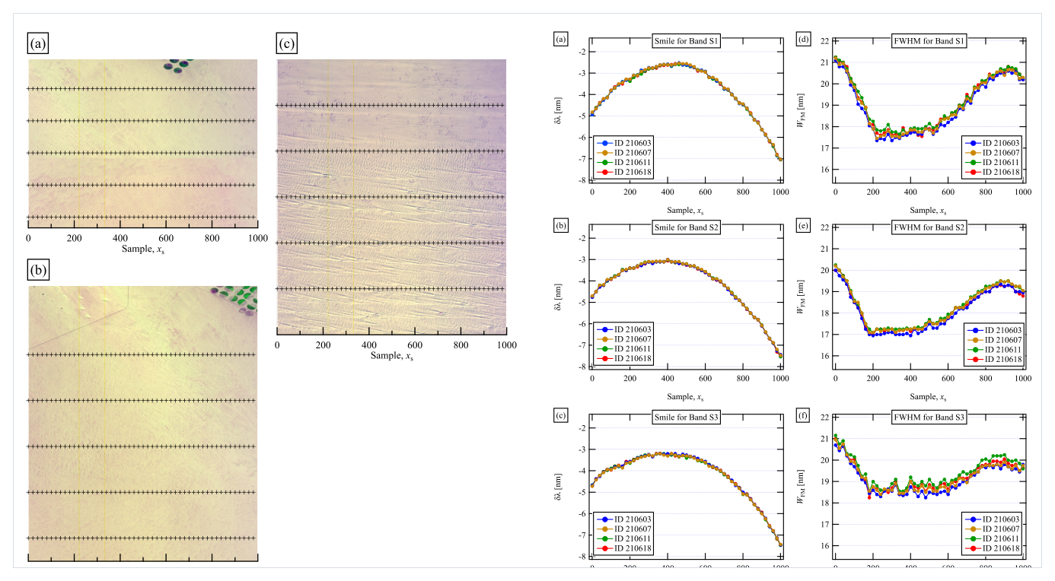
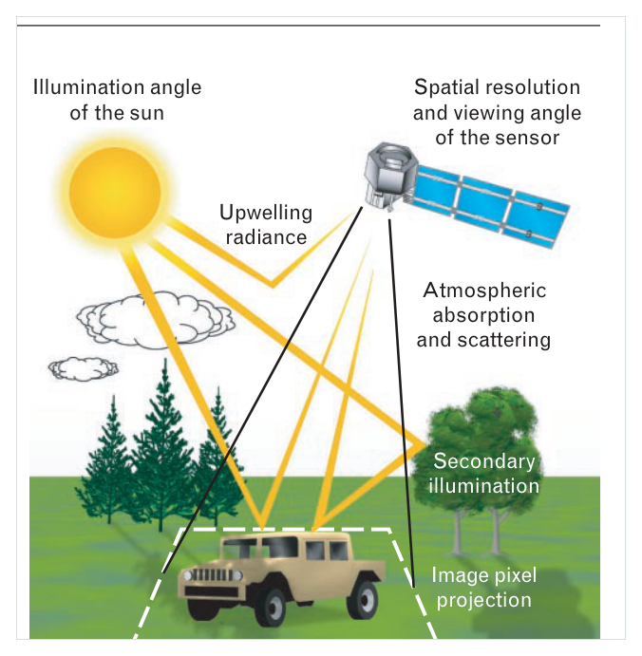
Figures from the Literature · Spectral Smile & Atmospheric Paths
Part 3 · Calibration & Atmospheric Correction
Fig. 9–10. SWIR colour composites (left) and measured centre-wavelength shift δλ of the spectral smile along across-track samples for SWIR bands S1–S3 of HISUI (right). (Yamamoto et al., 2022)
FIGURE 5. Solar illumination, atmospheric absorption and scattering, upwelling radiance and the ground pixel viewed by the sensor. (Shaw & Burke, 2003)
33 / 63
Yamamoto et al., 2022 · Shaw & Burke, 2003

Slide 34
Preprocessing (III) · Raman vs. FTIR 拉曼 vs 红外
Part 3 · Step 1 — Scatter & Baseline Correction
Fluorescence Baseline（荧光基线）
拉曼信号弱，被荧光背景盖住，要先做 Baseline Correction（基线校正）。
Cosmic Ray Spike（宇宙射线尖峰）
CCD 上突然冒出的假亮点，要先去掉。
ALS（Asymmetric Least Squares）
非对称最小二乘法，常用的拟合基线算法。
Mie Scattering（米氏散射）
细胞大小和红外波长差不多，会把光谱形状扭歪。
EMSC（Extended Multiplicative Scatter Correction，扩展乘性散射校正）
红外里最常用的预处理。
【文献出处】Gautam 2015：拉曼的荧光基线、宇宙射线尖峰、ALS、SG 平滑、SNV；FTIR 的 Mie 散射、MSC / EMSC。
“…the strong intrinsic fluorescence from many biomolecules. The fluorescence background is often many times more intense than the weak Raman signals.”
“…mid-infrared spectrum… is hampered by Mie scattering… Extended Multiplicative Scatter Correction (EMSC) can be employed for this purpose.”
— Gautam et al., 2015
34 / 63
Gautam et al., 2015

Slide 35
Dimensionality Reduction · PCA 降维：主成分分析
Part 3 · Step 2 — Dimensionality Reduction
二、降维：PCA
1
Hyperspectral Cube（高光谱数据立方体）
两个空间维度 + 一个光谱维度，一景图有几百个波段。
2
为什么降维？
因为波段之间高度相关。
3
PCA（Principal Component Analysis，主成分分析）
把几百个波段“拧成”几个 PC（主成分）。
4
Eigenvalue / Eigenvector（特征值 / 特征向量）
PCA 的数学基础，由协方差矩阵分解得到。
5
Score Plot（得分图） / Loading Plot（载荷图）
Score Plot 看样本分成几堆（分组与离群点）；Loading Plot 看哪些波长在起作用；Scree Plot（碎石图）用于选择保留的 PC 数。
6
【文献出处】Gautam 2015
PCA 原理、协方差矩阵特征分解、Score / Loading plot、碎石图选 PC 数。
“Eigenvectors of the covariance matrix of the data…” — Fig. 1: “Scatter Plots of score values of different Principal Components (PCs)…” used to inspect groups and outliers.
— Gautam et al., 2015
35 / 63
Gautam et al., 2015

Slide 36
PCA vs. MNF 主成分分析 vs. 最小噪声分离
Part 3 · Step 2 — Dimensionality Reduction
重点对比两个词：
PCA
按 Variance（方差）大小排序。
PCA 最大化方差，但不区分信号与噪声——高方差成分也可能只是噪声。
MNF（Minimum Noise Fraction，最小噪声分离）
先把噪声“白化”（noise whitening），再做 PCA，按 Signal-to-Noise Ratio （SNR，信噪比）排序。
高信噪比成分排在前面，噪声分离能力更强，高光谱里用得更多。
一句话：PCA 看方差大不大，MNF 看信噪比高不高。高光谱里 MNF 用得更多。
【文献出处】Gautam 2015：PCA 按方差排序的局限；MNF 按 SNR 排序与噪声分离能力。
36 / 63
Gautam et al., 2015

Slide 37
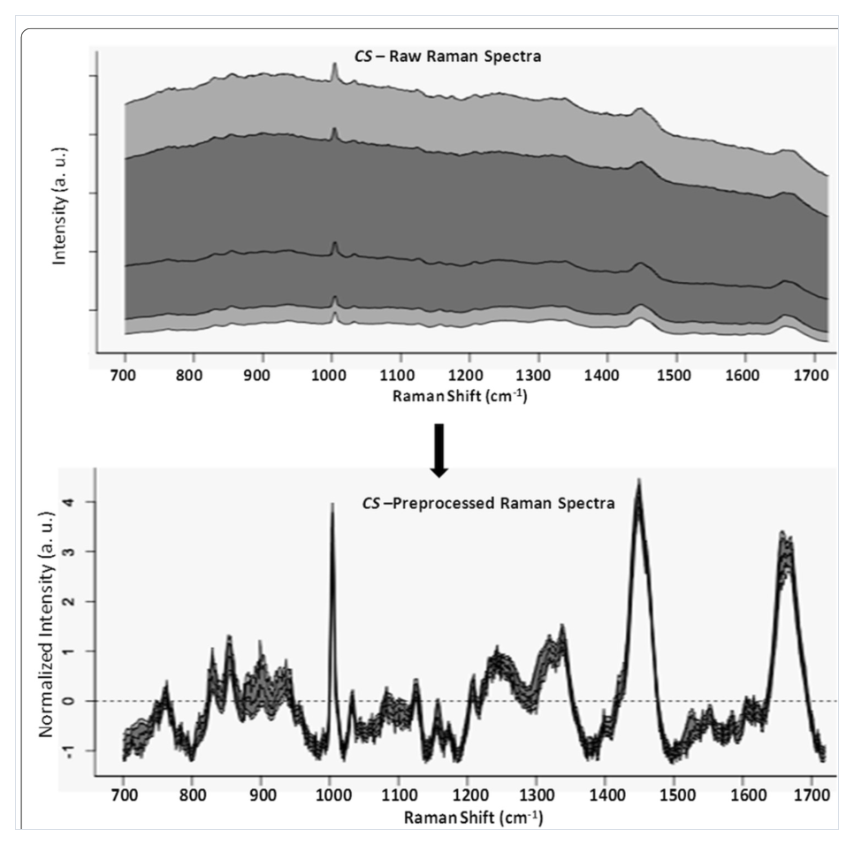
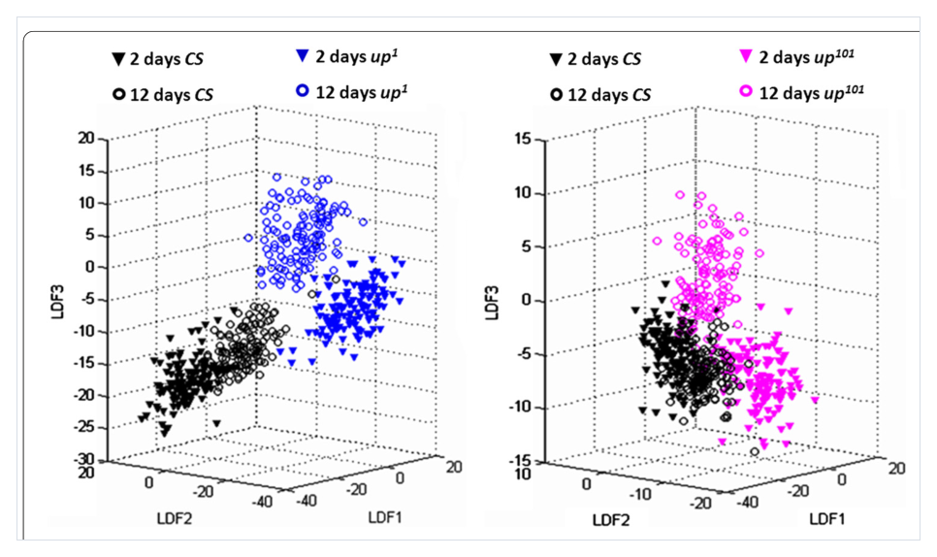
Figures from the Literature · Preprocessed Spectra & PCA Scores
Part 3 · Preprocessing & Dimensionality Reduction
Fig. 5. PC-LDA 3-D score plots of 2- and 12-day-old flies: upshed mutants (blue / magenta) separate well from control CS (black), whereas the two control age groups almost merge. (Gautam et al., 2015)
Fig. 4. Raw (top) and preprocessed (bottom) Raman spectra of muscle tissue (control CS flies, 2 days old); shaded band = ±1 SD around the mean. Preprocessing enhances the diagnostic Raman features. (Gautam et al., 2015)
Score plots visualise class separation — the goal of dimensionality reduction before classification.
37 / 63
Gautam et al., 2015

Slide 38
Classification · Spectral Angle Mapper 分类：光谱角度匹配
Part 3 · Step 3 — Classification & Recognition
SAM（Spectral Angle Mapper，光谱角度匹配）
关键：只看形状，不看亮度
把每条光谱看成一条向量，比较两条向量的夹角；夹角越小越像。
阴影像素虽然整体变暗，但光谱形状没变，照样能和光照下的同类对上号。
Sun-Shadow Strategy（光照-阴影分步策略）
【文献出处】Roussel 2017
先用光照像元（Sunlit Ground Truth, SGT）做分类（K-Means / SVM，SS-KM / SS-SVM），再用 SAM 去认阴影像元。
光照-阴影分步策略、用 SAM 匹配阴影像元、训练集只有光照像元（SGT）的真实城市场景。
“…a Spectral Angle Mapper (SAM) classification has been chosen for its ability to focus on the shape of spectra, which remains globally similar for a pair of pixels associated to the same material, even if one is located in a sunlit area and the other in a shadow area.”
— Roussel et al., 2017
38 / 63
Roussel et al., 2017

Slide 39
Validation of Spectral Models 模型验证
Part 3 · Step 3 — Validation
Cross-Validation（交叉验证）
Confusion Matrix（混淆矩阵）
常用 K-fold（K 折交叉验证）轮换训练 / 验证子集，检验模型的泛化能力。
TP 真阳性、TN 真阴性、FP 假阳性、FN 假阴性；由此算出 Sensitivity（灵敏度）、Specificity（特异度）和 Overall Accuracy（总精度）。
ROC Curve & AUC
Overfitting & Negative Controls
ROC 曲线与曲线下面积 AUC，用于评价不同阈值下的分类性能。
警惕 Overfitting（过拟合）；用阴性对照（negative controls）防止伪相关。
【文献出处】Gautam 2015：交叉验证、混淆矩阵、灵敏度 / 特异度、ROC-AUC、阴性对照防止伪相关。
39 / 63
Gautam et al., 2015

Slide 40
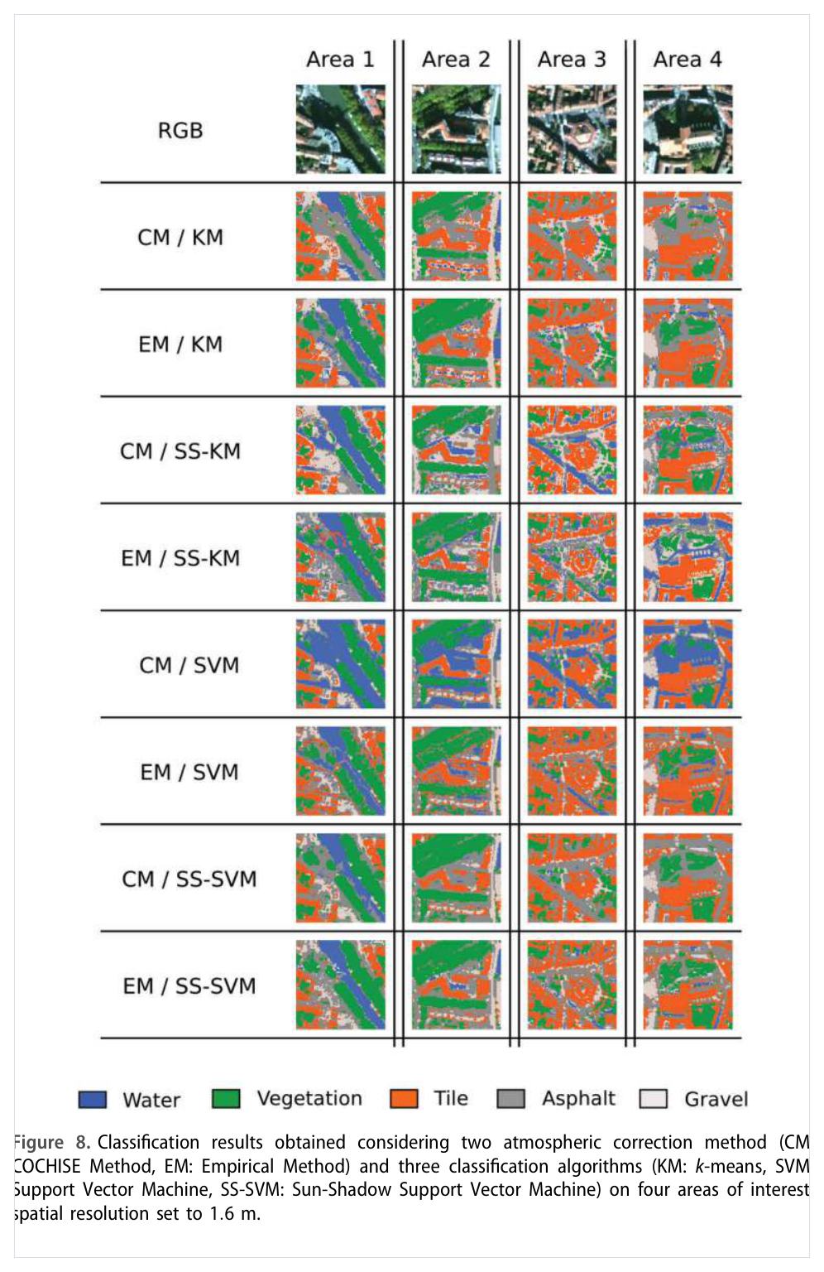
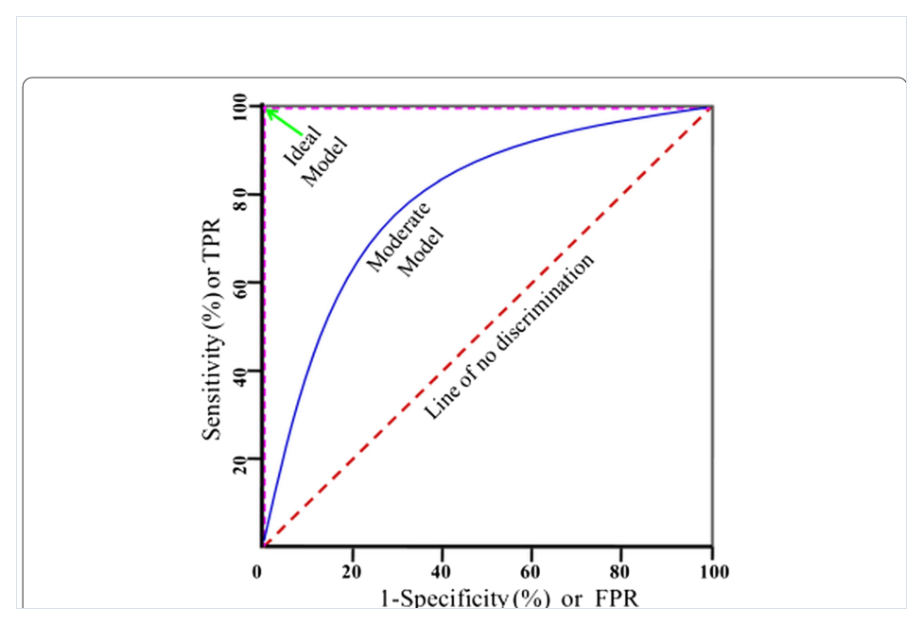
Figures from the Literature · Classification Maps & ROC Validation
Part 3 · Classification & Validation
Reading the ROC
• Curve to the upper-left corner = 100 % sensitivity & specificity (ideal model).
• 45° diagonal = line of no discrimination (random labels).
• AUC near 1: strong model; below 0.5: worse than random.
Fig. 9. Receiver-operating-characteristic (ROC) plot: ideal and moderate models vs. the line of no discrimination. (Gautam et al., 2015)
How to read these figures
• Maps let us compare algorithms visually: classes are water, vegetation, tile, asphalt and gravel — SAM-based chains recover shadowed pixels trained only on sunlit spectra.
• ROC curves trade sensitivity against false-positive rate across thresholds; AUC summarises overall discrimination in one number.
Figure 8. Classification results over four urban study areas for eight processing chains (CM/EM × KM, SS-KM, SVM, SS-SVM). (Roussel et al., 2017)
40 / 63
Roussel et al., 2017 · Gautam et al., 2015

Slide 41
Paper Excerpt 1 · MSI Limitations & Atmospheric Correction
Part 3 · Original Text — Roussel et al., 2017
However, multispectral imagery is limited regarding spectral analysis. Its low spectral resolution does not allow the discrimination among the large variety of urban materials. Hyperspectral imagery, which is characterized by a very high spectral resolution and whose spatial resolution tends to improve (Briottet et al. 2011), has proved to be a promising tool to overcome this matter.
One of the keypoints to achieve these applications is the atmospheric correction phase which aims to retrieve, from at-sensor radiance, the reflectance associated to the targeted surface, which is by nature independent of the irradiance conditions on the one hand and of the environment topography on the other hand. Different correction methods exist. ATREM (Goetz et al. 1997) for ‘Atmospheric REMoval program’ and ACORN (Miller 2002) for ‘Atmosphere CORrection Now’ assume a flat homogeneous ground hypothesis with a Lambertian surface.
Briottet et al. 2011
Goetz et al. 1997 · ATREM
Miller 2002 · ACORN
41 / 63
Roussel et al., 2017, Int. J. Remote Sensing

Slide 42
Paper Excerpt 2 · Principal Component Analysis (PCA)
Part 3 · Original Text — Gautam et al., 2015
Principal component analysis (PCA) is an unsupervised data transformation procedure of complex data sets. PCA is used for projecting a higher dimensional data matrix “X” onto a low component subspace. It reduces a set of variables into a smaller set of orthogonal, and therefore independent, principal components (PCs) in the direction of maximal variation — i.e. it reduces the dimensionality and retains the most significant information for further analysis.
Unsupervised transform
X → low-dimensional subspace
of complex, high-dimensional data sets
project the high-dimensional matrix X
Orthogonal, independent PCs
Maximal-variance direction
smaller set of uncorrelated components
retains the most significant information
42 / 63
Gautam et al., EPJ Techniques and Instrumentation, 2015

Slide 43
Paper Excerpt 3 · HISUI: Applications & Calibration Need
Part 3 · Original Text — Yamamoto et al., 2022
Hyperspectral data can be used to extract various information from discrete absorption and reflection features of a target surface or atmosphere. Thus, HISUI data are expected to be useful in various fields, such as natural resources, agriculture, forestry, environmental monitoring, and Earth science [1]. For such applications, both an accurate spectral calibration and a radiometric calibration are necessary for the reliability of the information extracted from hyperspectral data (see, e.g., [2]–[4]). In particular, for push-broom-type sensors, it is important to evaluate and calibrate the spectral smile, which is a phenomenon showing a cross-track dependence in a deviation from the original wavelength assignment caused by optical distortions incident on the detector array.
Natural resources
Agriculture
Forestry
Environmental monitoring
Earth science
In-text numbered citations
[1] HISUI mission overview · [2]–[4] hyperspectral spectral & radiometric calibration studies — accurate calibration is essential for the reliability of extracted information.
43 / 63
Yamamoto et al., IEEE TGRS, 60, 2022

Slide 44
Paper Excerpt 4 · Evaluating Spectral Smile by Atmospheric Correction
Part 3 · Original Text — Yamamoto et al., 2022
B. Evaluation of the Spectral Smile by Atmospheric Correction
The analytical procedure to evaluate the spectral smile by atmospheric correction was given as follows. In this analysis, we used the modeled radiance incident on HISUI from the target site, which was calculated using MODTRAN 6. MODTRAN calculations were performed using the U.S. Standard 1976 Atmospheric Profile, the desert aerosol model, and a Lambertian desert-barren surface type as representative parameter values. In addition, solar altitude, target latitude and longitude, ground height, and seasonal parameters were provided with values for each target and observation timing. These settings are a simple and efficient method for evaluating spectral smile for large numbers of pixels in a variety of HISUI scenes. Note that fine-tuning of MODTRAN parameters was not conducted for this analysis because the objective of this study was not to obtain accurate surface reflectance, but rather to estimate δλ using atmospheric absorption bands.
MODTRAN 6
U.S. Standard 1976
Desert aerosol
radiative-transfer model
atmospheric profile
aerosol model
Lambertian desert-barren
Solar altitude · lat/lon
No fine-tuning
surface type
ground height · seasonal
goal: estimate δλ, not reflectance
44 / 63
Yamamoto et al., IEEE TGRS, 60, 2022

Slide 45
PART 04
Applications & Future Trends
应用案例与未来趋势
Remote Sensing · Environmental Monitoring · Precision Agriculture
Biomedical Imaging · Industrial Sorting
Miniaturization · Real-time AI · Future trends
45 / 63

Slide 46
Application 1 · Remote Sensing
Part 4 · Applications & Future Trends
Background & Motivation
Spectral imaging arose as an alternative to high-spatial-resolution, large-aperture satellite imaging systems, using spectral signatures rather than spatial shapes to classify ground cover.
Three Major Application Categories
Anomaly Detection
isolate uncommon features — e.g. man-made materials in natural backgrounds
Target Recognition
identify specific materials using a priori spectral libraries
1972
1987
2000
Background Characterization
Landsat-1
AVIRIS
Hyperion
holistic scene analysis: land, ocean, and atmosphere
First spaceborne multispectral imager
First airborne hyperspectral imager (full solar-reflective)
First spaceborne HSI — 220 bands, 30 m GSD
Shaw & Burke, 2003, pp.1, 9, 13–14, 19–20
46 / 63
Shaw & Burke, 2003

Slide 47
Application 2 · Environmental Monitoring
Part 4 · Applications & Future Trends
Case: Mary Kathleen Uranium Legacy Mine, Australia
Tailings storage facility (~1.3 km², 5.5–7.5 Mt tailings) with acid mine drainage and heavy-metal / radionuclide migration risks.
Drone-Based HSI System
Sensor: HySpex Mjolnir VS-620 · VNIR–SWIR 400–2500 nm, 410 bands · Spatial resolution 6–10 cm/pixel (120 m altitude). Centimetre GSD reduces mixed-pixel effects.
Processing Methods
• SAM (Spectral Angle Mapper) — data-driven; classifies by spectral angle to endmembers
• BR (Band Ratios) — knowledge-driven; reactivity & clay-mixture indices
Key Results
• SAM differentiated mineral endmembers (gypsum, chlorite, clay) in visually uniform areas
• Mapped evaporite salt pathways; identified EP & tailings-barrier degradation points
“The results indicate that drone-based HSI can capture and distinguish complex surface trends, demonstrating the technology's potential to enhance the assessment and monitoring of environmental conditions at a mine site.”
— Tolentino et al., 2025, Drones 9:313
47 / 63
Tolentino et al., 2025

Slide 48
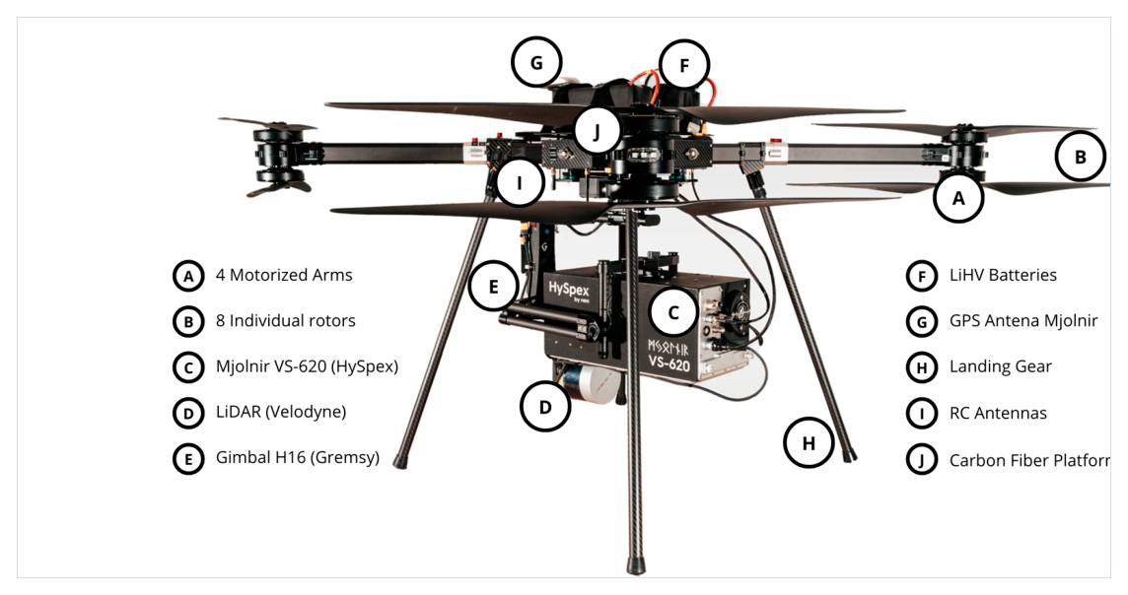
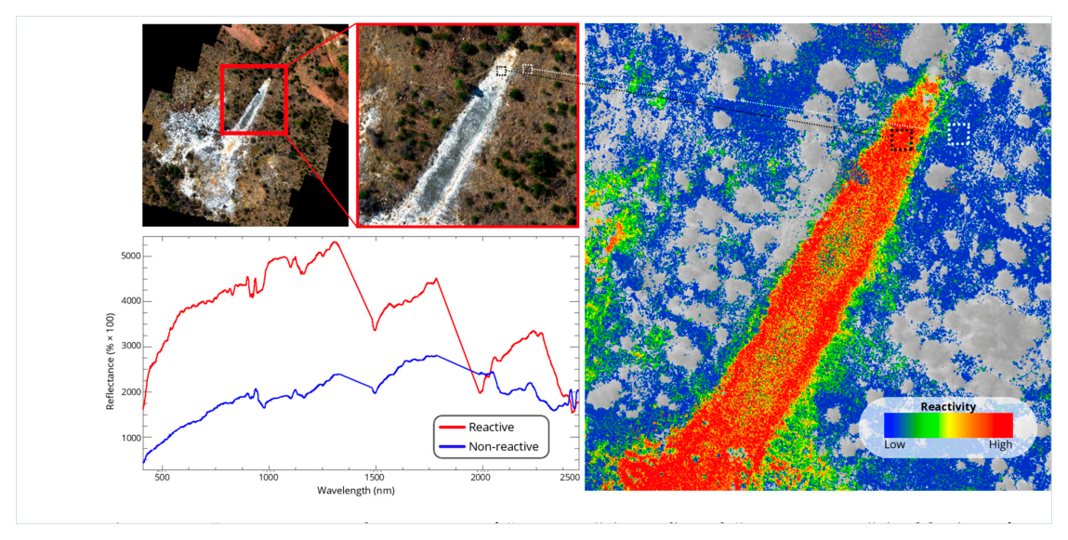
Figures from the Literature · Drone HSI at the Uranium Mine Site
Part 4 · Environmental Monitoring
Figure 3. The hyperspectral UAS: BFD SE-8 octocopter carrying a HySpex Mjolnir VS-620 camera and Velodyne LiDAR on a Gremsy gimbal. (Tolentino et al., 2025)
Figure 11. Distinct spectral responses of reactive (red) and non-reactive (blue) surfaces captured by the “Reactivity” band ratio over a section of Site 2, with the resulting classification map. (Tolentino et al., 2025)
48 / 63
Tolentino et al., 2025

Slide 49
Application 3 · Precision Agriculture
Part 4 · Applications & Future Trends
Challenge: Crop–Weed Differentiation in High-Density Fields
In organic farming, crop and weed foliage intertwine, defeating conventional classifiers — especially in celery. Innovation: Crop Signalling — pre-transplantation treatment of celery seedlings with Rhodamine B (Rh-B), a fluorescent compound producing machine-readable signals. Imaging: photometric monochrome camera + green LEDs (523 nm) + bandpass filter (575/25 nm); conveyor speed 2.4 km/h mimics tractor field speed.
100%
99.66%
30 ms
Crop–Weed Accuracy
Stem Location Precision
Processing Time / Frame
No false positives across 313 images
Avg. error 3.58 mm
Enables real-time robotic weeding
“…achieving a 100% accuracy rate in detecting and distinguishing crop plants from weeds in densely populated fields, with no instances of false positives.”
— Raja et al., 2025
49 / 63
Raja et al., 2025

Slide 50
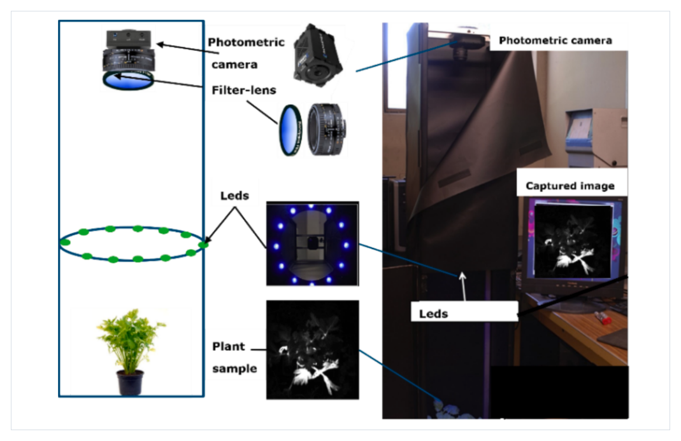
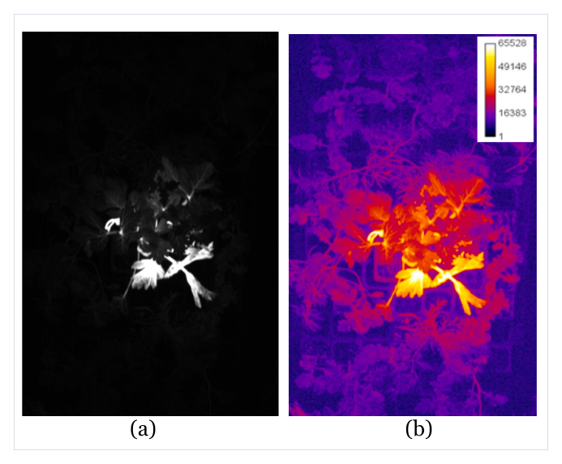
Figures from the Literature · Rh-B Fluorescence Imaging in the Field
Part 4 · Precision Agriculture
Fig. 1. Fluorescence macroscopic imaging system: photometric camera, bandpass filter-lens, 12 green LEDs (523 nm) and the treated plant sample, with a captured Rh-B fluorescence image. (Raja et al., 2025)
Fig. 7. (a) Monochrome image under green-light illumination and (b) false-colour analysis highlighting celery crop among randomly placed weeds. (Raja et al., 2025)
50 / 63
Raja et al., 2025

Slide 51
Application 4 · Biomedical Imaging
Part 4 · Applications & Future Trends
Why Spectral Imaging in Biomedicine?
Reveals physiological processes beyond RGB: metabolic processes, retinal oxygen saturation, tumours (skin / tongue / mucosa), and ischaemia (intestine & brain). Non-ionising, minimally invasive (VIS-NIR, 400–1500 nm).
Compact / Ultracompact Definition
Compact: ≤ 5 kg (no external lens / cables) · Ultracompact: < 500 g
Skin Cancer Diagnosis
Wound & Burn Healing
Retinal Diseases
100% sensitivity, 85% specificity (10 bands, 63 melanoma + 183 nevi images)
Hemoglobin concentration & oxygenation monitored over 2 weeks
Oxygen-saturation repeatability SD = 1.4% (fundus + compact SRDA/FPI)
Tran & Fei, 2023, pp.2, 28–34
51 / 63
Tran & Fei, 2023

Slide 52
Application 4 · Biomedical Imaging (cont.)
Part 4 · Applications & Future Trends
Surgical Guidance
Tumour Diagnosis
Laparoscopic HSI system
Simultaneous high-resolution video + hyperspectral imaging.
SNR 30–43 dB · acquisition as low as 4.6 s — overcomes motion artefacts of conventional pushbroom systems.
Intraoperative HSI (iHSI): wide-field, real-time, seamlessly integrated with surgical workflow.
Colorectal, head & neck, breast cancers
Normal mucosa vs. adenocarcinoma differ significantly in absorbance at 525 nm; in-vivo sensitivity up to 75%.
NIR-II (1000–1700 nm) imaging significantly enhances tumour-to-background ratio, enabling deeper tissue localisation — e.g. liver cancer surgery.
“a signal-to-noise ratio of 30–43 dB and acquisition times as low as 4.6 seconds.” — “Their intraoperative application in liver cancer surgeries showed that NIR-II imaging significantly enhanced tumour-to-background ratio…”
— Mukhtar et al., 2025; Tran & Fei, 2023
52 / 63
Tran & Fei, 2023 · Mukhtar et al., 2025

Slide 53
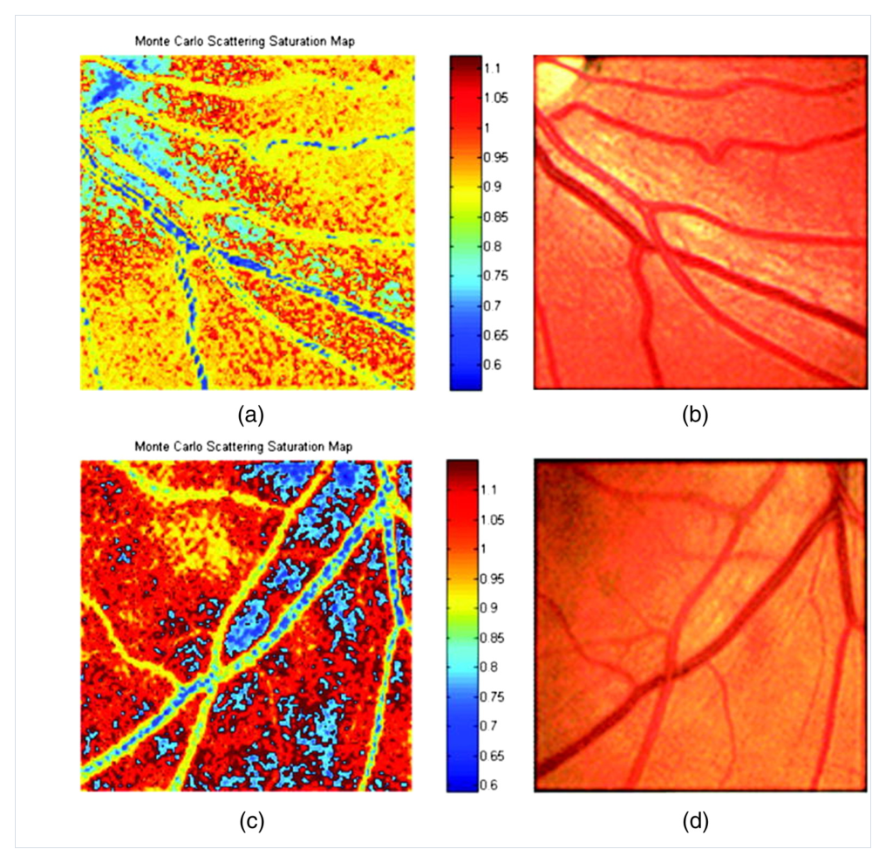
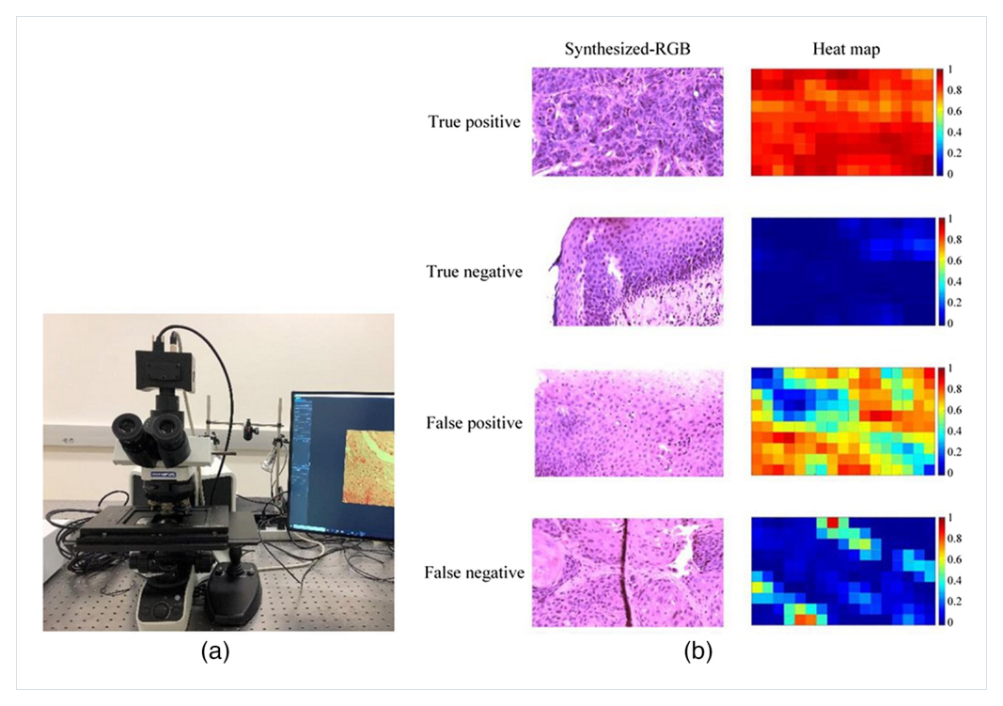
Figures from the Literature · Oxygenation Maps & Cancer Heat Maps
Part 4 · Biomedical Imaging
Fig. 12. (a) Compact hyperspectral Snapscan camera on a microscope; (b) synthesised-RGB pathology images and machine-learning probability heat maps of squamous head-and-neck carcinoma. (Tran & Fei, 2023)
HSI cubes are converted into physiological maps (saturation) and probability maps (cancer / normal tissue).
Fig. 4. Retinal oxygen-saturation maps of a healthy eye (a, c) with the corresponding general retinal images (b, d); vessels are separated from the background. (Lu & Fei, 2014)
53 / 63
Lu & Fei, 2014 · Tran & Fei, 2023

Slide 54
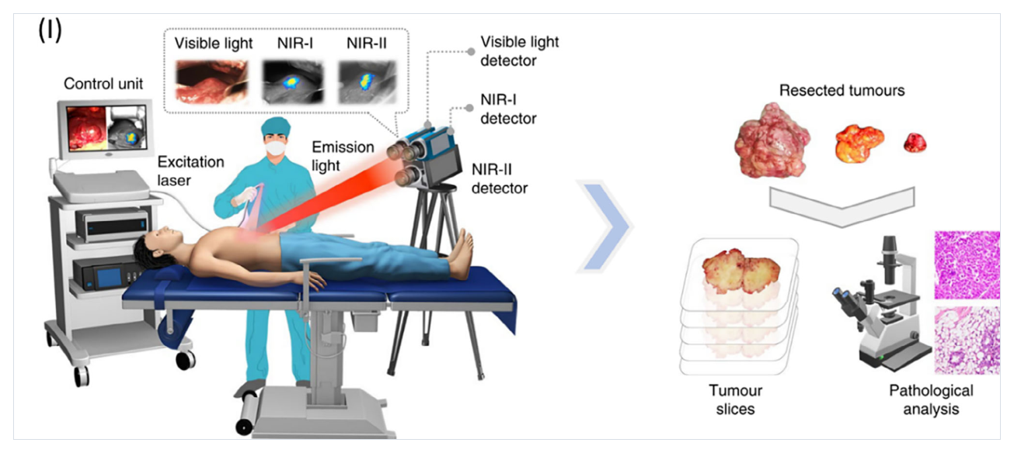
Figures from the Literature · NIR Spectral Imaging in the OR
Part 4 · Biomedical Imaging · Image-Guided Surgery
Figure 3 (I). Liver-surface examination of a liver-cancer patient with an integrated NIR-I/NIR-II and visible spectral instrument, and the resected tumours acquired during the first MS-fluorescence-guided liver-tumour surgery. (Mukhtar et al., 2025)
Excitation laser + visible / NIR-I / NIR-II detectors deliver real-time wide-field guidance; resected slices are validated by pathological analysis.
54 / 63
Mukhtar et al., 2025 (Laser & Photonics Reviews)

Slide 55
Application 5 · Industrial Sorting
Part 4 · Applications & Future Trends
Problem: Separating Gluten Contaminants from Legumes
Coeliac disease drives demand for gluten-free food. Must fully remove wheat / barley / oat from faba beans, chickpeas, and lentils — mechanical separation fails due to uneven shape & colour.
Why HSI in the Food Industry?
Speed, objectivity, low cost, and non-destructive — enables analysis of the entire production batch.
Lab HSI System & Classifier
• VIS/NIR: 400–1000 nm · SWIR: 1000–1700 nm (InGaAs)
• FS-MRMR feature selection + SVM-linear classifier
• 100% Correct Classification Rate (CCR) across all 6 datasets
Industrial Sorter Validation
• 2× NIR cameras (15,000 Hz, 0.06 mm) + 2× RGB (16 M colours)
• Free-fall detection + compressed-air ejection of contaminants
FPR = 0%
TPR > 99%
FNR 0.33–0.64%
False Positive Rate
True Positive Rate
False Negative Rate
No contaminants pass to product
Legumes correctly identified
Minimal product waste only
55 / 63
Romaniello et al., 2024

Slide 56
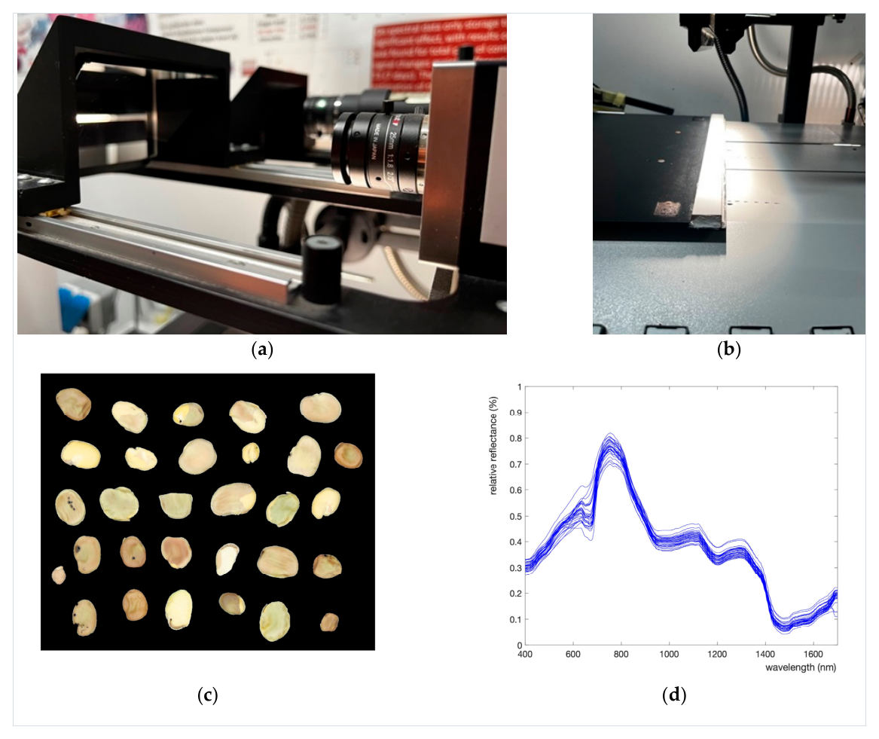
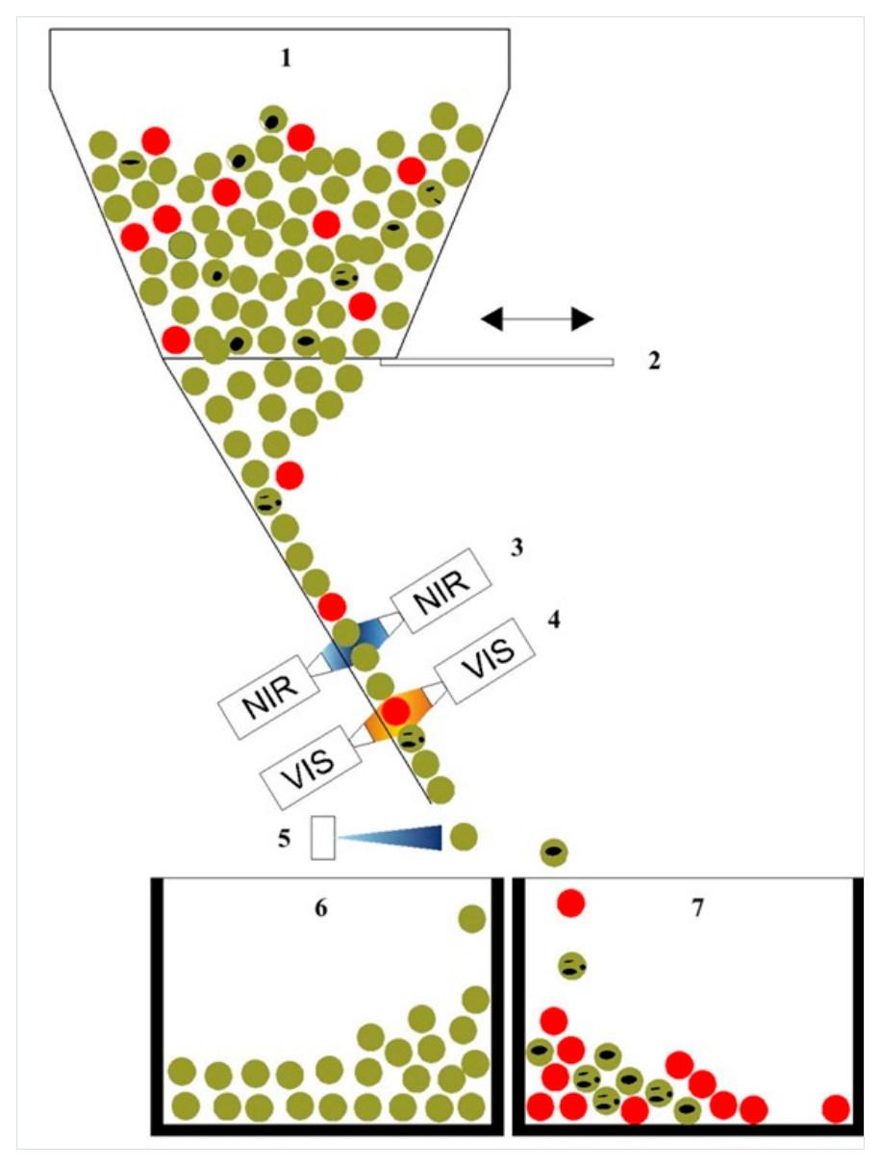
Figures from the Literature · From Lab HSI to the Optical Sorter
Part 4 · Industrial Sorting
Figure 2. Pushbroom hyperspectral imaging system: (a) the VIS/NIR and SWIR sensors with 45° mirrors, (b) fibre optics and light collimators, (c) pseudo-image of the VIS/NIR camera, (d) reflectance spectra of the segmented legumes. (Romaniello et al., 2024)
Figure 4. The five-channel industrial hyperspectral sorter: products fall from the hopper past VIS and NIR classification stations, which trigger compressed-air ejection into separate final boxes. (Romaniello et al., 2024)
56 / 63
Romaniello et al., 2024

Slide 57
Future Trend 1 · Miniaturization
Part 4 · Future Trends
DIY
Freeform Optics
COTS camera + off-the-shelf optics + 3D printing
Dispersion + aberration + focusing in one non-axisymmetric surface
✓ Low-cost, customisable
✓ Wide FOV, high fidelity, meets CubeSat / UAV limits
✗ Large mechanical tolerance, tedious calibration
✗ High manufacturing cost, long lead time
Filter-on-Chip
Metasurface
Fabry-Pérot / photonic-crystal filters monolithically on CMOS
Subwavelength meta-atoms for spectral / polarisation / computational control
✓ No moving parts, true snapshot, high SWaP efficiency
✓ Ultrathin, multifunctional, video-rate HSI
✗ Difficult large-area nanofabrication
✗ nm-precision fabrication across cm apertures
From 48 kg (1972 MSS) to < 30 g snapshot cameras — progress driven by manufacturing maturity, not new optical architectures.
57 / 63
Mukhtar et al., 2025

Slide 58
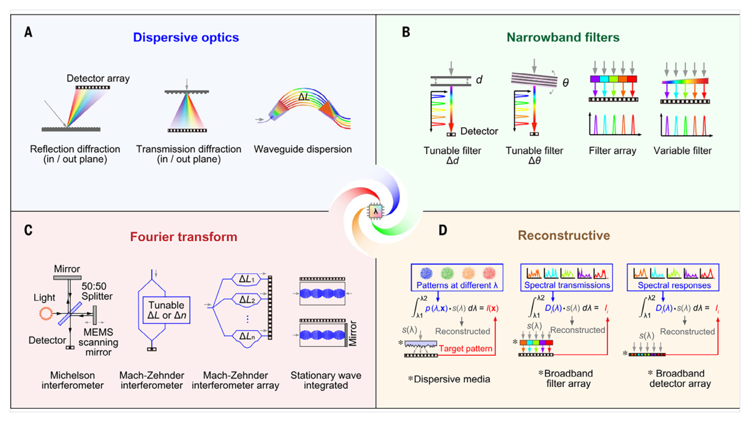
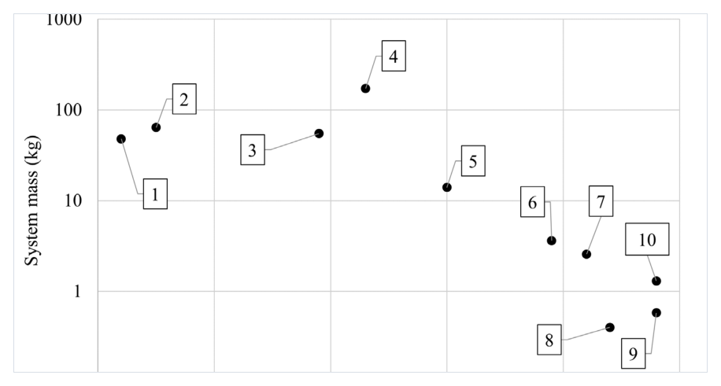
Figures from the Literature · Spectrometer Paradigms & 50 Years of Shrinking
Part 4 · Future Trend · Miniaturization
Fig. 1. System mass vs. year of spectral imagers, from MSS-1 (1972) to Specim IQ (2018). (Tran & Fei, 2023)
The shrinking trend
After 2000, manufacturing advances made systems dramatically smaller — down to < 30 g snapshot cameras.
Figure 15. Three decades of compact / miniaturized spectrometers: (A) dispersive optics, (B) narrowband filters, (C) Fourier-transform interferometers and (D) computational spectral reconstruction. (Mukhtar et al., 2025)
58 / 63
Mukhtar et al., 2025 · Tran & Fei, 2023

Slide 59
Future Trend 2 · Real-time Processing & AI
Part 4 · Future Trends
Industrial Sorting
Precision Weeding
Surgical Guidance
NIR cameras at 15,000 Hz · free-fall detection
30 ms per frame · real-time robotic control
Acquisition as low as 4.6 s · SNR 30–43 dB
Romaniello et al.
Raja et al.
Mukhtar et al.
AI & Computational Imaging Integration
Computational Spectral Reconstruction
Compressed sensing & deep-learning demultiplexing reduce hardware burden without losing spectral resolution.
Edge Intelligence
ML models embedded directly in handheld / UAV devices for on-site, real-time analysis (e.g. plant health, pollutant detection).
Algorithm–Hardware Co-Design
Physics-aware neural networks on ASICs → sub-Watt on-device spectral analytics for autonomous drones and handheld diagnostics.
59 / 63
Mukhtar et al., 2025

Slide 60
Future Trend 3 · Other Key Directions
Part 4 · Future Trends
Tunable Metasurfaces
Expanded Spectral Coverage
Reconfigurable spectral response in real time based on task requirements, with minimal size / power increase.
Extend from VIS-NIR to ultraviolet and mid-infrared — unlocks astronomy, chemical sensing, security.
Low-Cost & Open-Source
Multimodal Fusion
COTS components, 3D printing, open hardware / software; smartphones as camera + control + IoT node.
Combine with OCT (depth), LSCI (vasculature), Raman (chemistry), photoacoustic (up to 5 cm penetration).
IoT & Edge Networks
Scalable Manufacturing
UAV swarms / field sensors process data locally, transmit only key insights for scalable environmental monitoring.
Roll-to-roll nanoimprint, high-throughput DUV lithography, open calibration protocols → mass-market products.
Mukhtar et al., 2025, pp.51–52 · Tran & Fei, 2023, pp.35–38
60 / 63
Mukhtar et al., 2025 · Tran & Fei, 2023

Slide 61
Summary · Key Takeaways
Part 4 · Applications & Future Trends
Applications & Key Results
Future Trends
• Remote Sensing
• Miniaturization
Anomaly detection, target recognition, background characterization
DIY / Freeform Optics / Filter-on-Chip / Metasurface — snapshot cameras (< 30 g) & on-chip integration
• Environmental Monitoring
Drone HSI maps uranium-mine contamination at cm-scale
• Real-time Processing + AI
• Precision Agriculture
Edge intelligence & algorithm–hardware co-design — sub-Watt on-device spectral analytics
100% accuracy, 30 ms/frame with Rh-B crop signalling
• Biomedical Imaging
• Other Directions
100% skin-cancer sensitivity; surgery at 4.6 s
Tunable metasurfaces, UV/MIR expansion, low-cost, multimodal fusion, IoT networks, scalable manufacturing
• Industrial Sorting
0% FPR, >99% TPR for gluten-free legume sorting
All papers: 2003–2025
61 / 63
All 6 papers · 2003–2025

Slide 62
References
Bibliography · 13 sources across four parts
Part 1 · Fundamentals of Spectroscopy
Part 4 · Applications & Future Trends
[1]
Garini, Y.; Young, I.T.; McNamara, G. Spectral imaging: principles and applications. Cytometry Part A, 2006, 69(8): 735–747.
[8]
Shaw, G.A.; Burke, H.K. Spectral Imaging for Remote Sensing. Lincoln Laboratory Journal, 2003, 14(1).
[2]
Prasad, R.D.; Sarvalkar, P.D.; Prasad, N.; et al. A review on spectroscopic techniques for analysis of nanomaterials and biomaterials. ES Energy and Environment, 2024, 27: 1264.
[9]
Tolentino, V.; Ortega Lucero, A.; Koerting, F.; Savinova, E.; Hildebrand, J.C.; Micklethwaite, S. Drone-Based VNIR–SWIR Hyperspectral Imaging for Environmental Monitoring of a Uranium Legacy Mine Site. Drones, 2025, 9: 313.
Part 2 · Principles of Spectral Imaging
[3]
Mukhtar, S.; Arbabi, A.; Viegas, J. Advances in Spectral Imaging: A Review of Techniques and Technologies. IEEE Access, 2025, 13: 35848–35902. DOI: 10.1109/ACCESS.2025.3544476
[10]
Raja, R.; Su, W.-H.; Slaughter, D.C.; Fennimore, S.A. Real-time precision crop identification in high weed-density environments for robotic weed control using spectral fluorescence imaging in celery. Computers and Electronics in Agriculture, 2025, 231: 110022.
[4]
Lu, G.; Fei, B. Medical hyperspectral imaging: a review. Journal of Biomedical Optics, 2014, 19(1): 010901. DOI: 10.1117/1.JBO.19.1.010901
[11]
Tran, M.H.; Fei, B. Compact and ultracompact spectral imagers: technology and applications in biomedical imaging. Journal of Biomedical Optics, 2023, 28(4): 040901.
Part 3 · Data Processing & Analysis
[5]
Roussel, G.; Weber, C.; Briottet, X.; Ceamanos, X. Comparison of two atmospheric correction methods for the classification of spaceborne urban hyperspectral data depending on the spatial resolution. International Journal of Remote Sensing, 2017, 39(5): 1593–1614. DOI: 10.1080/01431161.2017.1410247
[12]
Romaniello, R.; Barrasso, A.E.; Perone, C.; Tamborrino, A.; Berardi, A.; Leone, A. Optimisation of an Industrial Optical Sorter of Legumes for Gluten-Free Production Using Hyperspectral Imaging Techniques. Foods, 2024, 13: 404.
[6]
Gautam, R.; Vanga, S.; Ariese, F.; Umapathy, S. Review of multidimensional data processing approaches for Raman and infrared spectroscopy. EPJ Techniques and Instrumentation, 2015, 2: 8. DOI: 10.1140/epjti/s40485-015-0018-6
[13]
Mukhtar, S.; Arbabi, A.; Viegas, J. Compact Spectral Imaging: A Review of Miniaturized and Integrated Systems. Laser & Photonics Reviews, 2025, 19: e01042.
[7]
Yamamoto, S.; Tsuchida, S.; Urai, M.; Mizuochi, H.; Iwao, K.; Iwasaki, A. Initial Analysis of Spectral Smile Calibration of HISUI Using Atmospheric Absorption Bands. IEEE Transactions on Geoscience and Remote Sensing, 2022, 60: 5534215. DOI: 10.1109/TGRS.2022.3190486
Total: 13 references · Part 1 (2) + Part 2 (2) + Part 3 (3) + Part 4 (6)
62 / 63

Slide 63
Thank You
Questions & Discussion
Spectroscopy and Spectral Imaging
Fundamentals · Principles · Data Processing · Applications & Trends
63 / 63

