Slide 1
Android Application Development Final-term Project：TIME TOOL
資工二
107590046 彭建豪
107590060 李永德

Slide 2
Contents
Introduction
App GUI
Android system components used
Interface display
Classes and Resources
Demo

Slide 3
Introduction
People's lives are closely related to time. Time tools can improve people's quality of life, work efficiency and help people manage their time well.

Slide 4
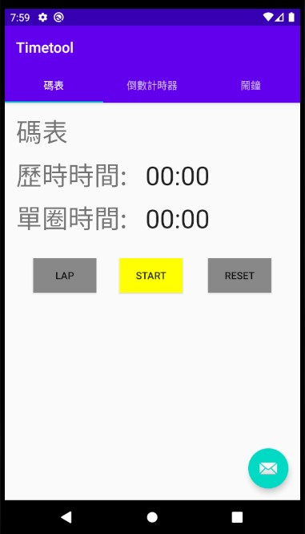
App GUI(碼錶畫面)
碼錶介面
時間顯示 chronometer
時間顯示 chronometer
單圈按鈕
重置按鈕，歸零清空
開始按鈕
單圈最短和歷時最短時間資訊顯示

Slide 5
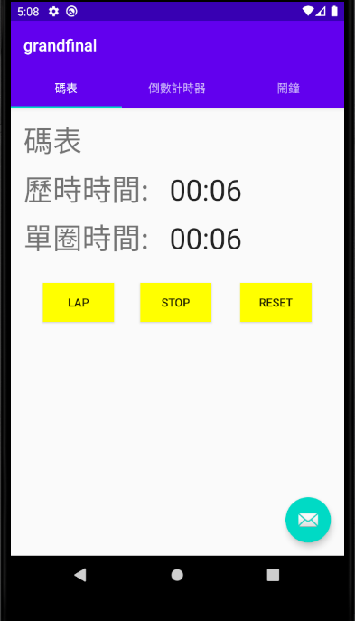
開始計時畫面(碼表)
時間開始變化
單圈按鈕變為可點擊
重置按鈕變為可點擊
文字變為STOP

Slide 6
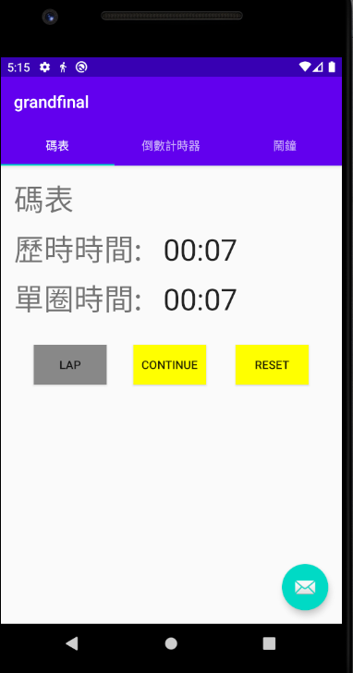
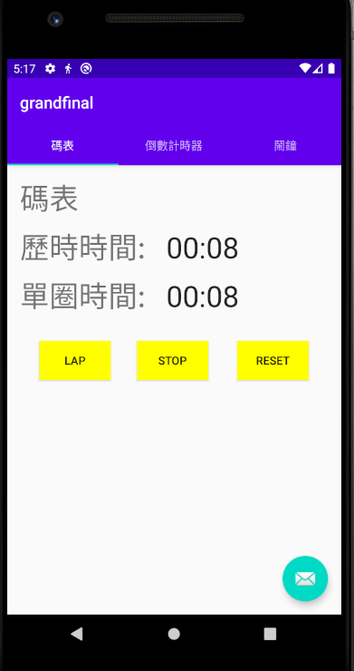
暫停畫面(碼表)
按下繼續按鈕
單圈按鈕變為不可點擊
文字變為
CONTINUE

Slide 7
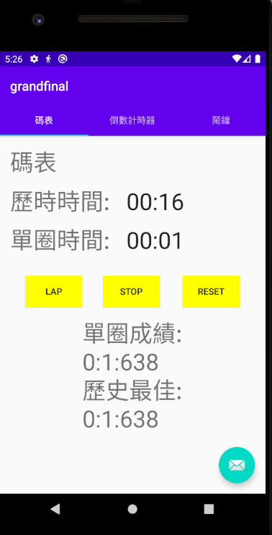
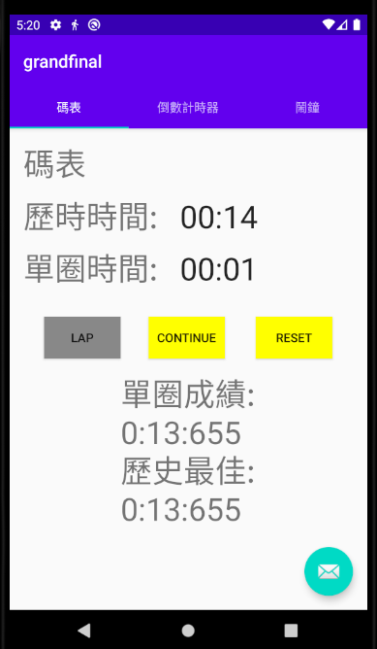
LAP點擊畫面(碼表)
單圈時間重新計時
於單圈計時一秒按下LAP
按下LAP，更新下方資訊
歷史最佳刷新

Slide 8
Reset點擊畫面(碼表)

Slide 9
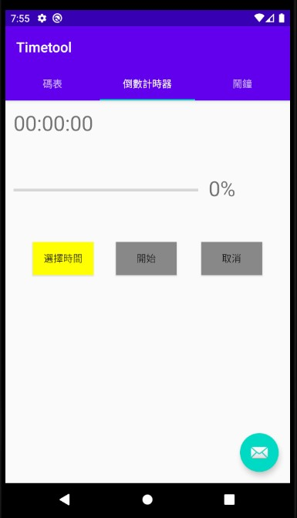
App GUI(倒數計時器)
倒數計時器界面
已選擇的時間顯示處
ProgressBar and progresstv
選擇時間按鈕
取消按鈕
開始按鈕

Slide 10
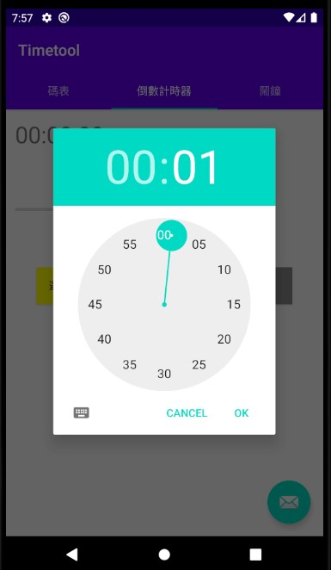
選擇時間畫面(倒數計時器)
Time Picker

Slide 11
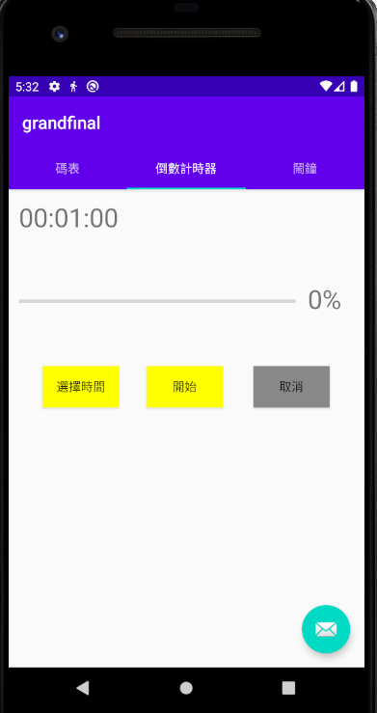
選擇時間畫面(倒數計時器)
Textview刷新
開始按鈕變為可點擊

Slide 12
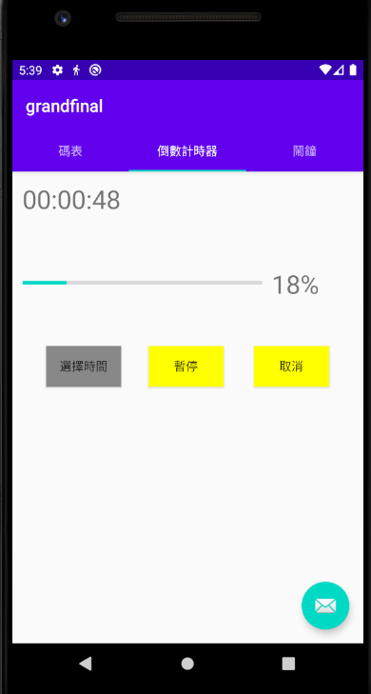
倒數計時畫面(倒數計時器)
Textview刷新
ProgressBar進度條顯示
計時中無法選擇時間
中間按鈕文字變為暫停
取消變為可點擊

Slide 13
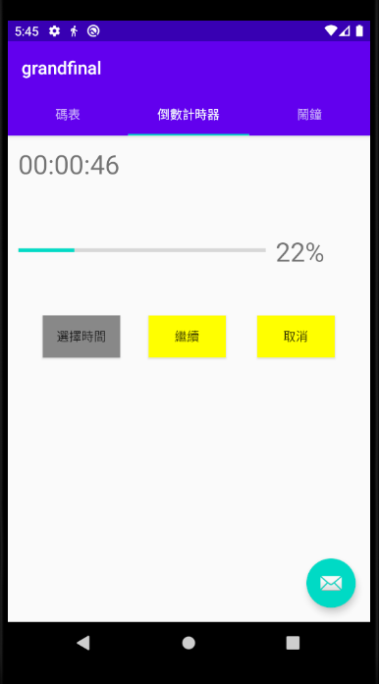
倒數計時暫停畫面(倒數計時器)
點擊繼續即可繼續倒數

Slide 14
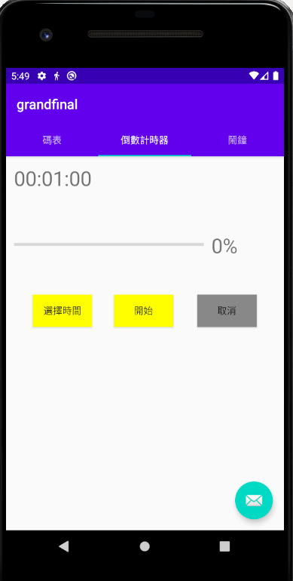
倒數計時取消畫面(倒數計時器)
重置為上次設定時間

Slide 15
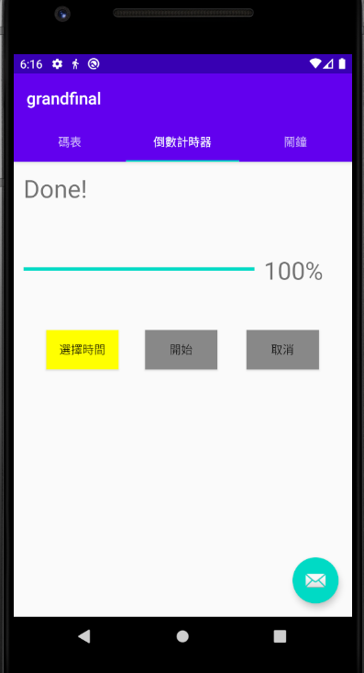
倒數計時完畢畫面(倒數計時器)

Slide 16
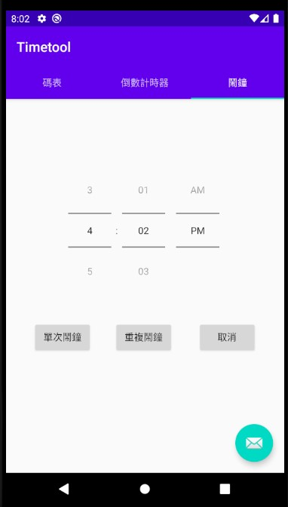
App GUI（鬧鐘畫面）
鬧鐘界面
Time Picker
單次鬧鐘按鈕
取消按鈕
重複鬧鐘按鈕

Slide 17
Interface display

Slide 18
Android system components used
Activity
Fragments
Picker of Time
Simple Async Task
Notification
Alarm Manager
broadcast receiver
Tab

Slide 19
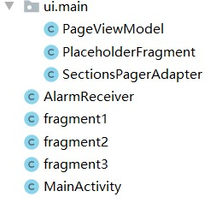
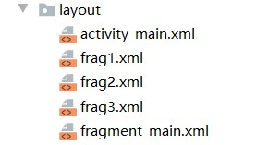
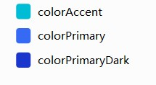
Classes and Resources
The project was mainly developed independently. Before starting this project, we had to find information and resources on the Internet about the content of the project.
We first developed the three major functions of the entire project separately. Finally, we integrated all the functions in the new project.

Slide 20
Demo

Slide 21
Thanks!

