Slide 1
Blood Bank Management System
Group 1 Members:
JinWoo Han,
Zeyu Lei,
Haonan Peng,
Yuqi Zheng

Slide 2
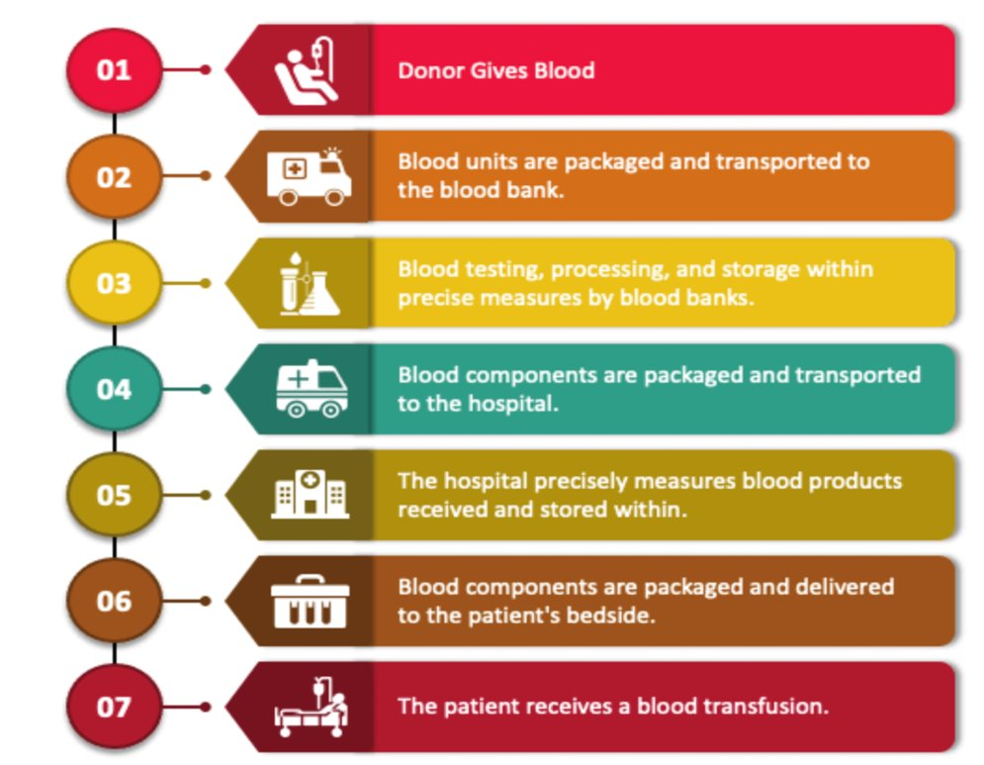
Objectives

Slide 3
Mission Statement
Optimize blood product management by improving surplus allocation, demand prediction, and donation site relocation. Enhance donor and patient data analysis, blood product processing, and understanding of local activities and feedback to increase blood donation and effectively meet regional demand.​

Slide 4
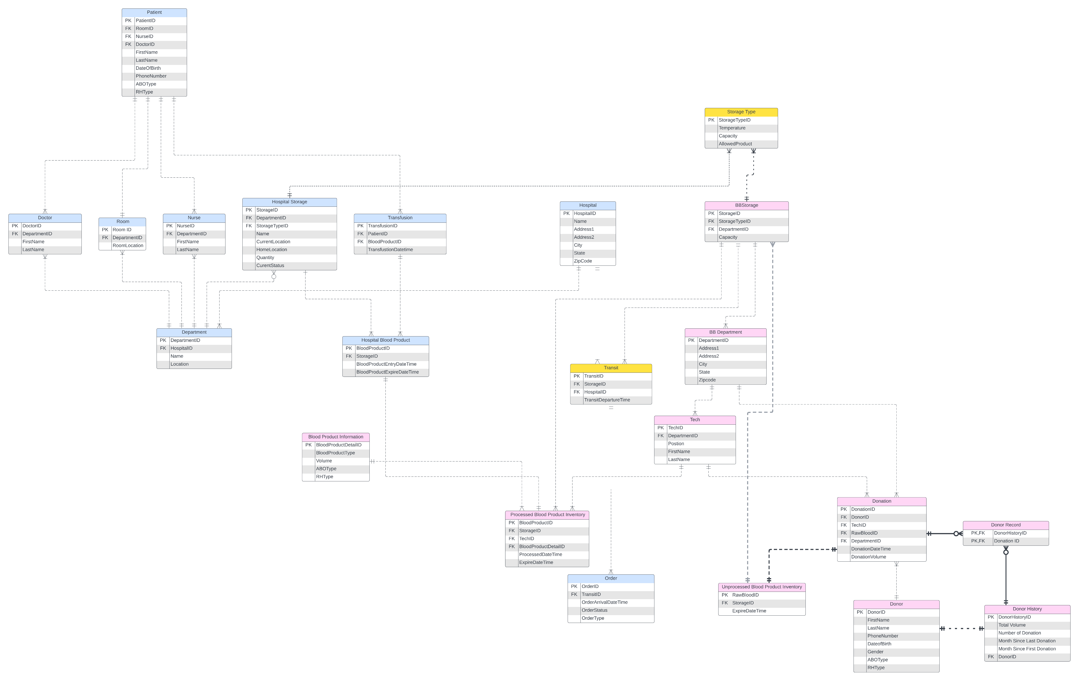
E-R Diagram

Slide 5
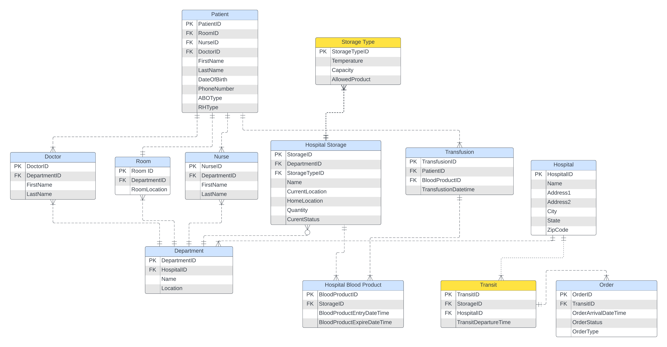
ER-Diagram: Hospital

Slide 6
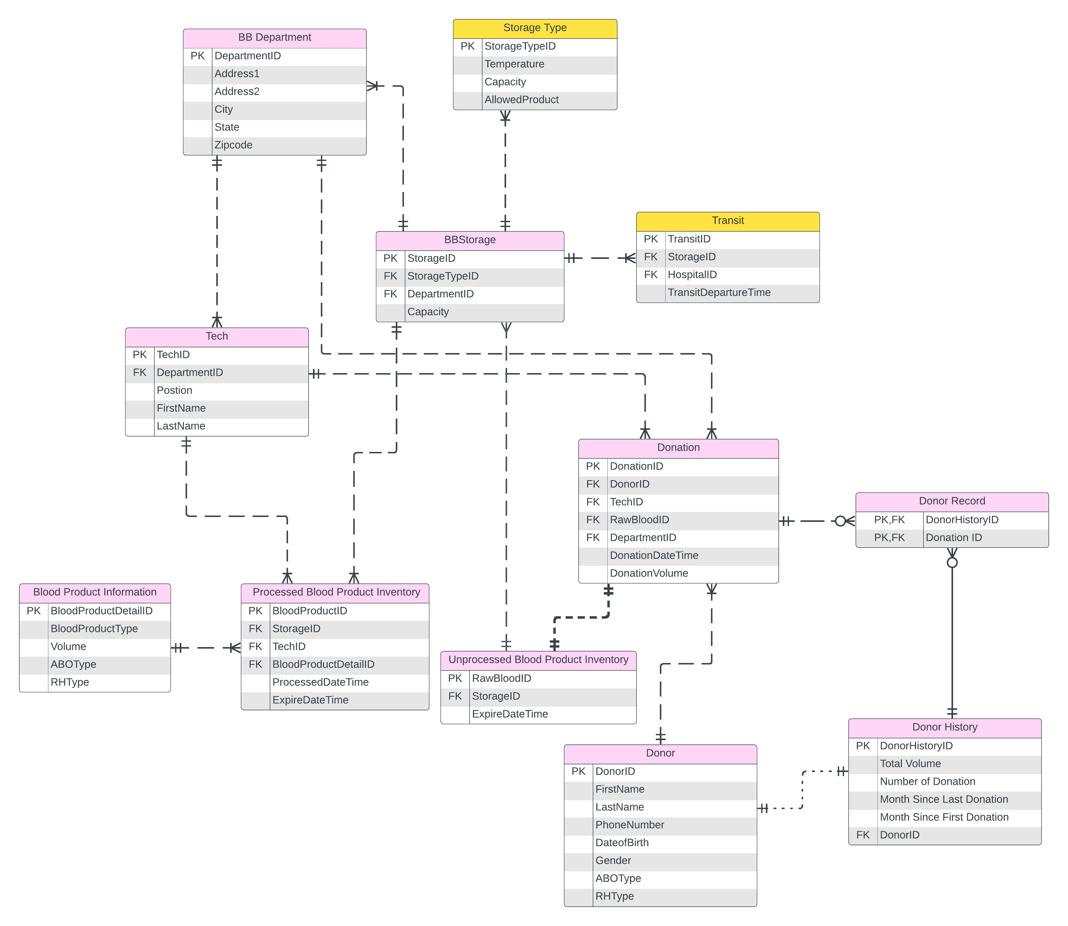
ER-Diagram: Donor

Slide 7
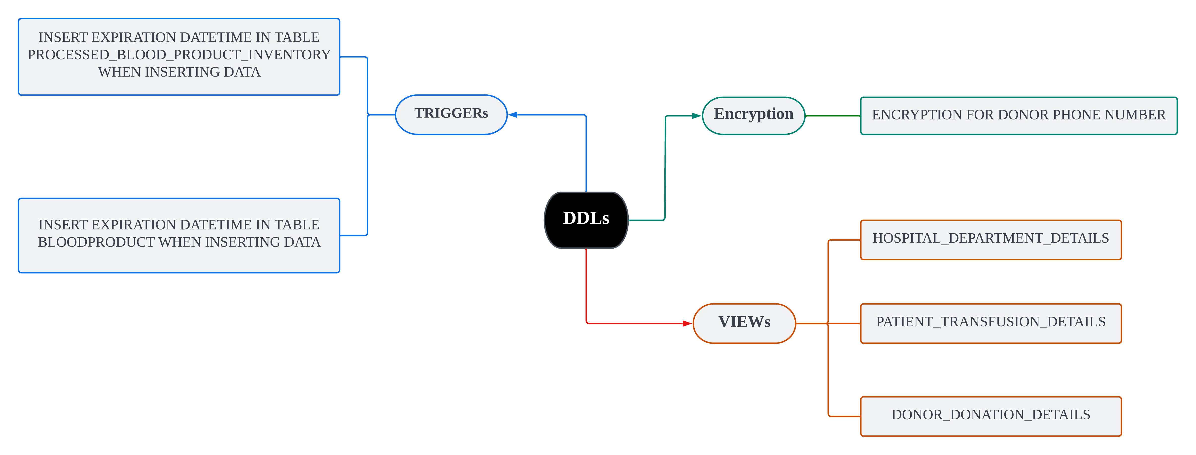
Database Objectives

Slide 8
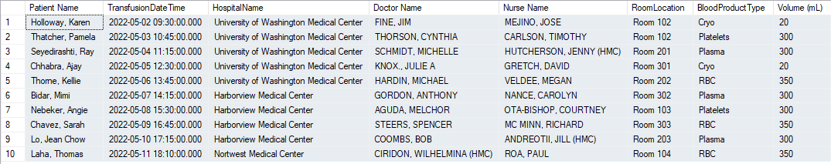
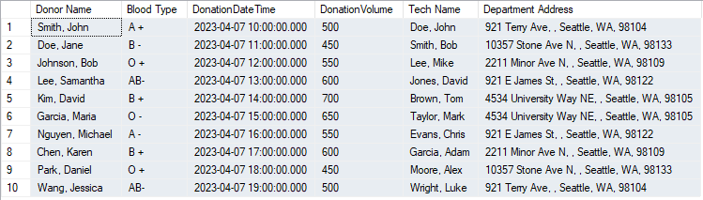
Views of Database
Table 1: View of Blood Transfusion
Table 2: View of Blood Donation

Slide 9
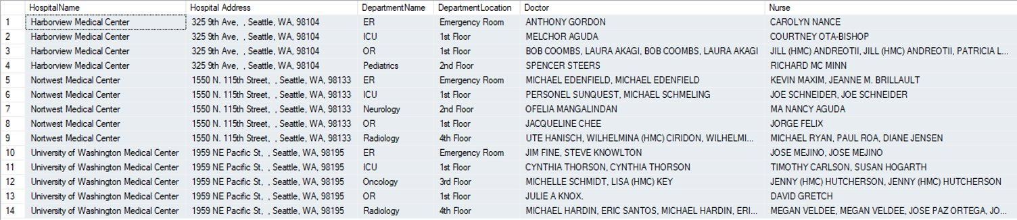
Views of Database
Table 3: View of Hospital Details

Slide 10
Visualization

Slide 11
Thank you!

