Slide 1
ECE158A: Computer Networks
Tara Javidi
TTH 5:00-6:30pm Center Hall 222
Topic 2
Layered Architecture
&
Protocol Stack

Slide 2
I am grateful to many authors/instructors around the country who have shared their educational material on this topic freely available online to everyone including me and my students. In particular, the content of these slides is heavily adapted from the educational resources that are made available by Pearsons authors:
Kuros & Ross and Tannenbaum & Weatherall (if you sign in you can see the slides and a whole lot more) in conjunction with the course material of Professor Jennifer Rexford at Princeton. Note that as such the content of these slides is subject to the copyright of the above authors and instructors.

Slide 3
















What is the Internet?
Internet: “network of networks”
Interconnected ISPs
Programmable: allows for nodes dynamically joining and departing
protocols control sending, receiving of messages
e.g., TCP, IP, HTTP, Skype, 802.11
Internet standards
RFC: Request for comments
IETF: Internet Engineering Task Force
mobile network
global ISP
home
network
regional ISP
institutional
network

Slide 4
Architecture Driven by Scale
Networks can be classified by their scale:
Scale | Type
Vicinity | PAN (Personal Area Network) »
Building | LAN (Local Area Network) »
City | MAN (Metropolitan Area Network) »
Country | WAN (Wide Area Network) »
Planet | The Internet (network of all networks)
Notes:
An “internetwork” is any larger network made up of smaller component networks. The “Internet” (with a capital I) is the set of all connected networks.

Slide 5
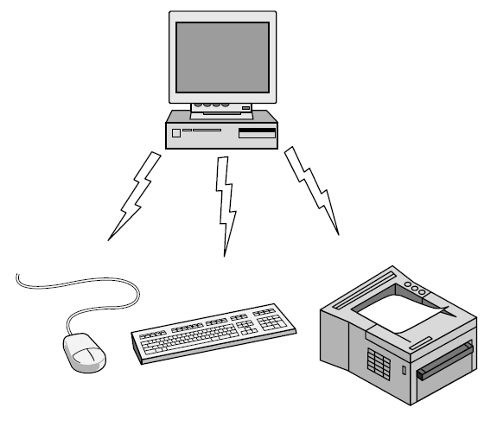
Personal Area Network
Connect devices over the range of a person
Example of a Bluetooth (wireless) PAN:

Slide 6
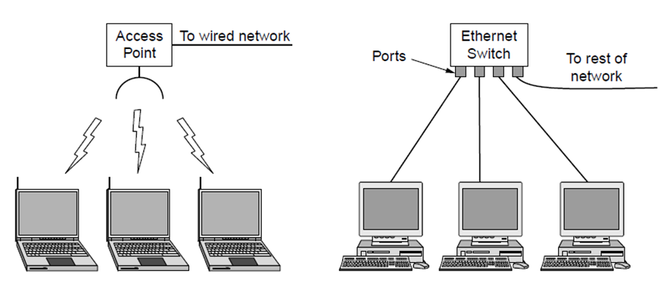
Local Area Networks
Connect devices in a home or office building
Called enterprise network in a company
Wireless LAN
with 802.11
Wired LAN with
switched Ethernet

Slide 7
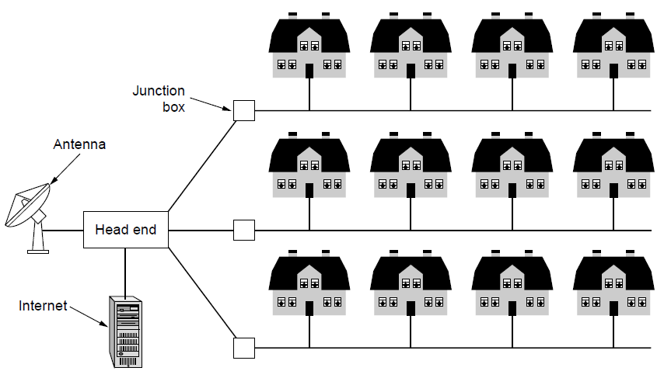
Metropolitan Area Networks
Connect devices over a metropolitan area
Example MAN based on cable TV:
Notes:
This is a common way in which home subscribers obtain access to the Internet in the US.

Slide 8
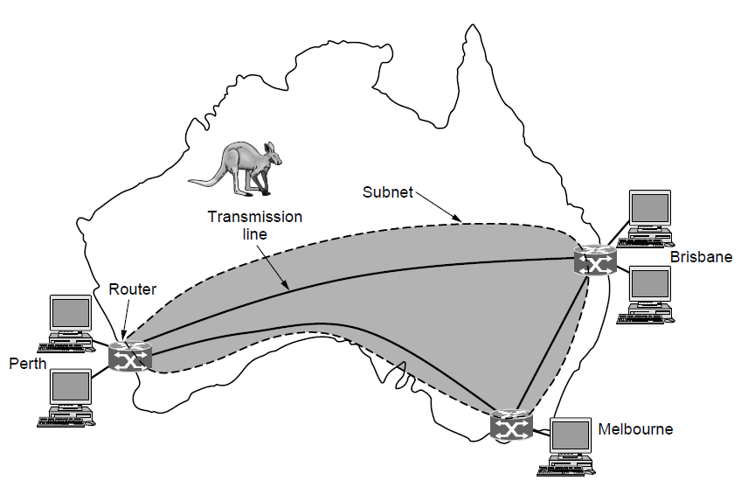
Wide Area Networks (1)
Connect devices over a country
Example WAN connecting three branch offices:
Notes:
The company probably leases the transmission lines (since most companies do not have their own lines).

Slide 9
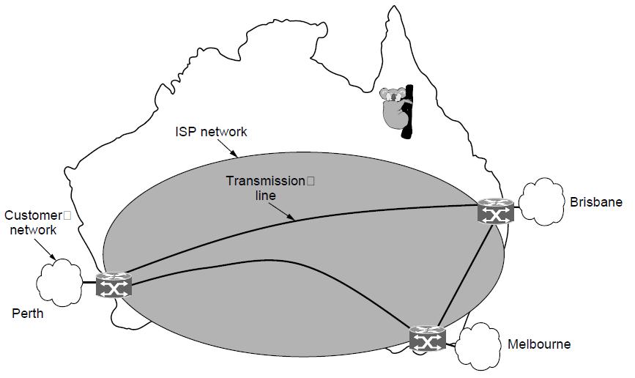
Wide Area Networks (2)
An ISP (Internet Service Provider) can be a WAN.
Customers buy connectivity from the ISP
Notes:
Now the company/customer buys service from an ISP who uses its own lines to deliver packets.

Slide 10
Architecture Driven by Scale
network edge:
hosts: clients and servers
servers often in data centers
mobile network (MAN)
global ISP
home
network
(LAN)
access networks, physical media: wired, wireless communication links
regional ISP
network core:
interconnected routers
network of networks
Institutional
network
(LANs)

Slide 11
Network Architcture
Last lecture we saw the division of labor among the application layer, operating system, and network layer allows for innovation in developing apps
We also saw the relationship between socket programming, network access (ports), networking APIs
Historically the development of sockets and the packetization give rise to an architecture

Slide 12
Giving rise to an architecture…
Process
A
Process
B
port X
port Y
Port Number
TCP/UDP
Required Service
IP
Host Address
Network Interface

Slide 13

Socket and Process Communication
application layer
application layer
User Process
Internet
User Process
Socket
Socket
OS network
stack
OS network
stack
transport layer (TCP/UDP)
transport layer (TCP/UDP)
Internet
network layer (IP)
network layer (IP)
link layer (e.g. ethernet)
Internet
link layer (e.g. ethernet)
The interface that the OS provides to its networking subsystem naturally creates an architecture

Slide 14
The Internet Protocol Stack?
Internet Architecture

Slide 15
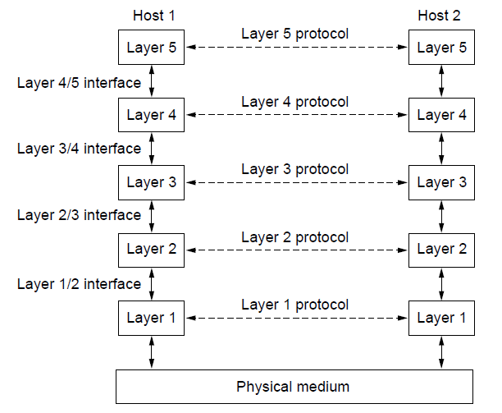
Protocol Layers as an Architecture
Protocol layering is the main structuring method used to divide up network functionality.
Each protocol instance talks virtually to its peer
Each layer communicates only by using the one below
Lower layer services are accessed by an interface
At bottom, messages are carried by the medium
Application
Application
Transport
Transport
Network
Network
Network
Datalink
Datalink
Datalink
Physical
Physical
Physical
Host A
Router
Host B

Slide 16
The Physical Layer
Foundation on which other layers build
Properties of wires, fiber, wireless limit what the network can do
Key problem is to send (digital) bits using only (analog) signals
Done through line coding, pulse shaping, and modulation
Application
Transport
Network
Link
Physical

Slide 17
PHY Layer Functionalities/Header
PHY layer functionalities (services) depend strongly on transmission technology
Synchronization per frame (preamble)
Bit-by-bit or symbol-by-symbol delivery over a standardized interface
Modulation and Line Coding: representing the digital signal by a waveform optimally tuned to the technology
Equalization, pulse shaping, forward error correction
Main task:
Transmitter a packet (binary sequence) into a waveform over the medium
Receiver reconstructs the transmitted packet

Slide 18
Theoretical Basis for Point-Point Data Communication
Fundamental limits on the rate of reliable communication
Nyquist Rate »
Bandwidth-limited signals »
Maximum data rate of a channel »
Eg. additive white Guassian noise (AWGN)
Max. data rate = B log₂(1 + S/N) bits/sec

Slide 19
Example PHY technologies
Media have different properties, hence performance
Wires:
Twisted pairs »
Coaxial cable »
Power lines »
Fiber cables »
Wireless
Reality check
Storage media »
Property | Wires | Fiber
Distance | Short (100s of m) | Long (tens of km)
Bandwidth | Moderate | Very High
Cost | Inexpensive | Less cheap
Convenience | Easy to use | Less easy
Security | Easy to tap | Hard to tap

Slide 20
Characteristics of selected wireless links
1300
802.11 ac
450
802.11n
54
802.11a,g
802.11a,g point-to-point
5-11
802.11b
4G: LTWE WIMAX
4
3G: UMTS/WCDMA-HSPDA, CDMA2000-1xEVDO
Data rate (Mbps)
1
802.15
.384
2.5G: UMTS/WCDMA, CDMA2000
.056
2G: IS-95, CDMA, GSM
Indoor
10-30m
Outdoor
50-200m
Mid-range
outdoor
200m – 4 Km
Long-range
outdoor
5Km – 20 Km

Slide 21
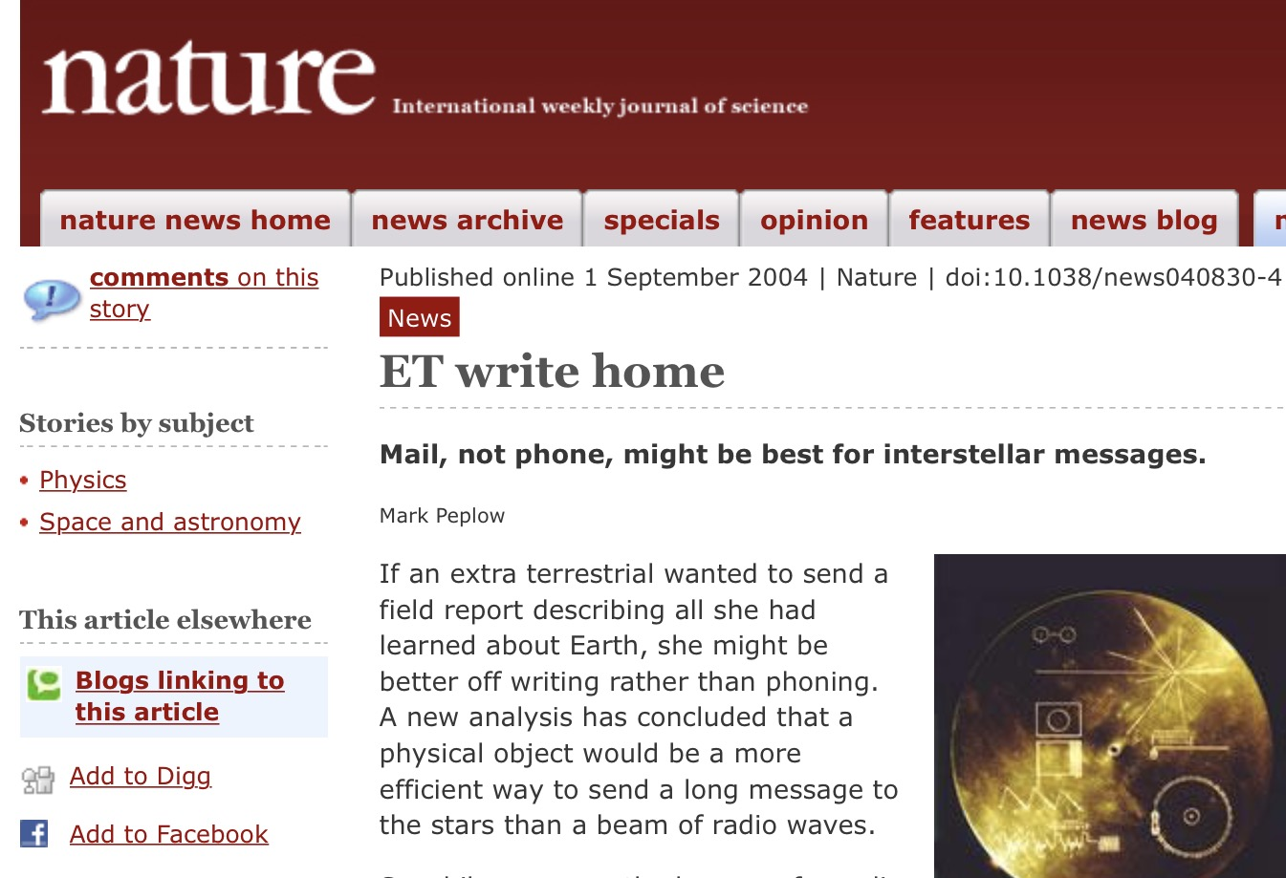

Reality Check: Storage media
Send data on tape / disk / DVD for a high bandwidth link
Mail one box with 1000 800GB tapes (6400 Tbit)
Takes one day to send (86,400 secs)
Data rate is 70 Gbps.
Data rate is faster than long-distance networks!
But, the message delay is very poor

Slide 22
Beyond Maximum Rate
Throughput: File size B transferred over T seconds results in throughput B/T bps
Not the same as link rate
Accounts for protocol issues, etc
Delay: the time interval between arrival and delivery (we will analyze later)
Jitter: Delay rarely the same for every packet of the file but a random variable; Jitter is maximum variation in delay

