Slide 1
ECE158A: Computer Networks
Tara Javidi
Lectures: TTH 5:00-5:30pm Center Hall 222
Topic 3
Link Layer

Slide 2
The Data Link Layer
Responsible for delivering frames of information over a single link
Handles transmission errors and regulates the flow of data (Link Layer)
Handles sharing the local communication link (Medium Access Control)
Application
Transport
Network
Link
Physical

Slide 3

















Link layer: introduction
terminology:
hosts and routers: nodes
communication channels that connect adjacent nodes along communication path: links
wired links
wireless links
LANs
layer-2 packet: frame, encapsulates datagram
data-link layer has responsibility of
transferring datagram from one node
to physically adjacent node over a link

Slide 4
Link layer: context
transportation analogy:
trip from La Jolla to Bristol
limo: La Jolla to SAN
plane: SAN to LHR
train: LHR to Bristol
tourist = datagram
Each transport segment = communication link
travel mode (tickets, check-in, boarding) = link layer protocol
planner/admin = routing algorithm
datagram transferred by different link protocols over different links:
e.g., Ethernet on first link, frame relay on intermediate links, 802.11 on last link
each link protocol provides different services
e.g., may or may not provide reliable over link

Slide 5
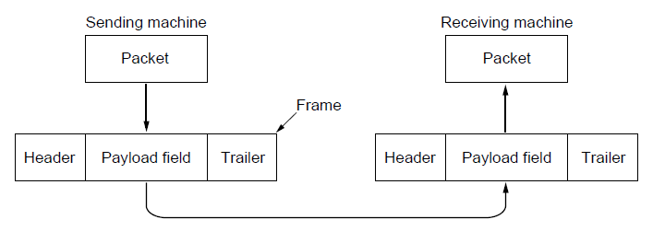
Frames
Link layer accepts packets from the network layer, and encapsulates them into frames that it sends using the physical layer; reception is the opposite process
Network
Link
Virtual data path
Physical
Actual data path

Slide 6
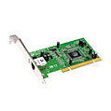
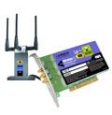

Where is the link layer implemented?
in each and every host
link layer implemented in “adaptor” (aka network interface card NIC) or on a chip
Ethernet card, 802.11 card; Ethernet chipset
implements link, physical layer
attaches into host’s system buses
combination of hardware, software, firmware
application
transport
network
link
cpu
memory
link
physical
host
bus
(e.g., PCI)
controller
physical
transmission
network adapter
card

Slide 7
Adaptors communicating
datagram
datagram
controller
controller
sending host
receiving host
datagram
frame
sending side:
encapsulates datagram in frame
adds error checking bits, rdt, flow control, etc.
receiving side
looks for errors, rdt, flow control, etc.
extracts datagram, passes to upper layer at receiving side

Slide 8
Possible Services
Unacknowledged connectionless service
Frame is sent with no connection / error recovery
Ethernet is example
Acknowledged connectionless service
Frame is sent with retransmissions if needed
Example is 802.11
Acknowledged connection-oriented service
Connection is set up; rare
Half-duplex and full-duplex
Nodes at both ends of link can(not) transmit simultaneously

Slide 9
Link layer services (I)
framing, link access:
encapsulate datagram into frame, adding header, trailer
channel access if shared medium
“MAC” addresses used in frame headers to identify source, destination
different from IP address!
only 6 bytes
reliable delivery between adjacent nodes
seldom needed on low bit-error link (fiber, some twisted pair)
wireless links: high error rates
We will see link-level is in addition to end-end reliability?

Slide 10
Link layer services (II)
flow control:
pacing between adjacent sending and receiving nodes
error detection:
errors caused by signal attenuation, noise.
receiver detects presence of errors:
signals sender for retransmission or drops frame
error correction:
receiver identifies and corrects bit error(s) without resorting to retransmission

Slide 11
Framing Methods
Byte count »
Flag bytes with byte stuffing »
Flag bits with bit stuffing »
Physical layer coding violations
Use non-data symbol to indicate frame

Slide 12
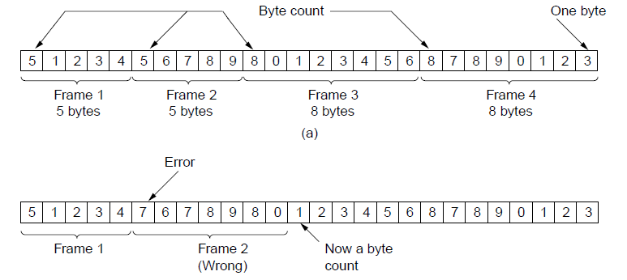
Framing – Byte count
Frame begins with a count of the number of bytes in it
Simple, but difficult to resynchronize after an error
Expected
case
Error
case

Slide 13
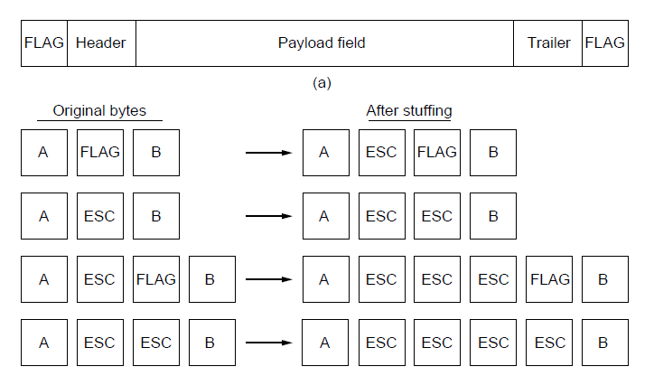
Framing – Byte stuffing
Special flag bytes delimit frames; occurrences of flags in the data must be stuffed (escaped)
Longer, but easy to resynchronize after error
Frame
format
Need to escape extra ESCAPE bytes too!
Stuffing
examples

Slide 14
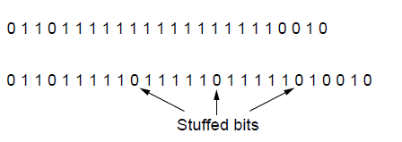
Framing – Bit stuffing
Stuffing done at the bit level:
Frame flag has six consecutive 1s (not shown)
On transmit, after five 1s in the data, a 0 is added
On receive, a 0 after five 1s is deleted
Data bits
Transmitted bits
with stuffing

Slide 15
Flow Control
Prevents a fast sender from out-pacing a slow receiver
Receiver gives feedback on the data it can accept
Rate in the Link layer as NICs run at “wire speed”
Receiver can take data as fast as it can be sent
Flow control is a service provided by the Link and Transport layers
Notes:
We’ll get to this later in the chapter (sliding window protocol) but note that flow control is mostly the responsibility of the Transport layer in practice (e.g., TCP)

Slide 16
Line Cards (Interface Cards, Adaptors)
Receive incoming packet from link input interface
Lookup packet destination port in forwarding table
Validate checksum, decrement ttl, update checksum
Buffer packet in input queue
Send packet to output interface (interfaces?)
Buffer packet in output queue
Send packet to output interface link
Packet handling
Packet forwarding
Buffer management
Link scheduling
Packet filtering
Rate limiting
Packet marking
Measurement
to/from link
Receive
lookup
Transmit
to/from switch

Slide 17
Queue Management Issues
Scheduling discipline
Which packet to send?
Some notion of fairness? Priority?
Drop policy
When should you discard a packet?
Which packet to discard?
Goal: balance throughput and delay
Huge buffers minimize drops, but add to queuing delay (thus higher RTT, longer slow start, …)

Slide 18
Examples: FIFO Scheduling & Drop-Tail
Access to the bandwidth: first-in first-out queue
Packets only differentiated when they arrive
Access to the buffer space: drop-tail queuing
If the queue is full, drop the incoming packet
✗

Slide 19
A Simple Queuing System
Average Wait
in Queue (W_{q} )
Service
Arrival Rate (λ )
Departure
Average Number
in Queue (L_{q} )
Rate ((μ ))
Avg Time in System (W )
Avg Number in System (L )

Slide 20
Basic Terminology
Queuing system
Data network where packets arrive, wait in various queues, receive service at various points, and exit after some time
Arrival rate
Long-term number of arrivals per unit time
Occupancy
Number of packets in the system (averaged over a long time)
Time in the system (delay)
Time from packet entry to exit (averaged over many packets)

Slide 21
Components of a Basic Queuing Process
Input Source
The Queuing System
Served Jobs
Packet Types
Jobs
Service Mechanism
Queue
leave the system
Arrival Process
Queue Discipline
(order of service)
Service Process
Configuration
of Queue(s)

Slide 22
1. The Packet Types
Population of packets and their size characteristics
The size can be fixed or varying (random)
The latter is most common
Can be
Homogeneous: Only one type of packets (easiest to handle)
Heterogeneous: Several different kinds of packets

Slide 23
2. Arrival Process
In what pattern do packets arrive to the queueing system?
Distribution of arrival times?
Batch arrivals?
Finite many packets?
Finite queue length?
Memoryless arrival process often assumed
First order approximation for Many real-world arrival processes which do not have heavy dependency across time

Slide 24
3. Service Process
How long does it take to transfer/communicate packets?
Distribution of service times?
Retransmission (fully or incremental redundancy)?
Hardware/service breakdown?
Memoryless service times is a good start
Works well for wireless channels with short memory (and not too long-term dependence)

Slide 25
4. Number of Servers
How many service lines are available?
Single Server Queue
Multiple Server Queue

Slide 26
Example – Two Queue Configurations
Multiple Queues
Single Queue
Servers
Servers

Slide 27
5. Queue Discipline
How are packets selected from the queue for service?
First Come First Served (FCFS)
Shortest Processing Time (SPT)
Earliest Due Date (EDD)
Priority (jobs are in different priority classes)
FCFS default assumption for most systems

Slide 28
Performance Metrics
Admission Control and Service Disciplines
Delay
Delay variation (jitter)
Packet loss
Efficient sharing of bandwidth
Relative importance depends on traffic type (audio/video, file transfer, interactive)
Challenge is to provide adequate performance for (possibly) heterogeneous traffic

Slide 29
How much buffering?
RFC 3439 rule of thumb: average buffering equal to “typical” RTT (say 250 msec) times link capacity C
e.g., C = 10 Gpbs link: 2.5 Gbit buffer
recent recommendation: with N flows, buffering equal to
.
RTT C
N

Slide 30
Error Control
Error control repairs frames that are received in error
Requires errors to be detected at the receiver
Typically retransmit the unacknowledged frames
Timer protects against lost acknowledgements
Detecting errors and retransmissions are next topics.
Notes:
We’ll get to this later in the chapter (error detection/correction, and elementary data link protocols)

Slide 31
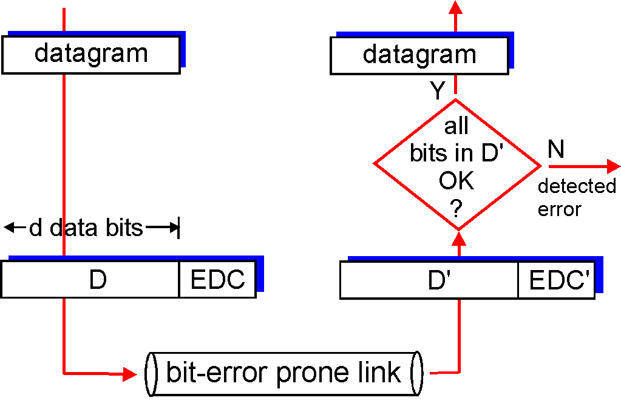
Error detection
EDC= Error Detection and Correction bits (redundancy)
D = Data protected by error checking, may include header fields
Error detection not 100% reliable!
protocol may miss some errors, but rarely
larger EDC field yields better detection and correction
otherwise

Slide 32
Error Detection – Parity (1)
Parity bit is added as the modulo 2 sum of data bits
Equivalent to XOR; this is even parity
Ex: 1110000 → 11100001
Detection checks if the sum is wrong (an error)
Simple way to detect an odd number of errors
Ex: 1 error, 11100101; detected, sum is wrong
Ex: 3 errors, 11011001; detected sum is wrong
Ex: 2 errors, 11101101; not detected, sum is right!
Error can also be in the parity bit itself
Random errors are detected with probability ½
Can be generalized to more errors detected (and corrected)

Slide 33
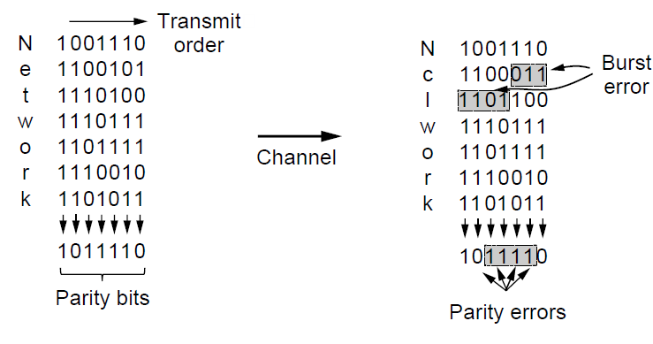
Error Detection – Parity (2)
Interleaving of N parity bits detects burst errors up to N
Each parity sum is made over non-adjacent bits
An even burst of up to N errors will not cause it to fail

Slide 34
Error Detection – Checksums
Checksum treats data as N-bit words and adds N check bits that are the modulo 2^{N} sum of the words
Ex: Internet 16-bit 1s complement checksum
Properties:
Improved error detection over parity bits
Detects bursts up to N errors
Detects random errors (with what probability?)
Vulnerable to systematic errors, e.g., added zeros

Slide 35
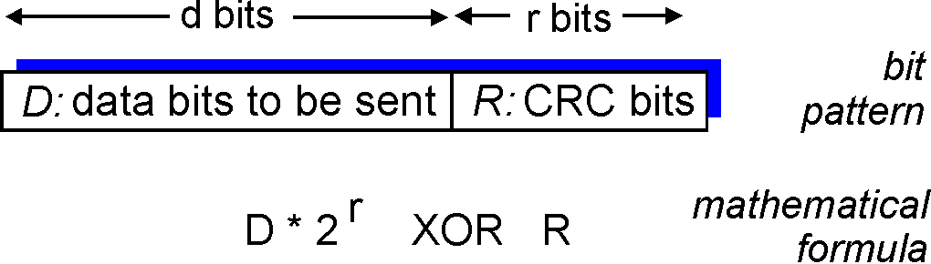
Cyclic redundancy check
more powerful error-detection coding
view data bits, D, as a binary number
choose r+1 bit pattern (generator), G
goal: choose r CRC bits, R, such that
<D,R> exactly divisible by G (modulo 2)
receiver knows G, divides <D,R> by G. If non-zero remainder: error detected!
can detect all burst errors less than r+1 bits
widely used in practice (Ethernet, 802.11 WiFi, ATM)

Slide 36
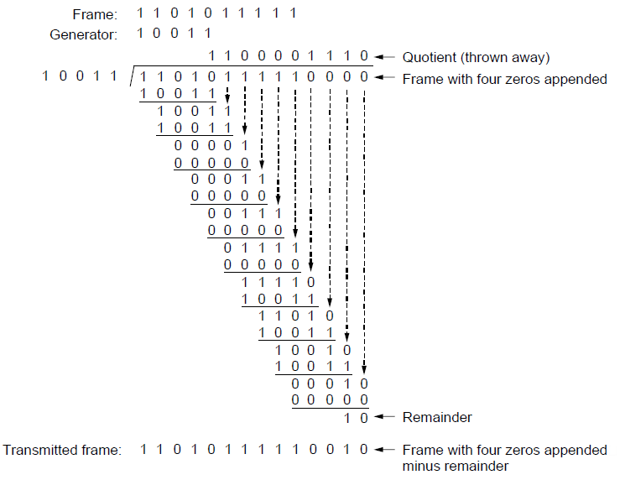
Error Detection – CRCs
Adds bits so that transmitted frame viewed as a polynomial is evenly divisible by a generator polynomial
Start by adding 0s to frame and try dividing
Offset by any reminder to make it evenly divisible

Slide 37
Error Detection – CRCs
Based on standard polynomials:
Ex: Ethernet 32-bit CRC is defined by:
Computed with simple shift/XOR circuits
Stronger detection than checksums:
E.g., can detect all double bit errors
Not vulnerable to systematic errors

Slide 38
Error Detection and Correction
Codes’ structured redundancy allow some errors to be detected
Error detection codes:
Parity »
Checksums »
Cyclic redundancy codes »
Structured redundancy can help correction of likely errors
Forward error correction codes:
Hamming codes »
Binary convolutional codes »
Commonly used as inner codes
Reed-Solomon and Low-Density Parity Check codes »
Mathematically complex, widely used in space systems as outer codes

Slide 39
Error Correction – Hamming code
Hamming code gives a simple way to add check bits and correct up to a (dmin-1)/2
Check bits are parity over subsets of the codeword
Recomputing the parity sums (syndrome) gives the position of the error to flip, or 0 if there is no error
(7, 4) Hamming code adds 3 check bits and can correct 1 error

Slide 41
Computationally much more efficient!

