Slide 1
ECE 158 A: Computer Networks
Tara Javidi
Lectures: TTH 5:00-5:30pm Center Hall 222
Topic 4
Link Layer: MAC

Slide 2
The Data Link Layer
Responsible for delivering frames of information over a single link
Handles transmission errors and regulates the flow of data (Link Layer)
Handles sharing the local communication link (Medium Access Control)
Application
Transport
Network
Link
Physical

Slide 3




Multiple access links protocols
two types of “links”
Point-to-point medium
PPP for dial-up access
point-to-point link between Ethernet switch, host
Shared medium (wired or wireless)
old-fashioned Ethernet
802.11 wireless LAN
two or more simultaneous transmissions by nodes interfere
Collision: packets lost
Better models: See ECE 154 series
shared wire (e.g.,
cabled Ethernet)
shared RF
(e.g., 802.11 WiFi)
shared RF
(satellite)

Slide 4
MAC protocols: taxonomy
three broad classes:
Static channel partitioning
divide channel into smaller “pieces” (time slots, frequency, code)
allocate piece to node for exclusive use
random access
channel not divided, allow occasional collisions
“recover” from collisions
Dynamic channel partitioning (“taking turns”)
polls the nods
partitions real time based on the “need”
time slots: nodes take turns, but nodes with more to send take longer turns

Slide 5
Channel partitioning MAC protocols: TDMA
TDMA: time division multiple access
access to channel in "rounds"
each station gets fixed length slot (length = packet transmission time) in each round
example: 6-station LAN, 1,3,4 have packets to send, slots 2,5,6 idle
unused transmission time slots go idle
6-slot
frame
6-slot
frame
1
3
4
1
3
4

Slide 6
Channel partitioning MAC protocols: FDMA
FDMA: frequency division multiple access
channel spectrum divided into frequency bands
each station assigned fixed frequency band
example: 6-station LAN, 1,3,4 have packet to send, frequency bands 2,5,6 idle
unused transmission time in frequency bands go idle
time
frequency bands
FDM cable

Slide 7
Random access protocols
when node has packet to send
transmit at full channel data rate R.
little or no a priori coordination among nodes
two or more transmitting nodes ➜ “collision”,
random access MAC protocol specifies:
how to detect collisions
how to recover from collisions (e.g., via delayed retransmissions)
examples of random access MAC protocols:
slotted ALOHA
ALOHA
CSMA, CSMA/CD, CSMA/CA

Slide 8
Slotted ALOHA
assumptions:
all frames same size
time divided into equal size slots (time to transmit 1 frame)
nodes start to transmit only slot beginning
nodes are synchronized
if 2 or more nodes transmit in slot, all nodes detect collision
operation:
when node obtains fresh frame, transmits in next slot
if no collision: node can send new frame in next slot
if collision: node retransmits frame in each subsequent slot with prob. p until success

Slide 9
Slotted ALOHA
Very low efficiency (we will analyze later)
Only appropriate for low load/contention networks
node 1
1
1
1
1
node 2
2
2
2
node 3
3
3
3
C
E
C
S
E
C
E
S
S
Pros:
single active node can continuously transmit at full rate of channel
highly decentralized: only slots in nodes need to be in sync
simple
Cons:
collisions, wasting slots
idle slots
nodes may be able to detect collision in less than time to transmit packet
clock synchronization

Slide 10
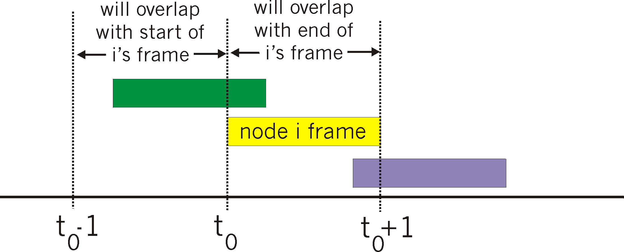
Pure (unslotted) ALOHA
unslotted Aloha: simpler, no synchronization
when frame first arrives
transmit immediately
collision probability increases:
frame sent at t₀ collides with other frames sent in [t₀-1,t₀+1]
Even lower efficiency (we will analyze later)!

Slide 11
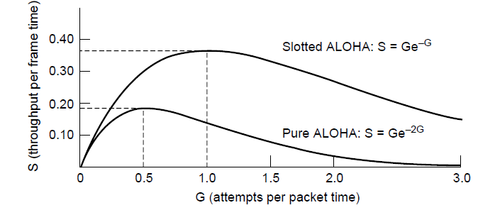
Efficiency of ALOHA MAC
Slotted ALOHA is twice as efficient as pure ALOHA
Low load wastes slots, high loads causes collisions
Efficiency up to 1/e (37%) for random traffic models
Very low efficiency (we will analyze later)!
Even worse: unstable equilibrium

Slide 12
Analysis (ALOHA)

Slide 13
Analysis (Pure ALOHA)

Slide 14
CSMA (carrier sense multiple access)
CSMA: listen before transmit:
if channel sensed idle: transmit entire frame
if channel sensed busy, defer transmission
human analogy: don’t interrupt others!

Slide 15
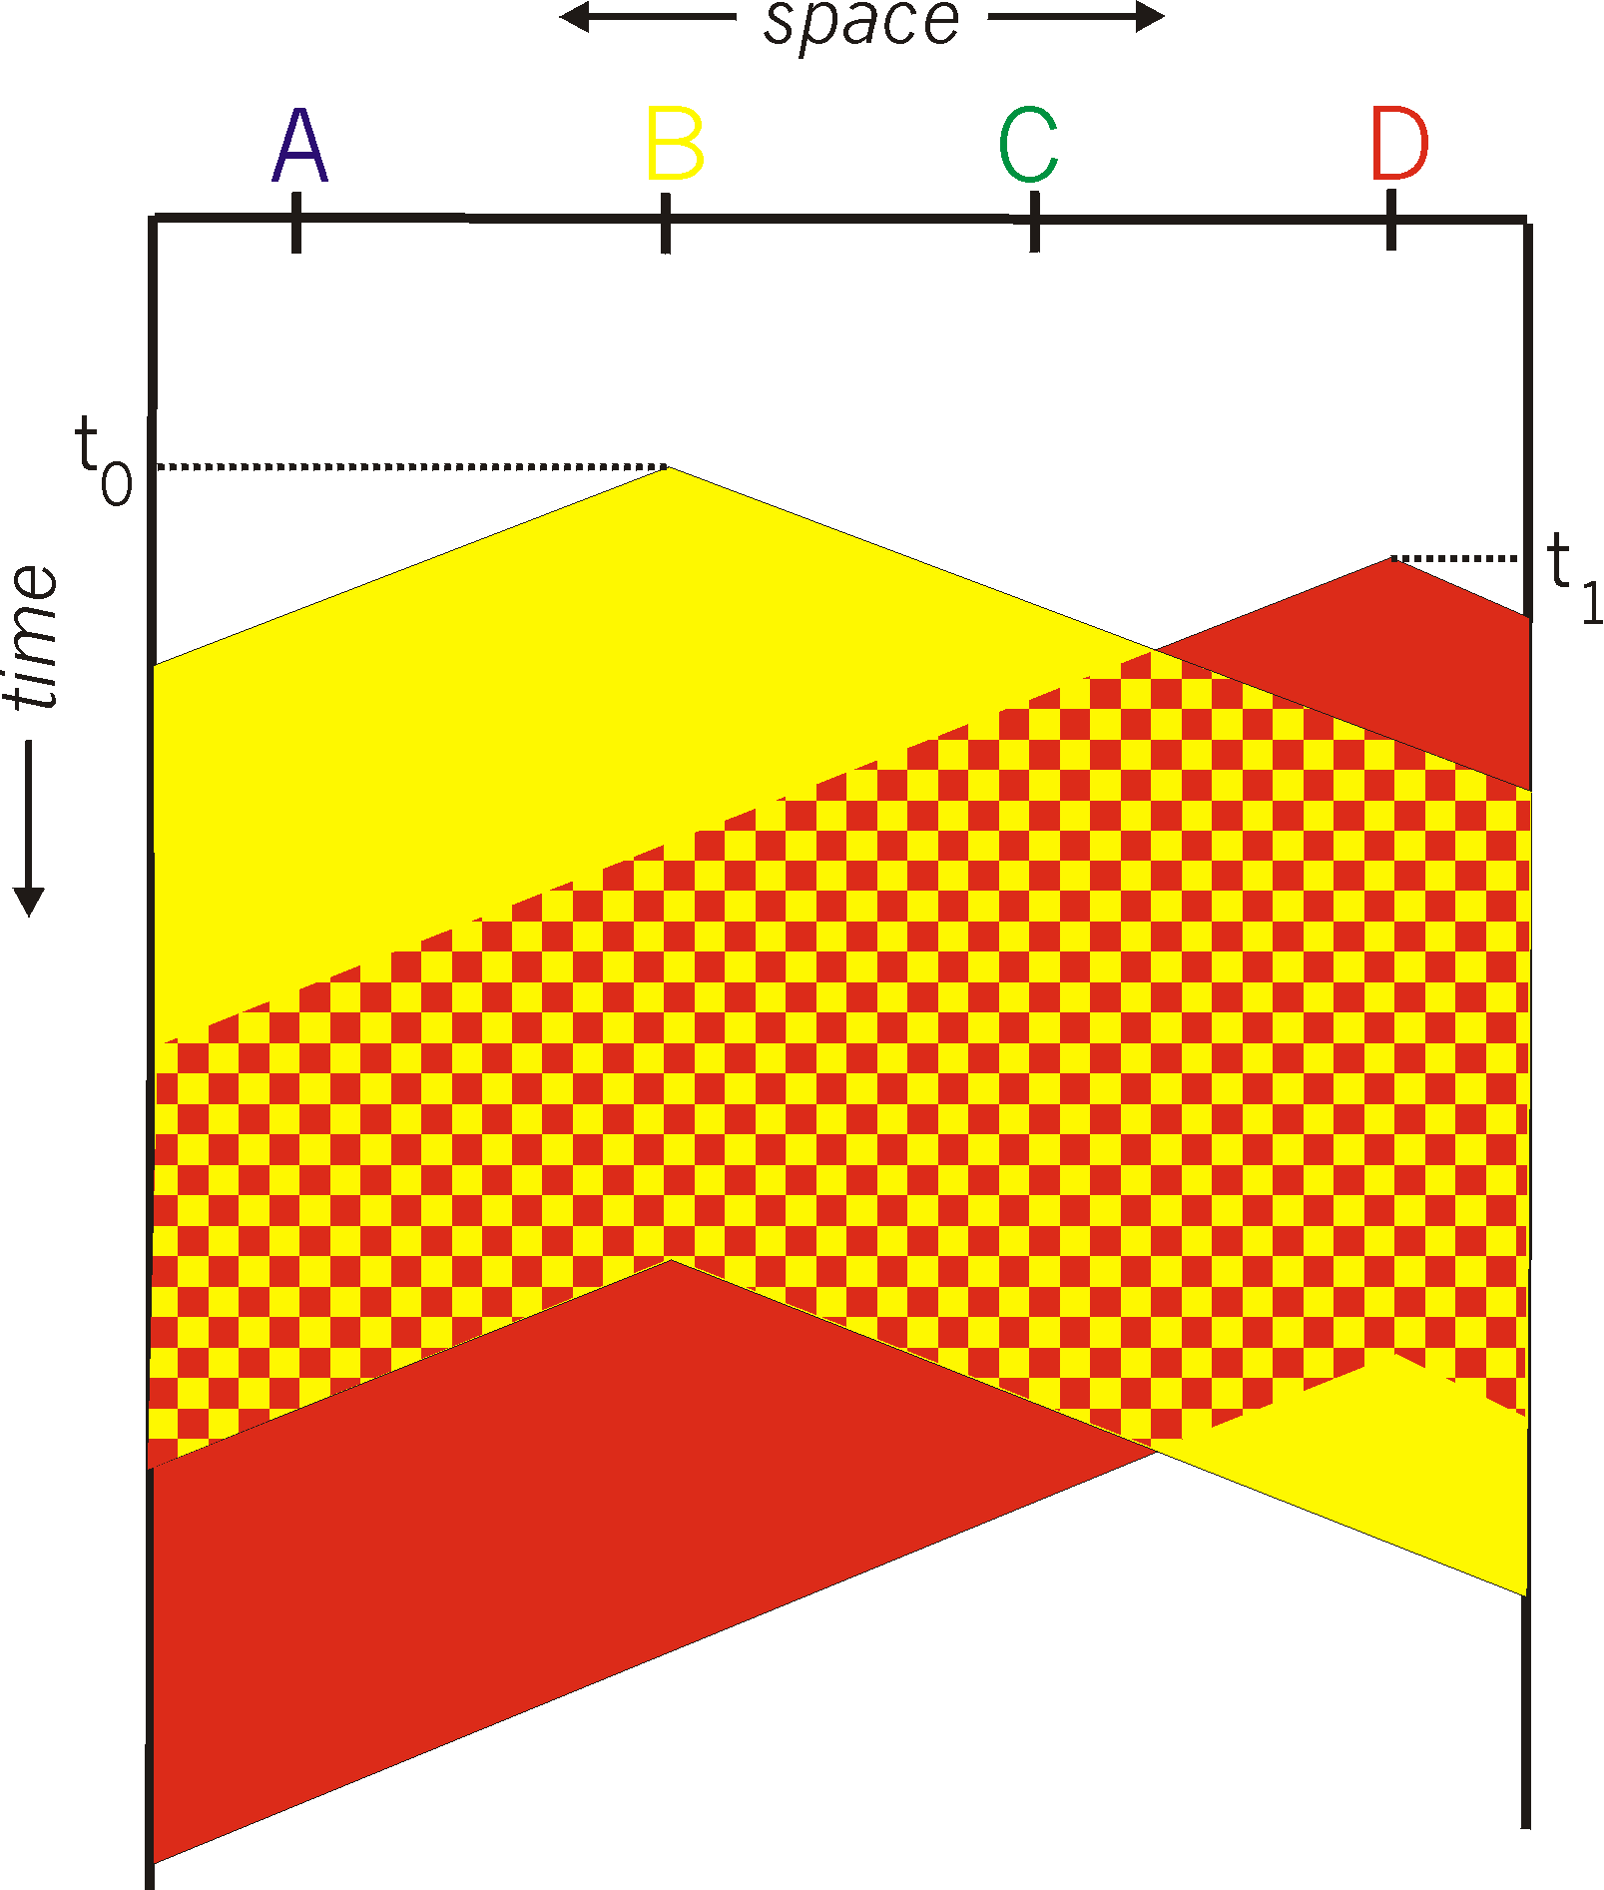
CSMA collisions
spatial layout of nodes
collisions can still occur: propagation delay means two nodes may not hear each other’s transmission
collision: entire packet transmission time wasted
distance & propagation delay play role in in determining collision probability

Slide 16
CSMA/CD (collision detection)
CSMA/CD: carrier sensing, deferral as in CSMA
collisions detected within short time
colliding transmissions aborted, reducing channel wastage
collision detection:
easy in wired LANs: measure signal strengths, compare transmitted, received signals
difficult in wireless LANs: received signal strength overwhelmed by local transmission strength
human analogy: the polite conversationalist

Slide 17
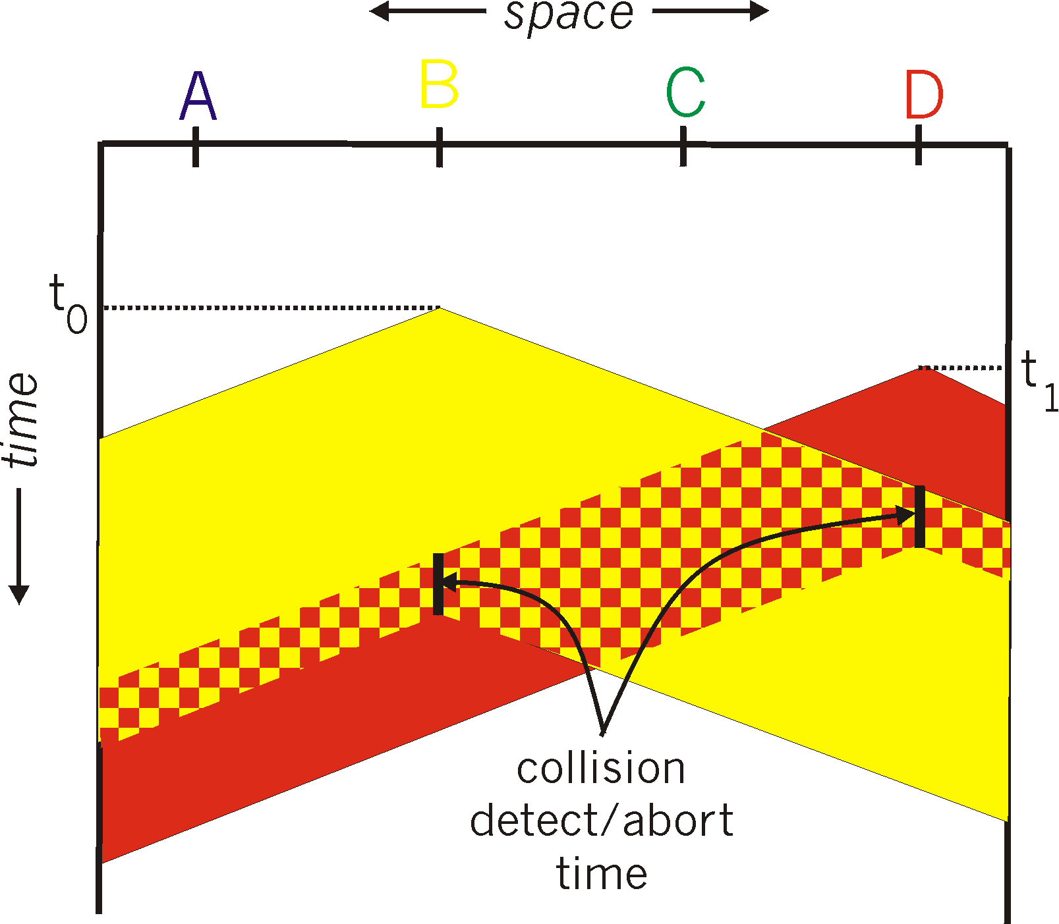
CSMA/CD (collision detection)
spatial layout of nodes

Slide 18
Ethernet CSMA/CD algorithm (non-persistent)
1. NIC receives datagram from network layer, creates frame
2. If NIC senses channel idle, starts frame transmission. If NIC senses channel busy, waits until channel idle, then transmits.
3. If NIC transmits entire frame without detecting another transmission, NIC is done with frame !
4. If NIC detects another transmission while transmitting, aborts and sends jam signal
5. After aborting, NIC enters binary (exponential) backoff:
after mth collision, NIC chooses K at random from {0,1,2, …, 2^{m}-1}. NIC waits K·512 bit times, returns to Step 2
longer backoff interval with more collisions
Variations on what to do if the channel is busy:
Non-persistent waits a random time then tries again
1-persistent (greedy) sends as soon as idle
p-persistent sends with probability p when idle

Slide 19
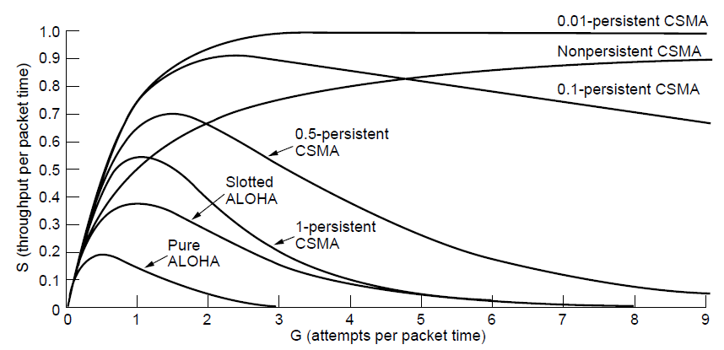
CSMA (w & w/o Persistence)
CSMA outperforms ALOHA, and being less persistent is better under high load

Slide 20
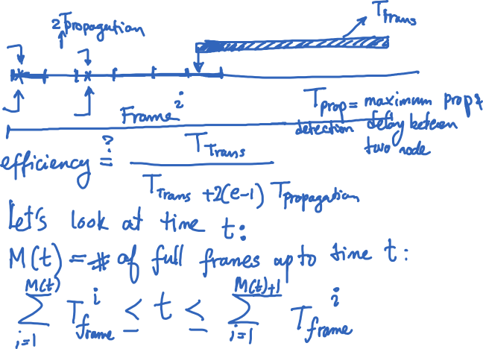
Analysis (CSMA/CD)

Slide 21
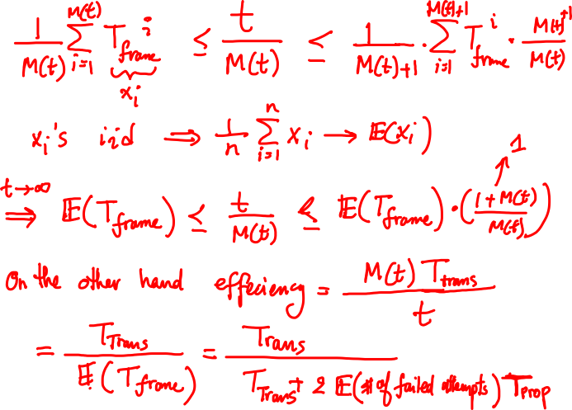

Slide 22
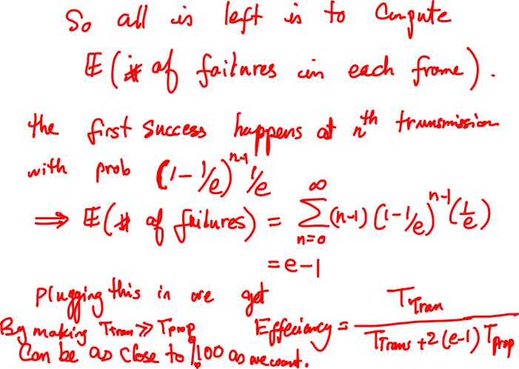

Slide 23
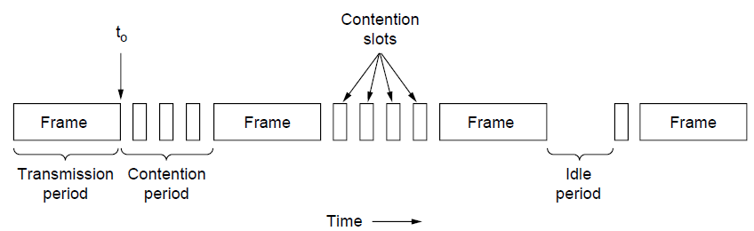
How Did Collision Detection Help?
CSMA/CD improvement is to detect/abort collisions
Reduced contention times improve performance
Inspires a reservation-based system (“taking turn”)
Collision time is much shorter than frame time

Slide 24
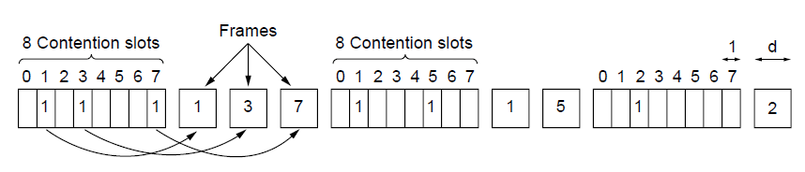
Collision-Free (1) – Bitmap
Collision-free protocols avoid collisions entirely
Senders must know when it is their turn to send
The basic bit-map protocol:
Sender set a bit in contention slot if they have data
Senders send in turn; everyone knows who has data

Slide 25
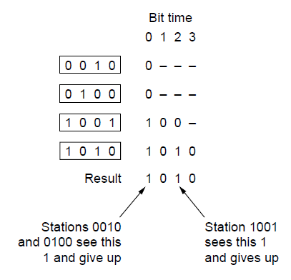
Collision-Free (2) – Countdown
Binary countdown improves on the bitmap protocol
Stations send their address in contention slot (log N bits instead of N bits)
Medium ORs bits; stations give up when they send a “0” but see a “1”
Station that sees its full address is next to send

Slide 26
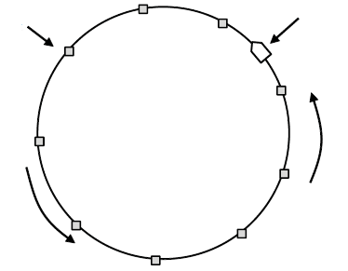
Collision-Free (3) – Token Ring
Token sent round ring defines the sending order
Station with token may send a frame before passing
Idea can be used without ring too, e.g., token bus
Token
Station
Direction of
transmission

Slide 27
Wireless LAN Protocols (1)
Sharing the wireless medium is more complicated
Nodes may not detect transmissions, i.e., have different coverage regions
Leads to hidden and exposed terminals
Nodes can’t detect collisions, i.e., sense while sending
Makes collisions expensive and to be avoided

Slide 28
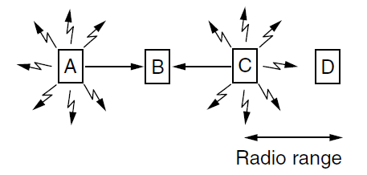
Wireless LANs (2) – Hidden terminals
Hidden terminals are senders that cannot sense each other but nonetheless collide at intended receiver
Want to prevent; loss of efficiency
A and C are hidden terminals when sending to B

Slide 29
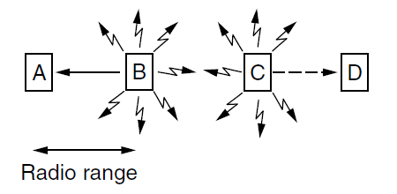
Wireless LANs (3) – Exposed terminals
Exposed terminals are senders who can sense each other but still transmit safely (to different receivers)
Desirably concurrency; improves performance
B → A and C → D are exposed terminals

Slide 30
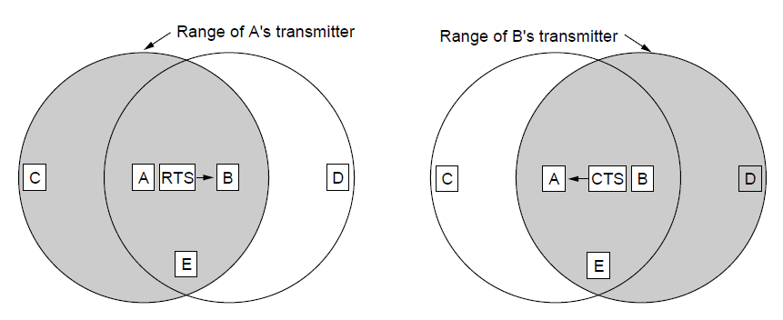
Wireless LANs (4) – MACA
MACA protocol grants access for A to send to B:
A sends RTS to B [left]; B replies with CTS [right]
A can send with exposed but no hidden terminals
A sends RTS to B; C and E hear and defer for CTS
B replies with CTS; D and E hear and defer for data
Notes:
This protocol solves the issue of expensive collisions too, since the RTS/CTS are short packets – if there is a collision it will be brief, not as long as a data frame.

