Slide 1
EXAMPLES

Slide 2
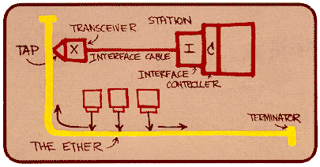
Ethernet
“dominant” wired LAN technology:
single chip, multiple speeds (e.g., Broadcom BCM5761)
first widely used LAN technology
simpler, cheap
kept up with speed race: 10 Mbps – 10 Gbps
Metcalfe’s Ethernet sketch

Slide 3



Ethernet: physical topology
bus: popular through mid 90s
all nodes in same collision domain (interfere with each other)
sharing the channel
star: prevails today
active switch in center
each “spoke” runs a (separate) Ethernet protocol (nodes do not collide with each other)
switch
star
bus: coaxial cable

Slide 4
Ethernet frame structure
sending adapter encapsulates IP datagram (or other network layer protocol packet) in Ethernet frame
preamble:
7 bytes with pattern 10101010 followed by one byte with pattern 10101011
used to synchronize receiver, sender clock rates
type
preamble
dest.
address
source
address
data (payload)
CRC

Slide 5
Ethernet frame structure (more)
addresses: 6 byte source, destination MAC addresses
if adapter receives frame with matching destination address, or with broadcast address (e.g. ARP packet), it passes data in frame to network layer protocol
otherwise, adapter discards frame
type: indicates higher layer protocol (mostly IP but others possible, e.g., Novell IPX, AppleTalk)
CRC: cyclic redundancy check at receiver
error detected: frame is dropped
type
preamble
dest.
address
source
address
data (payload)
CRC

Slide 6
Ethernet: unreliable, connectionless
connectionless: no handshaking between sending and receiving NICs
unreliable: receiving NIC doesn't send acks or nacks to sending NIC
data in dropped frames recovered only if initial sender uses higher layer rdt (e.g., TCP), otherwise dropped data lost
Ethernet’s MAC protocol: unslotted CSMA/CD with binary backoff

Slide 7
802.3 Ethernet standards: link & physical layers
many different Ethernet standards
common MAC protocol and frame format
different speeds: 2 Mbps, 10 Mbps, 100 Mbps, 1Gbps, 10 Gbps, 40 Gbps
different physical layer media: fiber, cable
application
transport
network
link
physical
MAC protocol
and frame format
100BASE-TX
100BASE-T2
100BASE-FX
100BASE-T4
100BASE-SX
100BASE-BX
copper (twister
pair) physical layer
fiber physical layer

Slide 8
Wireless LANs
802.11 architecture/protocol stack »
802.11 physical layer »
802.11 MAC »
802.11 frames »

Slide 9
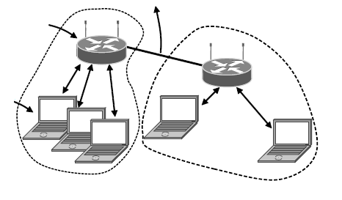
802.11 Architecture/Protocol Stack (1)
Wireless clients associate to a wired AP (Access Point)
Called infrastructure mode; there is also ad-hoc mode with no AP, but that is rare.
To Network
Access Point
Client

Slide 10
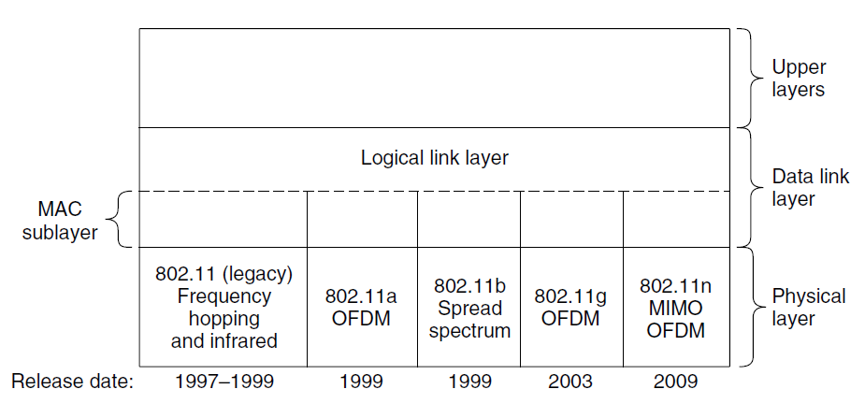
802.11 Architecture/Protocol Stack (2)
MAC is used across different physical layers

Slide 11
802.11 physical layer
NICs are compatible with multiple physical layers
E.g., 802.11 a/b/g
Name | Technique | Max. Bit Rate
802.11b | Spread spectrum, 2.4 GHz | 11 Mbps
802.11g | OFDM, 2.4 GHz | 54 Mbps
802.11a | OFDM, 5 GHz | 54 Mbps
802.11n | OFDM with MIMO, 2.4/5 GHz | 600 Mbps

Slide 12
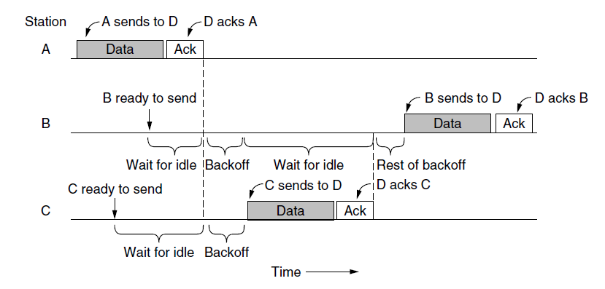
802.11 MAC (1)
CSMA/CA inserts backoff slots to avoid collisions
MAC uses ACKs/retransmissions for wireless errors

Slide 13
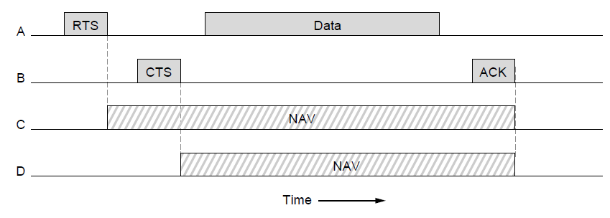
802.11 MAC (2)
Virtual channel sensing with the NAV and optional RTS/CTS (often not used) avoids hidden terminals

Slide 14
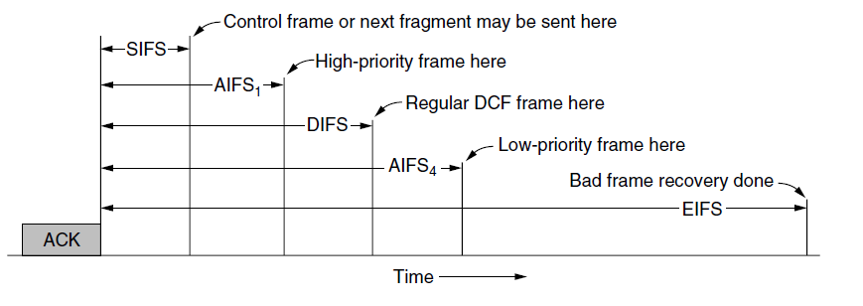
802.11 MAC (3)
Different backoff slot times add quality of service
Short intervals give preferred access, e.g., control, VoIP
MAC has other mechanisms too, e.g., power save

Slide 15
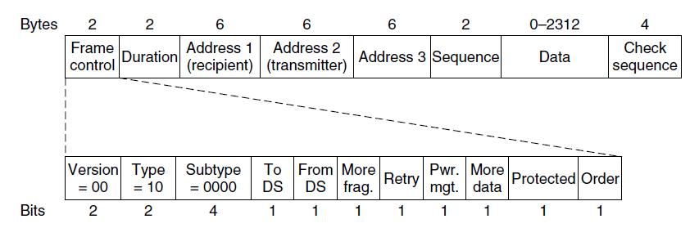
802.11 Frames
Frames vary depending on their type (Frame control)
Data frames have 3 addresses to pass via APs

Slide 16
Broadband Wireless
802.16 Architecture / Protocol Stack »
802.16 Physical Layer »
802.16 MAC »
802.16 Frames »

Slide 17
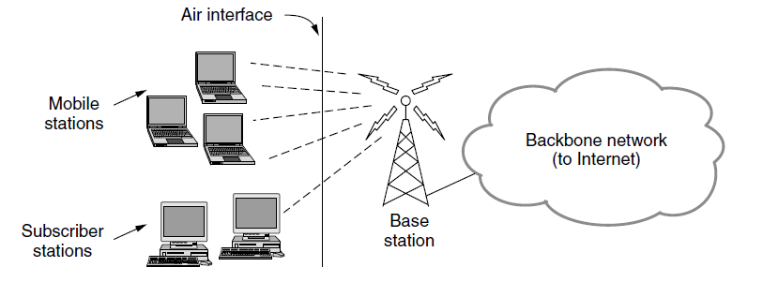
802.16 Architecture/Protocol Stack (1)
Wireless clients connect to a wired basestation (like 3G)

Slide 18
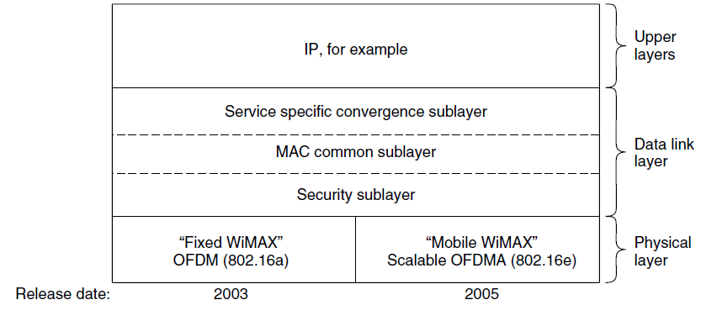
802.16 Architecture/Protocol Stack (2)
MAC is connection-oriented; IP is connectionless
Convergence sublayer maps between the two

Slide 19
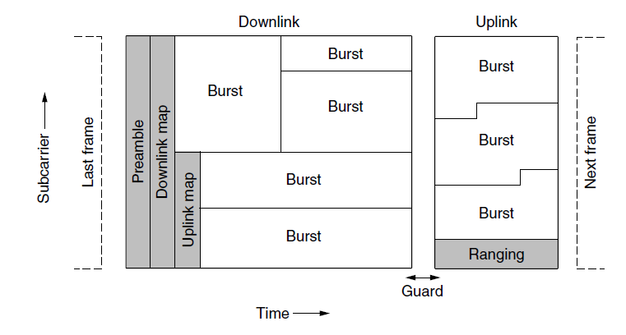
802.16 Physical Layer
Based on OFDM; base station gives mobiles bursts (subcarrier/time frame slots) for uplink and downlink

Slide 20
802.16 MAC
Connection-oriented with base station in control
Clients request the bandwidth they need
Different kinds of service can be requested:
Constant bit rate, e.g., uncompressed voice
Real-time variable bit rate, e.g., video, Web
Non-real-time variable bit rate, e.g., file download
Best-effort for everything else

Slide 21
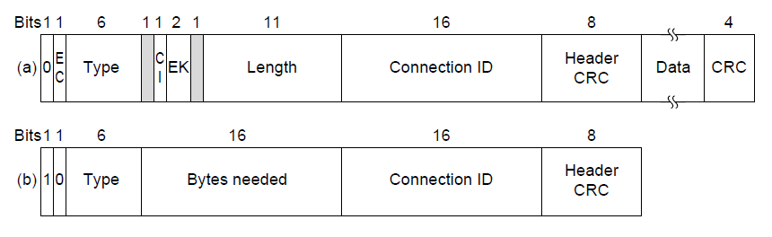
802.16 Frames
Frames vary depending on their type
Connection ID instead of source/dest addresses
(a)
(b)
(a) A generic frame. (b) A bandwidth request frame

Slide 22
Bluetooth
Bluetooth Architecture »
Bluetooth Applications / Protocol »
Bluetooth Radio / Link Layers »
Bluetooth Frames »

Slide 23
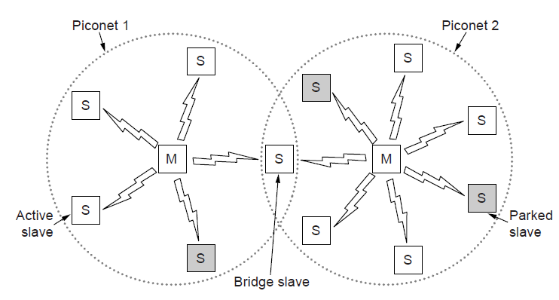
Bluetooth Architecture
Piconet master is connected to slave wireless devices
Slaves may be asleep (parked) to save power
Two piconets can be bridged into a scatternet

Slide 24
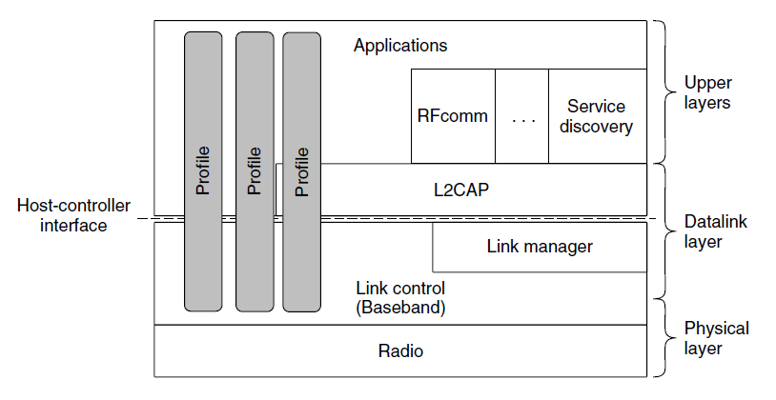
Bluetooth Applications / Protocol Stack
Profiles give the set of protocols for a given application
25 profiles, including headset, intercom, streaming audio, remote control, personal area network, …

Slide 25
Bluetooth Radio / Link Layers
Radio layer
Uses adaptive frequency hopping in 2.4 GHz band
Link layer
TDM with timeslots for master and slaves
Synchronous CO for periodic slots in each direction
Asynchronous CL for packet-switched data
Links undergo pairing (user confirms passkey/PIN) to authorize them before use

Slide 26
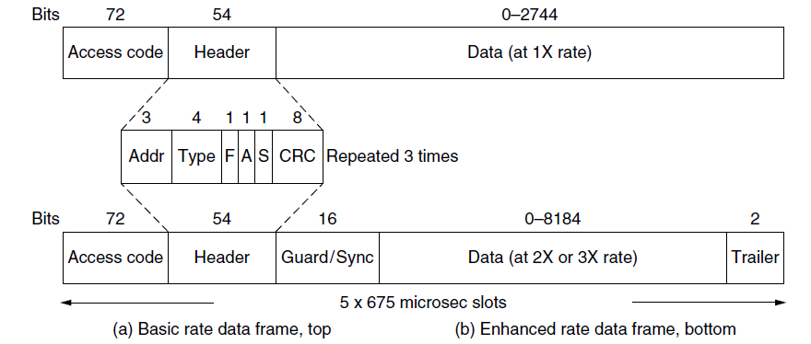
Bluetooth Frames
Time is slotted; enhanced data rates send faster but for the same time; addresses are only 3 bits for 8 devices
(a)
(b)
(a)
(b)

Slide 27
RFID
Gen 2 Architecture »
Gen 2 Physical Layer »
Gen 2 Tag Identification Layer »
Gen 2 Frames »

Slide 28
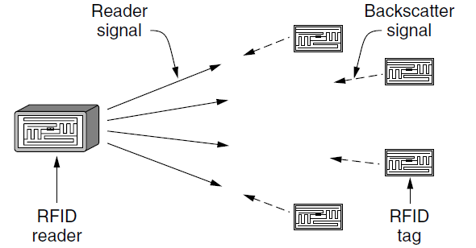
Gen 2 Architecture
Reader signal powers tags; tags reply with backscatter

Slide 29
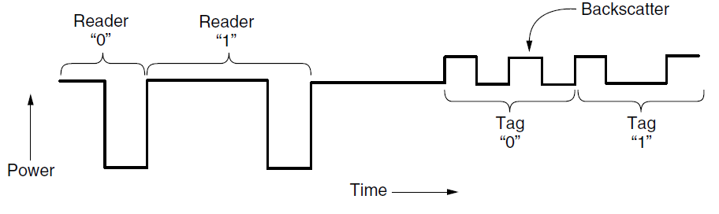
Gen 2 Physical Layer
Reader uses duration of on period to send 0/1
Tag backscatters reader signal in pulses to send 0/1

Slide 30
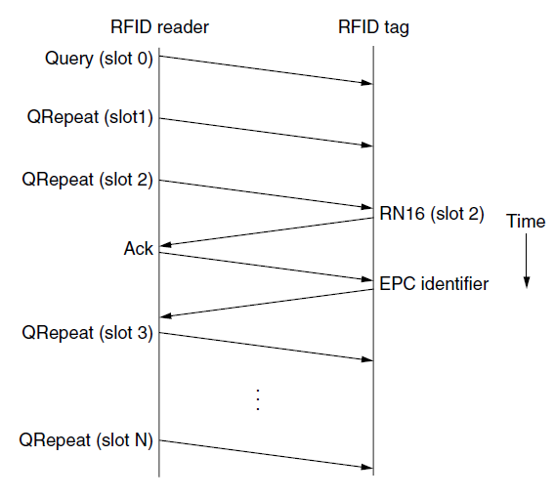
Gen 2 Tag Identification Layer
Reader sends query and sets slot structure
Tags reply (RN16) in a random slot; may collide
Reader asks one tag for its identifier (ACK)
Process continues until no tags are left

Slide 31
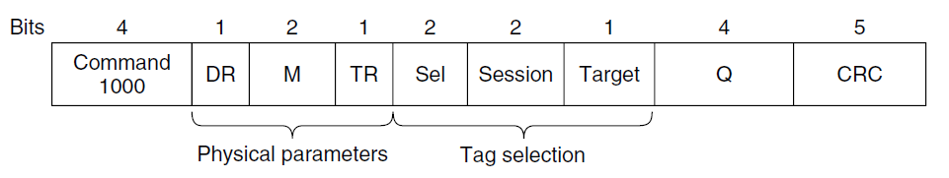
Gen 2 Frames
Reader frames vary depending on type (Command)
Query shown below, has parameters and error detection
Tag responses are simply data
Reader sets timing and knows the expected format
Query message

