Slide 1
ECE158A: Computer Networks
Tara Javidi
Lectures: TTH 5:00-6:20pm Center Hall 222
Topic 8
Shortest Path Routing on a Directed Graph

Slide 2
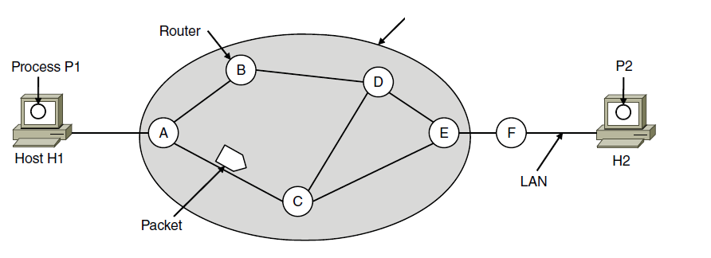
Network Layer
Responsible for delivering packets between endpoints over multiple links
Design principle of TCP/IP networks is “Store-and-Forward Packet Switching”
Hosts send packets into the network; packets are forwarded by routers
Application
Transport
Network
Link
Physical
ISP’s equipment

Slide 3
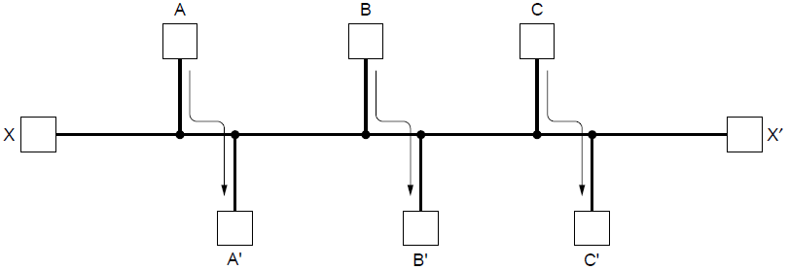
Routing Algorithms
Routing is the process of discovering network paths
Model the network as a graph of nodes and links
Decide what to optimize (e.g., fairness vs efficiency)
Update routes for changes in topology (e.g., failures)
Forwarding is the sending of packets along a path
Notes:
Distinguish routing from forwarding.
We focus on adaptive routing schemes that update routes in response to failures. Some traffic-aware schemes also adapt to changes in traffic, but we do not consider them in the algorithms that follow.
For the graph, the traffic demands are A->A’, B->B’, C->C’ and X->X’. What would be fair? For each flow the get the same amount of bandwidth. If all network links have unit capacity then we would give each flow ½ a unit of capacity. The total network traffic is then 2 units. What would be efficient? If we gave the X->X’ flow no bandwidth then we could give each of the other three flows 1 unit. The total network traffic is then 3 units. So it is more efficient, but it is not fair. So we will have to decide what we want to optimize.

Slide 4
Routing Algorithms
Routing Objective: determine “good” paths (equivalently, routes), from sending hosts to receiving host, through network of routers
path: sequence of routers packets will traverse in going from given initial source host to given final destination host
“good”: least “cost”, “fastest”, “least congested”
routing: a “top-10” networking challenge!

Slide 5
Graph abstraction of the network
5
v
3
w
2
5
u
2
1
z
3
1
2
x
y
graph: G = (N,E)
N = set of routers = { u, v, w, x, y, z }
E = set of links ={ (u,v), (u,x), (v,x), (v,w), (x,w), (x,y), (w,y), (w,z), (y,z) }
1
aside: graph abstraction is useful in other network contexts, e.g.,
P2P, where N is set of peers and E is set of TCP connections

Slide 6
Graph abstraction: costs
5
c(x,x’) = cost of link (x,x’)
e.g., c(w,z) = 5
cost could always be 1, or
inversely related to bandwidth,
or inversely related to
congestion
3
v
w
2
5
u
z
2
1
3
1
2
x
y
1
cost of path (x₁, x₂, x₃,…, x_{p}) = c(x₁,x₂) + c(x₂,x₃) + … + c(x_{p-1},x_{p})
question: what is the least-cost path between u and z ?
routing algorithm: algorithm that finds that least cost path

Slide 7
Routing algorithm classification
Q: static or dynamic?
Static (quasi-static):
routes change slowly over time
dynamic:
routes change more quickly
periodic update
in response to link cost changes

Slide 8
Dijkstra’s Algorithm
network topology and link costs are known
computes least cost paths to one node (‘sink’) to all other nodes
iterative: after k iterations, know least cost path from k node’s to the sink
notation:
c(x,y): link cost from node x to y; = ∞ if not direct neighbors
D(v): current estimated value of cost of path from node v to the sink
p(v): next node along path from v to sink
N': set of nodes whose least cost path definitively known

Slide 9
Dijkstra’s Algorithm
1 Initialization:
2 N' = {u}
3 for all nodes v
4 if v adjacent to u
5 then D(v) = c(u,v)
6 else D(v) = ∞
7
8 Loop
9 find w not in N' such that D(w) is a minimum
10 add w to N'
11 update D(v) for all v adjacent to w and not in N' :
12 D(v) = min( D(v), D(w) + c(v,w) )
13 /* new cost to v is either old cost mto v or known
14 shortest path cost to w plus cost from w to v */
15 until all nodes in N'

Slide 10
Dijkstra’s algorithm: example
D(v)
p(v)
D(w)
p(w)
D(x)
p(x)
D(y)
p(y)
D(z)
p(z)
Step
N'
0
u
7,u
3,u
5,u
∞
∞
1
uw
6,w
5,u
11,w
∞
2
uwx
6,w
11,w
14,x
3
uwxv
10,v
14,x
4
uwxvy
12,y
5
uwxvyz
x
9
notes:
construct shortest path tree by tracing child nodes
ties can exist (can be broken arbitrarily)
5
7
4
8
u
3
w
y
z
2
3
7
4
v

Slide 11
Dijkstra’s algorithm: another example
Step
0
1
2
3
4
5
N'
u
ux
uxy
uxyv
uxyvw
uxyvwz
D(v),p(v)
2,u
2,u
2,u
D(w),p(w)
5,u
4,x
3,y
3,y
D(x),p(x)
1,u
D(y),p(y)
∞
2,x
D(z),p(z)
∞
∞
4,y
4,y
4,y
5
v
3
w
2
5
u
2
1
z
3
1
2
x
y
1
* Check out the online interactive exercises for more examples: http://gaia.cs.umass.edu/kurose_ross/interactive/

Slide 12
Dijkstra’s algorithm: example (2)
resulting shortest-path tree to u:
v
w
u
z
x
y
NOTE: Repeat for all destinations; one can construct a forwarding table at each node
destination
Next-hop/ min-cost
u
(y,x) / 2
x
(y,x) / 1
Say for node y:
v
(y,x) / 3
w
(y,w) / 1
z
(y,z) / 2

Slide 13
Dijkstra’s algorithm, discussion
algorithm complexity: n nodes
each iteration: need to check all nodes, w, not in N
n(n+1)/2 comparisons: O(n²)
more efficient implementations possible: O(nlogn)
Centralized knowledge of network topology and cost
oscillations possible if cost is chosen carelessly:
e.g., suppose link cost equals amount of carried traffic:
A
A
A
A
1
1+e
2+e
0
0
2+e
2+e
0
D
B
D
B
D
B
D
B
0
0
1+e
1
0
0
1+e
1
0
C
e
0
0
1
0
0
1
C
C
1+e
C
1
e
initially
given these costs,
find new routing….
resulting in new costs
given these costs,
find new routing….
resulting in new costs
given these costs,
find new routing….
resulting in new costs

Slide 14
Routing algorithm classification
Q: global or decentralized information?
global:
complete topology and link cost info
( this requires global messaging, e.g. “link state” alg)
decentralized:
router knows physically-connected neighbors, link costs to neighbors
iterative process of computation, exchange of info with neighbors
( this allows for local messaging, e.g. “distance vector” alg)

Slide 15
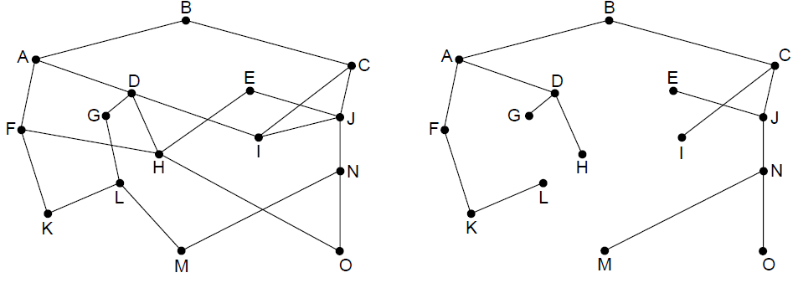
The Optimality Principle
Each portion of a best path is also a best path; the union of them to a router is a tree called the sink tree
Best means fewest hops in the example
B
Network
Sink tree of best paths to router B
Notes:
Proof by contradiction: if a portion of a best path is not a best path then there is something better. Substitute this better portion and you would have a better overall path, which cannot be the case if the overall path is a best path.
For sink trees, if there are multiple paths that are equally good, then one best path from one node to another is chosen at random. For example, H can be reached in 3 hops via H-D-A-B as shown, or by H-F-A-D (not shown). This is simple and useful as there is a single route from each router to each destination. If, instead, all equally best paths are kept then their union is a DAG (directed acyclic graph). This is a more general case that permits multiple paths from a router to a destination.

Slide 16
Distance vector algorithm
Bellman equation (dynamic programming)
let
d_{x}(y) := cost of least-cost path from x to y
then
d_{x}(y) = min {c(x,v) + d_{v}(y) }
v
cost from neighbor v to destination y
cost to neighbor v
min taken over all neighbors v of x

Slide 17
Bellman equation: example
5
clearly, d_{v}(z) = 5, d_{x}(z) = 3, d_{w}(z) = 3
v
3
w
2
5
u
z
B equation says:
2
1
3
1
2
d_{u}(z) = min { c(u,v) + d_{v}(z),
c(u,x) + d_{x}(z),
c(u,w) + d_{w}(z) }
= min {2 + 5,
1 + 3,
5 + 3} = 4
x
y
1
node achieving minimum is next
hop in shortest path, used in forwarding table

Slide 18
Distance vector algorithm
D_{x}(y) = estimate of least cost from x to y
x maintains distance vector D_{x} = [D_{x}(y): y є N ]
node x:
knows cost to each neighbor v: c(x,v)
maintains its neighbors’ distance vectors. For each neighbor v, x maintains D_{v} = [D_{v}(y): y є N ]

Slide 19
Bellman-Ford algorithm
key idea:
from time-to-time, each node sends its own distance vector estimate to neighbors
when x receives new DV estimate from neighbor, it updates its own DV using Bellman equation:
D_{x}(y) ← min_{v}{c(x,v) + D_{v}(y)} for each node y ∊ N

Slide 20
D_{x}(z) = min{c(x,y) + D_{y}(z), c(x,z) + D_{z}(z)}
= min{2+1 , 7+0} = 3
D_{x}(y) = min{c(x,y) + D_{y}(y), c(x,z) + D_{z}(y)} = min{2+0 , 7+1} = 2
node x
table
cost to
cost to
x y z
x y z
x
0 2 7
x
0
2
3
y
∞
∞
∞
y
2 0 1
from
from
z
∞
∞
∞
z
7 1 0
node y
table
cost to
x y z
y
2
1
x
∞
∞
z
∞
2 0 1
x
from
y
7
z
∞
∞
∞
node z
table
cost to
x y z
x
∞ ∞ ∞
y
∞
∞
from
∞
z
7
1
0
time
Network Layer: Control Plane

Slide 21
D_{x}(z) = min{c(x,y) + D_{y}(z), c(x,z) + D_{z}(z)}
= min{2+1 , 7+0} = 3
D_{x}(y) = min{c(x,y) + D_{y}(y), c(x,z) + D_{z}(y)} = min{2+0 , 7+1} = 2
node x
table
cost to
cost to
cost to
x y z
x y z
x y z
x
0 2 7
x
0
2
3
x
0 2 3
y
∞
∞
∞
y
2 0 1
y
from
from
2 0 1
z
z
7 1 0
from
∞
∞
∞
z
3 1 0
node y
table
cost to
cost to
cost to
x y z
x y z
x y z
y
2
1
x
∞
∞
x
0 2 7
∞
2 0 1
x
0 2 3
x
z
from
y
y
2 0 1
y
2 0 1
7
from
from
z
∞
∞
∞
z
7 1 0
z
3 1 0
node z
table
cost to
cost to
cost to
x y z
x y z
x y z
x
∞ ∞ ∞
x
0 2 7
x
0 2 3
y
y
2 0 1
y
2 0 1
∞
∞
from
from
from
∞
z
z
3 1 0
z
3 1 0
7
1
0
time
time
Network Layer: Control Plane

Slide 22
Bellman-Ford algorithm
iterative, asynchronous: each local iteration caused by:
local link cost change
DV update message from neighbor
distributed:
each node notifies neighbors only when its DV changes
neighbors then notify their neighbors if necessary
each node:
wait for (change in local link cost or msg from neighbor)
recompute estimates
if DV to any dest has changed, notify neighbors
FACT: under minor very natural conditions (e.g. non-negative costs) then the estimate D_{x}(y) converge to the actual least cost d_{x}(y)

Slide 23
If link cost changes
link cost changes:
node detects local link cost change
updates routing info, recalculates distance vector
if DV changes, notify neighbors
1
y
4
1
x
z
50
“good
news
travels
fast”
t₀ : y detects link-cost change, updates its DV, informs its neighbors.
t₁ : z receives update from y, updates its table, computes new least cost to x , sends its neighbors its DV.
t₂ : y receives z’s update, updates its distance table. y’s least costs do not change, so y does not send a message to z.
* Check out the online interactive exercises for more examples: http://gaia.cs.umass.edu/kurose_ross/interactive/

Slide 24
If link cost changes
link cost changes:
node detects local link cost change
bad news travels slow - “count to infinity” problem!
44 iterations before algorithm stabilizes (why?)
60
y
4
1
x
z
50
poisoned reverse:
If Z routes through Y to get to X :
Z tells Y its (Z’s) distance to X is infinite (so Y won’t route to X via Z)
will this completely solve count to infinity problem?

Slide 25
Comparison of Dijkstra vs Bellman-Ford
Information Structure
Dijkstra: requires global knowledge
Bellman-Ford: exchange between neighbors only
Complexity/convergence
Dijkstra: Less than O(n²) operations (one-shot calculation)
may have oscillations if cost is varying too fast
necessary to collect information across network
Bellman Ford: Complexity at each node is a function of node degree (convergence time depends on update rate)
computations can be handled in a distributed fashion
varying cost cause routing loops and count-to-infinity problem

