Slide 1
20221012 Learning Python
Python List
4110E230

Slide 2
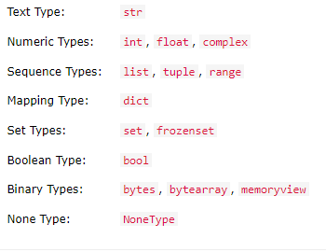
Python Data Type List
In programming, data type is an important concept.
Variables can store data of different types, and different types can do different things.
Python has the following data types built-in by default, in these categories:

Slide 3
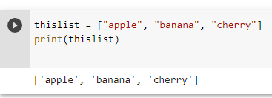
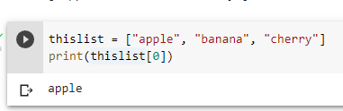
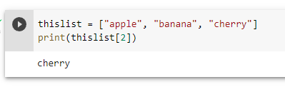
Python List
LIST
-Lists are used to store multiple items in a single variable.
-Lists are one of 4 built-in data types in Python used to store collections of data, the other 3 are Tuple, Set, and Dictionary, all with different qualities and usage.
-Lists are created using square brackets:

Slide 4
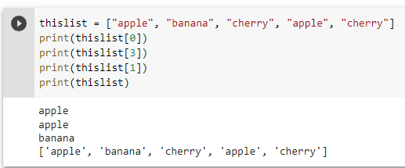
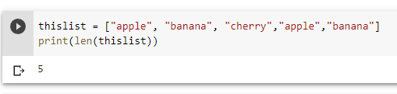
Python List
Allow Duplicates
-Since lists are indexed, lists can have items with the same value:
List Length
-To determine how many items a list has, use the len() function:

Slide 5
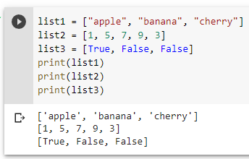
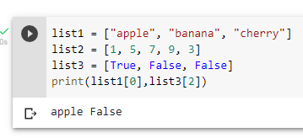
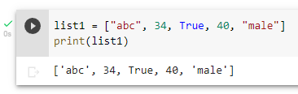
Python List
List Items - Data Types
-A list can contain different data types:

Slide 6
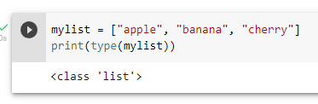
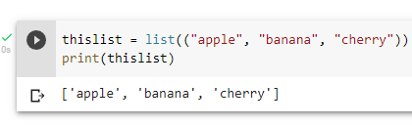
Python List
TYPE()
-From Python's perspective, lists are defined as objects with the data type 'list':
The list() Constructor
-It is also possible to use the list() constructor when creating a new list.
-Using the list() constructor to make a List:

Slide 7
CHINESE NAME: 彭哈帕
STUDENT ID: 4110E230
ENGLISH NAME: James Ryan H. Pregon
NICKNAME: Kaori
Email: jamesryanpregon@gmail.com
GITHUB: https://github.com/PengHaPa/cs2022.git
谢谢你

