Slide 1
Operation@Python
4110E230

Slide 2
Agenda
Python Strings
Slicing Strings
Modify Strings
Concatenate Strings
Format Strings
String Methods

Slide 3
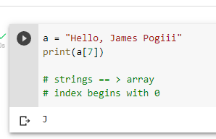
Strings in python are arrays of bytes representing Unicode characters:

Slide 4
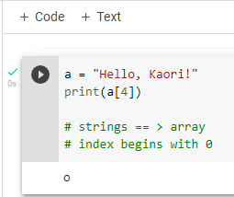
Strings are Arrays ==> access the element of array
Python does not have a character data type, a single character is simply a string with a length of 1

Slide 5
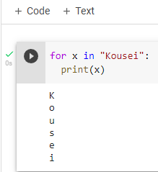
Looping Through a String

Slide 6
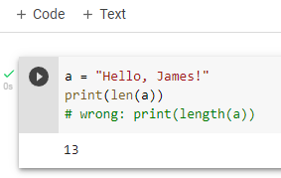
String Length:To get the length of a string, use the len()function.

Slide 7
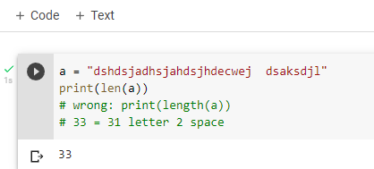
QUIZ: Tell me how many char appear in "dshdsjadhsjahdsjhdecwej dsaksdjl"

Slide 8
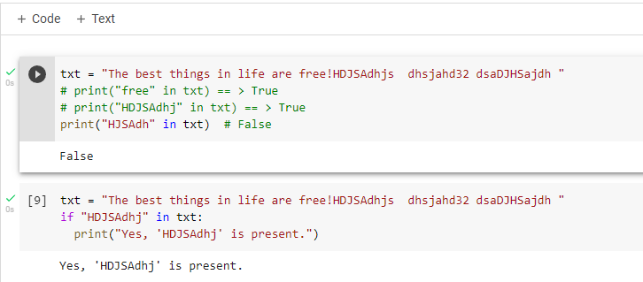
Check String :To check if a certain phrase or character is present in a string, we can use the keyword in.
keyword in vs if
True or False

Slide 9
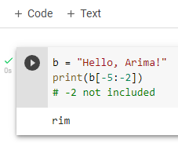
Negative Indexing

Slide 10
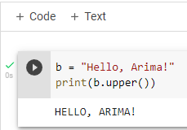
Python - Modify Strings
The upper() method returns the string in upper case:
The lower() method returns the string in lower case

Slide 11
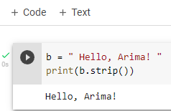
Remove Whitespace with strip() method
The strip() method removes any whitespace from the beginning or the end

Slide 12
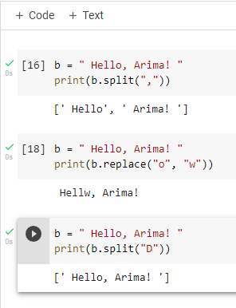
The replace()method replaces a string with another string
Separator

Slide 13
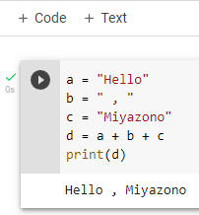
String Concatenation: To concatenate, or combine, two strings you can use the + operator.

Slide 14
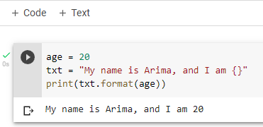
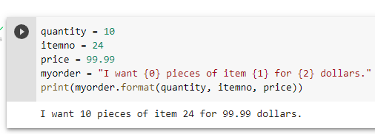
Python - Format - Strings

Slide 15
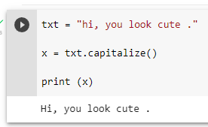
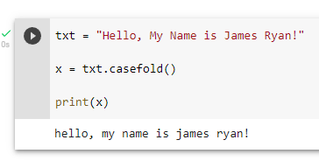
String Methods

Slide 16
THANK YOU!!
CHINESE NAME: 彭哈帕
STUDENT ID: 4110E230
ENGLISH NAME: James Ryan H. Pregon
NICKNAME: Kaori
Email: jamesryanpregon@gmail.com
GITHU: https://github.com/PengHaPa/cs2022.git

