Slide 1
Hidden Fork
Measuring Behavioral Divergence Across API, Web App, and Shadow Relay Endpoints for Large Language Models Peng Jiaxuan / 22265120128 / Neusoft Institute Guangdong Supervisor: Ren Meng

Slide 2
1. Research Question
Does the access path change what a benchmark measures?
▸ GPT-5.4 on 30 AIME problems: SDK scored 93.3%, ChatGPT browser scored 66.7%.
▸ Same model, same afternoon, same problems — but a 26.6 point gap.
▸ Papers report "GPT-5.4 scores X on Y" as if X is a model property.
▸ If the access path changes X, that assumption breaks.
▸ This thesis measures how badly, across 3 models × 3 endpoints × 6 benchmarks.
26.6 pp
SDK vs. Browser gap on AIME

Slide 3
2. Experimental Design
A 3 × 3 × 6 matrix = 54 test cells.
▸ Models: GPT-5.4, Claude Sonnet 4.6, Gemini 3 Flash (three providers).
▸ Endpoints: official API, official web app, commercial shadow relay.
▸ Shadow relay = third-party reseller forwarding API requests, ~83% of official price.
▸ Benchmarks: AIME, GPQA, MedQA, LegalBench, MMLU-Pro, JailbreakBench.
▸ All APIs set to reasoning effort "high" for fair comparison with web apps.
54
test cells (3 × 3 × 6)

Slide 4
3. Data Collection and Engineering
Three rounds of do-overs produced a zero-error dataset.
▸ Round 1: shadow relay changed backend mid-experiment → reran all shadow cells.
▸ Round 2: Anthropic free tier rate-limited after 8 items → upgraded to Max20, restarted.
▸ Round 3: Gemini API mixed two backends → locked to Vertex AI, reran.
▸ Browser automation: Playwright + real Chrome, stealth patches to evade bot detection.
▸ Answer extraction: 5-second text-stability check, interim-state keyword filter.
▸ Claude "Chat paused" safety popup detected and recorded as a refusal.
54 / 54
cells, zero errors zero missing data

Slide 5
4. Accuracy Results
Model | Endpoint | AIME | GPQA | MedQA | LegalBench | MMLU-Pro
GPT-5.4 | API | 93.3 | 89.0 | 95.0 | 87.0 | 89.0
GPT-5.4 | App | 66.7 | 81.0 | 96.0 | 87.0 | 88.0
GPT-5.4 | Shadow | 86.7 | 84.0 | 96.0 | 88.0 | 89.0
Claude Sonnet 4.6 | API | 60.0 | 68.0 | 88.0 | 78.0 | 87.0
Claude Sonnet 4.6 | App | 83.3 | 56.0 | 85.0 | 82.0 | 81.0
Claude Sonnet 4.6 | Shadow | 76.7 | 67.0 | 91.0 | 82.0 | 88.0
Gemini 3 Flash | API | 96.7 | 90.0 | 95.0 | 87.0 | 88.0
Gemini 3 Flash | App | 96.7 | 89.0 | 93.0 | 87.0 | 89.0
Gemini 3 Flash | Shadow | 0.0 | 71.0 | 91.0 | 85.0 | 85.0
Three anomalies sit in the AIME column: GPT drops 26.6; Claude's App beats its API; Gemini Shadow collapses to zero.

Slide 6
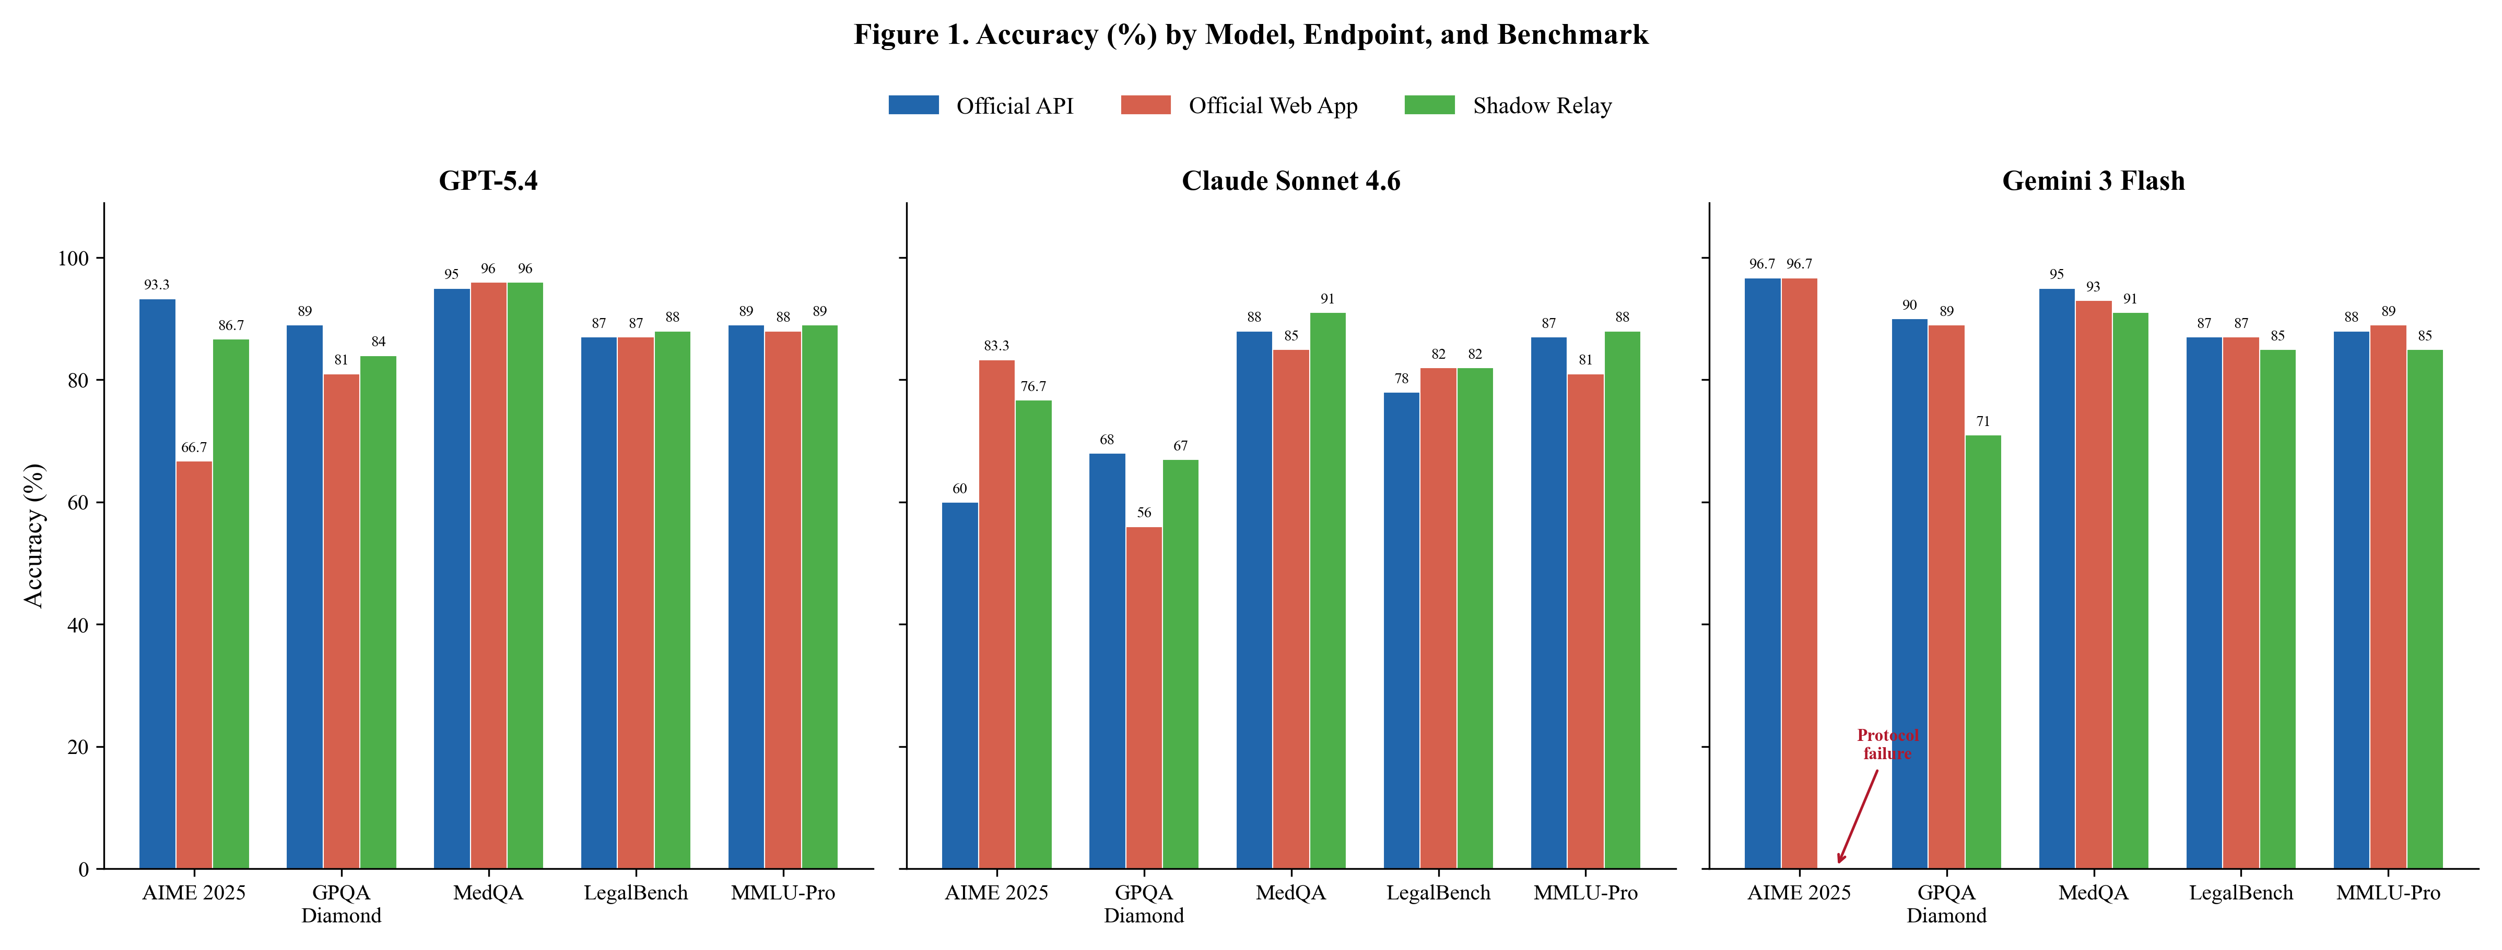
5. Endpoint Divergence Visualization
Three panels, three bars per benchmark — blue API, orange Web App, green Shadow. AIME is where everything happens.

Slide 7
6. Divergence Metrics
mean reasoning gap
RCI =
MMLU-Pro gap
▸ RCI Ratio of reasoning-task gap (AIME, GPQA) to knowledge-task gap (MMLU-Pro). RCI > 1 = endpoint hurts reasoning more. GPT-5.4 App RCI = 8.42.
▸ MEG Maximum Endpoint Gap — worst-case accuracy drop across five benchmarks. GPT-5.4 App: 26.6 on AIME. Gemini Shadow: 96.7 on AIME.
▸ MAG Mean Absolute Gap — average absolute gap across five benchmarks. GPT-5.4 App: 7.3. Gemini Shadow: 24.9. MEG = worst; MAG = typical.

Slide 8
7. Per-Model Findings
Different models, different stories — no single rule explains them.
▸ GPT-5.4: API beats App on AIME by 26.6 pp; other benchmarks barely move. Endpoint effect targets reasoning. RCI = 8.42.
▸ Claude Sonnet 4.6: App beats API on AIME by 23 pp — opposite of GPT. But App loses to API on GPQA by 12 pp. Direction flips.
▸ I don't know why Claude flips. Best guess: hidden task-type-specific budget allocation. Guess, not finding.
▸ Gemini 3 Flash: API = App (MAG 0.8). Shadow relay scored 0% on AIME — every response truncated mid-reasoning.
▸ Protocol failure, not capability failure: AIME needs a full chain before the answer; truncation wipes it out.
3
distinct behavioral patterns

Slide 9
8. Statistical Validation + Safety
Wilson CIs confirm the big gaps; safety shifts too.
▸ Wilson binomial CI is designed for small samples and extreme proportions.
▸ GPT-5.4 AIME: API CI [78.7, 98.2] vs App CI [48.8, 80.8] — no overlap, 26.6 pp is real.
▸ Small 1–5 pp gaps on 100-item benchmarks: CIs overlap, cannot confirm.
▸ Safety: Claude & Gemini refuse less on non-API endpoints (+4 to 7 pp harm).
▸ GPT-5.4 = 0.000 across all endpoints, but it also judged itself — treat with caution.
[78.7, 98.2]
vs [48.8, 80.8] no overlap

Slide 10
9. Discussion — Four Takeaways
Endpoint divergence is real, irregular, and a measurement problem.
▸ No simple rule. "APIs always win" is wrong. "Relays always hurt" is wrong. It depends.
▸ Hidden variables probably shift with server load. 2 AM ≠ 2 PM. Cannot calibrate moving targets.
▸ Fingerprinting paradox: identity tools assume same model = same behavior. My data breaks that assumption.
▸ Practical fix: report model string, SDK version, reasoning_effort, temperature — not just "GPT-5.4".
4
takeaways

Slide 11
10. Limitations and Conclusion
Endpoint choice moves a benchmark score by 0 to 96.7 percentage points.
▸ AIME has only 30 items — small gaps cannot be statistically confirmed.
▸ Each cell ran once; three runs would triple the cost (self-funded project).
▸ Black-box problem: hidden system prompts, budgets, relay backends — all invisible.
▸ Data from March 2026 only — may not replicate later. That instability is part of the finding.
▸ Takeaway: write down how you accessed the model. A browser score ≠ an API score.
▸ "The relay is part of the measurement apparatus, not a transparent pipe."
0 – 96.7
percentage points of movement

Slide 12
Thank You
Questions? Peng Jiaxuan 22265120128 Neusoft Institute Guangdong

