Slide 1
hw5-2
More Style-Transformer
蔡翔陞 張致強 鍾起鳴

Slide 2
5.2.1 More Style-Transformer

Slide 3
More Style-Transformer
Input
X, Style
model
?
Output
y
magic?
something realistic?

Slide 4
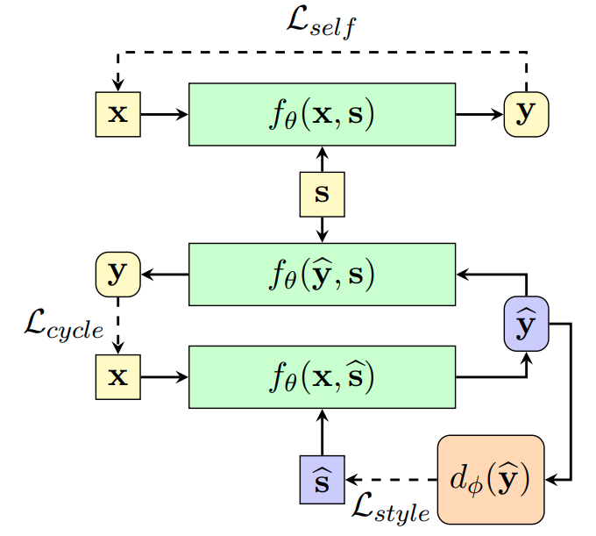
Gain insight into…….
How did output generate?
How did discriminator work?
How did input tokens affect output?

Slide 5
5.2.1 Tasks

Slide 6
Problem 1 - How did output generate?
Sty
Style
transformer
Y
X
memory
Y
encoder
decoder
Sty
X
Y

Slide 7
Problem 1 - How did output generate?
Sty
Y
X
memory
Y
</s>
encoder
decoder
Sty
X
<s>
Y

Slide 8
Problem 1 - How did output generate?
attending to previous states and memory (encoder output)
Sty
Y
X
Y
</s>
encoder
Sty
X
<s>
Y

Slide 9
Problem 1 - How did output generate?
Todo:
Select one sentence from test set
Transfer the style
Visualize the attention weights on memory while decoding (for each heads and layers)
The style token seems not being attended to while decoding, but the style is actually being transferred. Do you think it’s reasonable? Why or why not?
Hint: how does the information of “style” flow?

Slide 10
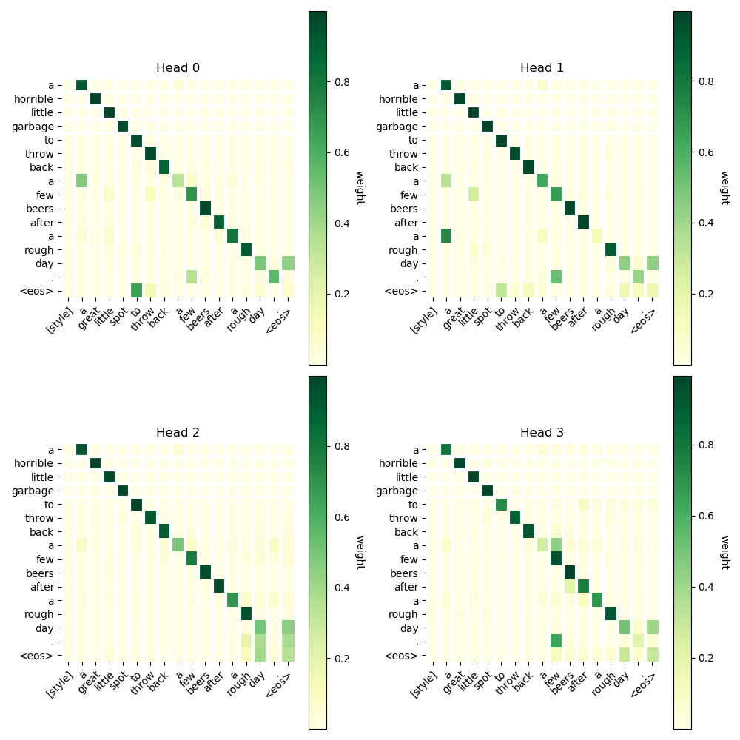
Problem 1 - How did output generate?
Todo:
Select one sentence from test set
Transfer the style
Visualize the attention weights on memory while decoding (for each heads and layers)
The style token seems like not being attended while decoding, do you think it’s reasonable?Why or why not?
[gold] a great little spot to throw back a few beers after a rough day .
[rev ] a horrible little garbage to throw back a few beers after a rough day .

Slide 11
Problem 1 - How did output generate?
Todo:
Select one sentence from test set
Transfer the style
Visualize the attention weights on memory while decoding (for each heads and layers)
The style token seems like not being attended while decoding, do you think it’s reasonable?Why or why not?
[gold] a great little spot to throw back a few beers after a rough day .
[rev ] a horrible little garbage to throw back a few beers after a rough day .

Slide 12
Problem 1 - How did output generate?
Todo:
Select one sentence from test set
Transfer the style
Visualize the attention weights on memory while decoding (for each heads and layers)
The style token seems like not being attended while decoding, do you think it’s reasonable?Why or why not?
[gold] a great little spot to throw back a few beers after a rough day .
[rev ] a horrible little garbage to throw back a few beers after a rough day .

Slide 13
Problem 2 - How did discriminator work?
Multi
Cond
X
Discriminator
P
S
N
F
P: Positive
N: Negtive
F: Fake
S: Score

Slide 14
Problem 2 - How did discriminator work?
Multi
Cond
X
P
S
Classifier
N
emb
emb
F
BERT( self-attention )
<cls>
X
P: Positive
N: Negtive
F: Fake
S: Score

Slide 15
Problem 2 - How did discriminator work?
useful for classifying
(maybe) contain the style information
Multi
Cond
X
P
S
Classifier
N
emb
emb
F
BERT( self-attention )
<cls>
X
P: Positive
N: Negtive
F: Fake
S: Score

Slide 16
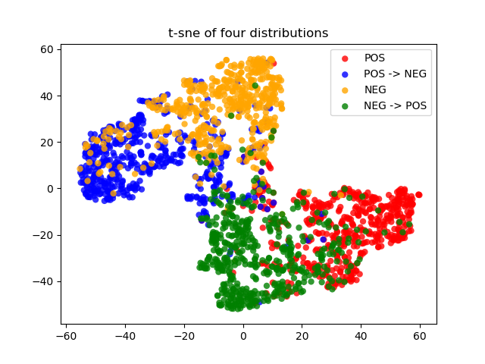
Problem 2 - How did discriminator work?
Todo:
Sample sentences of each style from dataset
Transfer style for each sentence
Collect the embedding of <cls>
Use T-sne to visualize the distributions
Does the result look reasonable?
expected result:
Pos
A
C
Neg
B
D
Sample
Transfer

Slide 17
Problem 3 - How did input tokens affect output?
Sty
Y
X
memory
Y
</s>
encoder
Sty
<s>
Y

Slide 18
Problem 3 - How did input tokens affect output?
observe the changes of output
Sty
Y
X
memory
Y
</s>
encoder
Sty
<s>
Y
masking input

Slide 19
Problem 3 - How did input tokens affect output?
Todo:
select one sentence from test set
mask one position at a time then do style transfer
observe the result and show your discovery
Hint: Does masking N or ADJ make any difference? what kind of token affect the mostly on style, why?

Slide 20
What you should do?
Understand the modules of Style-Transformer
Problem 1
sample one sentence and apply style tranfer
show the attention maps and your explanation
Problem 2
apply style transfer on test data and collect the sentence embedding
visualize the distribution of embedding by T-sne
Problem 3
sample one sentence, mask one position at a time and do style transfer
show the results and your explanation

Slide 21
What you should do? (Most important)
we have already written all the codes for you \OwO/
how to run?
python main.py --part2 --part2_model_dir=<trained model dir> --part2_step=<trained step>
example: python main.py --part2 --part2_model_dir=save/Feb15203331/ckpts/ --part2_step=1300
all the results could be found under ./part2_output/

Slide 22
5.2.3 Sample Report

Slide 23
hw5-2
b05902066 蔡翔陞

Slide 24
problem1
[gold] a great little spot to throw back a few beers after a rough day .
[rev ] a horrible little garbage to throw back a few beers after a rough day .
layer 1
layer 2
I think the style token isn’t being attented to while decoding because…...
layer 3
layer 4

Slide 25
problem2
It looks…...

Slide 26
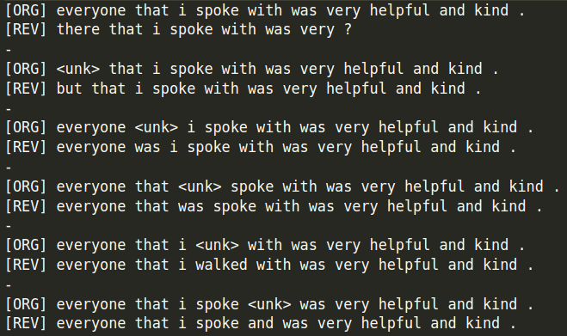
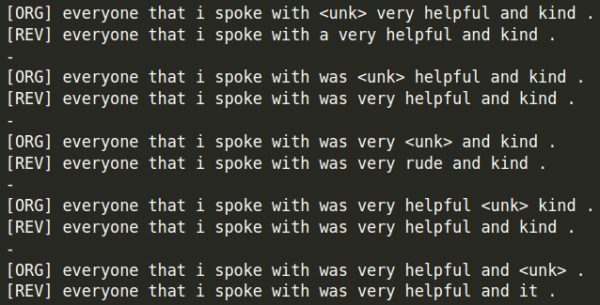
problem3
I think…...

Slide 27

Eazzzzzzzy
(this page is not included.）

Slide 28
5.2.4 Grading

Slide 29
Grading (6%)
Problem 1 (2.5%)
show the attention maps(0.5%)
your explanation (2%)
Problem 2 (1%)
show T-sne and simple explanation (1%)
Problem 3 (2.5%)
show the results (0.5%)
your explanation (2%)

Slide 30
Q&A

