Slide 1
HW 5-3
TA's
鍾起鳴
張致強
蔡翔陞

Slide 2
What you can do?
Improve your model - Add dataset. - Experiment at the discrete part.
Add more styles - Styles not related to positive and negative style.
Try other models You can choose some bonus to implement.

Slide 3
Improve your model
Option 1

Slide 4
Hint1: Add dataset
You can use other english dataset (neg/pos) to improve your model.
Yelp dataset is used in 5-1. You can use IMDB dataset which is also provided.
If you want to add or change dataset, you can train an evaluator for the dataset. (It is quick and no GPU required) 1. How to train evaluator: https://hackmd.io/NgYXPtOqRCWKHV33L1NofQ?view

Slide 5
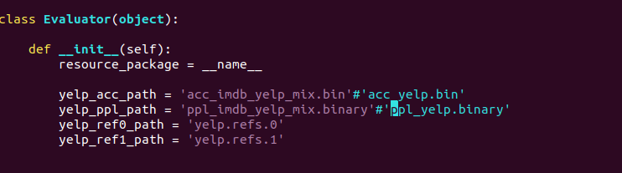
Example (mix imdb + yelp)
You can download the binary file for evaluator https://drive.google.com/drive/u/1/folders/1DBG0ZXHllHnxuEcJtCPVdHht0e0bpARj Or train your own binary file: https://hackmd.io/NgYXPtOqRCWKHV33L1NofQ?view (read part1 to part2)
You can train on yelp+imdb and test on yelp. Change the evaluator.py as follows:
Use mix-dataset(yelp+imdb): python main.py -data_path ./data/mix/ --use_wandb
Bigger dataset may need more train_iterations

Slide 6
Scoring Criteria for Option 1
You should show the auto evaluation and graphs.
You need to show the outputs (with same input sentences in 5-1) and report your findings.
You can submit the output (English) with these improvements for human evaluation.

Slide 7
Why train Evaluator?
The evaluator is used for calculating perplexity and accuracy. The default evaluator is trained on Yelp. Therefore, using the default evaluator may not suitable on different datasets.
Auto evaluations on 5-3 don’t need to be better than 5-1 since they have different evaluator.

Slide 8
Add more styles
Option 2

Slide 9
Hint: Styles not related to positive and negative
Any language is allowed.
For example: - PTT 噓文 vs PTT 推文 - Different Gender - Any kind of styles
If you want to add or change dataset, you need to train an evaluator for the dataset. (It is quick and no GPU required) How to train evaluator: https://hackmd.io/NgYXPtOqRCWKHV33L1NofQ?view

Slide 10
Provided Datasets
Gender: http://tts.speech.cs.cmu.edu/style_models/gender_data.tar
Political: http://tts.speech.cs.cmu.edu/style_models/political_data.tar
Any other datasets are allowed

Slide 11
Example( gender data )
Gender directory:
Yelp directory:
Change the Gender directory to the format like Yelp directory, for example: male->pos, female->neg.
Prepare your gender dataset. (Refer the https://hackmd.io/NgYXPtOqRCWKHV33L1NofQ?view , you can download from https://drive.google.com/drive/u/1/folders/1DBG0ZXHllHnxuEcJtCPVdHht0e0bpARj and jump to part 3)
(test.neg, test.pos , reference.neg, reference.pos should only contains 500 lines)

Slide 12
Scoring Criteria for Option 2
You should show the auto evaluation and graphs.
You should show 5 sentences of each style in the report.
The fluency of the sentence may affect your bonus point. Therefore you may want to cherry pick your results.

Slide 13
Try other models
Option 3

Slide 14
Use other models
Any code on Github is allowed

Slide 15
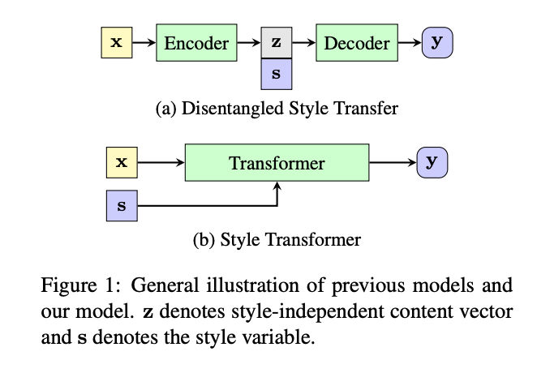
Scoring Criteria for Option 3
You should show 5 sentences of each style in the report.
You should explain that whether your model type is entanglement or disentanglement. For example: HW5-1 is entanglement.
The model of HW5-1 is shown as (b), without a combination of disentangled representations z(latent) and s(style) as described by (a).

Slide 16
Grading

Slide 17
Choose an option to implement(3%)
Improve your model If you choose to improve your model from 5-1, you can use the result for submission.txt in 5-1.
Add more styles
Try other models
The report format should be same as HW5-1
show configuration (1%)
show loss plot (1%)
show metrics (0.5%)
show examples & comment on them (0.5%)

Slide 18
Sample Report of option 1

Slide 19
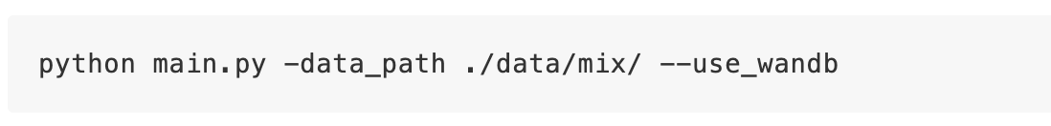
Configuration
Example1 : We use the default settings
Example2: We add the iterations to 4000 steps

Slide 20
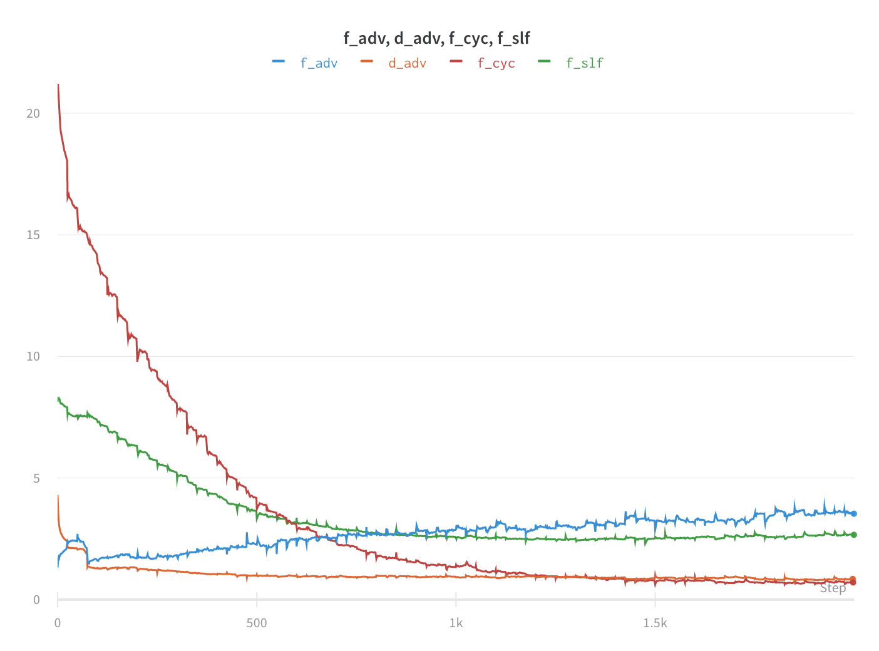
Loss
d_adv | discriminator loss
f_adv | style controlling loss
f_cyc | cycle consistency loss
f_slf | self reconstruction loss

Slide 21
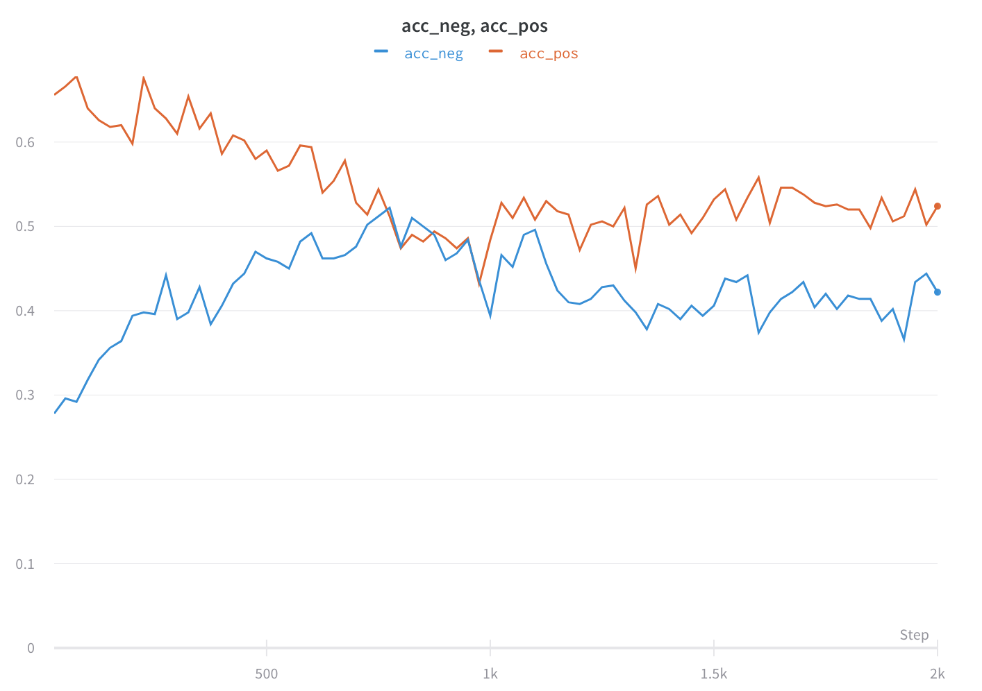
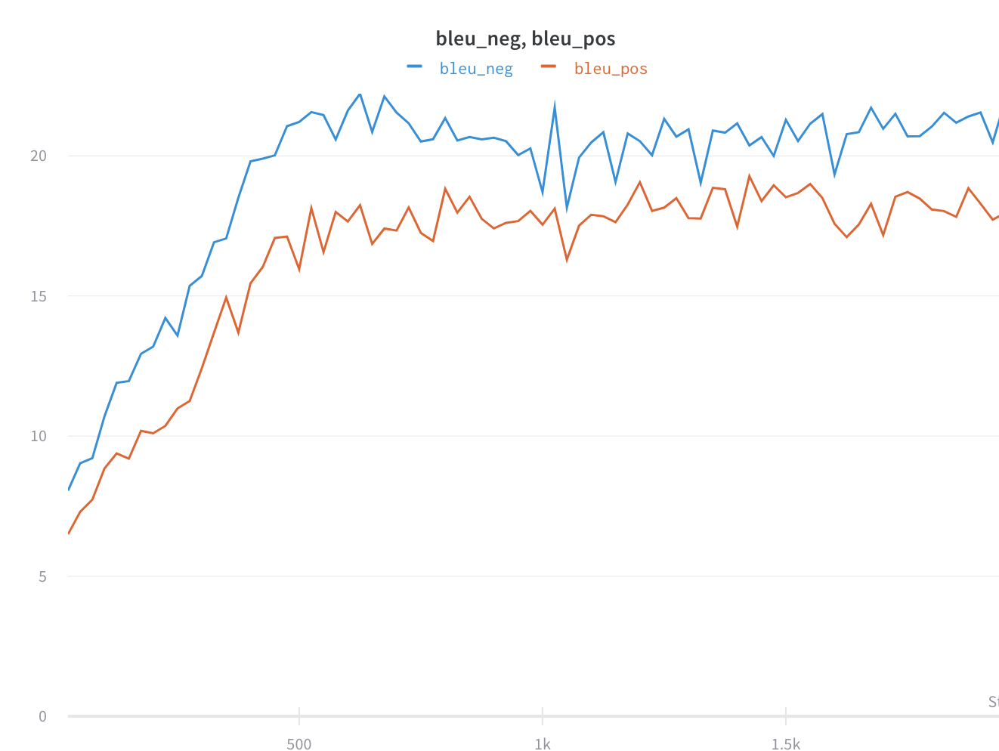
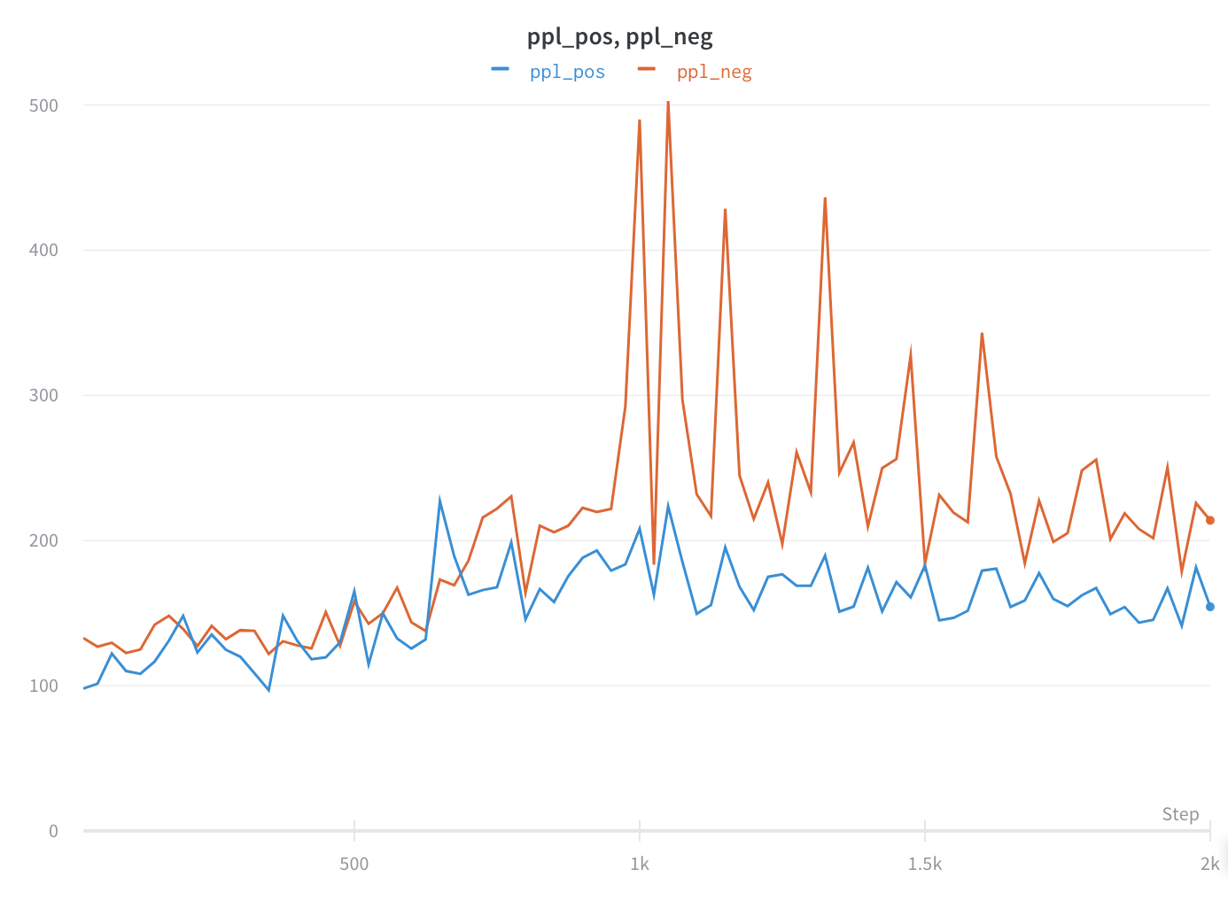
Evaluation Metric
 | pos | neg | avg
accuracy | 0.524 | 0.422 | 0.473
ref-bleu | 18.146 | 20.881 | 19.513
perplexity | 154.369 | 213.897 | 184.133

Slide 22
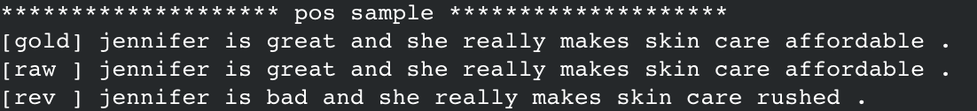
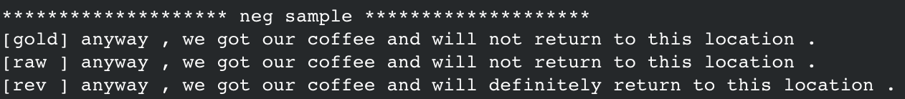
Evaluation

Slide 23
Observation (optional)
The generated sentence are longer than the sentence in hw5-1 because the sentences in yelp are shorter than those in imdb.

Slide 24
Sample Report of option 2

Slide 25
Configuration
We use the provided gender data

Slide 26
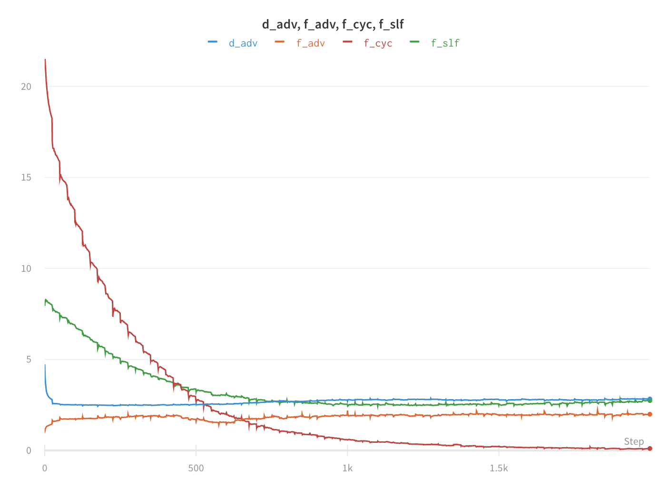
Loss
d_adv | discriminator loss
f_adv | style controlling loss
f_cyc | cycle consistency loss
f_slf | self reconstruction loss

Slide 27
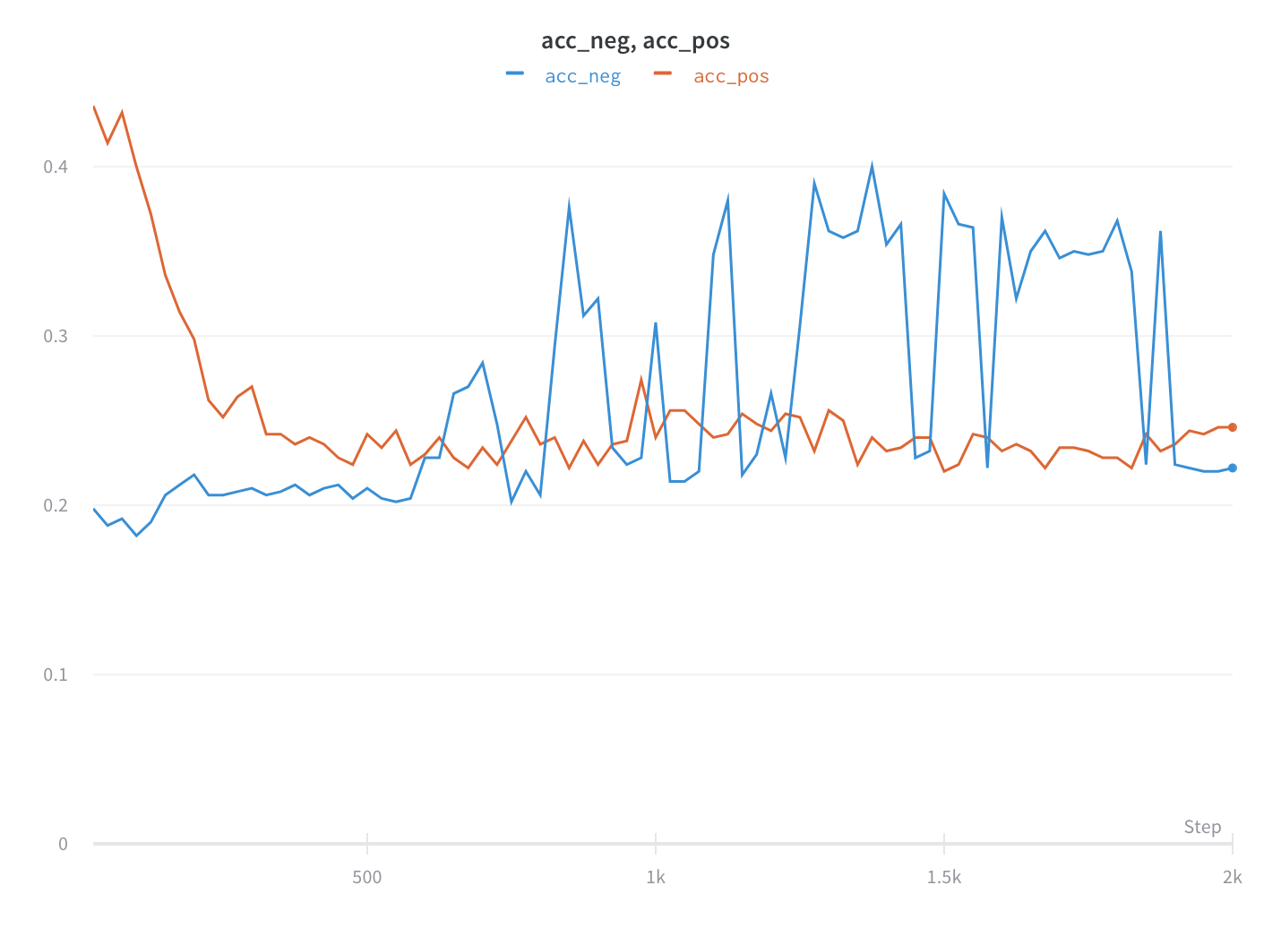
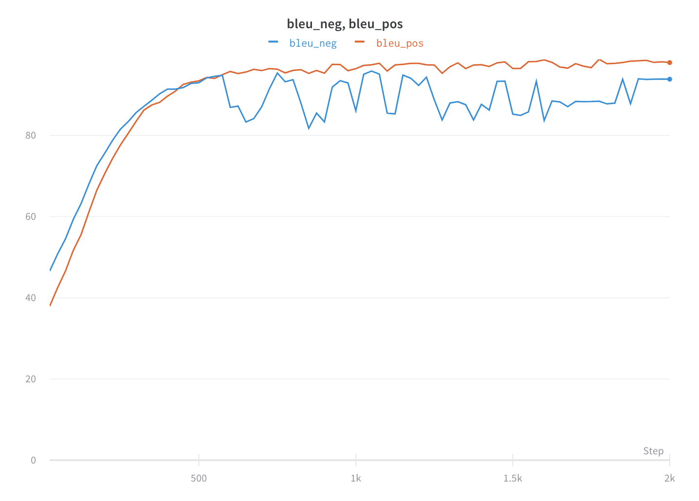
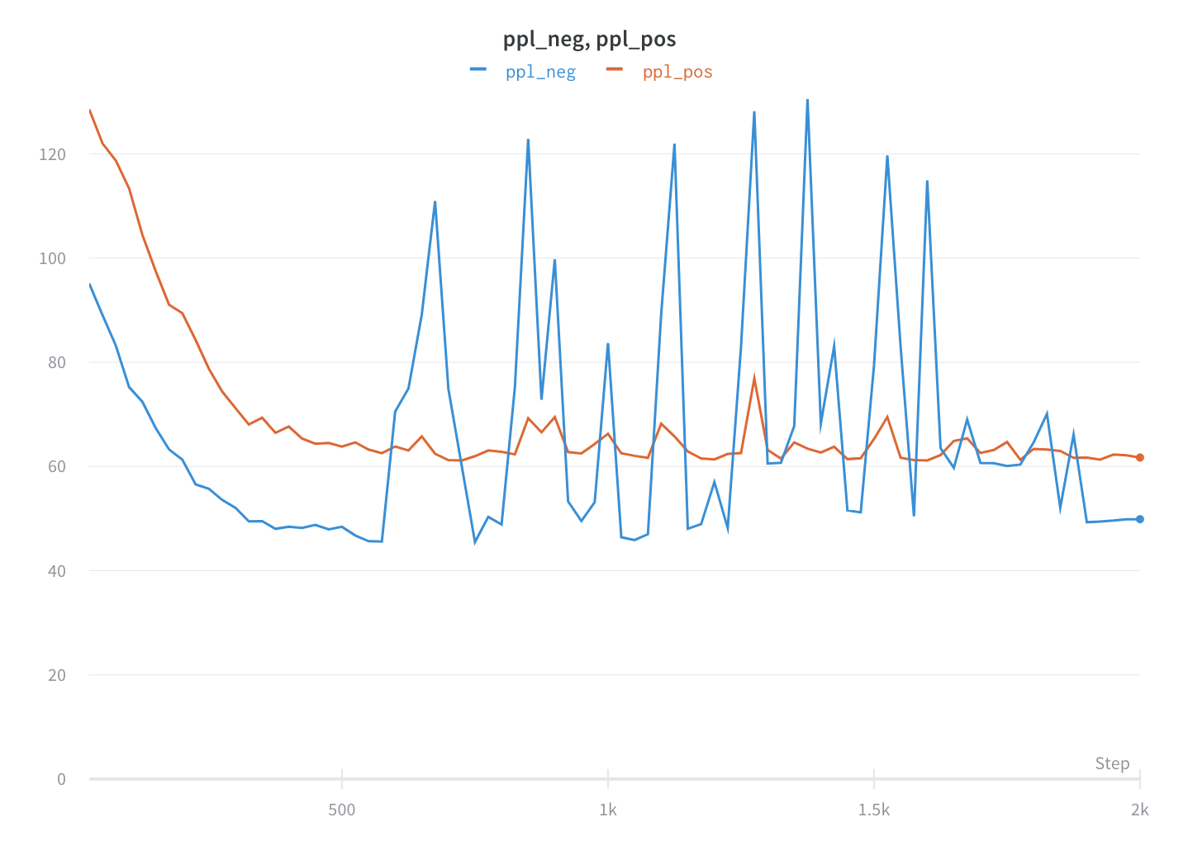
Evaluation Metric
 | pos | neg | avg
accuracy | 0.246 | 0.222 | 0.234
ref-bleu | 97.951 | 93.853 | 95.902
perplexity | 61.715 | 49.883 | 55.799

Slide 28
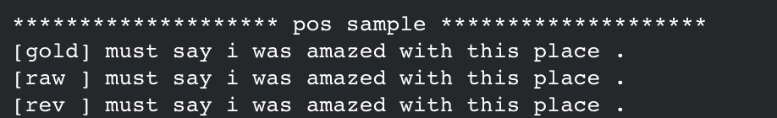
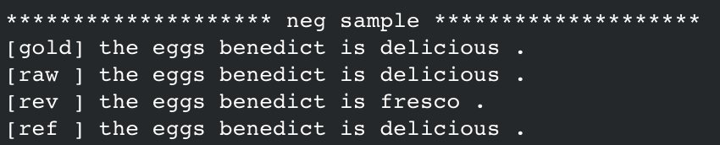
Evaluation

Slide 29
Observation (optional)
The generated sentences of female and male are similar. There is no big difference between female and male in speech.

Slide 30
Q&A

