Slide 1
DLHLP HW4-2
謝濬丞 紀伯翰

Slide 2
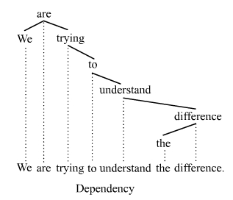
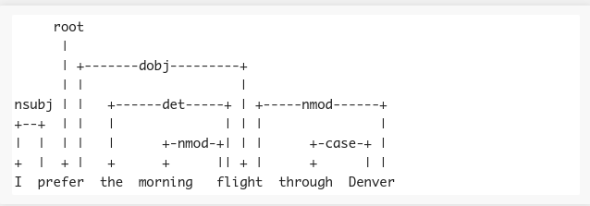
Dependency Parsing Tree
Dependency parsing is the task of extracting a dependency parse of a sentence that represents its grammatical structure and defines the relationships between head words and words, which modify those heads.
來源: https://en.wikipedia.org/wiki/Dependency_grammar , http://nlpprogress.com/english/dependency_parsing.html

Slide 3
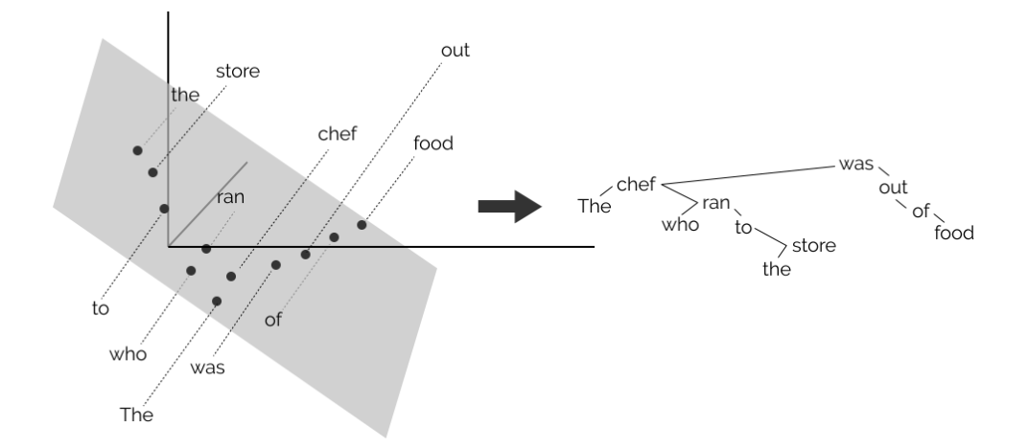
Tree structure of contextualized word embeddings learnt by Bert
The chef who ran to the store was out of food.
Notes:
https://github.com/john-hewitt/structural-probes
https://nlp.stanford.edu//~johnhew//public/hewitt2019structural_slides.pdf

Slide 4
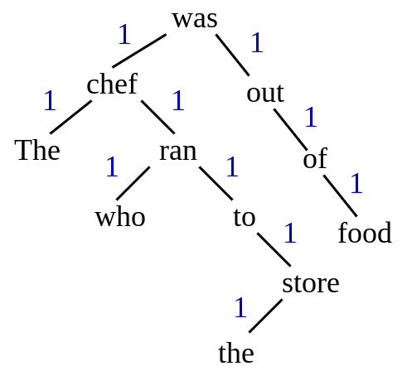
Definition 1
According to the tree, we define the distance between two neighbor is 1.
The operations are simple. First, subtract the two vectors after projection ,and then take the square of L2 norm of the subtracted vector, which is the square of their distance (for simplicity ,we simply use the square distance instead of the real one).
And use L1 loss to optimize the ground truth distance.
All parameters will be tuned is the projection matrix B. (No BERT model)

Slide 5
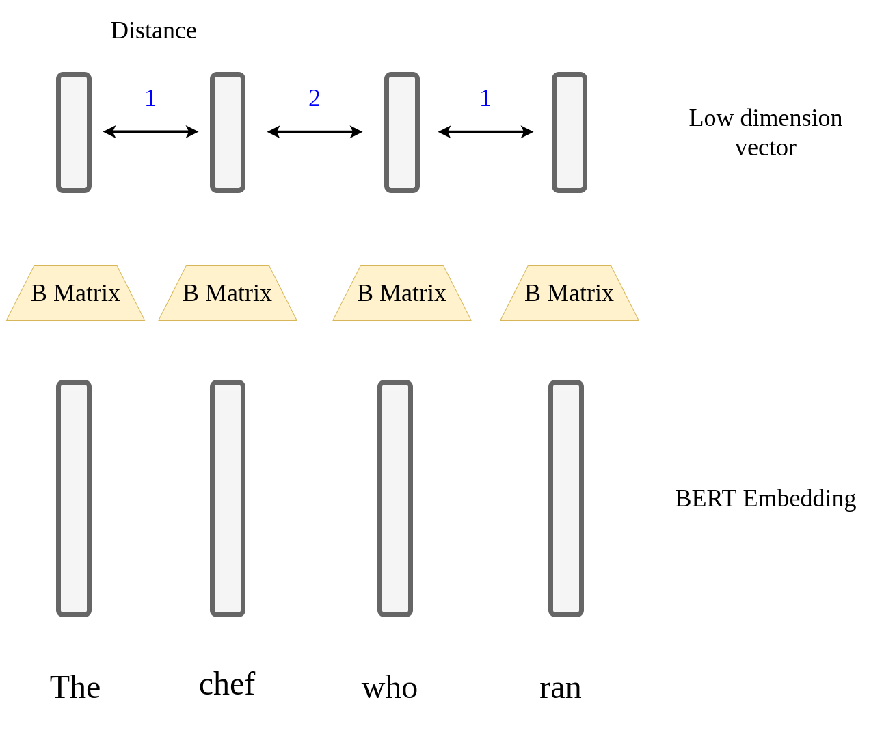
Process Detail

Slide 6


Definition 1
Distance of high-dimensional vectors
By definition, a valid distance metric is semi-positive definite
We can learn a matrix B s.t with
Which is equivalent to finding the subspace where the dependency tree is embedded.
For a sentence of length N, with all N(N-1)/2 distances known, we can reconstruct an undirected dependency parse tree.
Notes:
https://nlp.stanford.edu//~johnhew//structural-probe.html

Slide 7
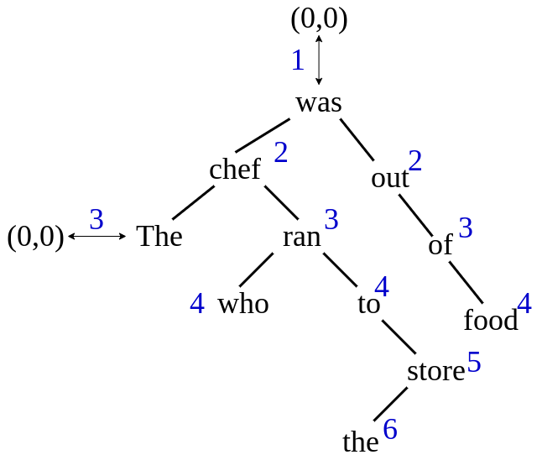
Definition 2
According to the tree, we define another distance like right picture.
The operations are simple. All our procedure is just calculate the square of L2 norm ( the distance) of the vector after projection.
And use L1 loss optimize the ground truth distance.
All parameters be tuned is the projection matrix B. (No BERT model)

Slide 8
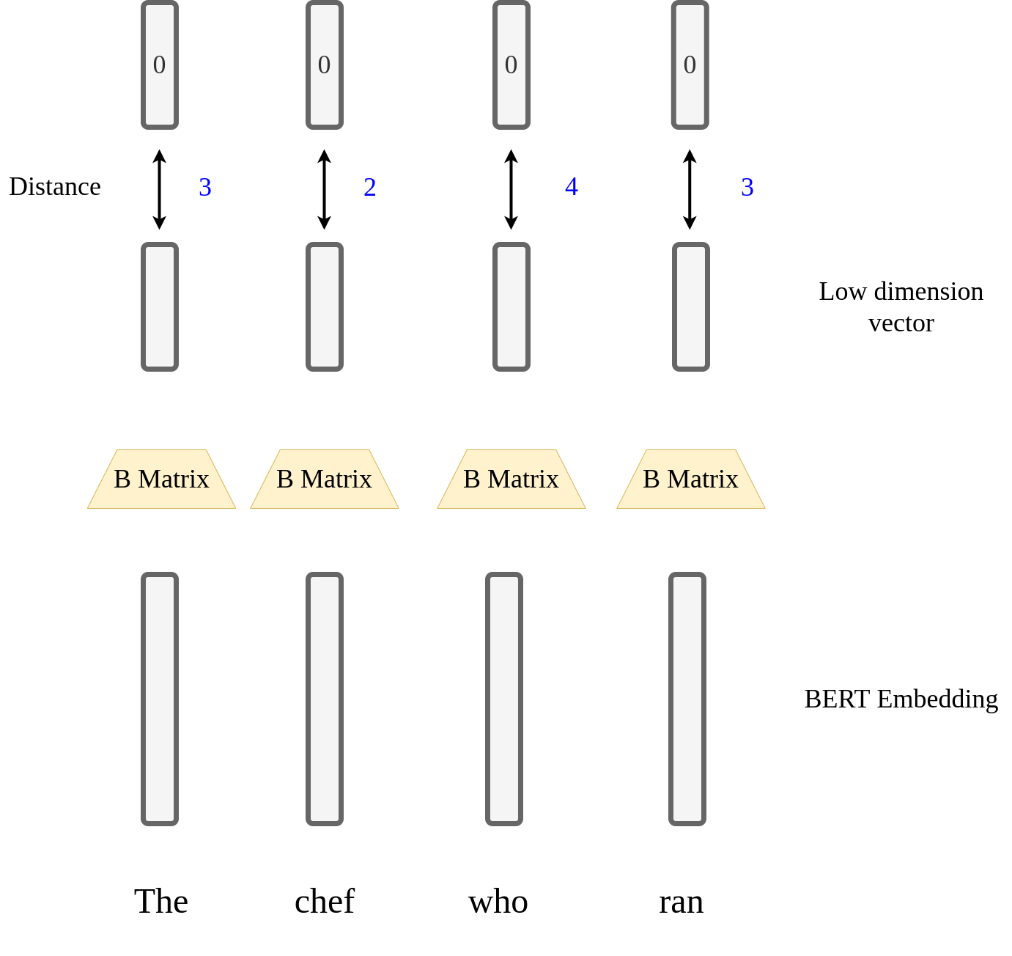
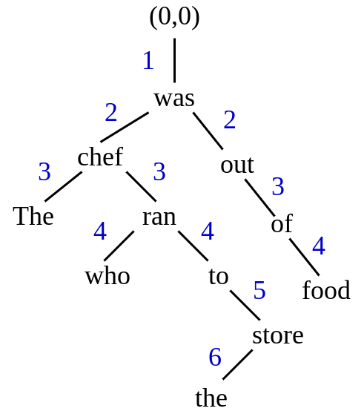
Process Detail

Slide 9
Procedure
https://github.com/Sologa/structural-probes
Dataset (Chinese Treebank): https://drive.google.com/open?id=1KMC-JYZ1wHYMFrAz_7iEiBWiGyBz94S4
(Copyrights belongs to LDC; Please do not distribute)

Slide 10

Bonus: Regression v.s. Rank loss
L1 loss forces the model to regress on the exact value of the true distances.
What if we simplify the task of getting the exact depth of the dependency tree right, to getting just the ordering of the depth right ?
Instead, minimize a pair-wise learning-to-rank loss (d: depth):
You can also take the square out of the vector norm and see if regression still performs better.

Slide 11
Scoring: Submission
Create a folder ‘hw4-2’ under your team Github repo
‘hw4-2/’ contains:
report.pdf
loss.py in structural probes if you have completed the bonus. And you should redo report problem 2 with rankloss.
Report Template

Slide 12
DLHLP HW4-3
陳延昊 吳宗翰

Slide 13
Attention
沒有強制要用Sample Code!
沒有強制要用Sample Code!
沒有強制要用Sample Code!

Slide 14
Question Answering
Context
Question

Slide 15
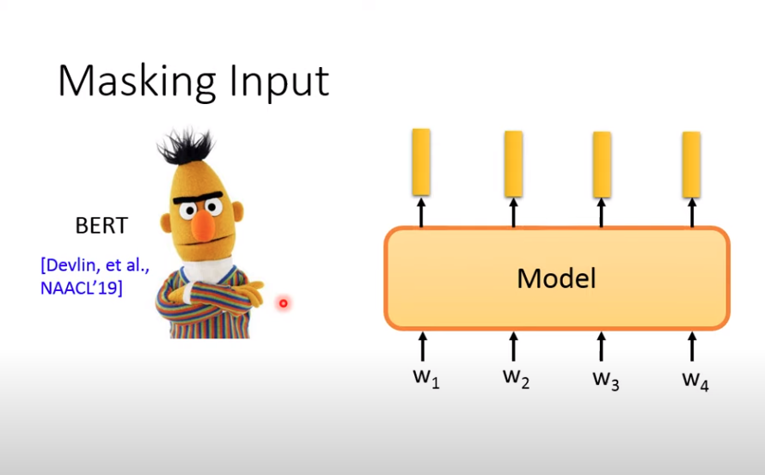
Model
https://youtu.be/Bywo7m6ySlk?t=1293

Slide 16
Question Answering
Answer
Question

Slide 17
Code
https://github.com/YNNEKUW/DLHLP_HW4-3

Slide 18
Dataset
In Github

Slide 19
Kaggle rules
Website: DLHLP(2020, Spring) HW4-3
Your team name should be in [team_github_id]_[any_string] e.g. daikin_大金
5 submission per team & per day
Using any extra kaggle account to submit is cheating!
Choose two submission as the final submission for private leaderboard before deadline
Extra training data for fine-tuning is not allowed, but it is okay to use other pretrained models (please cite the source clearly in your report)

Slide 20
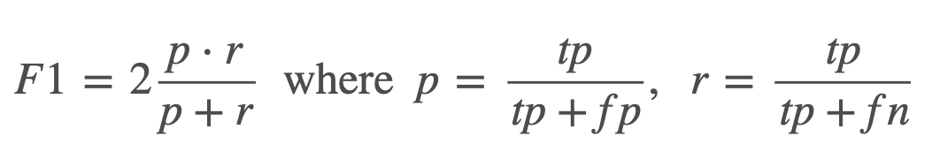
Kaggle Evaluation Metric
The evaluation metric for this competition is Mean F1-Score. The F1 score, commonly used in information retrieval, measures accuracy using the statistics precision p and recall r. Precision is the ratio of true positives (tp) to all predicted positives (tp + fp). Recall is the ratio of true positives to all actual positives (tp + fn). The F1 score is given by:
The F1 metric weights recall and precision equally, and a good retrieval algorithm will maximize both precision and recall simultaneously. Thus, moderately good performance on both will be favored over extremely good performance on one and poor performance on the other.

Slide 21
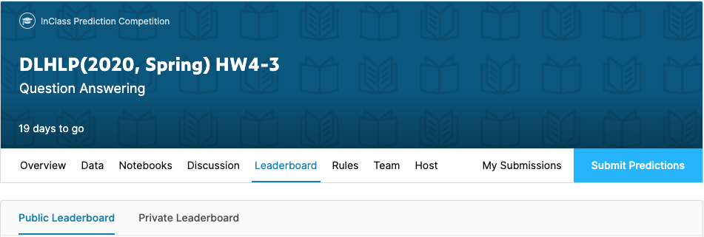
Baselines (5%)
Public Simple Baseline: 0.75544 (2 pt) Public Strong Baseline: 0.75945 (1 pt)
Private Simple Baseline: (?) (1 pt) Private Strong Baseline: (?) (1 pt)
P.S. private score will be shown after the deadline
Both would be easy to beat :p

Slide 22
Report Questions (5%)
Please give some examples predicted correctly and incorrectly respectively. At least one for each case is required. Screenshot recommended. (2 points)
Which hyper hyperparameter(s) should be modified in order to reach better performance? Please explain why it works briefly. (e.g. learning_rate, batch_size, warmup_steps, layer_norm_eps, attention_probs_dropout_prob) (3 points)
Template

Slide 23
Bonus (2%)
Presentation in class
Selection criteria
Innovation
Different models compare bert-base-chinese
Existing github is valid, but you have to understand, explain, and cite it.
Good performance
The team quota and the presentation time will be announced based on the time we have.

Slide 24
Scoring: Submission
Create a folder ‘hw4-3’ under your team Github repo
‘hw4-3/’ should contains:
report.pdf
download.sh
reproduce.sh
config.json (Optional. If you use the sample code, uploading this is recommended.)
other files and directories
We restrict Python version 3.6.8 and must compatible with these package
Scoring
Report (5%)
Kaggle (5%) (over baseline + successfully reproduce)

Slide 25
Reproduce
We will run the following command to reproduce:
```bash download.sh <OUTPUT_MODEL_PATH>```
```bash reproduce.sh <OUTPUT_MODEL_PATH> <TEST_DATA_PATH> <OUTPUT_FILE_PATH>
e.g.
```bash download.sh ./pytorch_model.bin```
```bash reproduce.sh ./pytorch_model.bin ./hw4-3_test.json ./output.csv```

Slide 26
Github maximum capacity
Use Dropbox to put your model, use ‘wget’ to download
Dropbox Tutorial: https://docs.google.com/presentation/d/1SsIeIij9ZOEN_TGdbAS1oWcI6bT1uSTI6b5__u2wdDc/edit?usp=sharing
Your shell script files should be able to download the model automatically

Slide 27
Code (for bonus)
Transformer:
huggingface/transformers: 🤗 Transformers: State-of-the-art Natural Language Processing for Pytorch and TensorFlow 2.0.
Models: https://github.com/ymcui/Chinese-BERT-wwm?fbclid=IwAR13Cr8iQEIsFTU60jYhJPS9yixjU817hMrE59h9tdFdRVefgy8d9SuuRX0

Slide 28
Deadline
2020.5.27 9:00

Slide 29
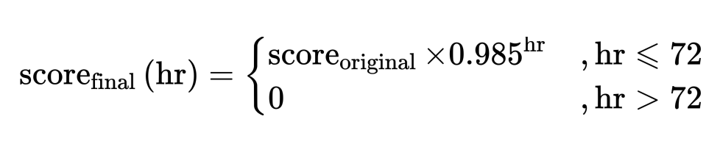
Late submission policy
You can submit file until 3 days after deadline
The score will be calculated as:
Late submision form would be anounced after deadline

Slide 30
Attention
沒有強制要用Sample Code!
沒有強制要用Sample Code!
沒有強制要用Sample Code!

Slide 31

Q&A
dlhlp.ta@gmail.com
FB Group: Deep Learning for Human Language Processing (2020,Spring)

