Slide 1
A Mobile Auxiliary Diagnosis System for Melanoma
Based on Multi-Modal Fusion and ONNX Quantization
Mid-term Project Presentation
Core idea
Pengcheng Sun
Supervisor: [to be inserted]
Dataset: ISIC2020 | Backbone: ResNet50
Combine dermoscopic images and clinical metadata, then optimize the trained model for mobile inference using ONNX quantization.
ISIC2020
ResNet50
Feature Fusion
Notes:
Opening: introduce the project as a practical mobile auxiliary diagnosis system, not only a classification experiment. Mention the three technical pillars: ISIC2020 data, multimodal feature-level fusion, and ONNX quantization.

Slide 2
1. Aims, Significance and Engineering Context
Problem motivation, stakeholders and engineering constraints
Aim
Significance
Engineering context
Develop a mobile auxiliary melanoma diagnosis prototype that predicts melanoma risk from skin lesion images and clinical metadata.
Melanoma is clinically important because early detection can strongly influence treatment decisions and patient outcomes.
The system must balance diagnostic performance, model size, inference latency and deployability on mobile devices.
Stakeholders and constraints
Target outcome
Patients and clinicians benefit from accessible preliminary screening support
The model is an auxiliary tool, not a replacement for professional diagnosis
Ethics, risk assessment, data privacy and bias must be considered
Deliverable by the end of the project
A trained and evaluated multi-modal model, exported to ONNX, quantized to INT8, and integrated into a mobile inference workflow.
Notes:
Spend about 2.5 minutes here. Make clear why this is an engineering project: dataset processing, model design, evaluation, compression, and mobile deployment.

Slide 3
2. Previous Work and Project Gap
Literature and design choices that motivate the proposed solution
CNN skin lesion classification
Clinical context matters
Deployment gap
Deep CNNs such as ResNet have become a common baseline for dermoscopic image classification because they learn hierarchical visual features.
Clinical metadata such as age, sex and anatomical site can provide complementary information to visual features.
High-performing models can be too large or slow for mobile use, so model conversion and quantization are required.
Image model
+ Metadata
+ Quantization
Mobile demo
Project gap addressed
This project combines diagnostic accuracy and deployability: a multi-modal melanoma classifier is designed and then compressed for mobile inference.
Notes:
Keep this to about one minute. Summarise previous work briefly, then emphasise the gap: most work focuses on classification performance, while this project also considers deployment.

Slide 4
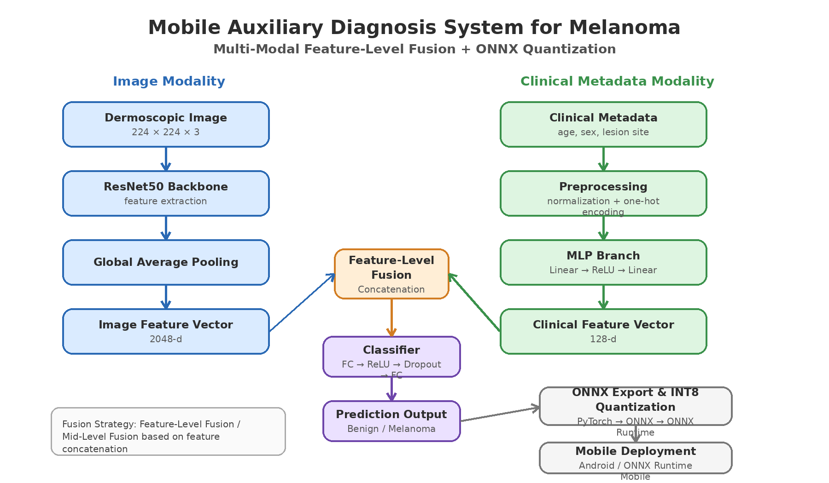
3. Overview of the Design Solution
System-level flow from data to mobile deployment
Architecture name: ResNet50-MLP Multimodal Feature-Level Fusion Network
Notes:
Spend about two minutes here. Explain the two input modalities, the two branches, feature-level concatenation, classifier, and ONNX deployment route.

Slide 5
4. Dataset and Preprocessing
ISIC2020 images and clinical metadata
Input data
Target label
Clinical features
ISIC2020 dermoscopic lesion images with patient metadata.
Binary classification: melanoma vs benign / non-melanoma.
age_approx, sex, anatomical_site_general_challenge.
Image preprocessing
Metadata preprocessing
Resize to 224 x 224
Normalization with ImageNet statistics
Data augmentation: flip, rotation, colour jitter
Train / validation / test split
Age normalization
Sex: one-hot encoding
Anatomical site: one-hot encoding
Missing values: imputation or unknown category
Key issue to handle
Class imbalance in melanoma classification requires careful evaluation using AUC, recall and F1-score, not accuracy only.
Notes:
Mention that you use ISIC2020 because it includes both images and metadata, which matches the multi-modal aim.

Slide 6
4. Methods and Justification
ResNet50 baseline and multi-modal feature-level fusion
Baseline model
Clinical branch
Fusion classifier
Image only
ResNet50 -> global average pooling -> FC classifier
Metadata only
Normalized / encoded clinical vector -> lightweight MLP
Image feature 2048-d + clinical feature 128-d -> concatenation -> FC classifier
Why ResNet50?
Why feature-level fusion?
Why not attention first?
Strong and well-understood CNN backbone; suitable as a reliable baseline for skin lesion image classification.
Combines high-level visual features and structured clinical context before classification, while staying simple and ONNX-compatible.
Attention can be explored later, but it increases complexity and mobile deployment risk at mid-project stage.
Selected strategy: Feature-Level Fusion / Mid-Level Fusion based on feature concatenation
Notes:
Use this slide for methods. Mention the baseline will establish a reference point, and the fusion model will show whether metadata improves performance.

Slide 7
4. ONNX Quantization and Mobile Deployment Method
Path from trained PyTorch model to mobile inference
PyTorch training
ONNX export
INT8 quantization
Mobile inference
Train baseline and fusion models
Convert computational graph
Reduce model size and latency
Run with ONNX Runtime Mobile
Evaluation after deployment optimisation
Accuracy impact
Efficiency gain
Practical output
Compare classification metrics before and after ONNX conversion / INT8 quantization.
Measure model file size and inference latency on CPU / mobile runtime.
Prepare a mobile inference workflow or app demo for project deliverables.
Notes:
Explain the technical deployment method and why model size and inference time matter for a mobile auxiliary diagnosis system.

Slide 8
5. Results and Progress to Date
Tangible deliverables completed or in progress
Progress checklist
Current tangible outputs
ISIC2020 dataset selected
Completed
1. Project architecture diagram
2. Defined data pipeline
3. Baseline training pipeline being prepared
4. Evaluation table template for baseline upload
5. Plan for ONNX and INT8 comparison
System architecture designed
Completed
ResNet50 baseline implementation
In progress
Clinical metadata preprocessing
In progress
Feature fusion model
Next
Evidence to show during presentation
ONNX export and quantization
Next
Code screenshots, training log, sample preprocessed images, baseline loss / AUC curves, and log-book pages.
Mobile inference workflow
Planned
Important assessment reminder
Bring printed / inspectable log-book including risk assessment and ethics assessment.
Notes:
This slide should convince the assessor that there are deliverables beyond literature review. Update the checklist before presentation with real training status.

Slide 9
5. Baseline Training Results Placeholder
Leave this slide for the ResNet50 baseline results to be inserted later
ResNet50 image-only baseline
Training / validation loss curve
AUC / accuracy curve
INSERT BASELINE PLOT HERE
(loss vs epoch)
INSERT BASELINE PLOT HERE
(metric vs epoch)
Metrics table
Accuracy
Precision
Recall
F1-score
AUC
Inference
TBD
TBD
TBD
TBD
TBD
TBD
Use this baseline to compare against the multi-modal fusion model and the quantized ONNX model.
Notes:
Replace the TBD values and plots once the baseline training is complete. The baseline slide is essential because it supports the later comparison with feature fusion and quantization.

Slide 10
6. Discussion of Results and Progress
Critical reflection at the almost half-way stage
What is on track
Main challenges
Next technical focus
The project scope has been narrowed to a realistic pipeline: ISIC2020, ResNet50 baseline, feature fusion, ONNX quantization.
Class imbalance, missing metadata, overfitting risk, and maintaining performance after quantization.
Finish baseline results, train feature-fusion model, and measure accuracy-size-latency trade-offs.
Risk mitigation
Class imbalance
Use AUC, recall, F1-score; consider weighted loss / sampling
Metadata missing values
Add unknown category and document preprocessing choices
Mobile constraints
Compare FP32 ONNX vs INT8 ONNX model size and latency
Time pressure
Prioritise working baseline + fusion + ONNX over complex attention
Notes:
This is a reflective slide. Avoid just listing progress; discuss challenges and show that your planning is realistic.

Slide 11
7-8. Management Plan and Use of Feedback
Updated plan going forward and how project-plan feedback is used
Forward plan
Use of supervisor feedback
W1
W2
W3
W4
W5
W6
W7
Feedback: keep scope achievable
Preprocessing + baseline
Action: focus on ISIC2020, ResNet50 and feature-level fusion rather than multiple complex models.
Fusion model training
Feedback: show implementation evidence
Evaluation and analysis
Action: prepare baseline results, model architecture, code screenshots and training logs.
ONNX export + INT8
Feedback: measure trade-offs
Mobile demo / workflow
Action: compare accuracy, AUC, model size and inference time before and after quantization.
Final report and polish
To update
Replace this section with exact supervisor feedback once available.
Notes:
This slide covers both management and use of feedback. Before presenting, replace the generic feedback boxes with your actual supervisor feedback.

Slide 12
9. Conclusion
Current position and immediate next steps
Completed so far
Immediate next step
Final project target
Project aim, ISIC2020 dataset choice, system architecture, fusion strategy, and evaluation/deployment plan.
Insert baseline ResNet50 training results and use them as the comparison point for multi-modal fusion.
A working mobile auxiliary diagnosis workflow with ONNX INT8 model and performance evaluation.
Summary: the project is moving from planning to implementation, with the next milestone being baseline results and a measurable comparison against fusion and quantized models.
Questions?
Notes:
Conclude in about 30 seconds. Reiterate progress, deliverables, and next milestone.

Slide 13
Key References
Use standard referencing style; update before final presentation
ResNet50 baseline
He, K., Zhang, X., Ren, S. and Sun, J. (2016). Deep Residual Learning for Image Recognition. CVPR.
ISIC2020 dataset
Rotemberg, V. et al. (2021). A patient-centric dataset of images and metadata for identifying melanomas using clinical context. Scientific Data.
Skin lesion benchmark
Tschandl, P., Rosendahl, C. and Kittler, H. (2018). The HAM10000 dataset. Scientific Data.
Deployment
ONNX Runtime documentation: model conversion, runtime inference and quantization workflow.
Dataset documentation
ISIC 2020 Challenge dataset documentation: images, metadata fields and target labels.
Note
Appendix / backup slide. Replace or expand references with the exact sources used in the report.
Notes:
References slide. Keep it as backup unless you have time.

