Slide 1
TensorTEE: Unifying Heterogeneous TEE Granularity for Efficient Secure Collaborative Tensor Computing
Husheng Han, Xinyao Zheng, Yuanbo Wen, Yifan Hao, Erhu Feng, Ling Liang, Jianan Mu, Xiaqing Li, Tianyun Ma, Pengwei Jin, Xinkai Song, Zidong Du, Qi Guo, Xing Hu

Slide 2
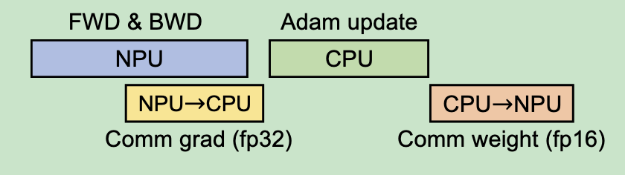
Background
ZeRO-Offload: Offload the gradients and optimizer states to the CPU while keeping forward and backward computation on NPU
Zero-offload: Democratizing billion-scale model training (USENIX ATC 21)

Slide 3

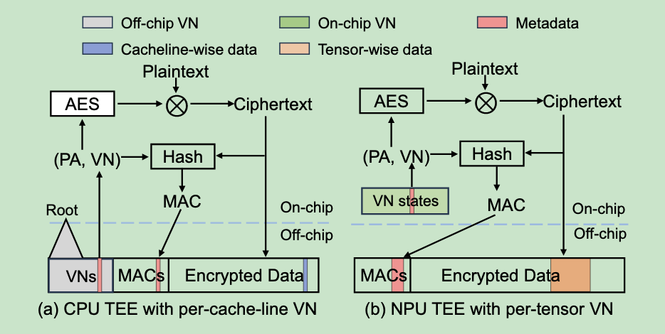
Background
Memory encryption

Slide 4
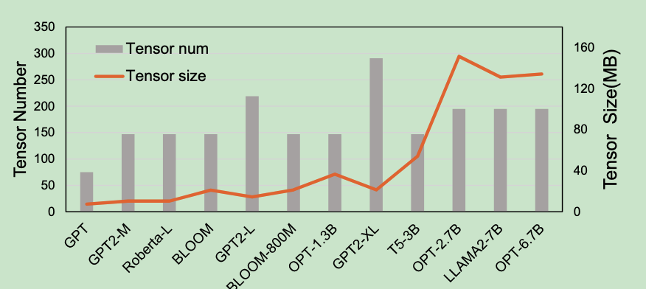
Background
Memory encryption
Mismatched granularity for VN:
cacheline: 56bit VN per 64B data block CPU TEE
tensor: Several MBs NPU TEE

Slide 5
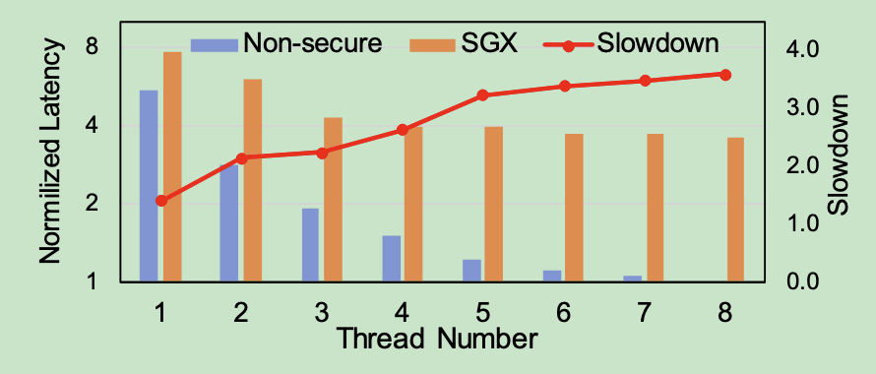
Motivation - 1
Inefficient CPU TEE Computation with Cacheline-Wise Metadata
Adma optimizer, 3.7x slowdown in TEE
compute-intensize to memory-intensive
increased memory access comes from metadata (VN and MAC).

Slide 6
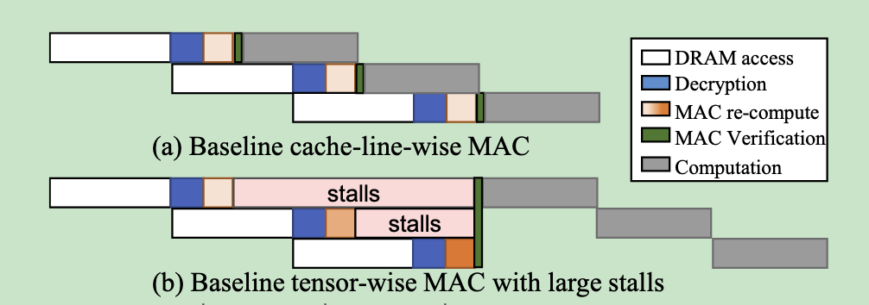
Motivation - 2
Cacheline-Wise MAC of NPU Leads to Large Storage and Performance Overhead
predictive execution -> storage overhead remains
increased granularity (64B to 512B) -> computation stall
tensor-wise MAC with delayed verification
Tampering can only occur on data but not code
Tampered data on the NPU cannot leave the NPU chip or memory

Slide 7
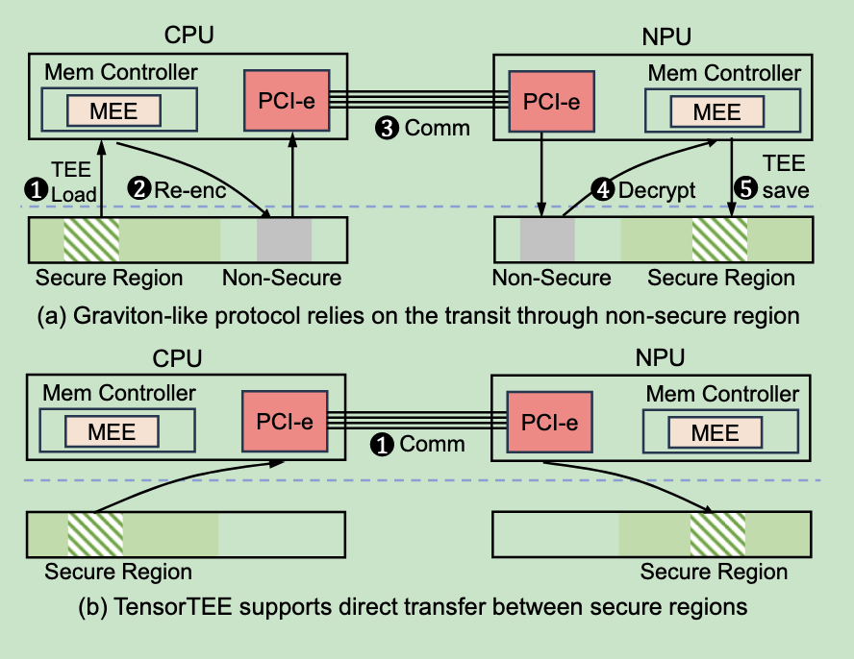
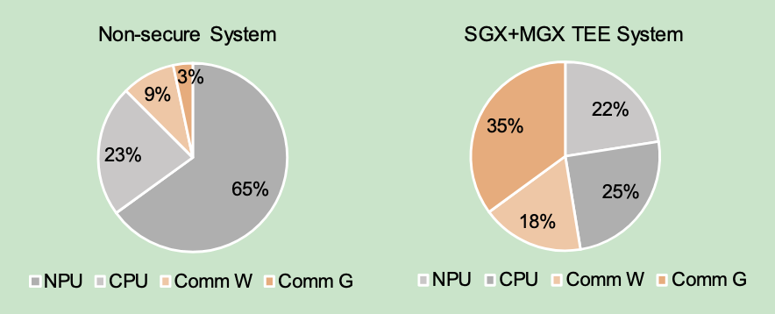
Motivation - 3
Inefficient Data Transfer Protocol

Slide 8
TensorTEE
Tensor-wise memory protection on CPU
Tensor-wise MAC with delayed verification on NPU
Direct data transfer protocol

Slide 9
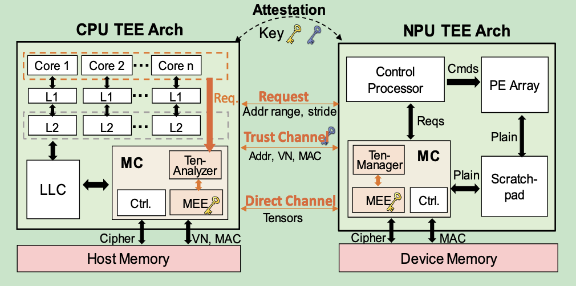
Tensor-wise memory protection
Tensor Management structure
Tensor-Analyzer 接受CPU核心的内存访问请求,构建和维护运行时meta table的数据结构. 每个条目持有tensor内所有缓存行的共享元数据(VN),消除后续内存请求中的元数据内存访问开销

Slide 10
Tensor-wise memory protection
Tensor Management structure Location:
CPU core or Memory Controller
CPU core (SoftVN):
acquisition of VNs occurs on critical paths (cache access)
-> performance down
waste of entries across multiple cores
Memory Controller
Cache interference
MC receives physical addresses, and their contiguity is limited by the page size
Long latency for accessing tensor data structures

Slide 11
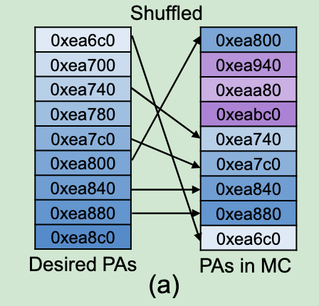
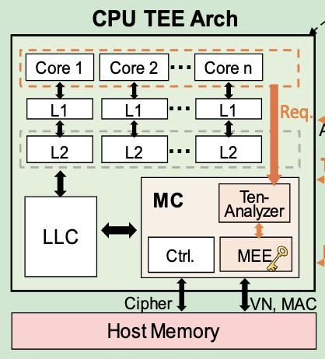
Tensor-wise memory protection
1. Cache interference
the process switches lead to random cache line evictions, disrupting memory access patterns. Additionally, cache prefetchers like stride prefetchers shuffle the access order when the wrong prefetch request is issued.

Slide 12
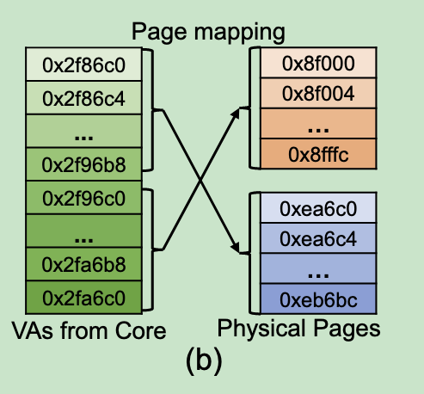
Tensor-wise memory protection
2. MC receives physical addresses, contiguity is limited by the page size
Leveraging virtual addresses from the cores maximizes the utilization of tensor contiguity

Slide 13
Tensor-wise memory protection
3. Long latency for accessing tensor data structures
parallel the data and metadata access

Slide 14
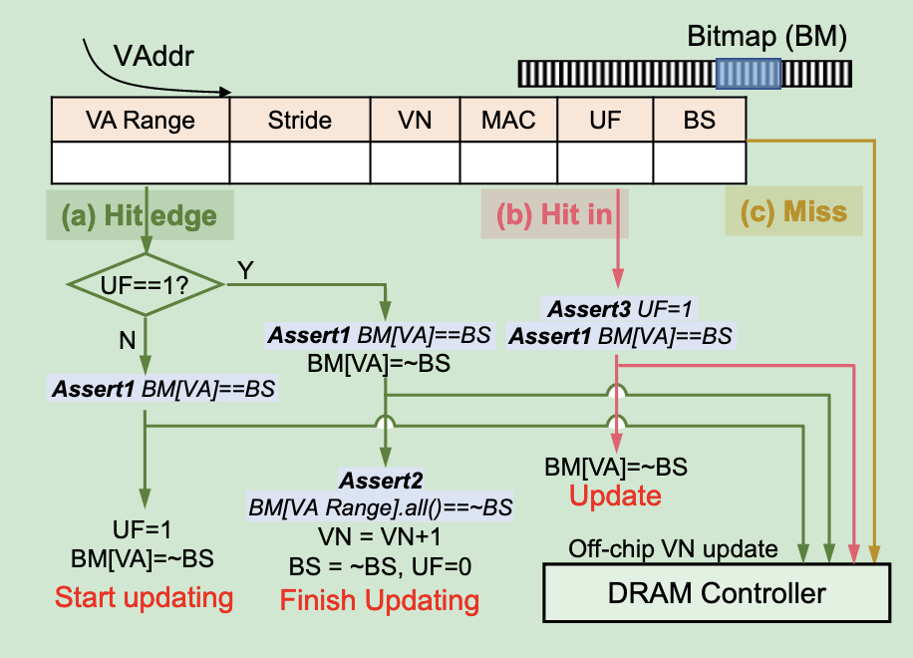
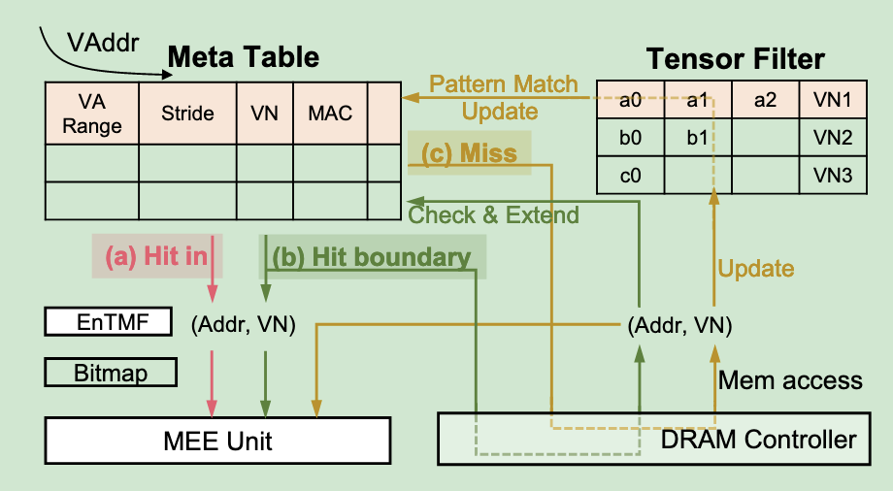
Tensor-wise memory protection
Reading dataflow
Writing dataflow

Slide 15
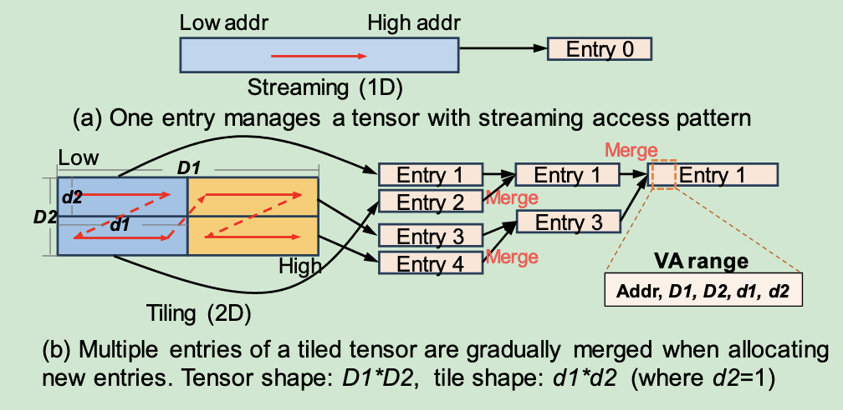
Tensor-wise memory protection

Slide 16
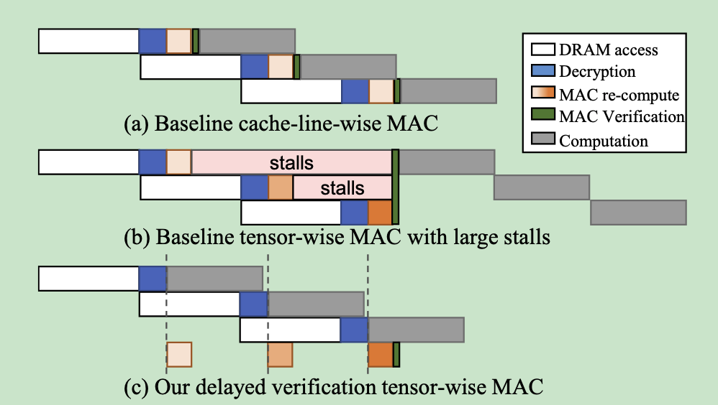
Delayed Verification for Tensor-Wise MAC

Slide 17
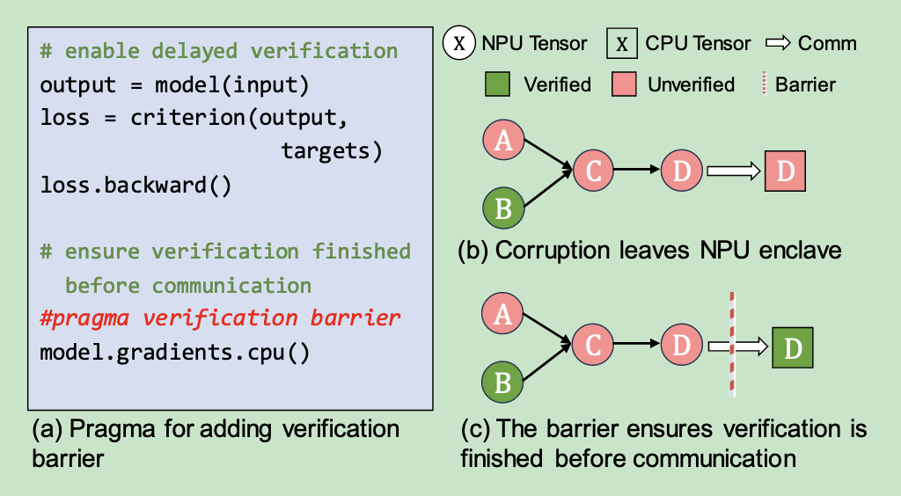
Delayed Verification for Tensor-Wise MAC
Why can we delay it?
NPU, being a pure accelerator, lacks the privileged software (like OS) and file I/O abilities.
Ensuring the completion of verification before communication
tensor poison tracing
-> poison bit
verification barrier

Slide 18
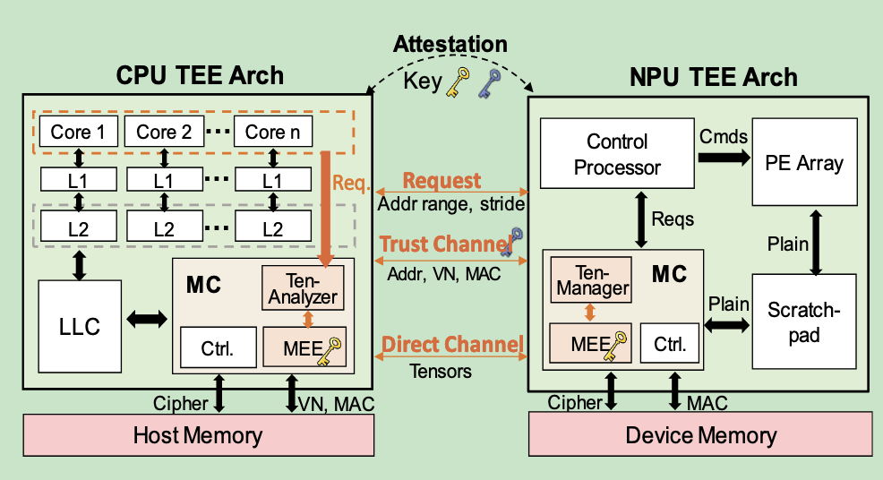
Direct Data Transfer Protocol Implementation
Remote attestation
Communication phase:
trusted metadata transfer
direct tensor transfer

Slide 19
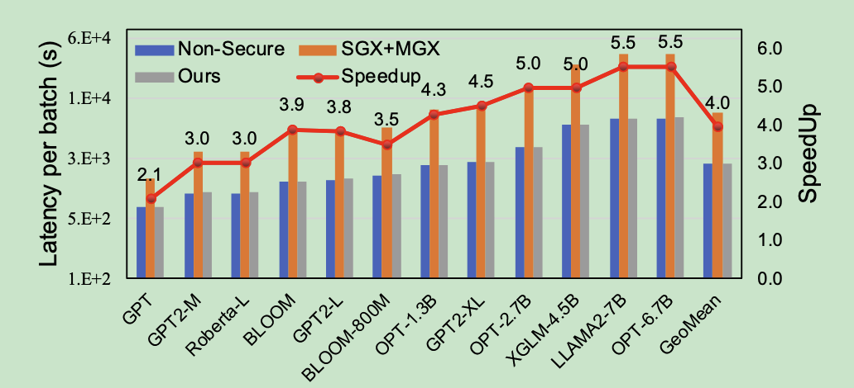
Evaluation
enhanced CPU simulator Gem5
cycle-accurate NPU simulator integrated with Ramulator

