Slide 1
DarKnight: An Accelerated Framework for Privacy and Integrity Preserving Deep Learning Using Trusted Hardware

Slide 2
Problems
train or infer with private data while exploiting accelerators
cloud systems are vulnerable to attackers
DarKnight: provide data privacy and computation integrity for both training and inference
cooperative execution between TEE and accelerators
TEE provides privacy and integrity verification
accelerators perform the bulk of the linear algebraic computation to optimize the performance
customized data encoding
create input obfuscation

Slide 3
Contributions
data privacy-preserving framework for DNN training and inference that uses a novel matrix masking scheme to encode data within the TEE
offloads linear computations on encoded data to be executed on GPUs
guarantee privacy even in the presence of colluding GPUs
low overhead mechanism for verifying computation integrity

Slide 4
Overview

Slide 5
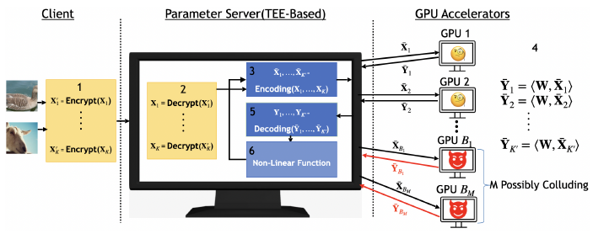
DarKnight Flow
A batch of training/inference input data set is encrypted by the client and sent to the TEE enclave on the server.
TEE initiates encoding on decrypted inputs.
The encoded data is offloaded to GPUs for linear operation. Each GPU receives only one encoded data inputs. （virtual batch）
GPUs perform linear operations on different encoded data sets and return the results to TEE.

Slide 6
DarKnight Flow
The TEE decodes the received computational outputs using DarKnight’s decoding strategy and then performs any nonlinear operations within the TEE.
This process is repeated both for forward pass and backward propagation of each layer.

Slide 7
Notations
K’: # of GPUs
K: size of virtual batch ( ≠ batch size in ML)
M: collusion tolerance
W: model parameters
L: # of layers
x: input
y: output / result
need to be protected / encoded

Slide 8



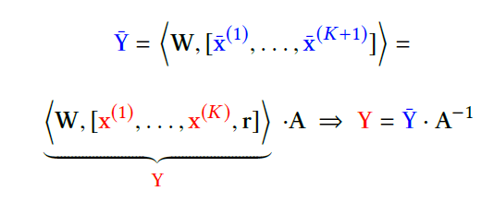

Forward Pass
Our goal: GPU performs
Without exposing x
Without encoding:
Decoding:
Encoding:
r, α are randomly generated for each virtual batch

Slide 9
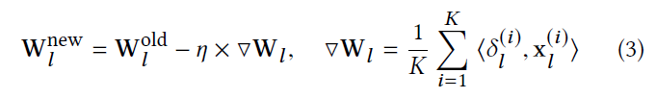




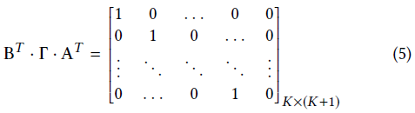
Backward Propagation
Our goal:
Without encoding:
Encoding:
Decoding:

Slide 10
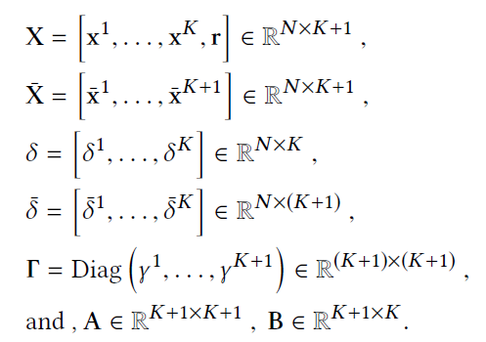
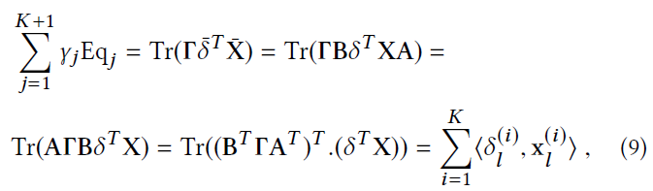
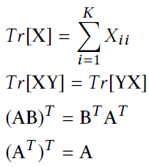



Decoding Correctness Proof

Slide 11

Computational Integrity
creates one additional linear combination of inputs
Having K+2 linear equations for recoveringK+1 unknowns
this additional equation allows us to verify the accuracy of each result by computing y redundantly

Slide 12
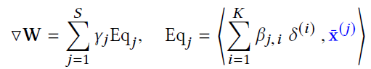
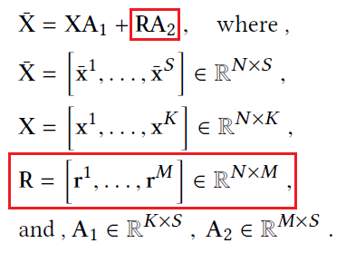

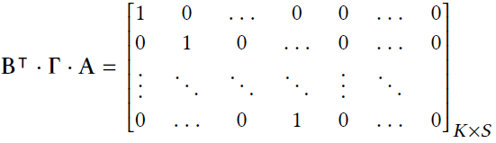
Colluding GPUs

Slide 13
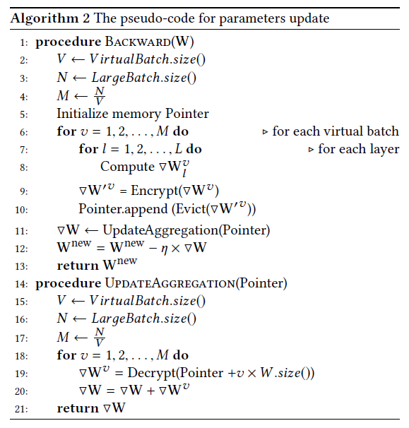
Implementation

Slide 15
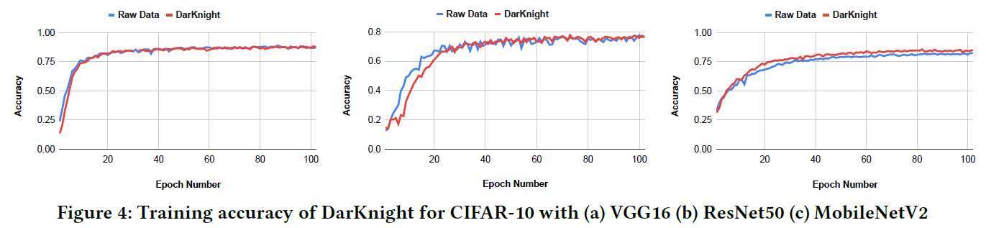
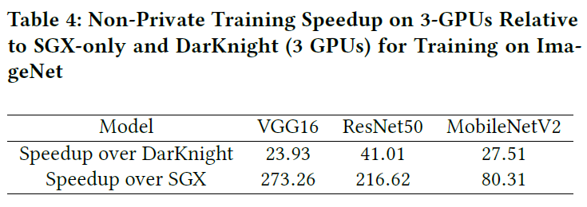
Results

Slide 16
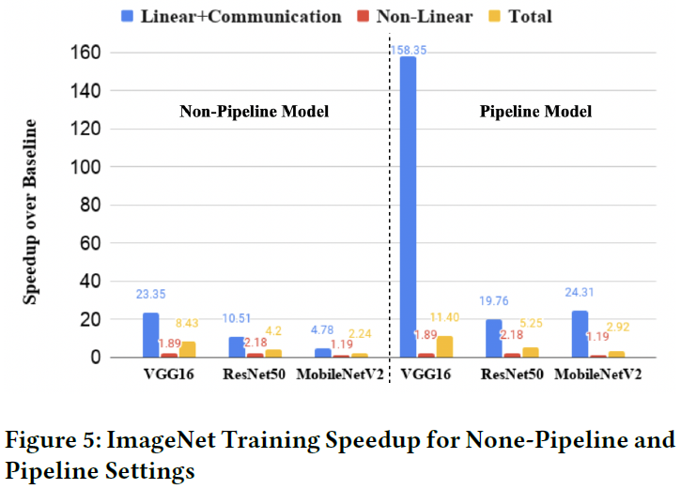
Results

Slide 17
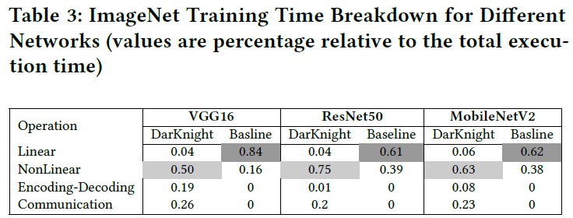
Results

