Slide 1
StateMover: Combining Simulation and Hardware Execution for Efficient FPGA Debugging FPGA ’20
王淼
2021-09-28

Slide 2
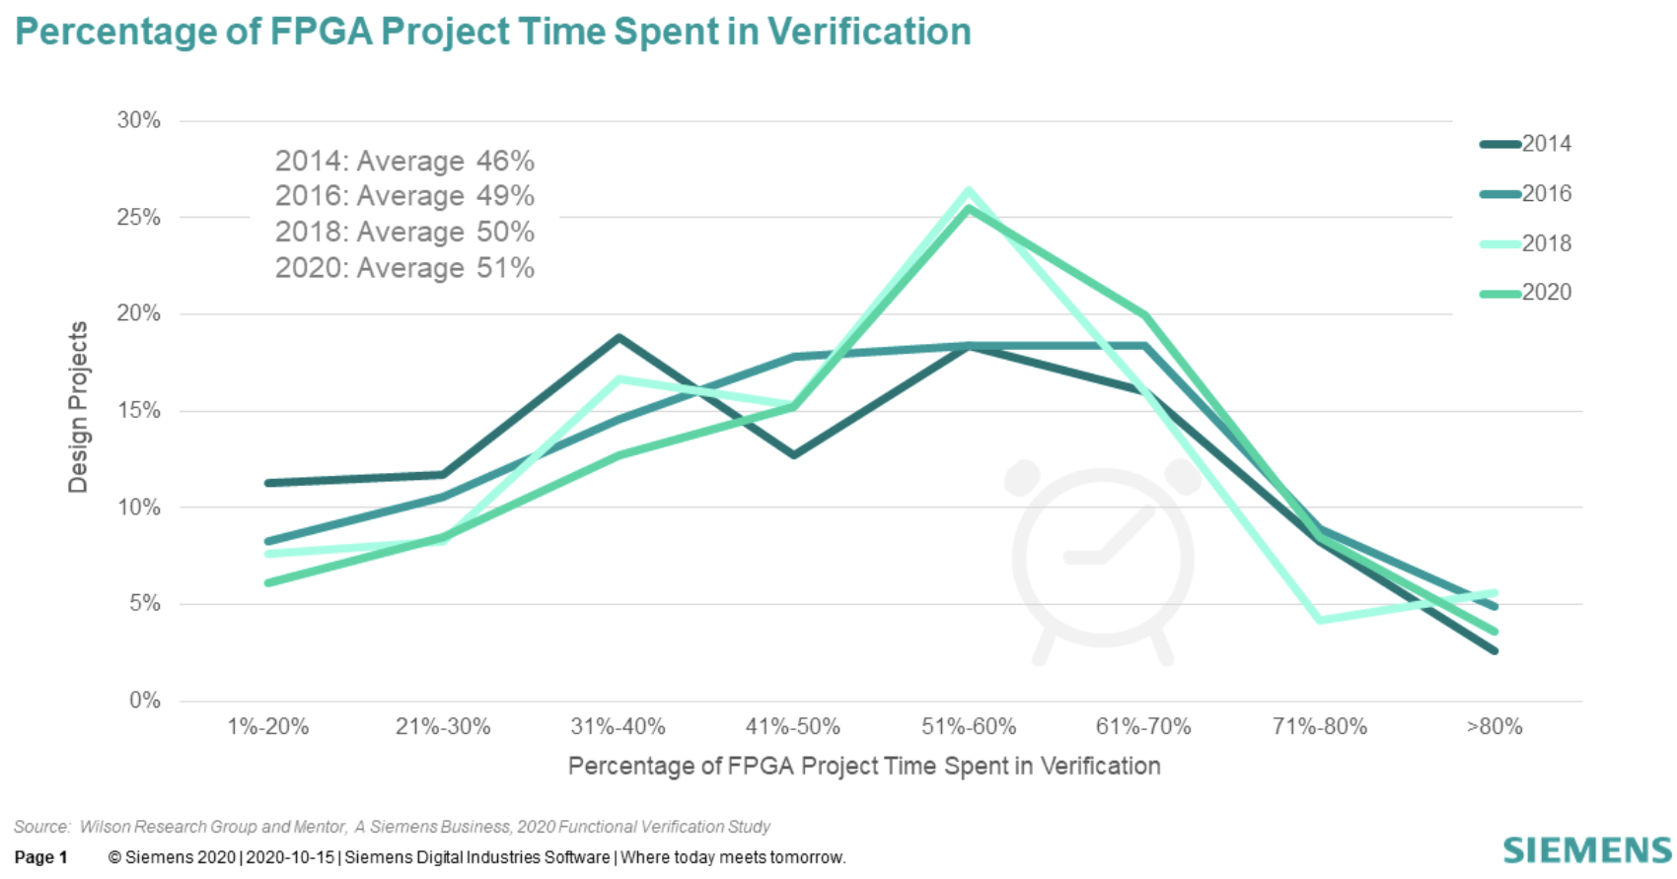
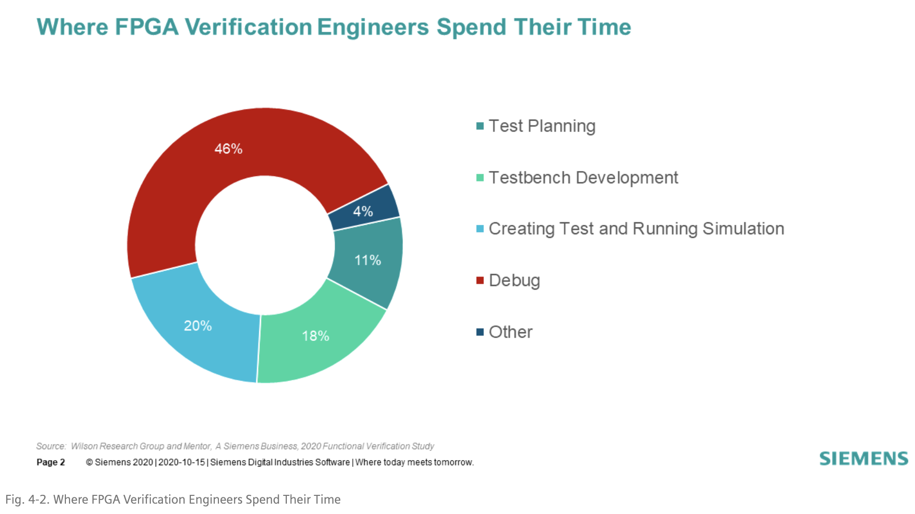
Background
FPGA design complexity increasing → debug time ↑
verification time often takes average 51% of the design cycle
46% of verification time spent on debugging
FPGA deployment in datacenter increasing

Slide 3
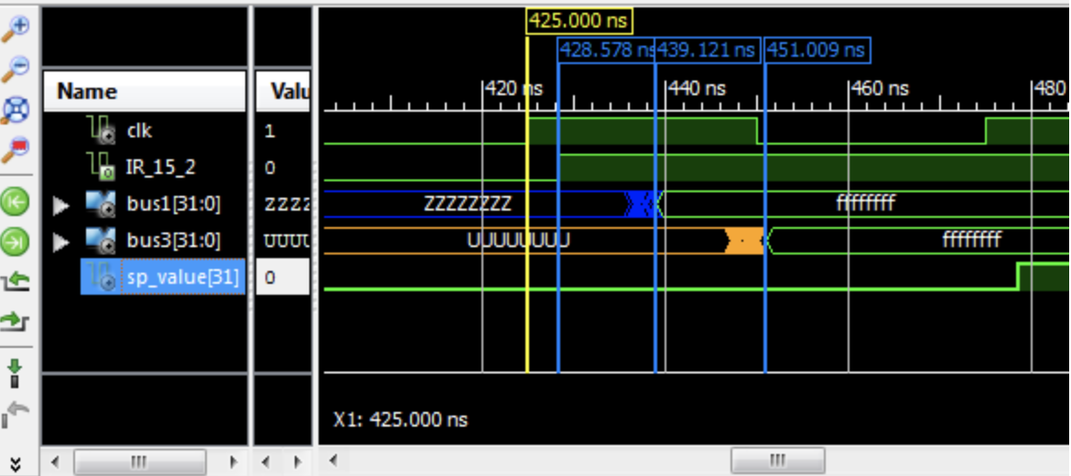

FPGA Debugging
Simulation
Full visibility but much slower
Runs without delays and the spectrum of different possible signal delays on different chips
On-Chip Debug
Full speed but limited visibility
Impossible for complex systems

Slide 4
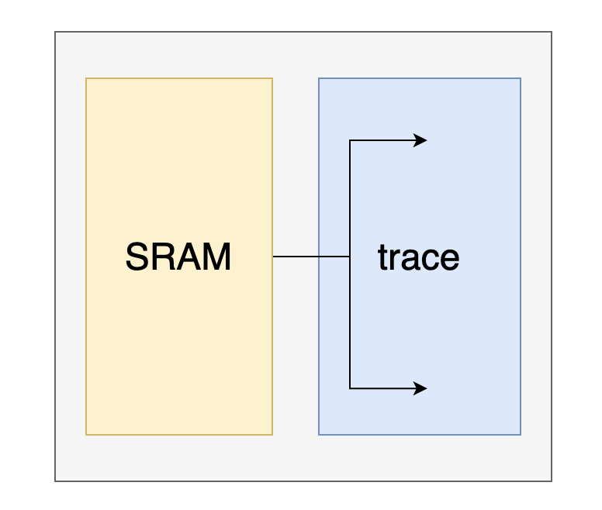
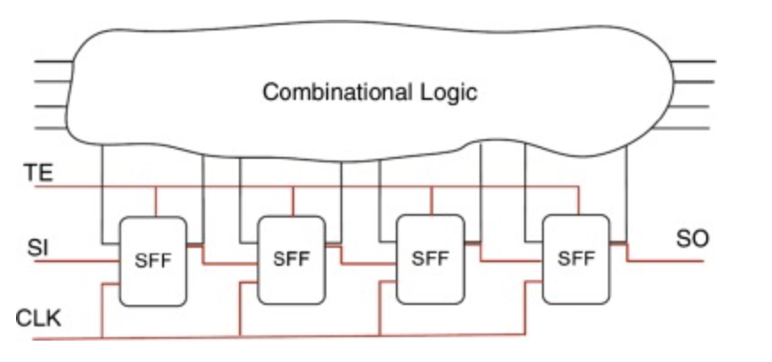
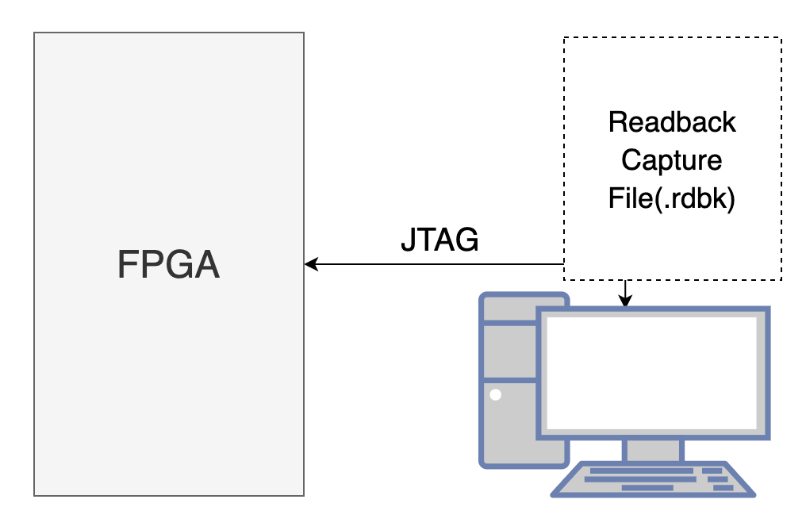
On-Chip Debugging Techniques
Trace-based
Full speed
Stored in on-chip memories
Only few can be observed for a limited time
Recompile when modified
Scan-based
Add additional state access hardware
Readback-based
No additional hardware
No instrumentation or modification
Available on Xilinx FPGAs and on Intel FPGAs
Requires stopping the design before reading

Slide 5
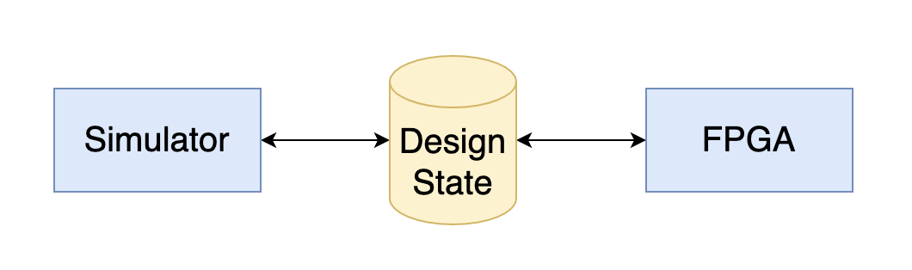
StateMover
A checkpointing-based debugging framework
Safely interrupts a design
Moves design state back and forth between FPGA & simulator
Reads the on-chip state of a design and loads it into simulator
Full visibility
Extracts the design state from simulator and writes it back to FPGA
Full controllability
Combine hardware speed with simulator observability

Slide 6
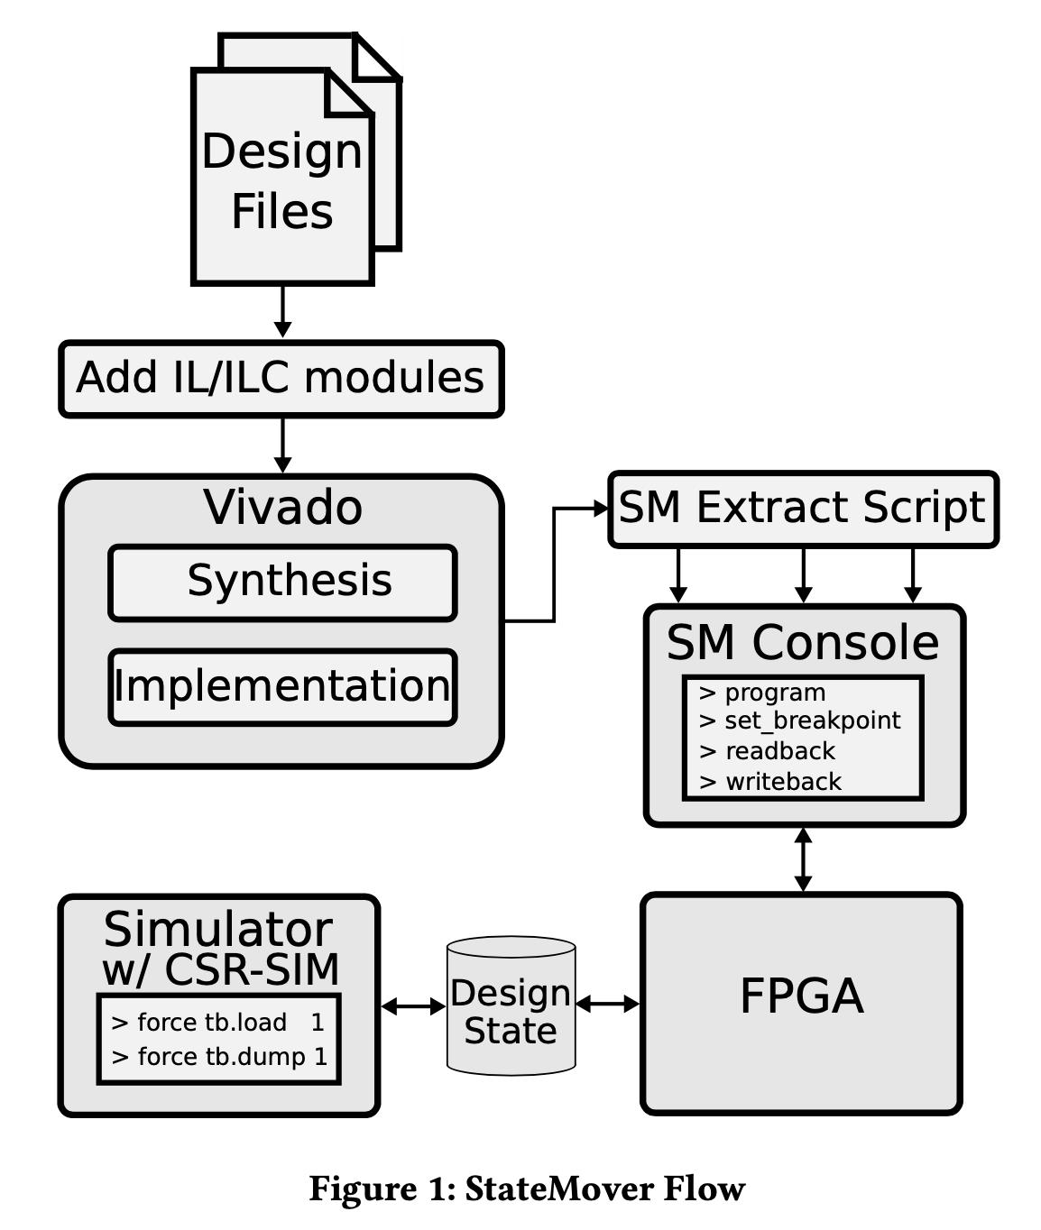
StateMover Flow
Add interruption logic (IL) Modules
Run implementation flow in Vivado
Run StateMover (SM) Extract script
Open the SM Console and start a simulation augmented with CSR-SIM

Slide 7
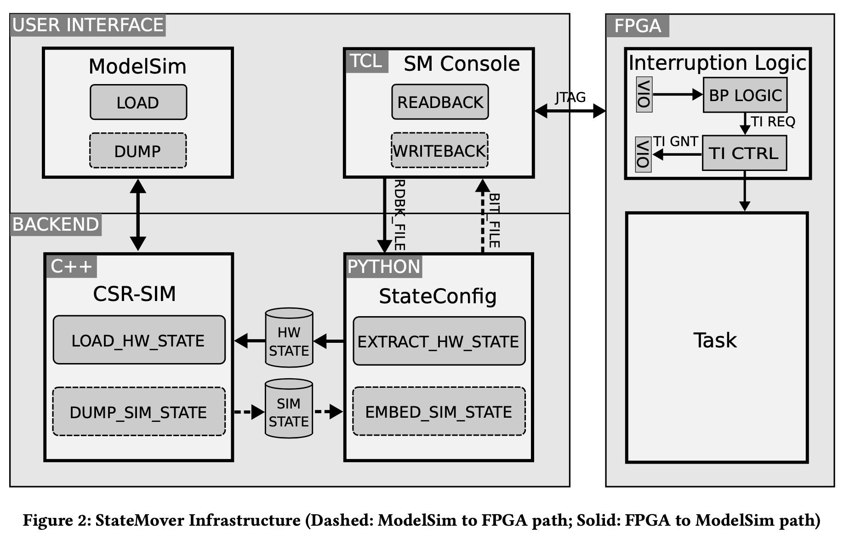
StateMover Infrastructure

Slide 8
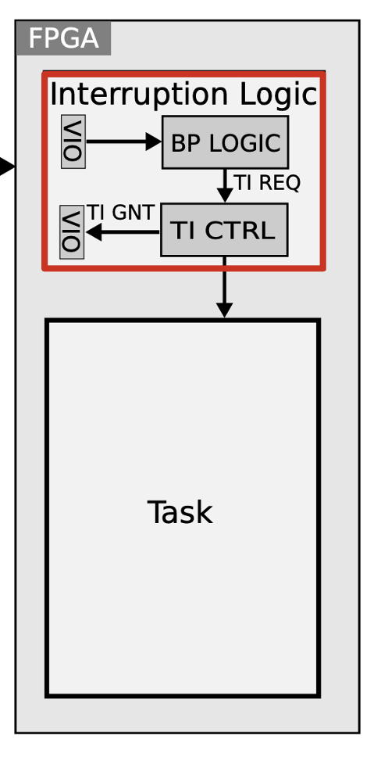
Safe Interruption Logic
Breakpoint (BP) Logic
Requests task interruption
At cycle n, or signal condition y
Task Interruption (TI) Controller
Safely stop the task
AXI/Avalon wrappers:
I/O transactions in-flight complete
New transactions issued

Slide 9
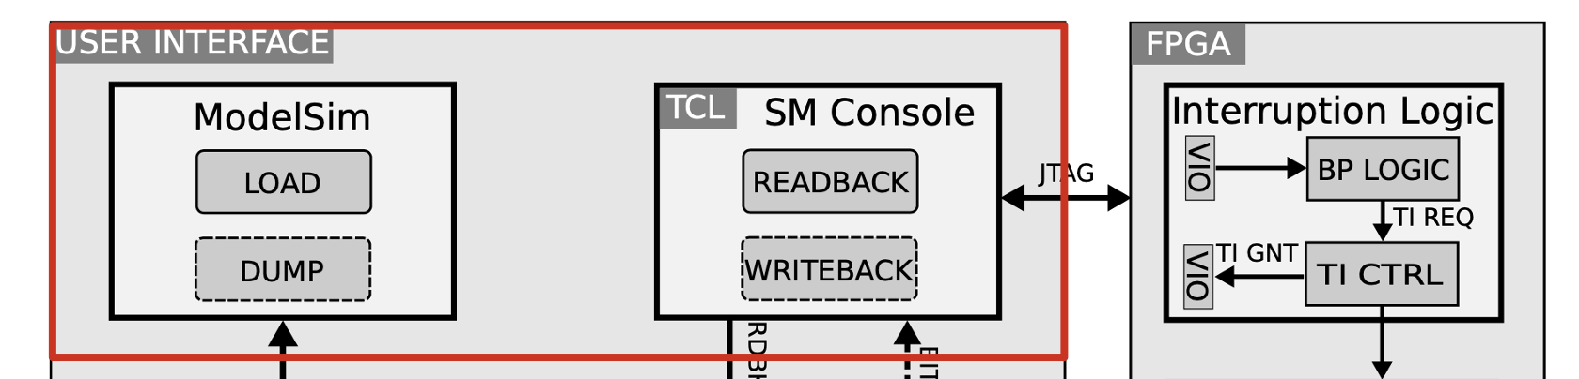
User Interface
Simulator
Load
Dump
SM Console
Readback
Writeback
Set a hardware breakpoint

Slide 10
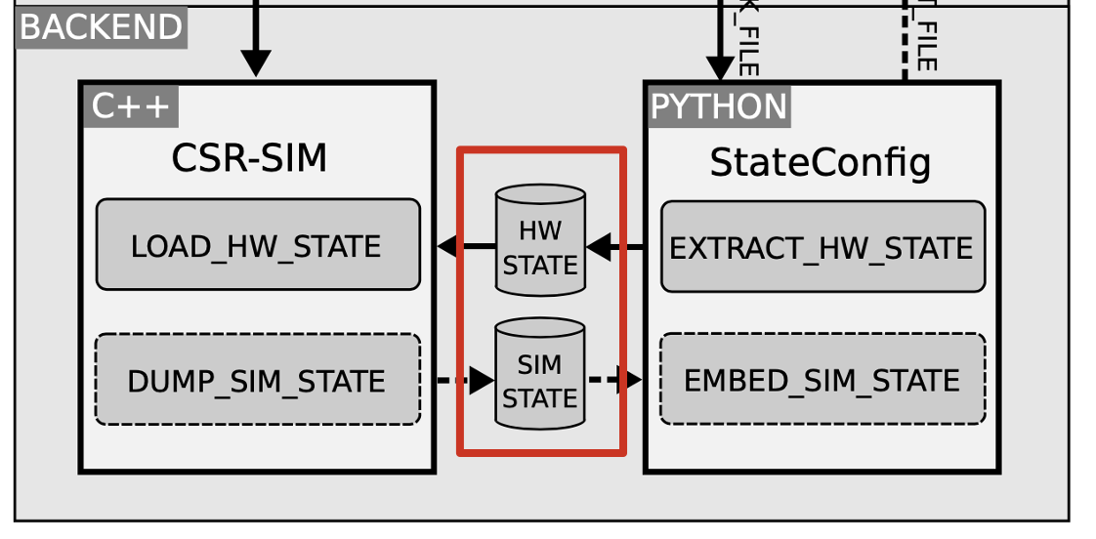
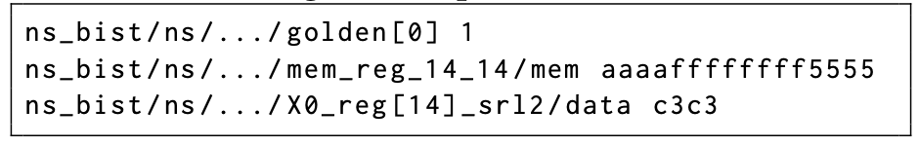
Checkpoint Files for Design State

Slide 11
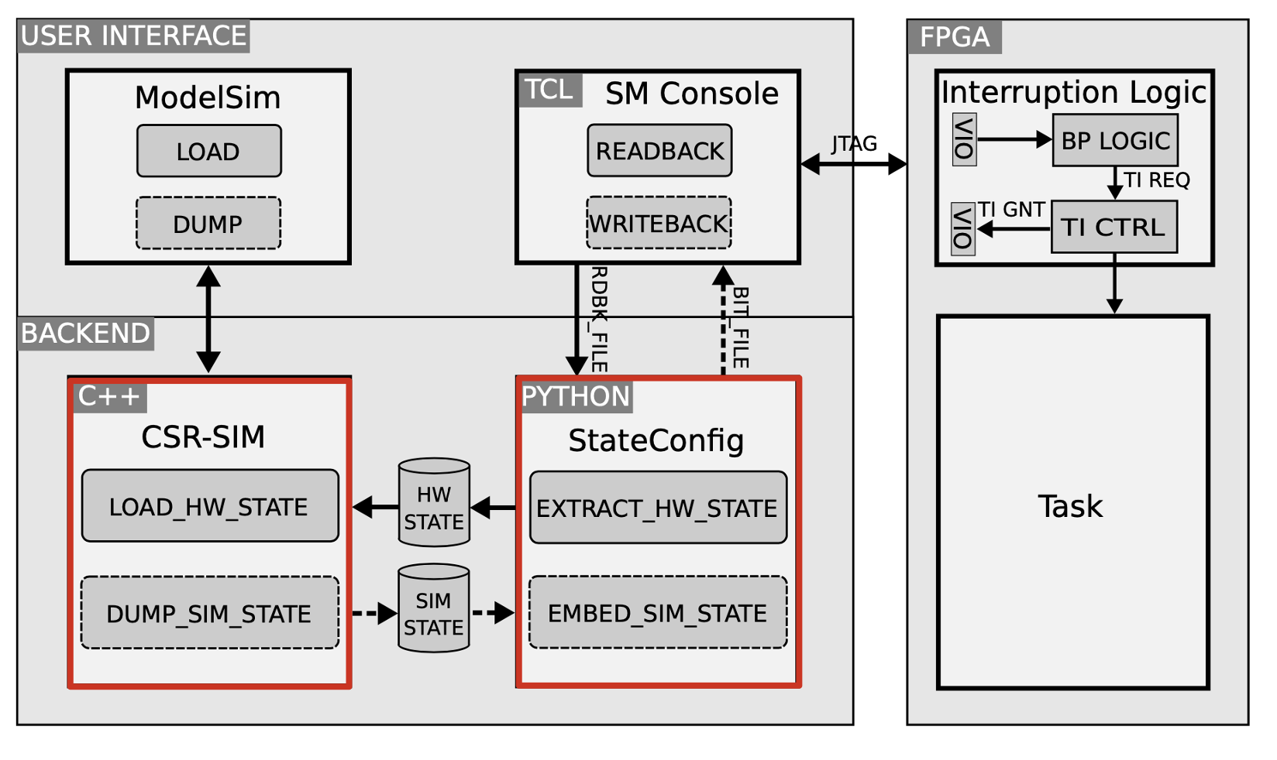
State Extraction & Insertion

Slide 12
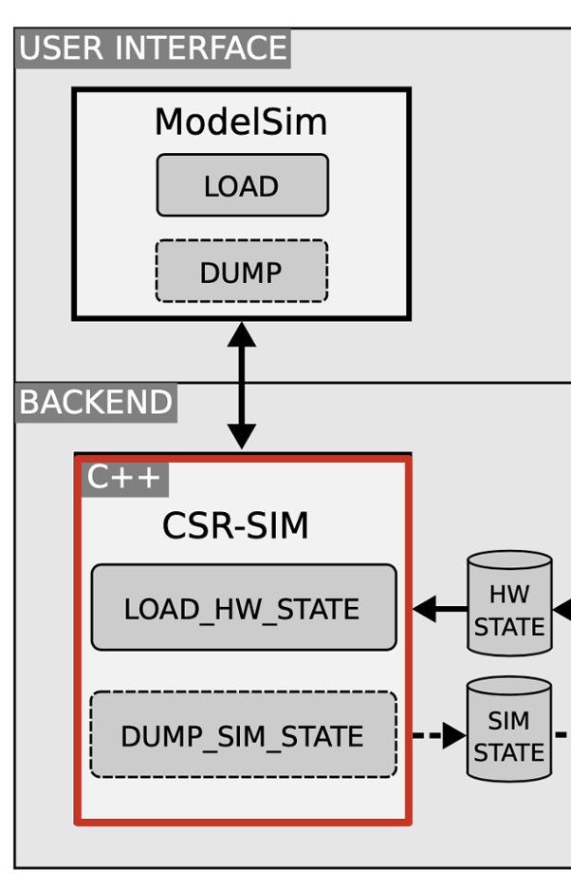
State Extraction & Insertion in Simulator
CSR-SIM
Context Save (dump) and Restore (load)
Match state element in the simulation model with the corresponding hardware element
Identifying physical state elements precisely
Matching hw/sim state element name

Slide 13
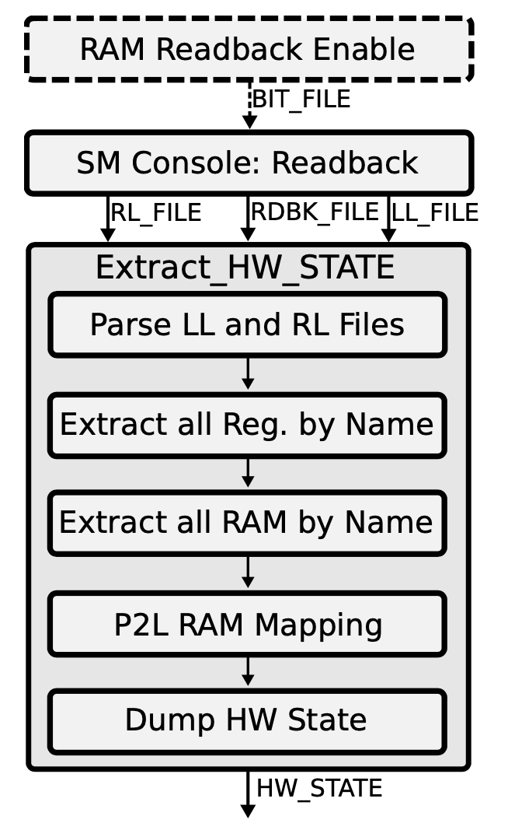
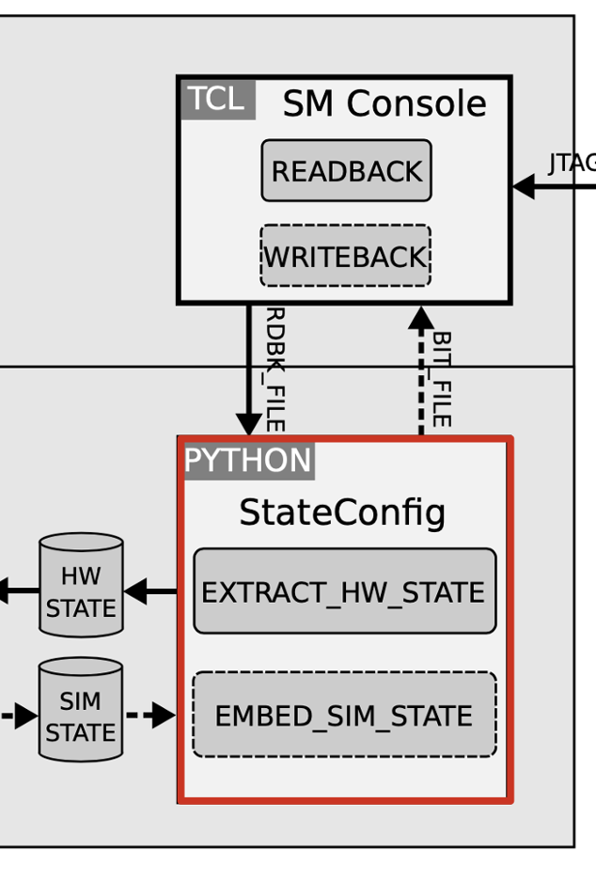
State Extraction in HW
StateConfig: Readback
Extract the state from Readback file
Physical to logical (P2L) RAM mapping
Reconstructs the logical representation of the memories

Slide 14
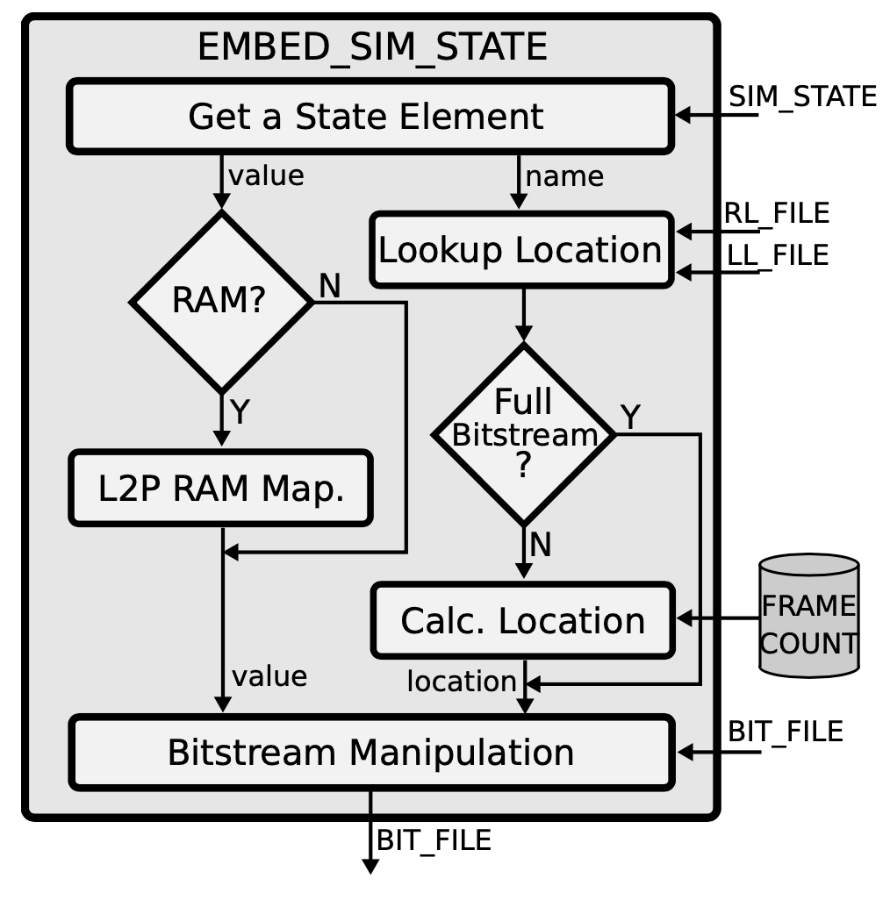
State Insertion in HW
StateConfig: Writeback
Lookup/Calculate location
Logical to physical (L2P) RAM mapping
Bitstream manipulation

Slide 15
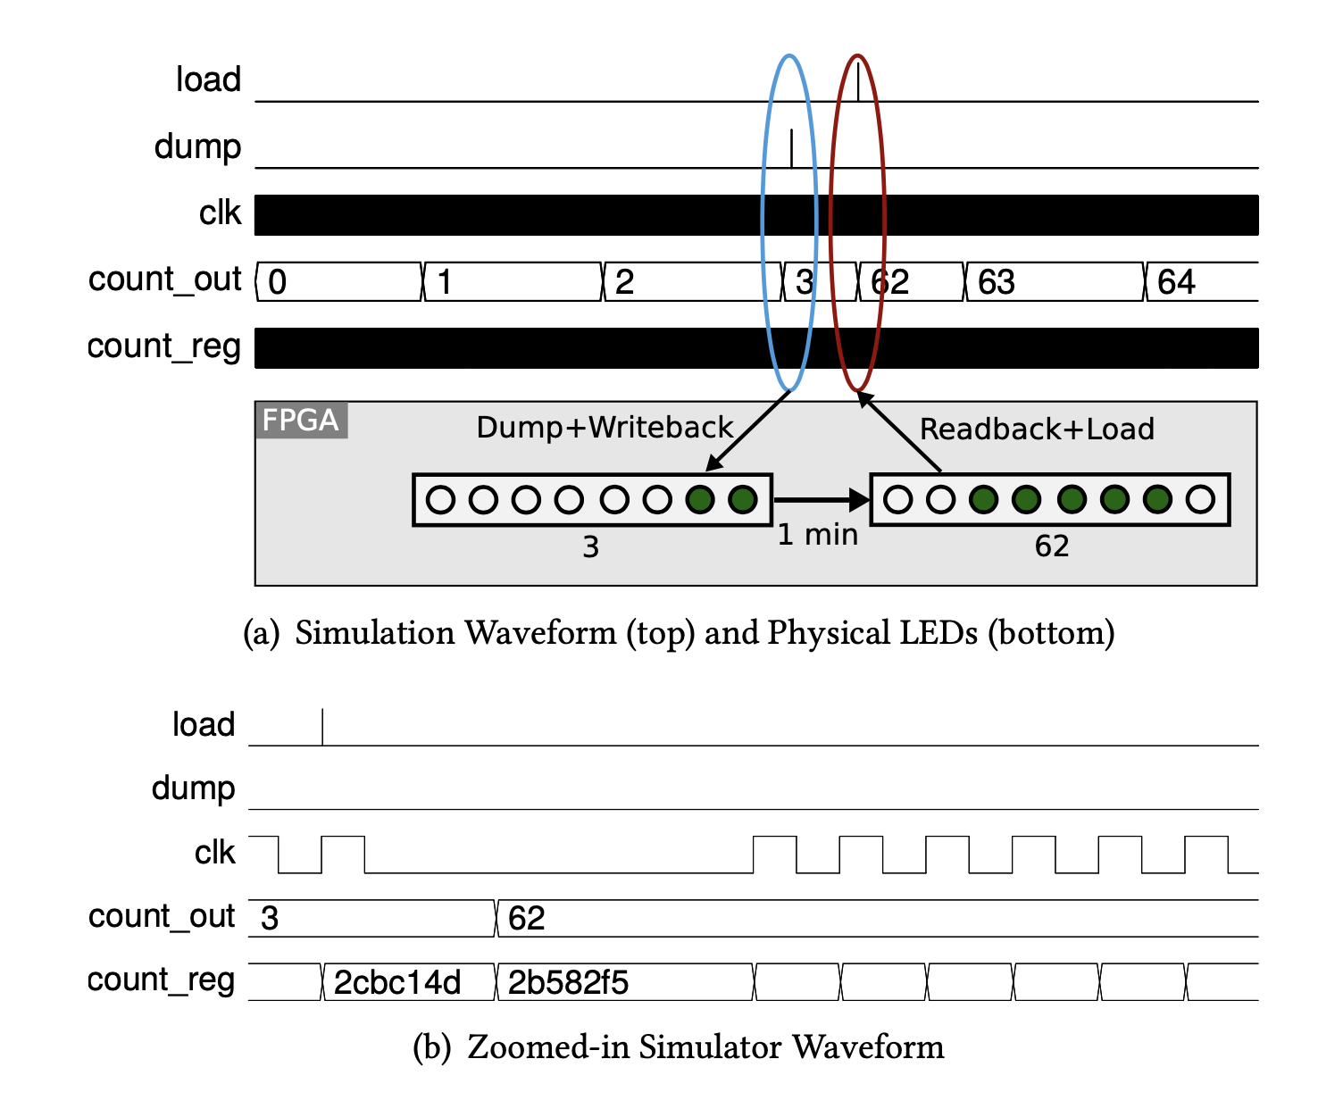
Example Session: counter

Slide 16
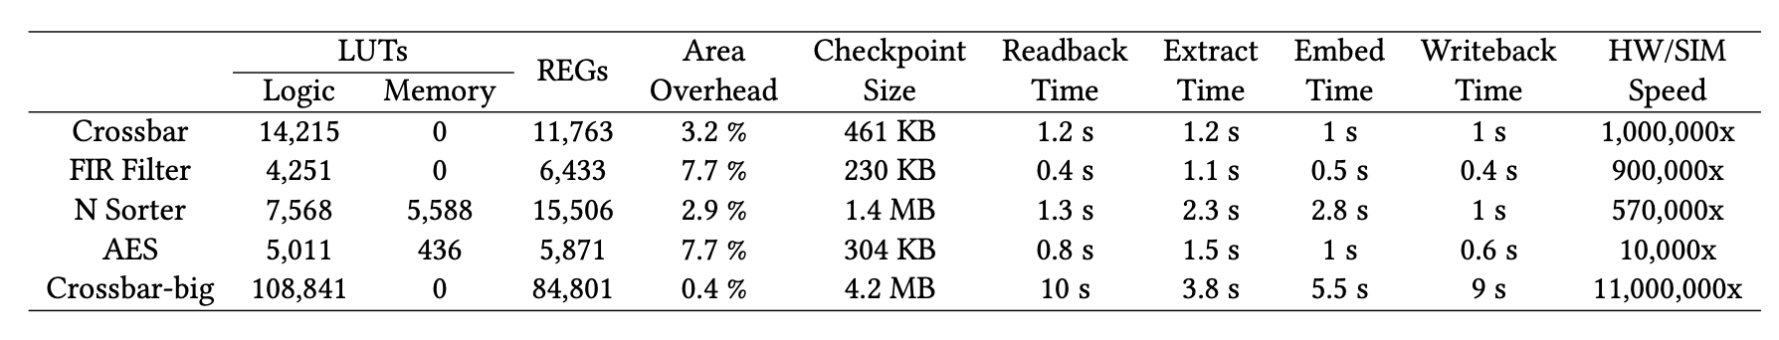
StateMover Speed & Scalability
Xilinx Kintex UltraScale KCU105

Slide 17
Conclusion
A noval FPGA debugging framework
StateMover combines hardware speed with simulator observability
Not capable for BRAM, DSP…
Only for Xilinx Kintex UltraScale series

