Slide 1
FINN: A Framework for Fast, Scalable Binarized Neural Network Inference 2017 ACM/SIGDA International Symposium on Field-Programmable Gate Arrays
王淼
2021-07-29

Slide 2
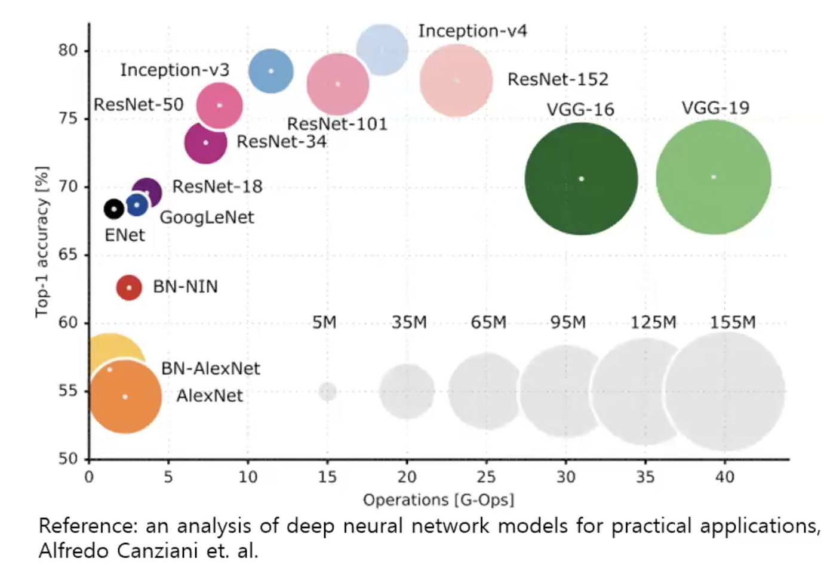
Background
Modern CNN: Millions of FP parameters & Billions of FP operations
Accurate classification using one- or two-bit quantization for weights and activations
small memory footprint -> parameters on-chip -> remove off-chip memory bottleneck
binary operations in hardware -> higher theoretical peak performance

Slide 3
FINN
Framework for building scalable and fast BNN inference accelerators on FPGAs
Millions of classifications per second with sub-ms latency of FINN-generated accelerators
Compute resources can be scaled to meet a given classification rate requirement
Contributions
Quantification of peak performance for BNNs on FPGAs using a roofline model
A set of novel optimizations for mapping BNNs onto FPGA more efficiently
A BNN architecture and accelerator construction tool, permitting customization of throughput
A range of prototypes that demonstrate the potential of BNNs on off-the-shelf FPGA platforms
GitHub
https://github.com/Xilinx/finn

Slide 4
BNN
FP parameters in CNN can contain a lot of redundant information
BNN: constrain some or all the arithmetic to single-bit values
Reduce redundancy
Small drop in accuracy
3 aspects of BNN layers
Binary input activations
Binary synapse weights
Binary output activations
Partial binarization
One or two components are binary
Full binarization
All three components are binary
Only XNOR and popcnt operations are necessary

Slide 5
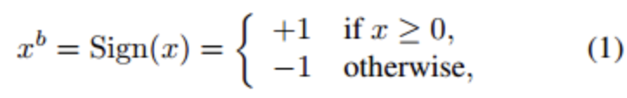
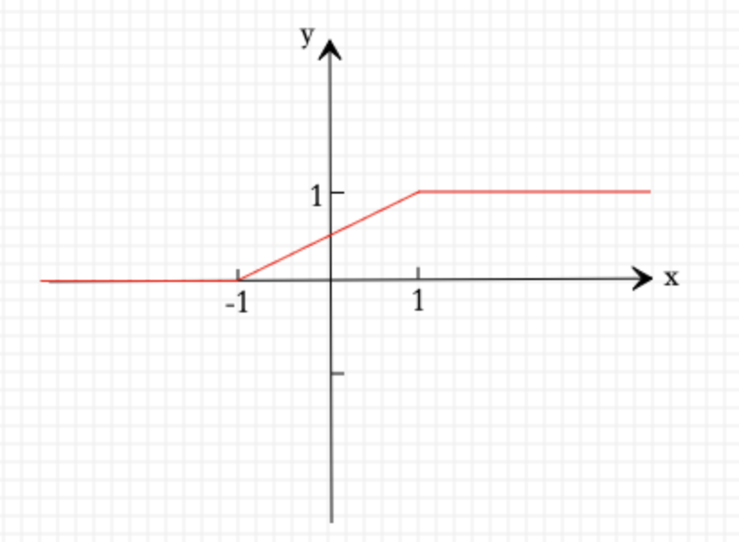
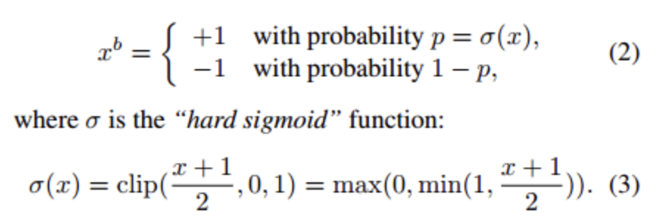
How to binarize FP CNN?
BNN express weight and activation by 1 and -1
Sign function (deterministic)
Randomly (stochastic)

Slide 6

Why only XNOR and Popcnt in BNN?
XNOR vs multiplication
Popcount
Count how many set bits in a bit array
$N_{1}+ N_{−1}=L_{vec}$
$a· W= N_{1}× 1+ N_{−1} × \left(−1\right)=2N_{1}−$ $L_{vec}$
A | B | A XNOR B
1 | 1 | 1
1 | 0 | 0
0 | 1 | 0
0 | 0 | 1
A | B | A · B
1 | 1 | 1
1 | -1 | -1
-1 | 1 | -1
-1 | -1 | 1

Slide 7
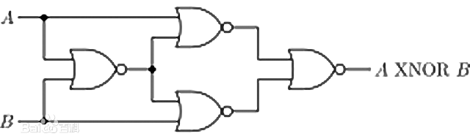
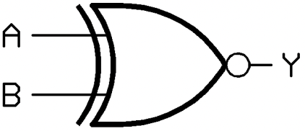
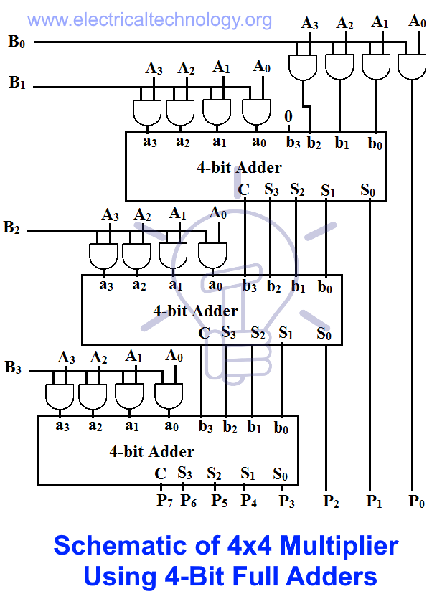
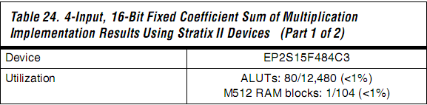
XNOR + PopCnt vs MAC
XNOR
PopCnt : ShiftRegister + AND gate
MAC

Slide 8
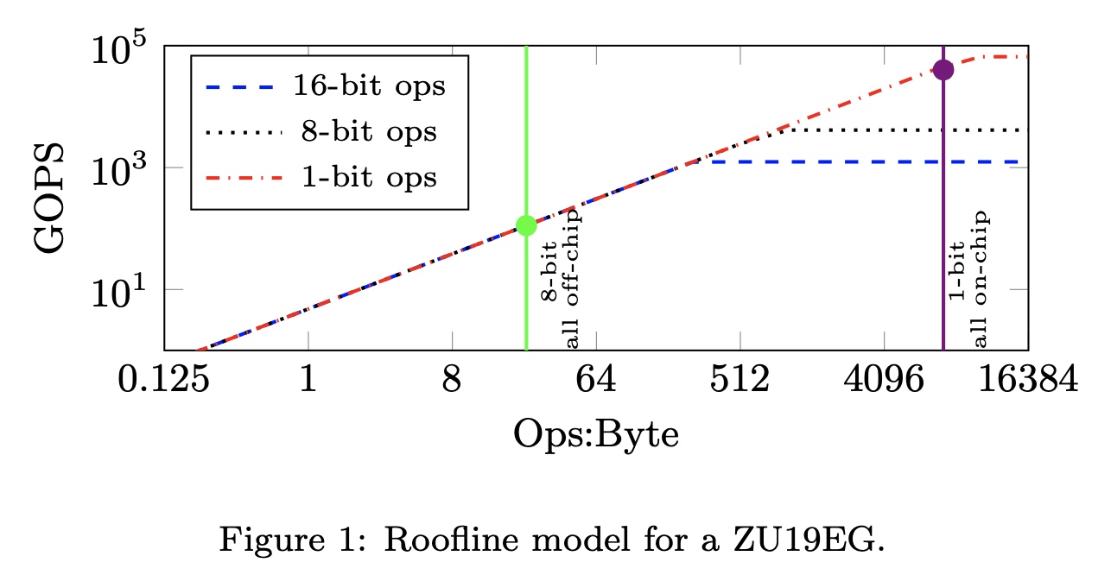
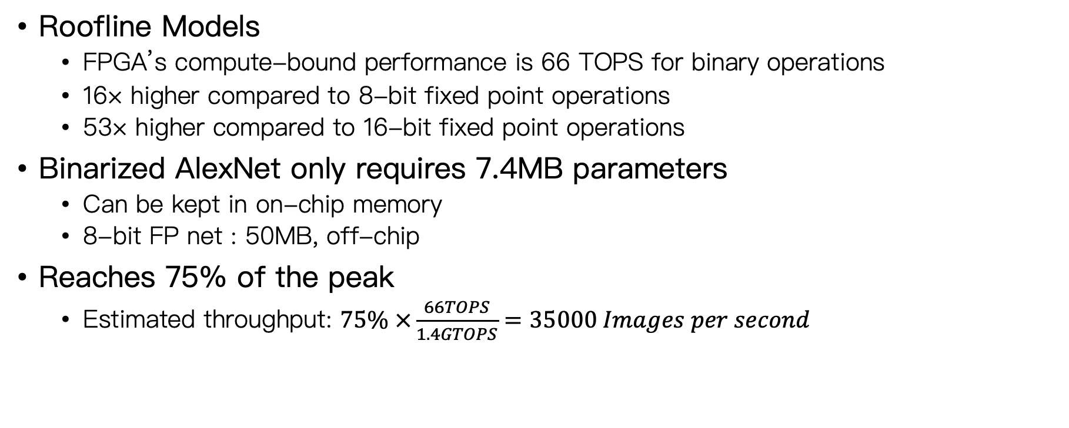
Performance compared to CNN
Roofline Models
FPGA’s compute-bound performance is 66 TOPS for binary operations
16× higher compared to 8-bit fixed point operations
53× higher compared to 16-bit fixed point operations
Binarized AlexNet only requires 7.4MB parameters
Can be kept in on-chip memory
8-bit FP net : 50MB, off-chip
Reaches 75% of the peak
Estimated throughput: $75\% ×\frac{66TOPS}{1.4GTOPS}=35000 Images per second$

Slide 9
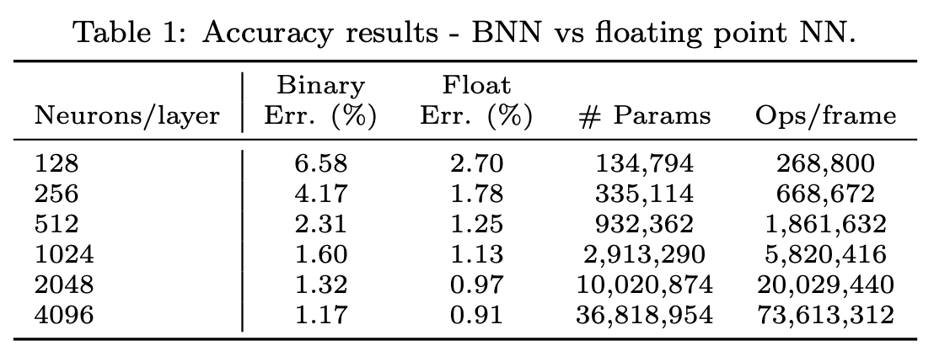
Accuracy–Computation Tradeoffs
A tradeoff between network size, precision and accuracy
Regular CNN with floating point precision？
Larger network but BNN?
Experiments on the MNIST dataset shows
network size increases -> the difference in accuracy decreases
to achieve the same level of accuracy, BNNs require 2–11× more paras and ops
16x speedup for BNN over 8-bit FP, 2-11x increase in parameters and operations

Slide 10
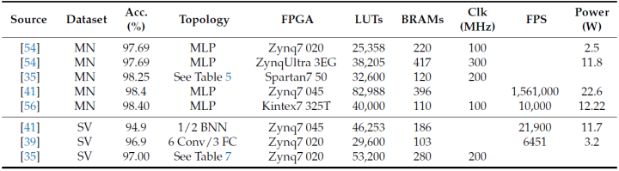
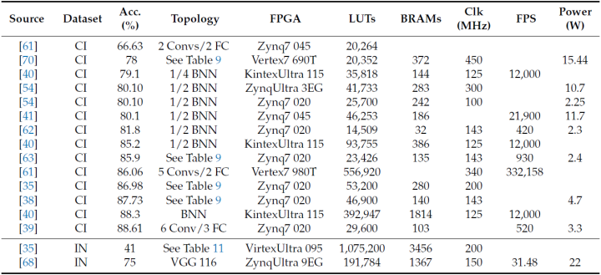
Accuracy of BNN
Reference: Binary neural networks: A survey, Haotong Qin et. Al.

Slide 11
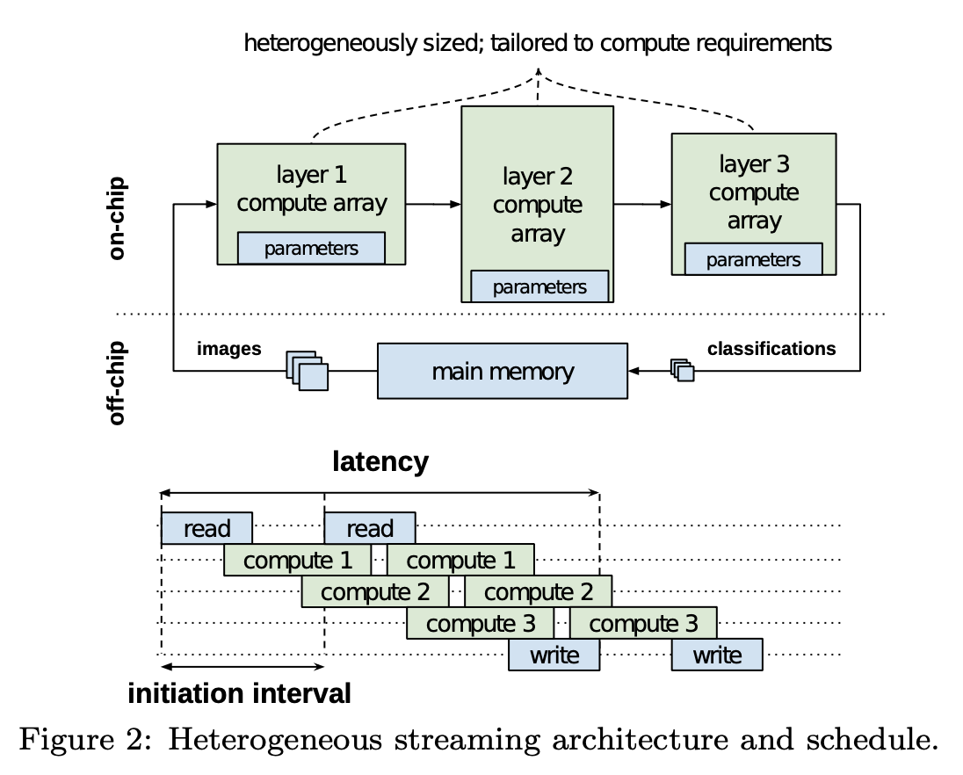
Architecture
Heterogeneous streaming architecture
✅ a custom architecture for a given topology
❌ scheduling operations on a fixed architecture
Separate compute engines each layer
communicate via on-chip data streams
Each engine starts to compute as soon as the previous engine starts to produce output
overlapping computation and communication
minimizes the initiation interval
Parameters are kept in on-chip memory
Implement in Vivado High-Level Synthesis (HLS) for portability

Slide 12
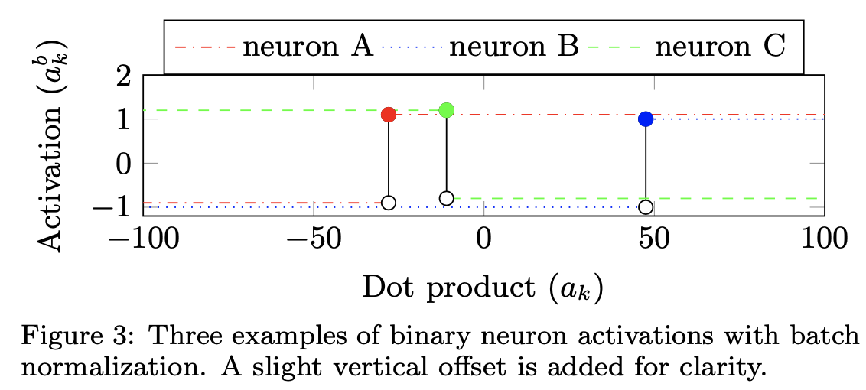
BNN-specific Operator Optimizations
Popcount for Accumulation
128-bit popcount-accumulate requires 376 LUTs and 29 FFs
128-bit signed-accumulate requires 759 LUTs and 84 FFs.
Batchnorm-activation as Threshold
a_{b}^{k} = Sign(BatchNorm(a_{k} , Θ_{k} ))
Θ_{k} = (γ_{k}, μ_{k}, i_{k}, B_{k})
BatchNorm(a_{k}, Θ_{k}) = γ_{k} ·(a_{k} −μ_{k})·i_{k} +B_{k}
BatchNorm(τ_{k} , Θ_{k} ) = 0
=> τ_{k} = μ_{k} − (B_{k}/(γ_{k} · i_{k}))
2 DSPs, 55 FFs and 40 LUTs vs 6 LUTS
Boolean OR for Max-pooling
a_{b} = (Max(a₁, a₂, . . . a_{Y} ) > τ⁺)
a_{b} = (a₁ > τ⁺)∨(a₂ > τ⁺)...∨(a_{Y} > τ⁺)
min-pooling (as Boolean AND) and average-pooling (as Boolean majority function)

Slide 13
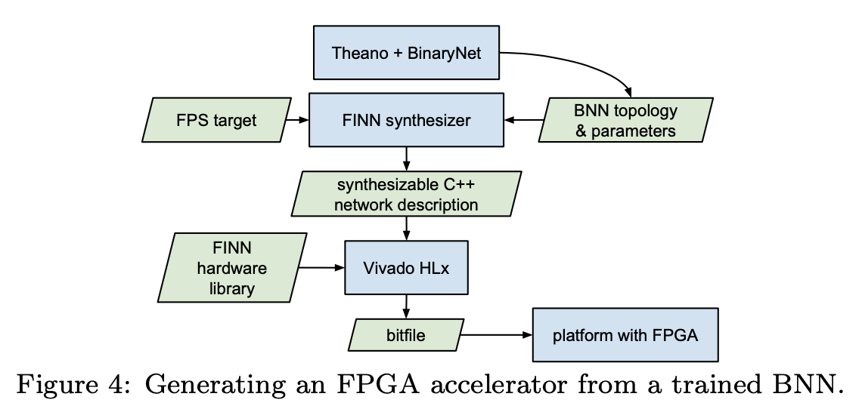
Design flow

Slide 14
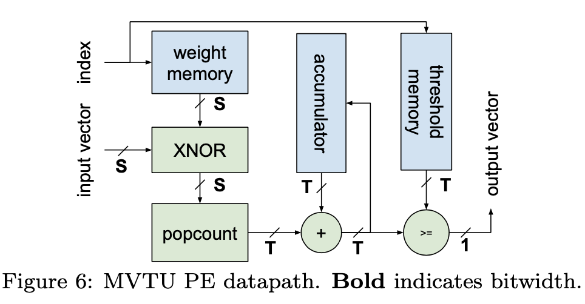
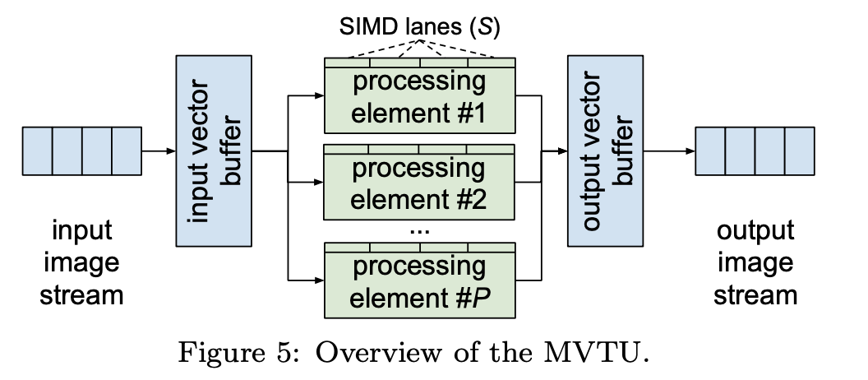
MVTU: Matrix–Vector–Threshold Unit

Slide 15
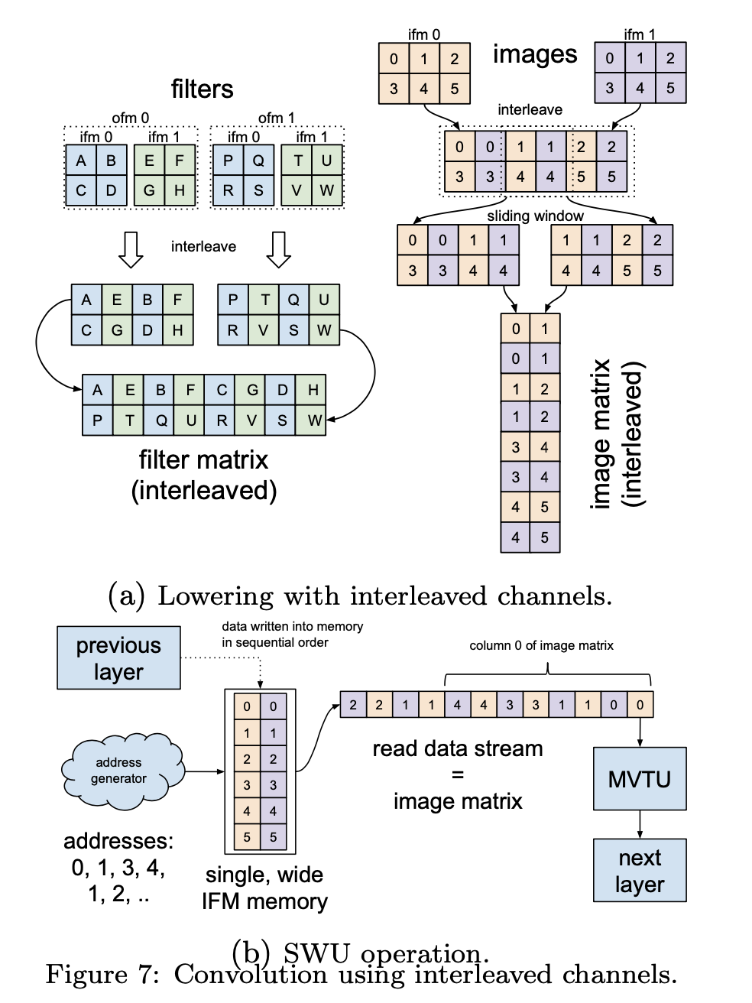
Convolution: The Sliding Window Unit

Slide 16
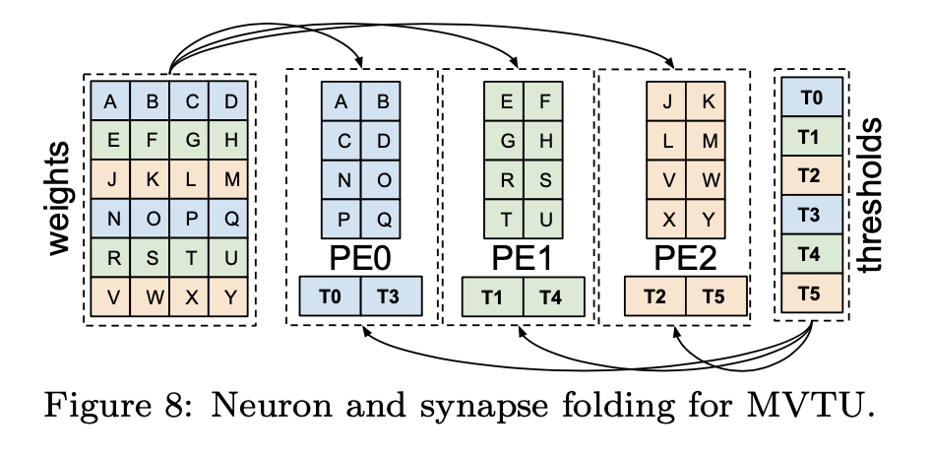
Folding
P-high, S-wide tile per time
P: the number of PEs
S: the number of SIMD lanes per PE
X × Y matrix
F_{n} = X / P as the neuron fold
F_{s} = Y / S as the synapse fold
F = F_{n} × F_{s} as total fold
Example: F = (6 / 3) × (4 / 2) = 4
Each matrix-vector multiply will take 4 cycles

Slide 17
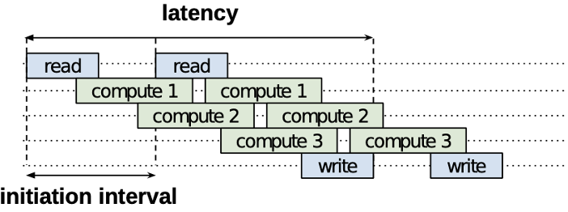
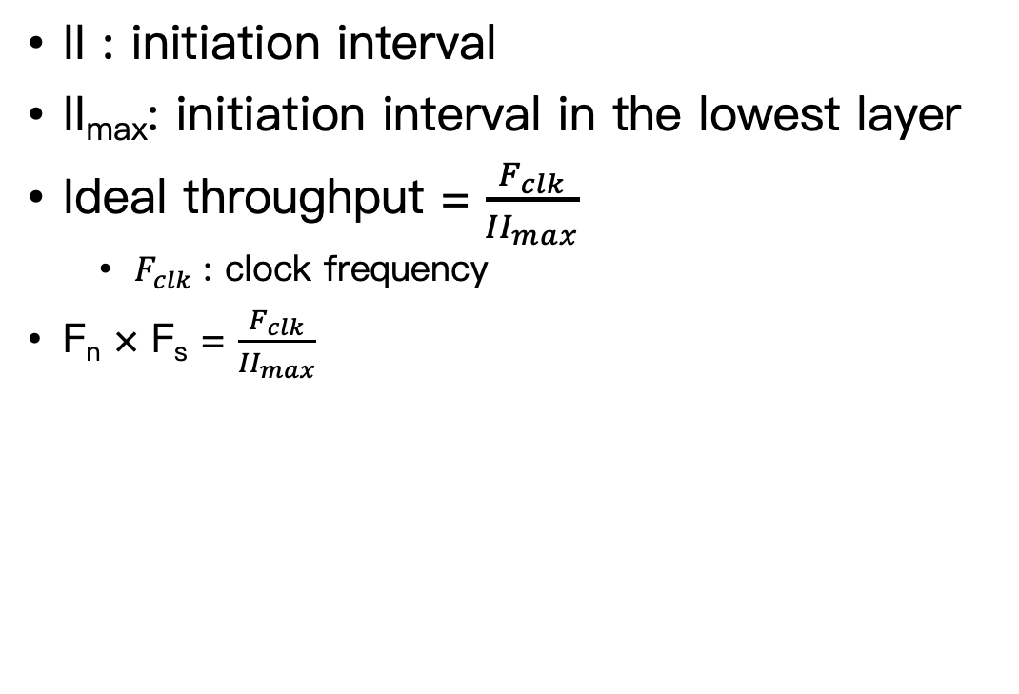
Determining F_{n} and F_{s}
II : initiation interval
II_{max}: initiation interval in the lowest layer
Ideal throughput = $\frac{F_{clk}}{{II}_{max}}$
$F_{clk}$ : clock frequency
F_{n} × F_{s} = $\frac{F_{clk}}{{II}_{max}}$

Slide 18
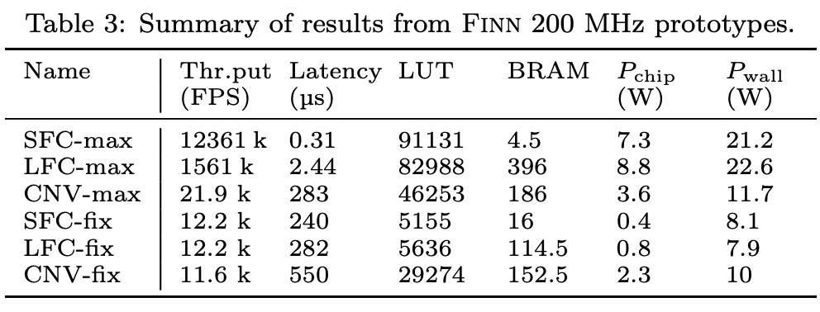
Experimental results

Slide 19
Conclusion
BNNs are particularly well-suited for FPGA implementations
The novel parameterizable dataflow architecture and optimizations presented
Unprecedented classification rates
Minimal power consumption and latency
Offering the flexibility of HLS design entry and the scalability
This technology is eminently suitable for embedded applications requiring real-time response
Surveillance
Robotics
Augmented reality

