Slide 1


Making Kernel Bypass Practical for the Cloud with Junction
Joshua Fried (MIT), Gohar Irfan Chaudhry, Enrique Saurez, Esha Choukse, Íñigo Goiri,
Sameh Elnikety, Rodrigo Fonseca, and Adam Belay NSDI 2024

Slide 2
Motivation: high I/O overheads
Datacenters today:
High network bandwidths, microsecond-scale latencies
100
80
Microseconds
60
OS kernels add large overheads to I/O operations
Applications can’t exploit full hardware performance
40
20
0
Raw Thread dispatch Interrupts TCP
Cumulative Overheads
Attack of the killer microseconds, Barroso et al. CACM 2017
2

Slide 3

Solution: bypass the kernel?
App
Sockets
OS
TCP/IP
NIC Driver
3

Slide 4
Solution: bypass the kernel?
App
Map packet queues directly into application’s address space
DPDK
RDMA
3

Slide 5
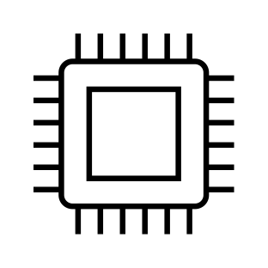
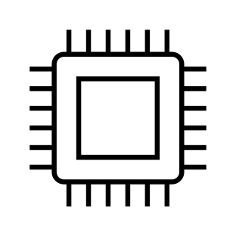
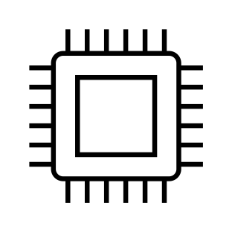
Solution: bypass the kernel?
Pinned memory
App
Map packet queues directly into application’s address space
Pre-assign cores and memory to get the OS out of the way
3

Slide 6
Drawback #1: Density
Resource usage varies over time
CPU
Densely packing applications keeps utilization high
Time
Memory
Pre-assigned resources can’t be shared between applications
Time

Slide 7
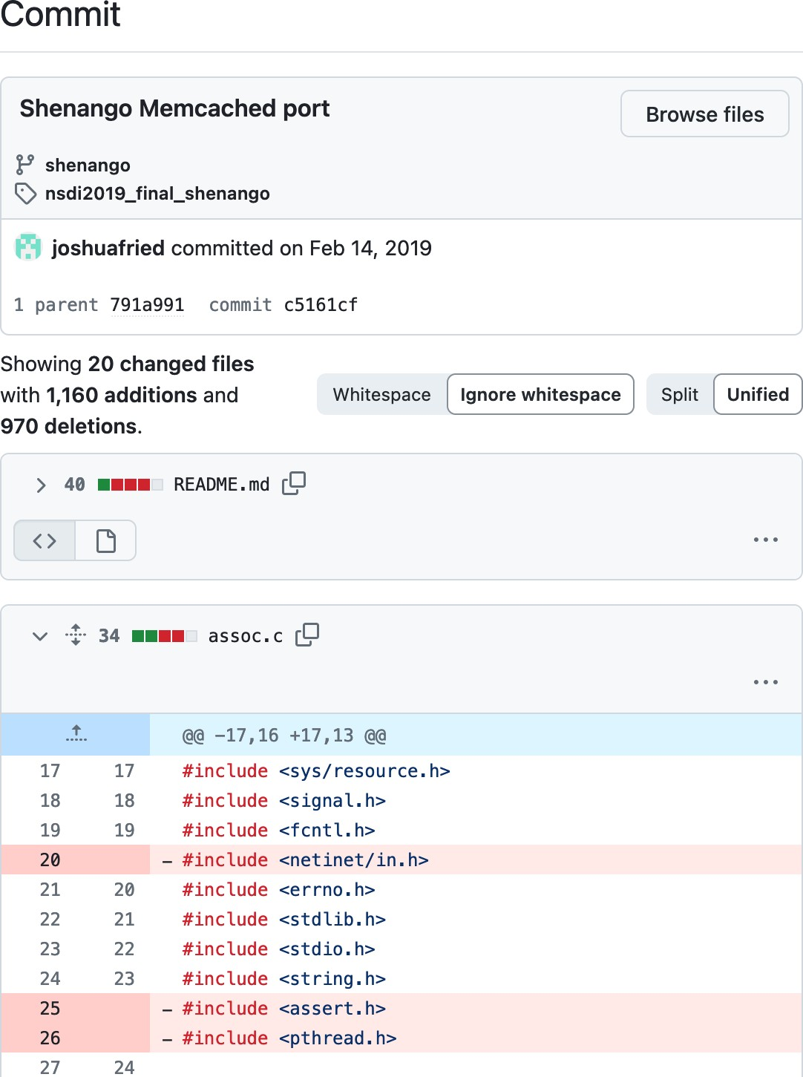
Drawback #2: Compatibility
Rewriting all applications would waste prior investments in software engineering
Only a small handful of applications have been ported to run on today’s kernel bypass systems!

Slide 8
Junction’s contributions
Enabling dense deployment of kernel bypass apps
Buffer management scheme to reduce pinned memory
NIC-assisted core scheduling to avoid polling
Achieving compatibility with unmodified apps
Userspace implementation of Linux syscall interface using kernel bypass
Modified libc to convert syscall instructions to function calls
User Interrupts to implement POSIX signals
Optimizations to avoid sacrificing performance
Use newer CPU instructions (WRFSBASE, RDRAND) to avoid syscalls
Exploit fate sharing to remove security overheads

Slide 9
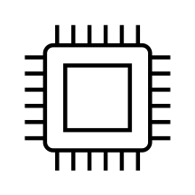
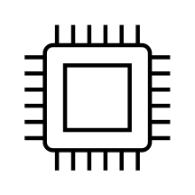
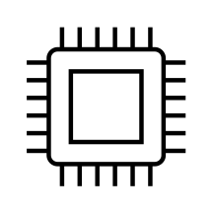
Density
Pinned memory
Goal: pack thousands of kernel bypass apps on a machine
App
Memory: Reduce pinned memory to fit more instances
Cores: Avoid spin polling so cores can be shared

Slide 10
Pinned memory
Pinned memory
Receive path: need enough buffers to absorb bursts and accommodate delays
App
Two traffic patterns responsible for wasted pinned memory
Skewed traffic
Small packets

Slide 11
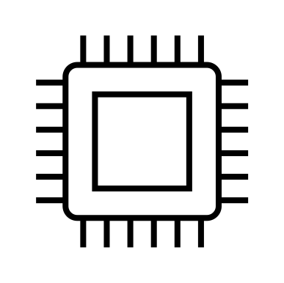
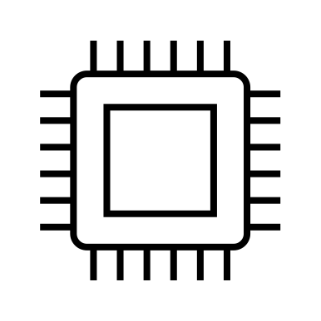
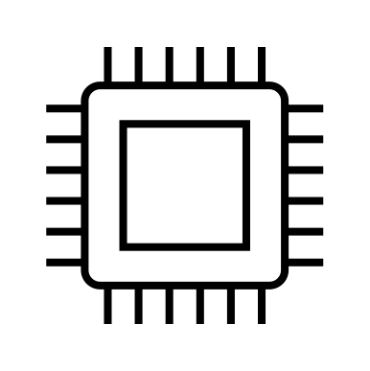
Pattern #1: skewed traffic
App
1 queue per-core to scale packet
processing
Each queue has a set of posted buffers
RSS assigns incoming packets to queues
Potential for skew requires
provisioning enough buffers to all queues

Slide 12
Pattern #2: small packets
App
All packets consume a whole buffer regardless of size
Results in memory fragmentation
High rates of small packets have greater buffering needs

Slide 13

Can we use NIC queues differently?
App
72 MB
8 core instance
11

Slide 14
Can we use NIC queues differently?
App
1. Sharing a buffer queue
16 MB
72 MB
8 core instance
11

Slide 15
Can we use NIC queues differently?
App
Sharing a buffer queue
Multiple packets per buffer
16 MB
4 MB
72 MB
8 core instance

Slide 16

Sharing requires synchronizing
App
Buffer can’t be reused until all cores are done with it
Updates to shared buffer queue must be synchronized
16 MB
4 MB
72 MB
8 core instance

Slide 17
Synchronization-free refill
App
Per-core buffer reference counters
2 0 0 0 0 0 0 0 0 0 0
0
1
0
Refill thread scans counters and re-posts buffers
16 MB
4 MB
72 MB
8 core instance

Slide 18
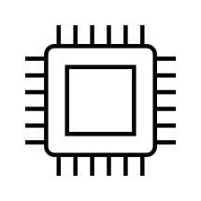
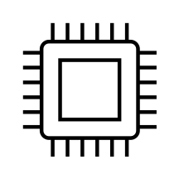
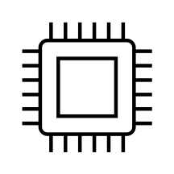

Density
Goal: pack thousands of kernel bypass apps on a machine
Pinned memory
App
Memory: Reduce pinned memory to fit more instances
Cores: Avoid spin polling so cores can be shared

Slide 19
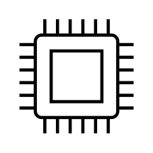
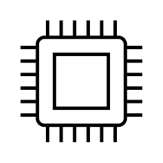
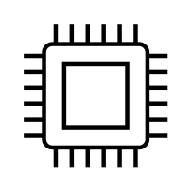
Kernel bypass usually spin polls
Achieves low latency
App
App
App
Opportunity to share cores between packet arrivals

Slide 20
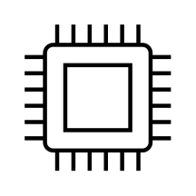
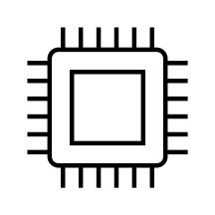

Recent work: delegating polling
Single spinning scheduler core
decides core assignments
App App
App
App
Spin polls queues on behalf of idle applications
Wake-up on packet arrival or app- specified timeout
Core scheduler

Slide 21


Problem: polling bottleneck
Performance collapse with many queues
Long delays from polling loop
Scheduler’s cache becomes polluted
…
App
App
App
App
2000
Core scheduler
500
0
4000
Max 8 core instances

Slide 22

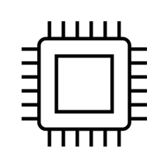

Solution: NIC notifications
Scheduler polls a notification queue
Idle queues are armed
Packet arrivals on armed queues generate notifications
…
App
App
App
App
2000
Core scheduler
500
0
4000
Max 8 core instances

Slide 23




Scaling further
Scheduler checks timeouts for idle applications
…
App
App
App
App
Use timer wheel to track timeouts
2000
Core scheduler
500
0
3500
4000
Max 8 core instances

Slide 24
Evaluation
1000
800
No optimizations
Junction
Latency P99 (µs)
600
400
200
Better
0
0
500
1000
1500 2000 2500
Number of applications
3000
3500
4000
Better

Slide 25
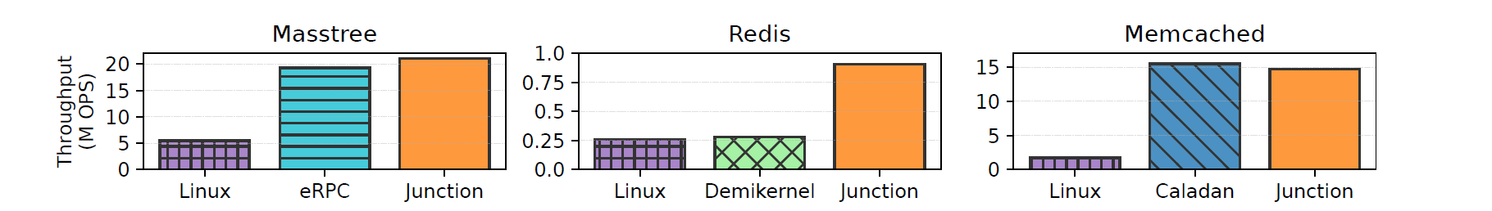
Evaluation

Slide 26
Related work
Scheduling
ZygOS [SOSP ‘17], Shinjuku [NSDI ‘19], Shenango [NSDI 19’], Caladan [OSDI ‘20],
Persephone [SOSP ‘21]
Hardware portability
Demikernel [SOSP ‘21]
Dataplane OSes
mTCP [NSDI ‘14], IX [OSDI ‘14], Arrakis [OSDI ‘14], eRPC [NSDI ‘19],

Slide 27
Conclusion
Junction aims to eliminate OS overheads by making kernel bypass ubiquitous in the datacenter.
Preserves high performance of kernel bypass but delivers density and compatibility
Available open-source: https://github.com/JunctionOS

