Slide 1
A Matrix-free Algorithm for PDE-governed Optimization with Inequality Constraints
Pengfei Meng

Slide 2
Outline
Motivation
Optimization Algorithm
Iterative Solver & Preconditioner
Test Problems

Slide 3
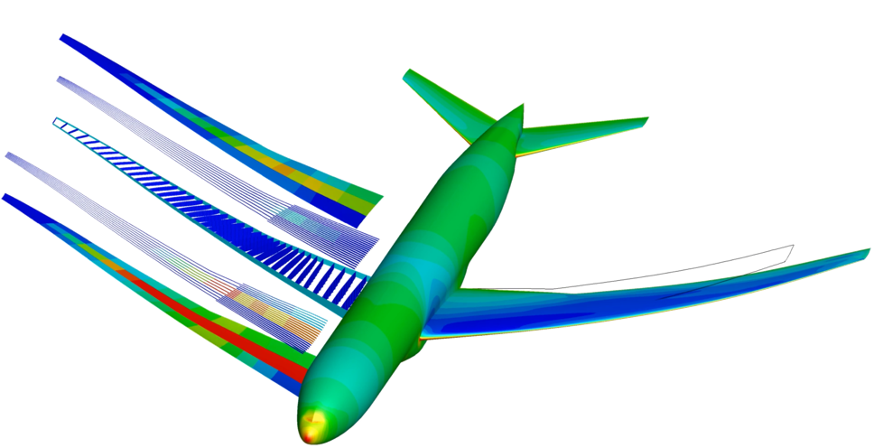
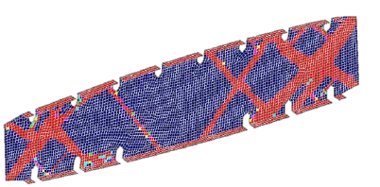
Optimization problems with state-based constraints are common, yet challenging to solve
Kenway and Martins [1]
Internet source [2]
Notes:
PDE solution is a subproblem associated with optimization, major cost; solving the PDE equation, adjoint equation is the most expensive part;
Size is very large, as the state and adjoint solve size mesh-dependent ; large-scale
discretized Euler equation

Slide 4
The total derivatives of state-based constraints w.r.t. the design variables are calculated via the adjoint vector
Conventional optimization algorithms are unsuitable as they require the explicit total constraint Jacobian
The gradient of each constraint requires the solution of a linear PDE (the adjoint)
Cost is intractable when there are hundreds of constraints
Storing the (dense) constraint Jacobian can also be expensive
Notes:
General-purpose gradient-based optimization algorithm

Slide 5
Optimal designs are defined by zeros of the first-order optimality conditions (KKT condition)
Adjoint Equation:
State Equation:
Complementarity:
A coupled, nonlinear system of equations; ill-conditioned; huge size
Notes:
Let’s look at PDE-constrained optimization problem from the start. The optimal solutions are defined by zeros ……
The first order optimality conditions are a system of coupled, nonlinear PDEs, that include state solve and adjoint solve;
While the simulation problem is well-posed, the optimization problem is ill-posed;

Slide 6
There are two common approaches used to solve PDE-constrained optimization problems
Full-Space Formulation
Solve for all the variables simultaneously
The KKT-system is large (at least 2 times the number of states), indefinite, ill-conditioned
Globalization algorithms for nonlinear PDEs are difficult to incorporate
If the optimization does not converge, the PDE is not even satisfied and cannot be used to inform decision making
Notes:
In optimization iteration, the state and adjoint solve do not converge tightly.

Slide 7
There are two common approaches used to solve PDE-constrained optimization problems
Reduced-Space Formulation
Treat the state and adjoint vectors as implicit functions of the design variables
Makes use of existing simulation solvers and adjoint solvers
Much smaller optimization system than the full-space method
Successfully implemented in unconstrained, equality-constrained problems Dener_IDF_2017 [3]

Slide 8
Thesis objective: extend the Reduced-Space Newton-Krylov method to general nonlinear constraints
Reduced KKT condition , so we have
Newton Iteration
KKT matrix
KKT vector
Notes:
Note that the dependence on the state and adjoint vector has been omitted, as for each new x, state and adjoint are updated implicitly;

Slide 9
Thesis objective: extend the Reduced-Space Newton-Krylov method to general nonlinear constraints
The method needs to address the following challenges
Solve the Newton-step efficiently without forming the KKT matrix explicitly, i.e. matrix-free
Avoid stationary points that are not local minimizers, i.e. handle nonconvexity.
-1
0
1
-1
0
1
Notes:
Matrix-free algorithm: keeping the computational cost in check
Matrix-free preconditioning: accelerate convergence rate for iterative solver
Nonconvexity is important issue, the algorithm has to be able to avoid local maximum, stationery KKT point

Slide 10
Outline
Motivation
Optimization Algorithm
Iterative Solver & Preconditioner
Test Problems

Slide 11
A homotopy map defines a solution path from an easy solution to the desired solution
a
x*
f(x)
Notes:
The solution trajectory, the path of x, goes from the zero of the simple function to the zero of the original function;
Each curve represents a solution trajectory for different value of a;
For this simple problem, the method is globally convergent, as different a, or different starting point, all lead to the same solution

Slide 12
A predictor-corrector algorithm has been implemented to trace the homotopy zero-curve
q
Predictor step
Corrector step
ϕ
δ
Zero-curve of the homotopy
1.0
0.0
μ
*
Notes:
Methods for tracing the solution curve of the homotopy; one type of predictor-corrector algorithm;
Calculate the tangential direction of the solution curve for updating q and mu; then mu is fixed, Newton-Krylov method to bring the predictor point closer to the solution curve;
go back two slides and explain that this is how the red lines on slide 8 are created.

Slide 13
A homotopy map for general, nonlinearly constrained problems has been developed
KKT condition
Homotopy term
Notes:
Trace the solution curve of the homotopy map as mu changes from 1 to 0
Compared with IP method, it apply homotopy continuation only on the complementarity condition, it separately calculates the proper amount of regularization,
And use separate globalization techniques; explicit constraint Jacobian;

Slide 14
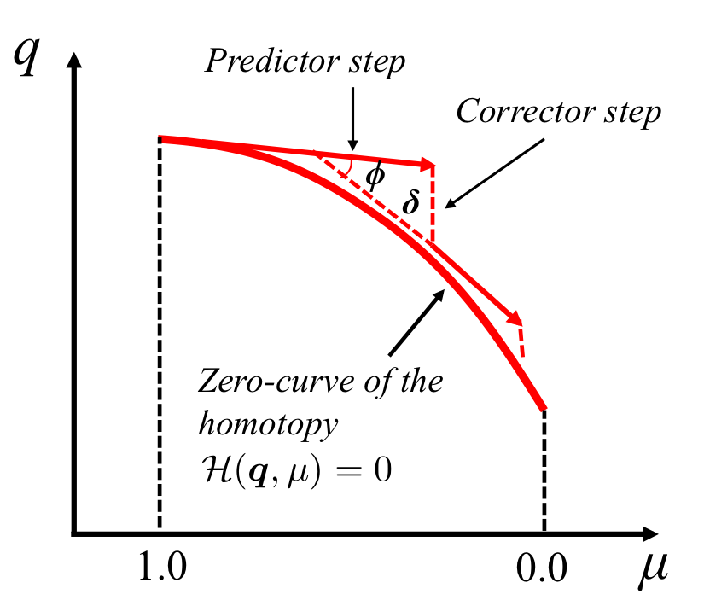
Some remarks regarding the predictor-corrector implementation
Sign restrictions on slack and multipliers
Fraction to boundary rule
Nonconvexity handling ability
Parameters control the tracing quality
Simple KKT matrix
True KKT matrix
Notes:
At the beginning of the solution path, when mu equals 1, the simple KKT system is at play;
At the end of the solution path, when mu equals 0, the true KKT system is in effect. In the middle, it’s a mixture of the two.
The simple KKT system has nice properties: the reduced Hessian is positive definite, and the calculated design update would be a feasible descent direction.
The added homotopy term functions as regularization and globalization unit;
When the true KKT system has nonconvex Hessian, the added regularization from the simple KKT helps the trajectory enter the neighborhood of the local minimum for the original problem; help bypass the local maximum stationery point;
Newton method behave poorly around stationery point, indefinite matrix

Slide 15
Outline
Motivation
Optimization Algorithm
Iterative Solver & Preconditioner
Test Problems

Slide 16
The most expensive part of the algorithm is solving the linear systems
Predictor Direction
Newton Step in Corrector
Notes:
Mention orally that you will describe the approach to solving these linear systems in the next section of the presentation.

Slide 17
The linear systems that arise are solved inexactly using FGMRES
In FGMRES, the solution basis satisfies
Solve the least square problem to get the solution

Slide 18
Iterative solvers like FGMRES require preconditioners to be effective
The convergence rate of iterative solver depends on the condition number of the system matrix
The true KKT system in optimization is ill-conditioned
Most general-purpose preconditioners are matrix-based, so they are not an option here

Slide 19
The preconditioner is designed to solve an approximation of the KKT system
Consider only
are approximations to the respective matrices

Slide 20
The matrix-free preconditioner involves several steps
Step 1: The slack and inequality multipliers are eliminated
Inequality-only case
Step 2: Lanczos SVD approximation
Step 3: Sherman-Morrison formula to obtain the desired design update
Notes:
Be sure to explain orally that the Lanczos method only requires matrix-vector product, and that these matrix-vector products are approximated inexpensively by using the PDE preconditioner in place of a full PDE solve.
Orally, explain what A and UV are in the context of the above matrices.

Slide 21
Outline
Motivation
Optimization Algorithm
Iterative Solver & Preconditioner
Test Problems

Slide 22
Remarks on the numerical tests
Optimization Convergence Criteria
Relative optimality and relative feasibility reduced by a target magnitude, e.g. 1e-6
2. For benchmarking, we compare against SNOPT, which is a state-of-the-art active-set algorithm frequently used in the engineering optimization community
Notes:
Note that SNOPT requires the explicit constraint Jacobian.

Slide 23
Test 1: a constructed non-convex problem
Q_{i} = 1
-1
0
1
-1
0
1
Q_{i} = -1
Notes:
1) Why you are considering this problem
2) the initial guess, and any parameters that are important
3) that more difficult nonconvex problems may require more iterations.
Animation on this slides

Slide 24
Test 1: a constructed non-convex problem
The new method successfully locates the solutions
It takes more iterations or could run into trouble for highly nonconvex problem

Slide 25
Test 2: a constructed quadratic optimization problem
Dimension of the problem n : 100, 200, 300, 400, 500
Q and A are full rank matrices, condition number unchanged when dimension increases
Notes:
be sure to explain why you are considering this problem.

Slide 26
Convergence Plots: New Method vs. SNOPT
Number of Design Variables : 200
Notes:
Without preconditioner, the last corrector step struggles as Newton iteration cannot be solved tightly enough
SVD preconditioner is effective

Slide 27
Convergence Plots: New Method vs. SNOPT
Number of Design Variables : 500

Slide 28
Convergence Plots: New Method vs. SNOPT
Notes:
The new method possess good scalability performance

Slide 29
Test 3: Stress-Constrained Mass Minimization
nx
ny
F
Notes:
X: thickness of each element
F: structural constitutive equation between thickness distribution x and displacements

Slide 30
The quality of the preconditioner can be controlled by the number of singular values approximated
This is the “Small” problem
The linear system is at the end of the zero-curve at
Notes:
Which problem is this, small, med, or large? Which linear system is this, at the beginning, middle, or end of the zero-curve?

Slide 31
Convergence Plots: New Method vs. SNOPT
Number of Design Variables : 128

Slide 32
Convergence Plots: New Method vs. SNOPT
Number of Design Variables : 512
Notes:
SVD preconditioner is effective helping with convergence
The increasing cost with scaling is driven by increasing SVD ranks
SNOPT has difficulty locating active constraints

Slide 33
Convergence Plots: New Method vs. SNOPT
Number of Design Variables : 2048

Slide 34
Thickness Distribution of the Optimized Solution
Large Case

Slide 35
Conclusions
Developed a matrix-free optimization algorithm for reduced-space PDE-constrained optimization problems that have state-based constraints
Nonconvexity and complementarity are handled using a homotopy map and predictor-corrector method
A novel and effective matrix-free preconditioner has been created for inequality-constrained problems
Future Work
Improve the robustness of the method in the context of nonconvex problems
Extend the matrix-free preconditioner to handle equality case
Test the method on a benchmark Aerodynamic Shape Optimization problem

Slide 36
Thanks! Questions?

Slide 37
References
3. Alp Dener and Jason E. Hicken. Matrix-free Algorithm for the Optimization of Multidis- ciplinary Systems. Structural and Multidisciplinary Optimization, 2017

Slide 38
The predictor step involves finding an approximate tangent to the zero-curve
The purpose of the corrector step is to bring the solution closer to the zero-curve
Notes:
3. Calculate the tangential direction, which involves solving a linear system; The step-length alpha is depend on an initial value, and the factor zeta
Use phi, delta to control the change of the step-length;
Phi is the angle between two consecutive tangential directions;
Delta is the distance passed during the corrector step;
for some difficult nonconvex problems, the \phi and \delta parameters may need to be small, leading to more expense.

Slide 39
SNOPT [3]
is a state of the art optimization algorithm for solving large-scale optimization problems
uses an active-set strategy for inequality constraints
uses explicit constraint Jacobian, limited-memory quasi-Newton approximations to the Hessian of Lagrangian
uses an augmented Lagrangian merit function promoting convergence
can accommodate problems with many degrees of freedom (thousands), but a few hundred or less is preferable
needs an adjoint solve for each constraint Jacobian

