Slide 1
Networking
400IT – W3-S3

Slide 2
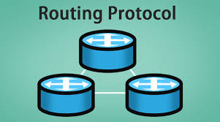
Routing protocol
A routing protocol is a set of rules and algorithms that determine how data packets should be forwarded from one network device to another within a computer network.

Slide 3
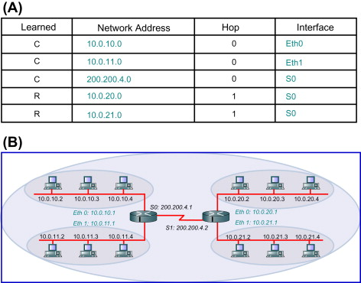
Routing protocol
The goal of routing protocols is learning the route .
Routing protocols are used to build and maintain routing tables, which contain information about the network topology and the best paths to reach various destinations.

Slide 4
Why Routing protocols are important
Routing protocols optimize data packet delivery paths in networks.
support network scalability by adapting to changes.
Routing protocols ensure network resilience by detecting and mitigating failures.
Load balancing is achieved through routing protocols for better performance.
adapt to dynamic network changes, keeping routing tables up-to-date.
Routing protocols aid network monitoring and troubleshooting efforts.

Slide 5
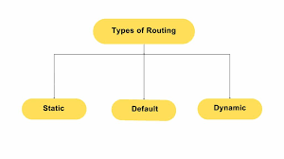
Types Of Routing Protocol

Slide 6
Why Routing protocols are important
Static Routing: In static routing, network administrators manually configure the routing table on each router or switch. It is simple and suitable for small networks but not scalable for large and dynamic networks.
Dynamic Routing: Dynamic routing protocols automatically update routing tables based on network changes, such as link failures or new devices joining the network.

Slide 7
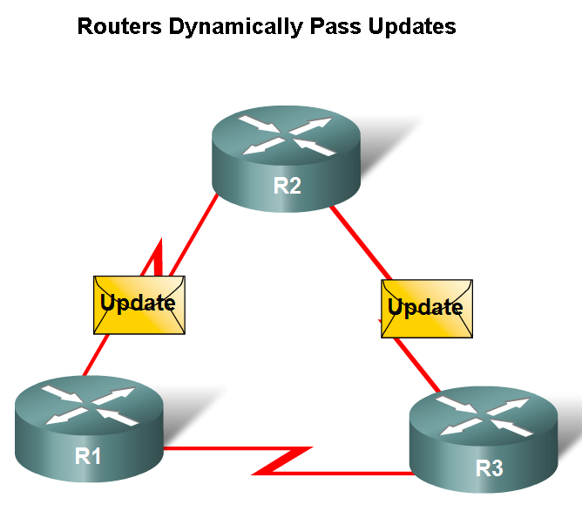
Dynamic Routing Protocols
Function(s) of Dynamic Routing Protocols:
Dynamically share information between routers.
Automatically update routing table when topology changes.
Determine best path to a destination.

Slide 8
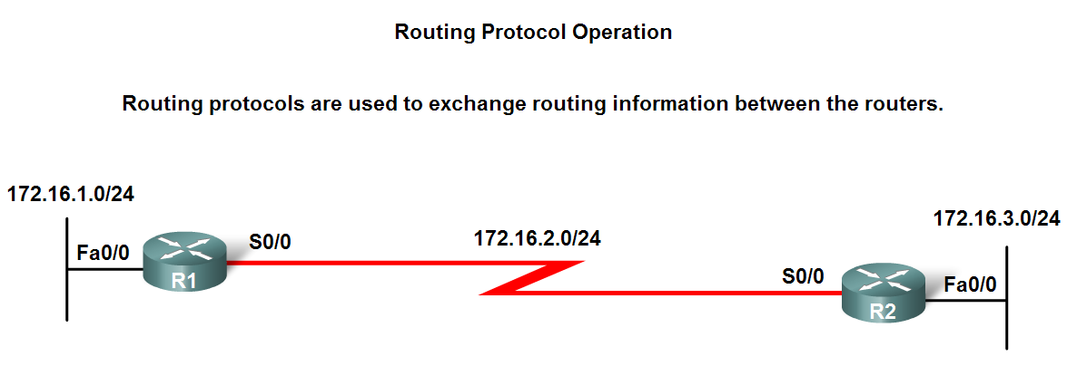
Dynamic Routing Protocols
The purpose of a dynamic routing protocol is to:
Discover remote networks
Maintaining up-to-date routing information
Choosing the best path to destination networks
Ability to find a new best path if the current path is no longer available

Slide 9
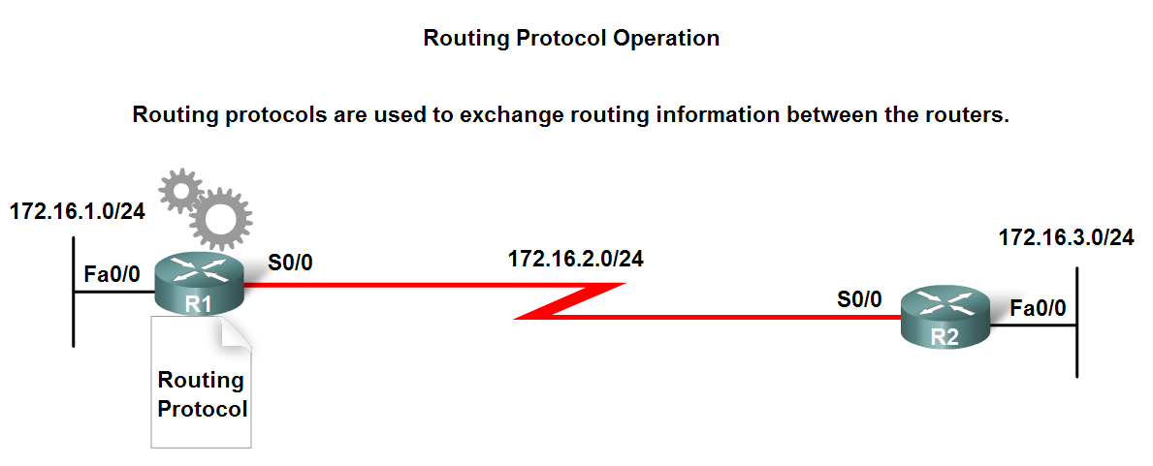
Dynamic Routing Protocols
Components of a routing protocol
Algorithm
In the case of a routing protocol algorithms are used for facilitating routing information and best path determination
Routing protocol messages
These are messages for discovering neighbors and exchange of routing information

Slide 10
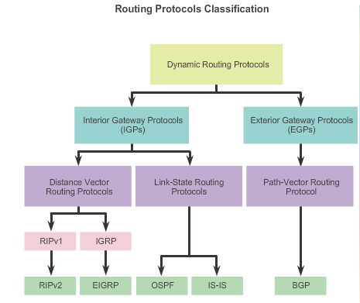

Slide 11
Classifying Routing Protocols
Dynamic routing protocols are grouped according to characteristics. Examples include:
RIP
IGRP
EIGRP
OSPF
IS-IS
BGP
Autonomous System is a group of routers and networks under the control of a single authority.

Slide 12
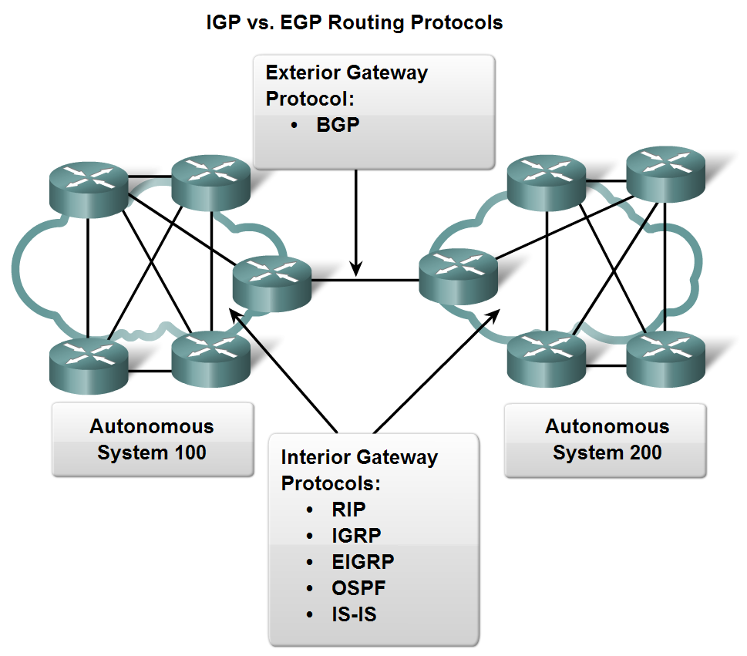
Classifying Routing Protocols
Types of routing protocols:
Interior Gateway Protocols (IGP)
Exterior Gateway Protocols (EGP)

Slide 13
Classifying Routing Protocols
Interior Gateway Routing Protocols (IGP)
Used for routing inside an autonomous system & used to route within the individual networks themselves
Examples: RIP, EIGRP, OSPF
Exterior Routing Protocols (EGP)
Used for routing between autonomous systems
Example: BGPv4

Slide 14
Classifying Routing Protocols
IGP: Comparison of Distance Vector & Link State Routing Protocols
Distance vector
Routes are advertised as vectors
of distance & direction
Incomplete view of network
topology
Generally, periodic
updates
Link state
Complete view of network
topology is created
Updates are not
periodic

Slide 15
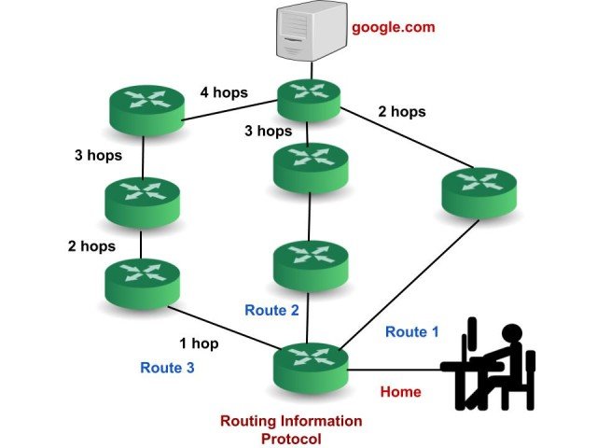
Distance-Vector Protocol
Routing Information Protocol (RIP): RIP uses the distance-vector routing algorithm to determine the best path to route packets.
Hop Count Metric: The metric used for routing decisions is hop count, with a maximum of 15 hops allowed; 16 hops are considered unreachable.

Slide 16
Distance-Vector Protocol
UDP-Based: RIP typically operates over the User Datagram Protocol (UDP) using port number 520.
RIPv1: The original version, which is classful and does not support subnet information, leading to inefficiencies and limitations in network design.
RIPv2: An improved version that supports classless inter-domain routing (CIDR), subnet masks, and route authentication for enhanced security and efficiency.

Slide 17
Routing Information Protocol (RIP)
Periodic Updates: Routers exchange their entire routing tables with immediate neighbours at fixed intervals (every 30 seconds by default).
Route Updates: If a router receives a new route that is shorter than the existing one, it updates its routing table with this new optimal route.
Limited Scalability: Due to its simplicity and limitations (such as high convergence time), RIP is not suitable for large or complex networks.

Slide 18
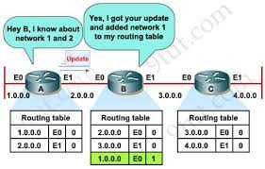
Routing Information Protocol (RIP)

Slide 19
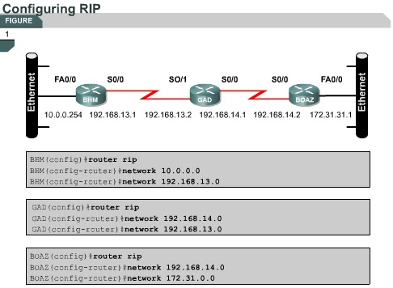
Configuring RIP

Slide 20
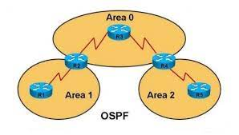
link-state routing protocol
Open Shortest Path First (OSPF) is a link-state routing protocol, which means it uses information about the state and cost of network links to calculate the best path for routing packets.
Open Standard: OSPF is an open standard protocol defined by the Internet Engineering Task Force (IETF).
VLSM and CIDR Support.
Administrative Distance: 110

Slide 21
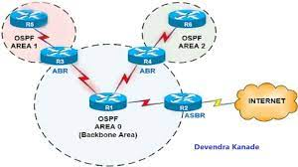
link-state routing protocol
Hierarchical Design: OSPF networks are typically organized into areas, with each area having its own routing table. This hierarchical design helps in scalability and reduces the amount of routing information exchanged between routers.

Slide 22
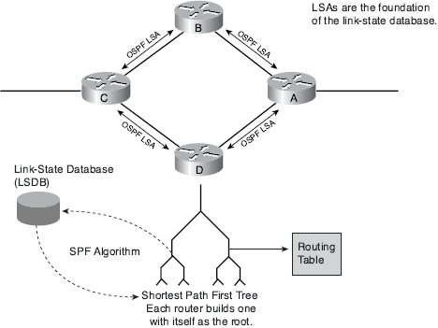
How OSPF work

Slide 23
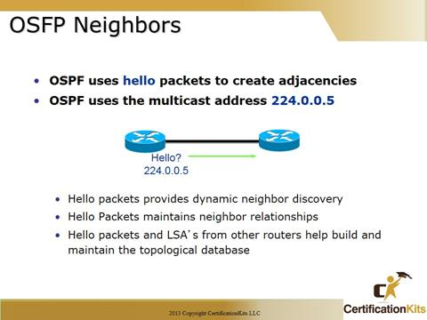
link-state routing protocol
Neighbour Discovery: OSPF routers discover and establish neighbour relationships with other routers in the same OSPF area or domain. This is done through the exchange of OSPF Hello packets. Routers must become neighbours before they can share routing information.

Slide 24
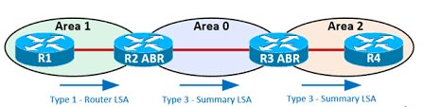
link-state routing protocol
Link-State Advertisements: OSPF routers exchange LSAs to convey information about their connected links and their states.
LSAs contain details about the routers, network segments, and links in the OSPF area. Each router maintains a Link-State Database (LSDB) that stores this information.

Slide 25
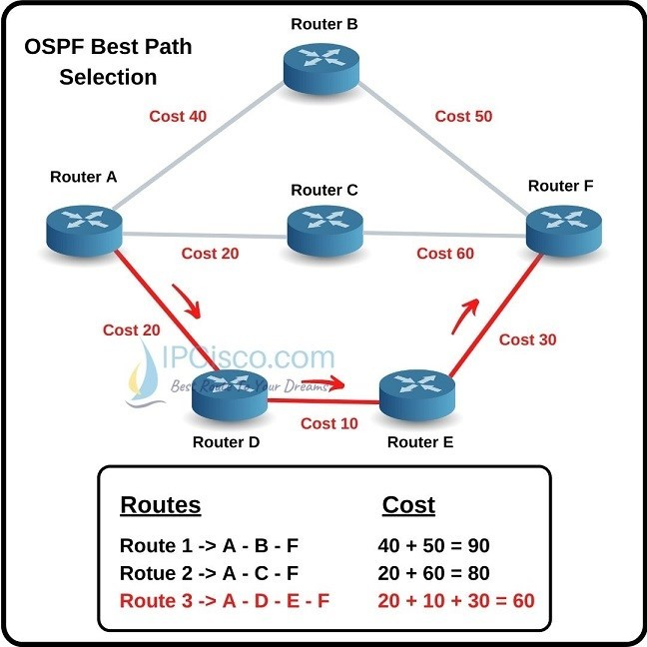
link-state routing protocol
Shortest Path First (SPF) Algorithm: OSPF uses the Dijkstra algorithm to calculate the shortest path tree for each router. This algorithm finds the shortest path to all destinations within an OSPF area.
Cost = 10⁸ / BW

Slide 26
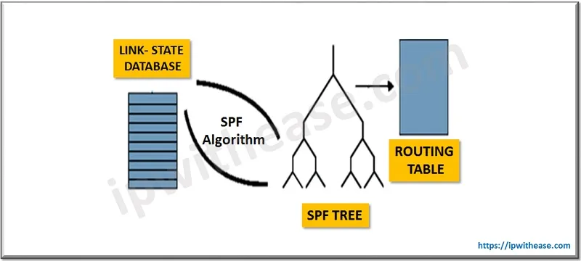
link-state routing protocol
SPF Tree Calculation: After building the LSDB, OSPF routers use a Shortest Path First (SPF) algorithm to calculate the shortest path tree. This tree represents the best path to reach all destinations within the OSPF area. The SPF algorithm takes into account the cost associated with each link (often based on bandwidth) to determine the shortest path.

Slide 27
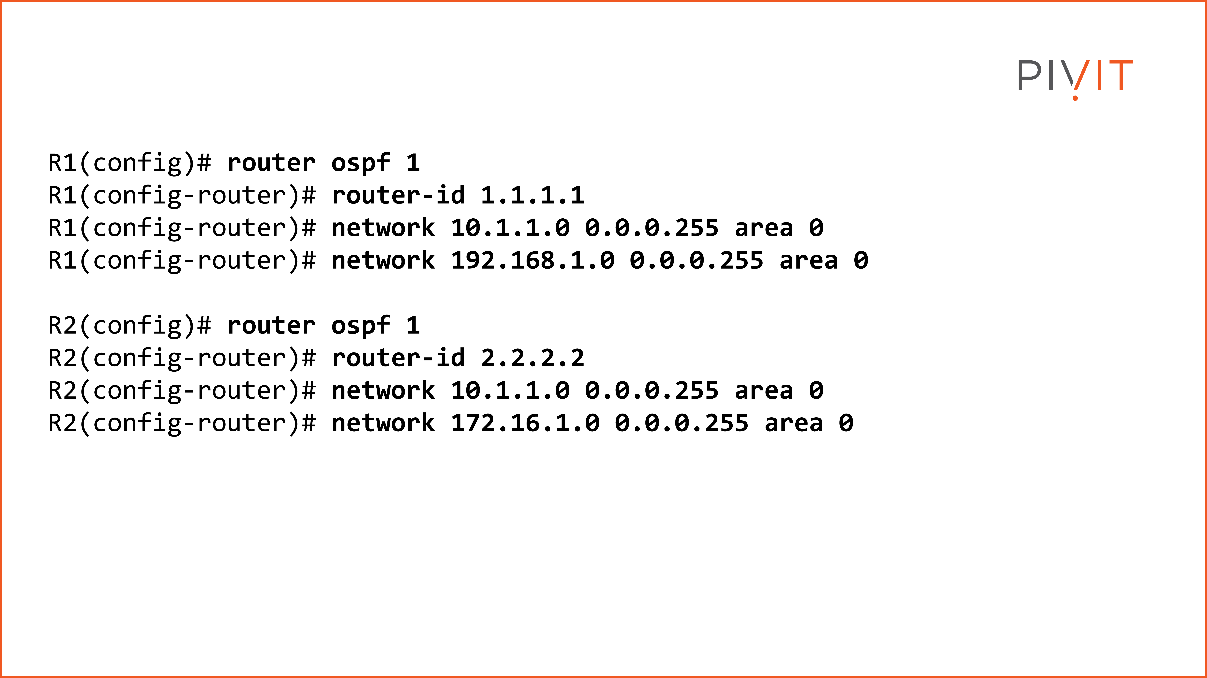
Configuring OSPF

Slide 28
Distance-Vector Protocol
EIGRP, which stands for Enhanced Interior Gateway Routing Protocol, It is a distance-vector routing protocol that is designed to help routers exchange routing information efficiently within an autonomous system (AS) or a network.
Cisco proprietary routing protocol used in computer networks.
Hybrid Routing Protocol.
VLSM and CIDR Support.
Administrative Distance: 90

Slide 29
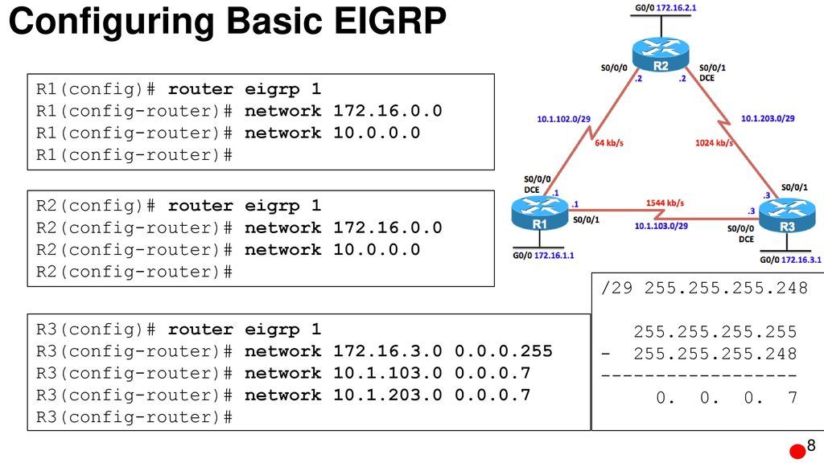
Configuring EIRGP

