Slide 1
Introduction to Coursework 2 (CW2)
Module: Problem Solving and Programming (403IT)
Assignment Type: Portfolio
Due Date: 21st February 2025, 18:00

Slide 2
Overview of CW2
• CW2 is a professional portfolio showcasing problem-solving and programming skills.
• You must select and complete at least two programming tasks.
• The portfolio should demonstrate knowledge of the Software Development Life Cycle (SDLC).

Slide 3
Assignment Details
• Assignment Type: Portfolio
• Weightage: 100% of module coursework
• Submission Deadline: 21st February 2025, 18:00
• You must submit a professional portfolio with at least two programming tasks.

Slide 4
Task Breakdown
Choose at least two tasks from the following:
1. Temperature Converter
2. Basic Calculator
3. Palindrome Checker
4. Contact Book
5. Tip Calculator
6. To-Do List Manager

Slide 5
Portfolio Requirements
Introduction: Provide an overview of your portfolio, explaining the purpose and goals of the tasks included. (10%)
Problem Solving Technique: Choose at least two of the tasks above stating the problem-solving techniques to be used, breaking down the problems into smaller components and then in each case discuss the requirements analysis stage of the SDLC, using tools such as mind maps and use case diagrams. (20%)
Algorithm Design and Generalised Problem Solutions: Present the algorithms in text format, pseudocode and flowcharts to solve the problems. Additionally, demonstrate how you can modify or generalise the algorithms e.g. using object-oriented concepts such as inheritance to handle similar problems of varying complexities and Big O notation analysing time complexity. (20%)

Slide 6
Portfolio Requirements
Programming Language Concepts: Write the Python code for the selected tasks to showcase your understanding of programming language concepts. Explain key syntax elements, classes, functions, data structures, control structures, and loops you used in your programs. (20%)
Software Development: Describe the software development process e.g. Agile or Waterfall that you followed while solving the selected tasks. Discuss the steps you took in analysing, designing, implementing, testing, and debugging the programs. Include a video demonstration of your developed applications e.g. record a 5-minute demonstration on MS Teams, or any screen recording tool of your choice and then upload the video recording to the Aula Artefact HandIn Submission Link. (20%)
Conclusion: Reflect on the overall experience of creating the portfolio of developed applications. Discuss the most significant insights gained, challenges encountered, and how this module has enhanced your problem-solving and programming skills. (10%)

Slide 7

Marking Criteria
• 80-100%: Exceptional understanding, creativity, and problem-solving skills.
• 70-79%: Excellent problem-solving and programming demonstration.
• 60-69%: Strong understanding with logical reasoning.
• 50-59%: Good understanding but with minor errors.
• 40-49%: Basic understanding, limited originality.
• <40%: Fails to meet learning outcomes.

Slide 8
Submission Instructions
Submit a single Microsoft Word document (2000 words) via Aula (Turnitin).
Submit program files and video demonstration via Aula (HandIn)
Submit a Personal Development Portfolio (PowerPoint) to show ALL Programming skills, not just the tasks for the assignment.
Use proper formatting: Calibri/Arial, size 12, 1.5 line spacing.
Ensure proper citations using APA7 referencing.

Slide 9
Support & Academic Integrity
• Seek help from tutors or support services if needed.
• Avoid plagiarism and properly reference sources.
• No group submissions – each student must submit their own work.
• Misconduct may lead to penalties or failure.

Slide 10
Q&A Session
Feel free to ask any questions regarding CW2!

Slide 12
Choosing Your Project
• Review the six available project options.
• Think about your interests and strengths.
• What excites you? What might challenge you?
• Activity: Rank your top 3 choices and discuss why you chose them.

Slide 13
What is the Software Development Life Cycle (SDLC)?
• SDLC provides a structured approach to developing software.
• It ensures clarity, efficiency, and quality in programming.
• The six key phases: Planning, Analysis, Design, Implementation, Testing, and Maintenance.

Slide 14
SDLC Phases
1. **Planning** – Identify the project goals and requirements.
2. **Analysis** – Break down the problem and define key components.
3. **Design** – Plan the structure, algorithms, and user interface.
4. **Implementation** – Write the actual code using Python.
5. **Testing** – Debug, refine, and validate your solution.
6. **Maintenance** – Review and improve based on feedback.

Slide 15
Apply SDLC to a Simple Example
Example: **Basic Calculator**
• **Planning:** What features will the calculator have?
• **Analysis:** What inputs/outputs are needed?
• **Design:** How will the user interact with the program?
• **Implementation:** Write the Python code.
• **Testing:** Ensure all operations work correctly.
• **Maintenance:** Consider adding new features like GUI.

Slide 16
Next Steps
• Finalize your project choices. - Find out who is doing the same.
• Begin the **Requirement Analysis** phase for your selected projects.
• Identify inputs, outputs, and core functionality.
Maybe share ideas with each other for this, but remember, it must be your own work.

Slide 17
**Requirement Analysis Worksheet**

Slide 18
Introduction to GUI & Tkinter
Problem Solving and Programming (403IT) – Enhancing Projects with GUI

Slide 19
What is a GUI?
• A **Graphical User Interface (GUI)** allows users to interact with a program visually.
• Examples: Buttons, menus, text boxes, sliders.
• GUIs improve usability compared to command-line programs.
• Common GUI frameworks: Tkinter (Python), PyQt, JavaFX, HTML+CSS+JS.

Slide 20
Why Use Tkinter?
• Tkinter is Python’s built-in GUI library.
• No extra installation required (in most cases).
• Simple syntax for adding windows, buttons, labels, and more.
• Cross-platform: Works on Windows, macOS, and Linux.

Slide 21
How GUI Links to CW2 Projects
• GUIs make applications **more user-friendly**.
• Instead of typing commands, users can **click buttons**.
• Example applications:
- **Temperature Converter** → Dropdown menu + entry box.
- **Calculator** → Number buttons + result display.
- **To-Do List** → Listbox + Add/Delete buttons.

Slide 22
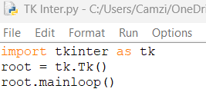
Installing Tkinter
• Tkinter is **pre-installed** with Python on most systems.
• To check if it's installed, run:
If not installed, use:
- **Windows:** `pip install tk`

Slide 23
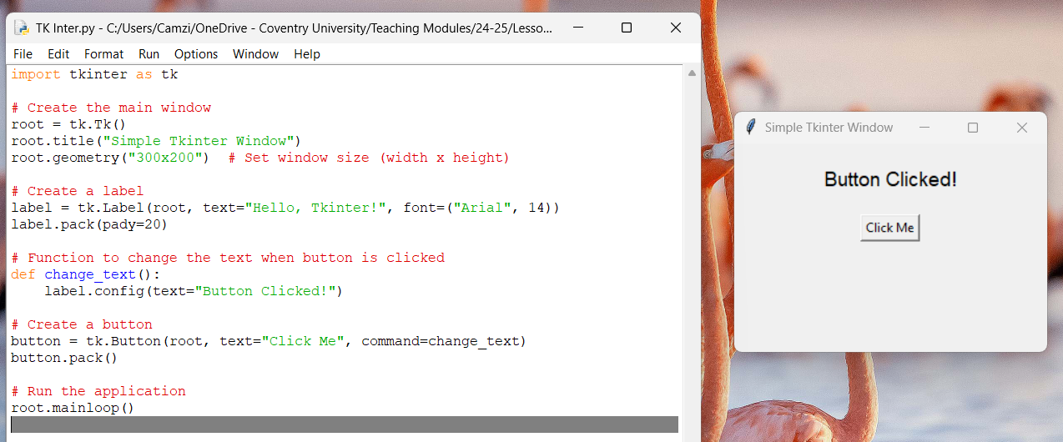
Creating a Basic Tkinter GUI
• Example: A simple window with a button.

Slide 24
How would you loop it to switch between the two each time its pressed?

Slide 25
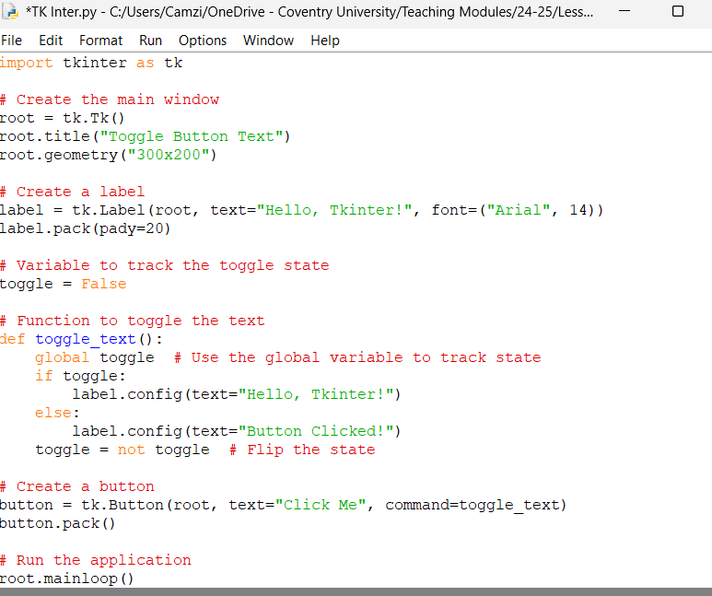
To toggle the text each time the button is pressed, you can use a Boolean variable (or an equivalent approach) to track the current state.

Slide 26
Task 1: Change the Window Size & Background Colour
Hint:
root.geometry("widthxheight")
root.config(bg="color_name") – It uses American spellings.

Slide 27
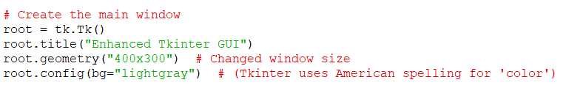
Task 1: Change the Window Size & Background Colour

Slide 28
Task 2: Change the Button Text & Color
Instructions:
Modify the text on the button to something else (e.g., "Press Me!").
Change the button color using fg (text color) and bg (background color).
Hint:
button.config(text="New Text", bg="blue", fg="white")

Slide 29
Task 2: Change the Button Text & Color

Slide 30
Task 3: Add a Second Button
Instructions:
Add a second button that changes the label to "Reset" when clicked.
Place it below the first button.

Slide 31
Task 3: Add a Second Button

Slide 32
A lambda function in Python is a small, anonymous function that can have multiple arguments but only one expression. It is useful for writing quick, throwaway functions without defining a full def function.
Here’s why lambda is useful:
✅ Avoids defining a full function for a simple action
✅ Allows passing arguments in command=
✅ Keeps the code clean and readable

Slide 33
In Tkinter, when you create a button, you often need to tell it what function to run when clicked. You do this using the command parameter.
What if we want to pass arguments to our function? We can’t do this directly in command=, because:
button = tk.Button(root, text="Click Me", command=say_hello("Hello!"))
What will be the issue when this code is run?

Slide 34
🚨 Problem:
This runs say_hello("Hello!") immediately when the program starts, instead of waiting for the button click.
Solution? Use lambda to create an "on-demand" function:
button = tk.Button(root, text="Click Me", command=lambda: say_hello("Hello!"))
✅ Now, say_hello("Hello!") runs only when the button is clicked! 🎉

Slide 35
Next Steps
• Experiment with adding Tkinter to your CW2 projects.
• Homework: Research different Tkinter widgets and their uses.

